Slide 1

Crowdfunding for Communities

Slide 2
Introduction
Notes:
My name is David Weinberger. My job is to…

Slide 3
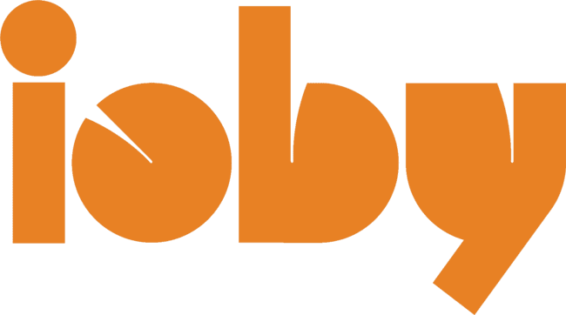
Training Objectives
You’ll leave here today:
Ready to effectively articulate your funding need, build a strong team, tell the story of your project, and prepare to lead a successful grassroots fundraising campaign.
Able to assess your fundraising capacity using a prospect chart.
With a stronger understanding of crowdfunding and ioby’s platform and services.
Notes:
Read these out loud.

Slide 4
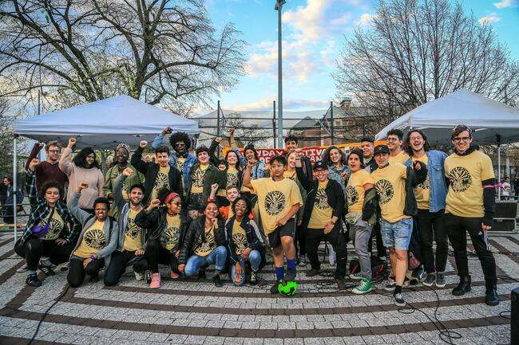
ioby stands for “in our backyards”
Notes:
ioby stands for in our back yards. They are a national nonprofit organization that helps residents fundraise for community change.

Slide 5
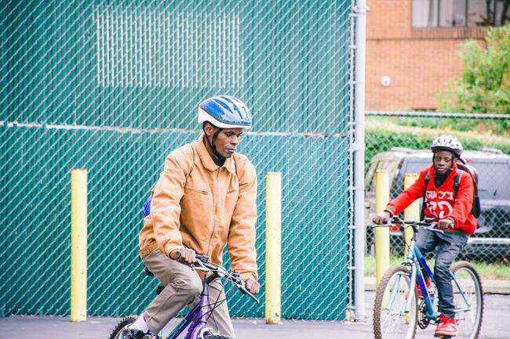
ioby projects are:
resident led
resident designed
resident funded
resident implemented
Notes:
All campaigns featured on ioby’s website are for projects led, created, funded, and implemented by residents. You’ll see everything on ioby.org, from community-designed murals to community gardens and neighbor-driven campaigns for protected bike lanes.

Slide 6
Short term
Long term
Deliver resources directly to the grassroots for immediate results
Strengthen civic infrastructure, working neighbor to neighbor, to support long-term change
Notes:
In the short-term, ioby delivers tax-deductible donations, volunteer labor, in-kind donations, and attention to grassroots projects. Over the long-term, they’re interested in how investing these resources in resident leadership can strengthen a place’s civic infrastructure.

Slide 7
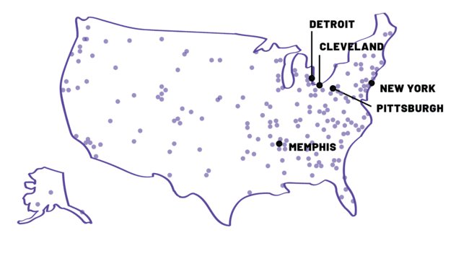
Where does ioby work?
Notes:
Anyone across the country can crowdfund with ioby now, but because they have a place-based approach to crowdfunding, they also have staff on the ground in New York and in Memphis, Cleveland, Detroit, and Pittsburgh, where they have a focus on working in neighborhoods with histories of disinvestment. To set down roots in the South, ioby wants to do things right and make sure that there really is a place for their platform and services. They also want to be careful not to duplicate any work that has already been done by people who live and work here. That’s where I come in. My role as a research fellow with ioby is to help them more deeply understand our history and institutions, as well as what motivates and constrains us when we decide to act on an idea for positive change.

Slide 8
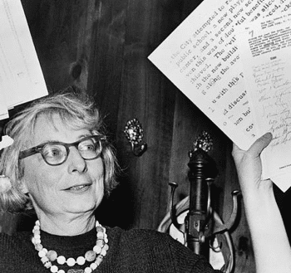
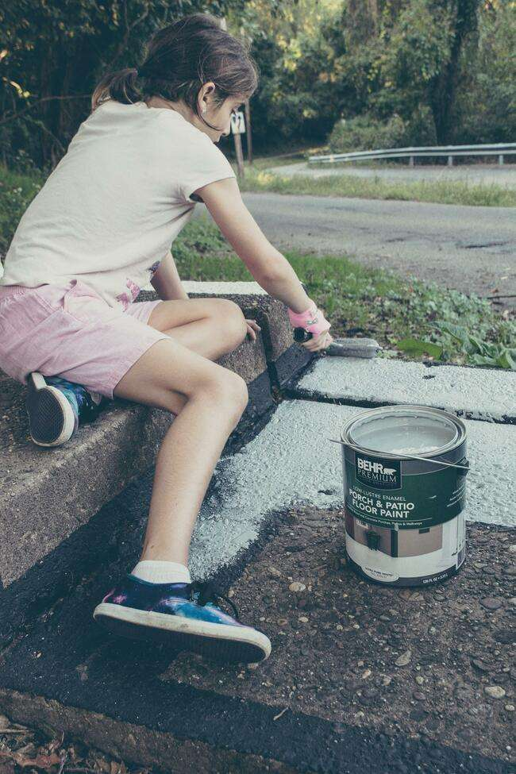
What is crowdfunding?
Online
Single project
New tool for an old strategy
Emphasis on small donations from individuals
Notes:
Just to be sure we’re all on the same page: when I say ‘crowdfunding’, I’m referring to a specific form of online fundraising, through which lots of small to mid-sized donations given toward a single project, via an engaging webpage set up on a third-party online platform such as ioby’s.
It’s important to note that community change has always been funded, in part, by small donations from neighbors. Crowdfunding is a new iteration of the old fundraising strategy of passing the plate. Crowdfunding is just the online manifestation of that kind of giving.

Slide 9
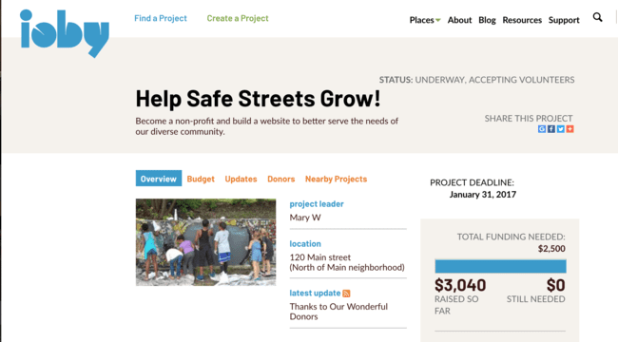
Defining features
Notes:
Some defining features of crowdfunding:
there should be a public deadline by which you are aiming to raise a certain sum;
the campaign page with the fundraising bar like you see here helps visualize your progress toward your goal,
the page functions as a place for you to share engaging content with your potential donors and explain the impact of your work and the importance of their support.

Slide 10
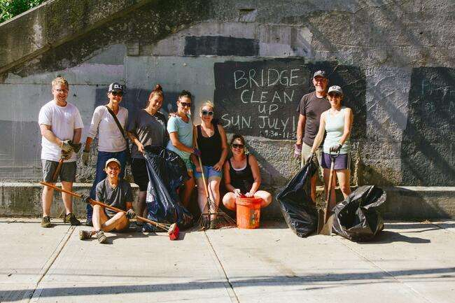
Raising Financial, Social, & Human Capital
Notes:
ioby’s platform allows groups to . . .
process donations, solicit in-kind donations
share their work through their social networks,
and recruit volunteers

Slide 11
What sets us apart
Built for community change
One-on-one coaching
Flexibility
Extensive resources
Reasonable fees
Notes:
So what sets ioby apart from other platforms?
1) ioby is a mission-driven organization. They’re creating a future in which our towns and neighborhoods are shaped by the powerful good ideas of our own neighbors.
2) they assign an experienced fundraising coach to work with everyone who comes to them with a funding need
3) they sometimes run matching campaigns with large national funders (there’s one underway with ArtPlace America right now), and they also let you leverage a large donation as a match (you can create your very own match campaign for your project)
5) they maintain a long list of resources on their site, meant for first-time fundraisers
6) because they’re a nonprofit organization, they can keep their fees very low. Most campaigns are only charged 3% for payment processing, plus a one-time fee of $35. This isn’t an upfront cost. It gets added to the amount that you set out to raise.

Slide 12
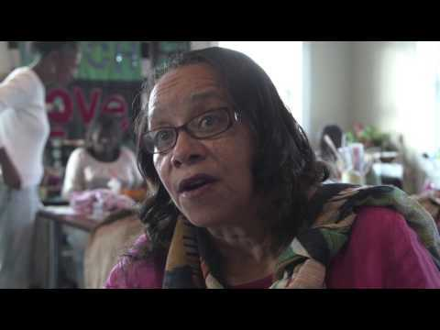
Notes:
Now that you know a little about us, I want to show you a quick video to show you what this looks like in action. As a mission driven organization, they are most interested in seeing community change happen and that could not happen without ioby Leaders. This is Deborah. She raised $2,800 for her project Sew Much Love in Memphis. In the video you will see how, what some would say is a small amount of money, is helping create amazing impact for the lives of her neighbors.

Slide 13

Notes:
Such a great project! Without leaders like Deborah, ioby could not accomplish their mission of mobilizing communities to plan, fund and make positive change in their own neighborhoods.

Slide 14
Why crowdfunding?
Generate flexible, unrestricted funding
Helps you get specific
Diversify and strengthen your donor base
It’s community engagement
Demonstrate public support
It’s a great testing ground
Notes:
Now I want to spend a couple of minutes talking about why groups should consider crowdfunding. I realize that many in this room may have a variety of income sources - grants, annual fundraisers, private donors etc. so you may be asking “Why should we ever consider crowdfunding.”

Slide 15
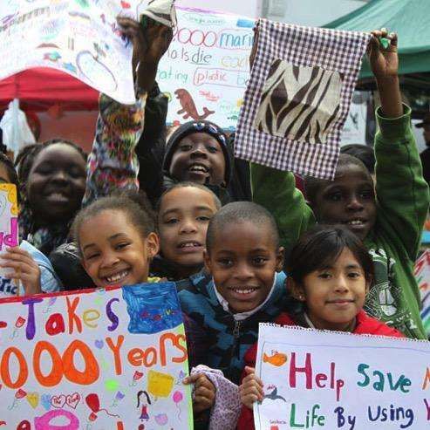
Generate flexible, unrestricted funding
Timely
Right-sized funding
Unrestricted funding that can fill the gaps
Notes:
Here it is: crowdfunding offers a chance to receive funding that’s on your schedule (rather than on a grant cycle), is the amount that you need (rather than what a funder thinks you need or deserve), and is unrestricted (meaning that a grantmaker or any other institution can’t tell you how to spend it).

Slide 16
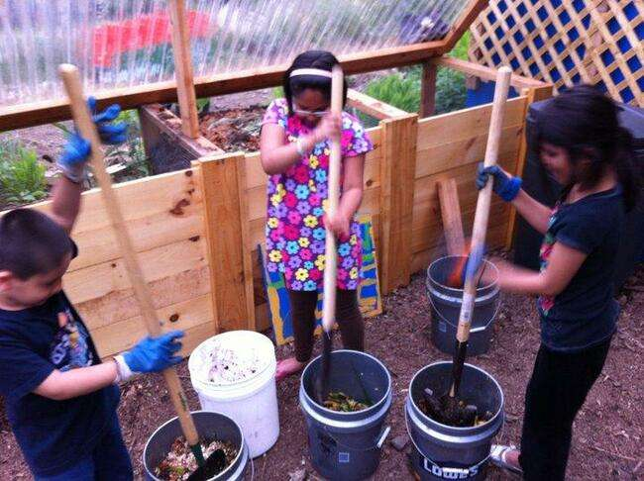
Helps you get specific
Creates clarity for donors
  They know exactly what they’re investing in
  They can easily track progress
Notes:
We know that fundraising is most successful for discrete projects. Why? Because your donors know exactly what they are investing in.
It can be tempting to just say “We need $50,000 so let’s just have a general fundraising campaign.” Fundraisers like this, that don’t communicate specific projects and outcomes within a certain time frame, struggle to be successful. Crowdfunding platforms are built for discrete projects so they force you to define discrete projects which should make you more successful.

Slide 17
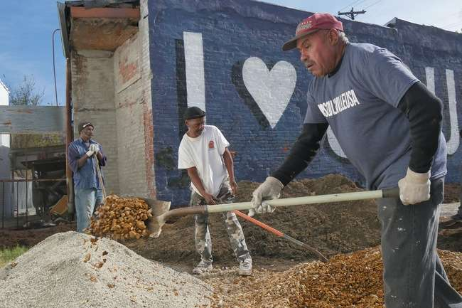
Diversify and strengthen your donor base
Helps you engage new donors, laggard donors, and younger donors
Creates a quick and powerful stewardship touch with donors
Help build donor base over time
Notes:
Who are you not reaching? Crowdfunding is an opportunity to target a new audience, or an audience that needs to be reengaged.
Here’s what I mean by a quick and powerful stewardship touch. We all know that stewarding donors is all about creating a series of touches, or interactions over time, that deepens our relationship with them, deepens their commitment our cause. Those touches are essentially feedback loops: “I invest, you do what you say you are going to do with my money, I see positive results, trust is built, my needs as a donor are met” People are more likely to remain donors if this cycle happens. Crowdfunding creates this cycle quickly – you fundraise within weeks and ideally you can show results in six months.
Finally, after a crowdfunding campaign is over, it’s not as if you never talk to those people again—they become part of your donor base.

Slide 18
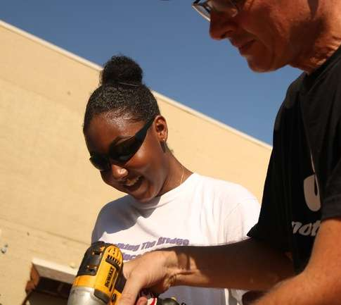
It’s community engagement
“It was the fundraising campaign that began the community engagement.”
Georgia Southworth
Jackson Heights Green Alliance
Notes:
When you run a successful crowdfunding campaign you have a team helping you do personal asks, send out e-blasts and social media posts, and a range of other creative things to engage with your potential donors. This is community engagement.

Slide 19
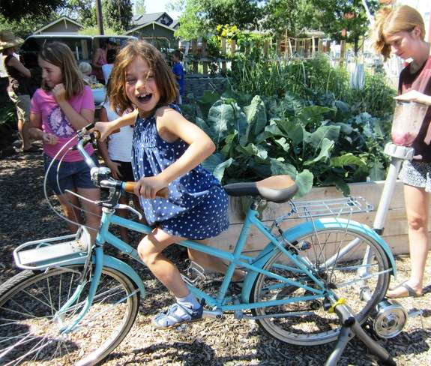
It’s a great testing ground
Test online giving, if you haven’t already
Test new ideas
Learn about your team and community
Notes:
Maybe you haven’t dabbled in online giving before, or maybe you have a new idea that you want to try out . . . Crowdfunding is a great way to have control of experimenting with these things.

Slide 20
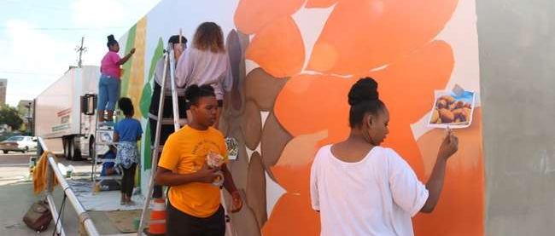
The best projects for crowdfunding are . . .

Slide 21

Innovative
Hollaback! Detroit, $265
Notes:
Leaders of a street art campaign to end catcalling and street harassment in Detroit raised the $265 they needed for stencils, chalk, and stickers.

Slide 22

Urgent
Cleveland Action, $8,870
Notes:
The most successful campaigns are also urgent. Cleveland Action and the local Black Lives Matter chapter ran a successful preemptive campaign for legal and bail support for protests in the weeks leading up to a direct action.

Slide 23
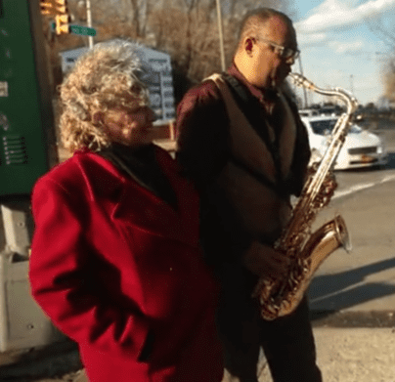
Concrete
Music on the Inside, NYC, $1,425
Notes:
The more concrete your idea, the better. A group working with incarcerated New Yorkers through music education and mentorships with seasoned jazz musicians raised $1,400 on ioby’s platform.

Slide 24
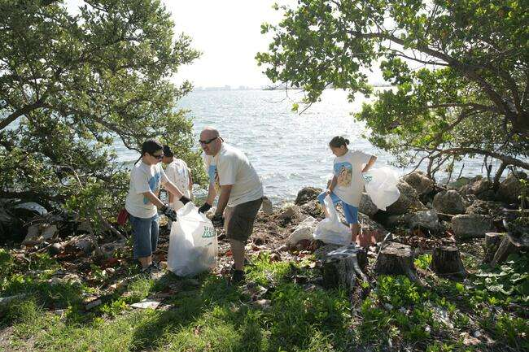
How to make your campaign a success!

Slide 25
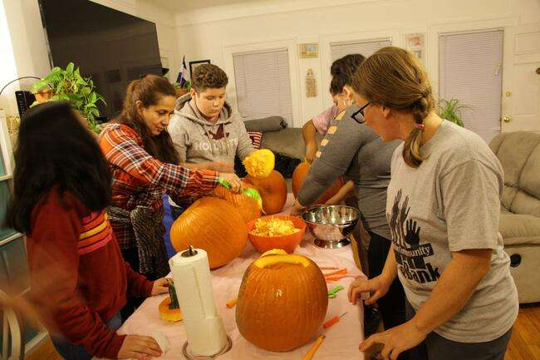
Build a strong and diverse fundraising team
From a variety of places
With a variety of skills
Notes:
Think of potential team members from a various places you have networks (churches, friends, schools, neighborhood associations, etc.)
Why? Because it will be best to reach your donors through a variety of sources
Look for the socialite, politico, digital wizard, and marketeer types to be on your team

Slide 26
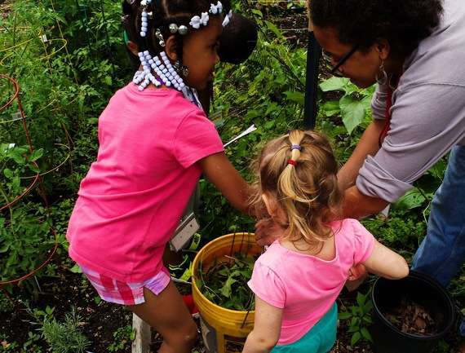
Set a smart target
How big is your team?
How much fundraising experience does your team have?
How much time do you have?
Notes:
when you’re setting your budget, consider how much you’re likely going to be able to raise, given the size of your team, the number of prospects on your list, the amount of experience your team has, and the amount of time you have to raise your money. After this presentation, I’m going to walk you through a prospect chart, probably the most helpful tool I can offer you to set a reasonable and achievable goal.

Slide 27

Know your donors
Notes:
- Who are your donors? What are they interested in? What matters to them? This will help you craft your story and think about how and where you’re going to ask them for donations.

Slide 28
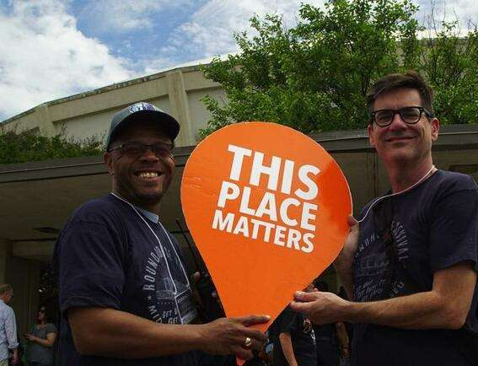
Tell a story that sticks
Drama
Authority
Significance
Focus
Notes:
When you’re telling the story of your campaign, you’ll want to include:
Drama: tell a compelling narrative that includes a conflict that your donors will care about; try to position your donor as the hero of this story.
Authority: why should the donor trust that your idea is the best idea for them to invest in? Have you lived in your town for a long time? Have you done projects like this one before? Do you have some relevant experience working in this issue area that’s worth mentioning?
Significance: Why should the donor care about what you’re doing? What happens if the campaign isn’t successful?
Focus: don’t forget to make your ask! You’re not telling a story for the sake of telling a story. You’re telling a story so that they’ll give to your campaign and then turn around and invite their friends and family to give to it, too.

Slide 29
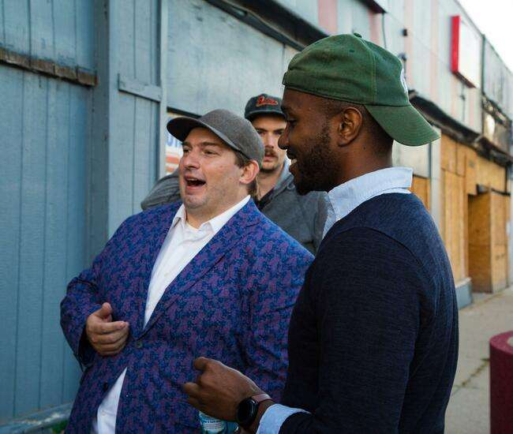
Shout your deadline from the rooftops!
Notes:
Urgency is important! Don’t forget to give your donor a deadline. If they feel like they have until forever to give to the campaign, they will never give to the campaign. Hold them accountable to a deadline and be consistent.

Slide 30
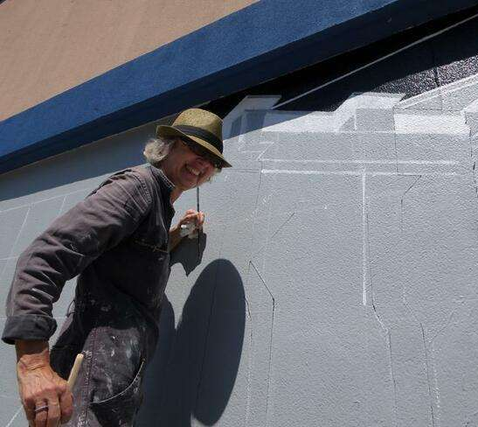
Plan more, work less
Notes:
The more you plan before your campaign, the less work you’ll have to do when the campaign launches. Put in the work now and you’ll thank me when the campaign begins.

Slide 31
Plan more: Fill out a prospect chart!

Slide 32
Intro to the Prospect Chart
Step 1:
Have each team member list 30-50 prospects.
Jot down an amount that you can reasonably expect each person to give.
Notes:
When you get back to your fundraising team, you should: (read from slide)

Slide 33
Intro to the Prospect Chart
Step 2:
Write down the method by which you’re going to ask for each donation.

Slide 34
Intro to the Prospect Chart
Method | Effectiveness for Asking
Face to Face | 50%
Personal Phone Call | 25%
Personal Email | 5%
Generic Email | 1%
Direct Mail | 1%
Facebook | <1%
Twitter | <1%
Notes:
Here’s why this is going to help you. From the Grassroots Institute for Fundraising Training (GIFT), we know that each method of asking carries its own rate of return. 50% of asks that you make face-to-face, for a donation amount that seems reasonable to the person, will be successful. 25% of people you ask by phone call will give. That rate of return drops considerably when you get less and less personal with your ask. Tweets and Facebook posts are easier to ignore than an ask to someone’s face, right? So you generally see a <1% rate of return on social media.

Slide 35
Intro to the Prospect Chart
Gift Amount | Number of Prospects | Method of Asking | Percent Likelihood They’ll Give | Total
$1,000 | 2 | Face to Face | 50% | $1,000
$500 | 10 | Face to Face | 50% | $2,500
$100 | 20 | Phone Call | 25% | $500
$50 | 450 | Personal Email | 5% | $1,125
$35 | 600 | Personal Email | 5% | $1,050
 |  |  |  | $6,175
Notes:
Now let’s put these numbers to work. Say you know 2 people who can reasonably give you $1,000 for your project. If you ask face-to-face, we know that--on average-- there’s a 50% chance that they’ll say yes. So from those two asks, you can expect $1,000. Now drop to the bottom of the chart. If your team has a list of 600 people who can give $35, and you ask by personal email (not a blast), you can expect to receive $1,050 because only 5% will actually give.
Does this all make sense?

Slide 36
Intro to the Prospect Chart
Target: $10,000
Gift Amount | Number of Prospects | Method of Asking | Percent Likelihood They’ll Give | Total
$1,000 | 2 | Face to Face | 50% | $1,000
$500 | 10 | Face to Face | 50% | $2,500
$100 | 20 | Phone Call | 25% | $500
$50 | 450 | Personal Email | 5% | $1,125
$35 | 600 | Personal Email | 5% | $1,050
 |  |  |  | $6,175
Notes:
Now, what if you know that you need to raise $10,000 but your prospect chart says you’re only able to raise $6,175. What do you do? You can ask more people face-to-face or by phone call, or you can grow your team, or ask for more money if you think that some donors will be able to give some more. By filling out your prospect chart and seeing where you are in terms of your fundraising capacity, you’ll be in a better position to plan your fundraising campaign.

Slide 37
Discussion
Notes:
As I said, my role is to help ioby create a strategy for working in our region that respects our local context. I have some questions for you, and I’ll be taking your anonymous responses back to ioby so that they have a better idea of how their content and approach resonates with people in our region.

