Slide 1


October 2, 2019
Modernize Your IT:
Better Secure Your Data, Improve Collaboration, and Increase Employee Productivity.
Presented by:
Russell Greenwald, Vice President
Insource Services, Inc.
Copyright © 2019 Insource Services, Inc. All Rights Reserved

Slide 2
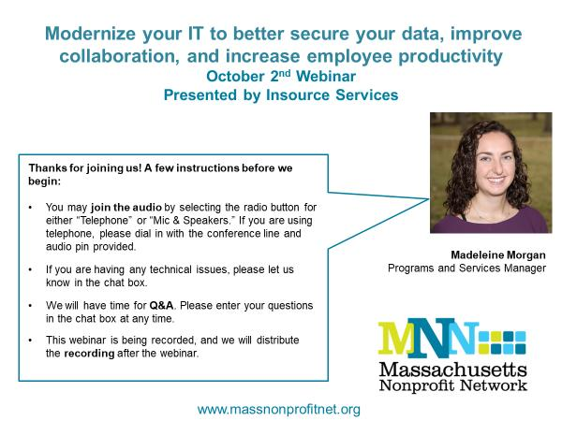

Slide 3
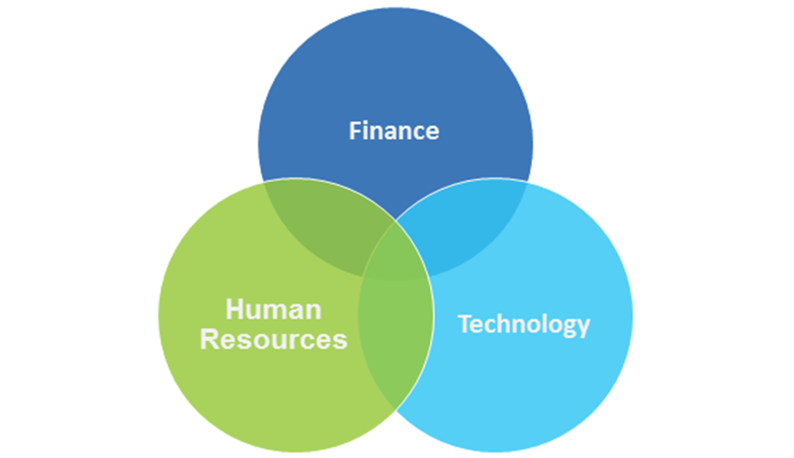

About Us: Insource Services, Inc.

Slide 4
About Us: Insource Services, Inc.
What We Do:
Full department outsourcing - generally part-time and long-term
“A la carte” services
Assessments
Trainings
Project/interim assignments
How We Do It:
Seek to understand client businesses and mission
Experienced, expert senior account leaders
Account team with multiple skill levels; work is performed at the most cost-effective level
Approximately 75 employees

Slide 5







Insource Services Technology Team
What we do:
MDM, IDM
SSO
Azure, AWS
Network
Cloud Migration
Support Services
How we do it:
Seek to understand client businesses and missions
Experienced, expert senior account leaders
Account team with multiple skill levels; work is performed at the most cost-effective level
Over 70 employees

Slide 6
Agenda
Who We Are
Why Dropbox
Dropbox Security
Collaboration
Application Integration
Demo
Summary

Slide 7




Who is Dropbox?
600M
End users
Ease of use drives adoption
Billions
of connections across teams
300,000
Business customers

Slide 8

Poll Question
Who here uses a:
File Server
Google Drive
OneDrive
Some other cloud file sharing
Dropbox

Slide 9


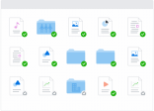
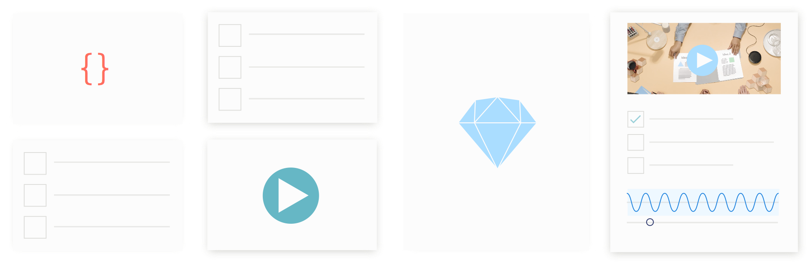


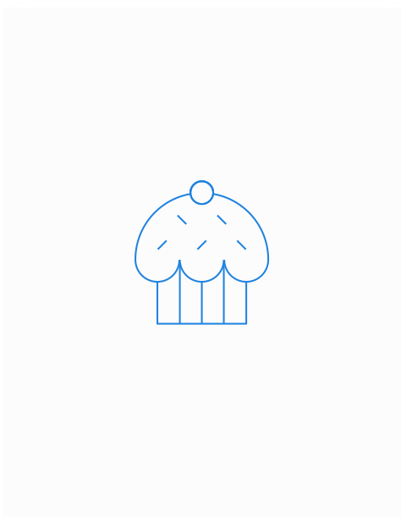


File Server Replacement
Collaboration
Securely collaborate with internal/external stakeholders
File Server Replacement
Manage cloud storage with resilience and capacity
Ease of Use
Increase productivity with an intuitive easy-to-use solution
Remote Working
Grant easy and secure remote access

Slide 10
File Server Replacement
Work anywhere, anytime
Dropbox makes all files securely available, no VPN required.
Teams can even collaborate offline.
Stay in sync
Always share the most up to date version of teams, partners, and customers.
Integrate with apps
Dropbox works without limitations on all the devices your customers’ teams work on.
Protect your data and replace backups
Files get an instant upgrade in protection, because everything put in Dropbox is stored on a distributed, reliable cloud infrastructure.

Slide 11
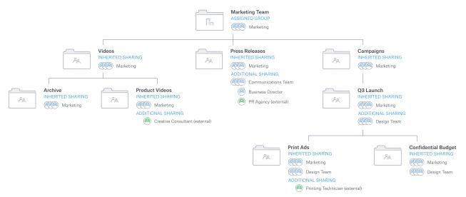
Team Folders
Manage membership at the team folder or sub-folder level
Grant people to only the specific folders they need
Allow external sharing to take place directly from the folders where content is stored
Manage access levels for any folder or subfolder

Slide 12
Sync
See all your work from your desktop
Files take up very little space until you need them.
Access to everything is just a click away
Open a cloud-only file and it will sync automatically.
Works where you do
On Windows and Mac, even if you’re not on the latest version.

Slide 13

Smart Sync

Slide 14




Security on Dropbox
Bank-level encryption
In transit (SSL/TLS)
At rest (256-bit AES)
Compliance and Certifications
SOC1/SOC2/SOC3
ISO 27001, 27018
HIPAA/HITECH support
FERPA/COPPA
Detailed Auditing
Deep-dives on user activity, file events, sharing, apps, sessions, and devices
Notes:
Crypto Locker Rollback

Slide 15
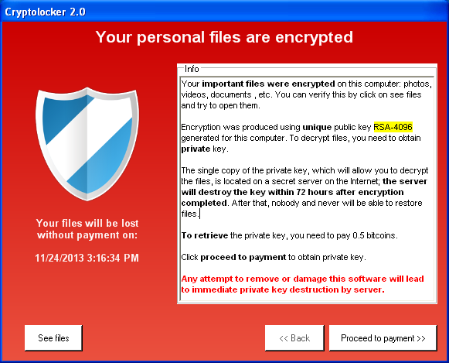
Security on Dropbox
Notes:
Crypto Locker Rollback

Slide 16
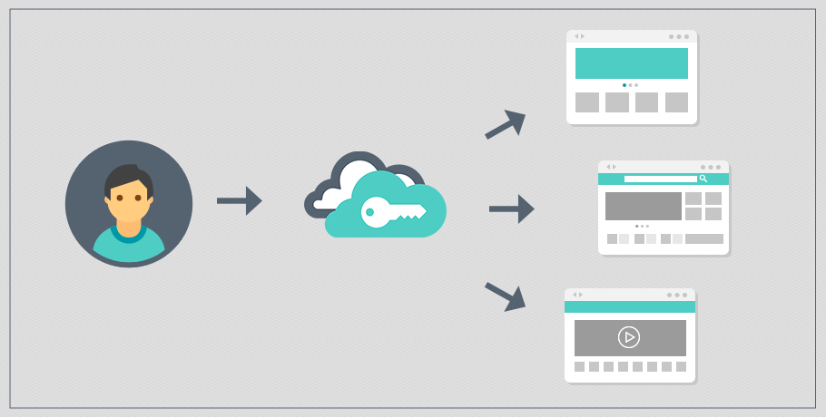
Security on Dropbox
Notes:
SSO,
Potential to couple with conditional access to ensure staff only access Dropbox on secured devices

Slide 17
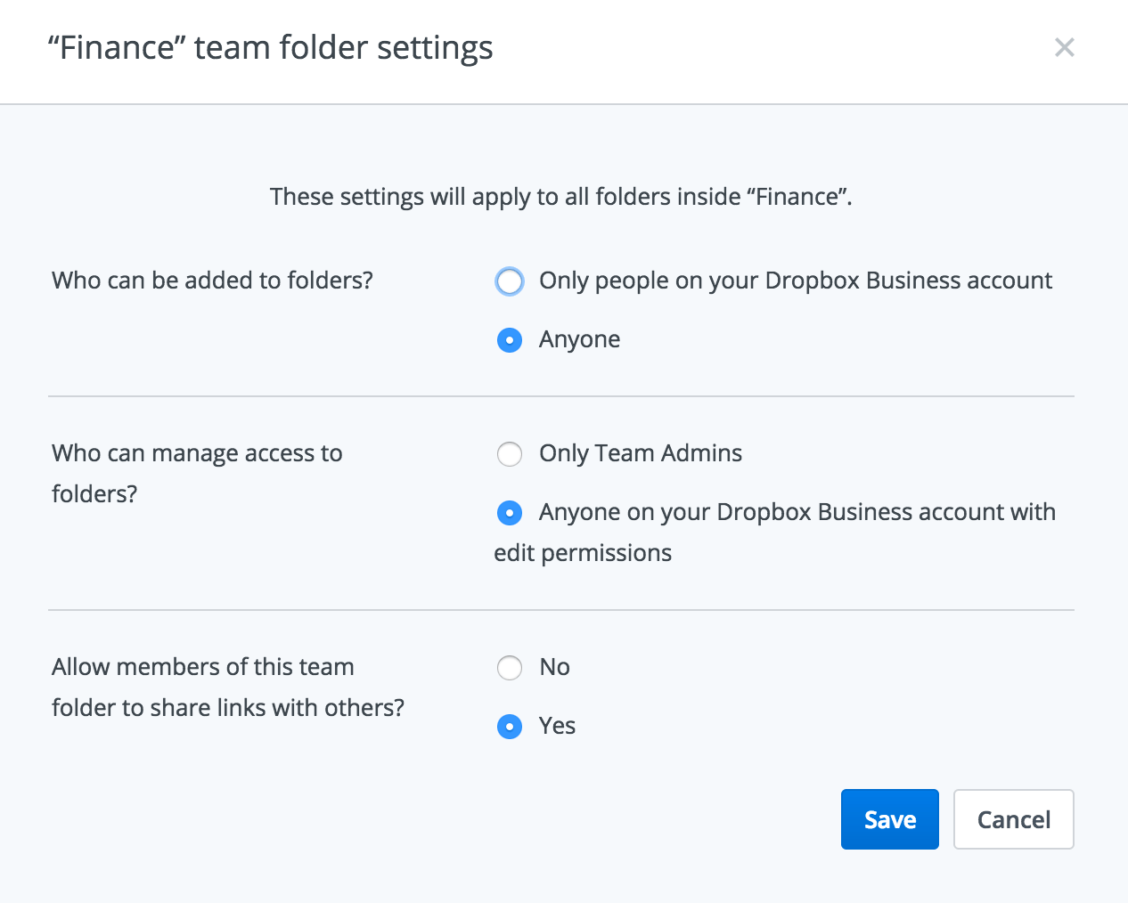
Security on Dropbox
Notes:
Team Folder Based

Slide 18
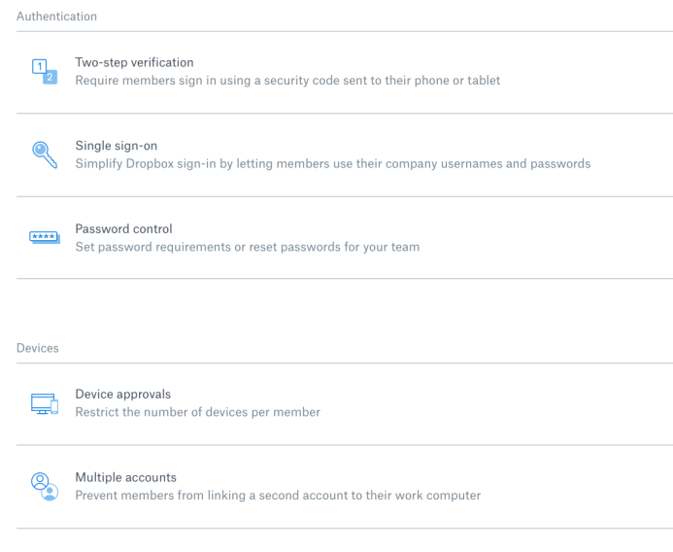
Security on Dropbox
Notes:
If no SSO
2 Step, PW complexity, Device approvals, etc

Slide 19
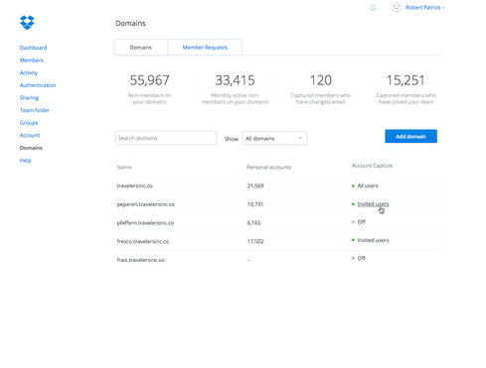
Security on Dropbox
Notes:
Domain Capture
Team Membership Rules of Engagement

Slide 20

Security on Dropbox
Notes:
Troubleshooting
Verifying Access
What is shared to them
Admins get notified
User by default will be notified

Slide 21
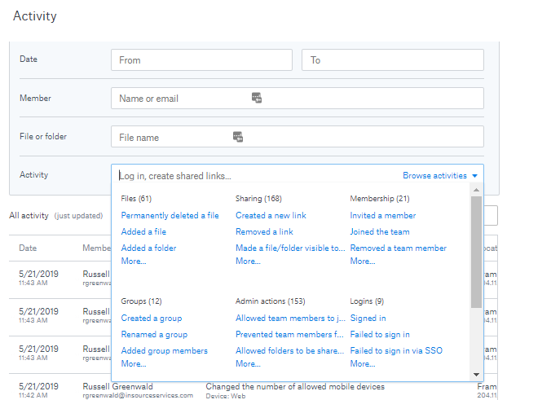
Security on Dropbox
Notes:
Audit Logs

Slide 22
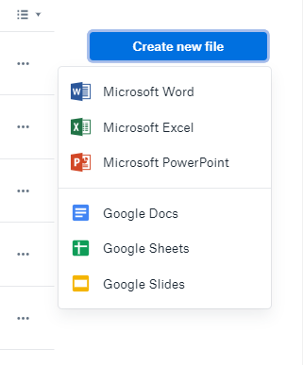
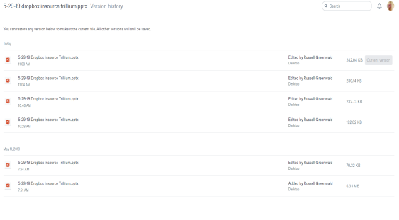
Editing
Dropbox Badge
Google and Office 365 Co Editing
Version History
Notes:
Ability to unify your document storage in one place in one folder structure

Slide 23
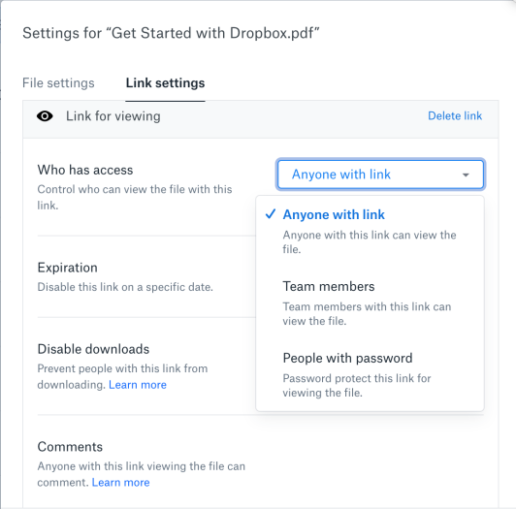
External Collaboration – Link Sharing
Notes:
Provide access to external parties who don’t have Dropbox with the ability to control who has access and for how long and ability to password protect links
Password Protect
Expire

Slide 24
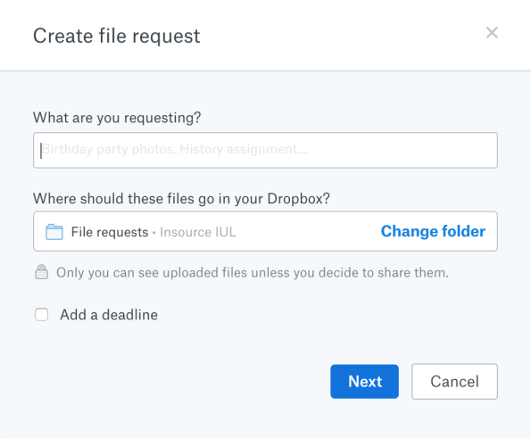
External Collaboration – File Requests
Notes:
Gather files from external parties without them needing a Dropbox account. Great alternative to having people email you files especially with sensitive content.

Slide 25
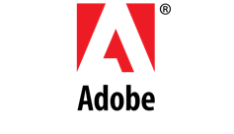




Integrations
Tens of billions of Adobe files in Dropbox
Notes:
Talk about receipt uploads, simplifying expenses, etc

Slide 26
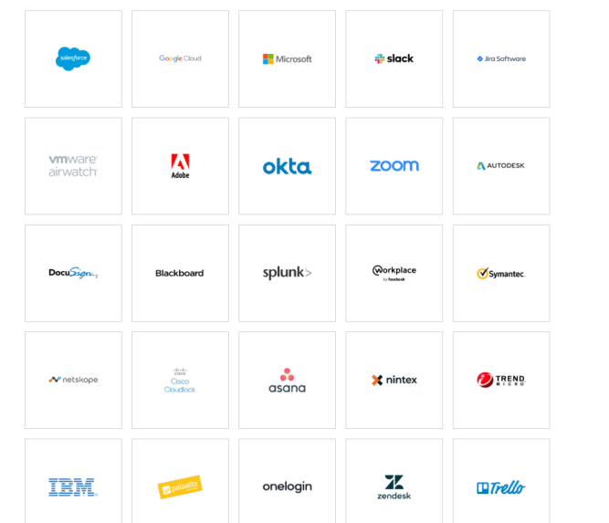
Integrations
Notes:
See comment

Slide 27


RoadMap
Notes:
See comment

Slide 28

Demo and Questions

Slide 29
Summary
Server Replacement
Secure
Simple
Sharing and Collaboration

Slide 30

Questions

Slide 31
Contact Information
Russell Greenwald
Vice President
rgreenwald@insourceservices.com
781-235-1490
www.insourceservices.com

Slide 32


LinkedIn: Insource Services, Inc.
Facebook: Insource Services, Inc.
Twitter: @InsourceSvcs

