Slide 1
THE FRONTIERS OF FUNDRAISING Crowdfunding, Co-Venturer Campaigns Third Party Agreements and Corporate Sponsorships
Ellen Lubell, Esq.
Tennant Lubell, LLC
May 15, 2019
© 2017 Tennant Lubell, LLC

Slide 2
Overview
Basic Massachusetts registration requirements and
use of professional solicitors and fundraising counsel.
Crowdfunding, crowdfunding platforms, and online
donor-advised funds.
Corporate sponsorships.
Commercial co-venture campaigns.
Fundraising by unrelated entities.
© 2017 Tennant Lubell, LLC

Slide 3
Basics for Massachusetts Charities
Prior to soliciting, charities must register with the Attorney General’s Office to obtain a Certificate of Solicitation.
Certificate must be renewed on an annual basis.
Organizations not required to register:
Certain religious organizations.
Organizations that receive < $5,000 in public contributions annually or contributions from fewer than 10 people per year, provided all functions are performed by volunteers and no assets or revenue is used to benefit insiders.
© 2017 Tennant Lubell, LLC

Slide 4
Basics for Massachusetts Charities
If a charity wants to begin soliciting before the due date of its first Form PC, may submit Schedule A-2 and fee to the AG.
Charities that want to use a “professional solicitor” or “fundraising counsel” must file a copy of contracts with the AG.
“Professional solicitor” - individual or business hired by a charity to conduct a fundraising campaign.
“Fundraising counsel” - individual or firm hired by a charity to provide advice regarding a fundraising campaign.
© 2017 Tennant Lubell, LLC

Slide 5
Basics for Massachusetts Charities
Professional solicitors must file with the AG before beginning:
Registration Statement
Filing fee of $1,000
$25,000 bond
Copies of contracts with charities they serve
Financial report at end of year
Fundraising counsel must file with the AG before beginning :
Registration Statement
Filing fee of $400
Copies of contracts with charities they serve
© 2017 Tennant Lubell, LLC

Slide 6
Fundraising Outside Massachusetts
Most states, like Massachusetts, have registration requirements for both in-state and out-of-state charities that wish to fundraise in the state.
State-by-state analysis and costs can be overwhelming.
“Multistate Registration and Filing Portal” will provide an online system for charities and professional fundraisers to comply with state filing requirements through a single portal.
It’s clear how to comply when fundraising is traditional (i.e. occurs within particular geographically boundaries), but murkier when its done on line.
© 2017 Tennant Lubell, LLC

Slide 7
The “Donate” Button
Existing laws have not taken into consideration the globalizing impact of the Internet. Prime example is the now-ubiquitous “donate” button.
Does having a donate button trigger the need for registering in every state that has registration requirements, or is it not solicitation at all?
Only a few states have weighed in. Colorado looks at:
whether an out-of-state charity’s website “receives contributions from Colorado on a repeated and ongoing or substantial basis,” and
whether the charity “specifically targets persons physically located in Colorado for solicitation.”
© 2017 Tennant Lubell, LLC

Slide 8
The “Donate” Button
Massachusetts and most other states have not passed any legislation on this subject.
Consider registering if your organization:
is receiving contributions from a particular state on a repeated and ongoing or substantial basis, or
is specially targeting individuals or companies from a particular state.
© 2017 Tennant Lubell, LLC

Slide 9

Crowdfunding
Funding a project, an individual, or an organization by raising small amounts of money via the Internet from a large number of people.
© 2017 Tennant Lubell, LLC

Slide 10

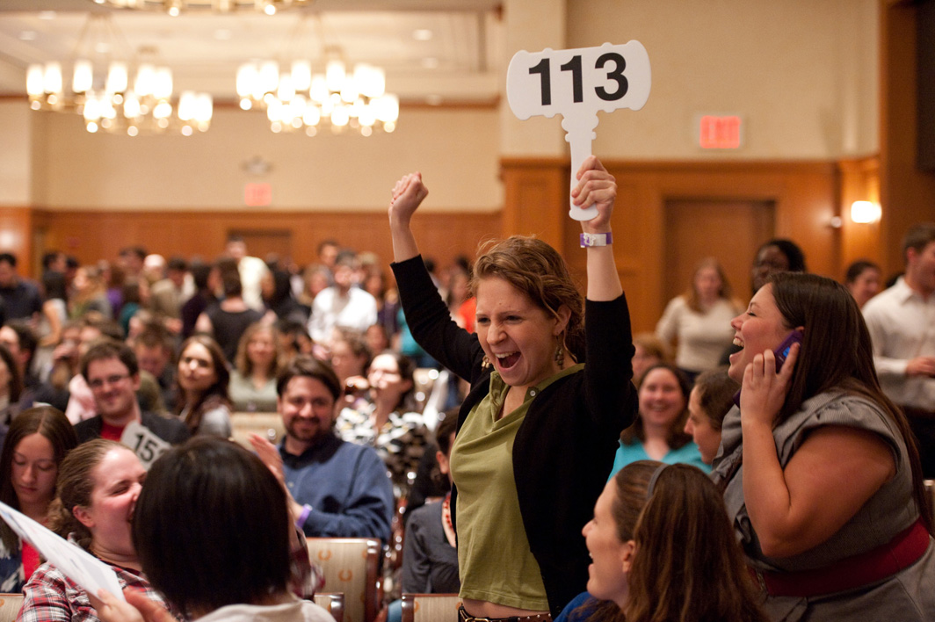
Crowdfunding
Used frequently to raise money for needy individuals, but also by charities.
Doesn’t have to differ from traditional charitable fundraising, but often more project-focused and intended to reach a wider number of potential donors.
© 2017 Tennant Lubell, LLC

Slide 11
Crowdfunding: Multi-State Registration
Crowdfunding crosses state boundaries, so multi-state registration must be considered:
Are a charity’s crowdfunding contacts (via the Internet) with a state sufficient to trigger the state’s registration requirements?
Are people or businesses located in the state targeted?
Are contributions received from people/businesses in the state on a repeated and ongoing basis or a substantial basis?
© 2017 Tennant Lubell, LLC

Slide 12
Crowdfunding: Multi-State Registration
Analysis of the need for state registration is challenging in practice:
May be difficult to track and categorize donations with sufficient precision to know in which states to register.
May be costly and time-consuming to determine state requirements, file forms, and pay fees.
Multistate Registration and Filing Portal will eventually be helpful, but guidance will still be needed from state regulators to know exactly when registration requirements are triggered.
© 2017 Tennant Lubell, LLC

Slide 13
Crowdfunding: Functions and Status of Platforms
Platforms provide the online services necessary to make a campaign happen.
May simply channel donations through payment processing services for processing credit card / bank information.
May actually receive and control funds that are raised.
May be set up to take donations on behalf of many charities at the same time and provide descriptions of causes from which donors may select.
© 2017 Tennant Lubell, LLC

Slide 14
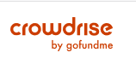
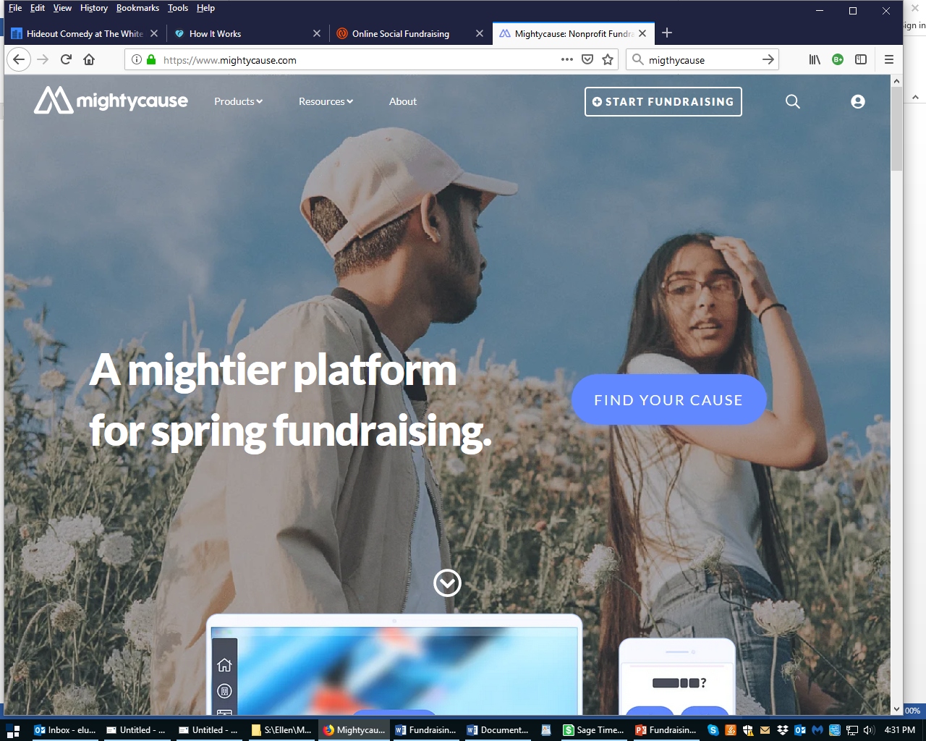


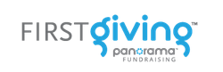
Crowdfunding Models
© 2017 Tennant Lubell, LLC

Slide 15

Crowdfunding: Basic Rules Apply
Retain the right to use donations as the charity sees fit.
Follow through on any promises to use donations for particular purposes.
Watch out for unauthorized use of the charity’s name for fraudulent campaigns. May pose risk of reputational harm and potential liability.
M.G.L ch. 68 $§$28D requires a charity’s express permission to use its name to solicit.
Provide written substantiation.
© 2017 Tennant Lubell, LLC

Slide 16
Corporate Sponsorships
A payment made by a business to a nonprofit to advance the nonprofit’s mission, in exchange for the nonprofit’s public acknowledgment of the business.
Valuable funding source for nonprofits to increase visibility and appeal.
Valuable marketing strategy for businesses, which become identified with charitable activity and the ideals and mission of the nonprofits.
© 2017 Tennant Lubell, LLC

Slide 17
Corporate Sponsorships
Tax issue: “Qualified sponsorship payment” versus “advertising.”
Qualified sponsorship payment - received in exchange for acknowledgement or value-neutral description of the business or product lines, with no expectation of substantial return benefit.
Not taxable to the charity.
Advertising payment - received in exchange for promotion of the business or other substantial benefits.
Taxable to the charity as “unrelated business income.”
© 2017 Tennant Lubell, LLC

Slide 18
Corporate Sponsorships
Examples:
Payment made in exchange for a table at a conference = qualified sponsorship payment.
Payment made in exchange for an opportunity to meet invited guests = qualified sponsorship payment.
Payment made in exchange for promotion of the business, where charity endorses business’ products = advertising.
Payment made in exchange for listings of the business or product lines in regularly scheduled materials published by the charity = advertising.
© 2017 Tennant Lubell, LLC

Slide 19


Co-Venturer Campaigns
Mutually beneficial collaboration between a for-profit business and a charity to communicate the shared values of the two organizations.
© 2017 Tennant Lubell, LLC

Slide 20
Co-Venturer Campaigns
State regulators will scrutinize to assure that charitable assets are being used appropriately and not unduly benefiting private business interests.
Charity considering a campaign should consider whether it may divert the charity from its stated mission or require it to use its resources in a way that primarily serves private interests.
© 2017 Tennant Lubell, LLC

Slide 21

Co-Venturer Campaigns: Challenges for Charities
Business partner resistance to contract - differing views of the need for transparency.
Assumption by business partner that “charity” equals “free.”
Lack of alignment between charitable cause and business partner.
External factors – e.g. celebrity falls from grace, consumer attitudes change, products are found to be dangerous, business decision is made that does not reflect the values of the charity.
© 2017 Tennant Lubell, LLC

Slide 22
Co-Venturer Campaigns
Charity must enter into and file a written contract with the co-venture-that sets forth the terms of the campaign. For example:
Description of the product
Responsibility for costs and decisions
Charity review and approval of packaging and advertising
Percentage of profits to benefit the charity
Time period
When and how payments will be made to the charity
Consumer communications
Financial accounting
Trademark licenses
© 2017 Tennant Lubell, LLC

Slide 23
Co-Venturer Campaigns: Legal Obligations
Co-venturer must file:
Registration statement
$25,000 bond
Filing fee of $200
Copy of fundraising contract
Annual Financial Report
© 2017 Tennant Lubell, LLC

Slide 24


Unrelated Third Party Fundraising Agreements
Events held to benefit a charity by a non-affiliated group or individual, where the charity has no fiduciary responsibility and little or no staff involvement.
© 2017 Tennant Lubell, LLC

Slide 25
Unrelated Third Party Fundraising Agreements
Increasing awareness of potential liabilities associated with these events and risks to reputation.
Agreements are important to set out the terms of the relationship between charities and fundraisers.
© 2017 Tennant Lubell, LLC

Slide 26
Unrelated Third Party Fundraising Agreements
Third party agreements may require fundraiser to:
Present a proposal describing planned event for approval by charity.
Cover all costs, secure necessary permits, recruit volunteers, publicize and manage event, and carry insurance.
Send donor acknowledgements or provide donor information to charity.
Comply with limitations on use of charity’s name and logo.
© 2017 Tennant Lubell, LLC

Slide 27
Unrelated Third Party Fundraising Agreements
Get approval from the charity of all promotional materials and press releases.
Assure all revenue and expenses relating to the event flow through the fundraiser’s books—not the charity’s.
Provide accounting to the charity of all funds collected and expenses related to the event.
Assure net proceeds from the event are donated to the charity.
© 2017 Tennant Lubell, LLC

Slide 28
Questions?
© 2017 Tennant Lubell, LLC

