Slide 1


The Buyers Guide to Program Evaluation
May 1st Webinar
Presented by Civitas Strategies, LLC
Thanks for joining us! A few instructions before we begin:
You may join the audio by selecting the radio button for either “Telephone” or “Mic & Speakers.” If you are using telephone, please dial in with the conference line and audio pin provided.
If you are having any technical issues, please let us know in the chat box.
We will have time for Q&A. Please enter your questions in the chat box at any time.
This webinar is being recorded, and we will distribute the recording after the webinar.
Jenny Yuan
Operation and Membership Coordinator
www.massnonprofitnet.org

Slide 2
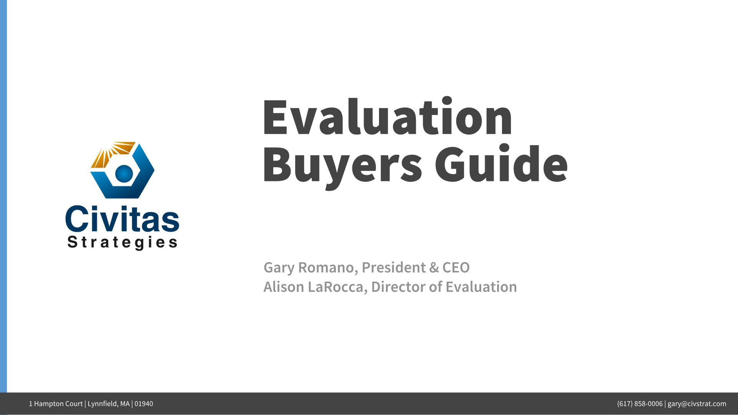

Slide 3
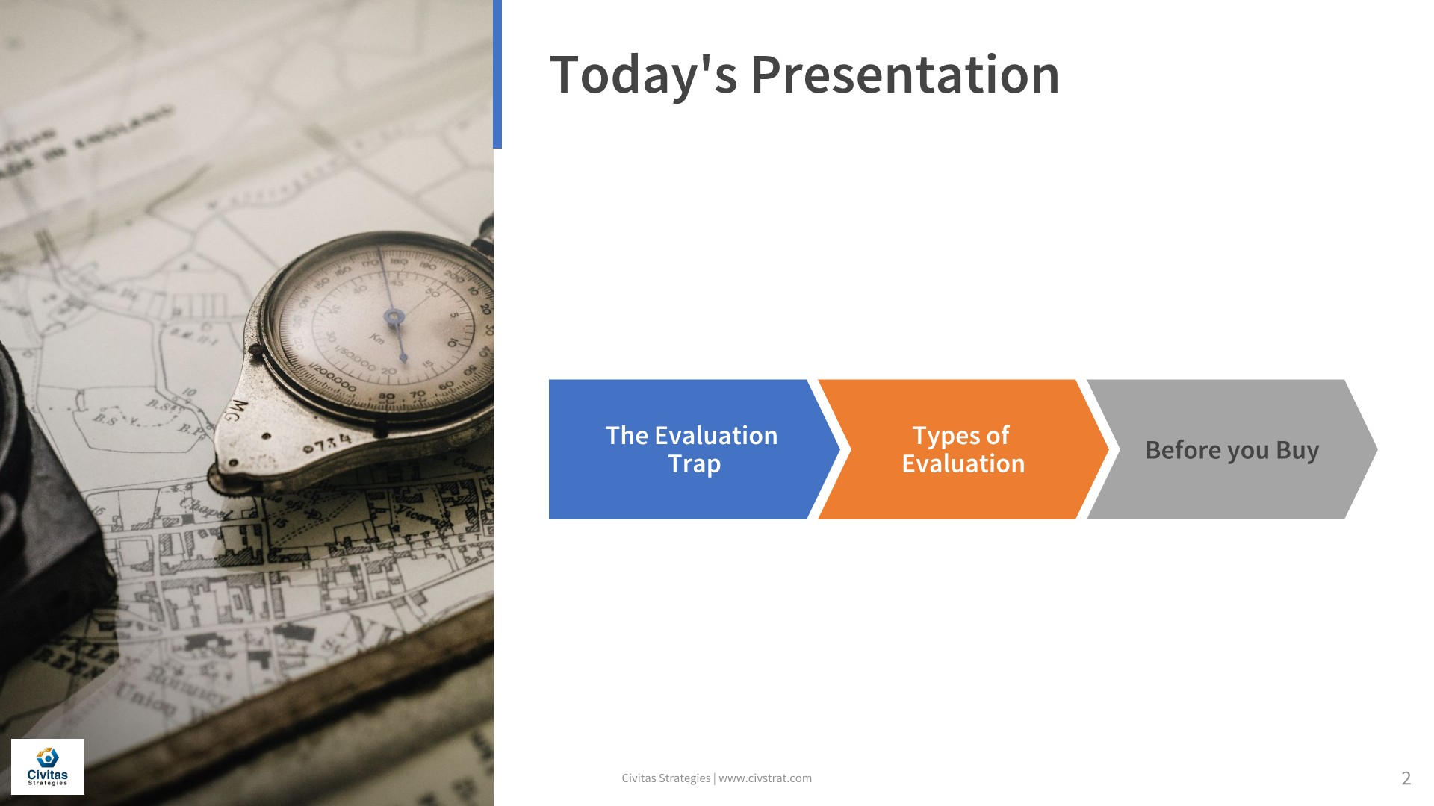

Slide 4
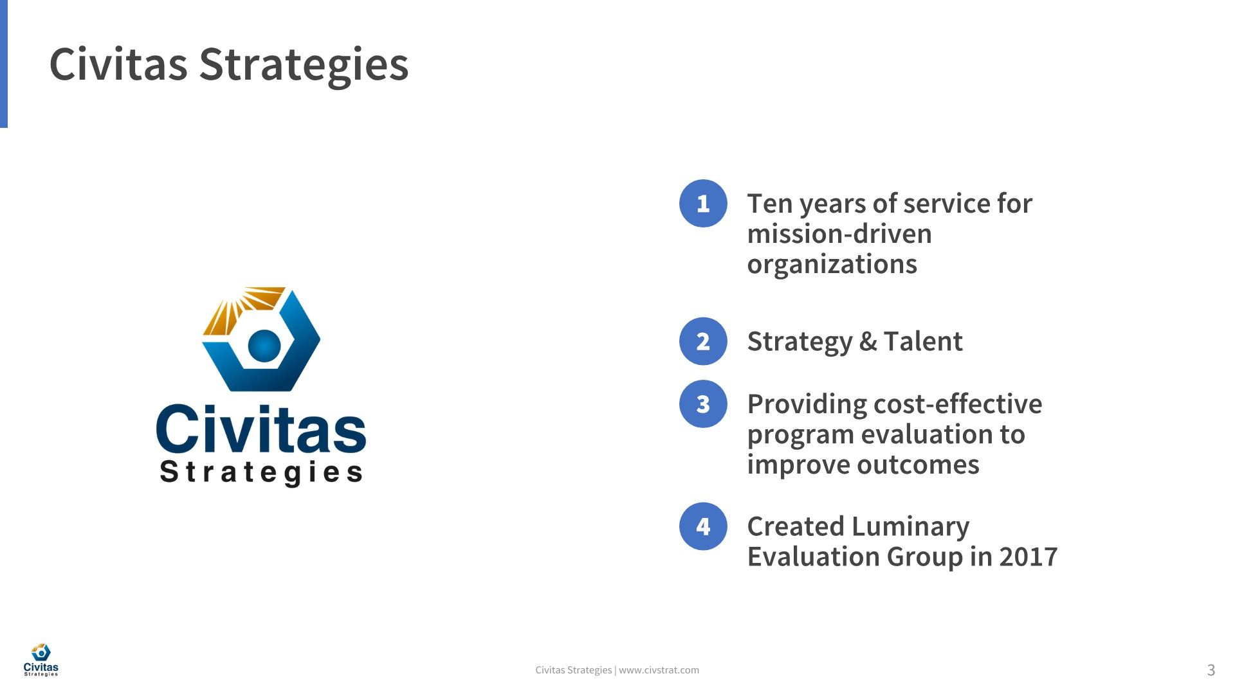

Slide 5


Slide 6


Slide 7
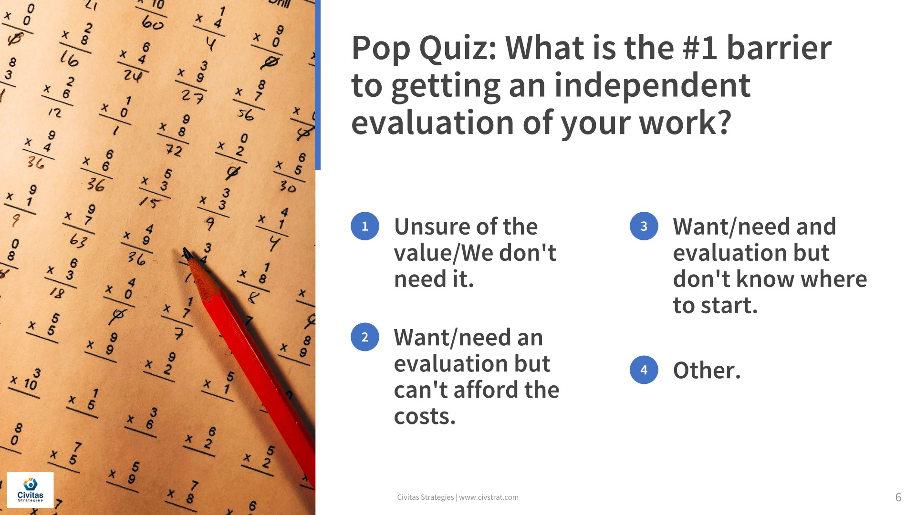

Slide 8
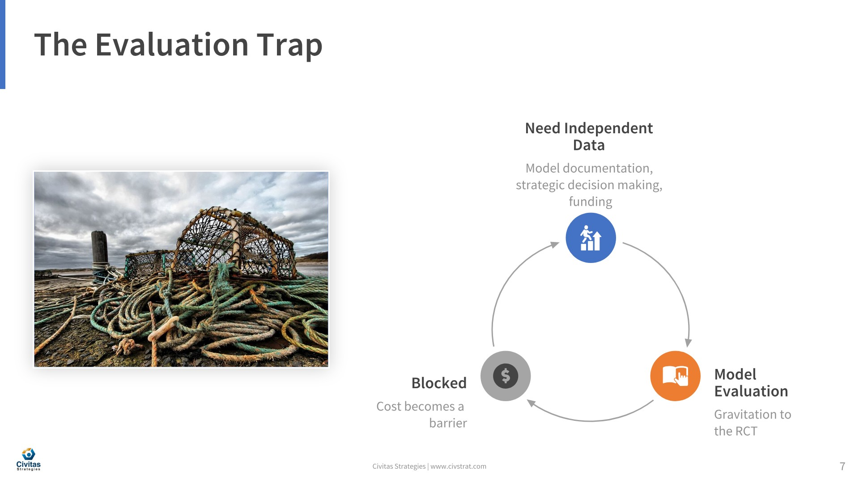

Slide 9
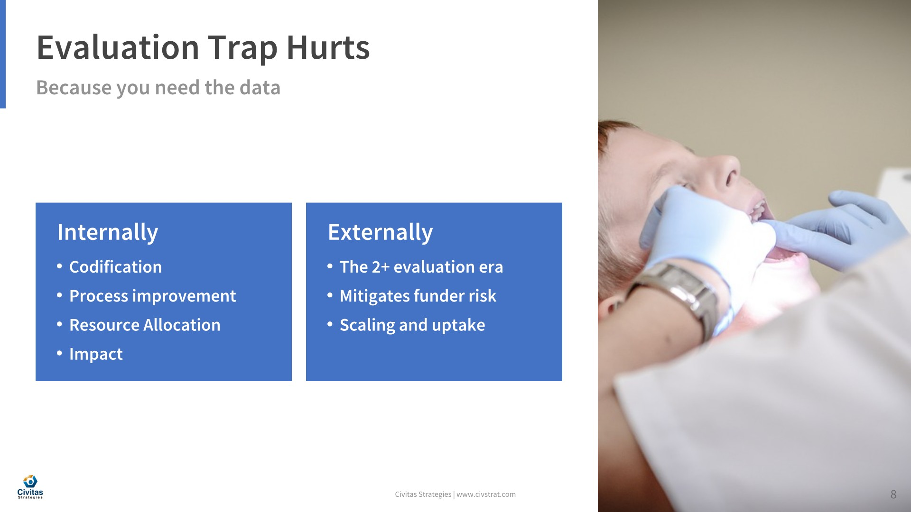

Slide 10
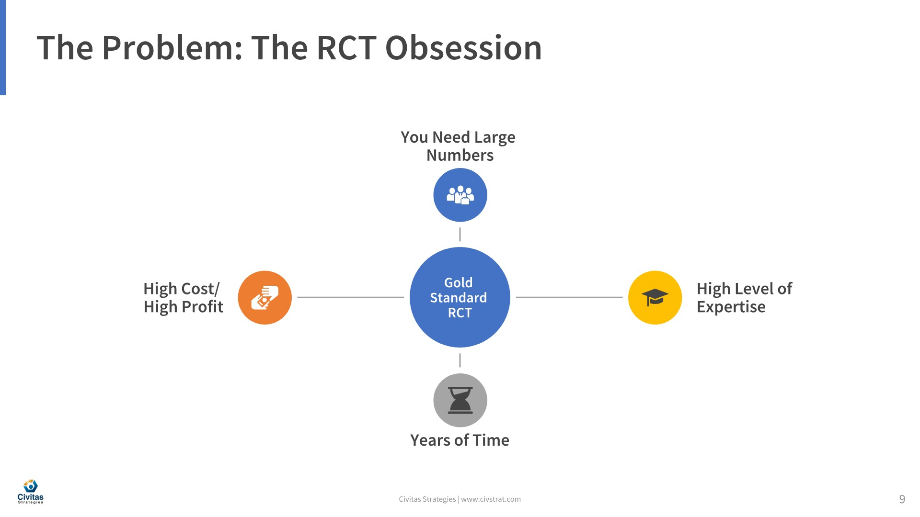

Slide 11
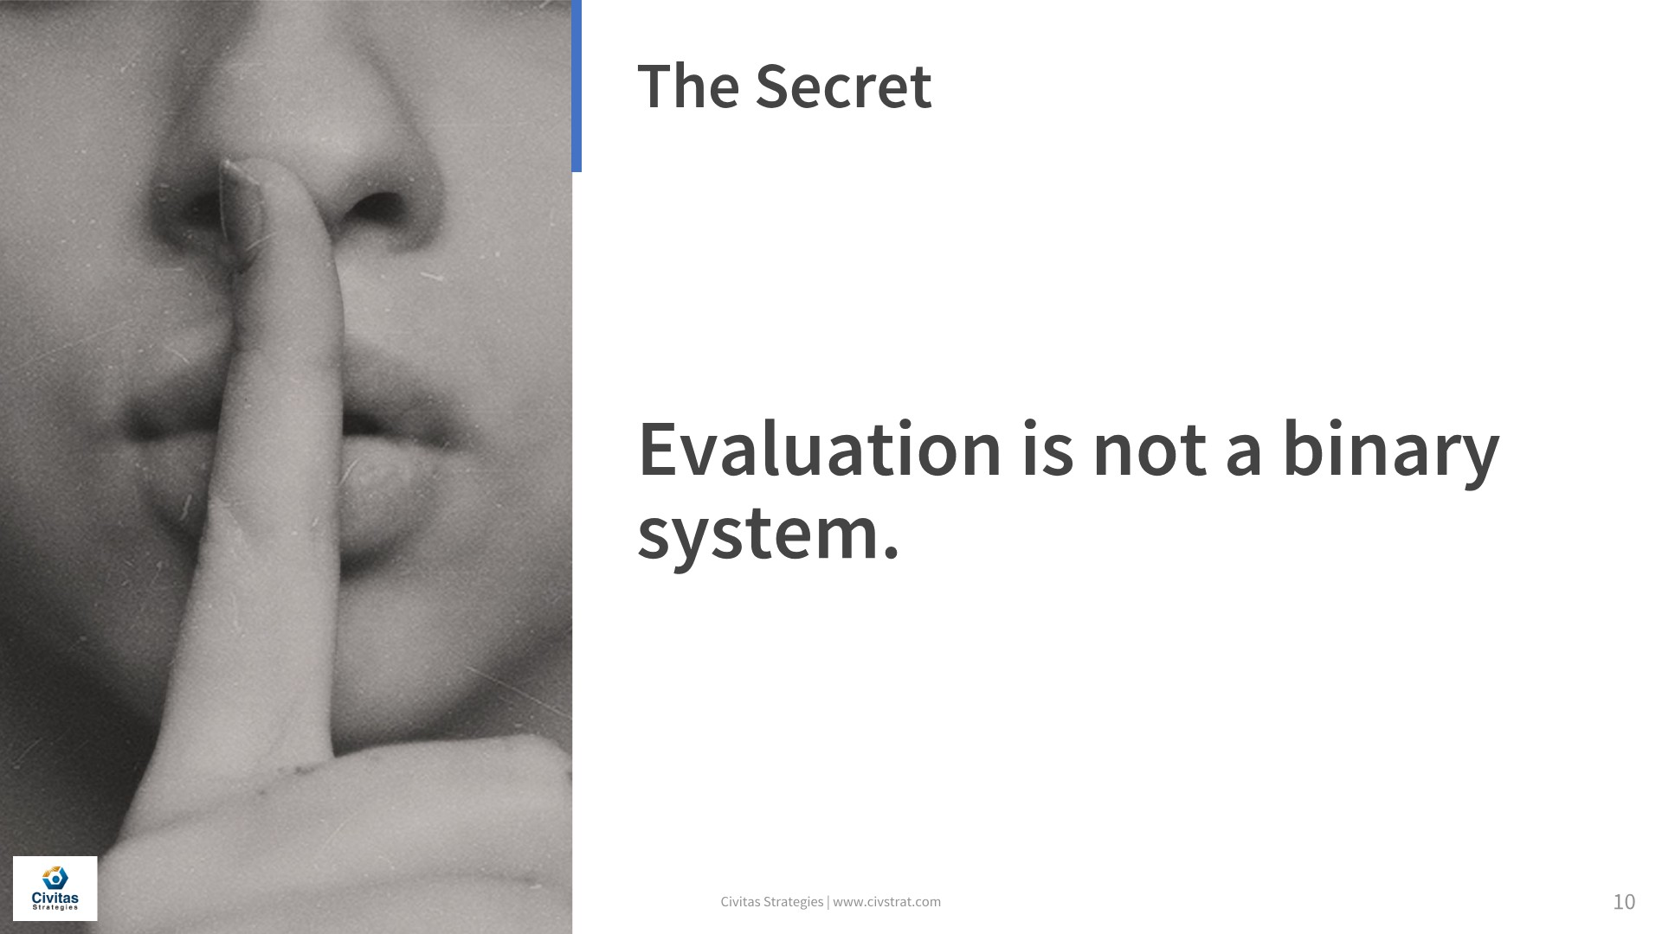

Slide 12
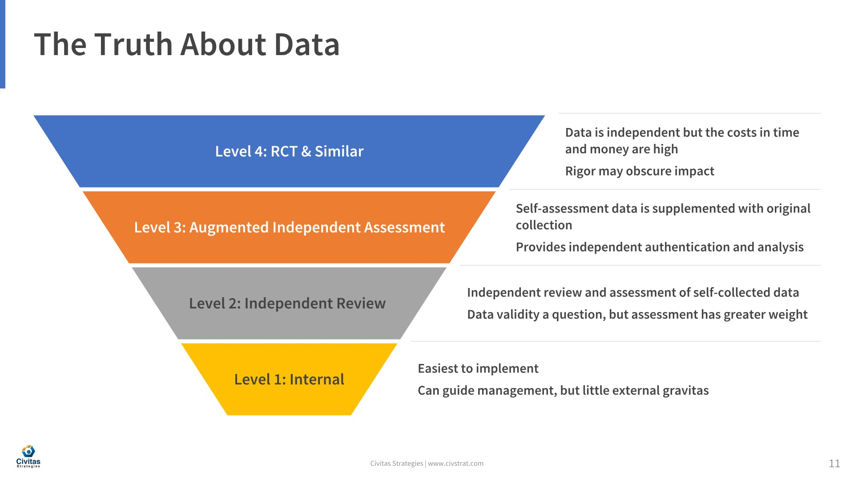

Slide 13
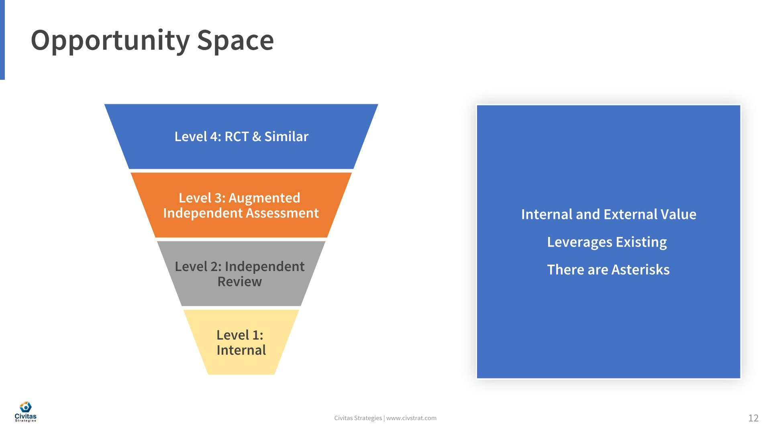

Slide 14
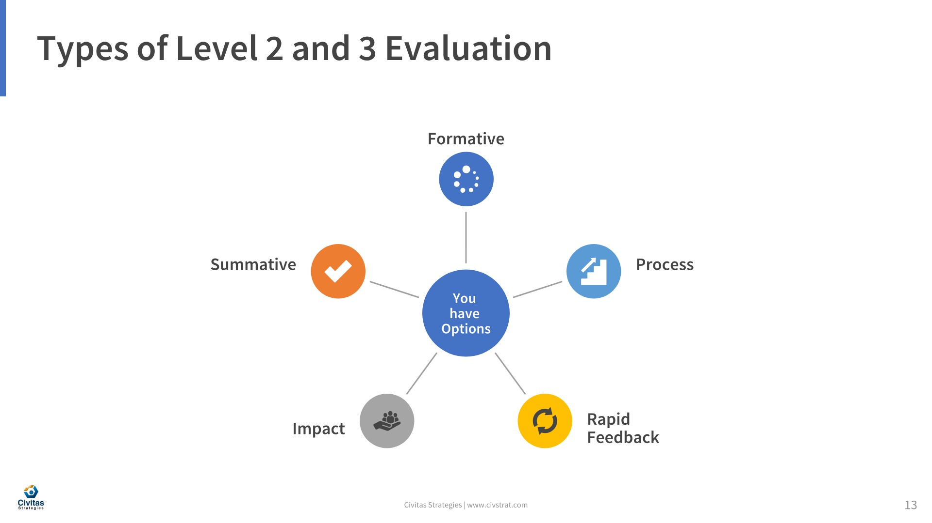

Slide 15
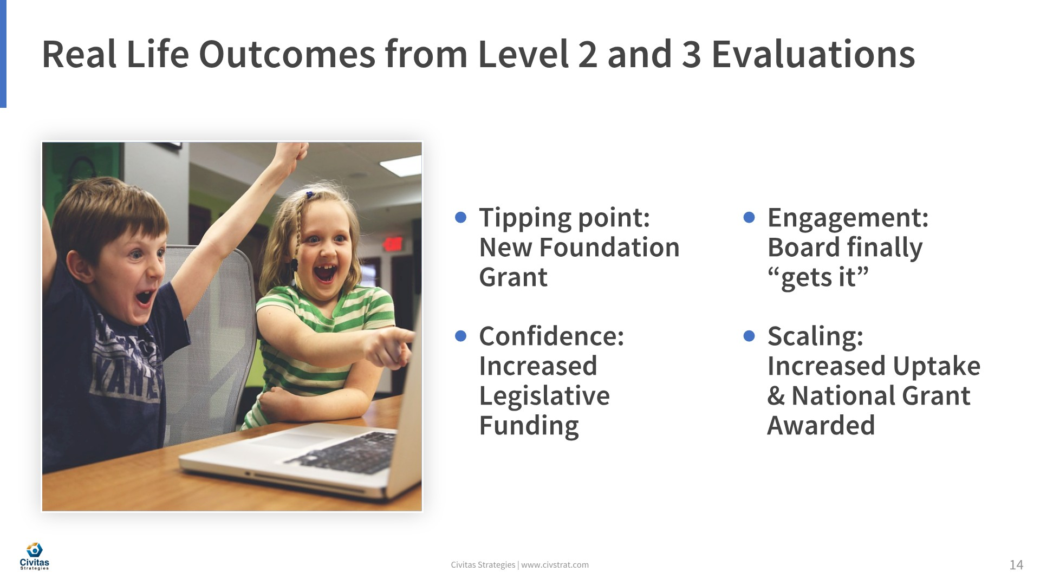

Slide 16
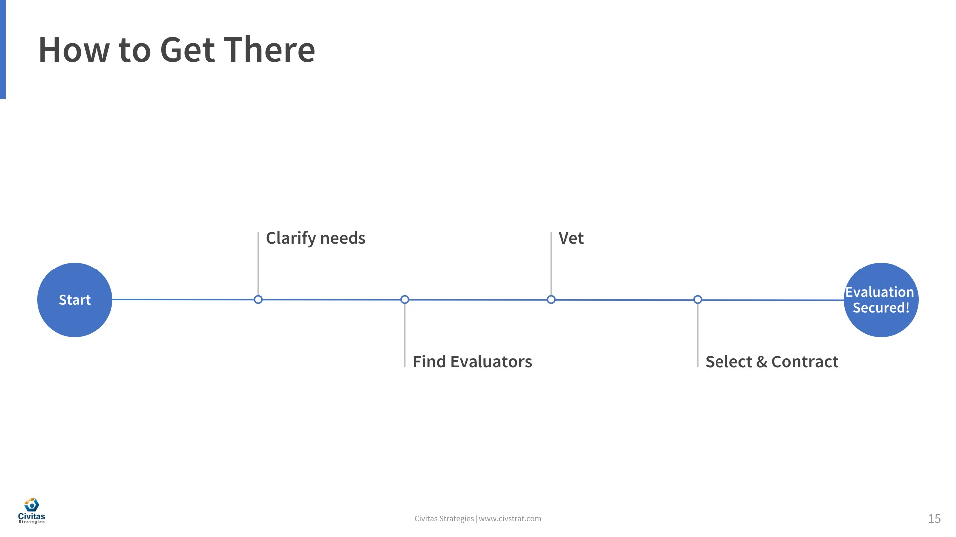

Slide 17
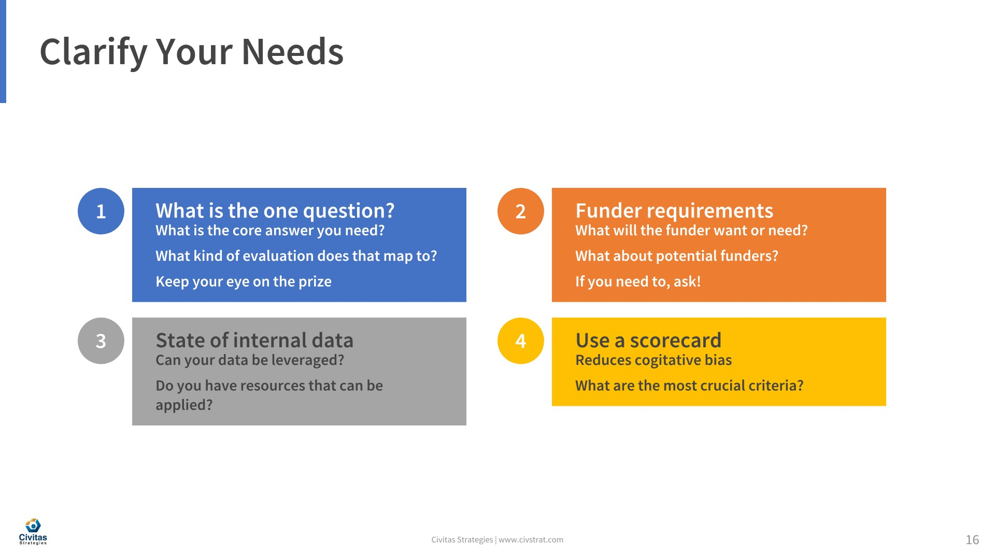

Slide 18
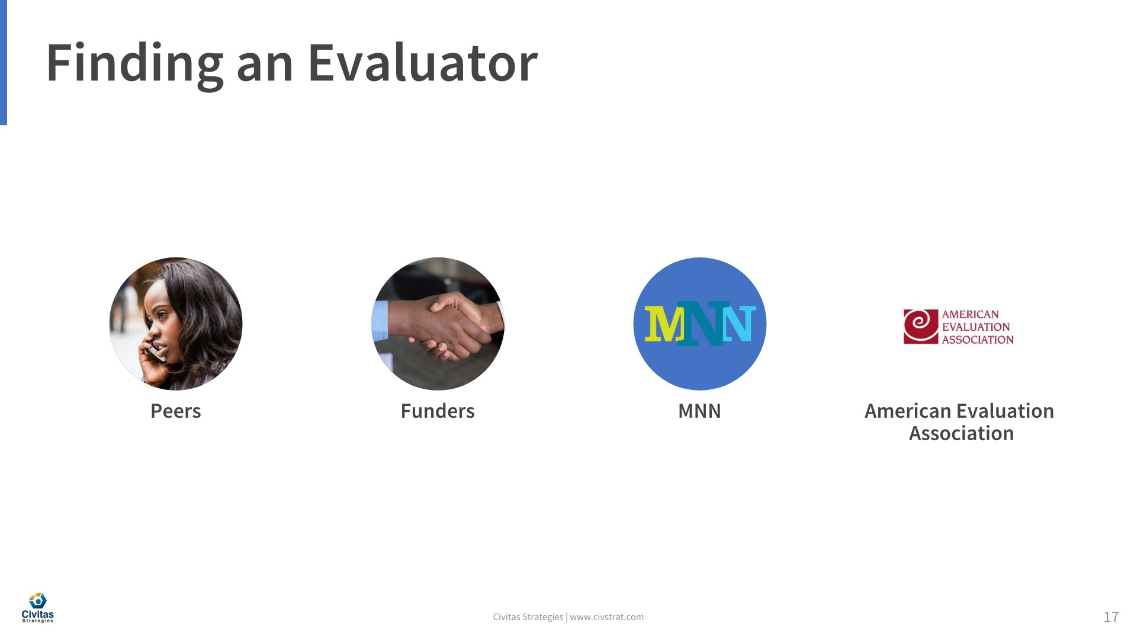

Slide 19
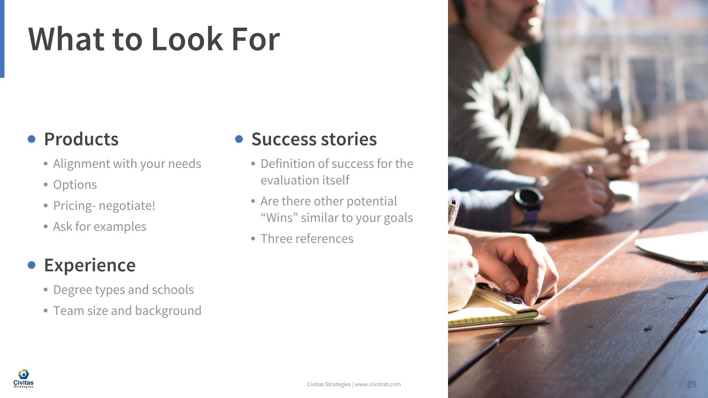

Slide 20
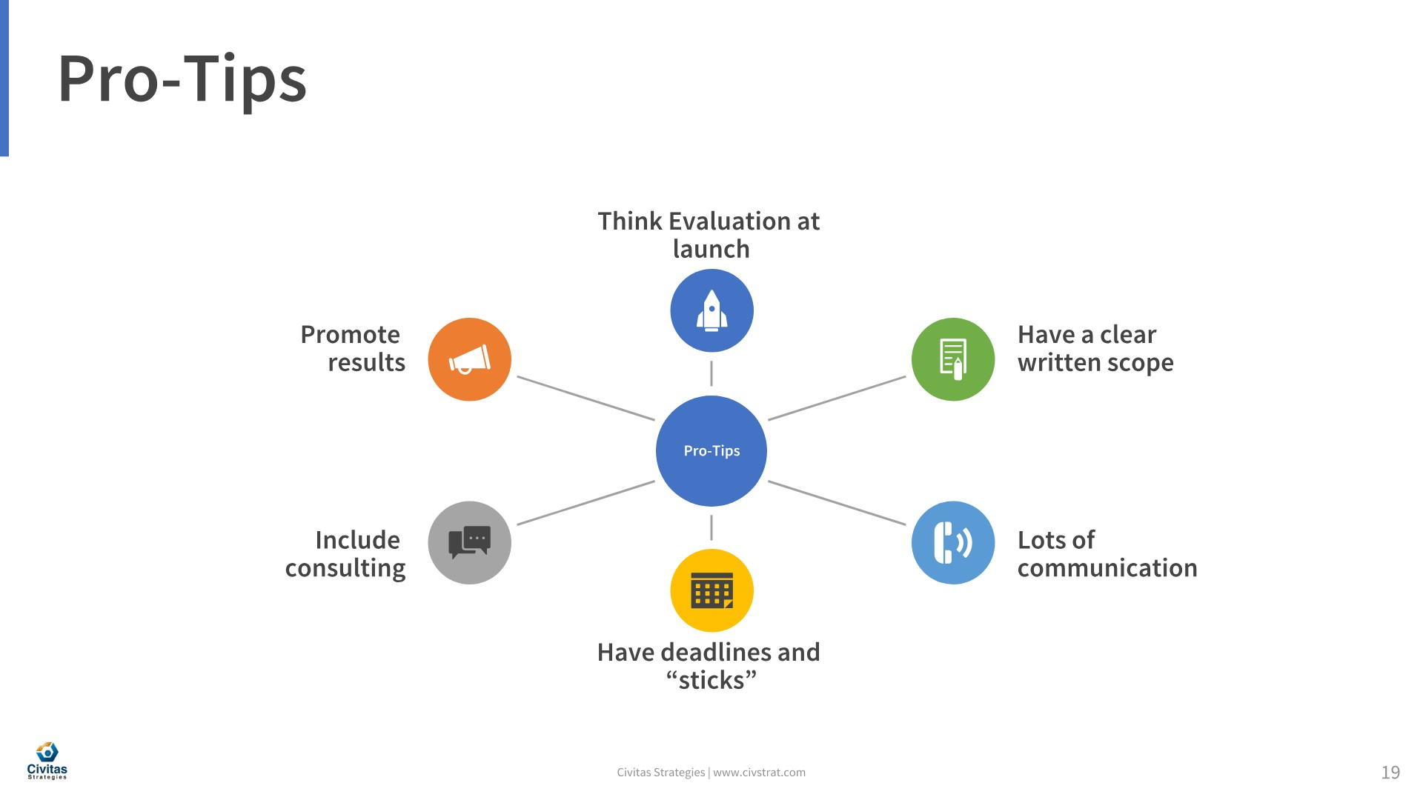

Slide 21


Slide 22
