Slide 1
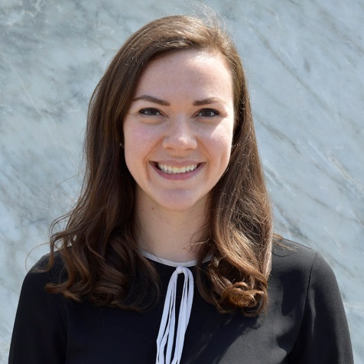

What is Culture Really and How Can You Use it as a Tool?
March 13th Webinar
Presented by Charity Shaman
Thanks for joining us! A few instructions before we begin:
You may join the audio by selecting the radio button for either “Telephone” or “Mic & Speakers.” If you are using telephone, please dial in with the conference line and audio pin provided.
If you are having any technical issues, please let us know in the chat box.
We will have time for Q&A. Please enter your questions in the chat box at any time.
This webinar is being recorded, and we will distribute the recording after the webinar.
Marta Hodgkins-Sumner
Director of Membership and Programs
www.massnonprofitnet.org

Slide 2

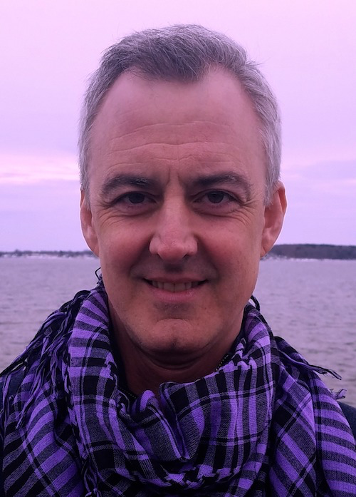

- former CFO & COO
leadership & team development coach
- podcast host
CHARITYSHAMAN.ORG WORKPLACEHEALER.PODBEAN.COM

Slide 3
How we do things
Simple examples…
Voice levels
Birthdays
Email habits
Timeliness of meetings
But, so what?

Slide 4
What is culture?
My favorite expert
Edgar Schein –
  artifacts
  espoused values
  assumptions
A bit abstract in practice

Slide 5
Values
Our “go to” starting point
Integrity
Respect
Innovation
Excellence
Customer focus
If so much similarity, are espoused values truly part of culture?

Slide 6
Looking for “fit”
An outdated approach?
Pass on promising talent
Create an “insider’s” atmosphere
Suppress diversity + its benefits
Whim of personal preference

Slide 7
Applying culture
FOCUS AND DISCIPLINE
Thing 1 - Mindsets
Thing 2. – Soft Skills
Thing 3 – Rituals

Slide 8
Applying culture
MINDSETS
Choose one “espoused value” each month and organize a meaning-making event... exchange stories of what that value looks like in action.
(Sure, serve cupcakes.)

Slide 9
Applying culture
SOFT SKILLS
Select one soft skill each quarter, asking teams to periodically discuss examples of how the skill is applied (ie: active listening, exchanging feedback, collaboration, facilitation, ideation, experimentation…)
Don’t make this a performance thing.

Slide 10
Applying culture
RITUALS
Identify, clarify and brand several existing or new “rituals” (how you do things around there) and be very deliberate about supporting their consistent use.
Senior management must champion.

Slide 11
Applying culture
RITUALS
Open chair
The 10-foot rule
Story circles
Questions first
An unexpected lunch
The Skinny
“Before we walk away”
“Pencils down”
Desk exchange
Last one in dances

Slide 12
Before we walk away…
daniel@braveshift.com

