Slide 1


Leveraging Technology to Improve Your Back Office
February 13th Webinar
Presented by Kevin P. Martin & Associates
Thanks for joining us! A few instructions before we begin:
You may join the audio by selecting the radio button for either “Telephone” or “Mic & Speakers.” If you are using telephone, please dial in with the conference line and audio pin provided.
If you are having any technical issues, please let us know in the chat box.
We will have time for Q&A. Please enter your questions in the chat box at any time.
This webinar is being recorded, and we will distribute the recording after the webinar.
Marta Hodgkins-Sumner
Director of Membership and Programs
www.massnonprofitnet.org

Slide 2
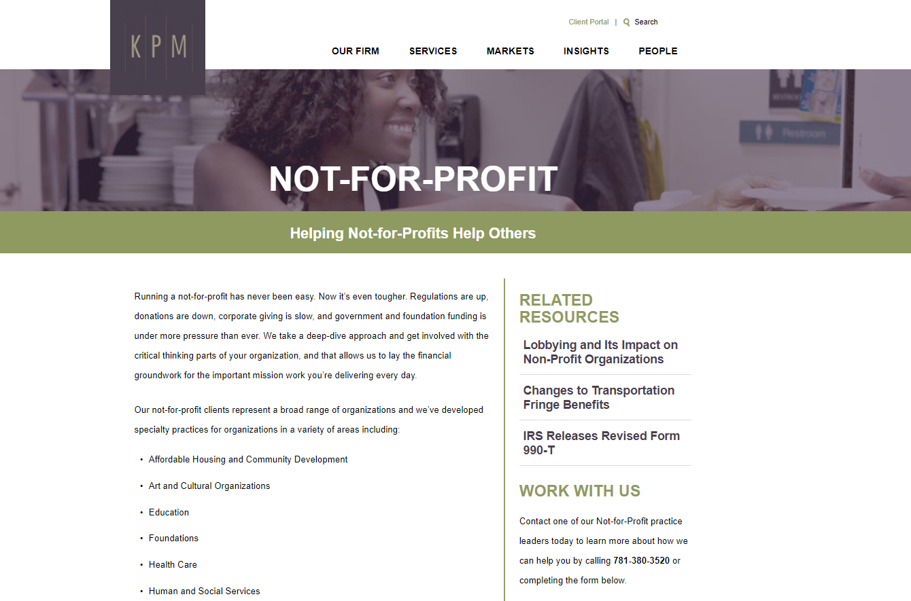
www.kpm-us.com

Slide 3
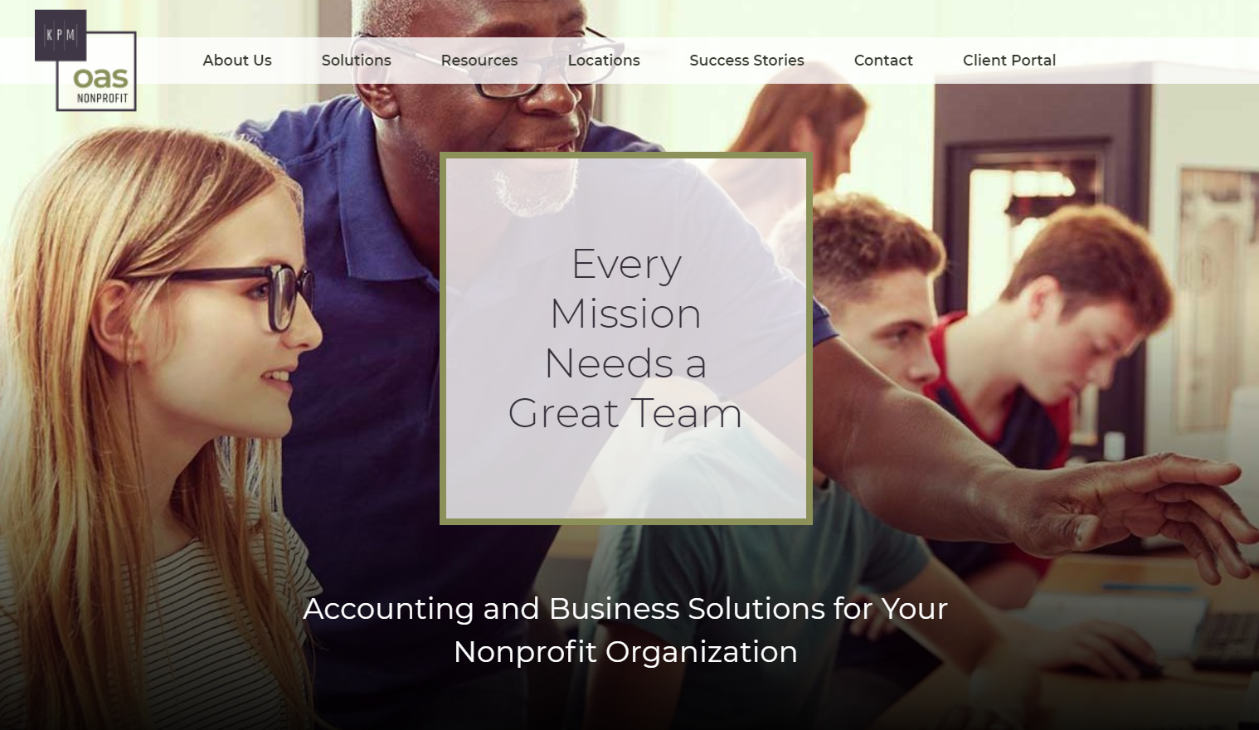
www.KPMnonprofitOAS.com

Slide 4
Our Agenda
  Documenting your process
  Technology you can leverage
  The process of change

Slide 5
Documenting Your Process
  Donations and invoicing
  Cash collections
  Vendor bills
  Cash payments
  Payroll
  Discovering two things

Slide 6
Technology You Can Leverage
  Processing vendor bills
  Expense reporting
  Vendor payments
  Data integration
  Accounting software

Slide 7
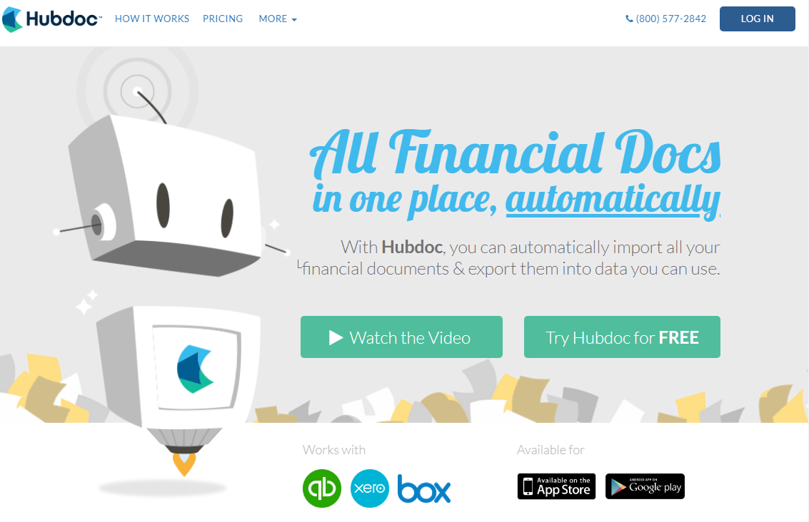
Processing Vendor Bills

Slide 8
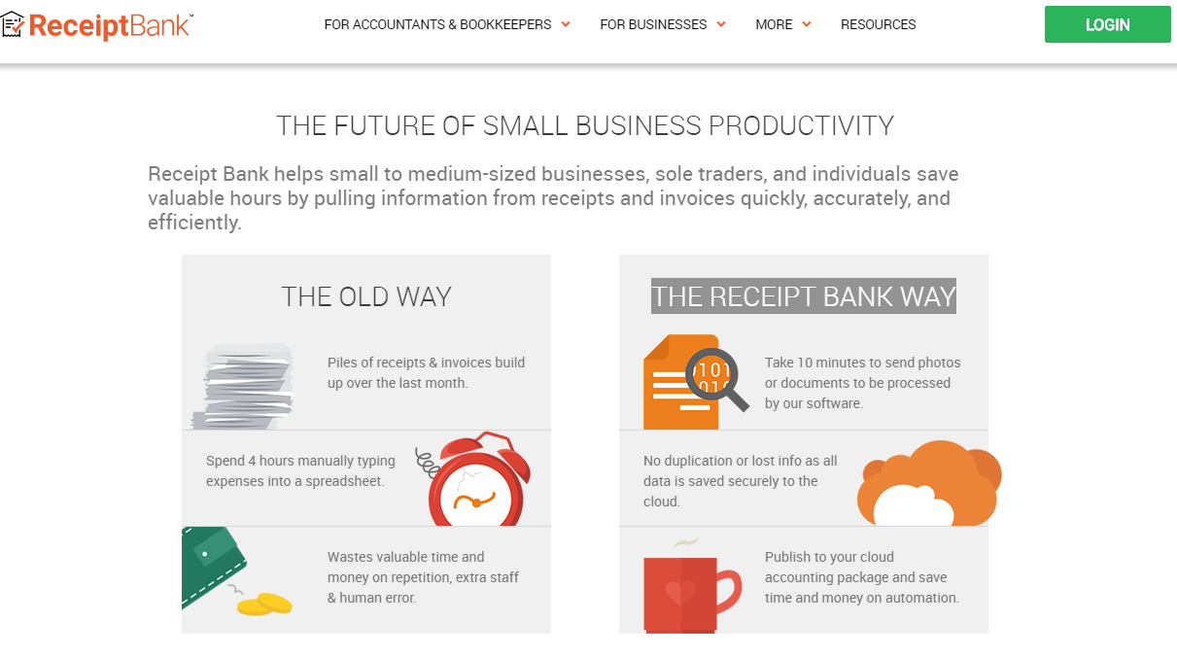
Processing Vendor Bills

Slide 9
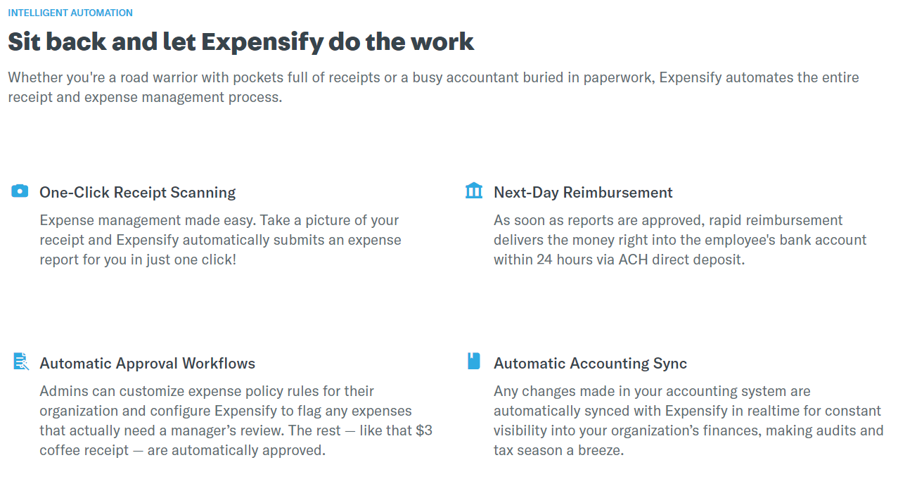
Expense Reporting

Slide 10
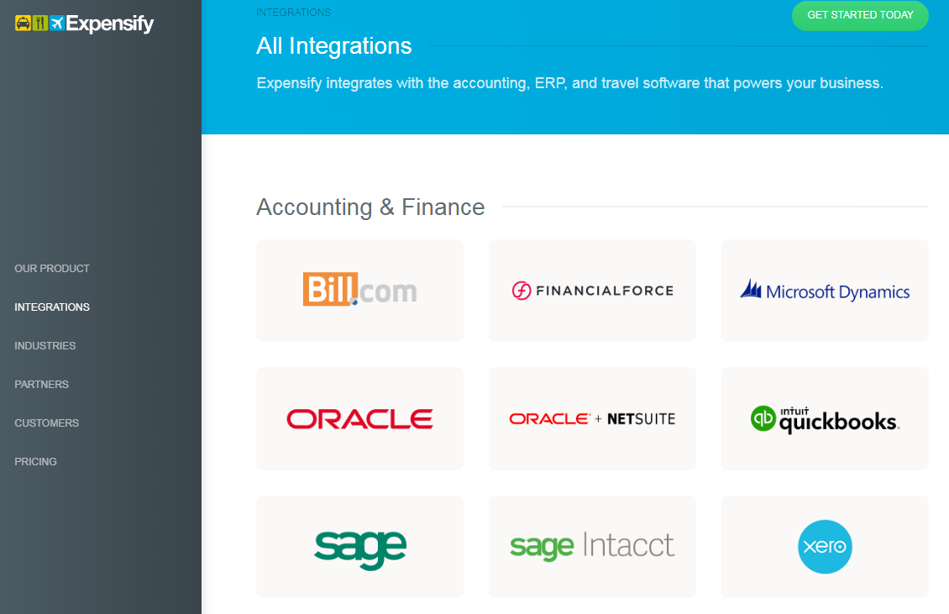
Expense Reporting

Slide 11
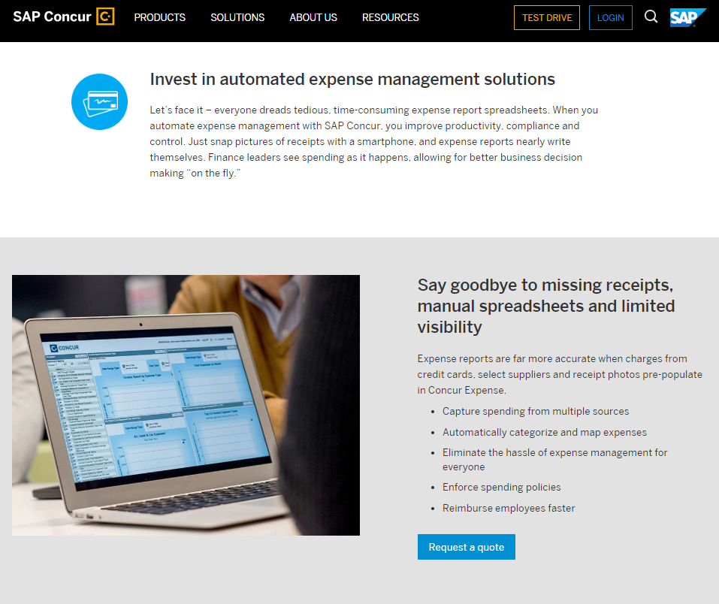
Expense Reporting

Slide 12
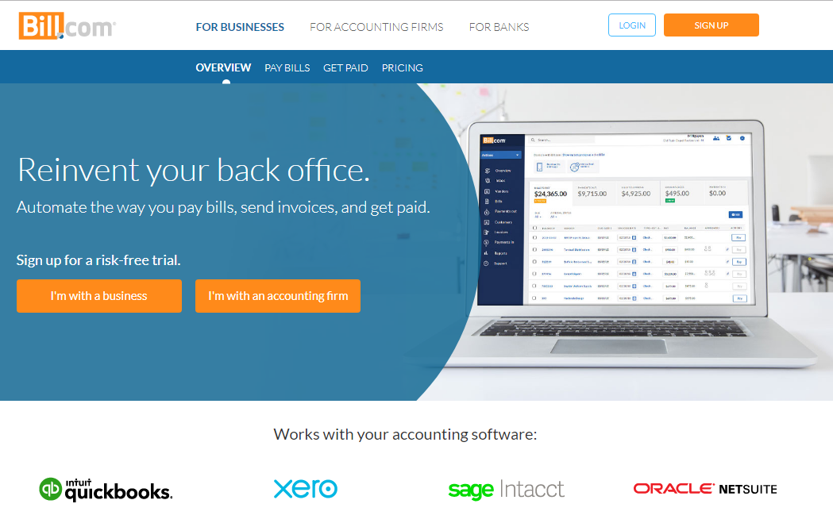
Vendor Payments

Slide 13
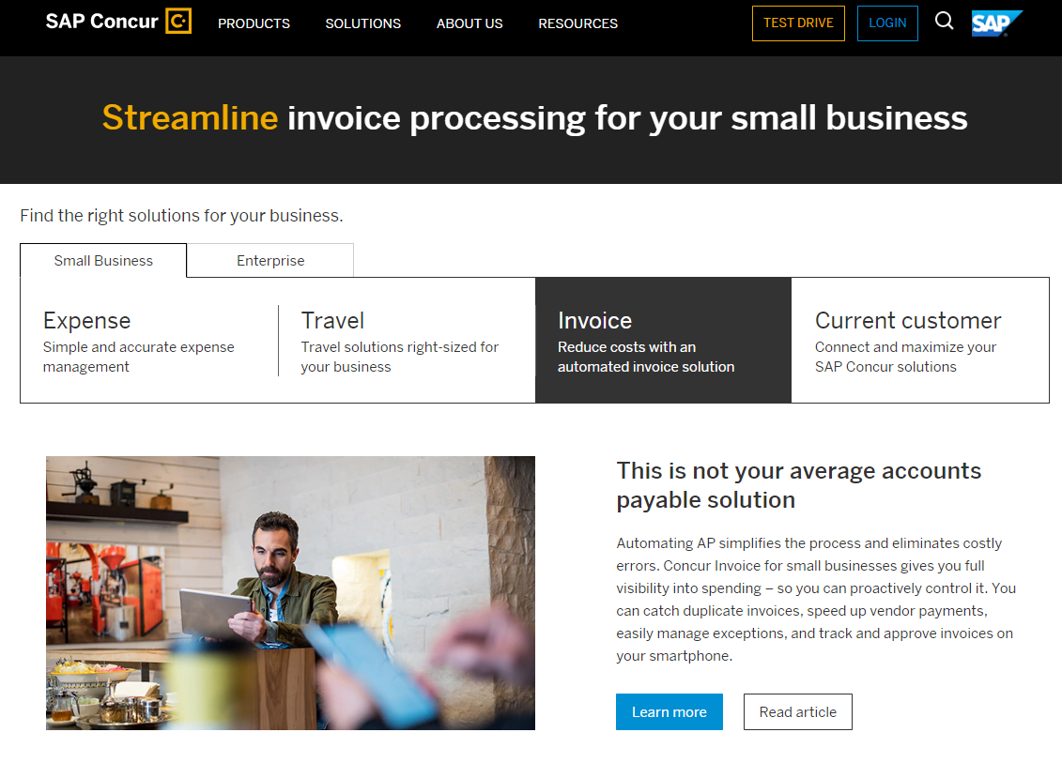
Vendor Payments

Slide 14
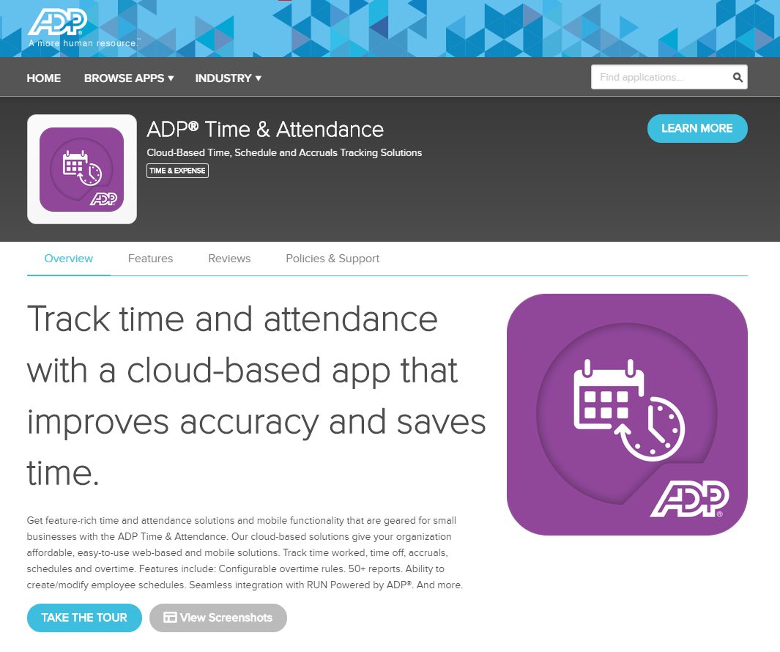
Data Integration

Slide 15
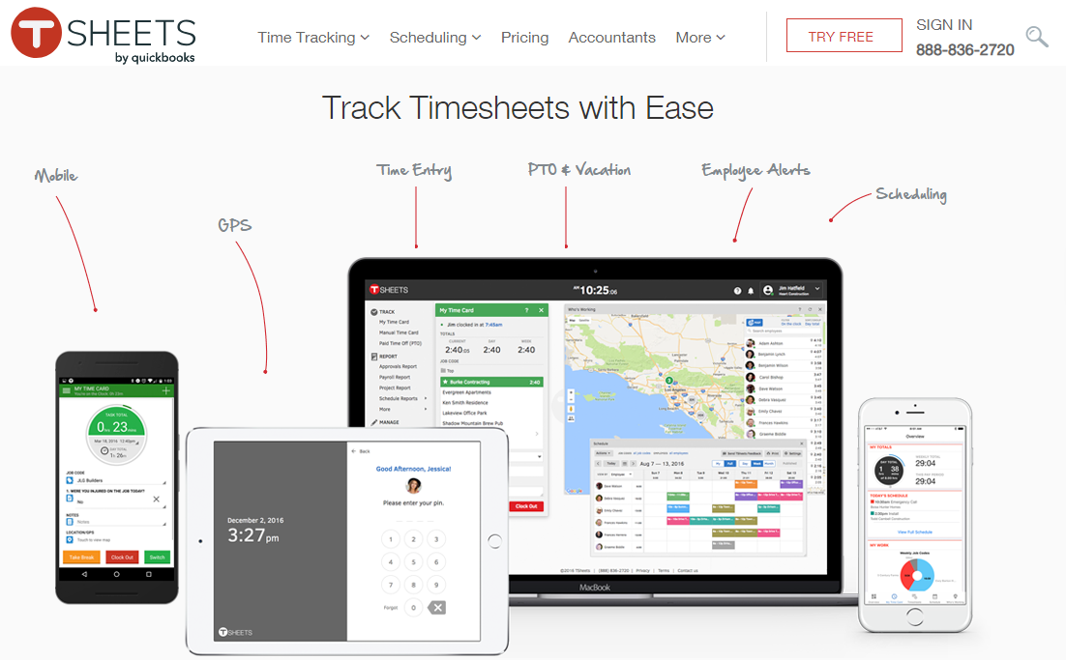
Data Integration

Slide 16
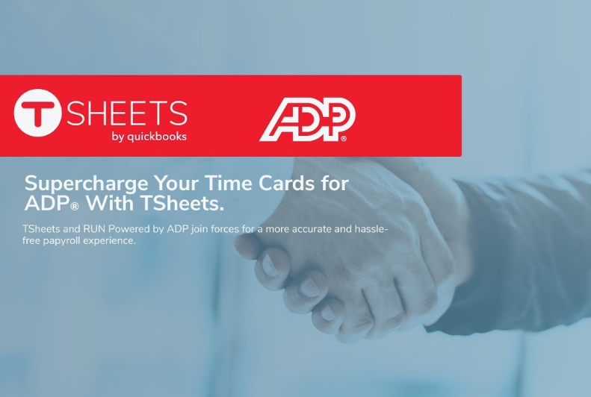
Data Integration

Slide 17
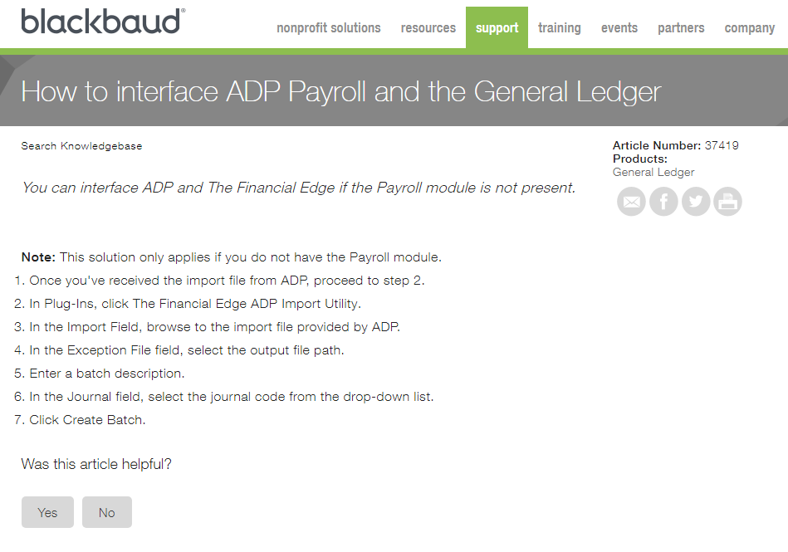
Data Integration

Slide 18
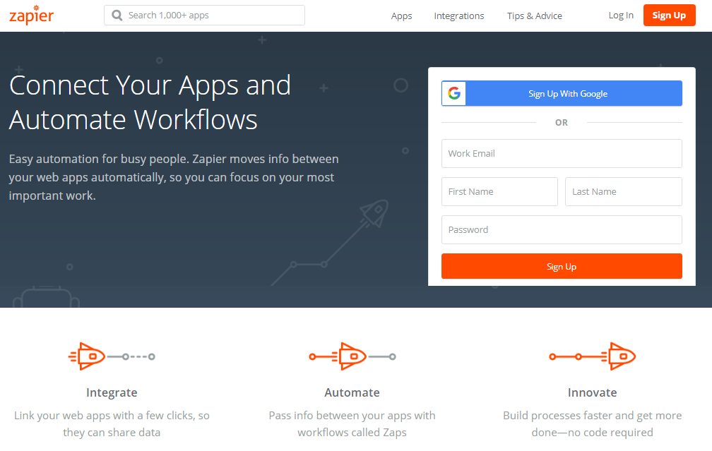
Data Integration

Slide 19
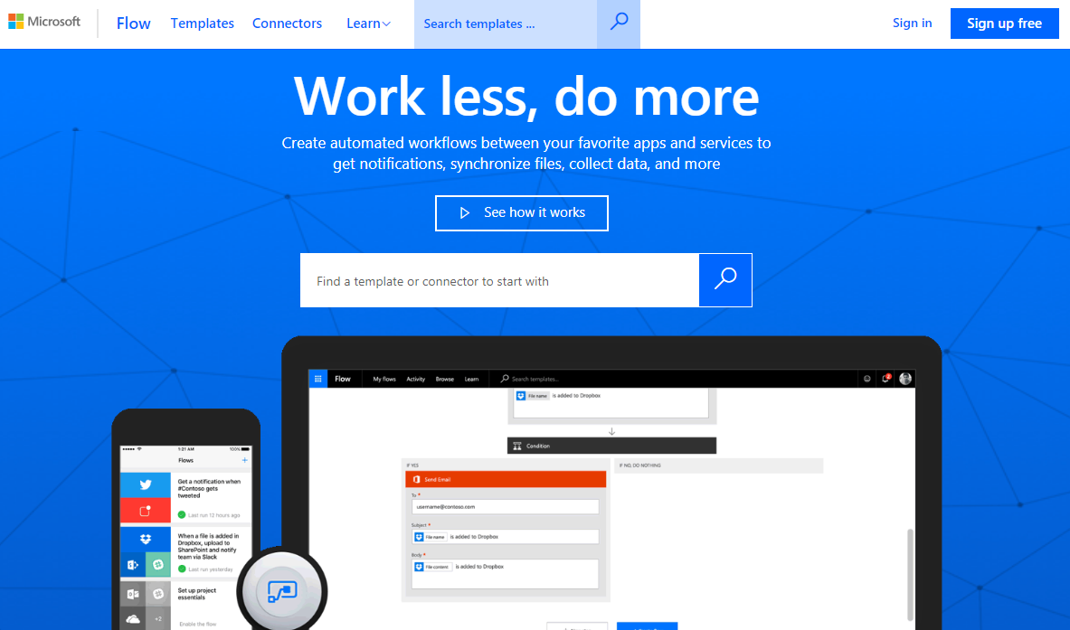
Data Integration

Slide 20
Accounting Software
  Online or on-premise
  Written for nonprofits
  All inclusive or only accounting
  Third party apps

Slide 21
The Process Of Change
  Map your process
  Determine your “that’s not changing” list
  Identify where you rekey data
  Focus on needs not features
  Plan for disruption
  Do your homework

Slide 22


Contact Information
  Barry MacQuarrie, CPA
  bmacquarrie@kpm-us.com
  James Matzdorff, CPA
  jmatzdorff@kpm-us.com

