Slide 1


How to Build a Strong Nonprofit Brand

Slide 2
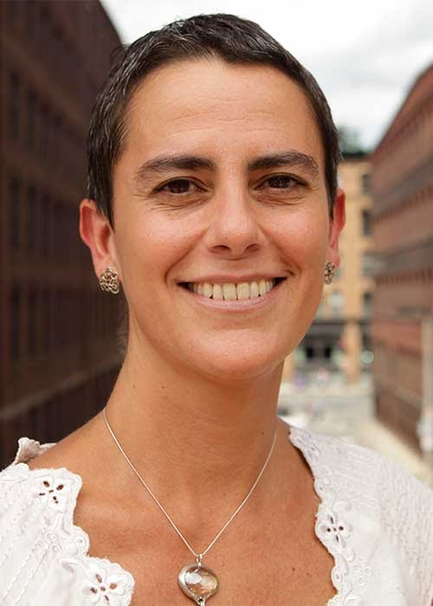
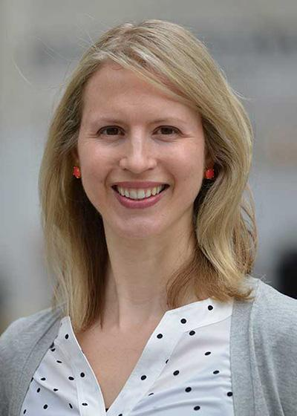
@flowetikboston
Zamawa Arenas
@ZamawaArenas
Brianne Miers
@Brimiers

Slide 3
What are we going to do today?
How to build a strong brand
Telling your brand story
Small group breakout session
Report out on key takeaways

Slide 4

What are we going to do today?
Brand is the image people have of your organization.
It is the sum total of perceptions about what a nonprofit stands for, what it does, and how much social impact it is thought to achieve.
Notes:
It is the sum total of perceptions about what a nonprofit stands for, what it does, and how much social impact it is thought to achieve.

Slide 5
What are we going to do today?
Or, quoting Jeff Bezos, “your brand is what people say about you when you’re not in the room.”
Notes:
It is the sum total of perceptions about what a nonprofit stands for, what it does, and how much social impact it is thought to achieve.

Slide 6
What are we going to do today?
Strong nonprofit brands are
engineered & stand for something
Different
Superior
Add value
Preferred
Sustainable

Slide 7
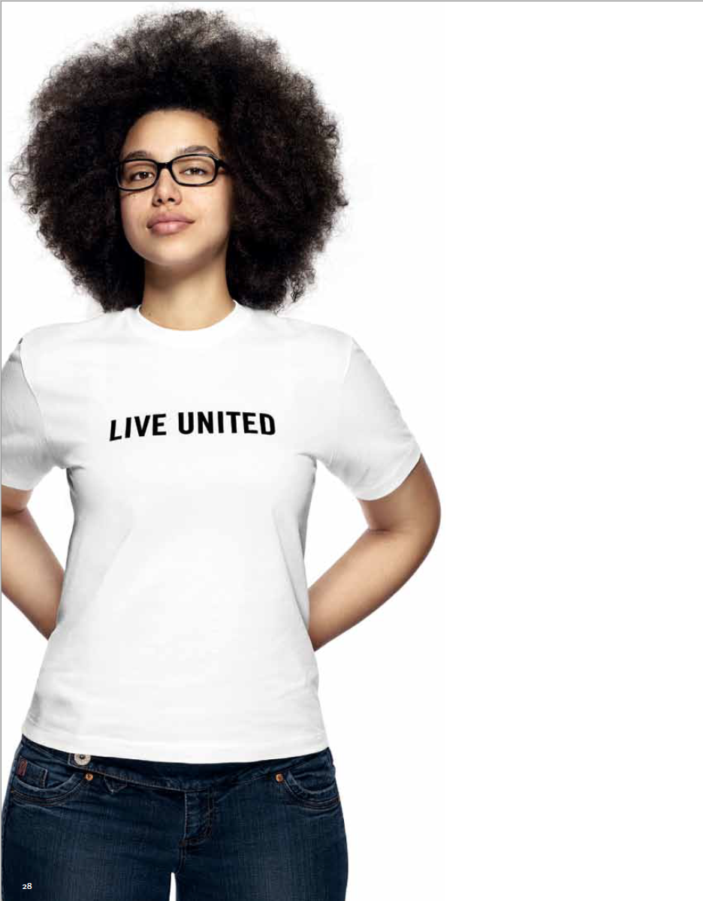
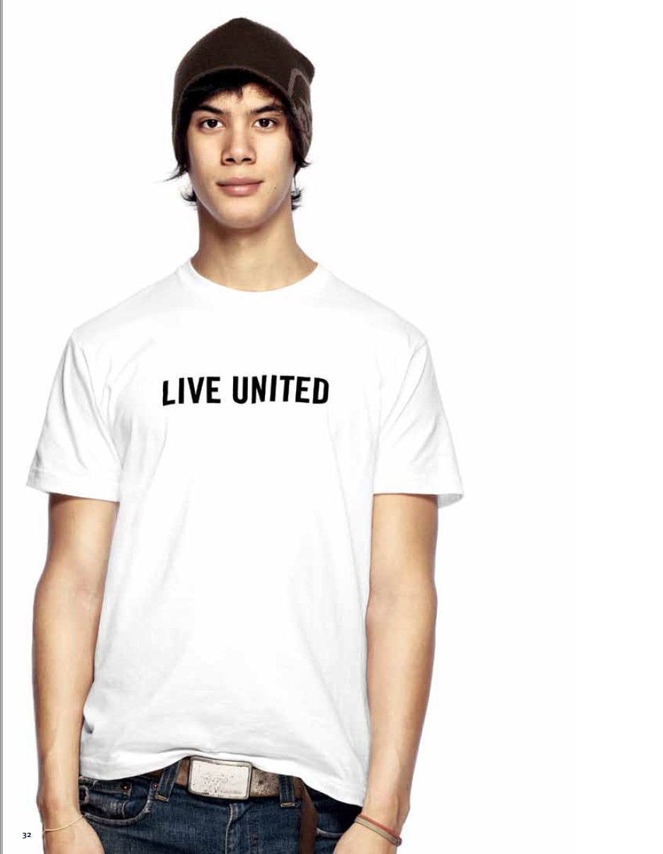

Notes:
Large organizations have the resources to maintain a strong brand presence, but smaller organizations can be successful by making managing their brand a strategic objective.

Slide 8
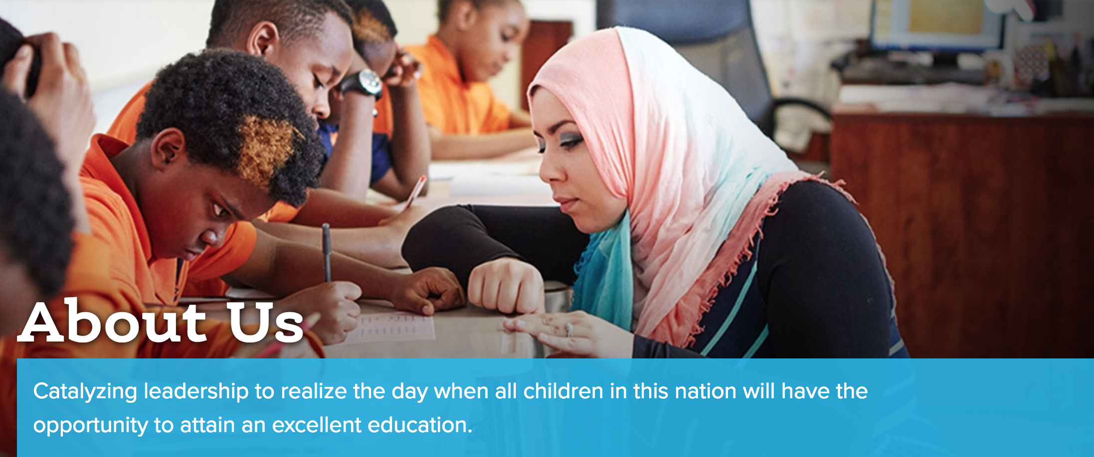



Slide 9

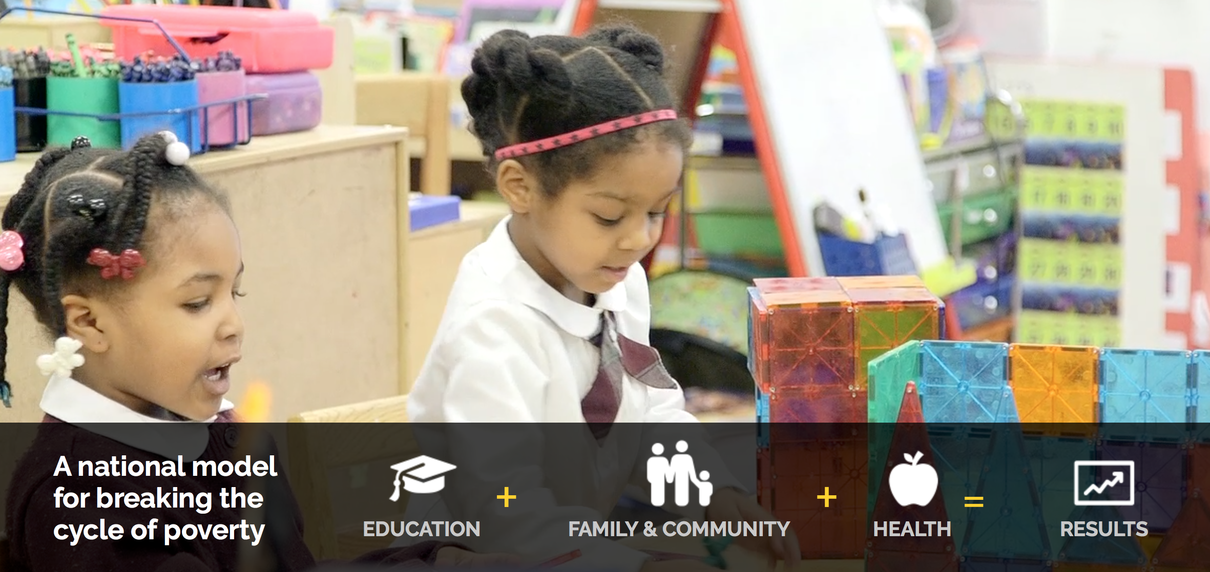

Slide 10
What are we going to do today?
3 building blocks

Slide 11
Have a clear impact claim
# 1
How an organization defines a social impact objective that is broadly accepted, consistently relevant, and compelling to multiple audiences
Notes:
All the clever positioning and communication in the world will not help a nonprofit that is unclear about its objectives and why they should matter to others.

Slide 12
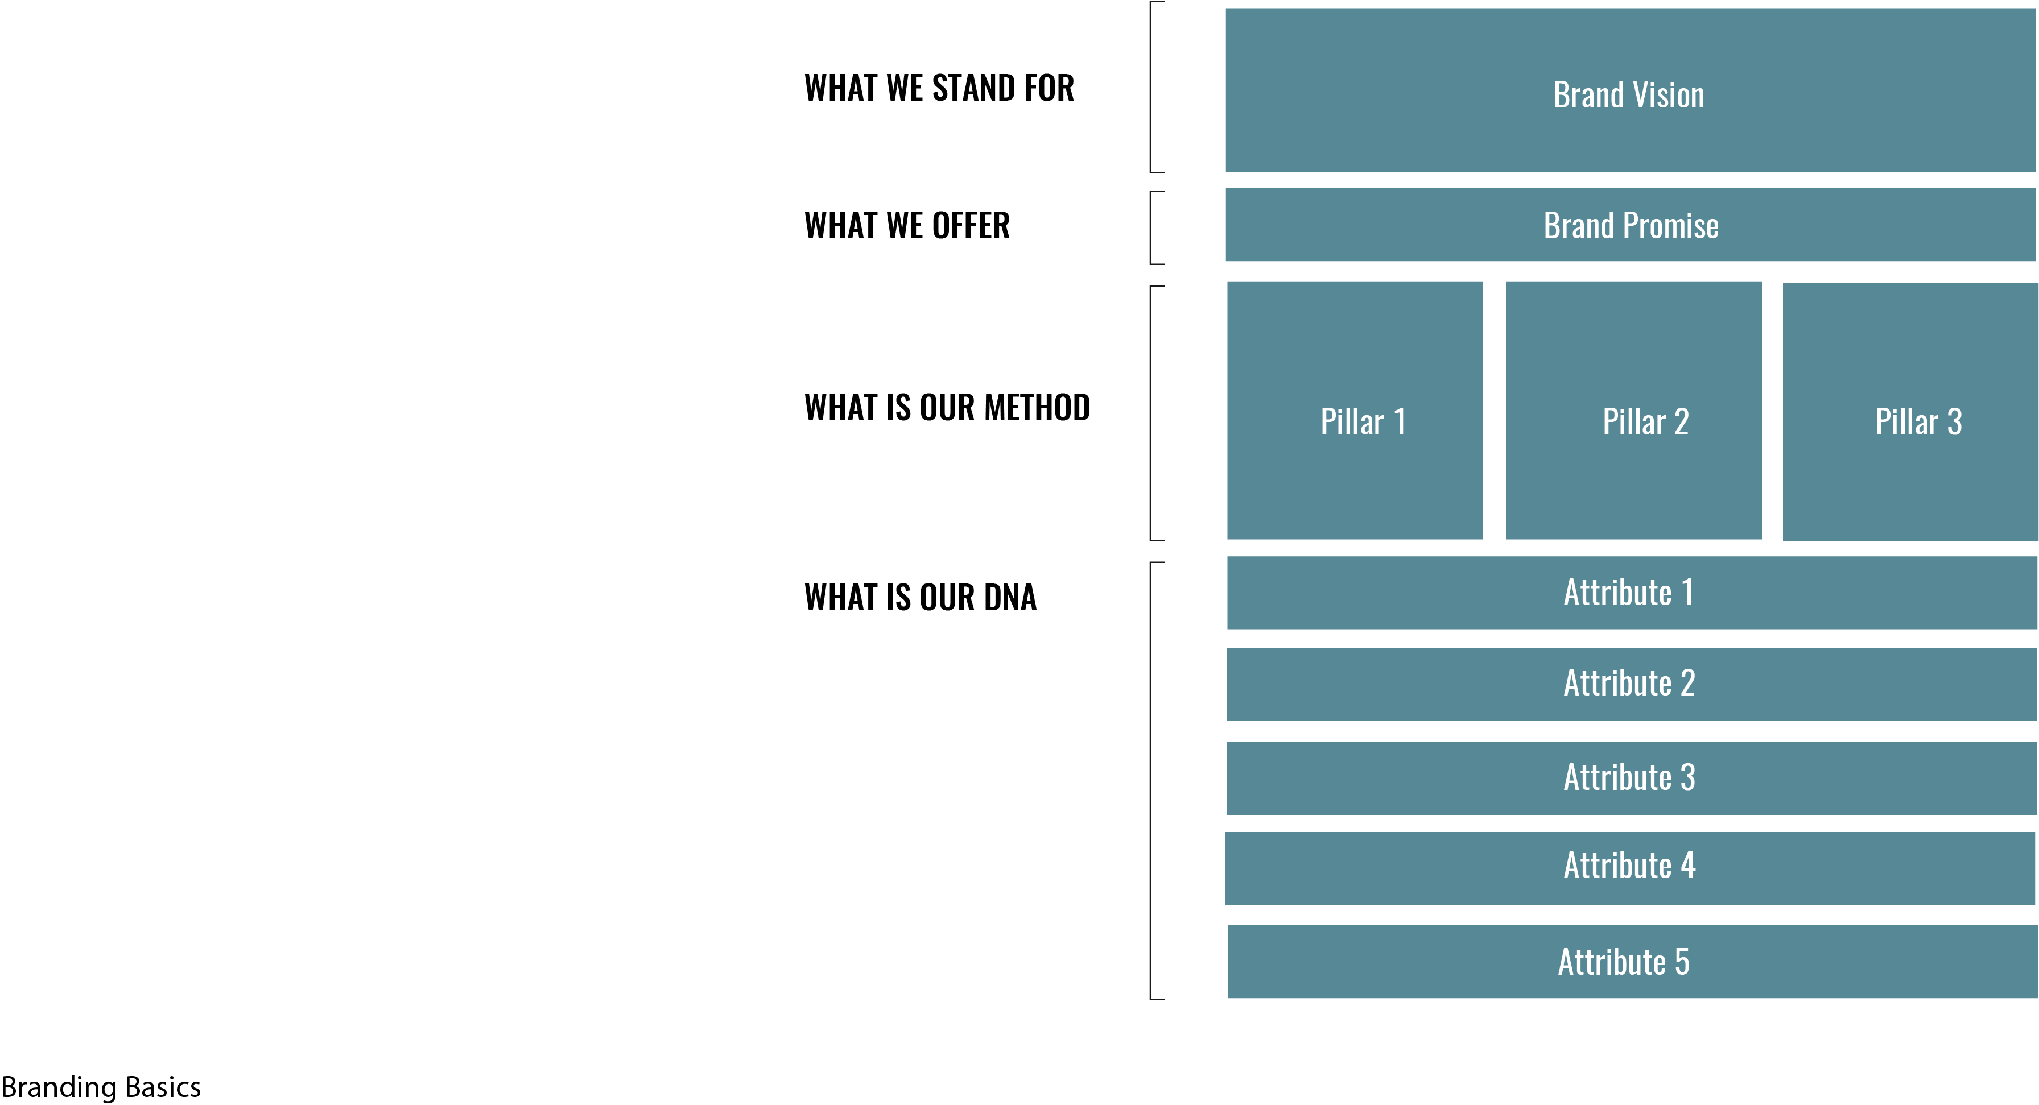

Define and position your brand
#2

Slide 13

Define and position your brand
#2
End of economic exclusion
Bring public/private forces together
Grantmaking
Convening
Research
Inclusive
Resourceful
Impatient
Hopeful

Slide 14
Sweat the visual identity details
# 3
Your visual identity is the visual aspect of branding
It evokes your brand position, feelings and experiences with the brand
Visual repetition creates recognition

Slide 15

What are we going to do today?
Logo
Color palette
Photography
your visual identity matters

Slide 16
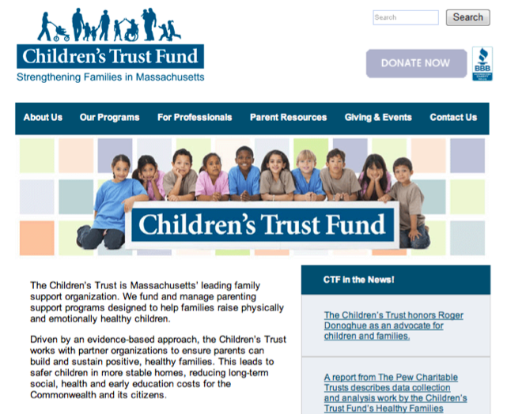

Slide 17


Slide 18



Slide 19
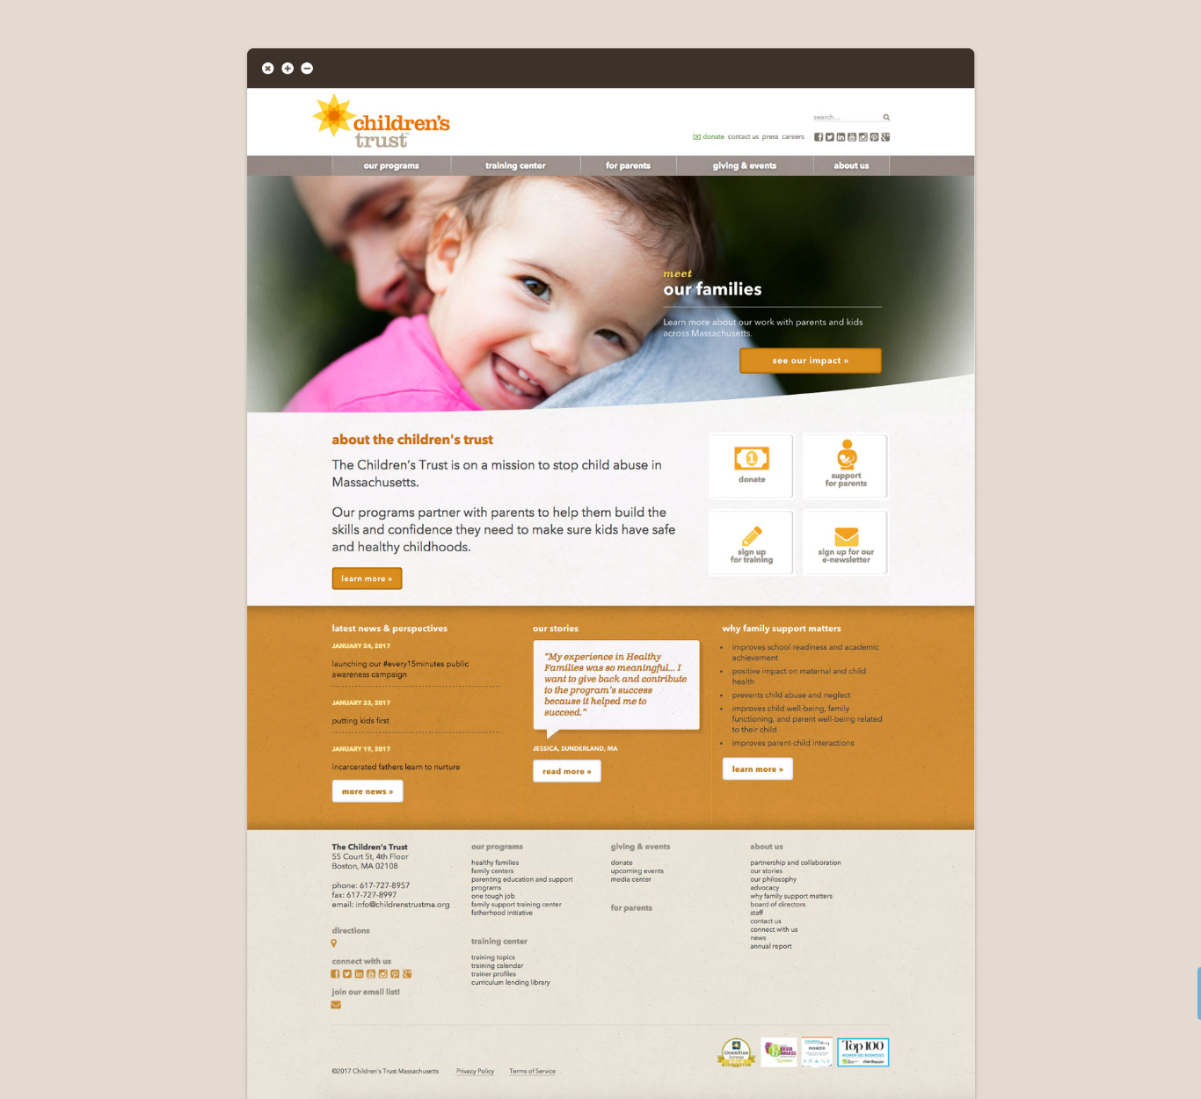
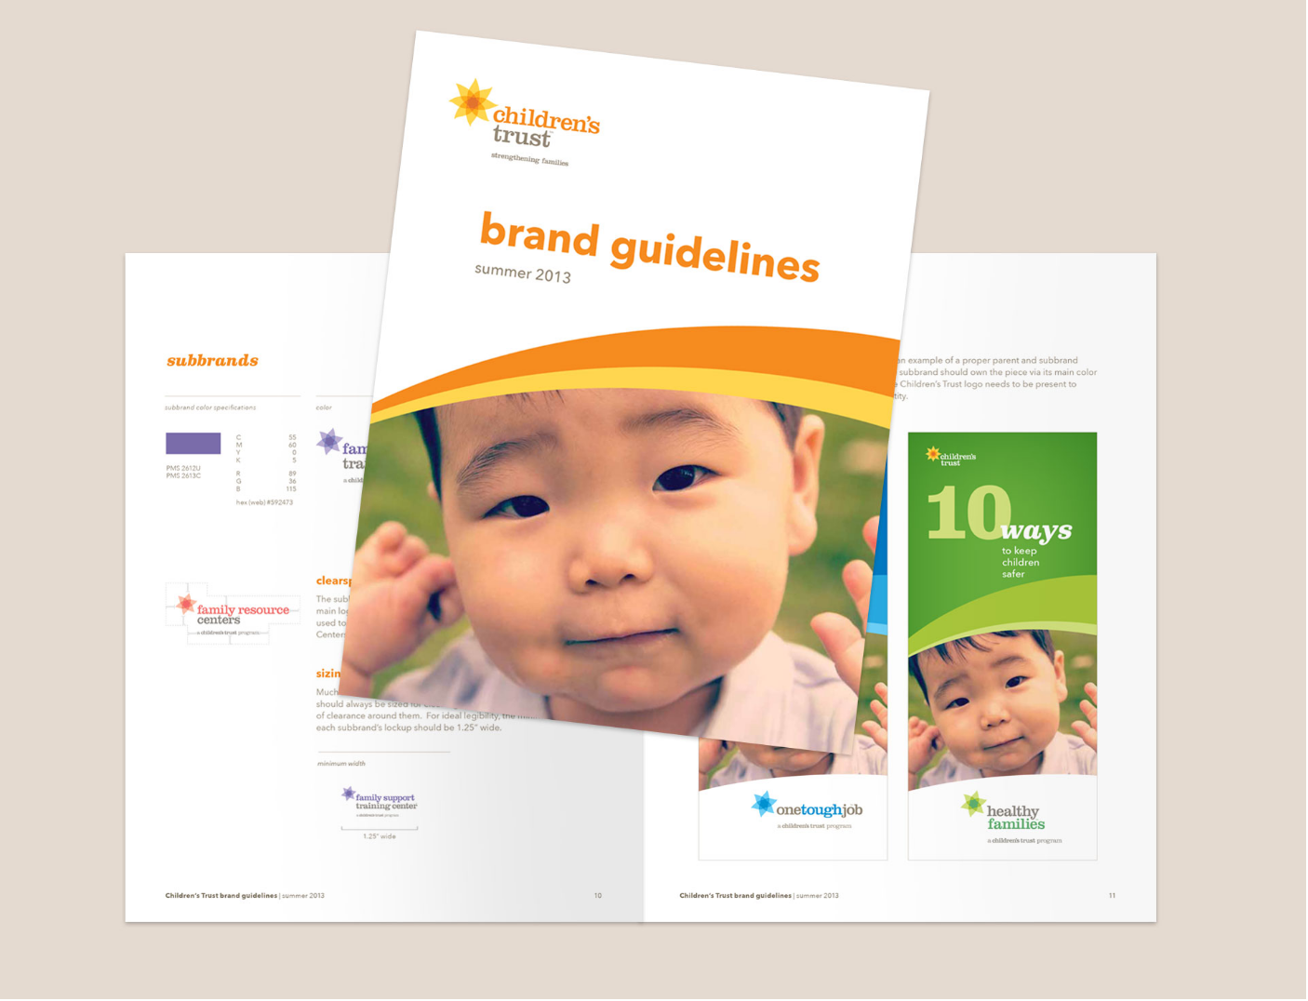

Slide 20
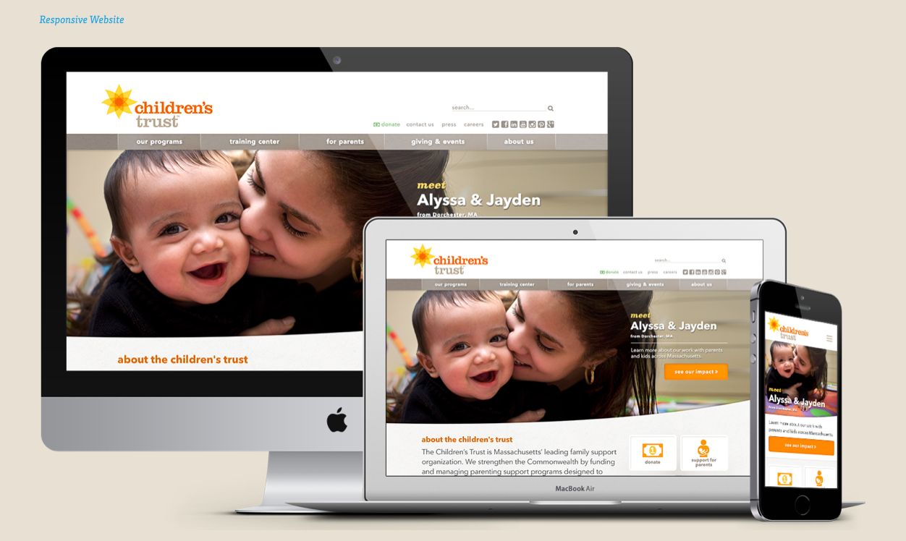

Slide 22
a brand that captures your mind gains behavior
a brand that captures your heart gains commitment
What are we going to do today?

Slide 23

telling your brand story

Slide 24

know your goals

Slide 25
SET THE STRATEGY
What do we want to accomplish?
Define big-picture goals
  Building brand & reputation
  Raising profile as thought leader
  Acquiring new donors
  Attracting new members or volunteers
  Recruiting new participants
Set measurable, achievable objectives
Make sure your messaging is clear

Slide 26
SET THE STRATEGY (cont.)
What do we want to accomplish?
Conduct an audit
  What activities are helping meet goals & objectives?
  What activities have the highest engagement & ROI? (Look at analytics.)
Determine capacity & resources
  What can you handle now?
  What can you outsource?
Map out priorities for the quarter/year

Slide 27

know your audiences

Slide 28
DEVELOP LISTS OF AUDIENCES
Who are we talking to?
  Who is currently important to your organization?
  Who do you want to be important to your organization?
  Who needs to be informed about your organization? – community influencers, media, gov. officials
  These lists should be reevaluated regularly.

Slide 29
GET TO KNOW THEM
Who are we talking to?
  Who are they? (Get specific!)
  How do they get information & make decisions?
  Who are they listening to?
  Join relevant Facebook groups for geography & niche.

Slide 30

know what to say

Slide 31
THINK IN STORIES
Who are we talking to?
  Client story
  Staff story
  Volunteer story
  Donor story
  Community story – validation from influencer

Slide 32
CONTINUALLY COLLECT & CREATE CONTENT
What do you have to say?
  Numbers – services, successes (Piktochart)
  News & Events – new staff, programs, awards
  Issues – What’s going on in the news?
  Testimonials – clients, volunteers, donors
  Photos – clear & creative images (Canva)
  Videos – short & sweet, show personalities, use Facebook Live & Instagram stories
  Holiday tie-ins – Thanksgiving, New Year

Slide 33
USE IT, DON’T LOSE IT
What do you have to say?
Make sure it’s a priority
  Build process into operations.
  Who is taking the lead?
  Who needs to be involved?
Keep it organized & accessible (Dropbox / Drive)
Repurpose & reshare – modify for different audiences & channels

Slide 34
know how to say it

Slide 35
CHOOSE THE RIGHT CHANNEL
How do we connect?
  Start with your strategy
  Know what content works best
Facebook – Videos
Twitter – Advocacy, issues
LinkedIn – Blog posts
Traditional media – “hard news,” Op-Eds, events

Slide 36
BUILD YOUR COMMUNITY
How do we connect?
  Make it easy – Have social channels & hashtag visible
  Encourage engagement – polls, questions, contests, etc.
  Add value – share knowledge, engage in important issues, share community news, promote other orgs.
  Engage your ambassadors – Provide content to share

Slide 37
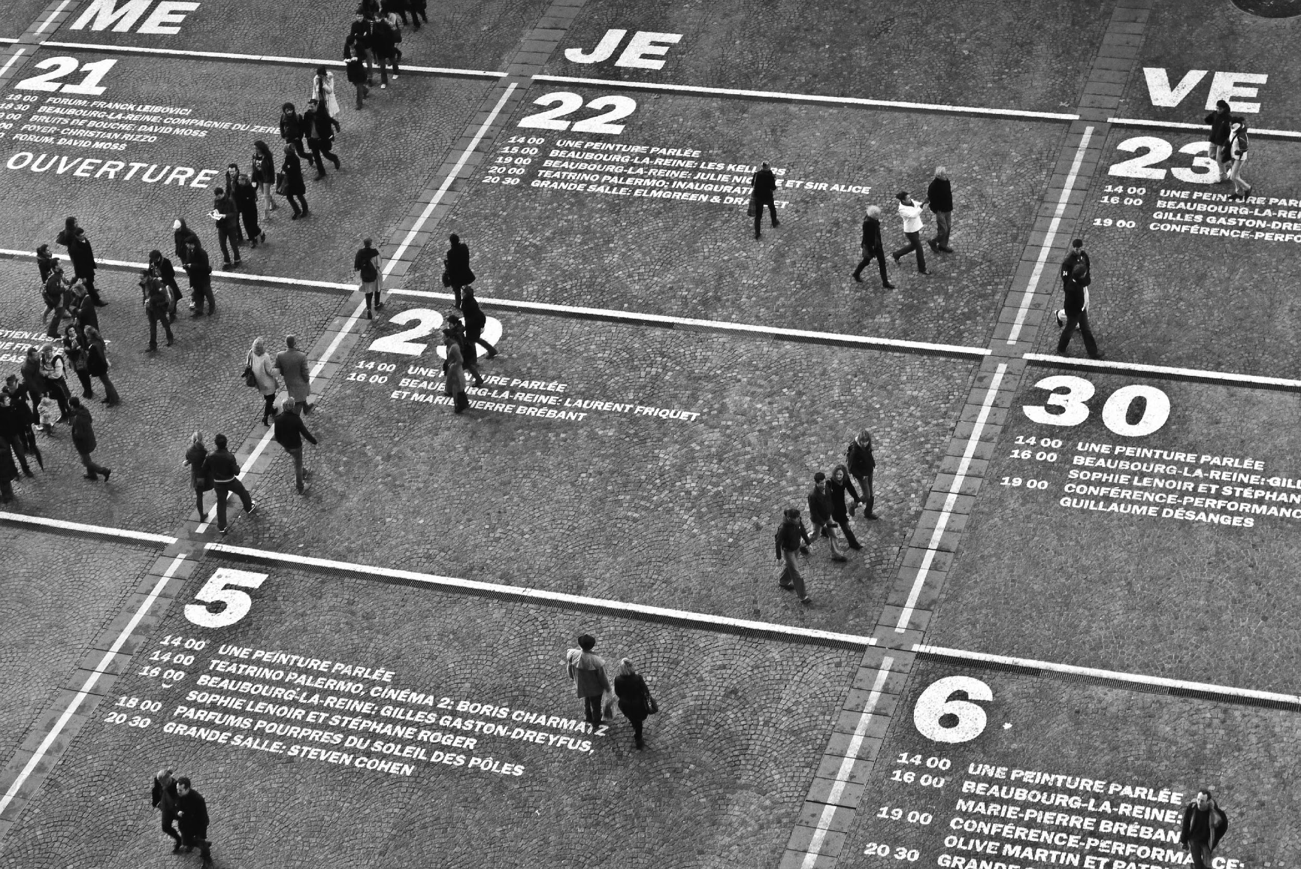
What are we going to do today?
know when to say it

Slide 38
KEEP A MASTER CALENDAR
When do we say it?
Social Media
  Facebook – 3x/week-daily, more for events
  Twitter – 3-5x/day (no limits, esp. w events)
  Instagram – no more than daily
Blog – 2-3x/month (rotate authors, use guest authors)
Email – shorter, more frequent updates
Good resource: Nonprofit Marketing Guide

Slide 39
Zamawa@Flowetik.com
Brianne@Flowetik.com
Thank you

