Slide 1





Evaluation Doesn’t Have to be Evil!
Mike Devlin,
Catherine Sands,
Francey Slater,
Janet’ O’Brien,

Slide 2
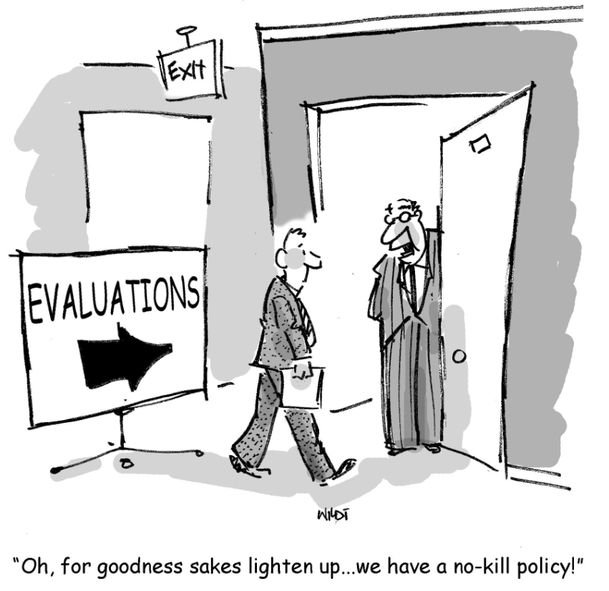

Slide 3
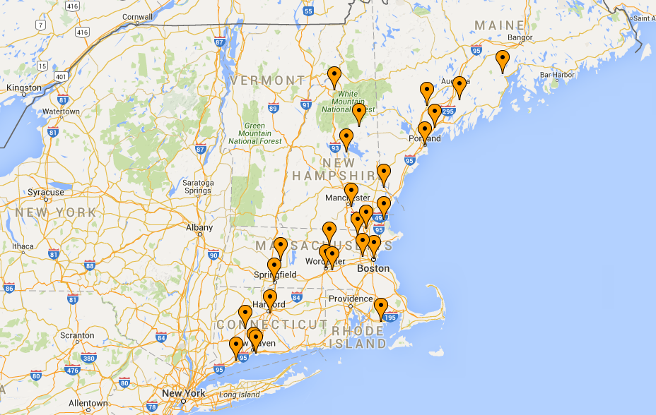
Healthy Food Fund Grantee Locations 2015-2018
Notes:
Look to Mike D: these locations are the results of alignment with information from the market leaders

Slide 4
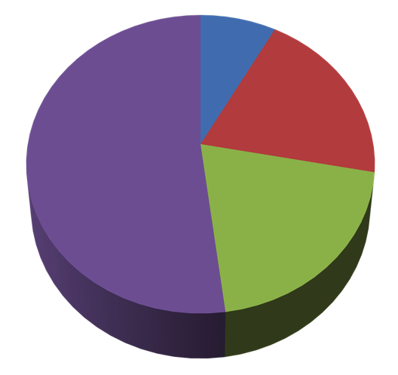
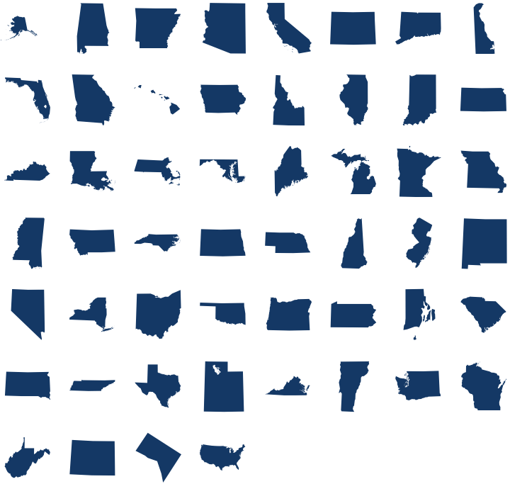
25 Healthy Food Fund Grantees
By Strategy
Sales
Only
By State
Free
Distribution Only
2
CT
5
Includes farmers markets/stands, CSAs
5
MA
11
Sales/Free Distribution
Mobile Markets
Includes gleaning*, food banks, community gardens, community meals, youth agriculture programs
13
ME
5
5
NH
4
*Gleaning refers to the act of collecting excess fresh food from farms, gardens, farmers markets or any other source in order to provide it to those in need (USDA).

Slide 5
Harvard Pilgrim Health Care Foundation Healthy Food Fund – Evaluation
2015-2018
Massachusetts Nonprofit Network Conference
Catherine Sands, Fertile Ground and UMASS Amherst

Slide 6
Team and approach
Team: Catherine Sands of Fertile Ground, Christa Drew and Daniel Ross of DAISA Enterprises
Build evidence: mixed methods (capture quantitative and qualitative data)
Participatory design - Grantee input on indicators
Create community of practice to share data collection methods and strategies
Iterative process
Evaluations cycle back into grantee communities

Slide 7
25 Healthy Food Fund Grantees
By Strategy
Sales
Only
By State
Free
Distribution Only
2
CT
5
Includes farmers markets/stands, CSAs
5
MA
11
Sales/Free Distribution
Mobile Markets
Includes gleaning*, food banks, community gardens, community meals, youth agriculture programs
13
ME
5
5
NH
4
*Gleaning refers to the act of collecting excess fresh food from farms, gardens, farmers markets or any other source in order to provide it to those in need (USDA).

Slide 8
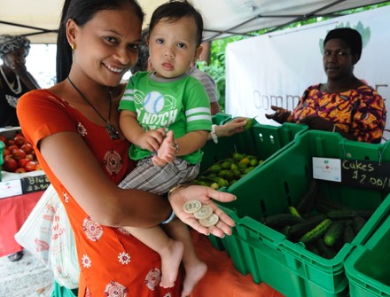
Healthy Food Fund Goals
Measurable impact on community food environment
Increase distribution of healthy local food in target communities
Capture and share learnings
Increase visibility
Photo: Mill City Grows

Slide 9


Healthy Food Fund: One View of Foundation’s Impact (ROI)
HFF Year 1+2 Investment = $2.8M
$4.9
$1,206,394
+
1,786,087
lbs
MILLION
value produced
=
$
$ VALUE OF HEALTHY FOOD REACHING HOUSEHOLDS IN TARGET HPHCF COMMUNITIES AND
IMPACT ON GRANTEES & PEOPLE IN TARGET HPHCF COMMUNITIES
Food Sales
($)
Food Distributed**
(lbs)
Year 1 + Year 2
Year 1 + Year 2
**distributed food valued @ $2.10/lb,
a USDA/retail value estimate

Slide 10





Healthy Food Fund (Base to Year 2)
DEC
2017
$771,605
959,581
1,187
6,090
461
$
Food
Sales
($)
Food Distributed
(lbs)
Access Points*
Skill-Building Participants**
Partners
189%
116%
341%
161%
50%
2015
$267,097
442,993
269
2,333
308
*Points of Sale & Points of Distribution. **Participants in food education programs and classes.

Slide 11
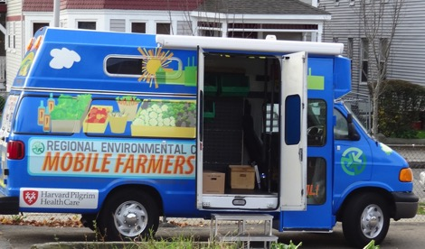
Evaluation Activities
Grantee in person & frequent video meetings (technical assistance & communities of practice)
Data gathering in reports
For HFF board and grantees
Select grantee site visits
Ongoing evaluation assistance, materials/tool and discussion listserve
Photo: Regional Environmental Council

Slide 12

What Else We Are Tracking
What works -- marketing, education, partnerships
Evidence of increased demand & repeat sales
Evidence of participant skill or attitude changes about healthy food/eating
How organizations focus on increasing racial equity within their organizations and externally
Photo credit: University of Maine Cooperative Extension

Slide 13
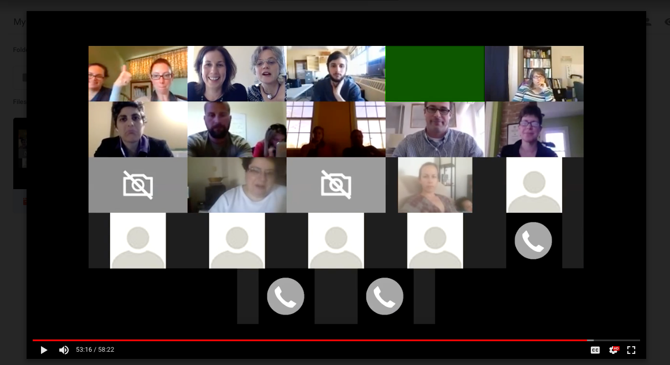
Community of Practice Video conferencing

Slide 14
Sample grantee strategy sharing topics
How to measure, assess, share out the impact of skill building strategies.
1
2
Distribution tracking technologies - Salesforce, Excel, Google Sheets, SquareSpace
3
Volunteer management strategies Time tracking tools; Gleaning management

Slide 15
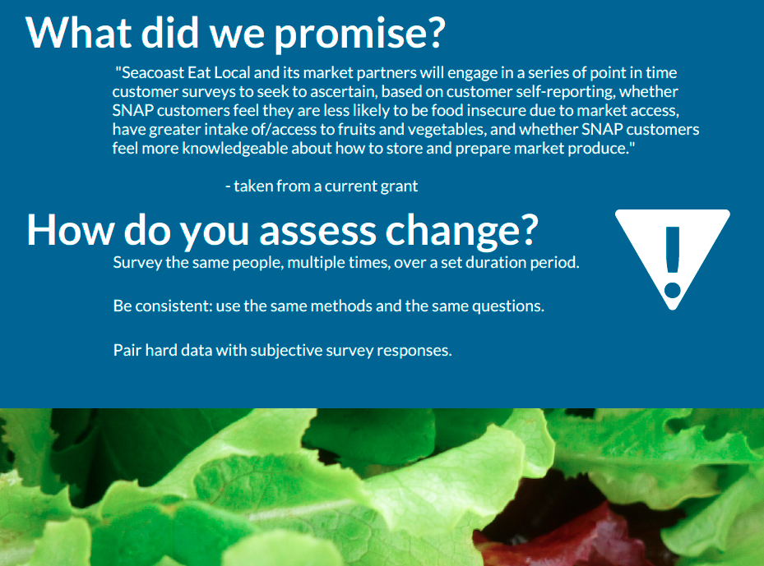
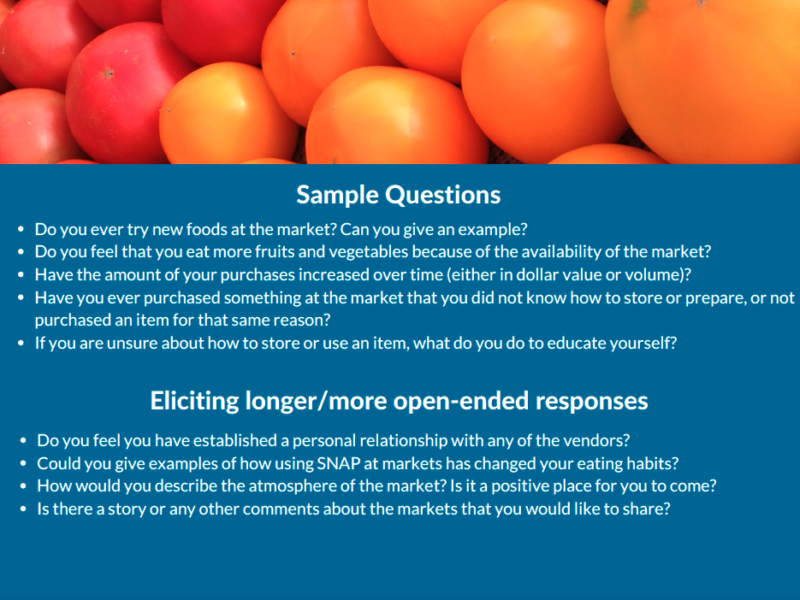
Assessing Change: Seacoast Eat Local

Slide 16
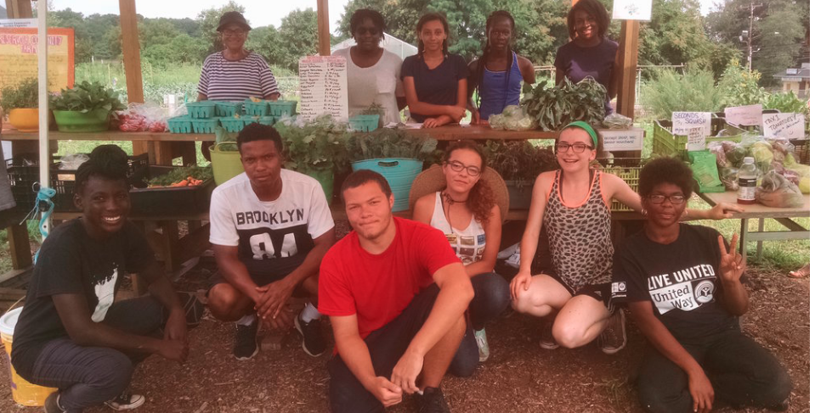
Tracking youth participation Green Village Initiative
Photo: Green Village Initiative

Slide 17
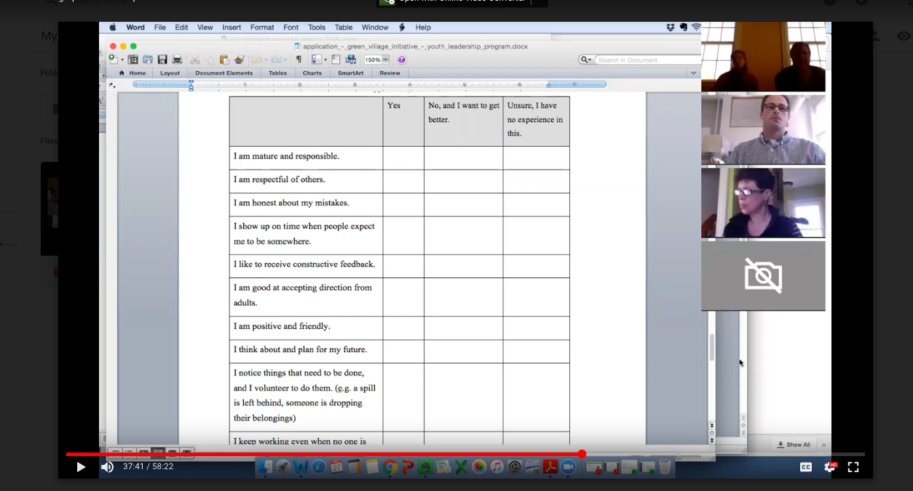
Youth self assessment Green Village Initiative

Slide 18
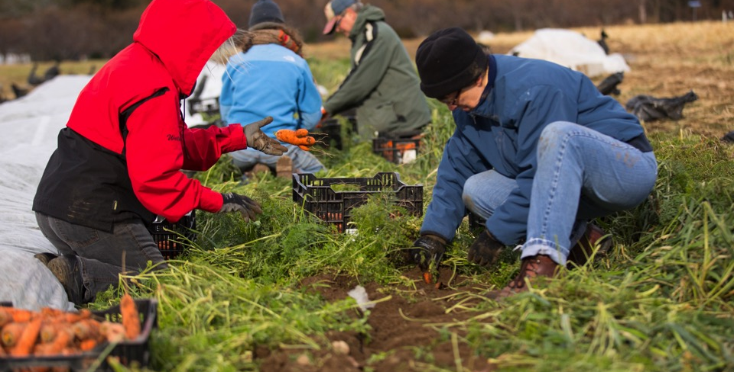
Boston Area Gleaners Tracking Gleaning on GleanWeb
Photo: Boston Area Gleaners
Notes:
comments.

Slide 19
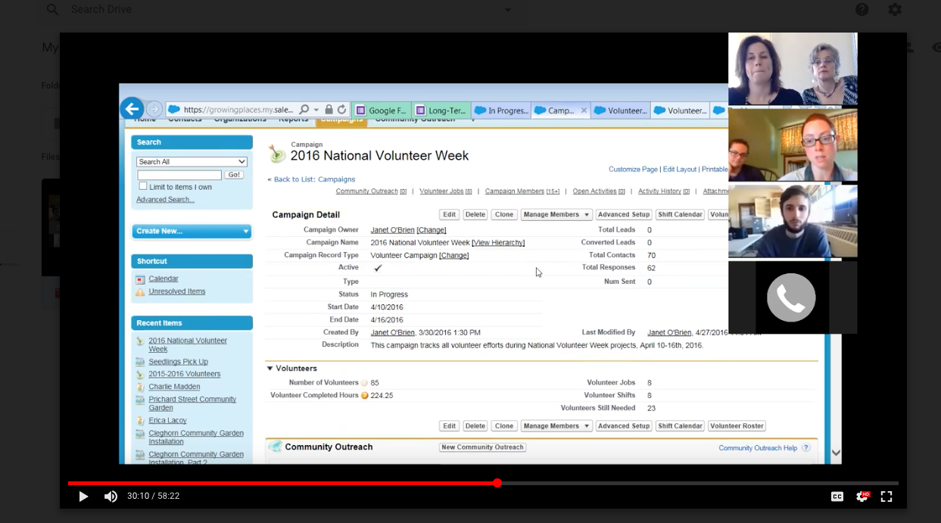
Volunteer Management Growing Places

Slide 20
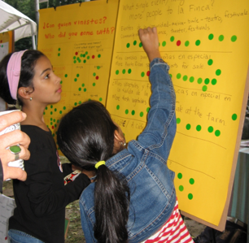
Toolbox Samples
Rapid Market Dot Survey
Story Spine
Once upon a time there was a…
And every day…
Until one day…
And because of that…
And because of that…
And because of that…
Until finally…
And ever since that day..
Photo: Fertile Ground/Nuestras Raíces

Slide 21
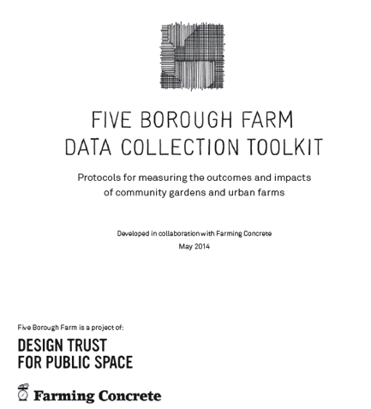

Additional Toolbox Samples
Rapid Market Dot Survey

Slide 22
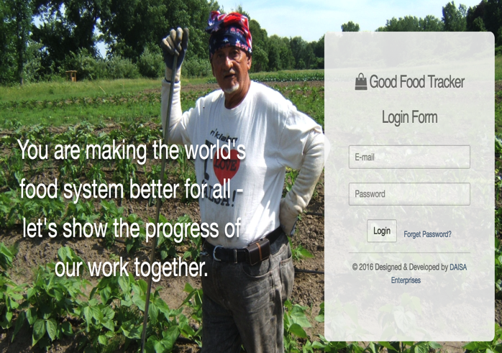
Good Food Tracker goodfoodtracker.com

Slide 23
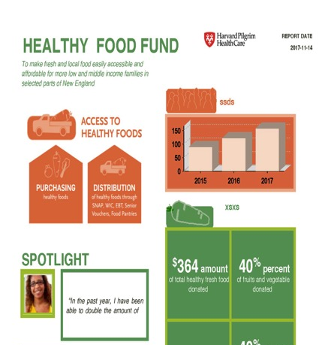

Create an infographic report

Slide 24
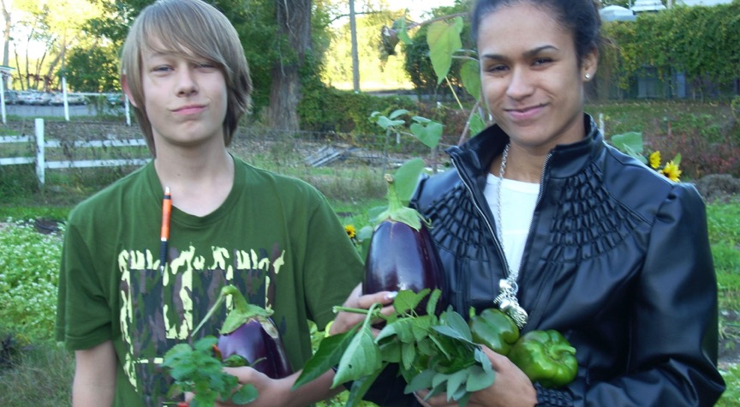

Thank you
chsands@fertilegroundschools.org
Photocredit: Nuestras Raices/Fertile Ground photovoice project

Slide 25

EVALUATION DOESN’T HAVE TO BE EVIL
A newbie’s perspective for newbies

Slide 26
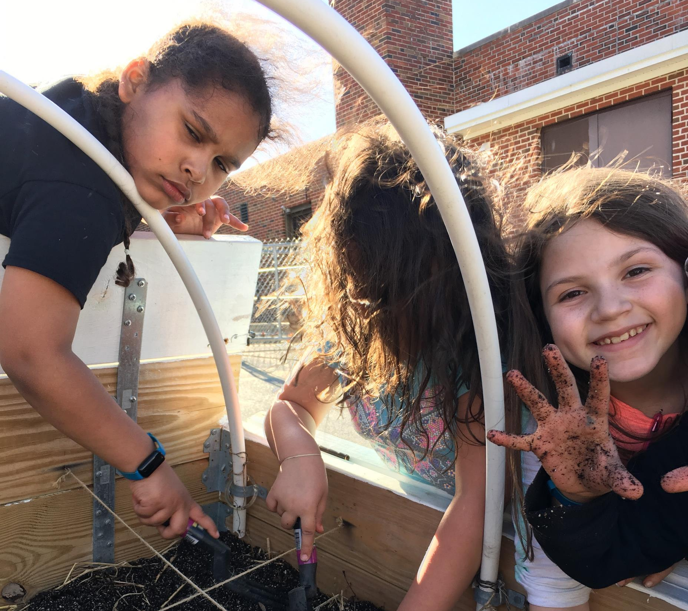
KNOW YOUR PURPOSE, KNOW YOUR PEOPLE
PLANNING PHASE
Prioritize: What MUST you measure?
Account for bias: Kids are a great litmus test!
Innovate: Have fun with your methods! Survey fatigue is real.

Slide 27

FIND YOUR (INNER) GEEK
IMPLEMENTATION PHASE
Evaluation champion
Flexible dissemination
Volunteer opportunities

Slide 28

CRUNCH, CRUNCH, CRUNCH
DATA COMPILATION
What can be automated?
What can’t?

Slide 29

REDUCE, REUSE, RECYCLE
COMMUNICATION PHASE
Internal
External
Information vs. Relationship-building

Slide 30
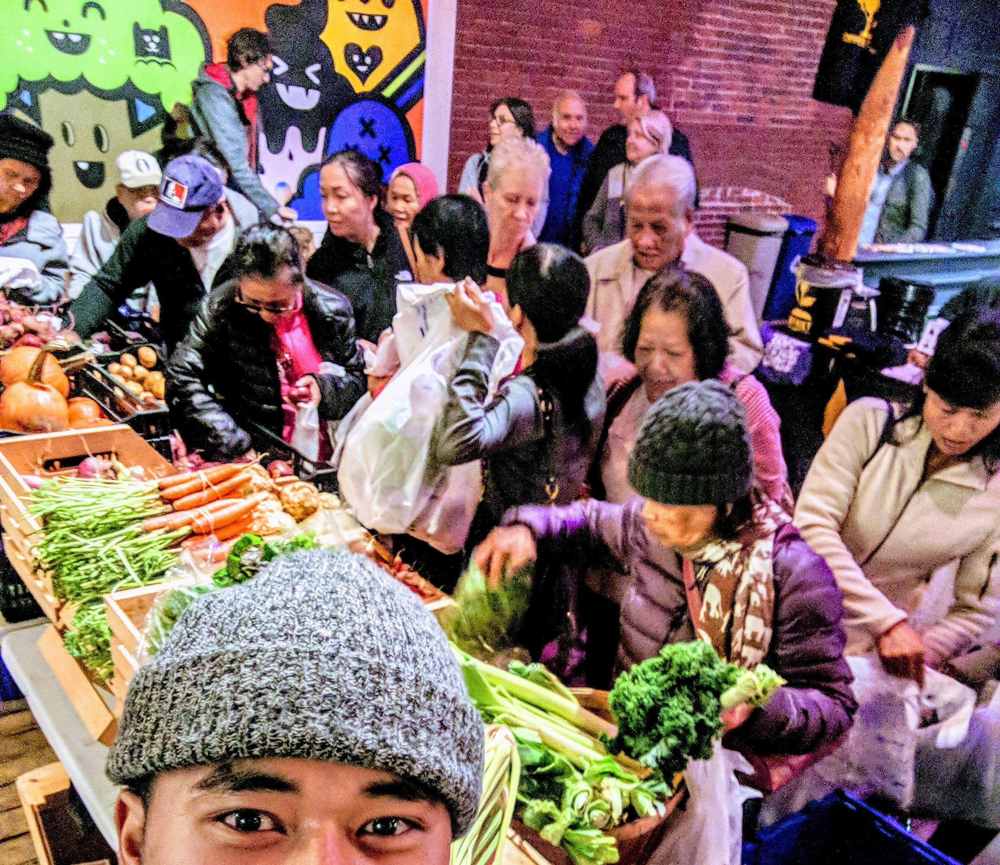

💚’s
Evaluation

Slide 31
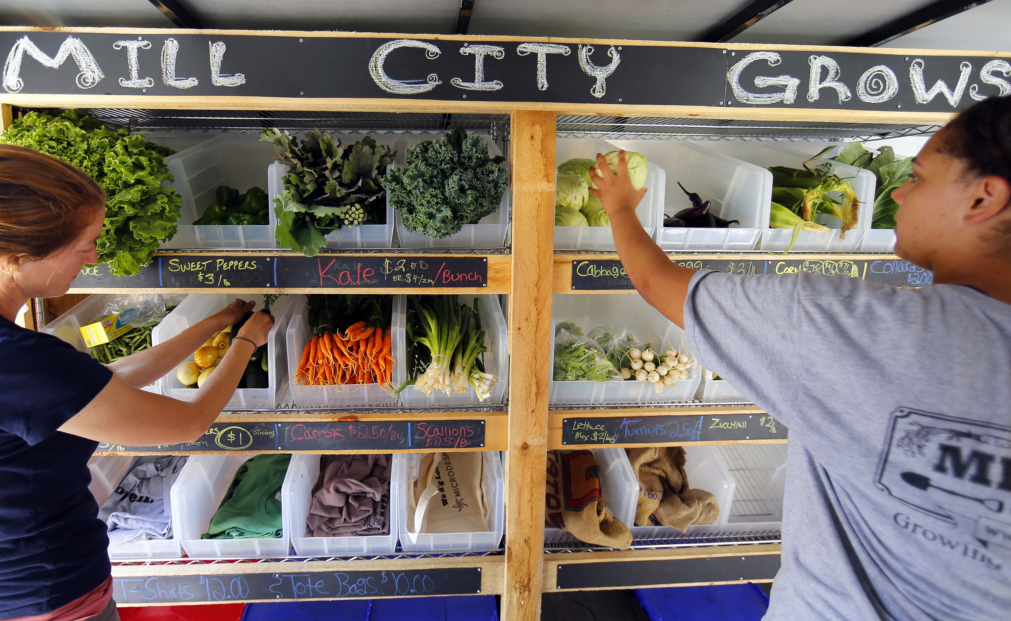
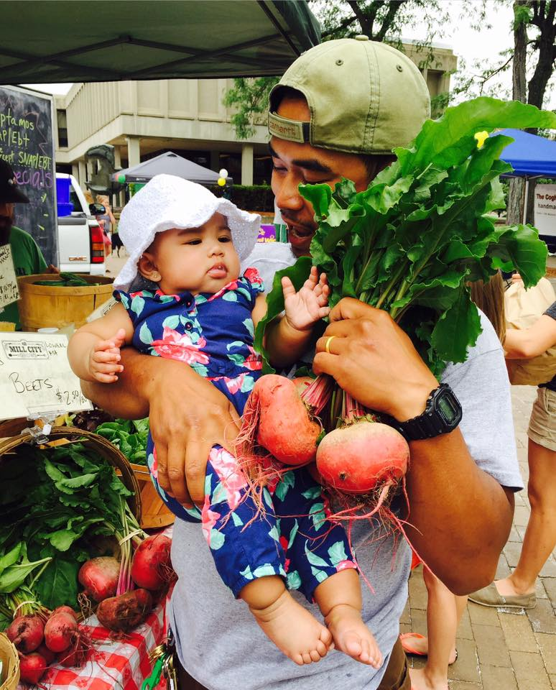
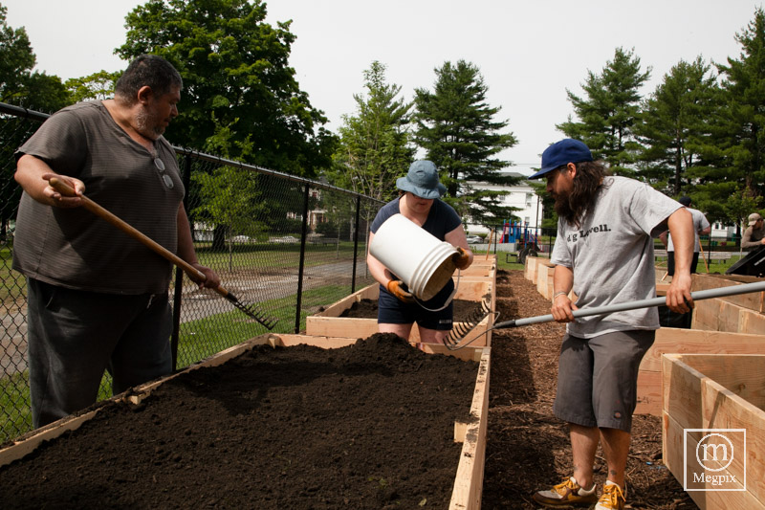
Founded in 2011/12, Mill City Grows is growing a healthy community through urban food production, food access, and education in Lowell. Annually we help 15,000 people across Lowell connect with ~45,000lbs of local food
Notes:
MCG background/context

Slide 32
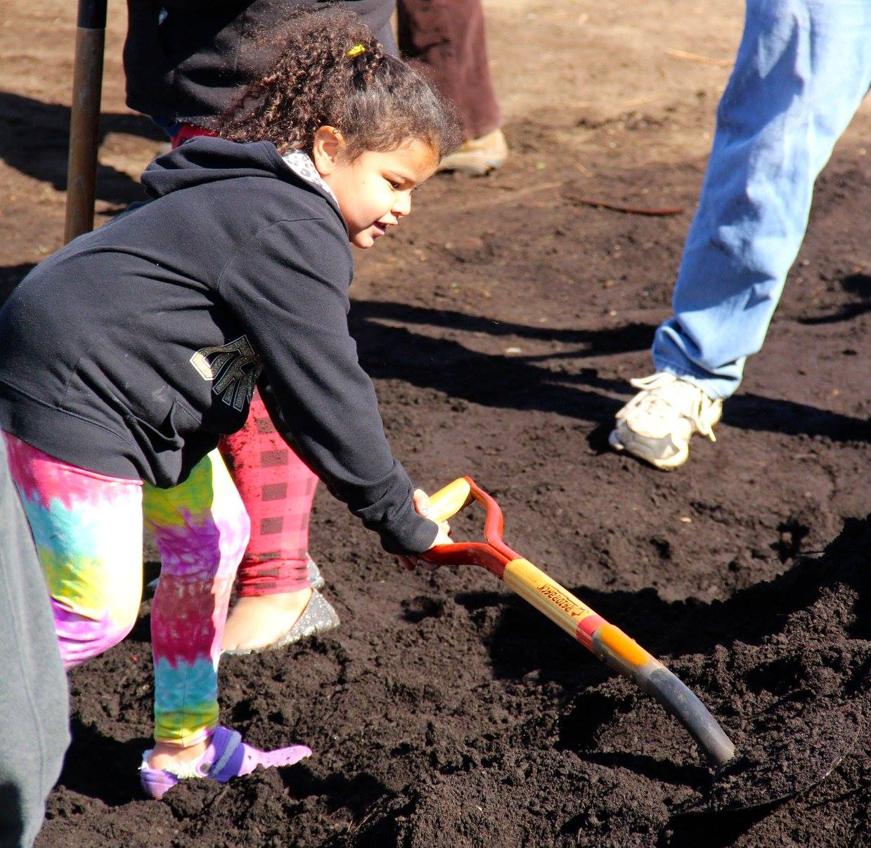
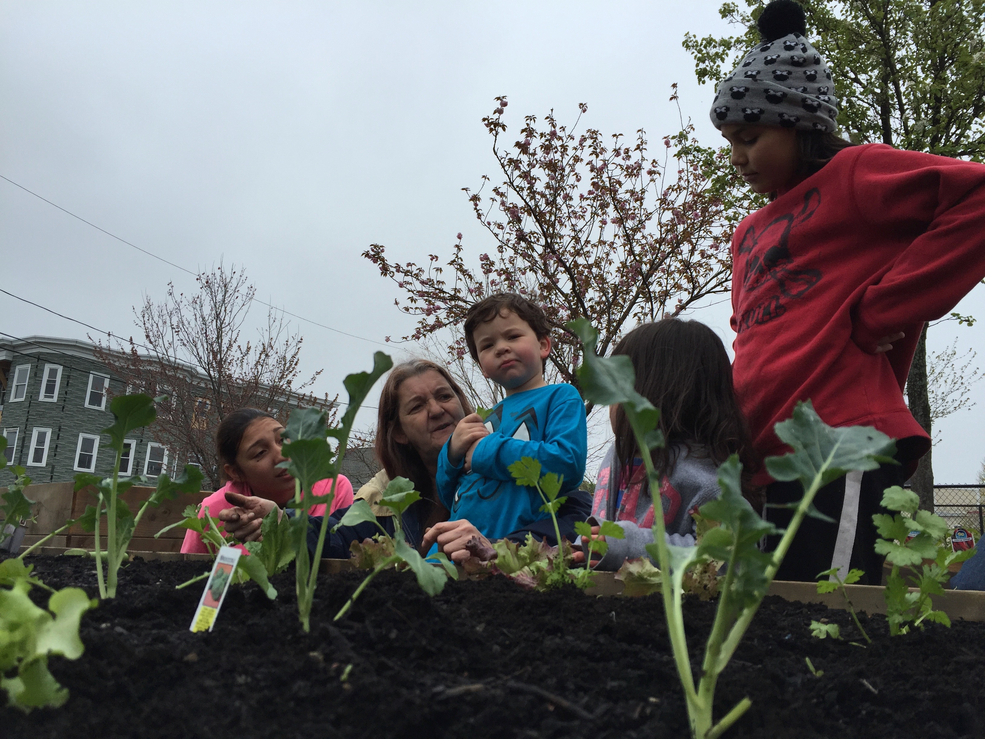
Why Evaluate?
Heavy Lifting
Stakeholder Sharing
Investor Encouraging
Community Engaging
Program Refining
Milestone Celebrating
Who
Cares?
Notes:
looking at data as an asset
Sharing information within our organization, across program areas that informs program development as well as investment
Knowing what is happening and what matters
Learning what we don’t know

Slide 33
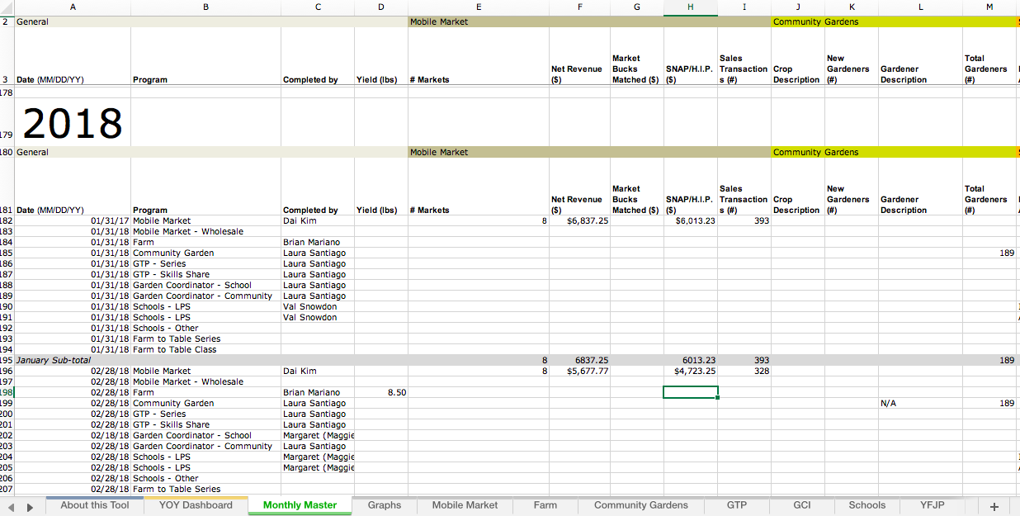
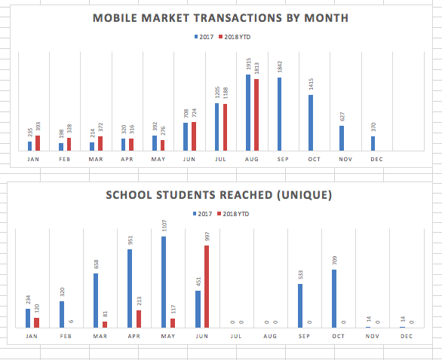
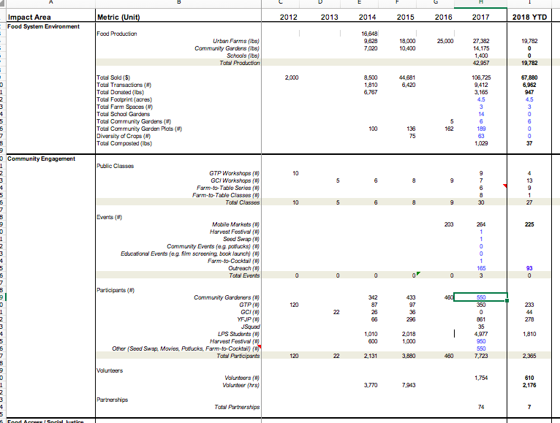
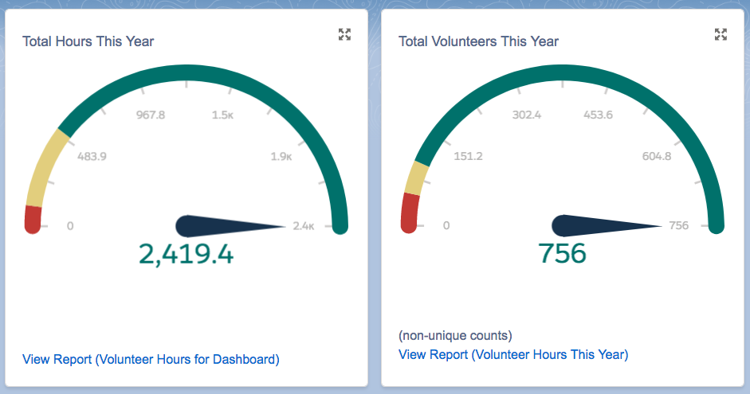
What can we capture?
Notes:
How are we gathering data
Challenges of developing universal tools that don’t have to be interpreted
Values- driven metrics

Slide 34
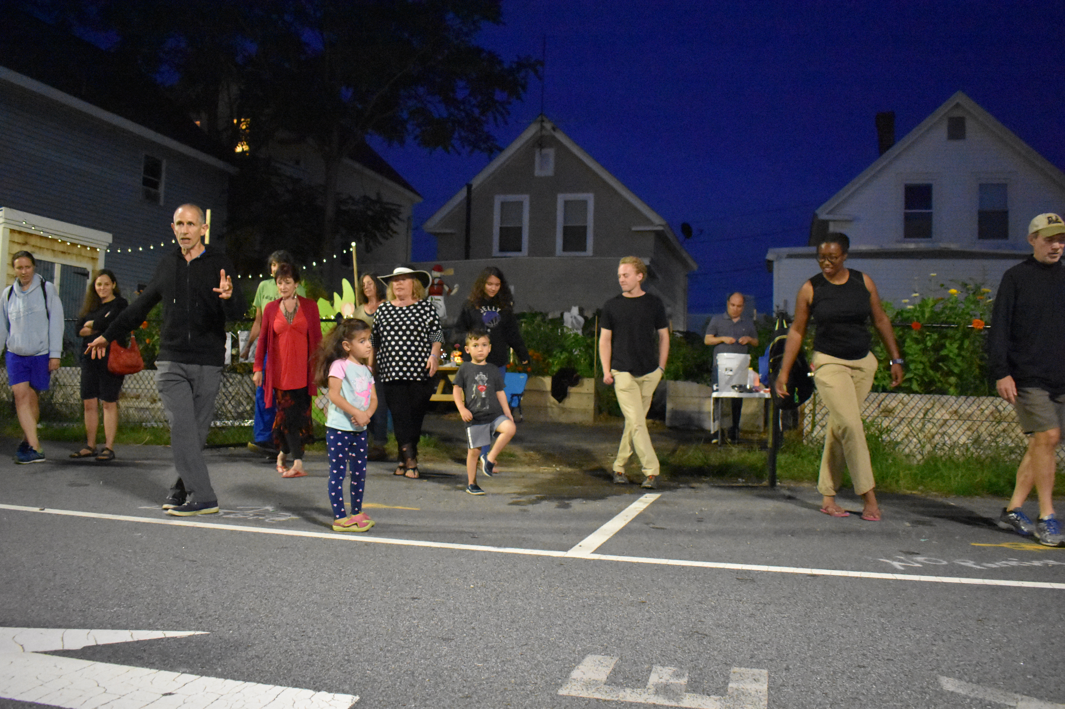
What do we have to gain?

Slide 35
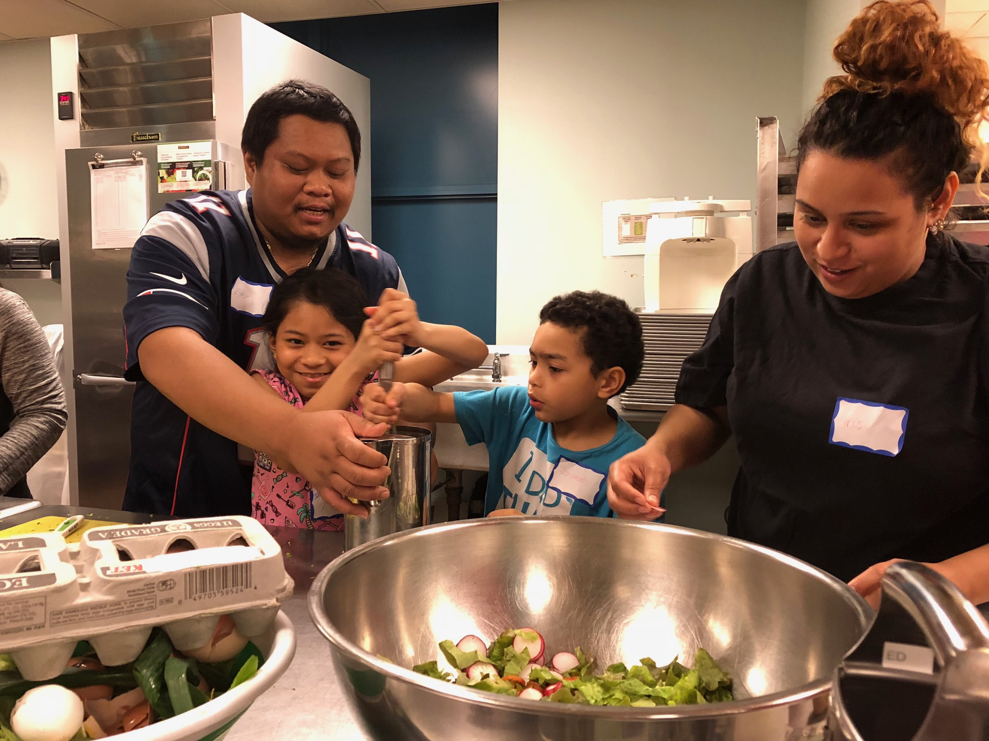

Slide 36
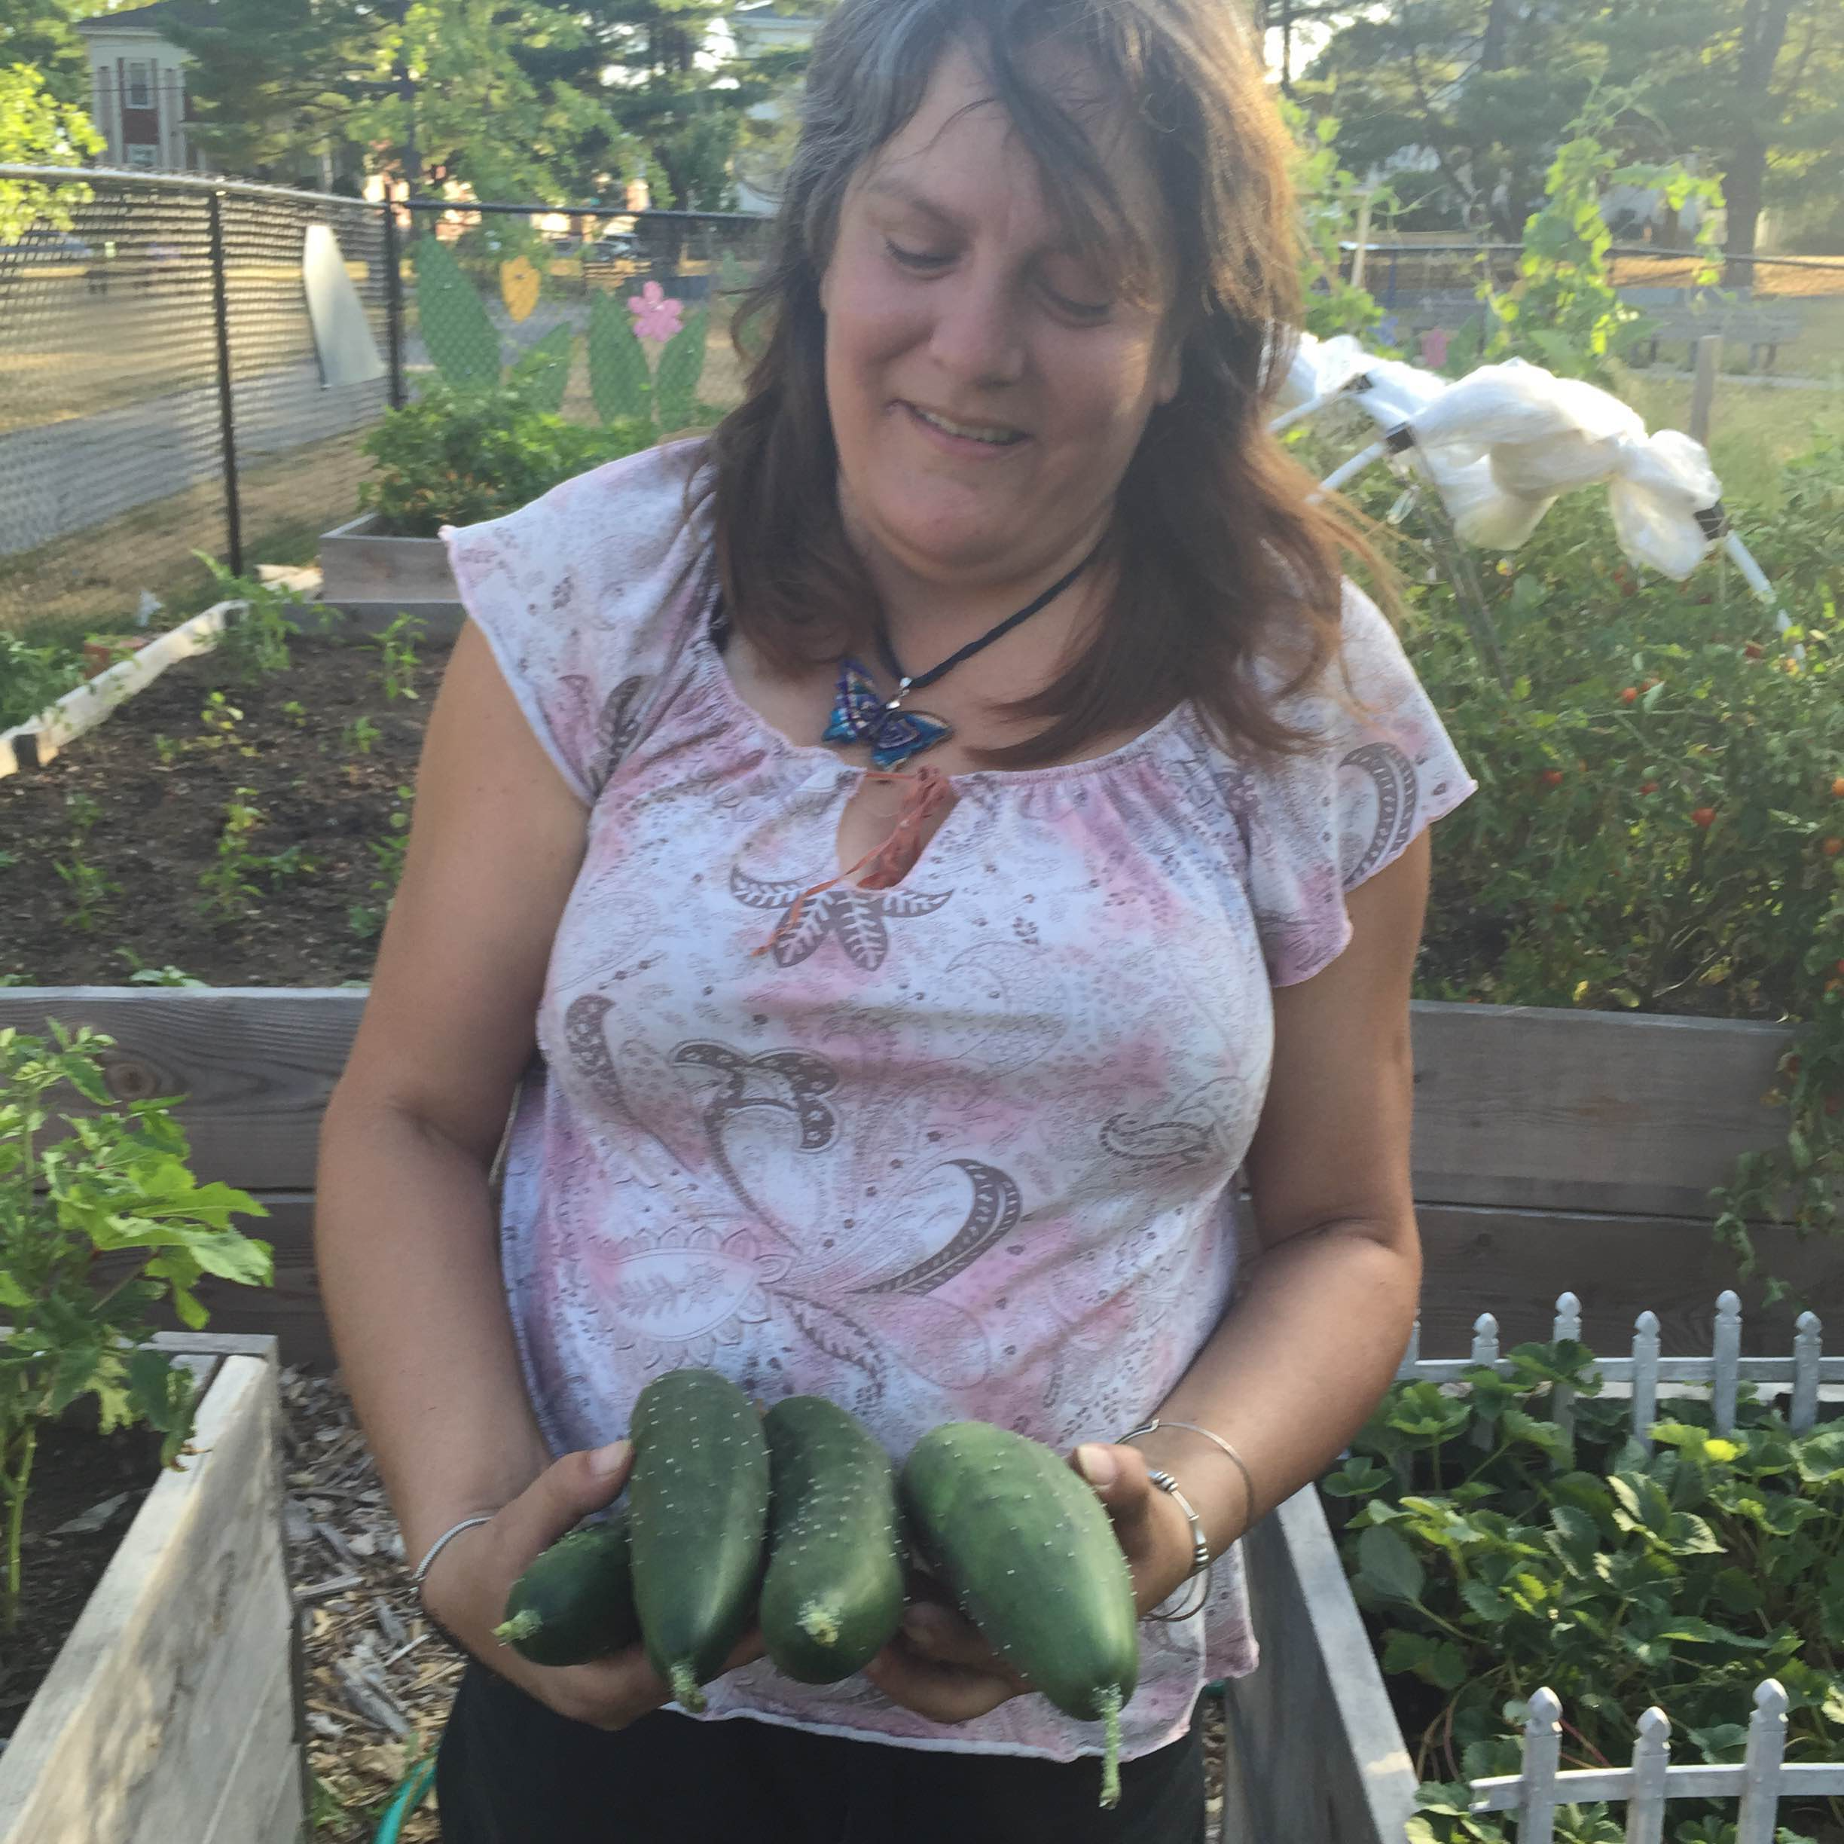
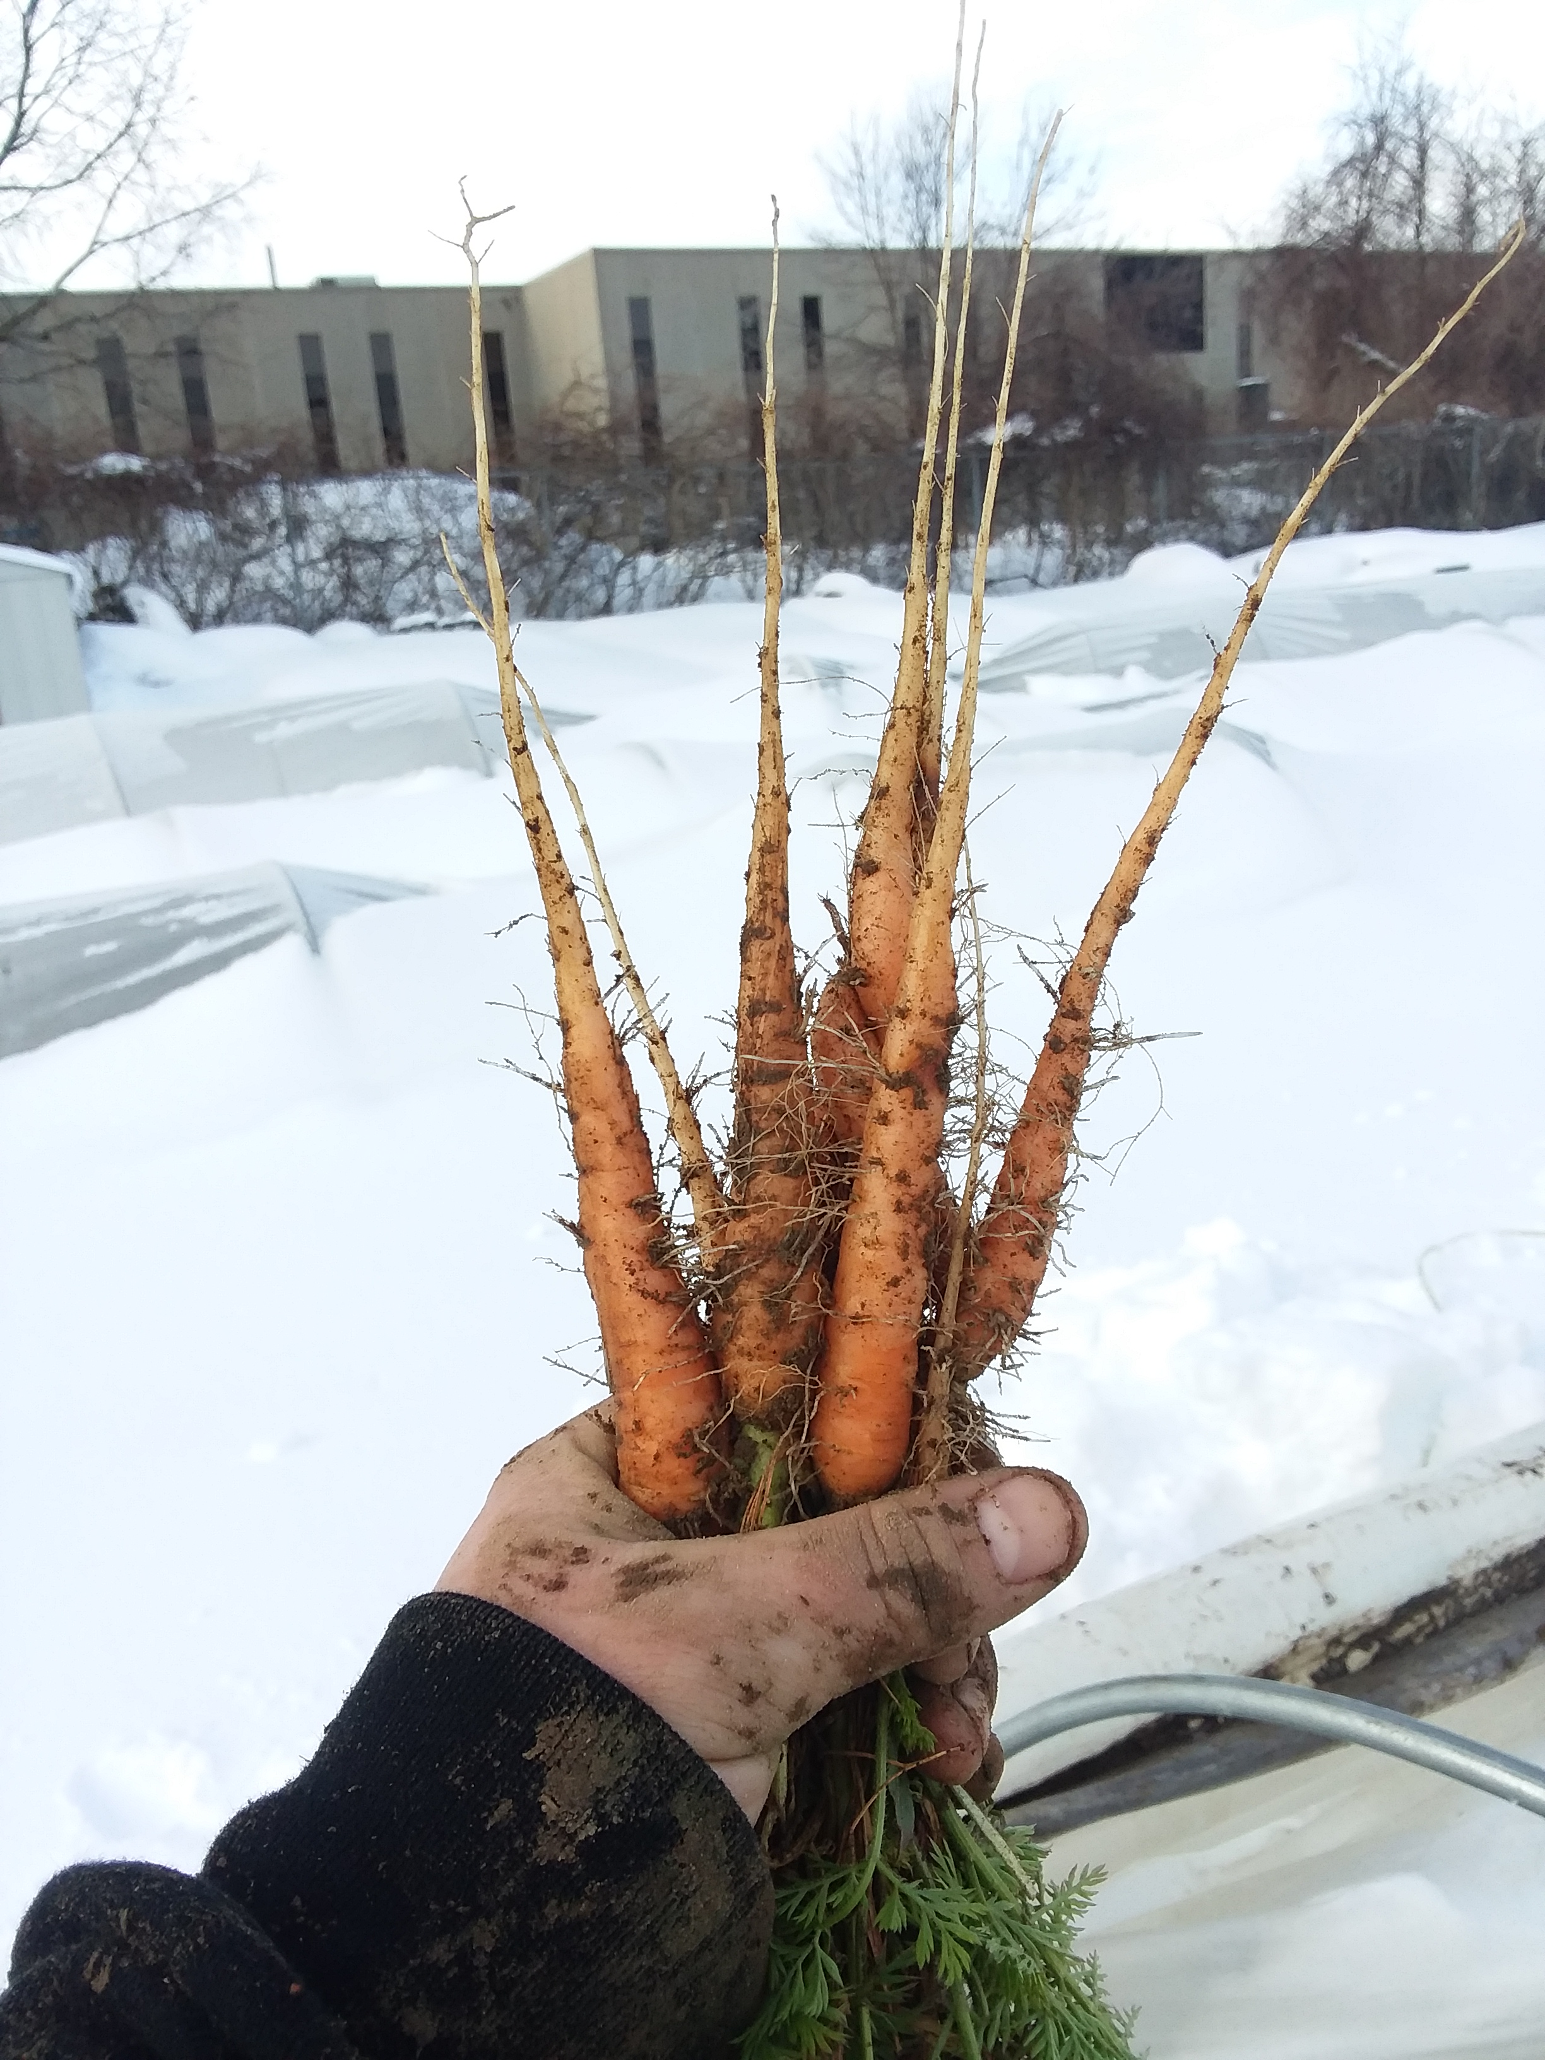
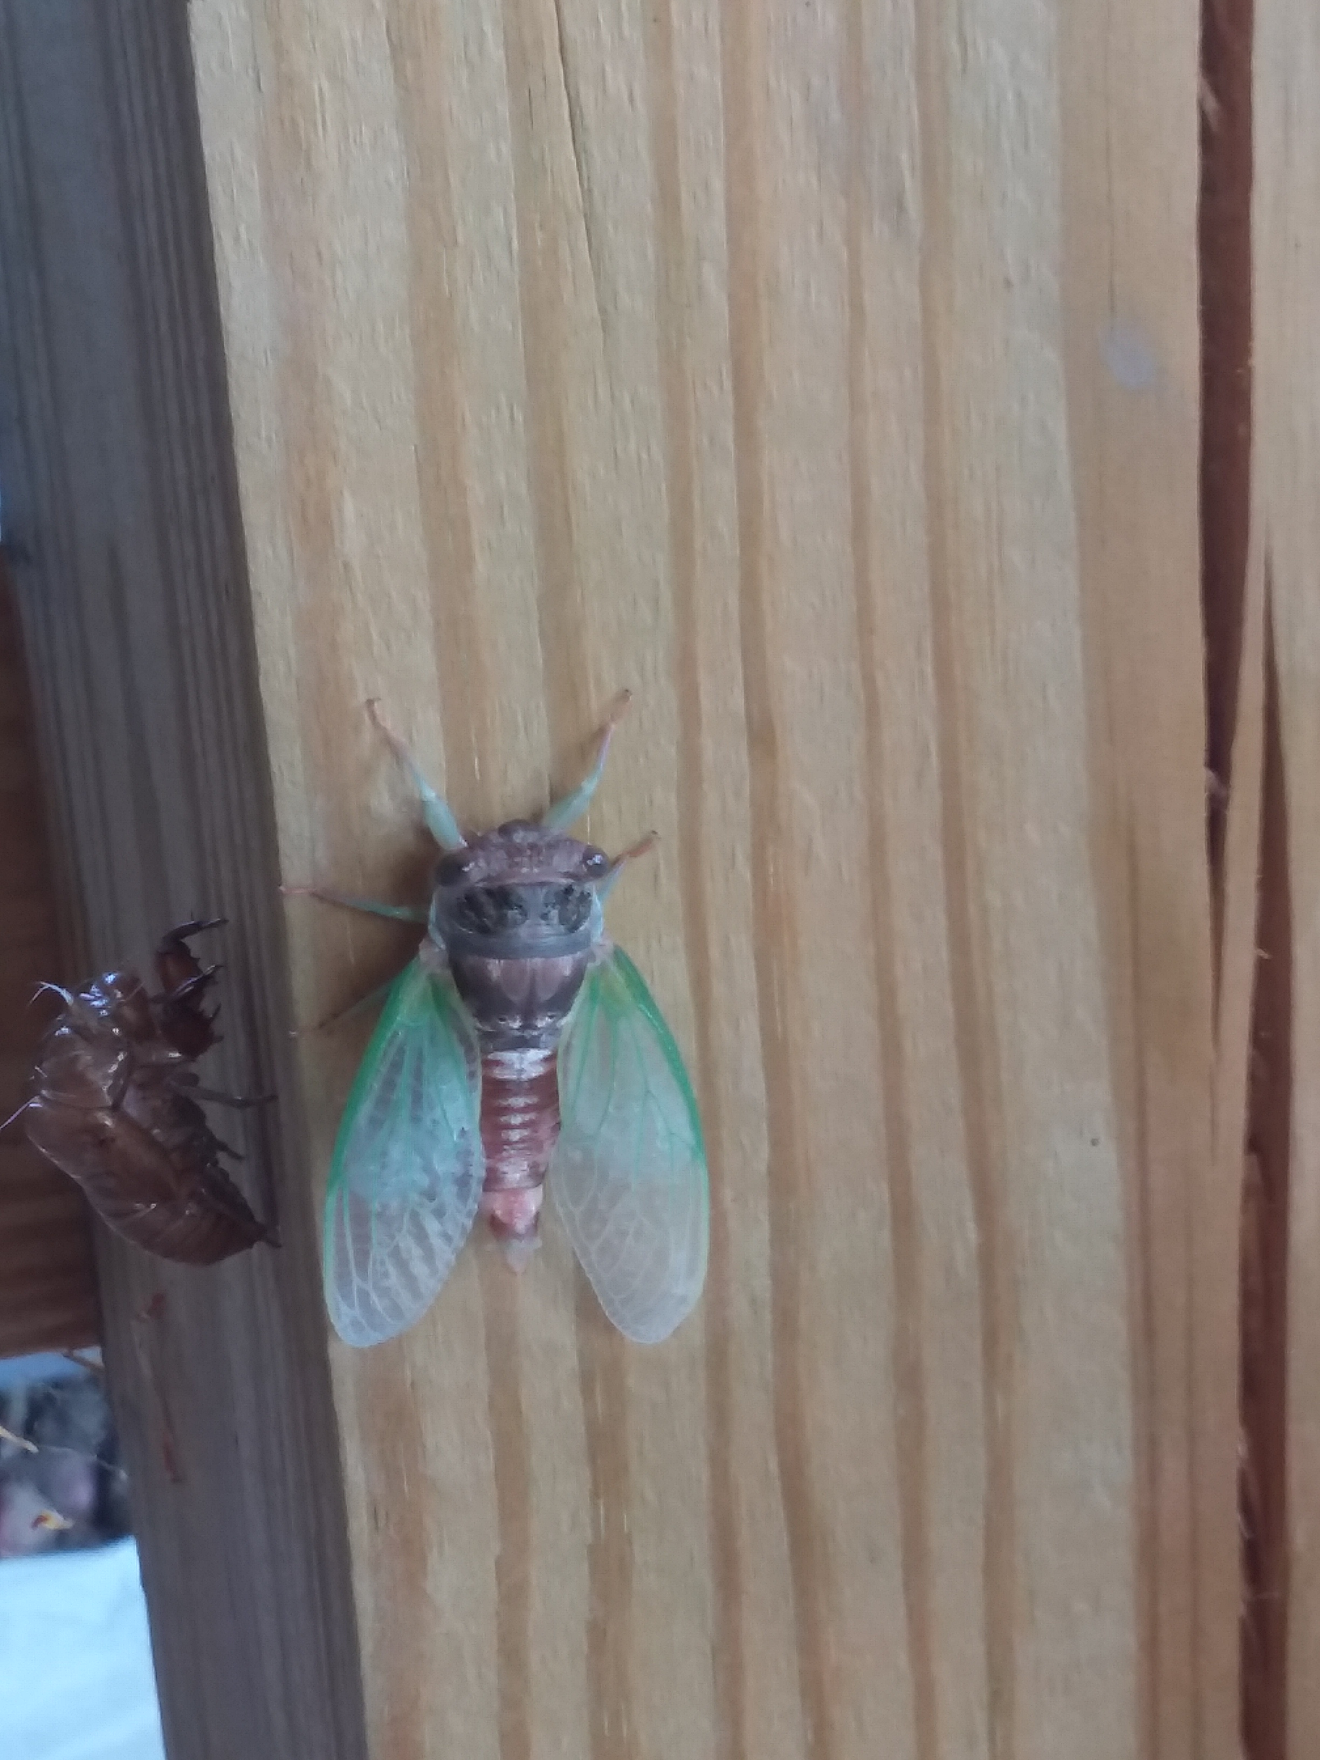

Slide 37
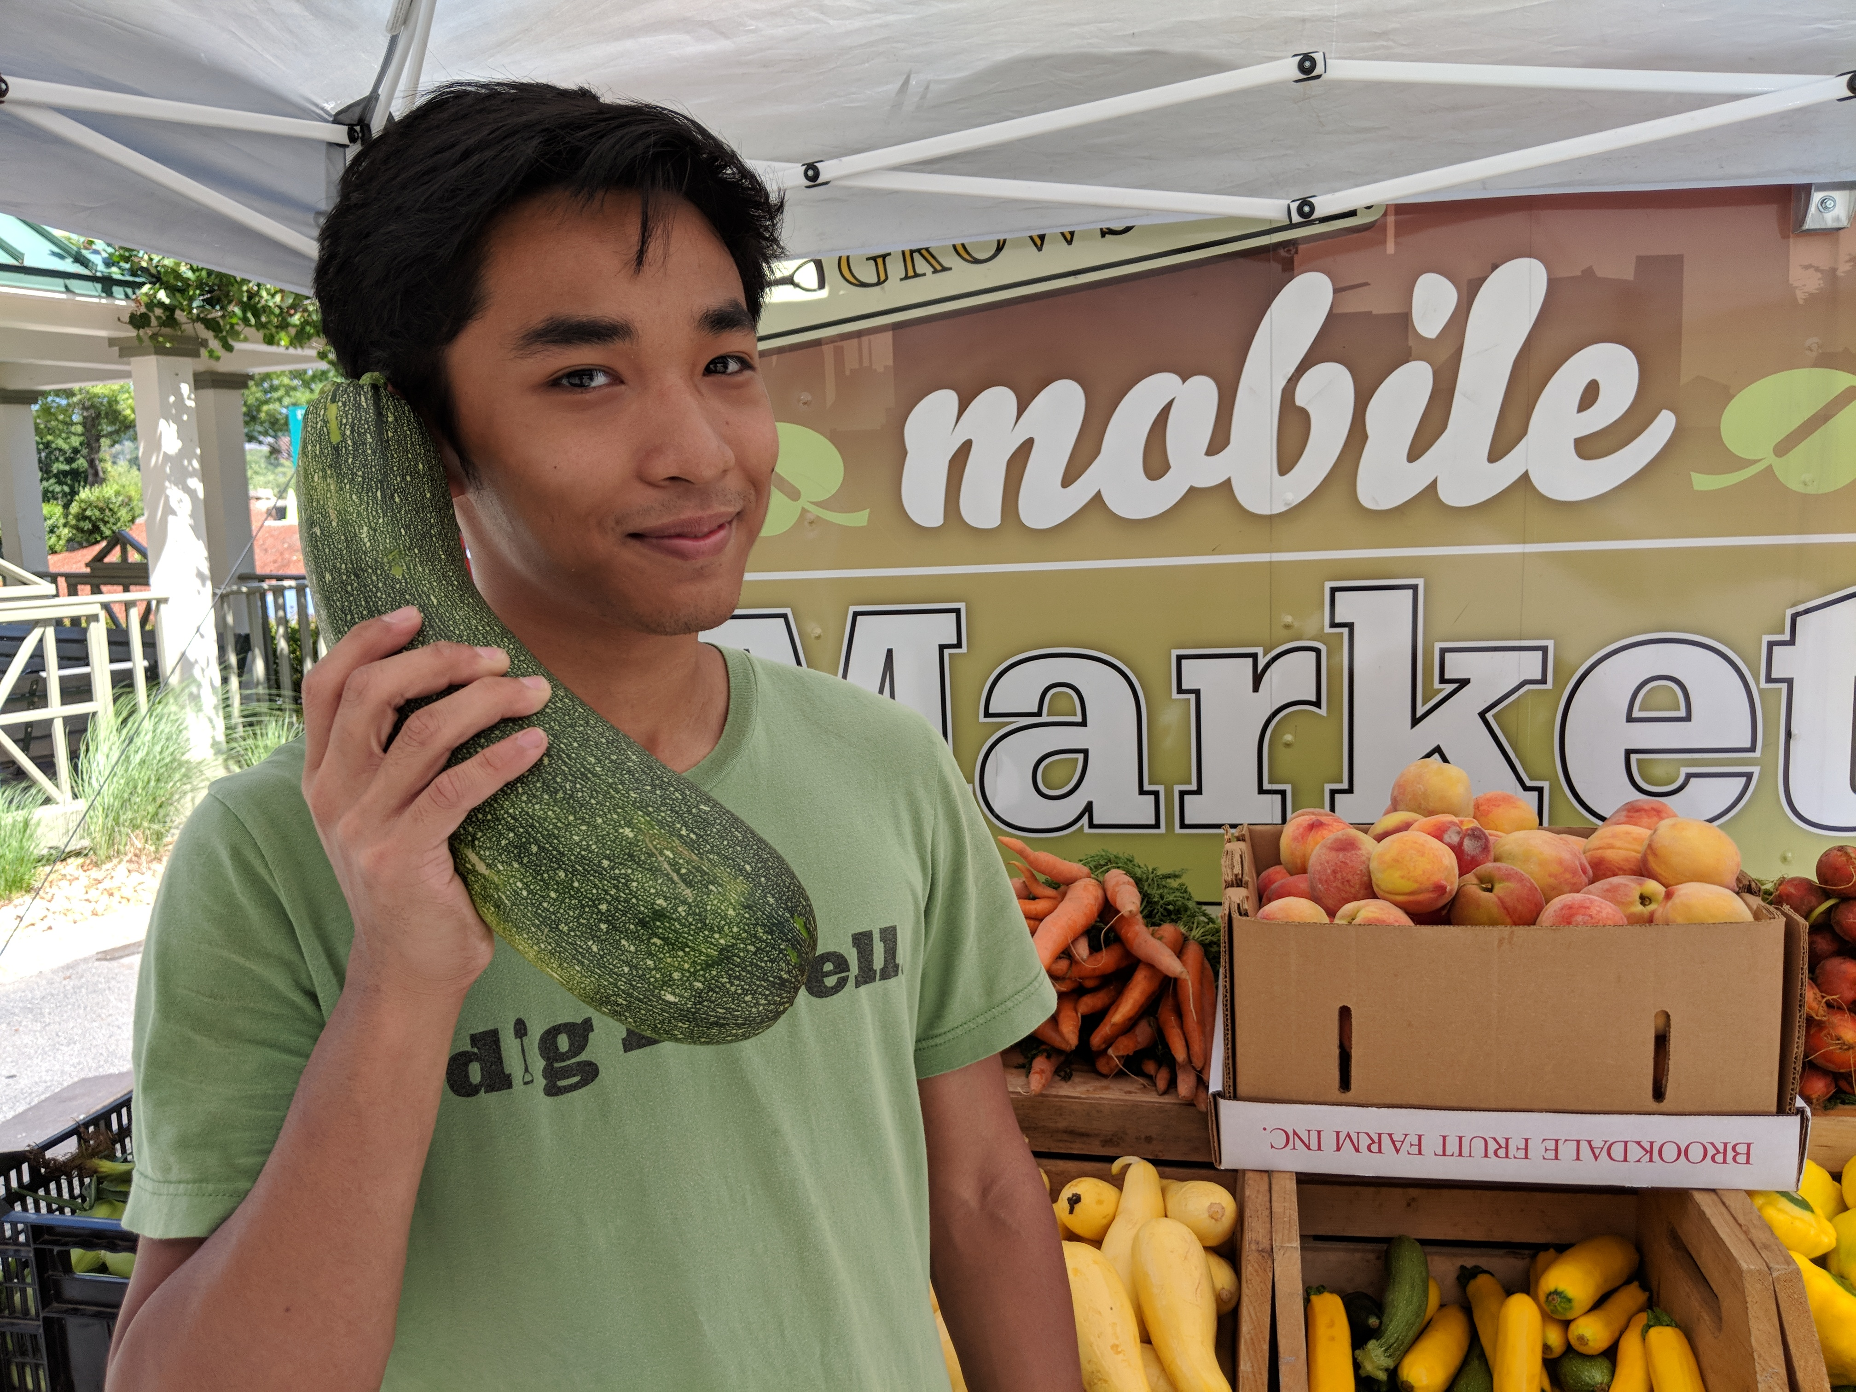

Slide 38
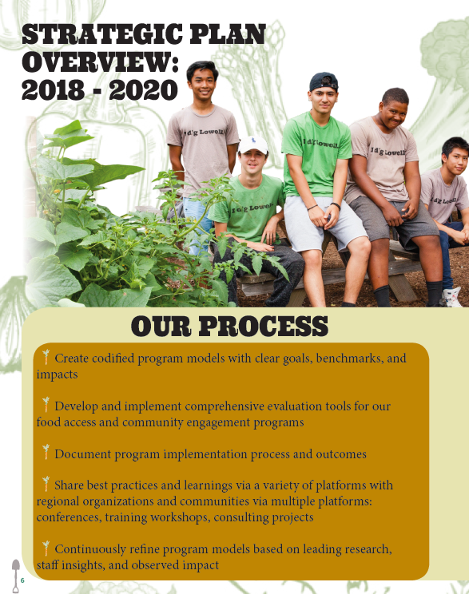
Next Steps
>> Universal Impact Metrics
>> Comprehensive Eval Tools
>> Internal/External Reporting
>> Program Iterations
>> Sharing for Amplification

