Slide 1







The new way for
Massachusetts small businesses to choose health insurance

Slide 2

Agenda
Introduction
Q & A
Benefits
How it Works

Slide 3


97% of Massachusetts residents are insured. Employers play a key role in securing our nation-leading ranking and being recognized as the healthiest state in the U.S.
60% of employees
say offering health insurance has led to higher productivity levels
46% of employees identified health insurance as the “deciding factor” or “a positive influence” in staying with their current employer
Data drawn from: Center for Health Information and Analysis Enrollment Trends Databooks and Massachusetts Employer Survey (2017); Health Policy Commission Cost Trends Report (2017); and Health Connector survey data (2012) and
https://benefittrends.metlife.com/media/1457/buildculturewintalent_exp1118.pdf
Notes:
The HCB is an online platform where small businesses are given the tools necessary to make informed decisions regarding health insurance and provide comprehensive health insurance to their employees. This is a ‘win win’ for employees and employers, and we have the testimonials to prove it…

Slide 4
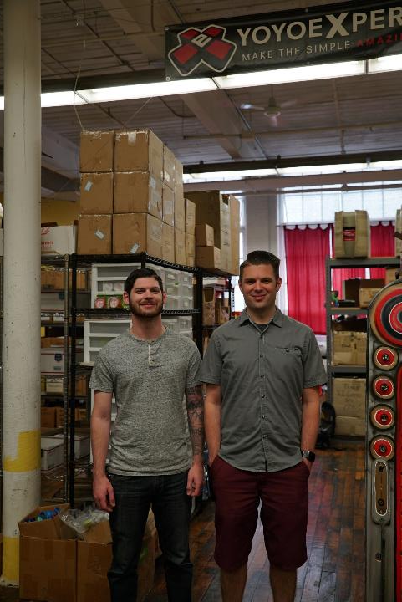
“One way for me to show my
appreciation early on, was to
put health insurance on the
table for my employees
if they needed it.”
Small Business Owner:
André Boulay
Owner, YoYo Expert and A2Z

Slide 5
Agenda
Introduction
Q & A
Benefits
How it Works

Slide 6
Benefits of the
Health Connector for Business
Tailored
We only serve employers with 50 or fewer employees; we understand the needs of small businesses.
Easy
Easily compare private health insurance plan options and manage your benefits. Free local brokers are available.
Flexible
Employers pick one plan for all employees OR let employees shop from a range of plans.
Savings
Employers select plans that best reflect their financial needs. Have access to a Wellness Rebate program. There are no membership fees or dues.
Notes:
It’s made for small businesses. We only serve employers with fewer than 50 employees, so we understand the needs of small businesses
It’s easy. Employers can easily compare between top private insurance plan options, set up and manage a plan, or find a local broker to help
It’s flexible. Employers can pick one plan for all employees, or set a contribution level and let employees shop from a range of plans
It makes costs predictable. Employers can select plans that best reflect their financial needs, setting costs for monthly predictability. There are no membership fees or dues. Plus, special programs like our Wellness Track can offer employers a 15 percent discount

Slide 7






Choice of Leading Insurers

Slide 8
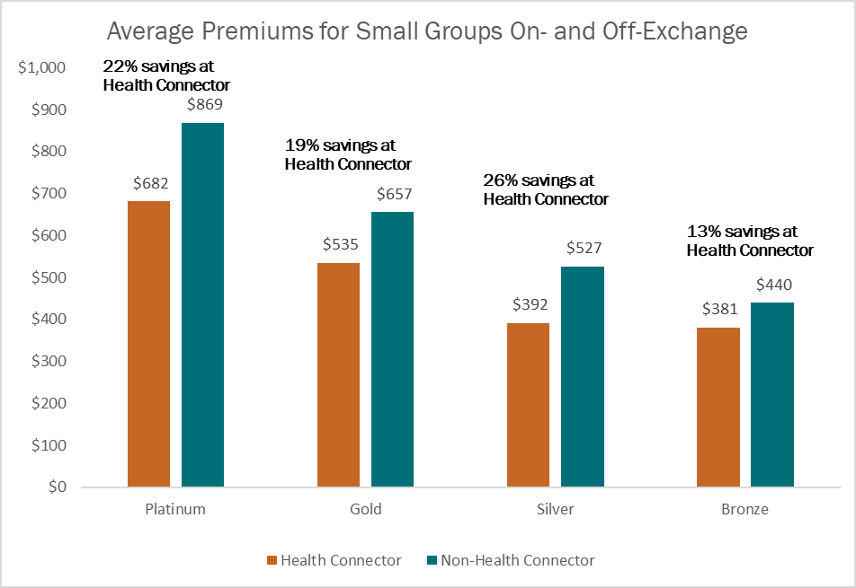
Shop and Save
Small businesses save over 20% on average by shopping through Health Connector for Business
Health Connector analysis of average premiums for a group of 42-year-olds in Boston in the “Eating places” industry. Illustrative only.

Slide 9

Coverage You Can Trust
Peace of mind when you shop through the Health Connector:
All plans are compliant with state and federal law
All plans meet the state requirement for your employees to have “minimum creditable coverage”
All plans have the Health Connector’s “Seal of Approval” for quality and value
Learn more at www.mahealthconnector.org/stay-covered

Slide 10
Comprehensive Coverage
Covered benefits:
Office Visits
Emergency services
Hospitalization
Maternity and newborn care
Preventive services with zero cost-sharing
Pediatric care
Prescription drugs
Rehabilitative services
Lab services
Mental health and substance use treatment
Notes:
All Health Connector plans meet “Seal of Approval” standards and are compliant with state and federal law
Plus, all Health Connector plans include certain preventive with no out-of-pocket cost-sharing when provided by an in-network doctor

Slide 11
Exclusive Benefits
1. Employee Choice Models
2. Wellness Track Rebate

Slide 12


Exclusive Benefits
Employee Choice Models
Employer can control costs while providing multiple insurance options to employees
Employees can easily compare options and choose a plan that fits their needs
Notes:
Small businesses that purchase coverage through the Health Connector can earn up to 15% of employer contributions back through a free online wellness program.
Wellness Track Eligibility for Employers:
Be enrolled in Health Connector for Business as a business
Employers with 2-25 covered employees are eligible
Employers create an online account and choose three easy-to-use health and wellness toolkits: Nutrition, physical activity or stress management
Promote employee engagement by offering incentives for employees ($100 gift cards)
33% of employees must complete the program
Wellness Track Eligibility for Employees:
Schedule a Physical OR Complete Online Health Assessment
Will receive a $100 gift card after completion of program

Slide 13

Exclusive Benefits
Wellness Track Program
15% rebate to employers on contribution costs
Employee incentives for participation
Notes:
Small businesses that purchase coverage through the Health Connector can earn up to 15% of employer contributions back through a free online wellness program.
Wellness Track Eligibility for Employers:
Be enrolled in Health Connector for Business as a business
Employers with 2-25 covered employees are eligible
Employers create an online account and choose three easy-to-use health and wellness toolkits: Nutrition, physical activity or stress management
Promote employee engagement by offering incentives for employees ($100 gift cards)
33% of employees must complete the program
Wellness Track Eligibility for Employees:
Schedule a Physical OR Complete Online Health Assessment
Will receive a $100 gift card after completion of program

Slide 14
Agenda
Introduction
Q & A
Benefits
How it Works

Slide 15
Employees Can Choose their Own Plans
One Plan
The employee is enrolled in the selected plan
Composite billing method
One Carrier
The employee can choose any plan within the selected carrier
List billing method
One Level
Employer selects a reference plan from a Metallic Tier
List billing method
Employer selects one health plan
Employer selects one carrier
The employee chooses any health plan within the selected tier
Notes:
Health Connector for Business is bringing something new to small businesses:
Set a monthly contribution level and allow employees to shop for the plan that best meets their individual needs.
The new platform enables multiple choice models – one plan, as we offer now; one carrier, for differing plans from the same carrier; and one level, differing carriers across the same metallic tier.

Slide 16


How One Plan Works
Imagine you and your employee are sharing the cost of a pizza.
You decide on a $10 pepperoni pizza from one pizzeria and agree to pay for half the cost.
You (the employer) pay $5 to cover half of the pizza
Employee pays $5 to cover the other half of the pizza
Notes:
Health Connector for Business is bringing something new to small businesses:
Set a monthly contribution level and allow employees to shop for the plan that best meets their individual needs.
The new platform enables multiple choice models – one plan, as we offer now; one carrier, for differing plans from the same carrier; and one level, differing carriers across the same metallic tier.

Slide 17
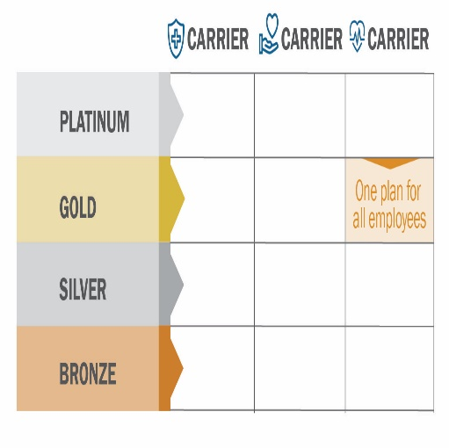
One Plan
Employer selects one health plan
All employees enroll in the selected plan
Composite billing method
Notes:
Health Connector for Business is bringing something new to small businesses:
Set a monthly contribution level and allow employees to shop for the plan that best meets their individual needs.
The new platform enables multiple choice models – one plan, as we offer now; one carrier, for differing plans from the same carrier; and one level, differing carriers across the same metallic tier.

Slide 18





How One Carrier Works
You (the employer) choose one pizza shop
You agree to pay for half the cost of a $10 pepperoni pizza from that shop, making your cost $5
Your employees can either:
Choose to keep pepperoni, OR
Choose a different style pizza from that same pizza shop.
No matter which pizza the employee chooses, you’ll still pay $5 towards their pizza
Notes:
Health Connector for Business is bringing something new to small businesses:
Set a monthly contribution level and allow employees to shop for the plan that best meets their individual needs.
The new platform enables multiple choice models – one plan, as we offer now; one carrier, for differing plans from the same carrier; and one level, differing carriers across the same metallic tier.

Slide 19
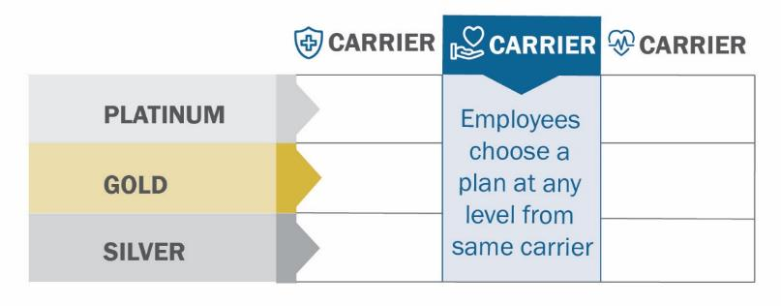
One Carrier
Employer selects one carrier
The employee can choose a plan at different metal levels offered by the carrier
List billing method

Slide 20





How One Level Works
You (the employer) choose one type of pizza (Pepperoni)
Using the cost of a pepperoni pizza from one pizza shop as a benchmark, you agree to pay half the cost ($5) towards any pepperoni pizza that your employees want.
Pepperoni costs $10 @ pizza shop you chose as benchmark
Your employees choose a pepperoni pizza from any pizza shop.
No matter which pizza shop the employee chooses to get their pizza from, you’ll still pay $5 towards their pizza.
Notes:
Health Connector for Business is bringing something new to small businesses:
Set a monthly contribution level and allow employees to shop for the plan that best meets their individual needs.
The new platform enables multiple choice models – one plan, as we offer now; one carrier, for differing plans from the same carrier; and one level, differing carriers across the same metallic tier.

Slide 21
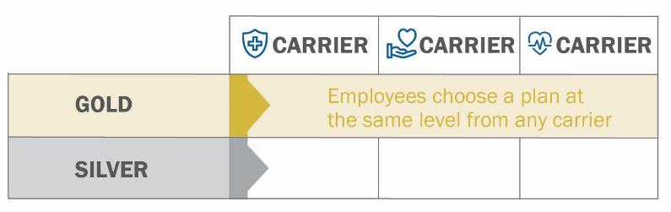
One Level
Employer selects a metal level and a Reference Plan within that level to use as a cost benchmark
The employee can choose a health plan offered by any carrier within the selected metal level
List billing method

Slide 22
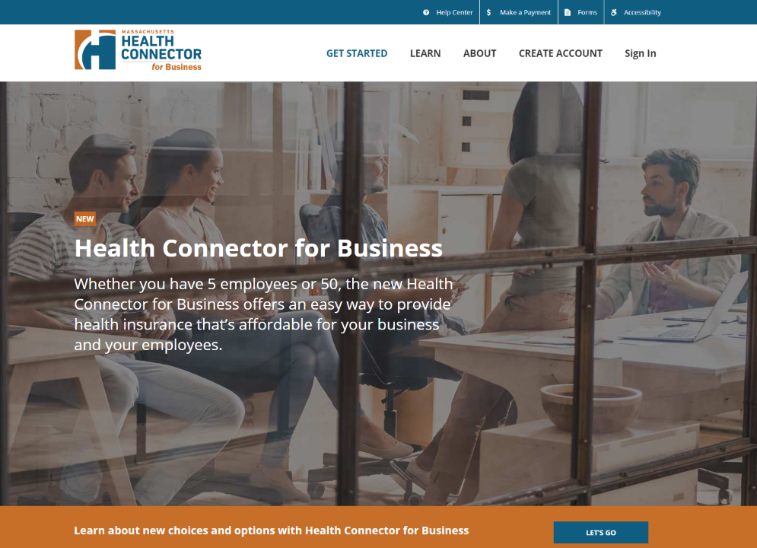
Notes:
The new website is easy to use for businesses and their employees
The website provides quick employee roster uploading, decision-making tools and online payment

Slide 23
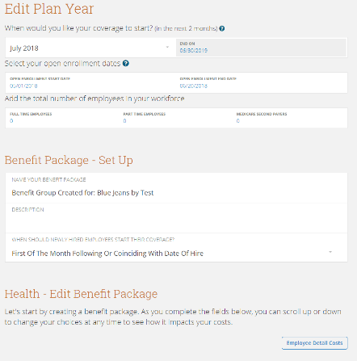
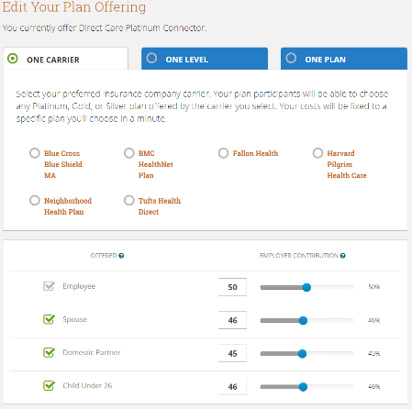
Employer View
FIX SCREENSHOT
Notes:
For most people, it will take less than 30 minutes to navigate through the system
You can get personal help from our customer service team or a broker in your area

Slide 24
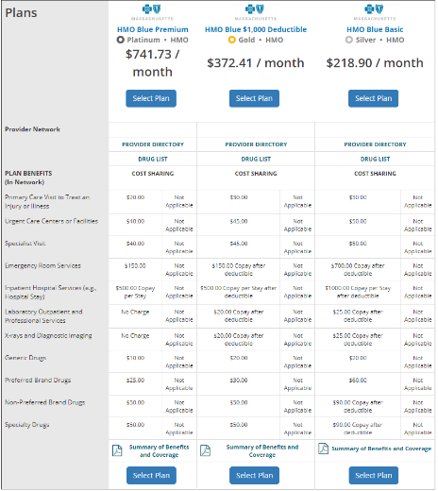
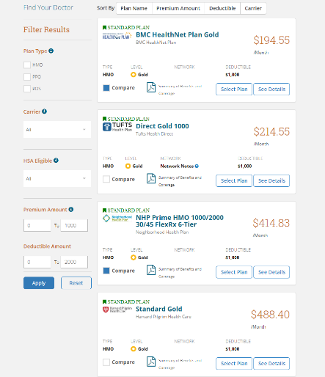
Employee View
Notes:
For most people, it will take less than 30 minutes to navigate through the system
You can get personal help from our customer service team or a broker in your area

Slide 25

What is new for 2019?
Health Savings Account Plans
Each carrier will offer a silver H.S.A. plan
Out-of-State Coverage
PPO plans for “One-Carrier” model
New Carriers
UnitedHealth for 1/1 and Tufts Premier for 4/1
Dental Plans
Altus and Delta Dental

Slide 26
Enrollment Requirements:
January vs. all other months
Minimum contribution and participation requirements are waived when enrolling in January 1 coverage through Health Connector for Business.
January 1 Effective Date
All Other Effective Dates
Employer Contribution Requirement
Employer Contribution Requirement
No minimum contribution - 0%
50% for employees
33% for dependents
Employer Participation Requirement
Employer Participation Requirement
No minimum participation - 0%
75% of employees
must enroll or validly waive
Notes:
All Health Connector plans meet “Seal of Approval” standards and are compliant with state and federal law
Plus, all Health Connector plans include certain preventive with no out-of-pocket cost-sharing when provided by an in-network doctor

Slide 27
Enrollment Timeline

Slide 28
Eligibility
Do you own a business in Massachusetts?
Do you have 1 – 50 full time employees?
Shop and enroll online at www.MAhealthconnector.org/business
or call 1-888-813-9220
Don’t meet these requirements?
You may be able to enroll in individual or family coverage during the
Health Connector’s annual Open Enrollment.
Visit MAhealthconnector.org to learn more

Slide 29

“Every day I know that people are relying on me for their livelihood. Medical insurance is critical to people, so if there are gaps with that, you feel the responsibility to make sure they’re filled.”
Small Business Owner:
Kin Lo
CEO and Founder, Kaymbu

Slide 30
Agenda
Introduction
Q & A
Benefits
How it Works

Slide 31

Shop and enroll online at www.MAhealthconnector.org/business or call 1-888-813-9220

