Slide 1

Let’s Get Digital
Digital Strategy & Social Media Crash Course
Kate Murphy & Ted Trevens of DSA Boston

Slide 2
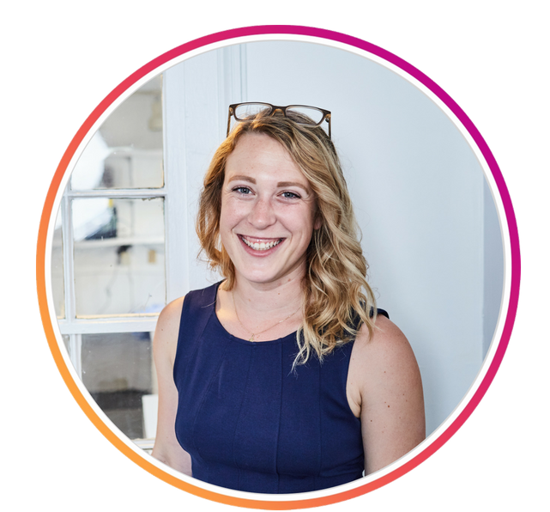
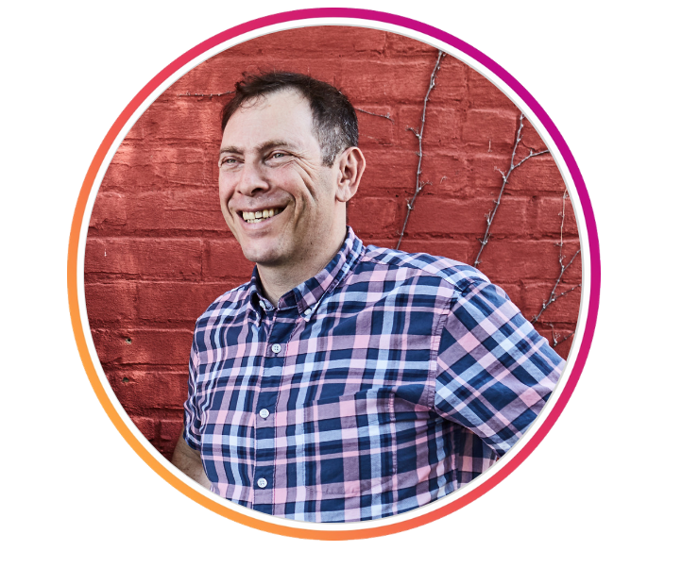




Kate Murphy
Director of Digital Strategy
Human Swiss army knife in online fundraising. Ask her about social media management, content marketing & analytics. <3’s to jet-set or dive nose-deep into travel lit.
Ted Trevens
Founder & President
30+ years in the sector. Passionate about bringing sustainable solutions to nonprofits. Runs on best practices and mint tea. Adjusts private sector methods to the public sector.
DSAboston
DSA_boston

Slide 3

Please describe your organization in an old-school tweet
(140 characters or fewer)
Tweet @Dsa_Boston to share your response!
DSA Example: Consultants working with domestic & international nonprofits. We’re your one-stop shop for fundraising, digital strategy, grant writing & more.

Slide 4

Our Road Map
Non-negotiable web basics
Social media best practices
Social media Advertising
Web Bonuses

Slide 5

Visit PollEv.com/katemurphy700 or text KATEMURPHY700 to 22333 once to join
Does your nonprofit currently have a mobile friendly website?

Slide 6
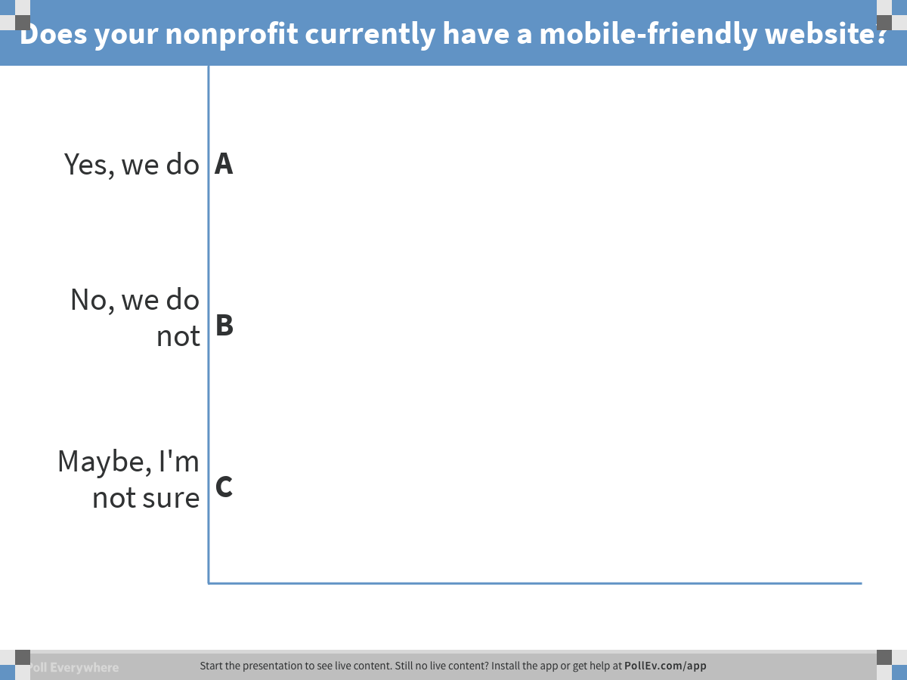

Slide 7
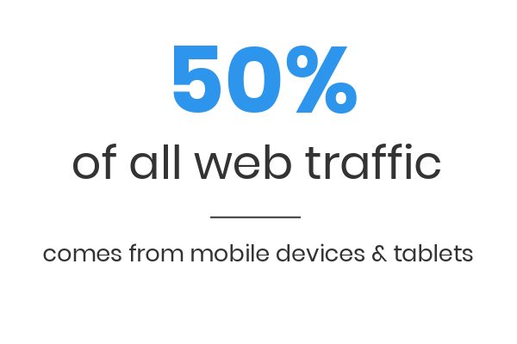
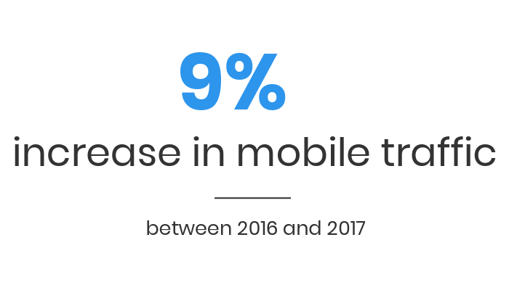
nonprofitssource.com

Slide 8
Quick tips for a great site
Visually Appealing & Intuitive
User Experience (UX) Design

Slide 9


Slide 10
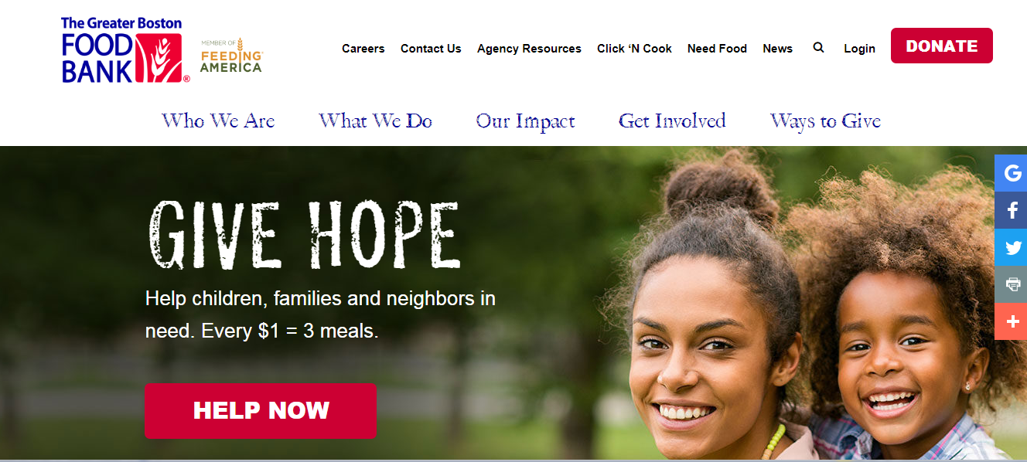
Easy to donate
gbfb.org

Slide 11
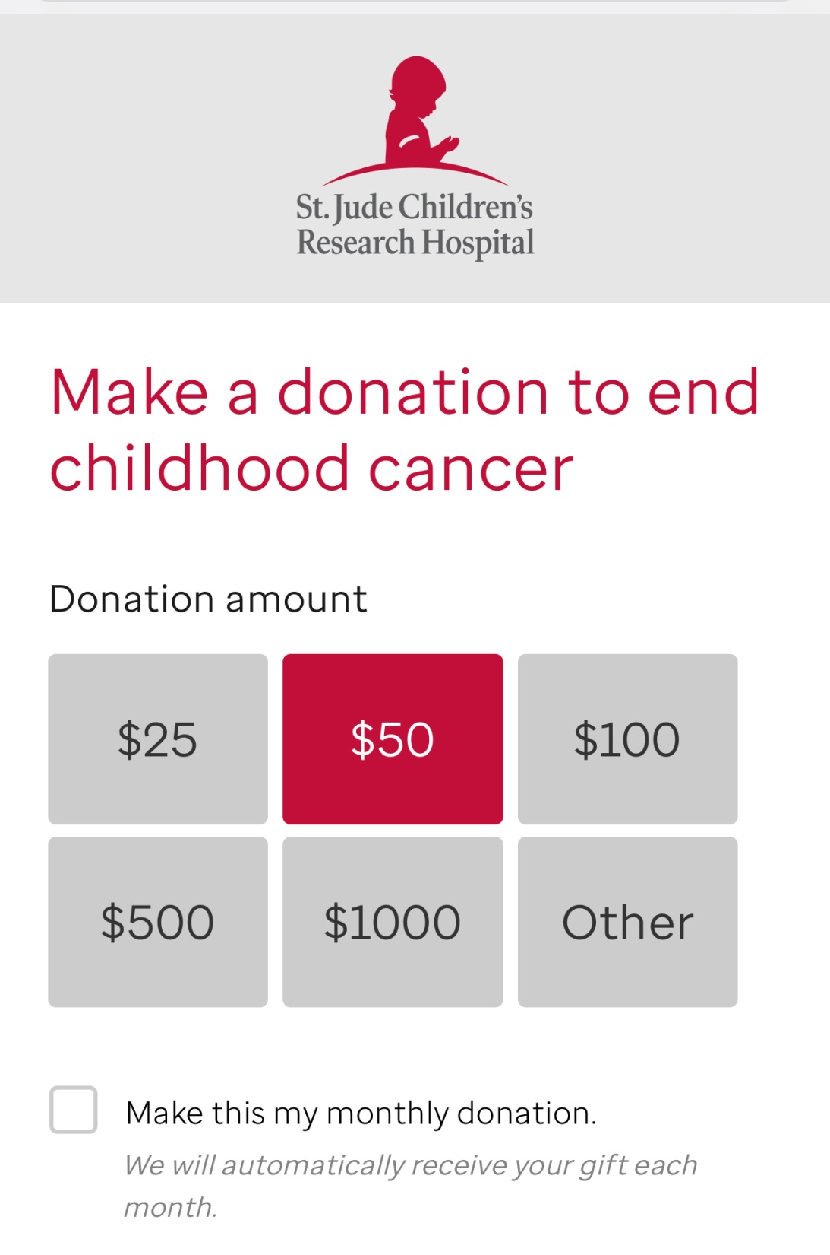
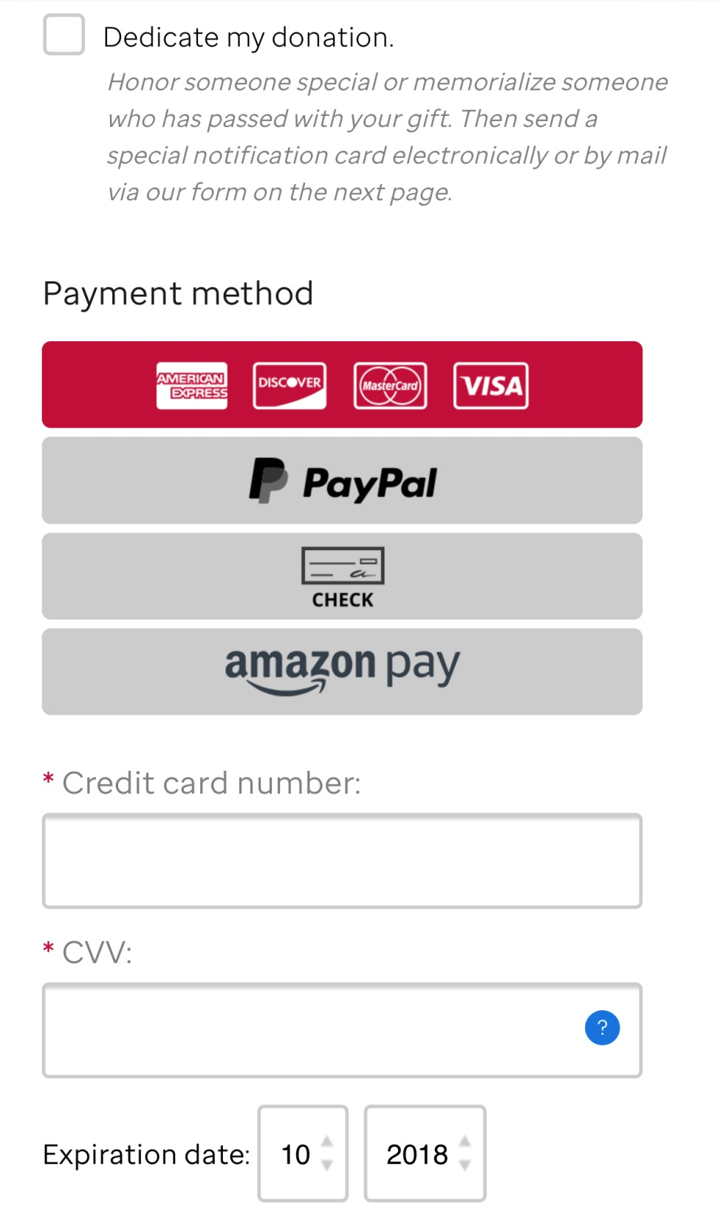

Slide 12
Analytics Tracking
“Know thy audience”

Slide 13

Entering the world of social media

Slide 14

Choosing Platforms
Not all social is created equal.
Where is your audience?
Do you have the capacity to manage the account?

Slide 15

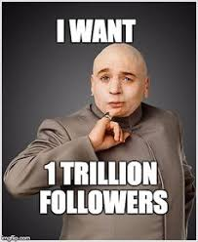
Engagement
Facebook prioritizes posts that are interacted with
Engagement is more important than number of followers
(sorry Dr. Evil)

Slide 16
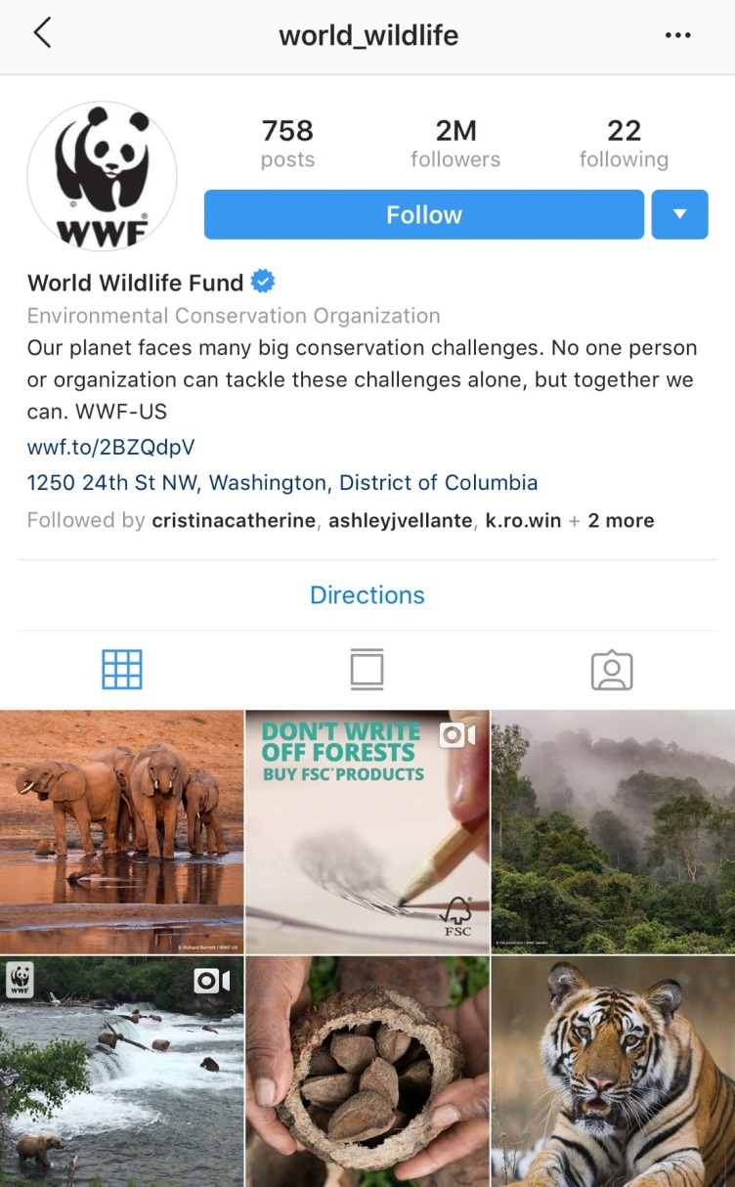
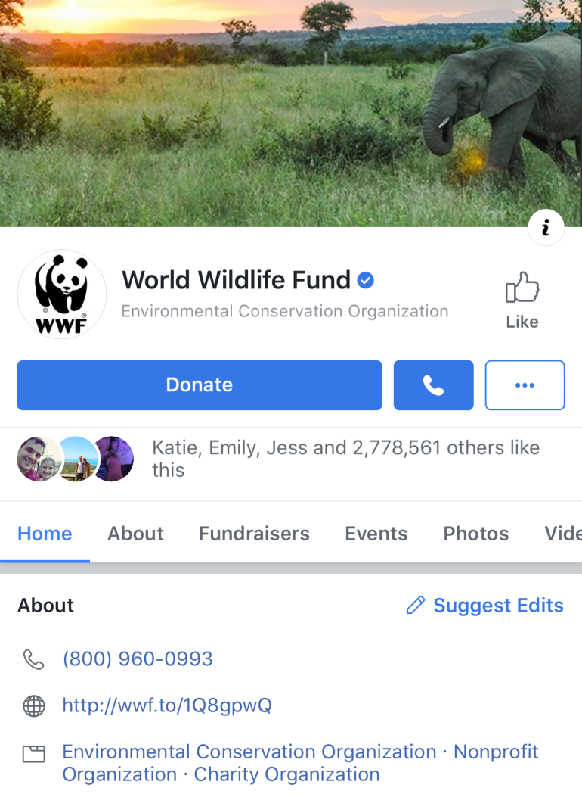
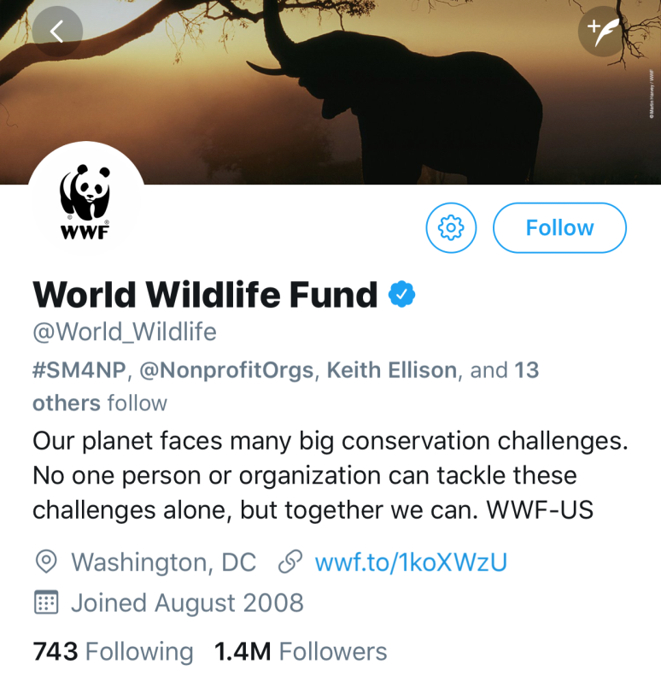
Branding
Build brand trust

Slide 17

Content that gets action
Tweets with images receive 18% more click-throughs, 89% more likes, and 150% more retweets.
DO:
Prioritize video & photo content
Share local content from other users
Share your mission via stories
DON’T:
Oversaturate your feed with asks
nonprofitssource.com

Slide 18
Visit PollEv.com/katemurphy700 or text KATEMURPHY700 to 22333 once to join
Has your organization ever run a paid ad on social
(including Google)?

Slide 19
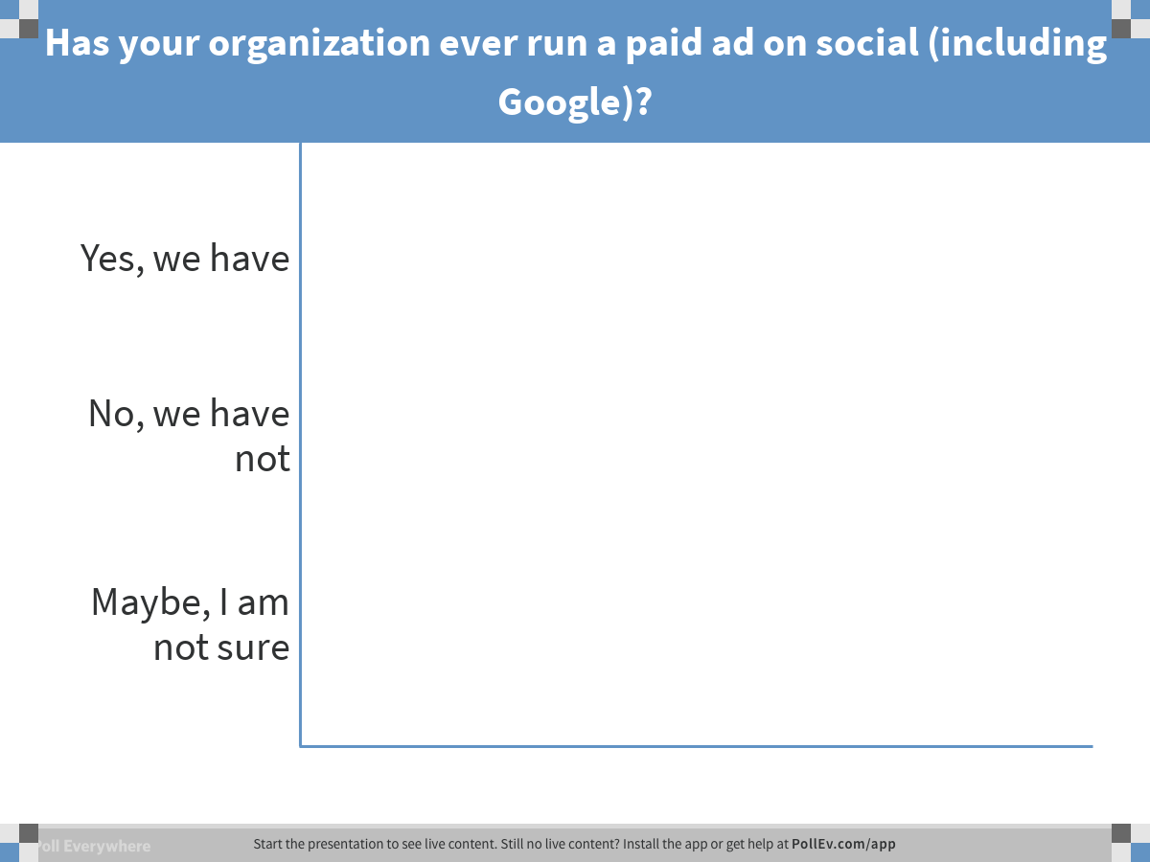

Slide 20
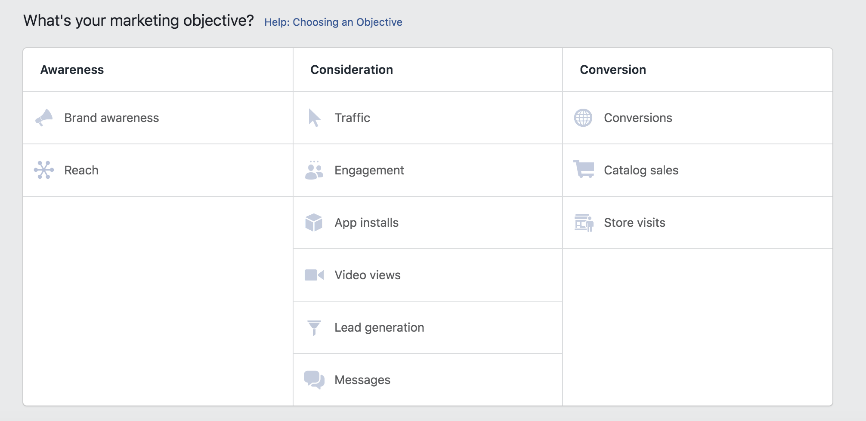
Paid Advertisements
What is the goal of our ad?
Are we trying to drive engagement on our page?
Are we looking for video views?
Are we selling event tickets?

Slide 21
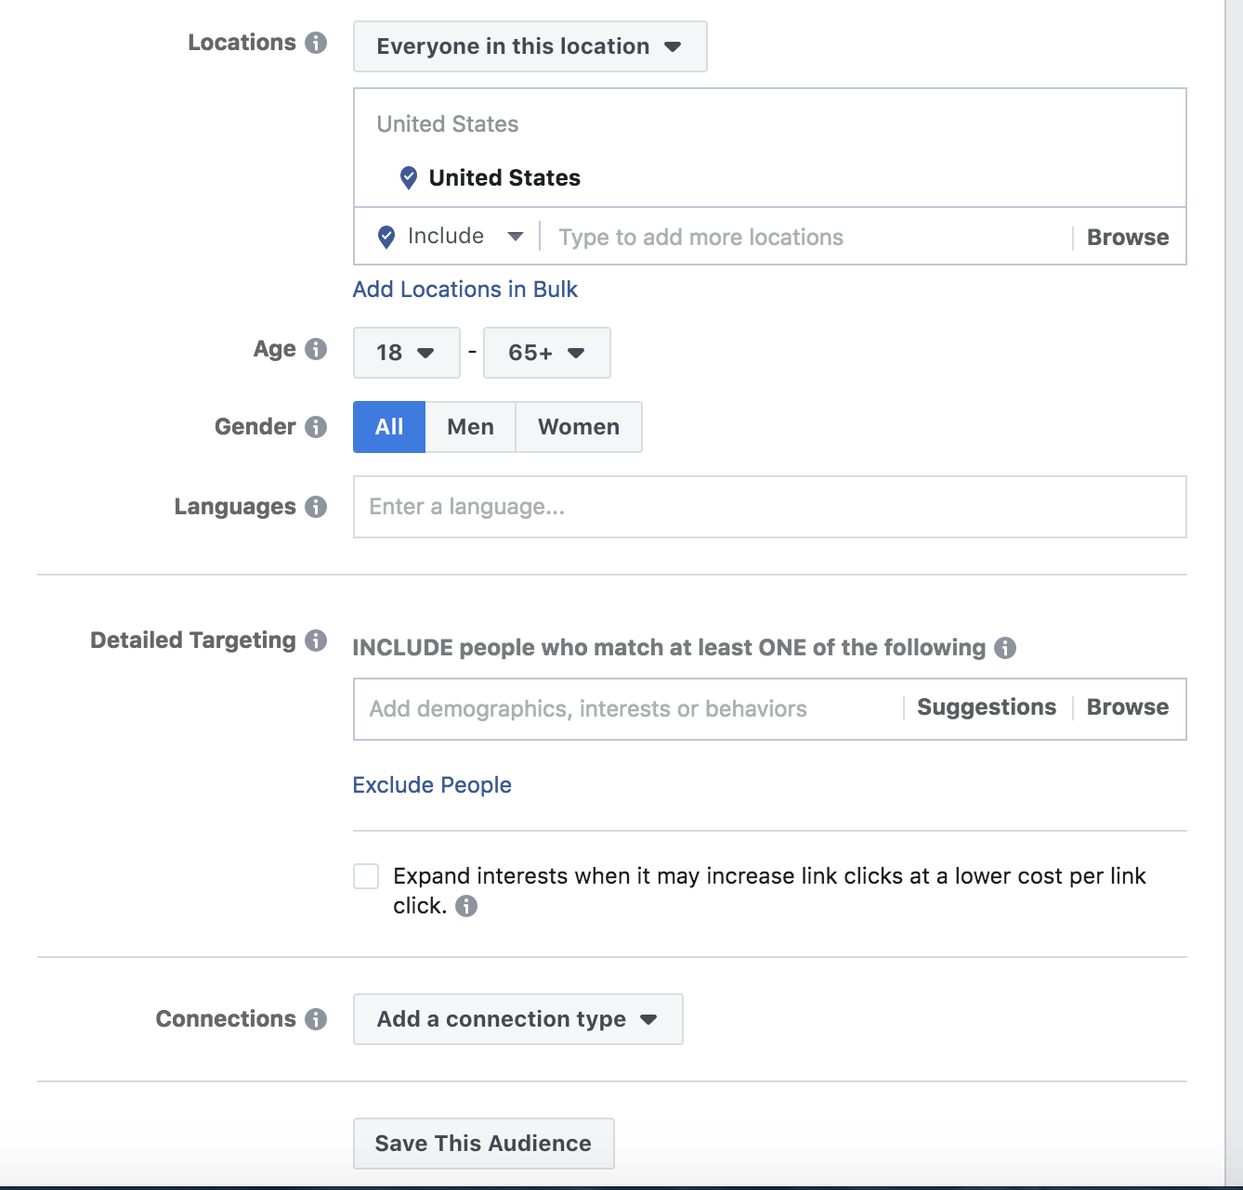
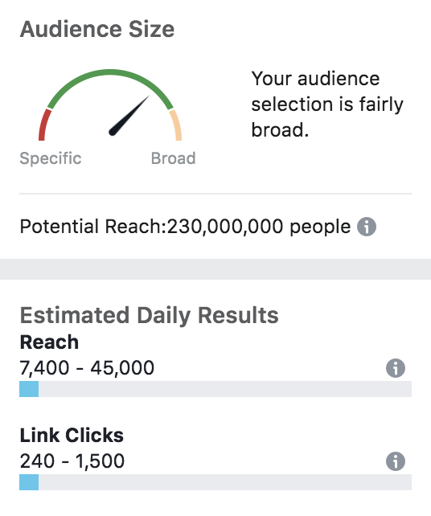
Defining & Reaching Your Audience

Slide 22
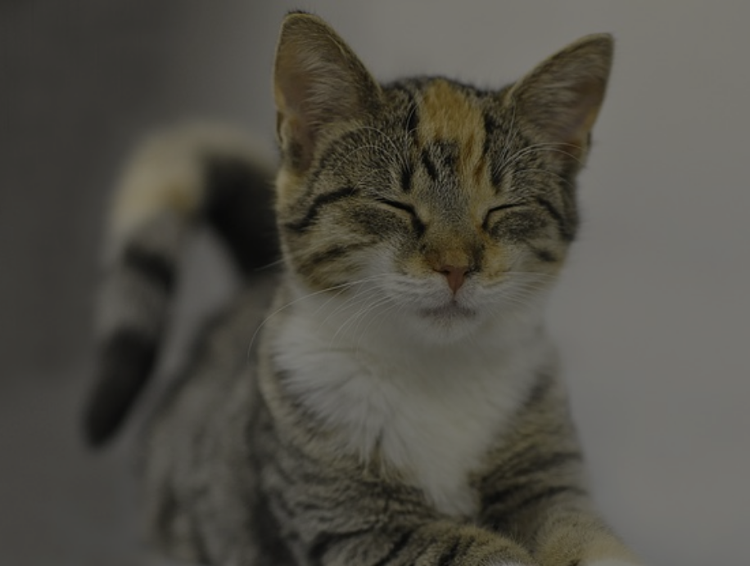
What demographics, interests, and behaviors would we use for a Nonprofit Animal Shelter?

Slide 23
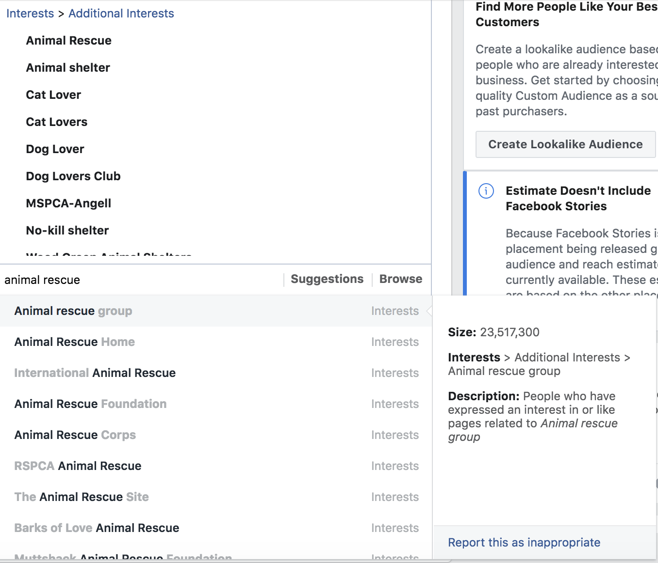
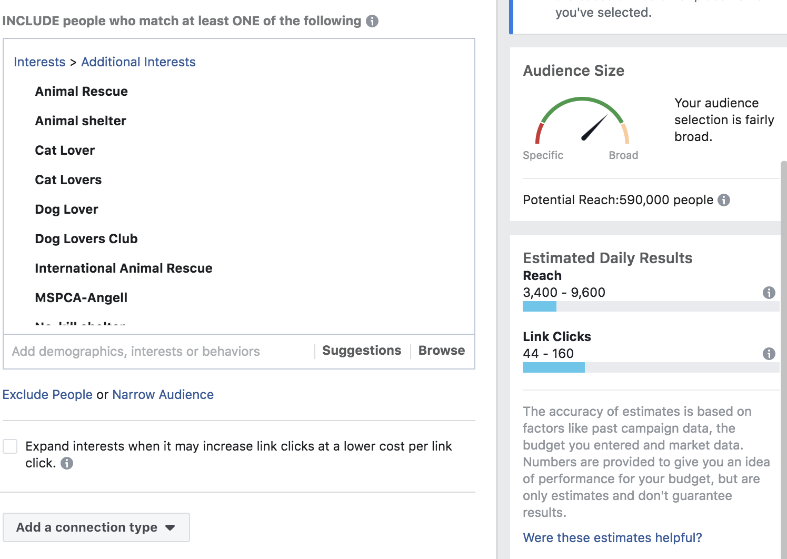

Slide 24
Other important notes on paid ads
Minimal text for a larger reach
Video performs really well
You can use Cost Per Click (CPC) as an easy measure of your ad’s success
Average CPC in 2016 was approximately 27.5 cents
Adepresso.com/blog/facebook-ads-cost

Slide 25




Web Bonuses
SEO Score: seositecheckup.com
Cultivating and Repurposing Content:
Filmmaker Pro
Clips

Slide 26
Have a question we didn’t get to?
Tweet @dsa_boston
OR
Email us at kate@dsaboston.com

