Slide 1
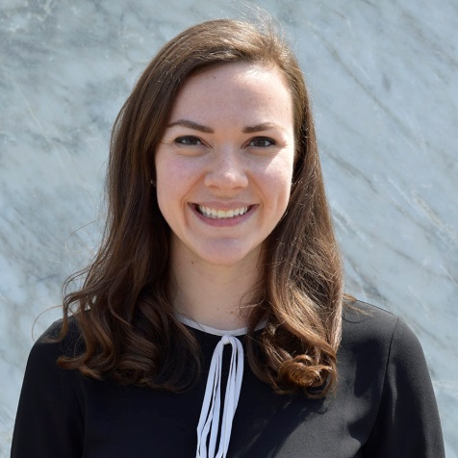

Beyond Diversity to Inclusion
August 1st Webinar
Presented by TSNE MissionWorks
Thanks for joining us! A few instructions before we begin:
You may join the audio by selecting the radio button for either “Telephone” or “Mic & Speakers.” If you are using telephone, please dial in with the conference line and audio pin provided.
If you are having any technical issues, please let us know in the chat box.
We will have time for Q&A. Please enter your questions in the chat box at any time.
This webinar is being recorded, and we will distribute the recording after the webinar.
Marta Hodgkins-Sumner
Director of Membership and Programs
www.massnonprofitnet.org

Slide 2
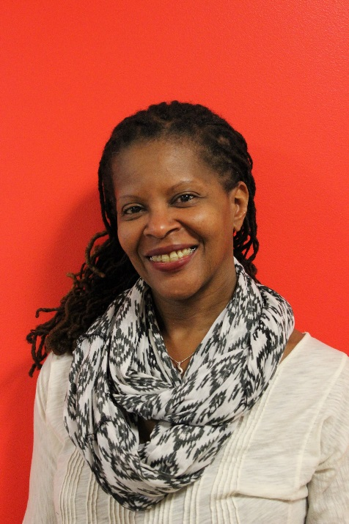
TSNE MissionWorks provides information and services to build the knowledge, power, and effectiveness of individuals, organizations, and groups that engage people in community and public life. The ultimate intention of our work is to create a more just and democratic society.
Trina Jackson, Community Engagement Manager, has nearly 20 years of community-based experience as an organizer, facilitator, and strategist in the social justice movement.
Notes:
This is the opening slide

Slide 3
Goals and Objectives
  Understand common language in Diversity, Equity and Inclusion (DEI) work
  Increased awareness of the ways racism pervades our society and organizations
  Better understanding of how “inclusion” is different from “diversity”
  Identify some steps for Inclusion work
Notes:
Here are our goals and learning objectives for this webinar

Slide 4

A Basic Assumption
In this webinar, we begin with the assumption that racism and white privilege are real and pervasive in US culture.
Notes:
Very important to start with this statement for our webinar.

Slide 5
The Four Levels of Racism
Norms and beliefs about what is good, right or beautiful.
Ideological
Institutional
Control of resources and power, laws and policies
Interpersonal
What we do, our
interactions with others
Internalized
Believing and acting out oppressive stereotypes about themselves and their group.
Notes:
Here is our analysis on the basic assumption we just shared,
How racism manifest within U.S. society
Review the different levels
Give examples for each level

Slide 6
Common Language
Diversity
Inclusion
Notes:
With that understanding of how racism manifest within US society,
We want to review some common language for the terms we use to
Describe this webinar.
The terms are used interchangeable, but they are different.

Slide 7
Diversity
Individual
Representational
Transactional
Notes:
Examples such as how many people of color on staff, how many people do you serve, how many attended our events, etc.
In this way, a team can be diverse and so can an organization, BUT
Diversity is relational.
A person is not “diverse.” A person may bring diversity to your team or your hiring pool, but they in themselves are not “diverse.”
They’re a woman; they’re a person of color; they’re part of the LGBTQ+ community; they may have purple hair
“Diverse” is often a coded-word to mean “someone who is outside of what is considered “the norm”.

Slide 8
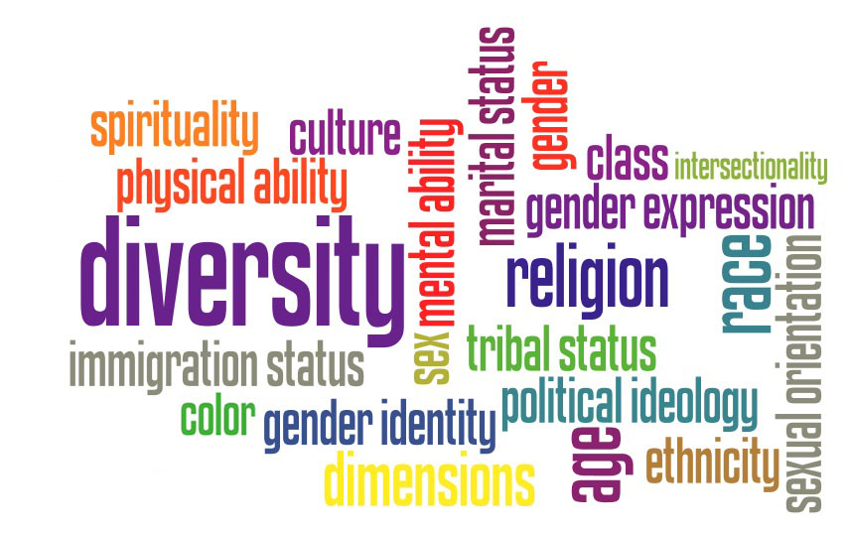
Diversity
Notes:
Here’s some examples and ways we can think about diversity.
Each individual is unique and groups of individuals reflect multiple
dimensions of difference.
Valuing diversity means embracing and celebrating the rich
dimensions of difference that exist in groups.

Slide 9
Diversity-focused questions
How can we attract a more “diverse” pool of candidates?
Number of outreach and recruitment activities (door knocking, house meetings, phone calls).
Number of leaders participating on committees, boards, and other leadership positions.
Notes:
Efforts to increase diversity involve more questions like this.
You can have a diverse team of talent but that doesn’t mean that everyone feels welcomed, or valued, or given opportunities to grow or lead, or developed by a mentor.

Slide 10
Inclusion
Collective
Way of being
Transformational
Notes:
Not everything
that counts
can be
counted, and
not everything
that can
be counted
counts.
Albert Einstein

Slide 11
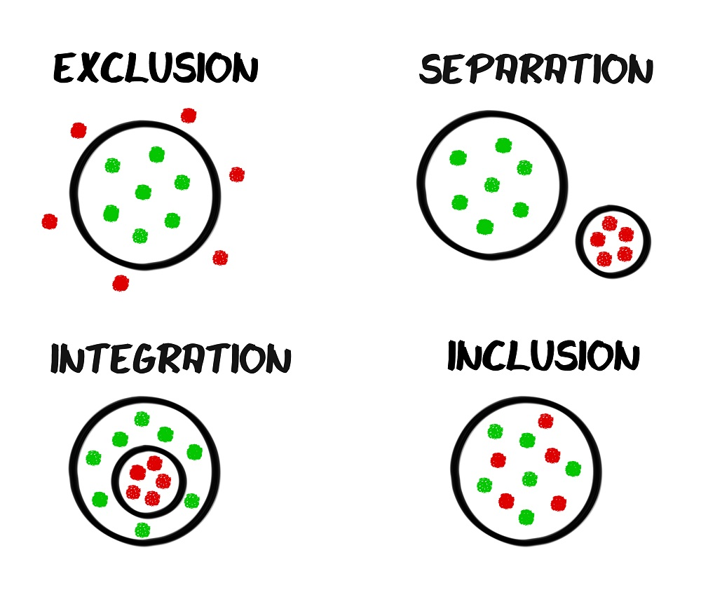
Inclusion
Notes:
Inclusion is not a natural consequence of diversity. You can spend millions of dollars on recruiting people in the door but never change the environment they walk into.
This is where we run into problems.
With inclusion, the “how” is as important, if not more important, than the “what?”
Goes beyond representation and numbers
And we ask ourselves different types of questions

Slide 12
Inclusion-focused questions
What barriers stand in the way of people with marginalized identities feeling a sense of welcome and belonging? What is their experience?
What don’t we realize about what we’re doing that negatively impacts more racially diverse teams?
What type of organizational culture do we want to create?
How are we prepared to deal with resistance?
Notes:
Here are some questions for reflection, to ask ourselves about a commitment to building inclusion.

Slide 13
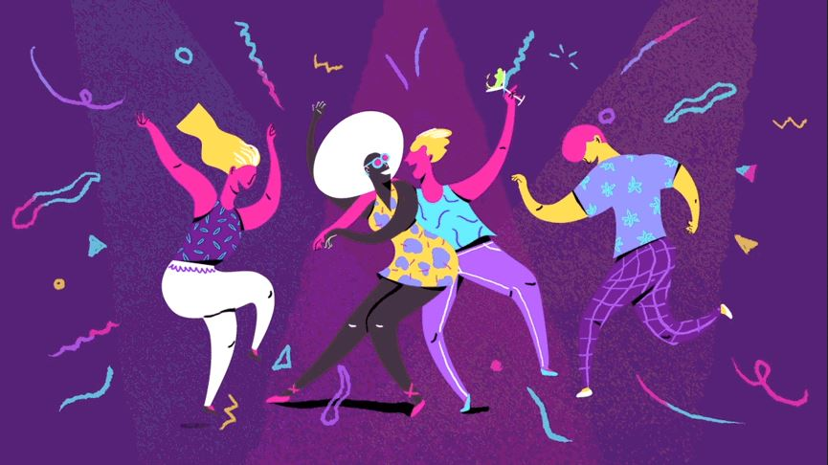
Diversity is being invited to the party. Inclusion is being asked to dance.

Slide 14
Organizational Culture
The ways an organization conducts its work, treats staff, and the wider community.
How much freedom is allowed in decision making, in developing new ideas, or in personal expression.
How power and information flows through its hierarchy.
How committed staff are towards collective objectives.
Notes:
Inclusion is deeply held value that is held by the culture of our society, of our organizations as institutions.
Important because we have to create a culture that supports people being welcomed, included, ideas and voices heard, leadership respected
What do we mean by “organizational culture”?

Slide 15
Dominant Culture
Most powerful group in society.
Receives the most support from major institutions and constitutes the major belief system.
Social institutions in the society perpetuate the dominant culture and give it a degree of legitimacy that is not shared by other cultures.

Slide 16
White Supremacy
White supremacy is a historically based, institutionally perpetuated system of exploitation and oppression of continents, nations and peoples of color by white peoples and nations of the European continent; for the purpose of maintaining and defending a system of wealth, power and privilege.
Notes:
What do we mean by white supremacy culture?

Slide 17
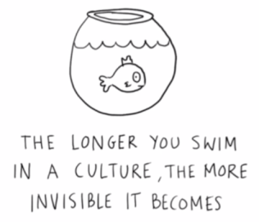
White Supremacy Culture within organizations
Perfectionism
Sense of Urgency
Defensiveness
Quantity over Quality
Worship of the Written Word
Only one right way
Paternalism
Either/Or Thinking
Power Hoarding
Fear of Open Conflict
Individualism
Progress = Bigger, More
Objectivity
Rights to Comfort
Notes:
In the work of addressing racism and the building inclusive organizations to
dismantle Racism within our organizations, it’s helpful to look at white
supremacy culture.
Here are some elements of that.

Slide 18
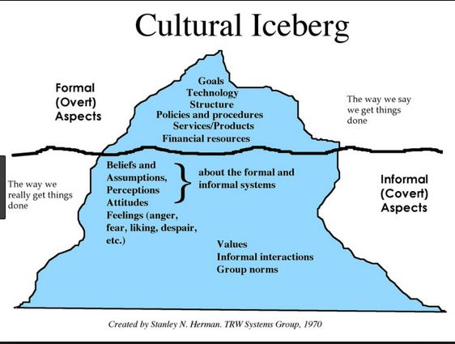
Iceberg Model

Slide 19
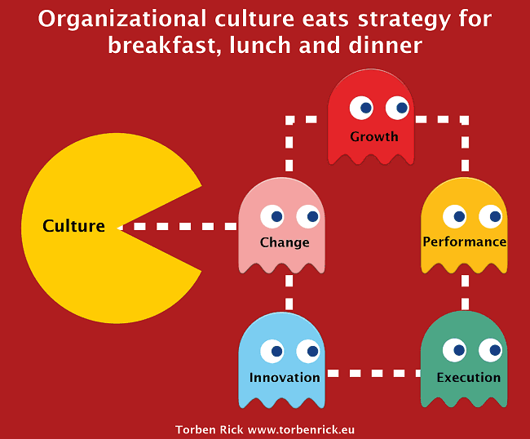
Culture > Strategy
Notes:
Term attributed to Peter Drucker, organizational management expert.
Believed that a company's culture normally thwarts any attempt to
create or enforce a strategy that is incompatible with that culture
Other lessons about this:
People are loyal to culture, not to strategy
Culture is more efficient than strategy
A brittle culture can doom even a great organization
When strategy and culture collide, culture will win
Culture provides an emotional safe zone and offers resilience in hard times
Culture will have a significant impact on your bottom line
Culture can eat change, growth, performance, execution, innovation when it
Comes to building inclusive organizations.

Slide 20
Exploring Dimensions of Your Organization
Big Picture Analysis
  How do we understand the issues we are addressing?
Program Design
  How do we engage our constituents/participants in the design and implementation of the our programs and activities?
Program Evaluation
  How do we engage our constituents/participants in defining success?
Storytelling
  How are we interrupting unproductive narratives?
Notes:
More specifically to the practices across the organization.
Particularly important in thinking about developing practices, even moving toward
Equity, which many of us also care about, and which is a different stage in the
Process.

Slide 21
Exploring Dimensions of Your Organization
Fundraising
  Who do we value as important donors to reach out to?
Financial Resources
  Who has control and influence over how we use our resources?
Organizational Structure
  To what extent does our structure reinforce hierarchies of value based on status rather than experience or expertise?
Governance
  How does our governance structure reflect our organizational values?
Notes:
Work in a more culturally proficient way with the people, organizations and communities we serve
More attractive employer to top talent with an ability to harness the rich experiences and diversity
Build a more ‘leaderful’ organization, where staff have a critical, decision-making role

Slide 22
Strategies to Build Inclusion
Engage in deliberate collective self-reflection to monitor biases and stereotypes.
Create opportunities for people to interact and develop new associations.
Foster a collaborative, cooperative environment with staff sharing equal and equitable status and common goals
Involve a cross-section of decision-makers.
Different viewpoints and multiple perspectives can also help reduce implicit bias
Notes:
So what action can we start to take?

Slide 23
Humanize the Impact
Refrain from detachment on the lives of people and their experience
Understanding oppression is not an intellectual exercise
Take responsibility for your own learning
Be aware of the privileges that you carry.
Notes:
And remember…

Slide 24
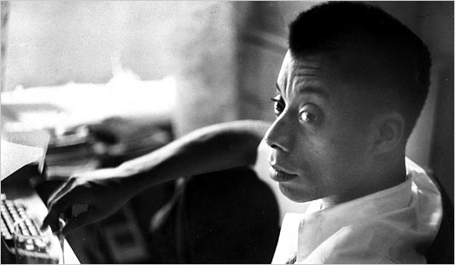

Questions?
“Not everything that is faced can be changed, but nothing can be changed until it is faced.”
- James Baldwin
Notes:
Pause here for some questions

Slide 25
