Slide 1
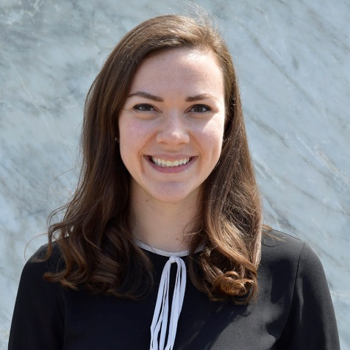

Tax Reform
February 21st Webinar
Presented by BlumShapiro
Thanks for joining us! A few instructions before we begin:
You may join the audio by selecting the radio button for either “Telephone” or “Mic & Speakers.” If you are using telephone, please dial in with the conference line and audio PIN provided.
If you are having any technical issues, please let us know in the chat box.
We will have time for Q&A. Please enter your questions in the chat box at any time.
This webinar is being recorded, and we will distribute the recording after the webinar.
Marta Hodgkins-Sumner
Director of Membership and Programs
www.massnonprofitnet.org

Slide 2

Tax Reform Agenda
Tax reform affecting tax-exempts
Tax provisions that didn’t pass
New tax provisions for tax-exempts
Charitable contribution provisions for donors

Slide 3

Tax Provisions That Did Not Pass
UBIT on royalty from use of name and logo
Exception related to political campaigns
Research income rules
Repeal of educational assistance benefits

Slide 4
Tax Provisions That Did Not Pass
Limitation on tax-free on-campus housing
Increased charitable mileage rate
Modifications to intermediate sanctions rules
Tax exemption for professional sports leagues

Slide 5

Tax Provisions That Did Not Pass
Repeal of tax-free dependent care assistance
Removal of adoption assistance benefits
Private foundation investment excise tax
Additional reporting for donor advised funds

Slide 6

New Tax Provisions for Tax-exempts
1. Higher education investment excise tax
1.4% excise tax on net investment income
Private colleges and universities
Institutions with 500+ tuition-paying students
$500k per full-time student
Effective tax years beginning after 2017

Slide 7

New Tax Provisions for Tax-exempts
2. Excise tax on executive compensation
21% excise tax on sum of:
  Compensation (other than excess parachute payment) in excess of $1 million paid to a covered employee, plus
  Any excess parachute payment paid to a covered employee
Employer is liable for excise tax
Effective for amounts paid after 2017

Slide 8
New Tax Provisions for Tax-exempts
3. Fringe benefits included in UBTI
Qualified transportation fringe
Qualified parking fringe
Use of on-premises athletic facilities
Effective for amounts paid or incurred after 2017

Slide 9
New Tax Provisions for Tax-exempts
Polling question 1 and response choices
  Does your organization offer tax-free commuting benefits, such as parking or mass transit fringe benefits to employees?
  Yes, parking
  Yes, mass transit
  Yes, both
  No

Slide 10

New Tax Provisions for Tax-exempts
Other provisions affecting tax-exempts
4. Tax-exempt bonds advance refunding
5. Entertainment expenses
6. Moving expenses

Slide 11
New Tax Provisions for Tax-exempts
7. Unrelated business activity silos
Separately calculate UBTI for each business activity
Prohibits use of losses against another activity
Can use excess deductions from one year to offset income from same unrelated business in another year
Applies to tax years beginning after 2017

Slide 12
New Tax Provisions for Tax-exempts
Polling question 2 and response choices
  Does your organization have one or more unrelated business activity?
  Yes, one
  Yes, more than one
  None
  Other/don’t know

Slide 13
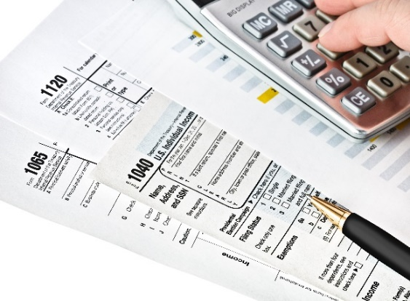
New Tax Provisions for Tax-exempts
Corporate and trust tax impacts on UBIT
8. Net operating loss deduction
9. Alternative minimum tax
10. Corporate and trust tax rates on UBIT

Slide 14

Tax Reform Provisions for Donors
Tax reform provisions for donors
Reduction of top marginal rate
Increase in standard deduction
Charitable deduction limit increase to 60% AGI

Slide 15

Tax Reform Provisions for Donors
Tax reform provisions for donors
No Pease limit on itemized deductions
No 80% deduction for payments for right to buy tickets to a college athletic event
Reduction in estate taxes

Slide 16
Tax Reform Provisions for Donors
How will tax reform affect charitable giving?
Why do people give?
What are your donor stratums?
How will your fundraising efforts change?
What is the panacea?

Slide 17
Tax Reform Provisions for Donors
Polling question 3 and response choices
  Has your organization strategized internally (with your development team, management team, board, etc.) on how to increase charitable giving in light of tax reform?
  Yes
  No or not yet
  Other/don’t know

Slide 18
Tax Reform Provisions for Donors
Why do people like to give …?
Fun!
Chance to win things
Opportunity to network
Opportunity to socialize
Because someone asked
Want to feel good
Want to be recognized
Want to know what their money does
Want to know they helped someone
Want to belong

Slide 19
Tax Reform Provisions for Donors
What are your strategies for different donor stratums?
Wealthy donors
Foundation donors
Corporate donors
IRA charitable rollover
Appreciated stock and other property
Bunching of donations
Donor advised funds
Charitable trusts
Gift tax exclusion
Communication and cultivation

Slide 20
“Sweet” 16 Tax Reform Provisions
Affecting Nonprofit Organizations
Estate Tax
+ Standard deduction
Estate tax
+ Standard deduction
Individual rate reduction
Char limit increase
Estate tax
+ Standard
deduction
Moving expenses
Executive compensation
Entertainment expenses
Estate tax
Executive compensation
Entertainment expenses
No Pease limit
Estate tax
Higher Ed investment tax
Fringe benefit UBI
Higher Ed investment tax
UBI silos
+ Standard deduction
UBI silos
College Athletic Seating
UBI silos
Higher Ed investment tax
NOL limits
Corporate tax rate
NOL limits
Corporate tax rate
AMT
Bonds advance refunding

Slide 21
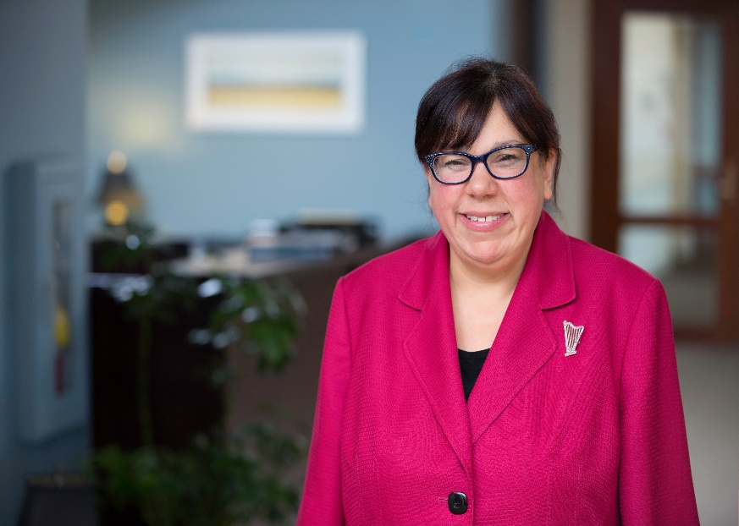
Thank you for participating today!
Laura J. Kenney, CPA, MST
Principal
617.221.1944
lkenney@blumshapiro.com
Non-Profit Tax Services

