Slide 1
Strengths Savvy Supervision
Building upon what’s best in our employees

Slide 2

3 Key Points
Strengths Savvy Supervision = increased engagement, productivity, and retention
Begins with the ability and commitment to recognizing strengths in action
Not about avoiding weaknesses or problems but instead confronting them with our best resources

Slide 3
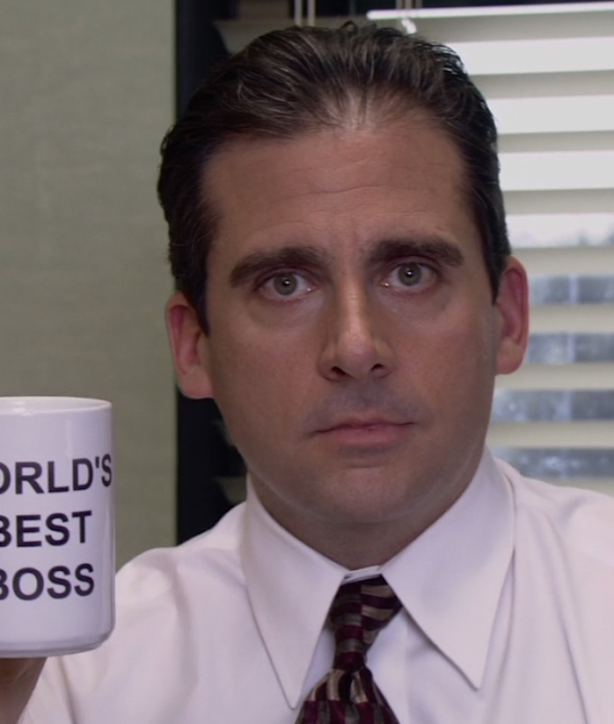
Best Boss, Coach, Mentor

Slide 4

The Business Case
When managers focus on strengths = 67% engagement
Average = 30%
Strengths-based companies see better sales, profit, and customer engagement, much lower turnover, and a big decrease in safety incidents
Rigoni, B., Asplund, J. Strenghts-Based Employee Development: The Business Results. Gallup Press, 2016.

Slide 5

VIA- Character Strengths
Fundamental human capacities for positive action

Slide 6
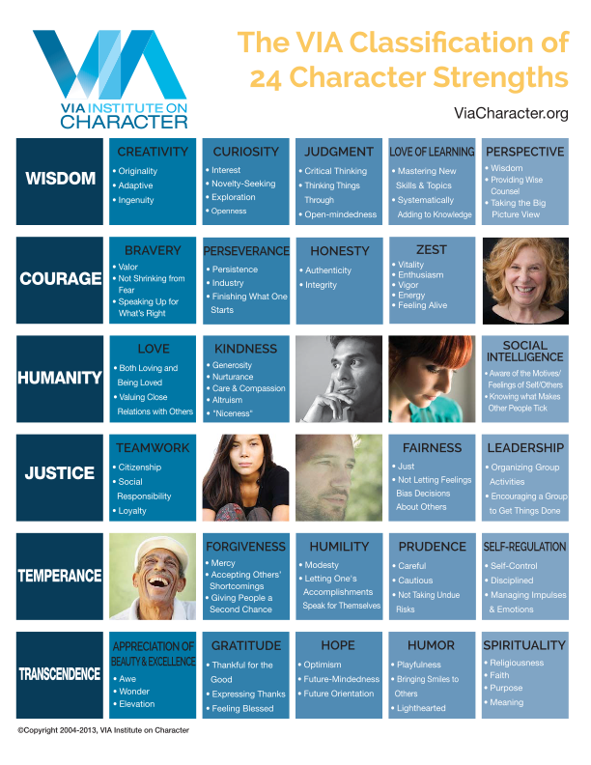
VIA Character Institute & Classification
Top positive psychologists > VIA Institute, 2000
Major research project around the world
Final list of 24 core strengths in 6 groups
strengths = combo of thoughts/feelings/behavior
Unique pathways to positive outcomes

Slide 7
VIA Character Survey
www.viacharacter.org
Only free, online, psychometrically-valid strengths survey
rank order of 24 strengths
NO Weaknesses measured
Signature Strengths = top 4-7

Slide 8
Translate 3 findings to Action
Character strengths function in groups
Choose combinations to confront challenges
Skilled use = right strength, right amount, at the right time
Choose strengths to balance each other
Some are better studied in the workplace
Use Perseverance, Hope, Creativity, Curiosity and Social Intelligence more often

Slide 9
“Me at My Best as an Employee”
Get with your partner
Share about a time in your career where you were really at your best
Partner listens and reflects strengths noticed
Take a few minutes each

Slide 10
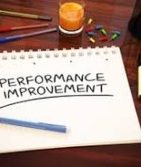
Conventional Wisdom- Manage + Fix Weaknesses
Long list of competencies for all developed to maximum
Deficit thinking
Links to lower retention, decreased engagement and productivity
“3rd Key”- Focus on strengths & manage weaknesses
Buckingham, M., Coffman, C. First Break All the Rules. Gallup Press, 2016.

Slide 11
Supervisor as Catalyst
To select for, cultivate, and position talent for maximum impact

Slide 12
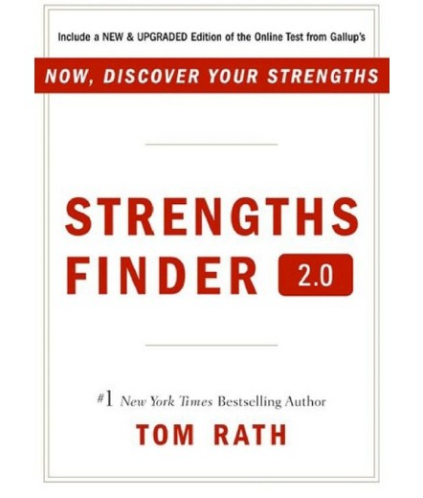
Strengths from Talents
“Talents” are inborn
Can be leveraged but not taught like skills
Naturally occurring
Strengths are applied talents (that get results)

Slide 13
Clifton Strengths Finder assessment
34 research-verified talents
Top 5 as critical
Rank ordering into 3 groups: top/middle/lesser
Cultivating skills and knowledge around top/middle talents is most effective

Slide 14
QUIZ!
What do the models have in common?
What is different about the models?
How could they be complimentary?

Slide 15
“What are your team’s top themes, and what are the patterns of behavior that result?”
*Get with your partner/look over the themes/discuss*

Slide 16
Aware-Explore-Apply Strategy
Aware
raise awareness through language & matching
Explore
the presence and particular impact
Apply
signature strengths to specific goals/situations

Slide 17
Activities/Interventions
“Me (You) At My (Your) Best”
“Strengths Spotting”
“Strengths as Hot Buttons”
“Defining Moments”
“Best Possible Team”

Slide 18
Program Applications
Hiring practices- assessing for talents/team fit
Promotions- job & team talent needs
Low motivation- signature strengths interventions
Recognition- individual & program
Talent-based skills and knowledge development

Slide 19
“Best Possible Team” ex. Development Department
Lots of Humanity, Wisdom, and Transcendence strengths
Not as strong in Courage or Temperance (conflicts + time to make decisions)
Focus on the team members with unique strengths in those areas
Fall events- combo of Teamwork, Zest, and Judgment to prepare
Perseverance, Kindness, and Self-Regulation during

Slide 20
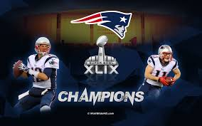
“Your best possible team”

Slide 21
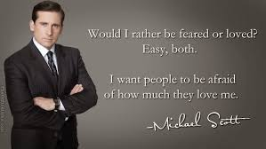
If all else fails…
(hint: love will get you much farther)

Slide 22
Resources for Continued Learning
www.viacharacter.org (free survey, blog)
“Making Positive Psychology Work” (podcast, Michelle McQuaid)
Character Strengths Interventions - Dr. Ryan Niemec
First, Break all the Rules - Gallup (2016 edition)
Resonant Leadership - Dr. Richard Boyatzis

Slide 23
#SSS Takeaways
Strengths Savvy Supervision = increased engagement, productivity, and retention
Begins with the ability and commitment to recognizing strengths in action
Not about avoiding weaknesses or problems but instead confronting them with our best resources

Slide 24
THANK YOU!

