Slide 1
What’s the Story?
How to equip your constituents to be effective brand ambassadors

Slide 2
I’ll feel good about you leaving here if…
You’re on your way to developing your organizational elevator pitch
You’ve learned how to create your own organizational messaging overview
You can tell your organization’s story in a consistent and interesting way—and equip your constituents to do the same
You have tips for engaging your constituents as brand ambassadors

Slide 3
It’s a crowded marketplace out there
“According to the Massachusetts Nonprofit Network, the state has roughly 33,000 nonprofits, although only about 20,000 have recurring annual revenues, an indicator of an active organization. The percentage of active nonprofits in Massachusetts is higher than in many other states with comparable populations, MNN says.”
– Does Boston have too many nonprofits? Sacha Pfeiffer, The Boston Globe, July 4, 2016

Slide 4
The art of the elevator pitch
An elevator pitch is a brief, persuasive speech that you use to spark interest in what your organization does.
A good elevator pitch should last no longer than a short elevator ride of 20 to 30 seconds, hence the name.
It should be interesting, memorable, and succinct. It also needs to explain what makes your organization unique.

Slide 5
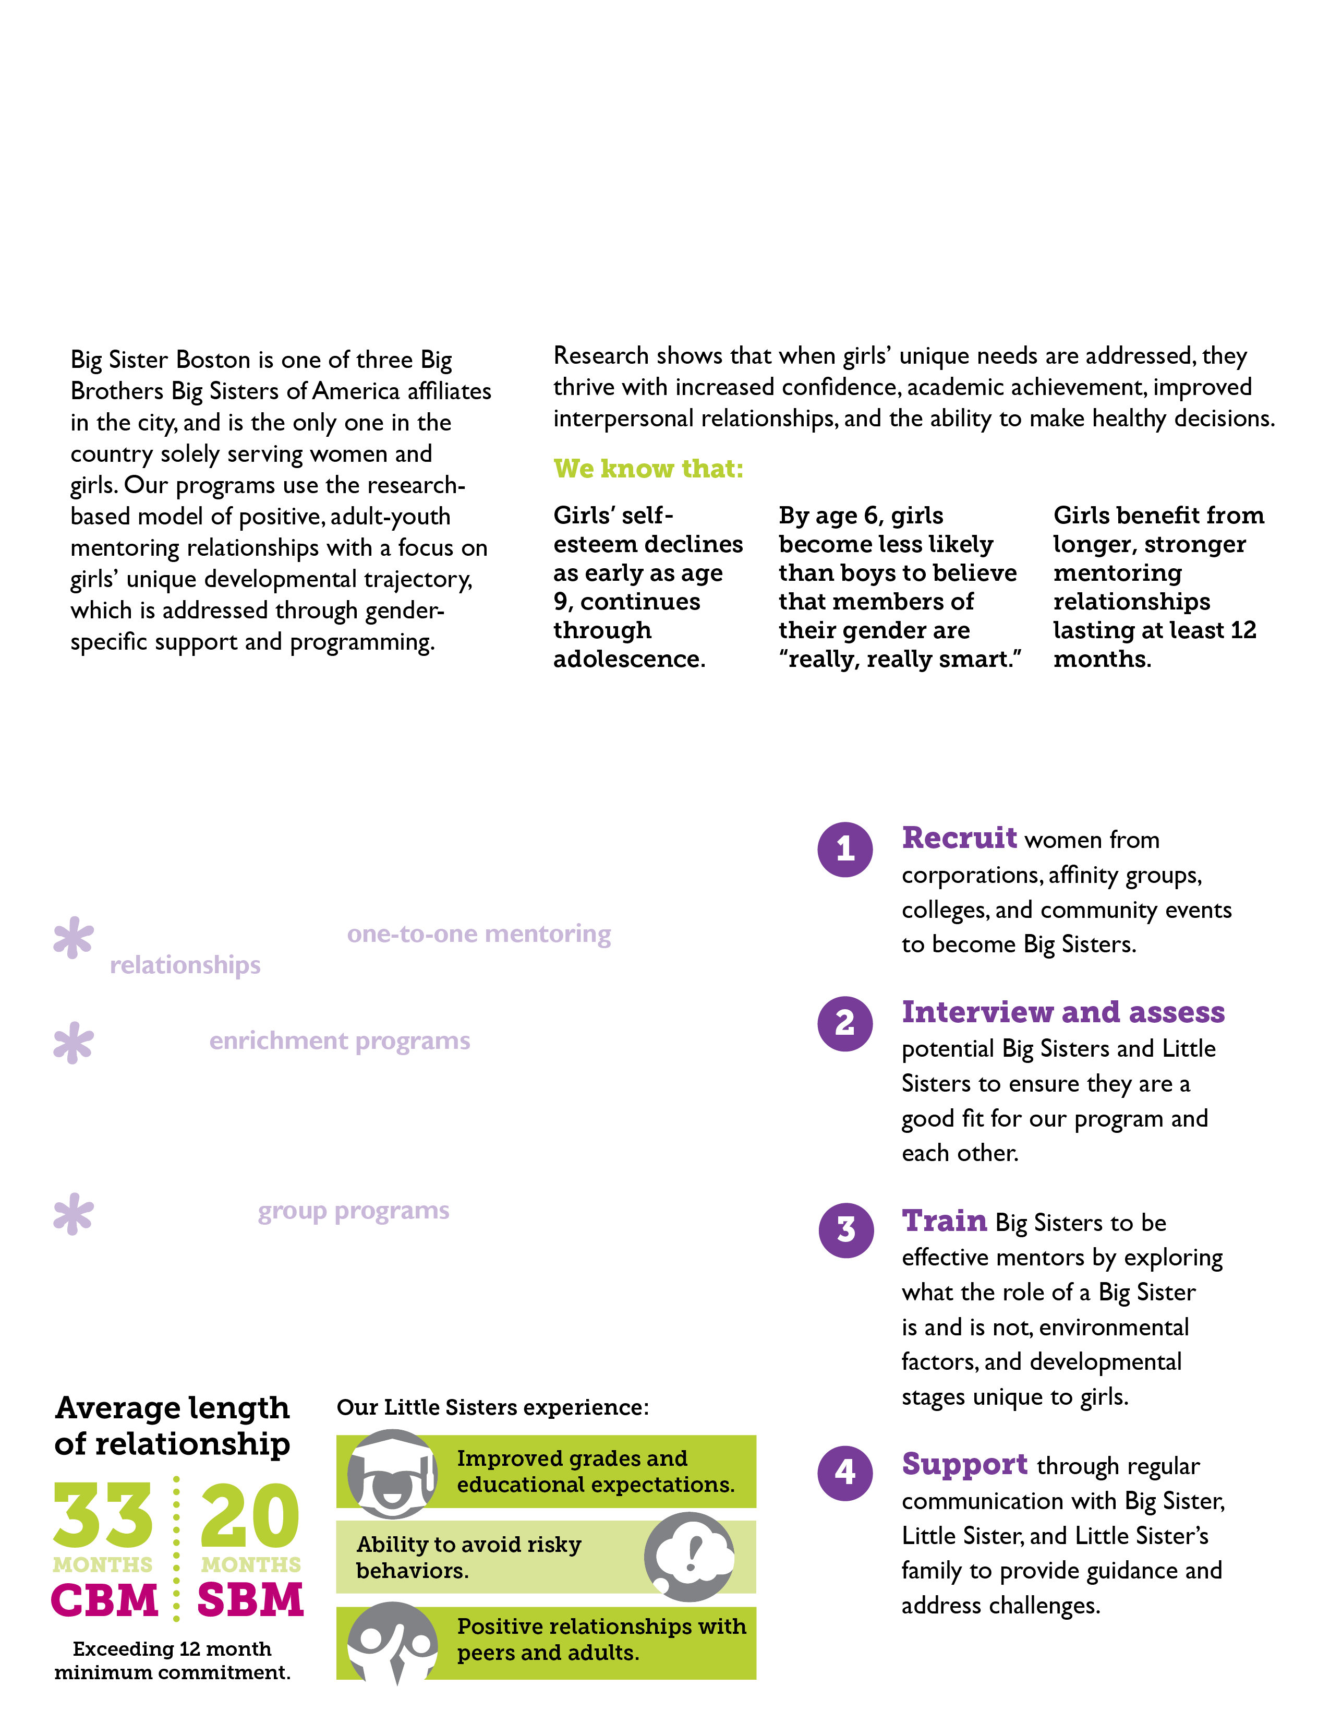

Who We Are
Developing your elevator pitch.

Slide 6
The Need
What makes you necessary, not nice?

Slide 7
What We Do
What are your organization’s unique selling points?

Slide 8
How We Do It
Describe your process for meeting the need.

Slide 9
What We Achieve
Your organization’s work gets results— now tell us about it!

Slide 10

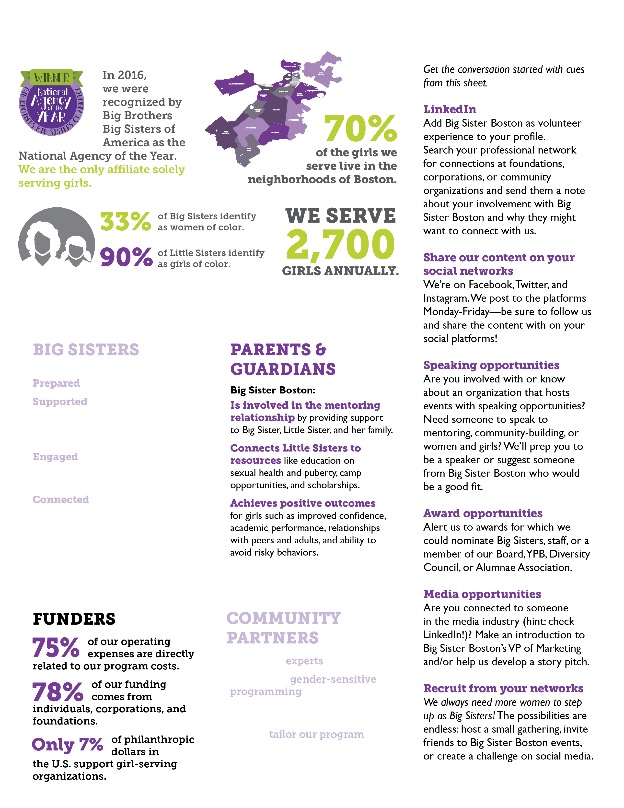
Quick Facts
Share your organizational highlights.

Slide 11
Key Messages For…
Identifying your audience and what information is important to them.

Slide 12
Consider your constituents
Staff
Board
Volunteers
Auxiliary groups (advisory councils, alumni, committees)

Slide 13
How can you equip them with the info so that they feel confident sharing it?
Host a gathering for an in-person training (great opportunity for role playing to get comfortable with the messaging!)
Host a webinar
Create a group of social media ambassadors
Include messaging training in your new employee orientation or onboarding process

Slide 14
Spread the Word!
Ok, you’ve got the info, now get out there and share it.

Slide 15
Put your new skills to work!
What does your organization do?
Why are you involved with the organization?
Why should I give/get involved?

Slide 16
Let’s review/Q&A
What are the two things I asked you to remember in the beginning of the session?
What is one main takeaway from today that you can start to implement tomorrow?

