Slide 1
Bored to Brilliant
Eric Phelps
RAINMAKER Consulting

Slide 2
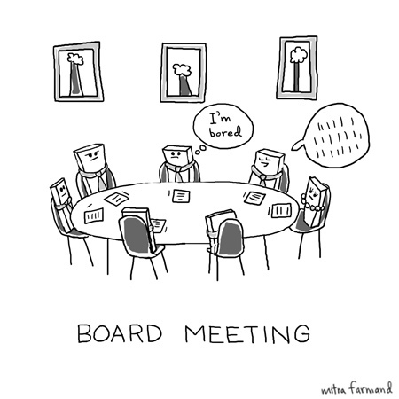
Bored to Brilliant: Better Board Meetings

Slide 3
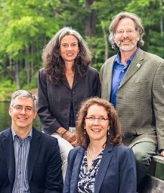
RAINMAKER Consulting
Fundraising Consulting
Strategic Planning
Executive Coaching
Organizational Development

Slide 4
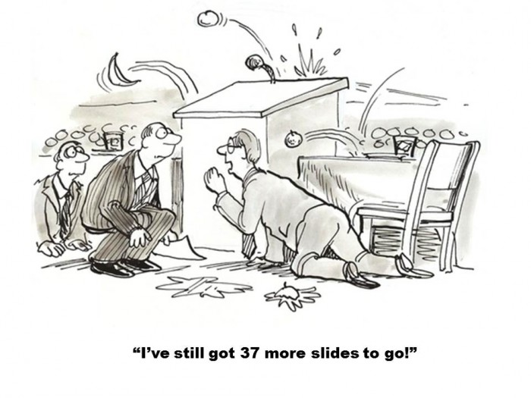

Slide 5


Slide 6

Meetings – Not Just Boring
Also a waste of time
  11 million meetings in US each day
  91% admit to day dreaming during meetings
  76% admit to bringing other work to meetings
  37% admit to dozing off!

Slide 7
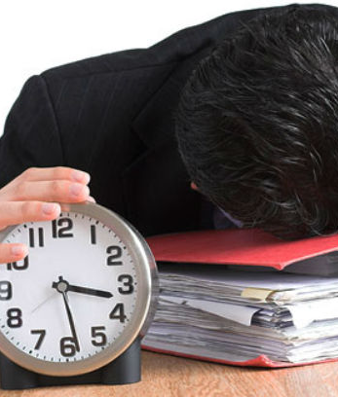
Unproductive
Average of 61 meetings per month
  50% rated as “unproductive”
  31 unproductive hours/ month (372 hours annually – 15 days!)
Results
  Lost work time/free time
  Frustration
  Stress

Slide 8
Why Do We Doo Doo This?
Most individuals have never experienced or witnessed the power of a truly effective meeting
It’s the way we’ve always done it (badly)
Most don't have access to information they need to improve their meetings
Staff and Board feel there's hardly enough time in a day to complete basic tasks. Who has the time or energy to commit to improving meetings?

Slide 9
What looks like “a people problem” is often a situation problem

Slide 10



The Meeting Starts
Before

Slide 11
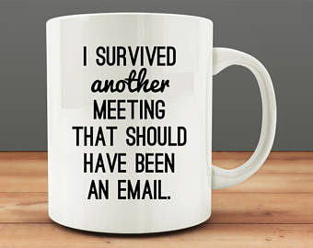

Slide 12
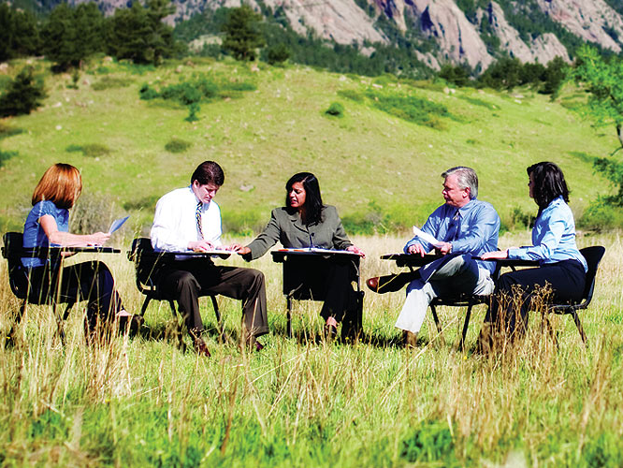

Slide 13
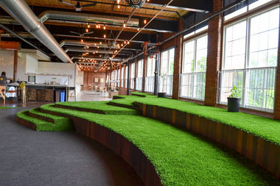
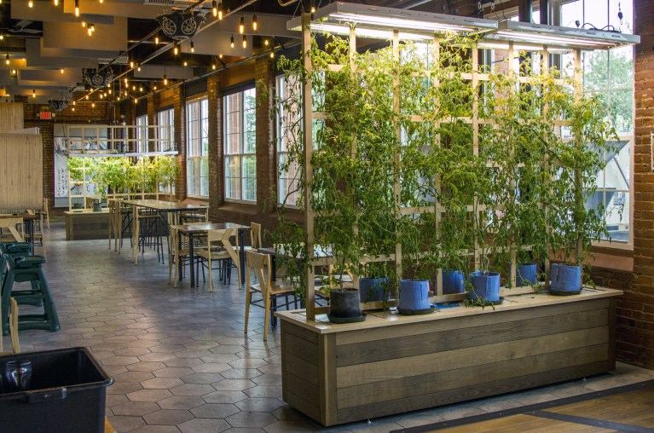
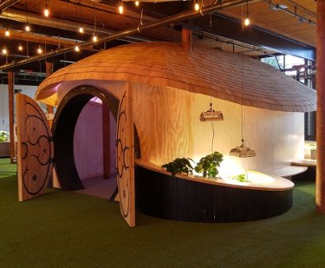

Slide 14
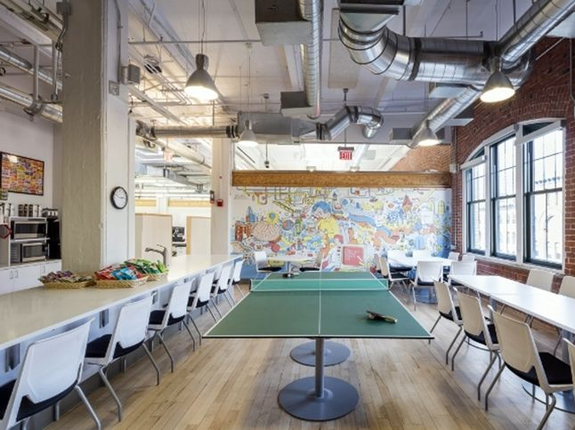

Slide 15
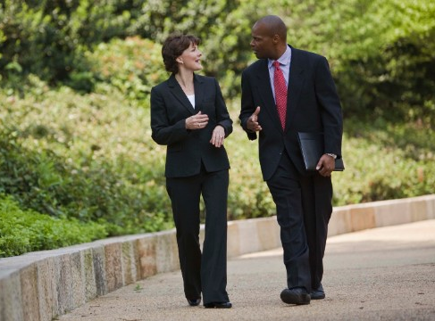

Slide 16
What looks like “Resistance”
is often confusion

Slide 17
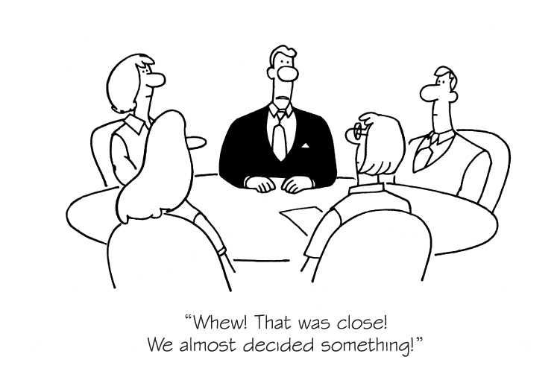
Set A Clear Agenda

Slide 18
Something like…
Item | Lead | Purpose | Duration
Call to Order | Kia |  | 2 mins.
Consent Agenda Approval | Kia | Vote | 5 mins.
Audit Report | Bill | Discussion/Vote | 20 mins.
Event Update | Beth | Information | 5 mins.
Mission Moment | Kerry | Information | 20 mins.
Strat Q: Board Development | Ramon | Discussion | 20 mins.
Other Business | Kia | Discussion | 10 mins.
Next Meeting | Kia | Information | 2 mins.
Adjourn | Kia |  | 1 min.

Slide 19
Or Something Like…
Item | Lead | Purpose | Duration
Meeting Agenda | Jennifer | Decision | 2 mins.
Keynote Speaker | Emily | Information | 5 mins.
Marketing | Jo Ellen | Discussion/ Dec. | 20 mins.
Registration Update | Allyson | Information | 5 mins.
Conf. Location Problem | Jennifer | Discussion/ Dec. | 20 mins.
Sponsorships | Duane | Discussion/ Dec. | 10 mins.
Other Business | Jennifer | Discussion | 10 mins.
Next Meeting | Jennifer | Information | 2 mins.
Adjourn | Jennifer |  | 1 min.

Slide 20


Slide 21
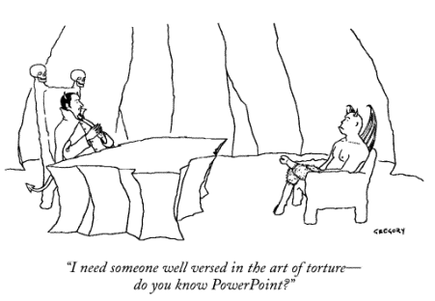
Plan for Technology

Slide 22
Help People Be Prepared
Request committee and staff reports 2 weeks in advance
Send materials to all meeting participants well in advance (3 – 5 Business Days)
  Put a Summary in the Email (Note any controversial or urgent matters)
Use a Board Portal
  Google shared docs
  Web site portal for members only
Send reminders

Slide 23
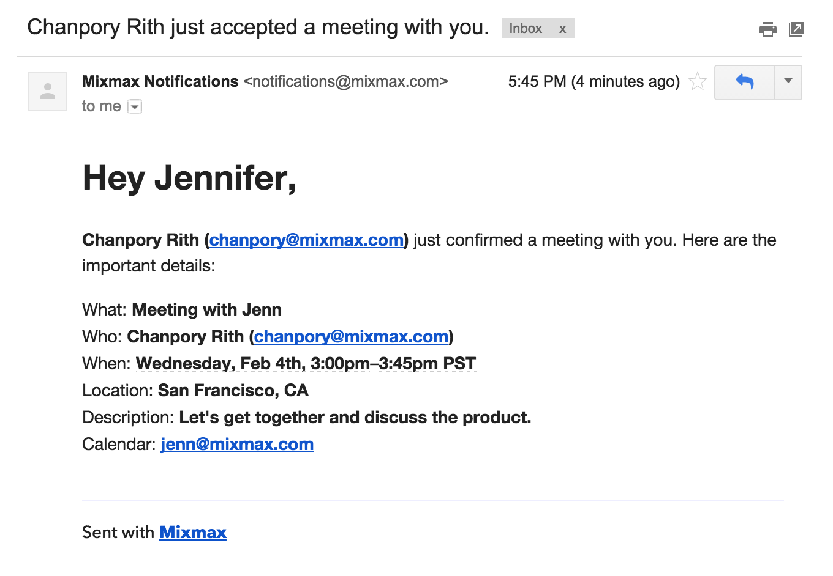
Confirm All Information – 24 hrs.

Slide 24

The Meeting

Slide 25
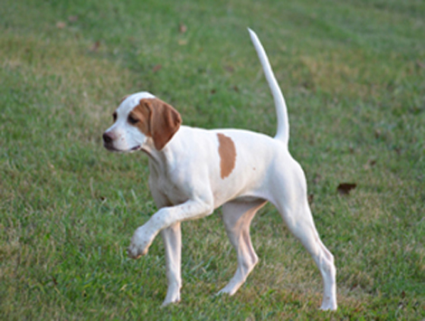
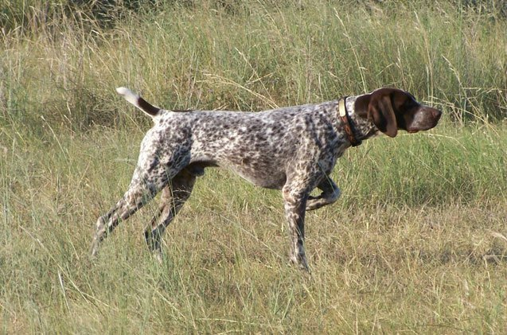
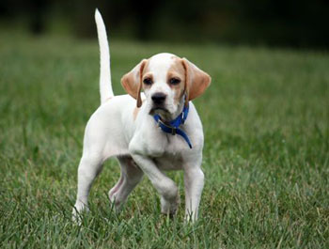
A Few Pointers…

Slide 26

Set a Clear Agenda
Be sure to set a strategic agenda
Include a Strategic Question
Stick to the Agenda
  Talk, Table, Delegate, Decide

Slide 27
Consent Agenda
Designed to address routine items and information only reports in less time
Board agrees to review material in advance of meeting
Developed by President and Secretary and distributed week in advance
Questions/Discussion
Approved as single agenda item
Agenda Includes
  President’s Report
  Executive Director Report
  Meeting Minutes
  Committee Reports
Note: Cannot contain…
  Budget approval
  Controversial items
  Policy changes

Slide 28

Simplify and Clarify Comm. Structure
Committees are loci of most board activity
All members participate in committees
Do not have TOO MANY committees
May The Task Force Be With You!

Slide 29
Committee vs. Task Force
Committees are loci of most board activity
All members participate in committees
Do not have TOO MANY committees
May The Task Force Be With You!

Slide 30
Committee or Task Force
Committee
Task Force
Executive
Fundraising/Development
Board Development
Finance
Marketing/Outreach
Search
Strategic Planning
Event Sub-Comm.
Handbook Revision
Other

Slide 31

Build A Team

Slide 32
Build A Team
Implement team-building exercises
Include in-depth introductions at each meeting
Applaud Committee efforts and successes!
Be true to your word
Take advantage of conflict by resolving it
Value all contributions
  Small ideas can have a BIG impact (Trim Tab)
Establish and maintain group norms

Slide 33

Listen and Ask

Slide 34

Recognize and Thank

Slide 35

Review Action Items
Immediately send out detailed minutes
  Motions/Votes
  Discussion
Summarize Action Items
  WHO is responsible
  By WHEN?
  WHAT else?
  HOW will you do it?

Slide 36

Check Technology at the Door

Slide 37

Implement 1:1 Meetings

Slide 38

Make Preparedness Mandatory

Slide 39

No Surprises!

Slide 40

Include Vision
& Inspiration

Slide 41

A Few Distinctions
And now for…

Slide 42
What looks like “Laziness”
is often exhaustion

Slide 43

Don’t Meet Too Often

Slide 44


Slide 45
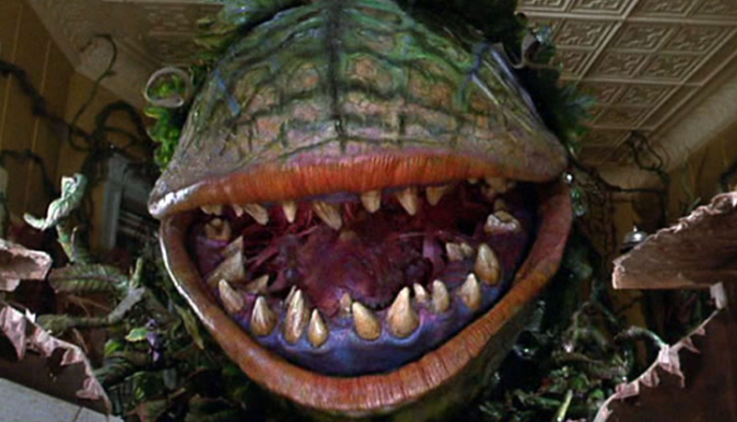
Culture Eats Strategy for Breakfast

Slide 46
Model the Culture You Want
YES
NO
Be on time for your meetings
Greet everyone in your meeting
Stay on track
Take responsibility
Be prepared with questions
Engage in side conversations
Come unprepared
Be negative
Avoid responsibility
Have distractions
Rehash what’s in your report
Be redundant & repetitive

Slide 47


Slide 48


Slide 50
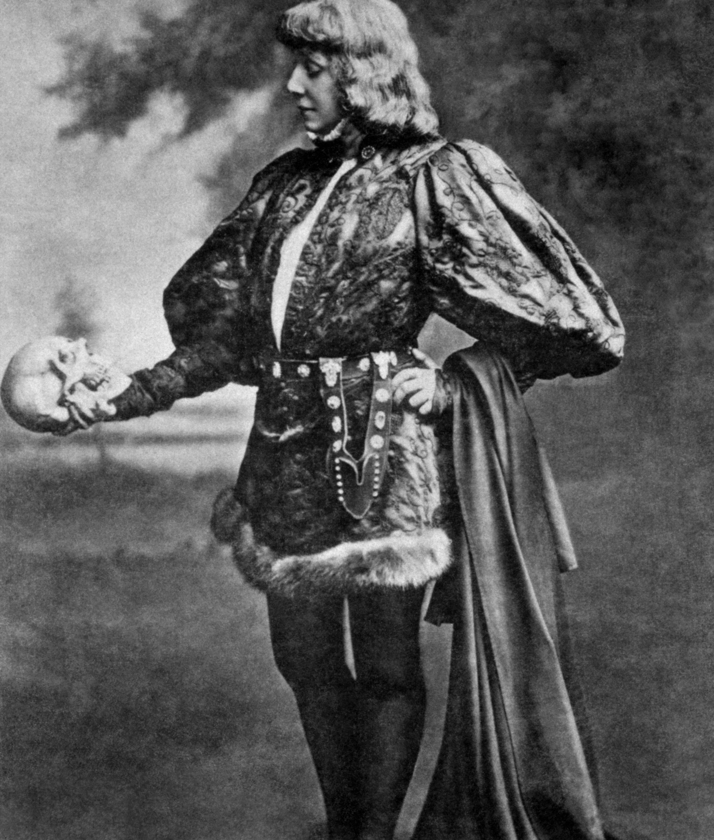
Summary
2BON2B
  Clear
  Prepared
  Creative
  Strategic
  Decisive
  Action-oriented
  Modeling what you want
  Of your word

Slide 51


Eric Phelps
eric@rainmkr.com
Twitter @rainmkr
@ericlphelps

