Slide 1

Using Financial Data to Inform Your Decisions:
Realizing the Value of the Information You Have
Adam Griffin
Director of Financial Consulting Services
Kate Mombourquette
Director of Accounting & Bookkeeping Services
November 1, 2017
Copyright © 2017 Insource Services, Inc. All Rights Reserved.

Slide 2
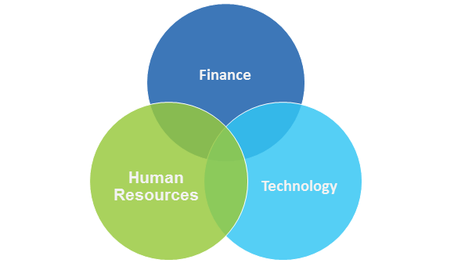
About Us: Insource Services, Inc.
At Insource, we believe that HR, Finance & IT
start with people

Slide 3
About Us: Insource Services, Inc.
What We Do:
  Full department outsourcing: part-time and ongoing
  Scalable services
  Assessments
  Trainings
  Project/interim assignments
How We Do It:
  Seek to understand client businesses and mission
  Experienced, expert team members
  Delivery team with multiple skill levels; work is performed at the most cost-effective level
  Around 65 employees and growing!

Slide 4
What to Take Away
  Practical ideas on how to make financial planning and analysis as painless as possible without sacrificing accuracy
  Ideas on what information is appropriate for the audiences who need it
  Ways to avoid TMI
Notes:
In our experience, it’s possible to get caught up in the details and confused about what to show to whom. By coming up with the right process that gets all of the necessary information to the right places, we can

Slide 5
Agenda
  Outline questions that help assess financial health
  Highlight key audience considerations
  Show some reports and metrics that can shed light on the answers
  Discuss dashboards including useful metrics to examine
  Q&A

Slide 6
Our Experience – Reflections on Client Challenges
  Reporting – from insufficient reports to unnecessary complexity
  Processes – from excluding important stakeholders to including too many cooks
Notes:
Does anyone want to share any current challenges with any of these – reporting, budgeting, etc.

Slide 7
Questions to Assess Financial Health
Profitability
  Are we earning enough to save?
  What is our subsidy versus earned revenue?
  Do funders think our surplus is too big?
Cash Flow/ Liquidity
  Cash deficit? Surplus?
  Are we using our LOC appropriately?
  Do we have cyclical cash problems or structural cash problems or no cash problems?
Capital Structure
  What is the mix of savings versus financing?
  How has it changed over time?
  Are we on top of our deferred maintenance?
  Are we using enough debt?
Restrictions
  Are we borrowing from our restrictions?
  Are we replenishing our restrictions annually?

Slide 8
Audience Considerations – Appropriate Levels of Info
 | Reports should reflect: | Allows audience to:
Budget Managers | YTD revenue and spending against the budget for specific programs/departments | Respond quickly to unexpected trends such as overspending or revenue under budget
Executive Management | Organization-wide revenue and spending against budget, cash flow projections | Compare year-to-date information against budget, plan for the next 12 months
Board/Finance Committee | Summary info, few key data points | Have productive strategic conversations, planning for long-term success
Funders | Expense and revenue isolated to funded project or program | Confirm that an organization has met the terms of the agreement
Notes:
Budget Managers:
and help inform spending for remainder of the year
i.e. monthly budget vs. actual by program plus necessary detail
Executive Management:
Reports give higher-level insight to spending against the budget and indicate critical trends
i.e. YTD P&L, Budget versus Actual, Balance Sheet, cash flow projection
Board of Directors
Reports should indicate trends in critical business areas and inform conversations about strategy and planning for the future
i.e. dashboard that tracks critical business indicators; high-level YTD budget-to-actual, 12-18 month cash flow projection, year-over-year Balance Sheet
Donors
key highlights that make you look good

Slide 9
Audience Considerations – Appropriate Levels of Info
 | Typical reports to give:
Budget Managers | Budget versus actual spending and revenue (detail) also line-by-line GL detail (for quality control)
Executive Management | Budget versus actual (detail and summary) Cash flow projection (detail and summary) Balance Sheet (detail and summary)
Board/Finance Committee | Dashboard tracking key indicators, YTD budget-to-actual, 12-18 month cash flow projection, year-over-year Balance Sheet
Funders | P&L selected by program or funder – as requested (summarized when possible)
Notes:
Budget Managers:
and help inform spending for remainder of the year
i.e. monthly budget vs. actual by program plus necessary detail
Executive Management:
Reports give higher-level insight to spending against the budget and indicate critical trends
i.e. YTD P&L, Budget versus Actual, Balance Sheet, cash flow projection
Board of Directors
Reports should indicate trends in critical business areas and inform conversations about strategy and planning for the future
i.e. dashboard that tracks critical business indicators; high-level YTD budget-to-actual, 12-18 month cash flow projection, year-over-year Balance Sheet
Donors
key highlights that make you look good

Slide 10
Reports and Metrics that Shed Light
  Decide what information you’re sharing and stick with it
    What’s relevant?
    Who should decide what’s relevant?
    How do you decide what’s relevant?
  Know the information you have on hand and its limitations
  Be realistic when deciding how much information you’re going to make available
  Have a cut off time for updates – too many manual updates at the last minute increases potential for error
  Be ready for the “you know what would be really nice to see…” Have a plan. Stay strong.

Slide 11
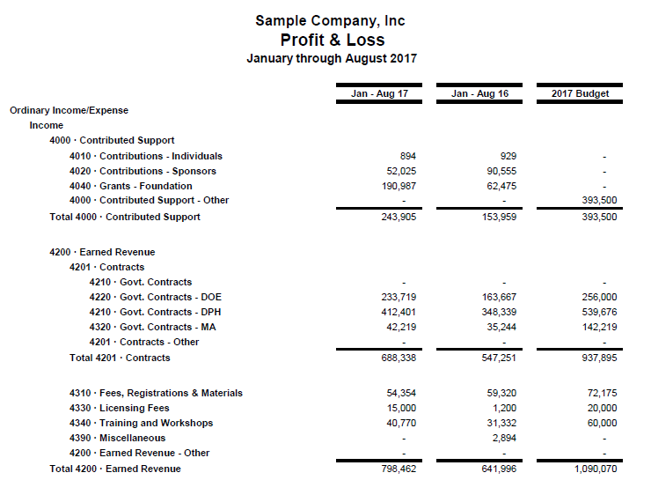
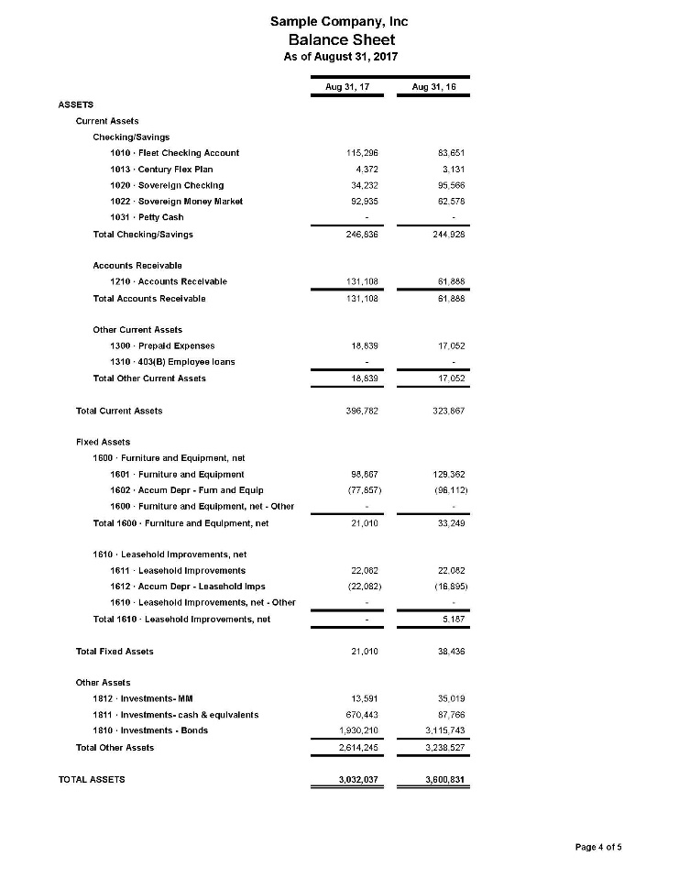
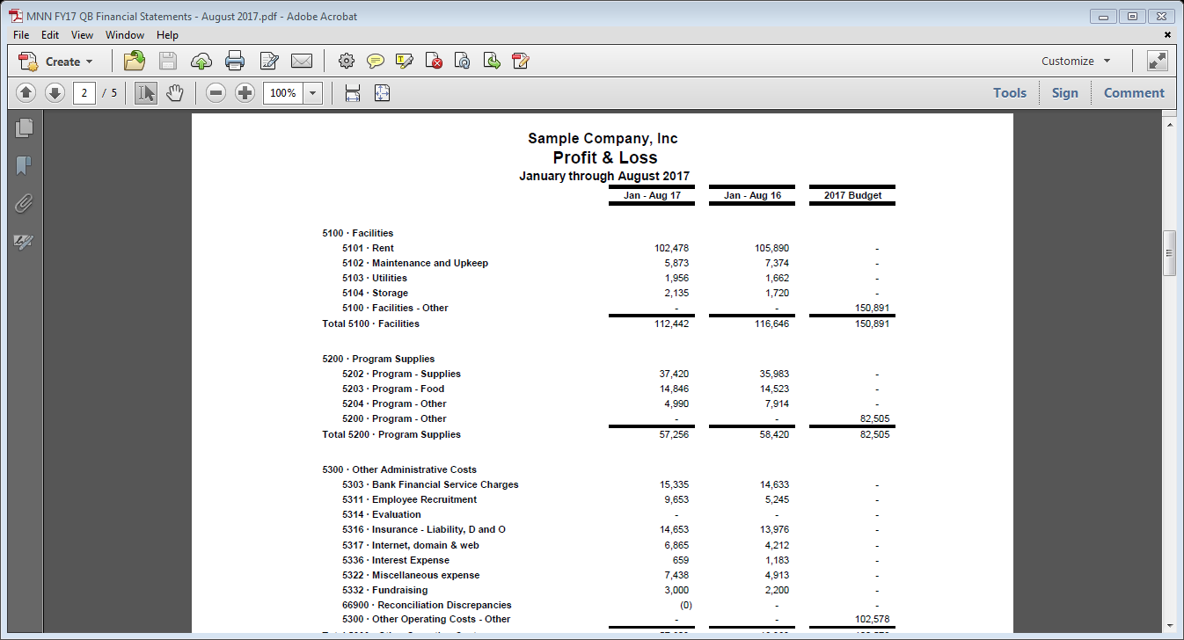
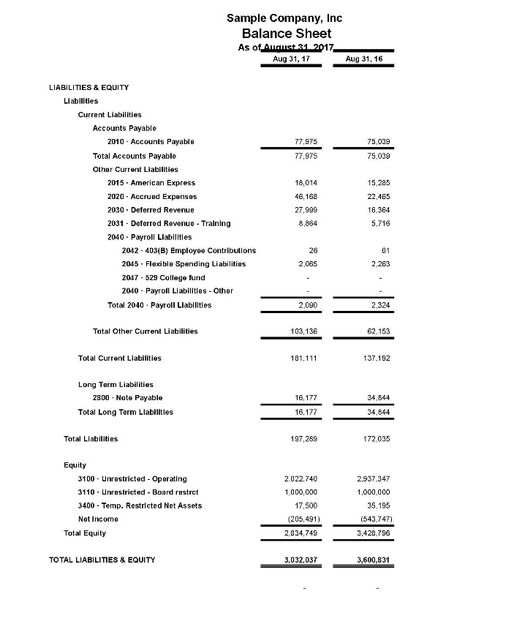
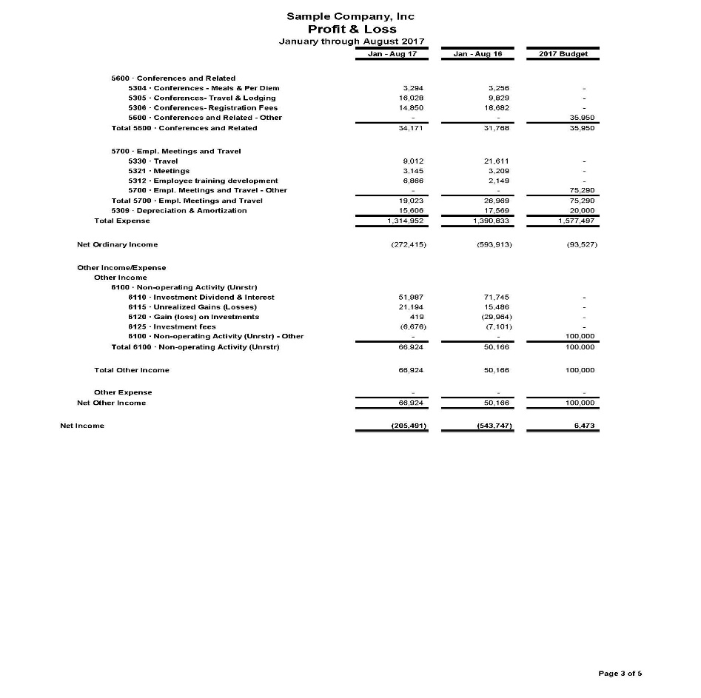
Reports and Metrics that Shed Light

Slide 12
 | 2017 YTD | 2017 Budget |  | Difference | 2016 YTD Actual | 2016 & 2017 Difference | 2017 Projection
Operating Revenue
Grants | 688,338 | 1,250,000 |  | (561,662) | 547,251 | 141,088 | 1,230,000
Service Fees | 69,354 | 200,00 |  | (130,646) | 59,320 | 10,034 | 200,000
Total Ops Revenue | 757,692 | 1,450,000 |  | (692,308) | 606,571 | 151,122 | 1,430,000
Operating Expenses
Personnel | 686,552 |  | 813,512 | (126,960) | 620,146 | 66,407 | 820,000
Consultants | 99,015 |  | 102,578 | (3,563) | 188,426 | (89,412) | 79,540
Prog. Supplies | 57,256 |  | 82,505 | (25,249) | 58,420 | (1,164) | 82,000
Facilities | 112,442 |  | 150,891 | (38,449) | 116,646 | (4,203) | 150,891
Office | 49,610 |  | 62,519 | (12,909) | 87,144 | (37,534) | 63,000
Travel | 19,023 |  | 35,950 | (16,927) | 26,969 | (7,947) | 36,000
Depreciation | 15,606 |  | 20,000 | (4,394) | 17,569 | (1,962) | 21,250
Total Ops Expenses | 1,039,504 |  | 1,267,955 | (228,451) | 1,115,320 | (75,815) | 1,231,431
Change in Net Assets | (281,812) |  | 182,045 | (463,857) | (508,749) | 226,937 | 198,569
Notes:
Last year’s information is in there but not everyone uses them – When appropriate, use YTD budget, not just annual budget

Slide 13

Dashboards

Slide 14
Dashboards
  Find the mix of data that is worth the time to measure and discuss
  Keep it simple and consistent on a monthly basis
  Mix different types of information to inform robust discussion
    Quantitative: i.e. bed night utilization, # of unique website views, number of new donors
    Qualitative: new programs started, programs ended, grant pipeline info, event feedback
Notes:
Doesn’t need to tell you everything – should only be the critical info that

Slide 15
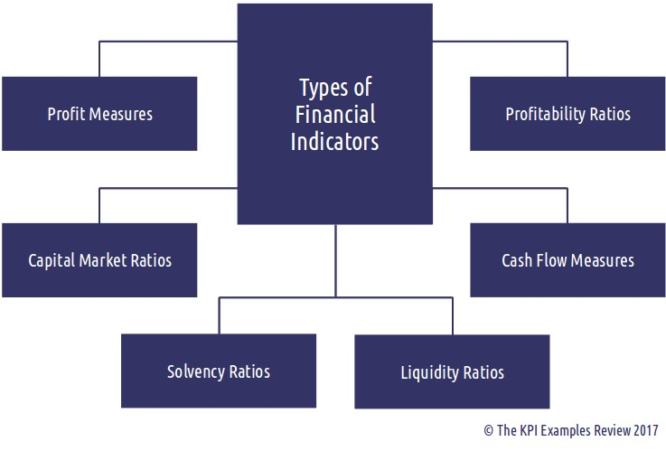
Financial Indicators

Slide 16
Dashboards: Useful Ratios
 | Formula | Measures
Current Ratio | Current Assets Current Liabilities | The ability to pay current debt with current assets
Debt-to-Equity | Total Liabilities Total Net Assets | The proportion of the assets which are externally financed
Months of Cash | Cash on Hand Avg. Monthly Operating Expenses | Ability of cash levels to cover operating expenses
Months of Net Assets | Total Net Assets Monthly Ops. Expenses | Level of Operating Net Assets (or savings you can use for operations)
Notes:
Budget Managers:
and help inform spending for remainder of the year
i.e. monthly budget vs. actual by program plus necessary detail
Executive Management:
Reports give higher-level insight to spending against the budget and indicate critical trends
i.e. YTD P&L, Budget versus Actual, Balance Sheet, cash flow projection
Board of Directors
Reports should indicate trends in critical business areas and inform conversations about strategy and planning for the future
i.e. dashboard that tracks critical business indicators; high-level YTD budget-to-actual, 12-18 month cash flow projection, year-over-year Balance Sheet
Donors
key highlights that make you look good

Slide 17
Dashboards: Example
ABC Theater, September 2017
Category | Performance Indicator | Last Period | Current Actual | Target
Balance Sheet Strength | Months Liquid Unrestricted Net Assets | 2.5 | 2.7 | >3 Months
Operating Results | Fiscal YTD Operating Margin | 3% | 8% | >5%
Program Performance | Median Revenue per Performance | 10K | 13K | >15K
Program Performance | Summer Workshop Enrollment | 375 | 310 | 315
Program Performance | Academy Retention Rate | 88% | 96% | >95%

Slide 18
Dashboards: Charts Help Clarify Trends

Slide 19

Contact Information
Question & Answer

Slide 20
Contact Information
Contact Information
Kate Mombourquette
kmombourquette@insourceservices.com
781-374-5125
Adam Griffin
agriffin@insourceservices.com
781-374-5219
www.insourceservices.com

