Slide 1

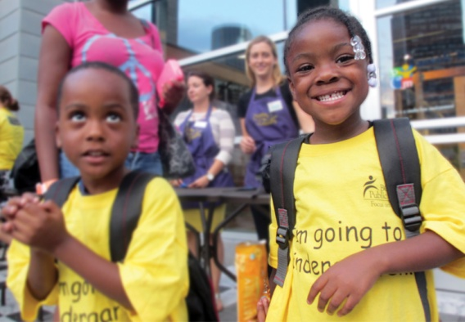
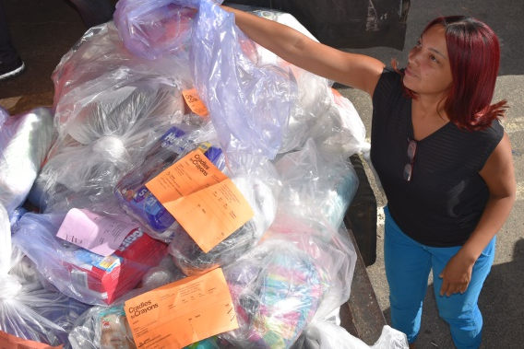
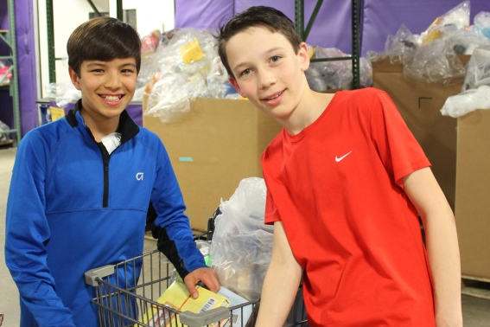
Massachusetts Nonprofit Network November 1 , 2017
High Performing Boards:
How to build and sustain them
Lynn Margherio, Founder & CEO
Cradles to Crayons

Slide 2
What We Will Cover:
Structuring your best Board
Building your Board
Keeping Board Members engaged
Q&A
Wrap-up

Slide 3
A Bit About Cradles to Crayons
Single 501c3 organization
National Board – fiduciary
Market Level Leadership
  Boards
  Leadership Councils (Corporate & Family)

Slide 4
Sharing our experiences
Take a moment to think about your Board of Directors
Now, turn to your neighbor and share:
  What brought you to this session
  What you believe the role of your Board should be
  What you most need/want from your Board
  How successful you feel you’ve been at coaching your Board to meet your needs

Slide 5
Areas to address to improve Board performance
Source: BoardSource Leading with Intent 2017

Slide 6
What’s going on around the table?
Role of your Board
  Governance, not management
  External Engagement
    Fundraising
    Ambassador
    Recruitment
It’s important to set expectations up front!

Slide 7
Who is around the table?
What are the capabilities I need?
What do I have today?
How do I get those capabilities?

Slide 8
Sample Profile:
The Philanthropist
Leading philanthropist known for commitment to charitable causes;
Active national network and willing to leverage that network;
Minimum annual and personal financial contribution of $X (fulfilled through give/get);
Demonstrated personal passion for mission
Diversity (race, gender, age, and/or geography).

Slide 9
Sample Profile:
The Corporate Partner
C-suite level executive or Division leader
National/local profile with an active network and willing to leverage network;
Company with assets that align with primary needs;
Minimum annual financial contribution of $X (fulfilled - give/get);
Demonstrated personal passion for mission
Diversity (race, gender, age, and/or geography).

Slide 10
Sample Profile:
The Nonprofit Partner
CEO, President, or Founder;
Led an organization that aligns with future growth/needs;
Annual personal financial contribution;
Demonstrated personal passion for mission;
Diversity (race, gender, age, and/or geography).

Slide 11
How do we get them to the table?
Prospecting
Cultivating
Asking
On-boarding
Engaging

Slide 12
How do we keep them there?
Build a team
Leverage your Board meetings
Check-in with individual members annually or bi-annually
Create a culture of accountability

Slide 13
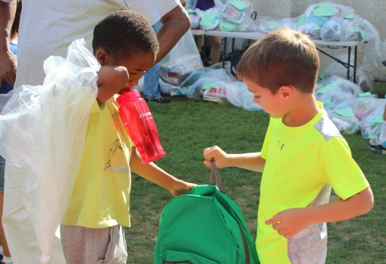
Questions?

Slide 14
Before We Go…
Let’s keep each other accountable!
Keep connecting!
Lynn Margherio
lmargherio@cradlestocrayons.org

Slide 15
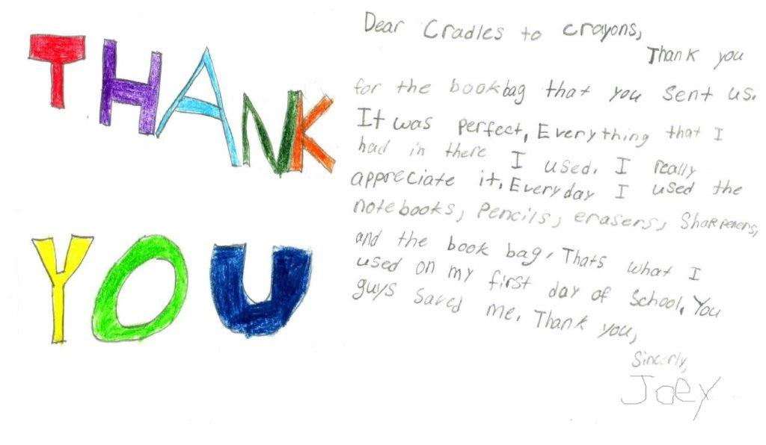
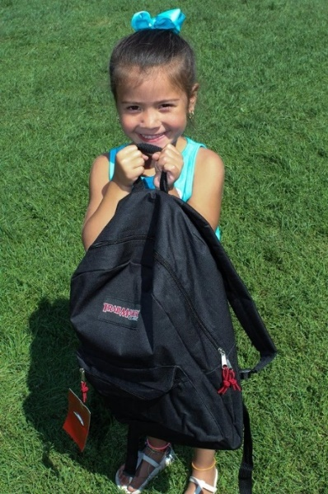
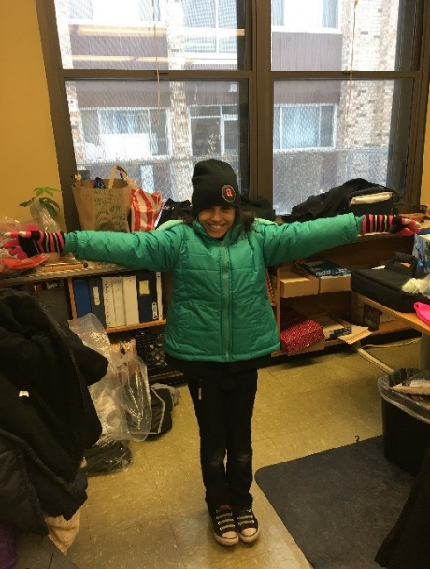
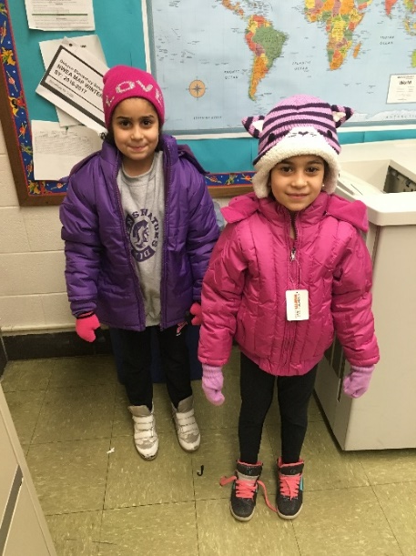
15

