Slide 1
2017 MNN Annual Conference:
Stewarding Corporate Sponsors
Presented by:
Wes Enicks
Executive Director
Generations Incorporated

Slide 2
TODAY’S AGENDA
Definition of corporate sponsorship
Finalizing the deal
Measuring the results of a sponsorship
Thanking the sponsor
- Communicating the results of a sponsorship
Ongoing stewardship of corporate sponsors
Sponsorship renewal

Slide 3
Definition of Corporate sponsorship
A corporate sponsorship can be defined broadly as any means by which a corporation may support an institution’s needs. Corporate sponsorship most frequently is in the form of direct funding.
Direct funding may be for unrestricted giving (eg, general operating support), or for restricted giving (eg, for specific programs, needs or events)
The reality though is that sponsorship is a business deal, not a donation.
Consumers want socially responsible products and companies, and today’s employees want to work for socially responsible companies.
Review Corporate Responsibility statements/content on company websites

Slide 4
Forms of Corporate Sponsorship
Corporate Sponsorship May Take Many Forms:
Dollars
Goods or services (items for events – food/beverages, raffle items such as sporting tickets, travel packages, etc)
Media Sponsorship (Boston Globe, Improper Bostonian, etc)
Volunteers

Slide 5
Finalizing the deal
The sponsorship expectations for both parties should be specified in as great a detail as possible in the Sponsorship Agreement - critical to avoiding misunderstandings and problems in the relationship
Sponsor status: Exclusive corporate sponsor? Lead corporate sponsor? Corporate sponsor?
Terms include description of sponsorship, nature of support and when paid/delivered; benefits to sponsor, including recognition benefits

Slide 6
Finalizing the deal
The signed sponsorship agreement should include the following:
    Pre – Event, Day of event, and Post-Event Benefits
      Exclusive benefits
      Logo placement
      Social Media, website, and PR recognition
      Tickets, access, ect.
      Sponsor Status
      Underwriting
      Sponsor payment schedule (consider highlighting in cover letter with agreement)
Sponsorship Brochure sample in supplemental materials

Slide 7
Finalizing the deal
On-site selling / Product displays
Opportunity for sponsors to display/sell their products
    Example: Pop – Up shops at Big Sister Boston Fashion Show
Selective and specific about where sponsorship will be recognized (avoiding misunderstandings at event ect.)
Signage at the event
Sponsor Level dependent placement

Slide 8
Finalizing the deal
Sponsor payment schedule
Sponsor/pledge confirmations
Invoices
Ongoing invoice schedule
Invoice Sample in supplemental materials
Invoice tracking Sample in supplemental materials

Slide 9
Finalizing the deal
Public relations schedule
Timeline for pre and post event public relations
Work closely with your marketing/public relations department to establish a schedule. Collaboration critical! It is very important not to promise anything to corporation without first confirming you can deliver!
Media partnerships
Sample: Boston Globe
Media Contacts
Inviting media photographers
and representatives to your event
Press Releases
Sample in supplemental materials
Personally review and confirm marketing deliverables implemented as promised

Slide 10

Finalizing the deal
Media Partnerships
Advertisement Sample

Slide 11
Finalizing the deal
Paid media
How do you ensure you are getting a return on your investment
VIP/Hospitality
When does VIP or exclusive guest experiences make sense
Include specific number of tickets, parking vouchers, type of tickets (reserved or general admission?) that sponsorship includes as part of Agreement Make sure you work with your box office or events team before offering terms to ensure you can deliver the number of tickets or other benefits
Mailing production schedule
Invitations, event materials, post event recap
Your event work plan
Have regular check-in with marketing
Social Media schedule – Always check sites!

Slide 12
Volunteer Opportunities
Employee participation/volunteering
Discuss with funder the number of volunteer positions available, dress code, duties and hours
Work with staff to ensure employees assigned to meaningful and public-facing roles where time respected
Check in with employees during event or opportunity to gain feedback and make any necessary adjustments
Have a photographer take photos of employee volunteering to post on your social media and to offer the corporation

Slide 13
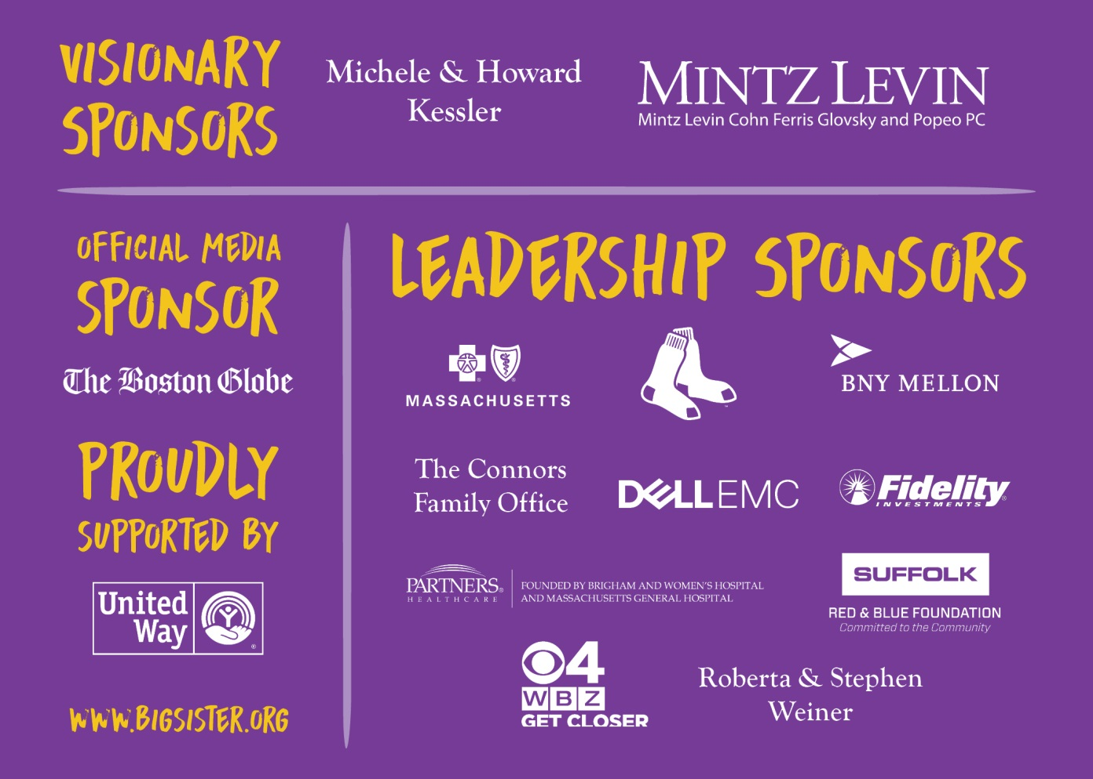
Finalizing the deal
Sponsorship recognition on event invitation

Slide 14
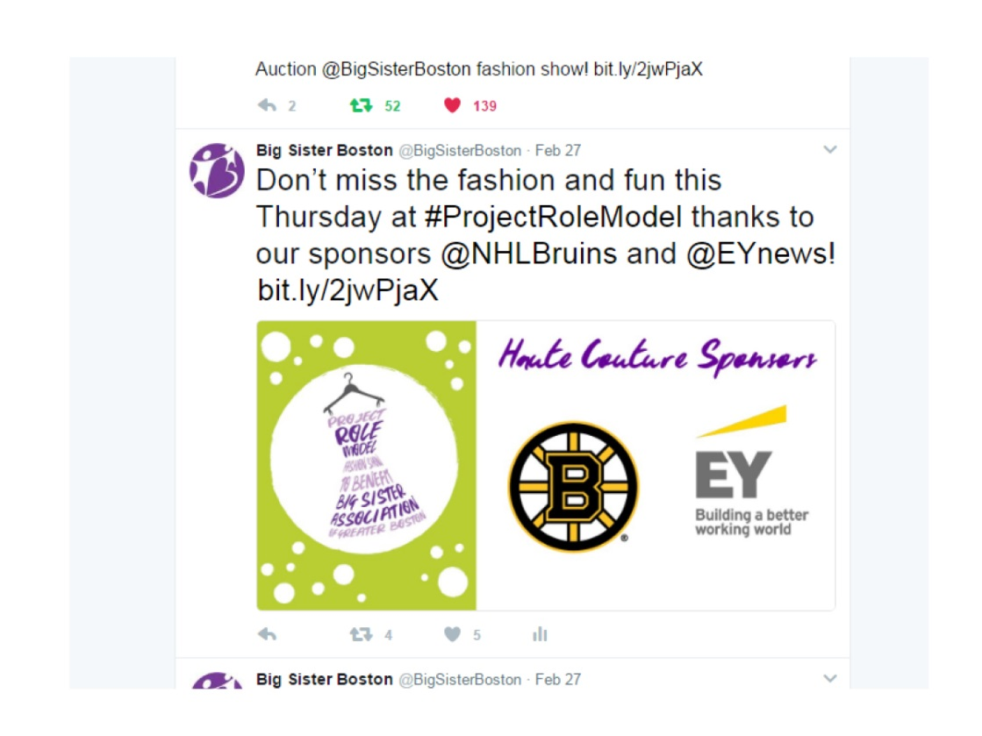
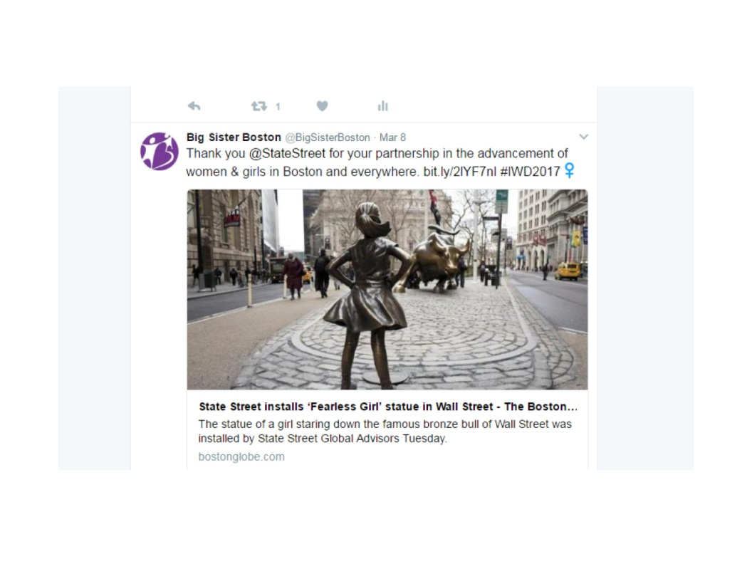
Finalizing the deal
Social Media Recognition

Slide 15
Post Event Plan
Have a post event plan for corporate sponsorship thank you and stewardship with clearly defined responsibilities
Post event plan
Personalized Thank you Notes
Photos!
Time is of the essence

Slide 16
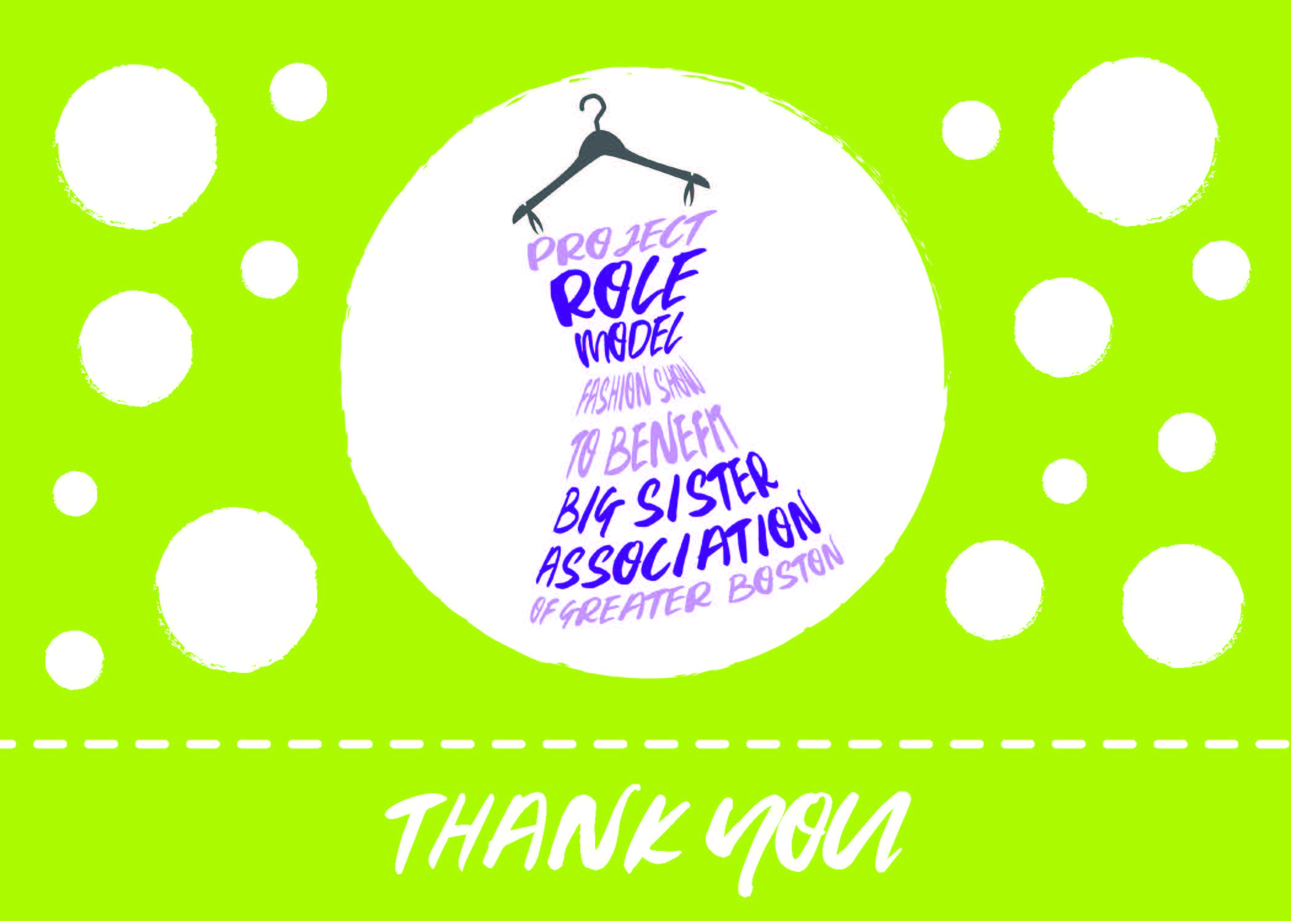
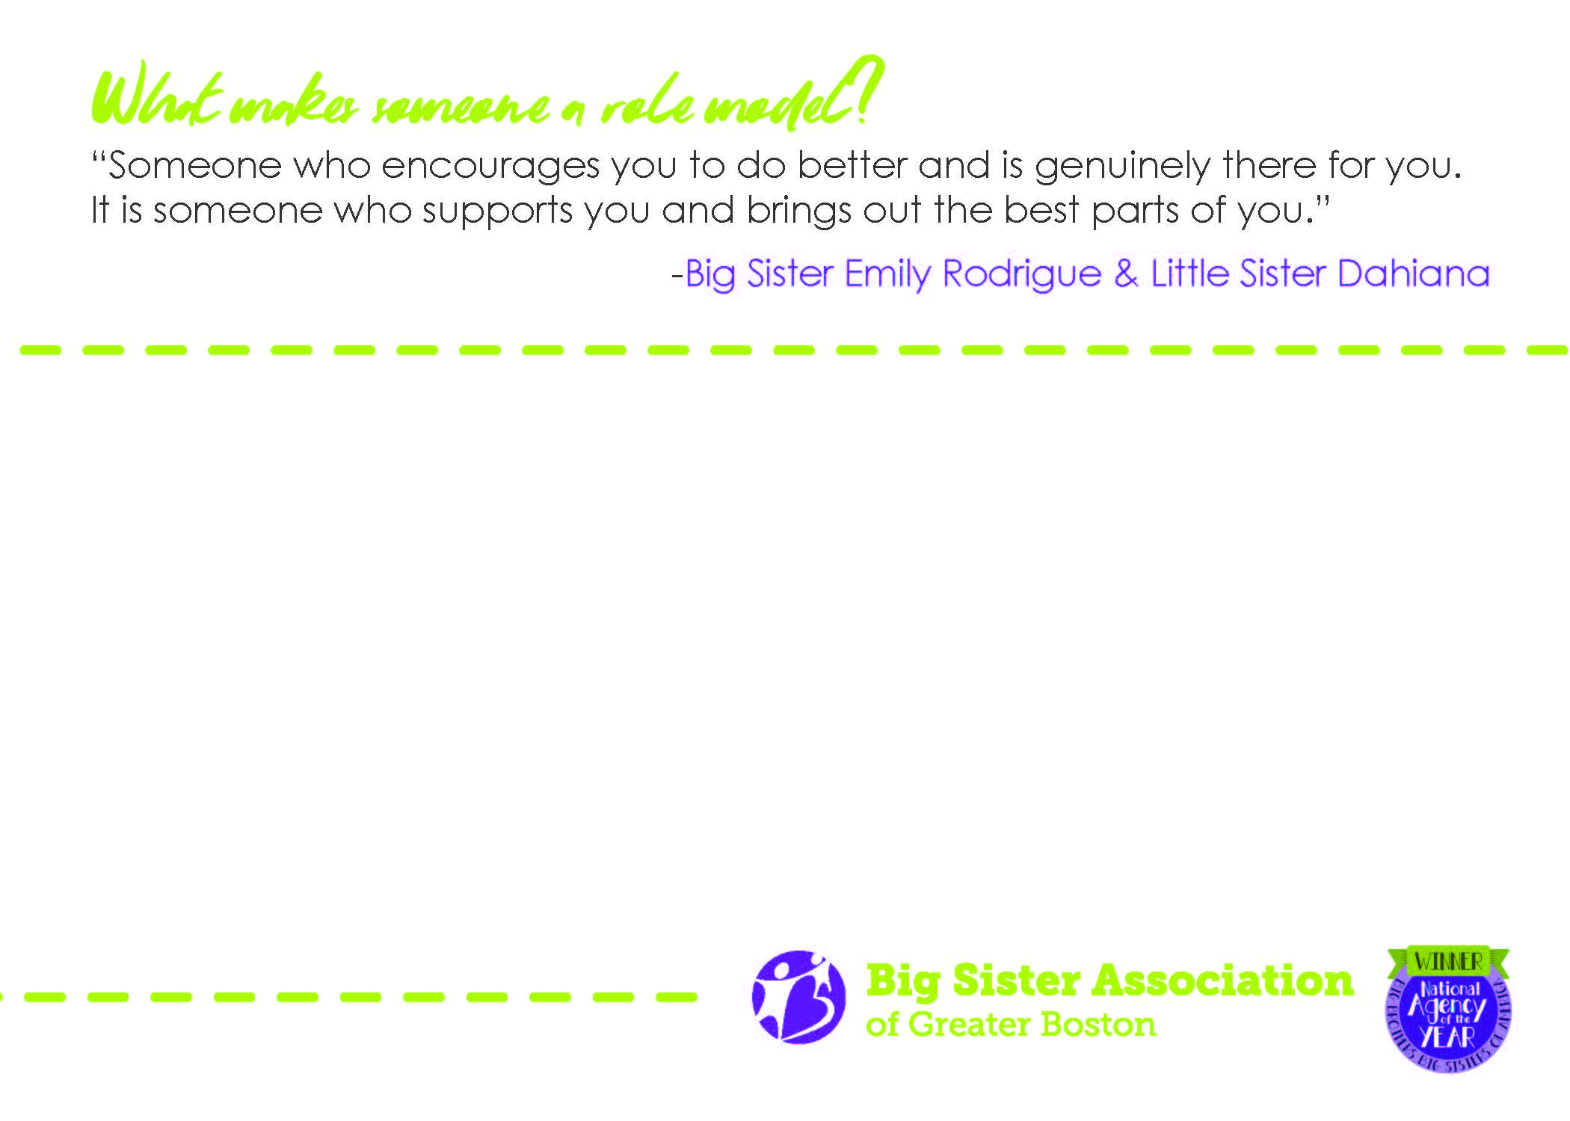
Post Event Plan
Personalized Thank You Notes

Slide 17
Measure the results
Once the event is over, benchmark results so that the sponsor knows what they achieved. This includes:
Promotional participation (sales, media, online, etc.)
How did you create value for the sponsor?
Program outcomes and impact
The ties between social responsibility and marketing impact

Slide 18
Measure the results
Social media promotional participation (sales, media, online, etc.)
Press coverage and paid media advertisement
Visits to sponsorship-driven web pages
Sponsorship-driven newsletter sign-ups
Coupon or merchandise redemption
Employee participation/volunteering

Slide 19
Communicate the results
Final reports should whenever possible be presented in person and contain the following:
A narrative describing the project (event) and its outcomes
  How are you helping the corporate sponsor reach their goals
Pictures speak a thousand words (signage, guest experience)
A list of all media that covered the event, including relevant media clippings
Budget VS. Expense Report
Results of any on-site/post-event surveys
  Guest experience/feedback tells the best story

Slide 20
Ongoing Stewardship
The time between sponsored event and renewal is the key to long term success
Creating value year round
Mutually beneficial partnerships
Programmatic impact (what have they allowed you to do?)
Personal touch points, meetings, and outreach
How do corporate sponsors fit into your ongoing stewardship plan
Dedicating the time and energy to stewardship will pay off in the long run
  Examples include – Newsletters, free/special invitations to events, ways to engage employees as well as executives

Slide 21
Sponsorship renewal
Before you approach a sponsor for renewal, assess the relationship to date. This includes the following:
Have you regularly communicated the sponsor’s impact on your organization?
Have you built and fostered personal relationships?
- Review last year’s event/program to determine if successfully advanced funder’s objectives

Slide 22
Sponsorship renewal
Has the sponsor given any indication that it may exit the relationship?
If so, ask for candid feedback about the reason why exiting the relationship
Are there benefits you could provide and previously didn’t? Are they seeking to achieve different objectives? If so, try offering a different sponsorship opportunity

Slide 23
REACHING OUT TO gauge interest
Send a renewal letter with your sponsorship packet to last year’s sponsors.
What is the story you want to tell
Who signs the letter matters
What is the personal follow up to the renewal letter
Whenever possible reach out in person or phone

Slide 24
REACHING OUT TO gauge interest
Sit down with the sponsor and ask how you can make the next event more valuable to the sponsor
Spend less time talking and more time listening
What ideas do they have that would create more value
Ask if there are specific recognition benefits that are of interest
Employee volunteering at an event is another attractive benefit
Have this conversation before sending out the renewal request!

Slide 25
REACHING OUT TO gauge interest
Be willing to reinvent the sponsorship relationship. This includes revisiting the benefits package to see how it might be improved
If the sponsor seems less engaged decide whether to let them go, renegotiate a smaller sponsorship, or otherwise modify the sponsorship relationship

Slide 26
Why sponsors exit
Shift in objectives or target markets
Demographics
Corporate Philanthropic Goals
Misalignment of goals between the sponsor and your organization
demographic reach (age, affluence)
level of publicity (privacy of guest lists)

Slide 27
Why sponsors exit
New leadership in the company that wants to overhaul the sponsorship portfolio
different corporate philanthropy objectives
personal relationships between leaders of institutions
Relationships Matter!

Slide 28
Why sponsors exit
Sponsor is unhappy with the level of service that has been provided
Taking the bad with the good
Always ask how you can improve
Budget cutbacks
A corporate merger resulting in duplication of sponsorship investments (may emphasize other avenues for corporate philanthropy
Example of Dell EMC

Slide 29
Why nonprofits exit
There is a better, more profitable sponsorship worth pursuing. The level of corporate recognition or other demands (eg, access to donor list) may make sponsorship not worth time devoted by staff or institutional cost
Could the corporation be redirected to sponsoring another event/program that would be a better fit? Think creatively

Slide 30
Committing to sponsorship
It takes time to build a long-term relationship with a company. Don’t give up on the rewards of a sponsorship too soon.
Corporations may have a very uneven level of giving due to economy, changing leadership, and philanthropic goals Even if at reduced level, generally worth preserving relationship for future funding potential

Slide 31
Committing to sponsorship
  It is about
  Relationships!!

Slide 32
Interactive Activity
What are creative or unusual ways that you steward funders and/or
provide recognition?

Slide 33
ADVICE
Spend Less time talking and more time listening

