Slide 1
Fiscal Sponsorship
Taking the fear out of financial management
Asta Petkeviciute and Josh Sattely
March 28, 2017

Slide 2
About TSNE MissionWorks
We help the people and organizations in the nonprofit sector work better, so they can do great works.
Every year, we count hundreds of nonprofits, foundations, community groups, advocates and activists as our partners in creating social change.
Our consulting and financial management services, training and leadership programs, and grantmaking are designed to strengthen their leaders, facilitate learning, guide strategic thinking, and build the capacity of organizations to achieve their missions and to reach their goals.

Slide 3
Poll Question
Have you heard about the concept of Fiscal Sponsorship before?
Never
I have heard of others using Fiscal Sponsorship services
I currently work with a Fiscal Sponsor
I am providing Fiscal Sponsorship services

Slide 4
What is Fiscal Sponsorship?
“A fiscal sponsor is a nonprofit organization that provides fiduciary oversight, financial management, and other administrative services to help build the capacity of charitable projects.”
Fiscal Sponsorship: a 360 Degree Perspective,
Trust for Conservation Innovation.

Slide 5
Our Fiscal Sponsorship Program
60 Years of Partnerships
For nearly six decades, we have been a fiscal sponsor to thousands of nonprofit projects.
We have built our reputation and our practice on the idea that an exceptional fiscal sponsor not only provides high-quality operational support services, but is also a partners that is committed to the same progressive values and ideals as the people and projects we serve.
Founder and steering committee member of National Network of Fiscal Sponsors

Slide 6
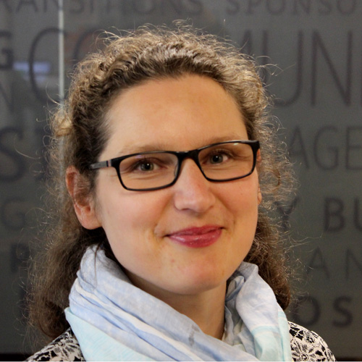
Who am I?
Asta Petkeviciute
Program Director
Two decades of experience in organization and project management
Nonprofits in dozens of countries
Extensive work with federal grant regulations and compliance

Slide 7
It’s my passion and my life’s work to help people see their organization’s potential in new and different ways. I love working with so many great projects and finding ways that they can do more with their resources, and have the capacity to serve more people, explore and innovate.
Asta Petkeviciute on why I love working at TSNE MissionWorks

Slide 8


How can fiscal sponsorship help me do more?
POLL: How much time your executive leadership team spend on operations/administration that should otherwise be allocated toward mission-critical work?
  Some
  Enough
  Too Much
Notes:
Poll: How much time do you spend on operational/Administrative work that should otherwise be allocated toward mission-critical work.
Some, Enough, Too Much

Slide 9
How can fiscal sponsorship help me do more?
Comprehensive administrative services
  Corporate entity (501(c)(3), employer, liability insurance, audit)
  Financial services (accounting, banking, cash flow)
  Human resource & benefits management
Financial, grants and compliance management
  Internal fiduciary oversight role (dedicated manager with experience in budgeting, financial analysis and resource management)
  Legal and compliance oversight
With a nonprofit whose mission and programs are similar
  additional organizational capacity building services available

Slide 10
How can you offer this kind of comprehensive support?
Share services with more than 90 projects and nearly 500 employees in 30 states.
Our team includes:
Accounting Team of accountants and controllers who prepare your accounts for audit, as well as process payables, receivables and payroll for each project. | Compliance and Legal Affairs A staff attorney and contracts managers review and process contracts, advise on legal agreements, and the file of business registrations in states where you operate. | Grants and Finance Management A dedicated grants and finance manager to oversee your account, coordinate services and monitor payments, cash flow, grants management and proposal support. | Human Resources A seasoned, professional team with decades of experience help you hire, retain and evaluate staff in addition to compensation and benefits administration and ensure compliance with all current labor laws.

Slide 11
Model A: Comprehensive
With a nonprofit whose mission and programs are similar
Fiscal Sponsor
Accounting
Finances
Compliance
Project
Corporate Home
Human
Resources
Grants
Contracts
Financial Oversight

Slide 12
Other Types of Fiscal Sponsorship?
Pre-Approved Grant Relationship (Models B or C)
The fiscally-sponsored project does not become a program belonging to the sponsor
The sponsor does not necessarily maintain ownership of any part of the results of the project’s work
A separate entity is responsible for managing its own tax reporting, overall financial management and liability issues
The sponsor simply assures that the project will use the grant funds received to accomplish the ends described in the grant proposal.
This is the model of fiscal sponsorship primarily utilized in the arts.

Slide 13
Who seeks fiscal sponsorship?
Spinoffs
Existing c3
Startups

Slide 15

TSNE has been an invaluable partner right from the start. Their expertise combined with our program know how enabled us to focus confidently on building a well-run, mission-driven organization, helping hundreds of students succeed in their careers. 21st century fiscal sponsorship is an effective hybrid organizational model that provides funders with opportunities to confidently invest in potent social justice efforts like Future Chefs.
Toni Elka
Executive Director
Future Chefs
Boston, Mass.

Slide 16
What’s the value to the projects?
Don’t have to build & maintain their own infrastructure
Cost effective and flexible
More time and focus for mission-related work
Access to sponsor’s expertise and experience
Better fringe benefits
Shared risk and responsibility
Better cash management

Slide 17
What’s the value to the funders?
Financial oversight and professional grant management
Capacity building, mentoring for the project
Cost efficient sharing of resources
Access to sponsor’s expertise and experience
Flexible: ease of entry and exit, transitions
Risk management

Slide 18


Due Diligence
http://www.fiscalsponsors.org/
Best Practices for Fiscal Sponsors
Questions Funders Should Ask Grantees Who Use Fiscal Sponsors
http://www.fiscalsponsordirectory.org/
Connects community projects with fiscal sponsors

Slide 19
We chose to work with TSNE because their commitment to strong, inclusive communities and social justice matched our mission and values. In addition, the staff are responsive and service-minded with strong financial and human resources supports that enhance our organizational capacity. We are thrilled to be affiliated with TSNE.”
Risa Wilkerson, Executive Director, Active Living By Design

Slide 20

Program Strategy
Fundraising
Mission
Accounting
Human Resources
Grants and Finances
Legal Affairs and Compliance
Operational Excellence
Program
Excellence

Slide 21
Thank you
Questions?

