Slide 1
Politicizing Nonprofits
What Charitable Nonprofits and Foundations Need to Know
(and What They Can Do About It)
David L. Thompson & Tiffany Gourley
National Council of Nonprofits
Massachusetts Nonprofit Network | June 14, 2017
© 2017 National Council of Nonprofits
www.councilofnonprofits.org | @NatlCouncilNPs

Slide 2
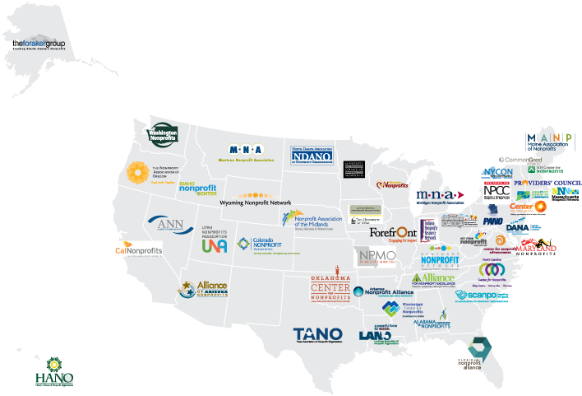


Slide 3
Politicizing Nonprofits
What Charitable Nonprofits and Foundations Need to Know
What We’ll Cover
  The Johnson Amendment:
  What is it and why it matters right now?
  Background on 501(c)(3) Status
  Benefits, Conditions, and History
  Nonpartisanship and Advancing Nonprofit Mission
  Administration and Legislative Challenges
  Executive Order, Bills to repeal or weaken
  Taking Action: Protect Nonprofit Nonpartisanship

Slide 4
The Johnson Amendment
§501(c)(3) Corporations, and any community chest, fund, or foundation, organized and operated exclusively for religious, charitable, scientific, testing for public safety, literary, or educational purposes, or to foster national or international amateur sports competition (but only if no part of its activities involve the provision of athletic facilities or equipment), or for the prevention of cruelty to children or animals, no part of the net earnings of which inures to the benefit of any private shareholder or individual, no substantial part of the activities of which is carrying on propaganda, or otherwise attempting, to influence legislation (except as otherwise provided in subsection (h)), and which does not participate in, or intervene in (including the publishing or distributing of statements), any political campaign on behalf of (or in opposition to) any candidate for public office.
What it is. Why it matters right now.

Slide 5
The Johnson Amendment
§501(c)(3) Corporations, and any community chest, fund, or foundation, organized and operated exclusively for religious, charitable, scientific, testing for public safety, literary, or educational purposes, or to foster national or international amateur sports competition (but only if no part of its activities involve the provision of athletic facilities or equipment), or for the prevention of cruelty to children or animals, no part of the net earnings of which inures to the benefit of any private shareholder or individual, no substantial part of the activities of which is carrying on propaganda, or otherwise attempting, to influence legislation (except as otherwise provided in subsection (h)), and which does not participate in, or intervene in (including the publishing or distributing of statements), any political campaign on behalf of (or in opposition to) any candidate for public office.

Slide 6
The Johnson Amendment
§501(c)(3) Corporations, and any community chest, fund, or foundation, organized and operated exclusively for religious, charitable, scientific, testing for public safety, literary, or educational purposes, or to foster national or international amateur sports competition (but only if no part of its activities involve the provision of athletic facilities or equipment), or for the prevention of cruelty to children or animals, no part of the net earnings of which inures to the benefit of any private shareholder or individual, no substantial part of the activities of which is carrying on propaganda, or otherwise attempting, to influence legislation (except as otherwise provided in subsection (h)), and which does not participate in, or intervene in (including the publishing or distributing of statements), any political campaign on behalf of (or in opposition to) any candidate for public office.
“which does not participate in, or intervene in (including the publishing or distributing of statements), any political campaign on behalf of (or in opposition to) any candidate for public office.”

Slide 7
The Johnson Amendment
§501(c)(3) Corporations, and any community chest, fund, or foundation, organized and operated exclusively for religious, charitable, scientific, testing for public safety, literary, or educational purposes, or to foster national or international amateur sports competition (but only if no part of its activities involve the provision of athletic facilities or equipment), or for the prevention of cruelty to children or animals, no part of the net earnings of which inures to the benefit of any private shareholder or individual, no substantial part of the activities of which is carrying on propaganda, or otherwise attempting, to influence legislation (except as otherwise provided in subsection (h)), and which does not participate in, or intervene in (including the publishing or distributing of statements), any political campaign on behalf of (or in opposition to) any candidate for public office.
“which does not participate in, or intervene in (including the publishing or distributing of statements), any political campaign on behalf of (or in opposition to) any candidate for public office.”
Two Limits:
Don’t endorse or oppose candidates for public office
Don’t contribute money, time, and resources to help elect or defeat candidates

Slide 8
The Johnson Amendment
§501(c)(3) Corporations, and any community chest, fund, or foundation, organized and operated exclusively for religious, charitable, scientific, testing for public safety, literary, or educational purposes, or to foster national or international amateur sports competition (but only if no part of its activities involve the provision of athletic facilities or equipment), or for the prevention of cruelty to children or animals, no part of the net earnings of which inures to the benefit of any private shareholder or individual, no substantial part of the activities of which is carrying on propaganda, or otherwise attempting, to influence legislation (except as otherwise provided in subsection (h)), and which does not participate in, or intervene in (including the publishing or distributing of statements), any political campaign on behalf of (or in opposition to) any candidate for public office.
Two Limits:
Don’t endorse or oppose candidates
Don’t contribute to help elect or defeat candidates
Opposed by Some:
Limits free speech rights
IRS intrudes in church affairs
Supported by Most:
Nonpartisanship in our DNA
Makes us trusted, effective problem solvers

Slide 9
501(c)(3) Status
§501(c)(3) Corporations, and any community chest, fund, or foundation, organized and operated exclusively for religious, charitable, scientific, testing for public safety, literary, or educational purposes, or to foster national or international amateur sports competition (but only if no part of its activities involve the provision of athletic facilities or equipment), or for the prevention of cruelty to children or animals, no part of the net earnings of which inures to the benefit of any private shareholder or individual, no substantial part of the activities of which is carrying on propaganda, or otherwise attempting, to influence legislation (except as otherwise provided in subsection (h)), and which does not participate in, or intervene in (including the publishing or distributing of statements), any political campaign on behalf of (or in opposition to) any candidate for public office.
  Benefits, Conditions, and History

Slide 10
501(c)(3) Status
§501(c)(3) Corporations, and any community chest, fund, or foundation, organized and operated exclusively for religious, charitable, scientific, testing for public safety, literary, or educational purposes, or to foster national or international amateur sports competition (but only if no part of its activities involve the provision of athletic facilities or equipment), or for the prevention of cruelty to children or animals, no part of the net earnings of which inures to the benefit of any private shareholder or individual, no substantial part of the activities of which is carrying on propaganda, or otherwise attempting, to influence legislation (except as otherwise provided in subsection (h)), and which does not participate in, or intervene in (including the publishing or distributing of statements), any political campaign on behalf of (or in opposition to) any candidate for public office.
Why Choose §501(c)(3) Status?

Slide 11
501(c)(3) Status
§501(c)(3) Corporations, and any community chest, fund, or foundation, organized and operated exclusively for religious, charitable, scientific, testing for public safety, literary, or educational purposes, or to foster national or international amateur sports competition (but only if no part of its activities involve the provision of athletic facilities or equipment), or for the prevention of cruelty to children or animals, no part of the net earnings of which inures to the benefit of any private shareholder or individual, no substantial part of the activities of which is carrying on propaganda, or otherwise attempting, to influence legislation (except as otherwise provided in subsection (h)), and which does not participate in, or intervene in (including the publishing or distributing of statements), any political campaign on behalf of (or in opposition to) any candidate for public office.
Why Choose §501(c)(3) Status?
Exempt from federal income taxes

Slide 12
501(c)(3) Status
§501(c)(3) Corporations, and any community chest, fund, or foundation, organized and operated exclusively for religious, charitable, scientific, testing for public safety, literary, or educational purposes, or to foster national or international amateur sports competition (but only if no part of its activities involve the provision of athletic facilities or equipment), or for the prevention of cruelty to children or animals, no part of the net earnings of which inures to the benefit of any private shareholder or individual, no substantial part of the activities of which is carrying on propaganda, or otherwise attempting, to influence legislation (except as otherwise provided in subsection (h)), and which does not participate in, or intervene in (including the publishing or distributing of statements), any political campaign on behalf of (or in opposition to) any candidate for public office.
Why Choose §501(c)(3) Status?
Exempt from federal income taxes
Eligible to receive tax-deductible donations

Slide 13
501(c)(3) Status
§501(c)(3) Corporations, and any community chest, fund, or foundation, organized and operated exclusively for religious, charitable, scientific, testing for public safety, literary, or educational purposes, or to foster national or international amateur sports competition (but only if no part of its activities involve the provision of athletic facilities or equipment), or for the prevention of cruelty to children or animals, no part of the net earnings of which inures to the benefit of any private shareholder or individual, no substantial part of the activities of which is carrying on propaganda, or otherwise attempting, to influence legislation (except as otherwise provided in subsection (h)), and which does not participate in, or intervene in (including the publishing or distributing of statements), any political campaign on behalf of (or in opposition to) any candidate for public office.
Why Choose §501(c)(3) Status?
Exempt from federal income taxes
Eligible to receive tax-deductible donations
Contributions
Type of Nonprofits Deductible?
501(c)(2) Title Holding Company for Exempt Organization NO
501(c)(3) Religious, Educational, Charitable, etc. YES
501(c)(4) Social Welfare, Civic Leagues NO
501(c)(5) Labor, Agricultural, and Horticultural Orgs NO
501(c)(6) Business Leagues, Chambers of Commerce NO
501(c)(7) Social and Recreational Clubs NO

Slide 14
501(c)(3) Status - Conditions
§501(c)(3) Corporations, and any community chest, fund, or foundation, organized and operated exclusively for religious, charitable, scientific, testing for public safety, literary, or educational purposes, or to foster national or international amateur sports competition (but only if no part of its activities involve the provision of athletic facilities or equipment), or for the prevention of cruelty to children or animals, no part of the net earnings of which inures to the benefit of any private shareholder or individual, no substantial part of the activities of which is carrying on propaganda, or otherwise attempting, to influence legislation (except as otherwise provided in subsection (h)), and which does not participate in, or intervene in (including the publishing or distributing of statements), any political campaign on behalf of (or in opposition to) any candidate for public office.
Condition #1 : No Private Inurement
“no part of the net earnings of which inures to the benefit of any private shareholder or individual,” (1909)

Slide 15
501(c)(3) Status - Conditions
§501(c)(3) Corporations, and any community chest, fund, or foundation, organized and operated exclusively for religious, charitable, scientific, testing for public safety, literary, or educational purposes, or to foster national or international amateur sports competition (but only if no part of its activities involve the provision of athletic facilities or equipment), or for the prevention of cruelty to children or animals, no part of the net earnings of which inures to the benefit of any private shareholder or individual, no substantial part of the activities of which is carrying on propaganda, or otherwise attempting, to influence legislation (except as otherwise provided in subsection (h)), and which does not participate in, or intervene in (including the publishing or distributing of statements), any political campaign on behalf of (or in opposition to) any candidate for public office.
Condition #2 : Lobbying Limits
“no substantial part of the activities of which is carrying on propaganda, or otherwise attempting, to influence legislation (except as otherwise provided in subsection (h)),” (1934 & 1976)

Slide 16
501(c)(3) Status - Conditions
§501(c)(3) Corporations, and any community chest, fund, or foundation, organized and operated exclusively for religious, charitable, scientific, testing for public safety, literary, or educational purposes, or to foster national or international amateur sports competition (but only if no part of its activities involve the provision of athletic facilities or equipment), or for the prevention of cruelty to children or animals, no part of the net earnings of which inures to the benefit of any private shareholder or individual, no substantial part of the activities of which is carrying on propaganda, or otherwise attempting, to influence legislation (except as otherwise provided in subsection (h)), and which does not participate in, or intervene in (including the publishing or distributing of statements), any political campaign on behalf of (or in opposition to) any candidate for public office.
Condition #3 : Johnson Amendment
“and which does not participate in, or intervene in (including the publishing or distributing of statements), any political campaign on behalf of (or in opposition to) any candidate for public office.” (1954 & 1987)

Slide 17
501(c)(3) Status
§501(c)(3) Corporations, and any community chest, fund, or foundation, organized and operated exclusively for religious, charitable, scientific, testing for public safety, literary, or educational purposes, or to foster national or international amateur sports competition (but only if no part of its activities involve the provision of athletic facilities or equipment), or for the prevention of cruelty to children or animals, no part of the net earnings of which inures to the benefit of any private shareholder or individual, no substantial part of the activities of which is carrying on propaganda, or otherwise attempting, to influence legislation (except as otherwise provided in subsection (h)), and which does not participate in, or intervene in (including the publishing or distributing of statements), any political campaign on behalf of (or in opposition to) any candidate for public office.
Benefits
Tax Exemption
Eligible to Receive Tax-Deductible Donations
Conditions
No Private Inurement
Lobbying Limits
Nonpartisanship

Slide 18
Nonpartisanship
§501(c)(3) Corporations, and any community chest, fund, or foundation, organized and operated exclusively for religious, charitable, scientific, testing for public safety, literary, or educational purposes, or to foster national or international amateur sports competition (but only if no part of its activities involve the provision of athletic facilities or equipment), or for the prevention of cruelty to children or animals, no part of the net earnings of which inures to the benefit of any private shareholder or individual, no substantial part of the activities of which is carrying on propaganda, or otherwise attempting, to influence legislation (except as otherwise provided in subsection (h)), and which does not participate in, or intervene in (including the publishing or distributing of statements), any political campaign on behalf of (or in opposition to) any candidate for public office.
  Nonpartisanship & Advancing Nonprofit Mission

Slide 19
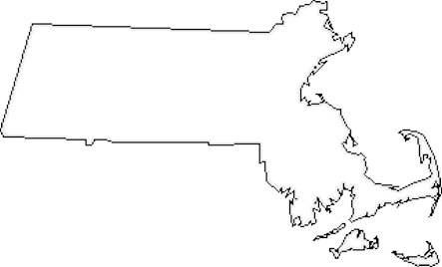











































What Massachusettsans are Saying

Slide 20

What Massachusettsans are Saying
“In communities locally and abroad, US nonprofits bridge the gap between public and private sectors. Our strength is that we are blind to political affiliation and work exclusively to serve the public good. Now, more than ever, nonprofits require protection from political influence and protection from the temptation to receive benefits as a result of engaging in political activities.”
Step Up International
Arlington

Slide 21
What Massachusettsans are Saying
“If this rule is lifted, nonprofits like ours would undoubtedly face pressure from constituents, funders, and elected officials to take sides in elections. The inevitable result would be to alienate people who otherwise support our charitable mission and reduce public trust in our organization as an institution.”
Neponset River Watershed Association
Canton

Slide 22
What Massachusettsans are Saying
“A nonprofit's reputation for fairness and transparency could be called into question and public confidence in the work threatened. Public confidence is a nonprofit's greatest asset. Please oppose changes to this tax policy.”
Lowell Telecommunications Corp.
Lowell

Slide 23
What Massachusettsans are Saying
“As a community organization we work with all residents and cannot be seen as being partisan. Weakening the Johnson Amendment could damage the meaning of the 501(c)(3) status and put doubt in people's minds and harm our fundraising efforts which would result in us not being able to provide important service to our community members.”
Franklin County Community Development Corporation
Greenfield

Slide 24


Challenges to Nonpartisanship

Slide 25
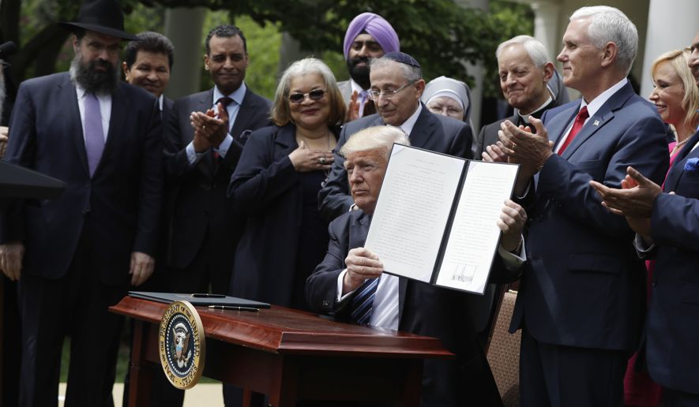
Executive Order
Rose Garden Ceremony on May 4, 2017
What President Trump Said
What the Executive Order Says
“… the Department of the Treasury does not take any adverse action against any individual, house of worship, or other religious organization on the basis that such individual or organization speaks or has spoken about moral or political issues from a religious perspective, where speech of similar character has, consistent with law, not ordinarily been treated as participation or intervention in a political campaign on behalf of (or in opposition to) a candidate for public office by the Department of the Treasury.”
“For too long, the federal government has used the power of the state as a weapon against people of faith, bullying and even pushing Americans for following their religious beliefs. You are now in a position where you can say what you want to say.”

Slide 26
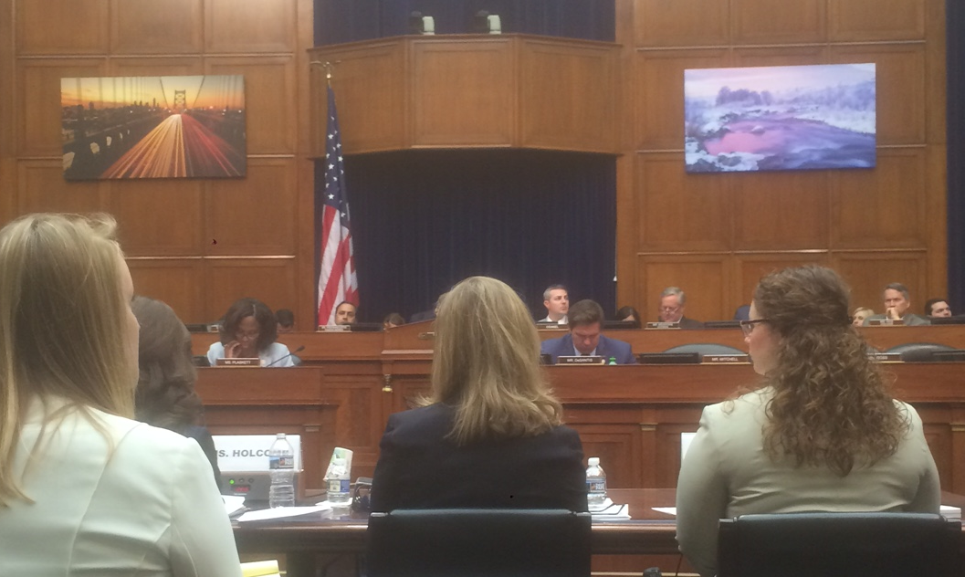
Legislation
Repeal Legislation H.R. 172
Weakening Legislation H.R. 781/S. 264

Slide 27
Legislation
Repeal Legislation H.R. 172
Weakening Legislation H.R. 781/S. 264
Opposed by Some:
Limits free speech rights
IRS intrudes in church affairs
Sen. Johnson’s Motive

Slide 28
Legislation
Repeal Legislation H.R. 172
Weakening Legislation H.R. 781/S. 264
“(A) is made in the ordinary course of the organization’s regular and customary activities in carrying out its exempt purpose,
and
“(B) results in the organization incurring not more than de minimis incremental expenses.”.

Slide 29
Legislation
Repeal Legislation H.R. 172
Weakening Legislation H.R. 781/S. 264
“(A) is made in the ordinary course of the organization’s regular and customary activities in carrying out its exempt purpose,
and
“(B) results in the organization incurring not more than de minimis incremental expenses.”.

Slide 30
Legislation
Repeal Legislation H.R. 172
Weakening Legislation H.R. 781/S. 264
“(A) is made in the ordinary course of the organization’s regular and customary activities in carrying out its exempt purpose,
and
“(B) results in the organization incurring not more than de minimis incremental expenses.”

Slide 31
Legislation
Repeal Legislation H.R. 172
Weakening Legislation H.R. 781/S. 264
Possible Legislative Vehicles
Tax Reform
Budget/Appropriations
Debt Ceiling
Other

Slide 32
Repeal/ Weaken Johnson Amendment
Charitable contributions will dry up: Who will give to a nonprofit in the future knowing that those funds may get re-routed to a political candidate that the donor opposes?
Expand dark money nightmares as people give to a charitable nonprofit, religious congregation, or DAF, both to get a deduction and hide their political donations.
Generate pressure from donors in advance who lean on a nonprofit to endorse a favorite candidate, and from other donors after the fact outraged by the organization’s political choices.
Divert board members from their missions, and polarize functioning when one board member says, “We should endorse my best friend who is running for office,” before another yells out, “No, we should endorse my business partner who is running for the same office!” For every elected office from dogcatcher to President.
Bottom-line: a no-win/all-loss situations for everyone – except politicians.

Slide 33

Take Action
Protect Nonprofit Nonpartisanship

Slide 34
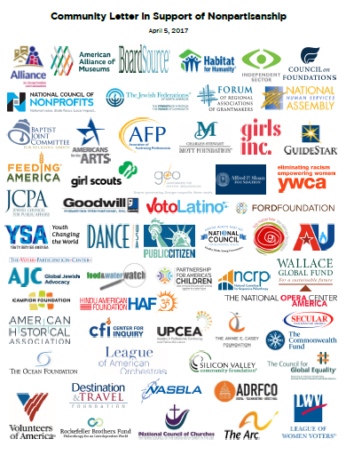
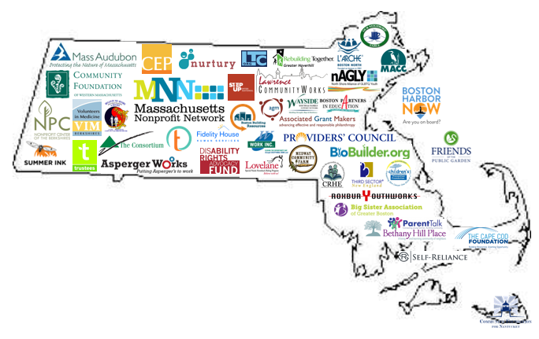
Take Action
Protect Nonprofit Nonpartisanship
Sign the
Community Letter in Support of Nonpartisanship
www.GiveVoice.org

Slide 35
Take Action
Protect Nonprofit Nonpartisanship
Sign the
Community Letter in Support of Nonpartisanship
x3
Share with colleague organizations
www.GiveVoice.org

Slide 36

www.GiveVoice.org
4,700+
Community Letter for Nonpartisanship
Charitable | Philanthropic | For-Profit
Americans for the Arts BoardSource Catholic Charities USA Feeding America Girl Scouts of the USA Habitat for Humanity League of Women Voters Mass. Nonprofit Network National Council of Churches National Council of Nonprofits Providers’ Council United Way YWCA | Private Foundations > Barr Foundation > Fireman Foundation > Ford > Mott > Rockefeller Bros. Fund Community Foundations > Cape Cod > Nantucket > Western Massachusetts > Worchester Associated Grant Makers Council on Foundations Forum of Regional Ass’ns of Grantmakers | Council Services Plus Dietel Partners Morino Ventures LLC NEO Law Group Smith’s Food & Drug The Cagney Company

Slide 37



Take Action
Protect Nonprofit Nonpartisanship
x3

Slide 38


Questions
Tonja R. Mettlach
tmettlach@massnonprofitnet.org
617-391-9175
David L. Thompson
dthompson@councilofnonprofits.org
Tiffany Gourley
tgourley@councilofnonprofits.org
202-962-0322
www.councilofnonprofits.org
www.GiveVoice.org

Slide 39

Thank You!

