Slide 1


Business Process Improvement for Nonprofits:
Efficiencies and Opportunities
June 28th Webinar
Presented by BerryDunn
Thanks for joining us! A few instructions before we begin:
You may join the audio by selecting the radio button for either “Telephone” or “Mic & Speakers.” If you are using telephone, please dial in with the conference line and audio pin provided.
If you are having any technical issues, please let us know in the chat box.
We will have time for Q&A. Please enter your questions in the chat box at any time.
This webinar is being recorded, and we will distribute the recording after the webinar.
Marta Hodgkins-Sumner
Director of Membership and Programs
www.massnonprofitnet.org

Slide 2

Efficiencies and Opportunities:
Business Process Improvement for Nonprofits
PRESENTED BY
Lisa Trundy-Whitten, CPA, FHFMA
Tina Bode, CISA, COBIT
Notes:
Good morning everyone, and welcome to our presentation on efficiencies and opportunities for business process improvement. I am Tina Bode, and together with Lisa Trundy Whitten, we are going to talk to you a little about how you may be able to improve the processes at your organizations.
I am Tina Bode, I am a manager in BerryDunn’s Management and Information Technology Consulting practice. My areas of expertise include analyzing and improving business processes, developing and assessing internal controls, and performing IT and security audits, reviews and risk assessments for organizations.
Lisa,

Slide 3

Objectives
Identify signs of process improvement needs within their own organization
Gain awareness of process improvement tools, techniques and benefits
Understand how to design improvements with internal controls in mind
3
3
Notes:
Our objectives for today are to talk about how to identify signs of process improvement, increase your awareness on process improvement tools and benefits, and help you understand how to design improvements with strong internal controls in mind.

Slide 4

Agenda
Introductions
About Process Improvement
Process Improvement Opportunities and Techniques
Internal Control Considerations
4
Notes:
This our agenda for today, so let’s get into it…

Slide 5
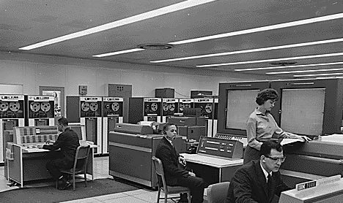
Legacy Software, Systems, and Processes
5
Notes:
We often see opportunities for process improvement when organizations are on really old legacy software systems. The same processes have been around since the system was developed, and haven’t changed as technology and your business have developed.

Slide 6

On-The-Job Training
6
Notes:
On the job training also provides for perpetuating some bad processes, if the new staff are being trained on bad processes, by someone who’s been around 15 years, doing it the same way, the cycle will continue.

Slide 7

Implementation of New Systems
7
Notes:
Implementing new systems may be a good opportunity to take some time to redesign the way work is performed, but often we just see the same old legacy processes, duplicated in new systems and not taking advantage of new system capabilities and new functionality to their fullest.

Slide 8

Regulatory and Industry Requirements
8
Notes:
Compliance with regulatory and industry requirements may also be another source of heartache for your processes. Being forced to implement steps and controls for the sake of compliance is never fun. Lisa will talk more about this later on in the hour.

Slide 9

Little Time to Examine Processes
9
Notes:
What is plain to see is that it can be really really difficult to take time out of your already busy day to take on additional projects such as process improvement. Typically, organizations are already trying to keep up and maxing out their resources.
Unfortunately, this is why it’s also important to try to make the time to think about how you’re doing things. When you’re maxxed out on resources, that is the time to ensure that you’re working most effectively, and making sure your resources are used the right way, on the right tasks that add value to your organization. Hopefully we can share with your some tools and ideas to help make the process of process improvement, much easier to take on.

Slide 10
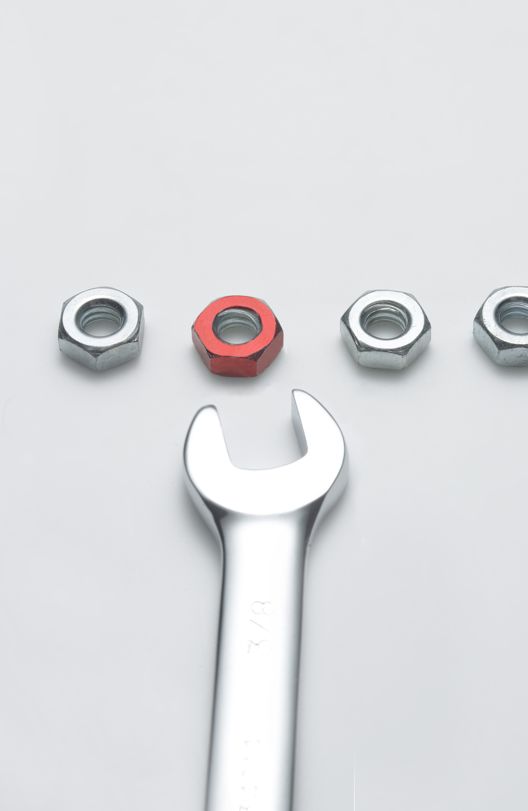
Background on Process Improvement
LOTS OF METHODOLOGIES
Lean
Six Sigma
Lean Six Sigma
Total Quality Management
10
Notes:
There are several different methodologies to pull from as you think about process improvement at your organization. Our presentation today is not going to focus on one specific method, but we wanted to give you some background on the leading methodologies.
Lean – is a business transformation concept introduced by Toyota, with a focus on eliminating waste.
Six Sigma – originated in manufacturing, it focuses on reducing variation and errors in processing. The concept here is to standardize all processing within six standard deviations (hence the term six sigma) of the average unit, and be 99% error free in those six standard deviations – think the bell curve from statistics class). This methodology is comprised of a specific process that includes activities to (Define Measure, Analyze, Improve, Control) –with a focus of customer satisfaction. This method is very prescriptive and requires the completion of specific steps in the process to achieve. This is the most quantifiable of all methods. Others are more qualitative in nature.
LSS – This methodology combines concepts from both Lean and Six Sigma to achieve efficiency and effectiveness. Lean identifies and eliminates the barriers and removes many forms of waste so that Six Sigma can focus on eliminating variability. Variation leads to defects, which is a major source of waste. So these two methodologies go hand in hand.
TQM – Is a methodology based on success through customer satisfaction. ALL members of the organization participate in improving processes, products, services and culture of the organization. Continual improvement, fact based decision, integrated system and communication are key elements of this methodology.
There is a lot of material out there on these methodologies that can be helpful to you to draw from as you undertake any internal efforts. What they all have in common is two primary themes: Eliminating Waste, and reducing errors.

Slide 11

Eliminate Waste
Over-production
Correction (defects)
Inventory
Motion
Over-processing
Conveyance
Waiting
11
Notes:
The first concept of process improvement is Eliminating Waste. These are some examples of waste that should be eliminated when undertaking process improvement efforts:
Over production – Making more than what is immediately required → multiple signatures required, printing extra documentation, duplicating system entries
Defects (errors) – Rework, scrap, incorrect documentation → collecting and entering incorrect information into the system. Re-issuing checks
Inventory – Storing parts, pieces, documentation ahead of requirements → unnecessary order, extra inventory
Motion – Unnecessary movement of people and equipment → large distance travelled to complete a process (physically)
Over processing – tasks, activities and materials that don’t add value → meetings in which nothing is accomplished, sending reports that aren’t read or used
Conveyance (transport) – Moving people, products & information → poor workplace layouts, moving equipment
Waiting – For parts, information, instructions, equipment → waiting to sign into a computer, time spent clicking through unnecessary screens.
These areas of waste are what to look for to reduce/eliminate as you work to improve your process.

Slide 12

Reduce Variation / Error
12
Notes:
The second concept is reducing errors and variation.
Reducing errors naturally comes from eliminating some types of waste that we discussed, but what the Six Sigma method really drives is also to reduce variation. Again, as it was derived from manufacturing, the goal was that all widgets produced were as close to identical as possible. I know that many of are in finance, accounting or in abusiness office, but this theme can also apply. For example, you’d want to process payroll the same, correct way each week, without errors or variation. You’d want to pay taxes correctly and accurately, regardless if your primary PR clerk is out on maternity leave this month. Reducing variation and errors is important in any environment

Slide 13

Polling Question #1
13

Slide 14
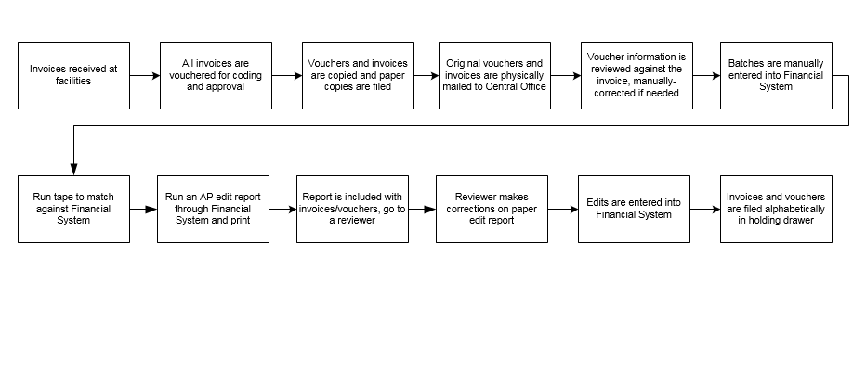
Workflow Example: Accounts Payable
14
Notes:
A good start to process improvement is to look at how the process is being performed today. We often use workflow diagrams such as this to document the steps in a workflow. Although this exercise is not required, it’s a good visual tool to understand the process and workflow that’s taking place currently. We call it an “as-is” diagram.
We thought it would be helpful to walk through a specific workflow example that everyone can relate to, such as accounts payable, to illustrate the process for making improvements.
Here, we’ve documented a sample accounts payable workflow, that starts with receiving invoices at several different facilities, and then sent to a central location for processing and entry to the accounting system. Many of you may not have these extra steps to your process., this is just an example
To create this diagram, all the information was obtained from conversations with people who do the work on a day to day basis. Just by undertaking the effort to document a process, you learn about it, and start to understand where some of the challenges are. The simple act of getting a group of people together to just talk about a process, is beneficial. You start to ask questions, try to understand why things are done a certain way, and challenge your previous perspective. Even if you don’t go through the step of creating a diagram, just talking through a process from start to finish is helpful.
So you meet with those who do the work and create this diagram, of the step by step process for how accounts payable is processed today. But where do you start improving this process? As you’re reading through this diagram, did any steps come to your attention that are creating waste, or are error prone??

Slide 15
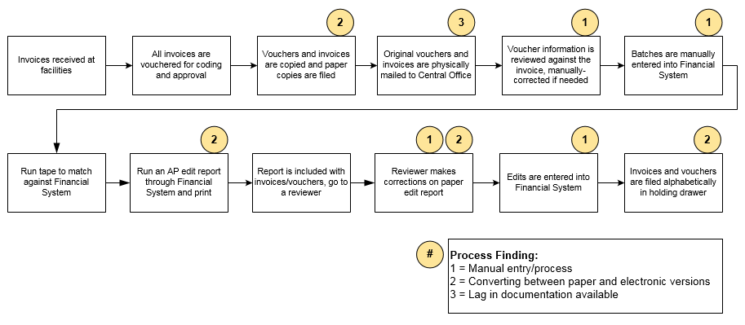
Workflow Example: Accounts Payable
15
Notes:
These are what we call “pain points” that we’ve marked with yellow circles. For example:
Making multiple copies of the same pieces of paper that are kept locally, and also another copy sent to the central office
Delays in receiving materials for processing using snail mail
Generating paper reports for review that sit on someone’s desk and manual edits made
These pain points are areas that you should be looking at for improvement. This is where we see the waste, or variation. Steps that are inefficient or ineffective. This is where you should start in your process improvement efforts to redesign.

Slide 16
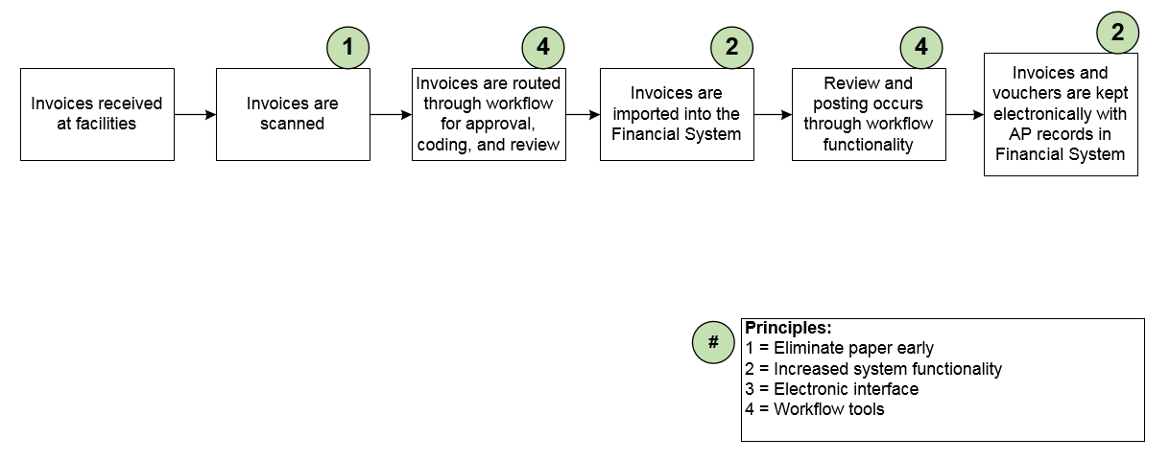
Workflow Example: Accounts Payable
16
Notes:
This is an example of an improved workflow process for accounts payable. By implementing a few changes to the areas of inefficiency we identified in the previous diagram, we can condense the time and steps it takes to complete the AP process. We went from 12 steps to 6 steps.
For example, the central office used to receive information from homes in paper via snail mail. By requiring that all information be scanned and saved electronically at the start, to shared network drives that can be accessed by the central office, you’re eliminating the lag time in physically mailing paper documents. We eliminated the paper early.
Additionally, by scanning documents at the start, there are no longer two physical copies of all invoices and vouchers, both at each location and the central office. All parties can access scanned copies on central drives for approving invoices, and answering vendor questions as needed.
Eliminating paper reports and using onscreen review, or workflow approvals also saves time. Very often in the AP process, vendors are calling, asking for payment. How many times is the answer to their question “I don’t know, I have to track down a paper invoice sitting on a desk somewhere in various state of approval or review?” Storing information centrally where everyone can access it for their piece of the process will save time and improve customer service
Looking to utilize system functionality such as importing invoice details as opposed to manually information could also be a way to save time, and reduce errors. Now, you may not be using import functionality because your current system doesn’t have it, or you may just not know that the functionality is available if you’re continuing to do things the way you’ve always done them, or the functionality may be available in a future version that you can upgrade to. It’s helpful to understand which of those situations it is, because the solution could be available in the system you have, or may be a version away to becoming a reality.
Sometimes it’s helpful to go through a couple iterations of this “future state” or “to-be” workflow diagram. One can capture changes to the process that you’re able to make now without a lot of investment – THE QUICK WINS. But feel free to also create an “ideal” workflow diagram that may be a few years down the road with some investment in systems and further redesign of the process. It’s okay to dream a little in this “ideal” diagram. You may not be able to achieve all of it, but through some new tools and systems that are becoming available your organization may decide the efficiencies are worth the investment.

Slide 17
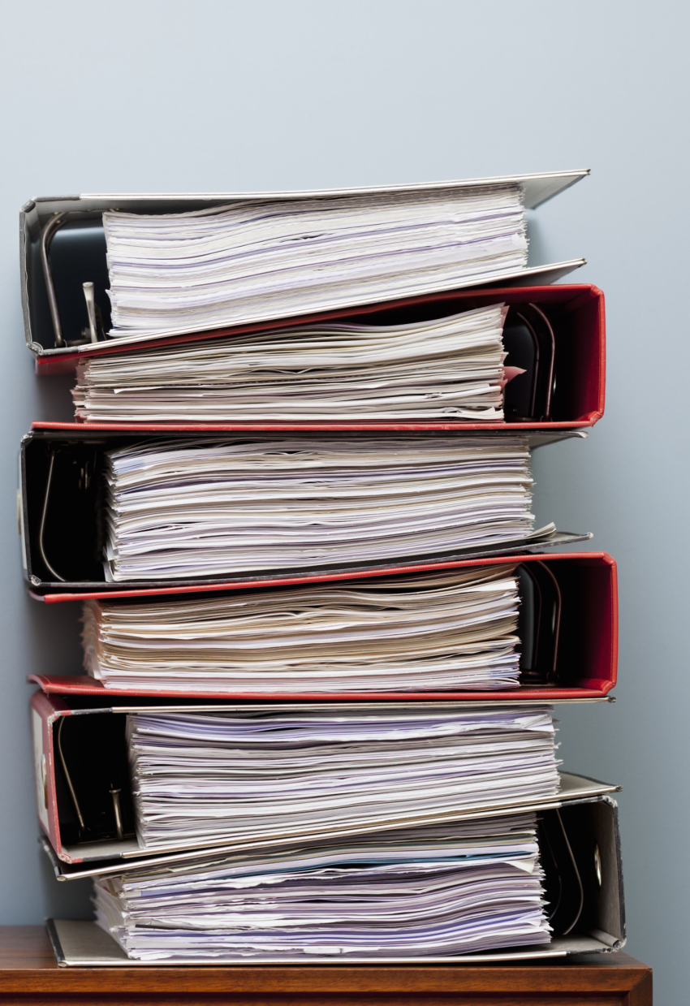
Principles of Process Improvement
Eliminate paper early
Capture data once electronically
Electronic interface
Direct lookup
Increased system functionality
Workflow tools
Standardize communication
Train to desired process
17
Notes:
We’ve put together these “common solutions” based on our experience helping organizations redesign their processes and consider these basic principle for workflow improvement. These tenets, or principles, are some rules to live by as you look to redesign your processes to be more efficient.
Eliminate paper early → get rid of the stacks and stacks of paper around and stop passing it around
Capture data once electronically → this eliminates passing paper around, and re-entering it multiple times
Electronic interface → keying is error prone, using imports and exports maintains the integrity of data
Direct lookup → digging around and thumbing through paper is not an effective use of anyone’s time, have information stored in systems where it can be accessed by who needs it, when they need it
Increased system functionality → take advantage of what’s there and not being used, or plan for an upgrade or new system implementation if needed
Workflow tools → use system tools to streamline approval and reduce delays
Standardize communication → set guidelines for WHEN information should be provided and HOW it should be provided. Reduce the wait time and reduce the many methods information is distributed
Train to desired process → document procedures and train and retrain once new process is implemented.
The workflow diagram is just one example of a tool you can use to assess your current operations and look for opportunities to improve. When your areas of concerns are process-driven like cash receipts and AP it makes sense. Other scenarios, like looking at the movement of work, may require different tools.

Slide 18
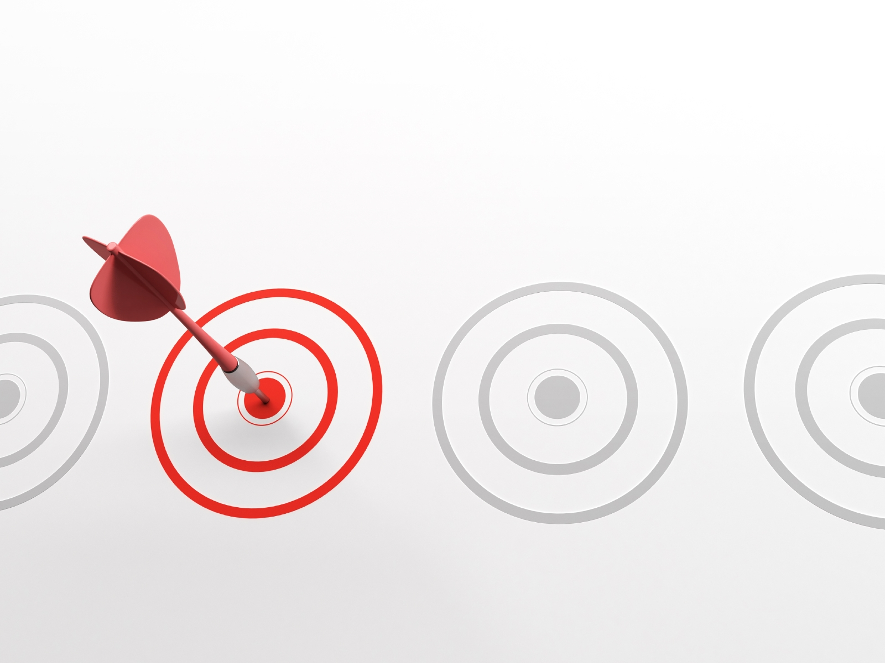
Potential Areas of Improvement
18
Notes:
We’ve identified some common benefits and potential areas of improvement by streamlining and undertaking business process areas. There are many, but these are opportunities that are very common across the board:

Slide 19
Accounts Payable
Fewer last minute vendor payments or overdue invoices
Increase in term discounts
Lower level of grief managing the process
19

Slide 20
Month End
Less cumbersome monthly close
Financial reports available faster
Decrease “cumbersome” tasks
Fewer last minute preparations for the board meeting
20

Slide 21
Billing and Collections
Reduce denials
Improve collections and aging
Increase revenue
Decrease time to resolve issues
21

Slide 22
Staff Scheduling and Payroll
Decrease time spent managing the schedule
Reduce overtime and/or agency staff
Fewer scheduling conflicts
Less after payroll corrections
22

Slide 23
Purchasing, Ordering, and Inventory
Operate with a smaller inventory
Reduce rush ordering for inventory shortages
Purchase in more optimal patterns
23

Slide 24
Fundraising
More efficient outreach
Increased accuracy in donation classification
Faster correspondence to donors
24

Slide 25
Registration and Intake
Fewer steps to register a patient, client, or student to receive services
Improve alignment with eligible services
Decrease repeated questions
25

Slide 26
IT Support
Decrease IT support ticket volume
Alleviate some of the “fire fighting” the team does
Increased end customer satisfaction
26

Slide 27

But…. The Auditors Said
27
Notes:
When we talk about improving processes in organization, we often hear this: The reason we’re doing this is because the auditors said we had to. I’ll turn it over to my auditor colleague Lisa, to talk more about this….

Slide 28

What is the Purpose of Internal Controls?
Safeguard assets
Reliability and integrity of financial information
Compliance with laws and regulations
Efficient and effective operations
28
Notes:
Internal control, as defined in accounting and auditing, is a process for assuring achievement of an organization's objectives in operational effectiveness and efficiency, reliable financial reporting, and compliance with laws, regulations and policies. A broad concept, internal control involves everything that controls risks to an organization.
Safeguard assets - well designed internal controls protect assets from accidental loss or loss from fraud.
Ensure the reliability and integrity of financial information - Internal controls ensure that management has accurate, timely and complete information, including accounting records, in order to plan, monitor and report business operations.
Ensure compliance - Internal controls help to ensure compliance with the many federal, state and local laws and regulations affecting the operations of our business.
Promote efficient and effective operations - Internal controls provide an environment in which managers and staff can maximize the efficiency and effectiveness of their operations.
Accomplishment of goals and objectives - Internal controls system provide a mechanism for management to monitor the achievement of operational goals and objectives.

Slide 29

Everyday Examples of Internal Control
29
Notes:
Lock your computer
Keep passwords separate and secret

Slide 30
COSO Framework
monitoring
information & communication
control activities
risk assessment
control environment
30

Slide 31

Control Environment
Tone at the Top
31

Slide 32

Risk Assessment
Identification and analysis of risks to the achievement of business objectives
Forms a basis for determining how risks should be managed
32
Notes:
Environmental Risk
Process Risk
Information for decision making

Slide 33
Polling Question #2
33

Slide 34

Control Activities
Policies and procedures that help ensure that the risk responses, as well as other entity directives, are carried out
Occur throughout the organization, at all levels and in all functions
Include application and general information technology controls
34
Notes:
To be effective:
Appropriate
Functioning
Cost effective, comprehensive and reasonable
Directly related to control objective
Based on risk

Slide 35
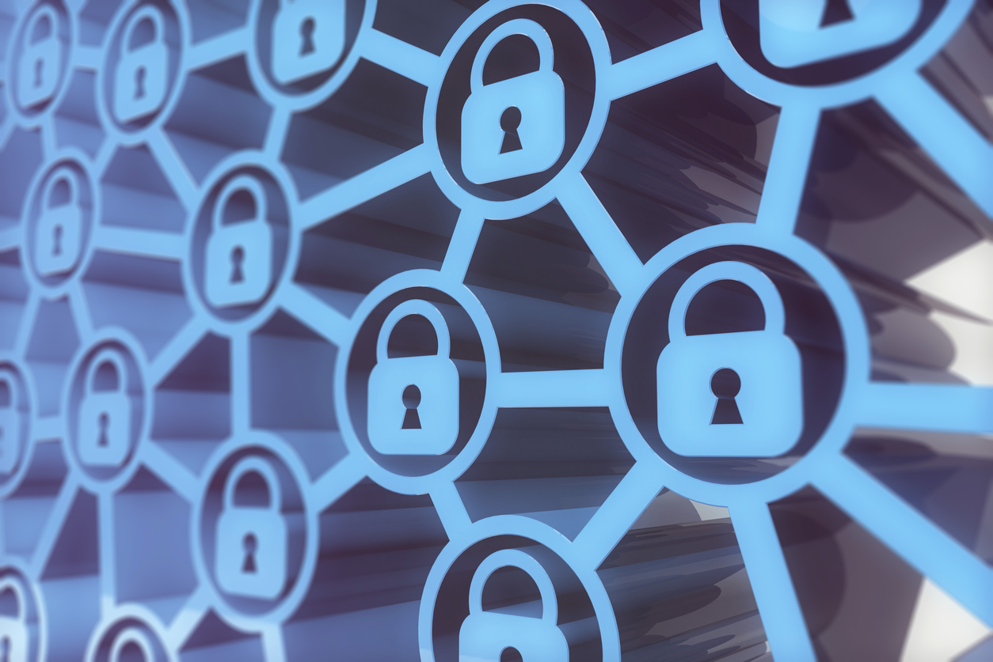
Types of Control Activities
Directive
Preventive
Detective
Corrective
Recovery
Automated
35

Slide 36

Monitoring
Are controls operating as intended?
36

Slide 37

Key Internal Controls
Segregation of Duties
Authorization and approval
Reconciliation and Review
Physical Security
37

Slide 38

Designing
Internal Controls
IN A PAPERLESS ENVIRONMENT
Establish prevention procedures
Enforce segregation of duties
Automate
Perform regular internal audits
38

Slide 39


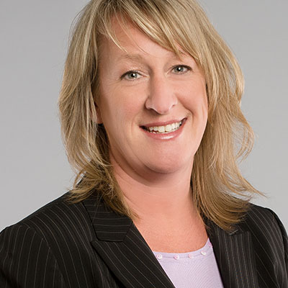

Contact Us
Lisa Trundy-Whitten, CPA
Senior Manager
ltrundy@berrydunn.com
Tina Bode, CISA, COBIT
Manager
tbode@berrydunn.com
39

Slide 40

Questions?
40

