Slide 1
Measuring What Matters –
Non-Profit Financial Metrics for Success
Webinar Wednesday April 26, 2017 – 10:00 PM EST
Presented by: David J. Fionda, MS, CPA

Slide 2
Agenda
Introductions
Success Metrics
Performance vs. Outcomes
Resources and Next Steps
Question and Answer
Summary and Wrap Up

Slide 3
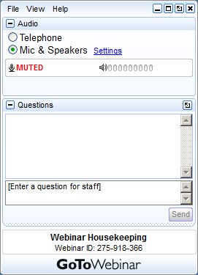

Webinar Tools
Your Participation
Please submit your questions and comments using the Questions panel. Please see example to the left.
Note: Today’s presentation is being recorded and will be provided within 48 hours.

Slide 4
Introductions
.
Notes:
Growing organizations that continue to use QuickBooks experience the following challenges:
Monthly Reporting Nightmares
Disconnected Critical Systems
Lack of Audit Trails and Controls
Month-End Close Takes Too Long
Inefficient Manual Processes
If you see any of these warning signs, you should join the hundreds of businesses like yours and
strongly consider replacing your QuickBooks
with a cloud accounting solution.

Slide 5

Today’s Presenter
David J. Fionda MS, CPA
David Fionda CPA, MS is a Director
at BlumShapiro Consulting.
He has been working with finance and
accounting systems for more than 30
years. Dave has also been a volunteer, fundraiser, executive and board member of several non-profits.
Dave is on the Executive Education faculty of Bentley University. Dave received his degree in Accounting from Bentley University and a Masters in Technology Commercialization from Northeastern University.

Slide 6






Today’s Presenter

Slide 7
POLL QUESTION #1
.
Notes:
Growing organizations that continue to use QuickBooks experience the following challenges:
Monthly Reporting Nightmares
Disconnected Critical Systems
Lack of Audit Trails and Controls
Month-End Close Takes Too Long
Inefficient Manual Processes
If you see any of these warning signs, you should join the hundreds of businesses like yours and
strongly consider replacing your QuickBooks
with a cloud accounting solution.

Slide 8
Success Metrics
.
Notes:
Growing organizations that continue to use QuickBooks experience the following challenges:
Monthly Reporting Nightmares
Disconnected Critical Systems
Lack of Audit Trails and Controls
Month-End Close Takes Too Long
Inefficient Manual Processes
If you see any of these warning signs, you should join the hundreds of businesses like yours and
strongly consider replacing your QuickBooks
with a cloud accounting solution.

Slide 9




Competition for Dollars

Slide 10

Success Metrics Defined
Demonstrate Accountability and
Transparency
Define Outcome Indicators
Balance Organizational Health
and Sustainability

Slide 11
POLL QUESTION #2
.
Notes:
Growing organizations that continue to use QuickBooks experience the following challenges:
Monthly Reporting Nightmares
Disconnected Critical Systems
Lack of Audit Trails and Controls
Month-End Close Takes Too Long
Inefficient Manual Processes
If you see any of these warning signs, you should join the hundreds of businesses like yours and
strongly consider replacing your QuickBooks
with a cloud accounting solution.

Slide 12
Mc Kinsey Strategic Planning Model
Mission & Vision
Goals & Strategies
Tactics & Activities

Slide 13
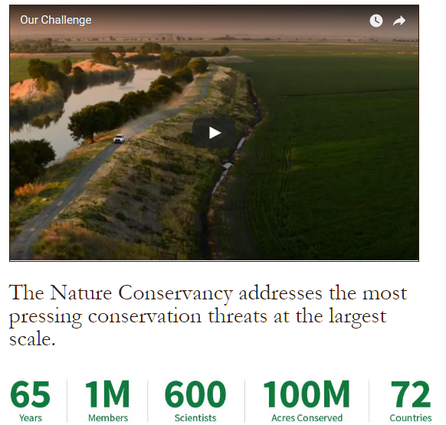

The Nature Conservancy

Slide 14
Link Metrics to Your Vision
Mission & Vision
Threat
Abatement
Impact Measures
Goals & Strategies
Projects
Launched
Activity Measures
Tactics & Activities
Members
Funding
Capacity Measures

Slide 15


The Pan Mass Challenge
Riders Volunteers Raised
6,200 4,000 $ 47 million

Slide 16
Link Metrics to Your Vision
Funding
Accountability
Stewardship
Reputation and Credibility
Growth
Impact

Slide 17

The Pan Mass Challenge
100% of every rider-raised dollar directly to the Jimmy Fund

Slide 18
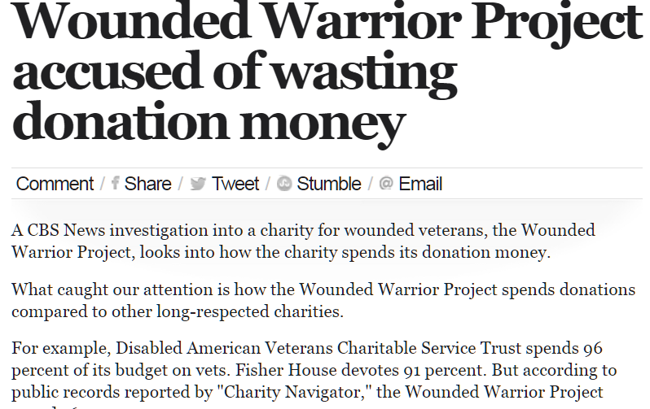
Wounded Warrior Project

Slide 19




Who’s Keeping Track?
Potential Donors
Charity Evaluators
Community
Other
Non-Profits
Fiscal Responsibility WITH Impact and Outcomes

Slide 20
Performance vs Outcomes
.
Notes:
Growing organizations that continue to use QuickBooks experience the following challenges:
Monthly Reporting Nightmares
Disconnected Critical Systems
Lack of Audit Trails and Controls
Month-End Close Takes Too Long
Inefficient Manual Processes
If you see any of these warning signs, you should join the hundreds of businesses like yours and
strongly consider replacing your QuickBooks
with a cloud accounting solution.

Slide 21
Performance or Outcomes?
What is most important to measure?
Financial Performance & Outcomes
Capacity & Sustainability
Activity/Program Success
Fundraising
Balanced Approach

Slide 22
Key Metrics – Getting Started
The key non-profit metrics
  Fundraising efficiency
  Operating reliance
  Program efficiency
Resources to help
  NTEN
  Charity Navigator
  National Council of Non-Profits
  Urban Institute

Slide 23
Ratio Calculations
Program Efficiency Ratio
Operating Reliance Ratio
Fundraising Efficiency
Program Service Expenses Total Expenses
Unrestricted Program Revenue
Total Expenses
Unrestricted Contributions
Unrestricted Fundraising
Expenses

Slide 24
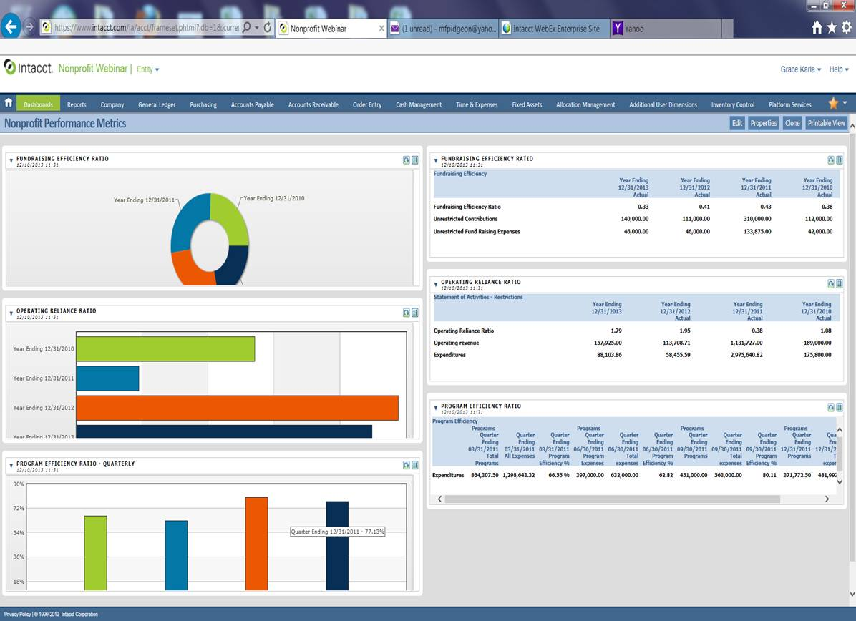
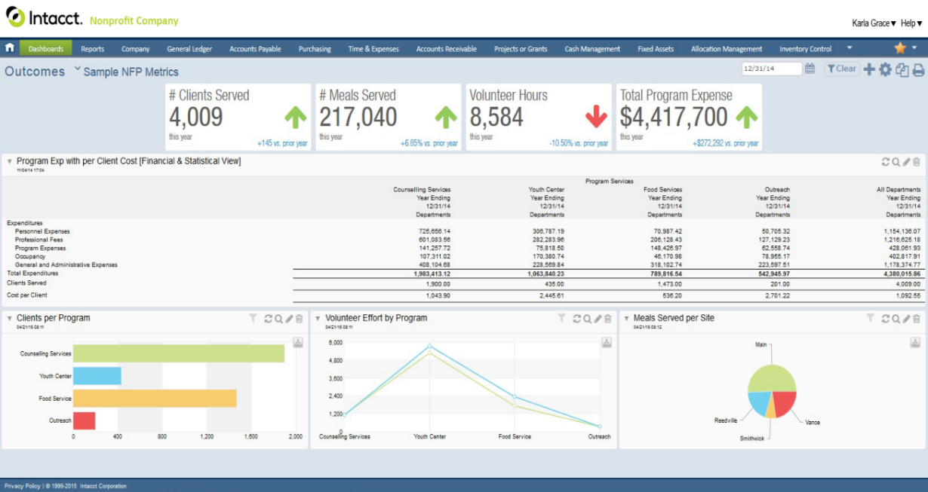
Step 1 – The Right Financial System
Statistical objects
Operational and
financial metrics
Business intelligence
and visibility
Comprehensive
automation
Lower TCO
Access and
availability
Easy integration

Slide 25
POLL QUESTION #3
.
Notes:
Growing organizations that continue to use QuickBooks experience the following challenges:
Monthly Reporting Nightmares
Disconnected Critical Systems
Lack of Audit Trails and Controls
Month-End Close Takes Too Long
Inefficient Manual Processes
If you see any of these warning signs, you should join the hundreds of businesses like yours and
strongly consider replacing your QuickBooks
with a cloud accounting solution.

Slide 26
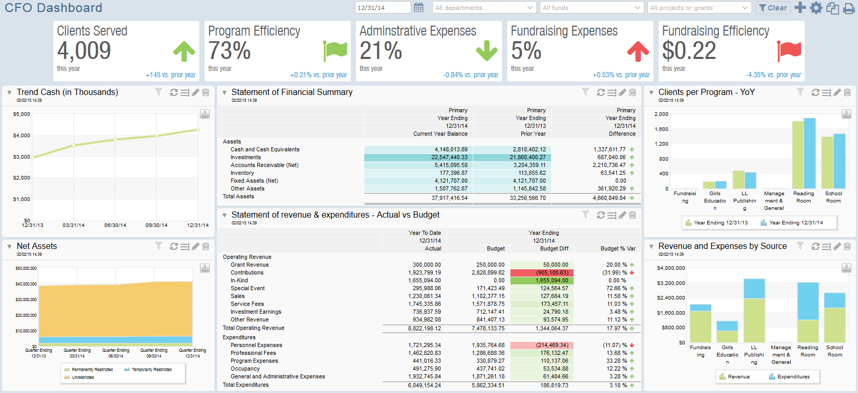
Intacct: Metrics at Your Fingertips

Slide 27
Conclusions
.
Notes:
Growing organizations that continue to use QuickBooks experience the following challenges:
Monthly Reporting Nightmares
Disconnected Critical Systems
Lack of Audit Trails and Controls
Month-End Close Takes Too Long
Inefficient Manual Processes
If you see any of these warning signs, you should join the hundreds of businesses like yours and
strongly consider replacing your QuickBooks
with a cloud accounting solution.

Slide 28
Q & A
.
Notes:
Growing organizations that continue to use QuickBooks experience the following challenges:
Monthly Reporting Nightmares
Disconnected Critical Systems
Lack of Audit Trails and Controls
Month-End Close Takes Too Long
Inefficient Manual Processes
If you see any of these warning signs, you should join the hundreds of businesses like yours and
strongly consider replacing your QuickBooks
with a cloud accounting solution.

Slide 29
Thank You
For the next 30 days, we are offering
you a complimentary review and
analysis of your finance system
with a prepared report on its ability to
measure outcomes and success metrics.
We will also provide you with a free
subscription to our Cloud Accounting
Blog , which focuses on technology for
Non-Profits.
You will receive an email following the
webinar with additional details on these
offers.
David J. Fionda CPA
BlumShapiro Consulting
dfionda@blumshapiro.com
781-610-1206

