Slide 1


Leveraging Your Organization’s Creativity: Legal Guidance
December Webinar
Presented by Tennant Lubell, LLC
Thanks for joining us! A few instructions before we begin:
You may join the audio by selecting the radio button for either “Telephone” or “Mic & Speakers.” If you are using telephone, please dial in with the conference line and audio pin provided.
If you are having any technical issues, please let us know in the chat box.
We will have time for Q&A. Please enter your questions in the chat box at any time.
This webinar is being recorded, and we will distribute the recording after the webinar.
Marta Hodgkins-Sumner
Director of Membership and Programs
www.massnonprofitnet.org

Slide 2
Repurpose materials the organization has developed to generate new sources of revenue.
Extend the reach of the organization’s ideas.
Advance the organization’s mission and contribute to its goals of impact and sustainability.

Slide 3




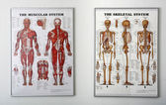


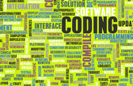
Examples:
collections
training materials
methodologies

Slide 4
Assumptions abound as to what can and cannot be done in nonprofit organizations.
“I don’t think we’re allowed to charge anything.”
“The funder won’t let us.”
“We can’t use those materials. The government owns them.”
“We’re not allowed to make a profit.”
Unless these issues are clarified, opportunities to benefit from the materials may be lost.

Slide 5
If you have materials that you think may be good candidates for repurposing, these are the questions you should ask:
Will repurposing the materials advance your organization’s mission?
Does your organization own adequate rights to the materials to be able to repurpose them?
Is your plan feasible from a business perspective?

Slide 6
Will repurposing the materials advance your organization’s mission?
Beware of “mission creep.”
Don’t get sidetracked by visions of wealth!
Be aware of whether you are generating “unrelated business income,” and track the income carefully if you are.

Slide 7
“Unrelated business income” is income generated from an activity that:
is a trade or business
carried on regularly
that is not substantially related to furthering the exempt
purpose of the organization.
Unrelated business income is subject to taxation, and too much
of it can jeopardize tax-exempt status.

Slide 8
General unrelated business income requirements:
An exempt organization that has $1,000 or more of gross income from an unrelated business must file Form 990-T.
The organization must pay estimated taxes if it expects its tax for the year to be $500 or more.
Unrelated business income is generally limited to 30% of total organizational income in order to maintain tax exempt status.

Slide 9
Is repurposing your collection a good plan?
Educational organization with a collection of 75-year old photos, produced as part of a Foundation-funded project, for teaching about physics and movement.
Repurpose for an exhibit to showcase the achievements of your organization.
versus
Repurpose by licensing the photos on an ongoing basis to sci-fi film producers.

Slide 10
If you have materials that you think may be good candidates for repurposing, these are the questions you should ask:
Will repurposing the materials advance your organization’s mission?
Does your organization own sufficient rights to the materials
to be able to repurpose them?

Slide 11
Ownership of rights to adapt, reproduce and sell are generally known as “intellectual property rights.”
Copyrights - original works of authorship that can be perceived, reproduced, or otherwise communicated.
Examples:
printed works
computer-based works
still photographs
video and audio recordings
films
visual aids

Slide 12
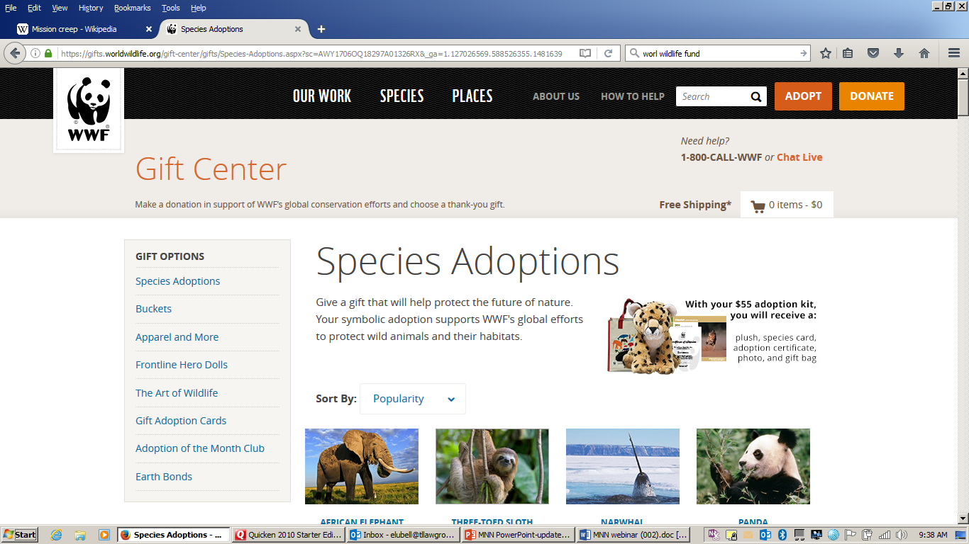


Ownership of rights to adapt, reproduce and sell are generally known as “intellectual property rights.”
Copyrights
Trademarks and logos – words and symbols that identify products or services, used to establish a “brand.”
Examples of trademarks:

Slide 13
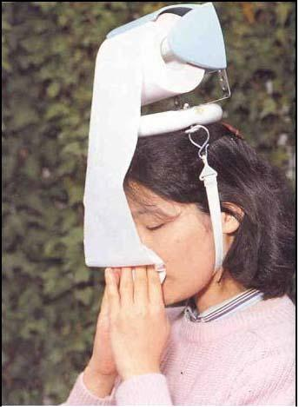
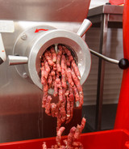
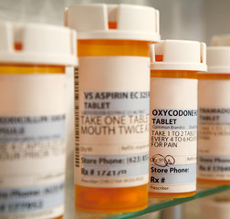
Ownership of rights to adapt, reproduce and sell are generally known as “intellectual property rights.”
Copyrights
Trademarks and logos
Patents – inventions and processes
Examples of patented inventions:

Slide 14
Is repurposing your training manual a good plan?
Organization with a mission of substance abuse prevention has a 10 year-old print training manual focused on the workplace.
Repurpose it to create an online interactive program for at-risk high school students in the region.
Does your organization own adequate rights to the training manual to be able to repurpose it for the new program?

Slide 15
To understand the rights to the training manual, you’ll need to ask:
What were the terms of original grant?
If you can repurpose the manual, are you permitted to sell or license the adapted version?
Will you have any obligation to credit the funder? Or, does the funder require you to use a disclaimer?
Did you co-author the manual with another organization?

Slide 16
If you don’t have the necessary rights, try asking for permission.
Make sure the permission is in writing and addresses:
the time frame for use
the amount that can or must be used
the form or medium
the territory
whether you can create derivative works
whether you can allow others to use
whether acknowledgments or disclaimers are required

Slide 17
If you have materials that may be good candidates, for repurposing, these are the questions you should ask:
Will repurposing the materials advance your organization’s mission?
Does your organization own sufficient rights to the materials to be able to repurpose them?
3. Is your idea feasible from a business perspective?

Slide 18
Is your plan to repurpose a methodology by developing and licensing software feasible from a business perspective?
Organization focused on health care delivery, which has developed a methodology for collecting and analyzing clinical data to measure effectiveness of an intervention.
Repurpose the methodology by developing software that collects and analyzes data far more efficiently, and license the software to other organizations.
Is this feasible from a business perspective?

Slide 19
To understand is your plan is feasible froma business perspective, you’ll need to ask:
Will there be development costs?
Is there a market?
If you are permitted to charge a fee, would it benefit your organization’s image to charge a fee?
Will your organization be restricted in its use of the revenue?
Will the software expose the organization to any new liability?

Slide 20
Your materials can be a source of benefit or liability depending on how they are managed.

Slide 21
What can you do to increase opportunities for the future?
Periodically assess the materials your organization creates and develop an inventory.
Put practices in place to address ownership and use of the materials your organization creates.

Slide 22
Practices that address ownership and use of the materials your organization creates:
Foster a workplace where everyone understands the importance of appropriate maintenance and dissemination of materials.
Use employee confidentiality and “work for hire” acknowledgements.
Be aware of funder policies on ownership and use of materials.
Make sure consultant, vendor, and subcontractor agreements address ownership and use of work product.

Slide 23
You can leverage your organization’s creativity by repurposing materials you’ve developed, but you have to do so carefully:
Make sure your plan will advance your organization’s mission.
Make sure you have the legal rights you need.
Make sure you’ve done a thorough business analysis.

Slide 24
Questions?

