Slide 1
Making The Ask
Creating Effective Appeals
2016 MNN Annual Conference

Slide 2
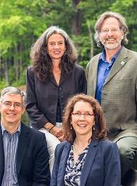
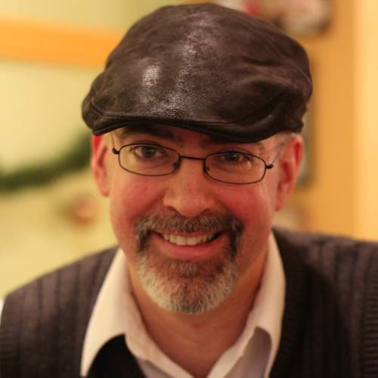
RAINMAKER Consulting
Fundraising Consulting
Strategic Planning
Executive Coaching
Organizational Development
Eric Phelps - Principal

Slide 3
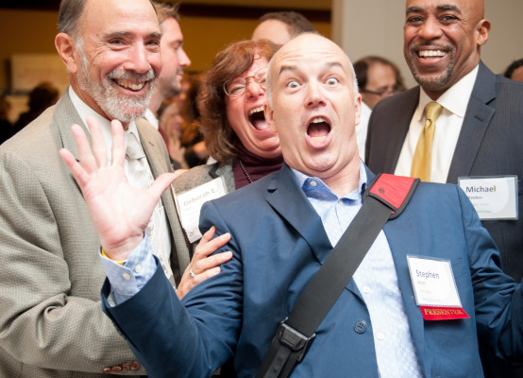
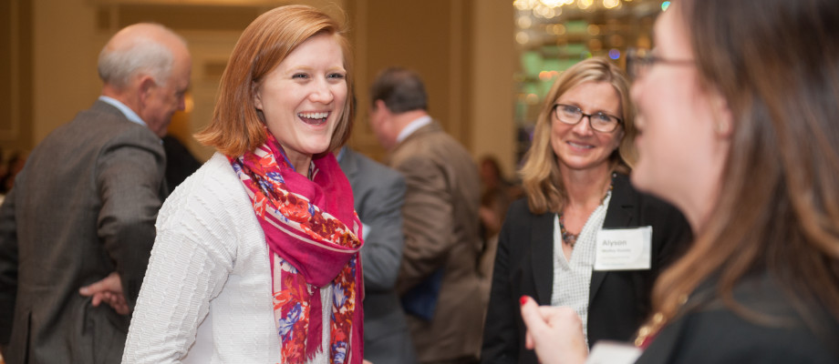
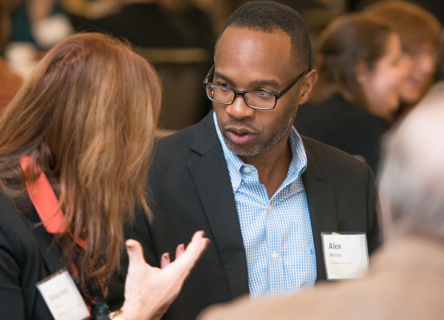
Who Are We? Who’s in the Room?

Slide 4
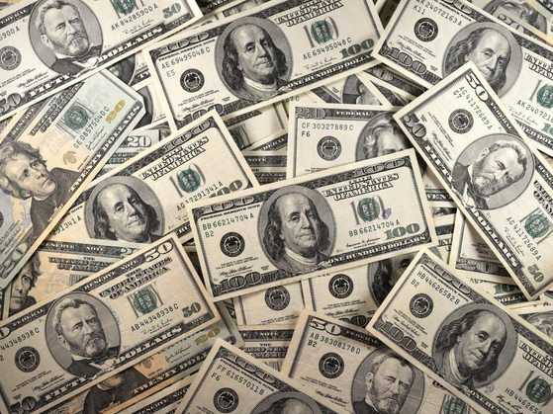
What is the possibility of individual giving?
Total Giving in US 2014?
$358.4 Billion
Up 5.4% from 2013
Individual Giving makes up 72% ($258.04B)
87% if you add Planned Giving
Source: Giving USA 2015 Report

Slide 5
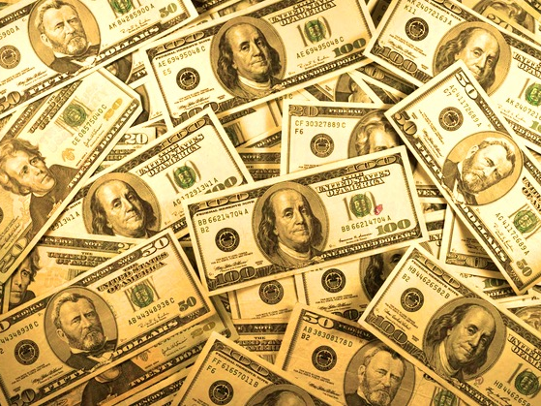
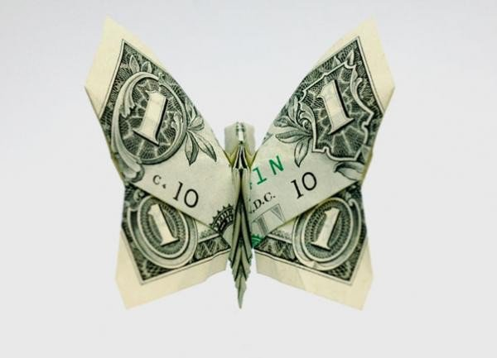
What would new funding enable you to do?

Slide 6

X

Slide 7
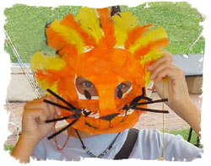
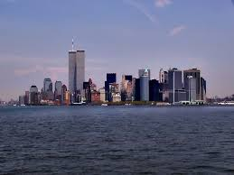
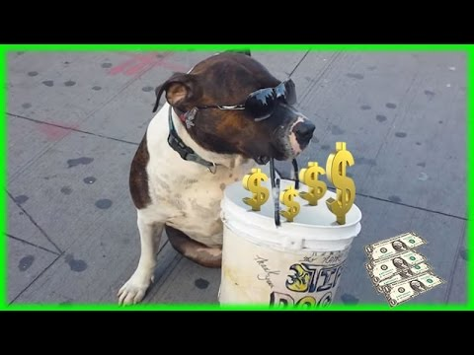
l
… without your support, there will be a hole left in our organization like the hole at Ground Zero…

Slide 8
How Did Campaign Do?
Cost ~$2,000 to send campaign letter (+ Staff and Committee time)
Garnered ~$3,500 in contributions
20% of the previous year’s total (down 80%!)
Resulted in loss of $20,000 gift from donor
Undermined organizational credibility

Slide 9

Attempted to tie to a “current” event (but was not relevant)
Addressed the audience from a position of weakness
Used guilt as a fundraising tactic
Did not tell a story
Was not believable
Was tacky & offensive

Slide 10
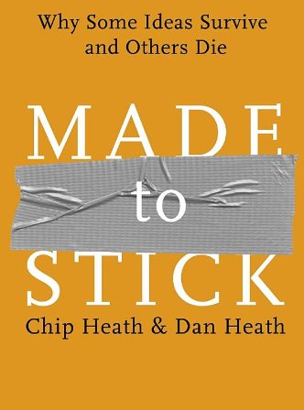
Simple
Unexpected
Concrete
Credible
Emotional
Stories
(short)
SUCCESs!

Slide 11

“Stickiness”…
Gets attention
Is memorable
Inspires people to act
(Purchase, share, discuss, donate, petition, etc)
Gets Shared

Slide 12
Our Campaigns
Tend to…
Could…
Talk about ourselves with internal jargon
Talk about our outputs
Tell a good story, then… (See above)
Include too much information
Forget the Matterness
Yadda yadda yadda
Make connections to donors
Make a case for our impact
Tell a good story (Stop)
Include enough information
Include Matterness
That’s it!

Slide 13
Simple
Don’t “Bury the Lead”
“If you say three things, you don’t say anything”
Don’t try to tell everyone everything
Names, Names, Names – Local Connections
Core + Compact
Use Generative Analogies
Jaws on a spaceship (Alien)

Slide 14
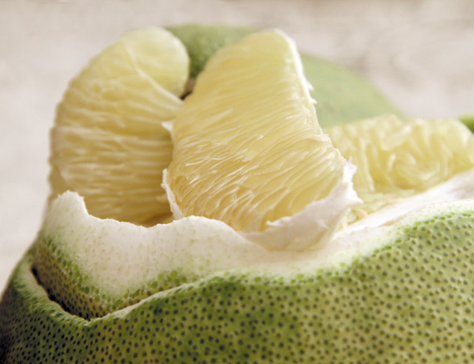
Polemo Schema
A polemo is the largest citrus fruit. The rind is very thick but soft and easy to peel away. The resulting fruit has a light yellow to coral pink flesh and can vary from juicy to slightly dry and from seductively spicy-sweet to tangy and tart.
A polemo is a super-sized grapefruit with a very thick, soft rind.

Slide 15



Simple
Help is a four-legged word
Our vision doesn’t require sight
Finding a cure now… so our daughters don’t have to

Slide 16
Make Meaning
Kenneth L. Peters, the Principal of Beverly Hills High School, announced today that the entire high school faculty will travel to Sacramento next Thursday for a colloquium in new teaching methods. Among the speakers will be Margaret Mead, college president Dr. Robert Maynard Hutchins, and California governor Edmund “Pat” Brown.
There will be no school next Thursday!

Slide 17
Unexpected
Surprise brow, https://www.youtube.com/watch?v=pRh1xH_oBOo

Slide 18
Unexpected
Create curiosity – Gap Theory
Gaps start with some knowledge
Start now with providing knowledge and lead to May 3
Use joke structure: “One of these things is not like the other”
Be creative!

Slide 19
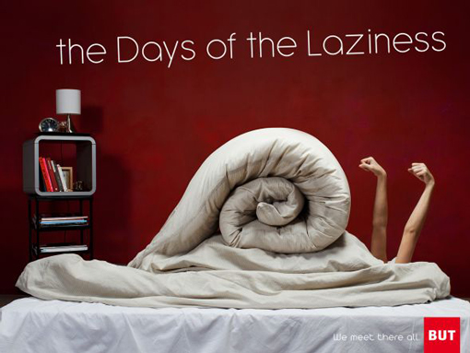
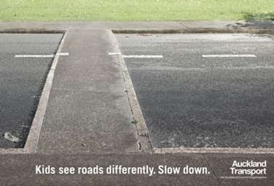

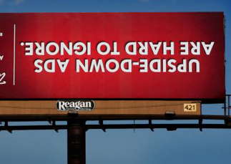

Slide 20
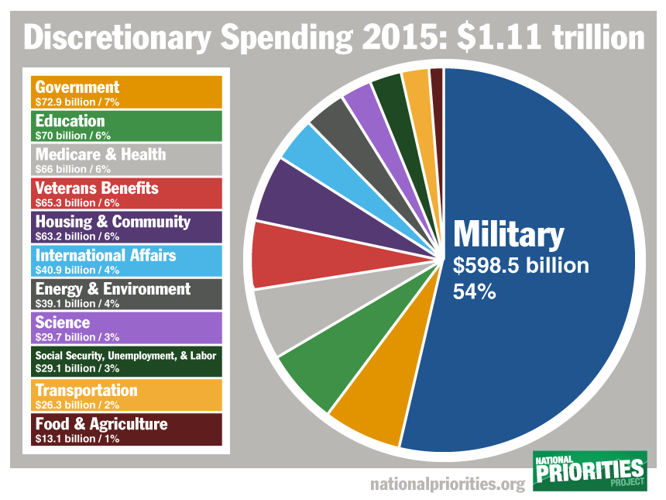
Concrete

Slide 21
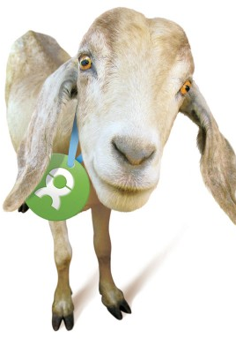
Tie Gift to Impact
Meals provided
Clients/patients served
Jobs created
Carbon offsets
Change
Goat - $50
No kid-ding here—this gift is an invaluable resource for rural communities.

Slide 22
Credible
Source: DEYTA/Medicaid

Slide 23
Emotional
Video, Love Has No Labels
https://www.youtube.com/watch?v=PnDgZuGIhHs

Slide 24
Emotional
Carnegie Mellon Study – 2004
Informational Appeal - $1.26
Story Appeal - $2.38
Mixed Appeal - $1.14
Primed for Emotion - $2.41

Slide 25
Story
One day during a meeting at work, I noticed a flash appearing out of the corner of my eye. I thought it was a reflection from the overhead lights, but then it happened again when I went home. It even happened when I closed my eyes – so I knew I needed to see an optometrist. The next day, I made the appointment, but it required a referral from my primary care physician. So I called his office as formality and to address the problem with my vision.
It turned out that I had not had a full physical in quite some time (which my doctor was quick to point out). In exchange for the referral, I agreed to have him check me out the following week…

Slide 26
Story
My heart began racing when I heard, “Everything checked out fine, except that I felt something on your prostate.” Incredulous, I said, “But I came in for my eye!”
From the beginning, Cancer Connection provided me with support, answered my questions, and made me feel like I had people to talk with who had gone through what I was facing…

Slide 27
SUCCESs-ful Videos
Follow The Frog
Charity: Water
Alex: Childhood Cancer Slayer
Office of Letters and Light
Anti-bullying PSA “Who Will Stop The Bullying?”
First World Problems
Africans for Norway
First World Problems Anthem

Slide 28
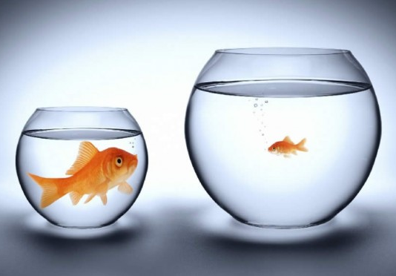
One Size…
Use Data Segmentation to customize your messages
Consider in cultivation, solicitation, stewardship
Further Discussion: April 7th Knowing Your Donors

Slide 29
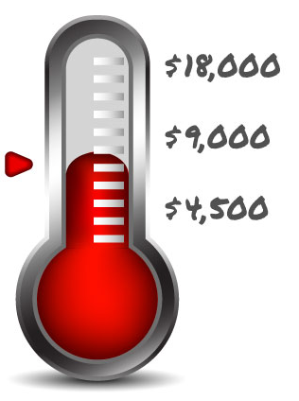
Campaign Goals & Focus
Matching Grants
Board
Business
Major Donor
Particular programs
Incentivize campaigns (end of year, balance budget, complete a campaign)
Stay unrestricted
Amplify success
Peer Network Fundraisers

Slide 30

Channels
Email
Social Media
Facebook
Twitter
LinkedIn
Live events
Your web site
Peer Fundraising

Slide 31





Clear Call to Action

Slide 32

Share Pair Exercise
Share a story about your organization that incorporates SUCCESs-ful principles

Slide 33
Notes:
Sample Letters

Slide 34

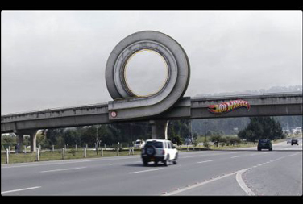

Draft or Outline a letter that incorporates SUCCESs-ful Principles

Slide 35
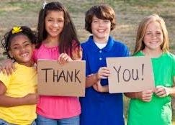


THANK YOU!!!
THANK YOU!!

Slide 36
No, Seriously…
Among those who didn't renew their annual contribution, many cite the fact that they were not thanked as a primary reason (2012 Giving Survey)
Individualized stewardship is easy, fun, and perfect for participants or board members! (Be sure to get their name right!)
People cannot be “over-thanked”!
Go “old school” and use a pen, paper, postcard.
It is not too late to thank someone…

Slide 37

Thank You!
Eric Phelps
eric@rainmkr.com
Twitter @rainmkr
@ericlphelps

