Slide 1
Selling social change
Why ‘build it and they will come’ doesn’t work and what to do about it
November 2, 2016

Slide 2

Who we are
13_84 12_88
About us: The Bridgespan Group is a nonprofit advisor and resource for mission-driven organizations and philanthropists
Mission
  We work to build a better world by strengthening the ability of nonprofit organizations to achieve breakthrough results in addressing society's most important challenges and opportunities.
History
  Founded as a nonprofit organization in 2000, incubated by Bain & Company
  Offices in Boston, New York, San Francisco, and Mumbai, India
  210+ staff
Engagements
  1000+ nonprofits, foundations, and philanthropists globally
Approach
  Through active listening and discussion, and data-driven, rigorous analysis, we collaborate with leaders to create customized and practical solutions that can be measured and adapted
  Close work with clients to develop practical solutions informed by rigorous analysis

Slide 3
What we do
3_84 9_84
Strategy
Consulting
We collaborate with social sector leaders to help scale impact, build leadership, advance philanthropic effectiveness, and accelerate learning
We work on issues related to society’s most important challenges and breaking cycles of intergenerational poverty
Philanthropy
Advising
Leadership
Development
Knowledge
Sharing

Slide 4

The Need = Demand Fallacy

Slide 5
3 Keys to generating demand
3_88 11_88 12_88
1
Design spreadable programs
2
Target early adopters
3
Invest in a salesforce

Slide 6



Design spreadable programs
15_84
1
Better
Compatible
Simple
Testable
Observable

Slide 7


Design spreadable programs
1

Slide 8

Design spreadable programs
13_84
1

Slide 9


Target Early Adopters
2

Slide 10
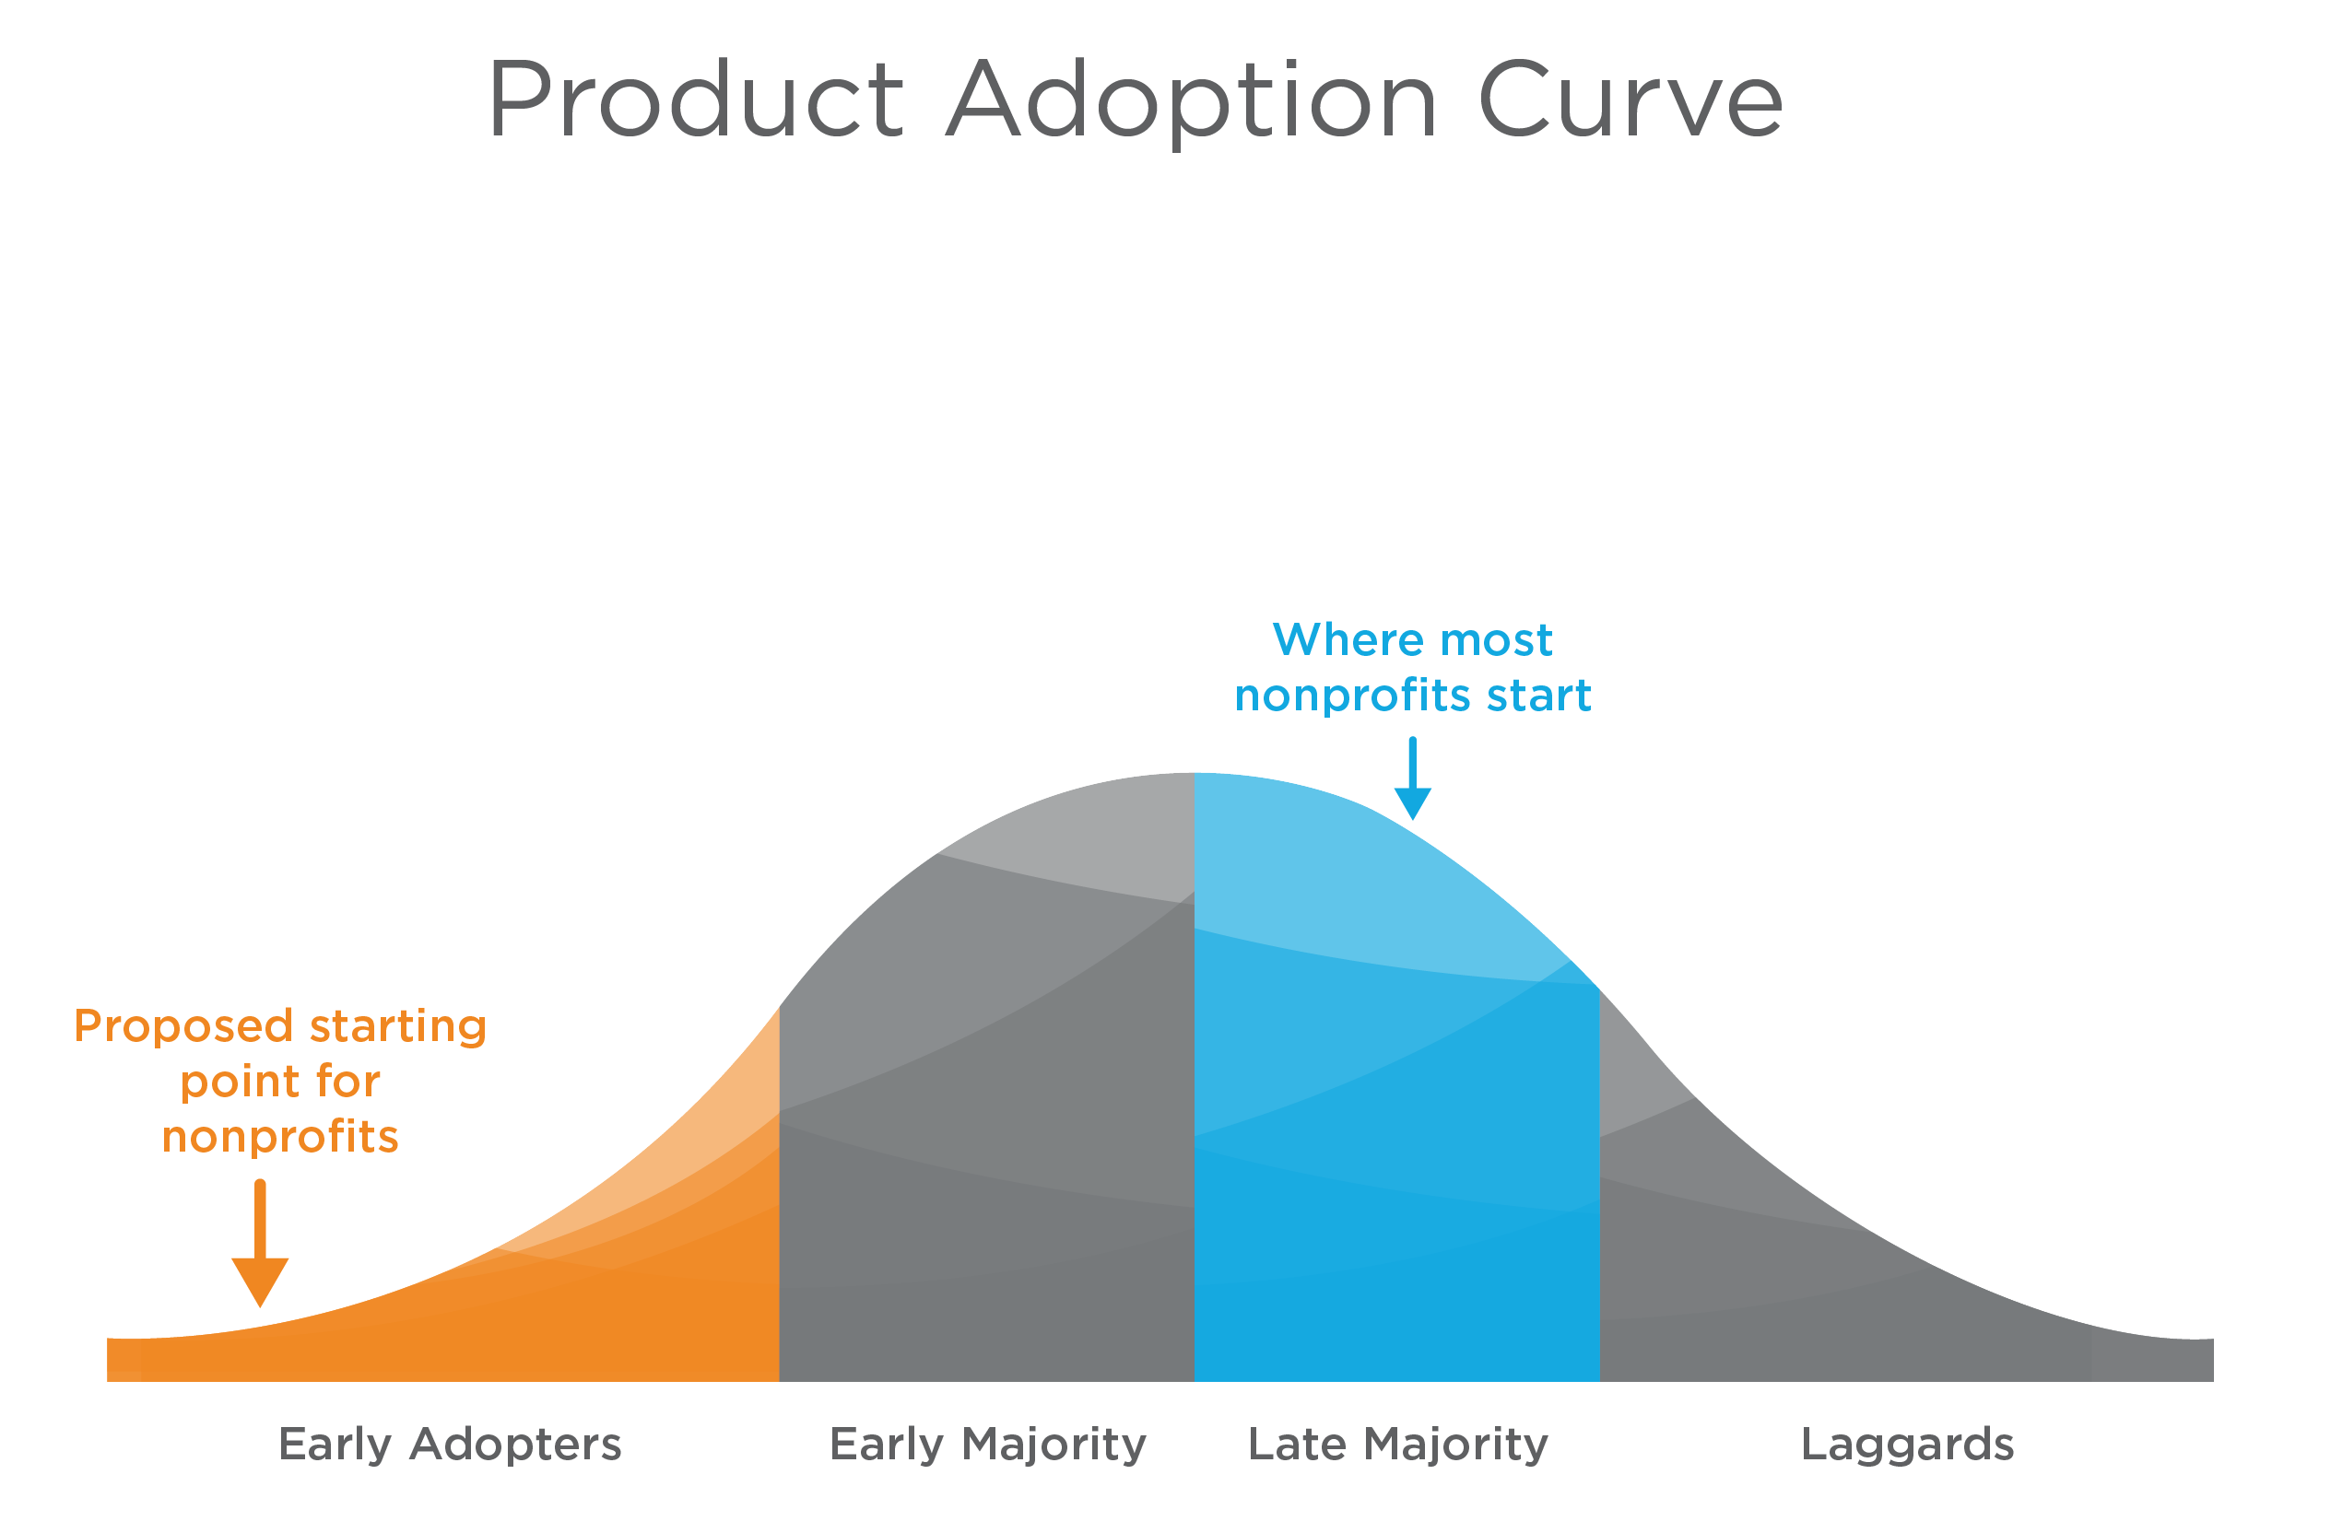
Target Early Adopters
2

Slide 11


Target Early Adopters
16_84
2

Slide 12

Target Early Adopters
17_84
2

Slide 13
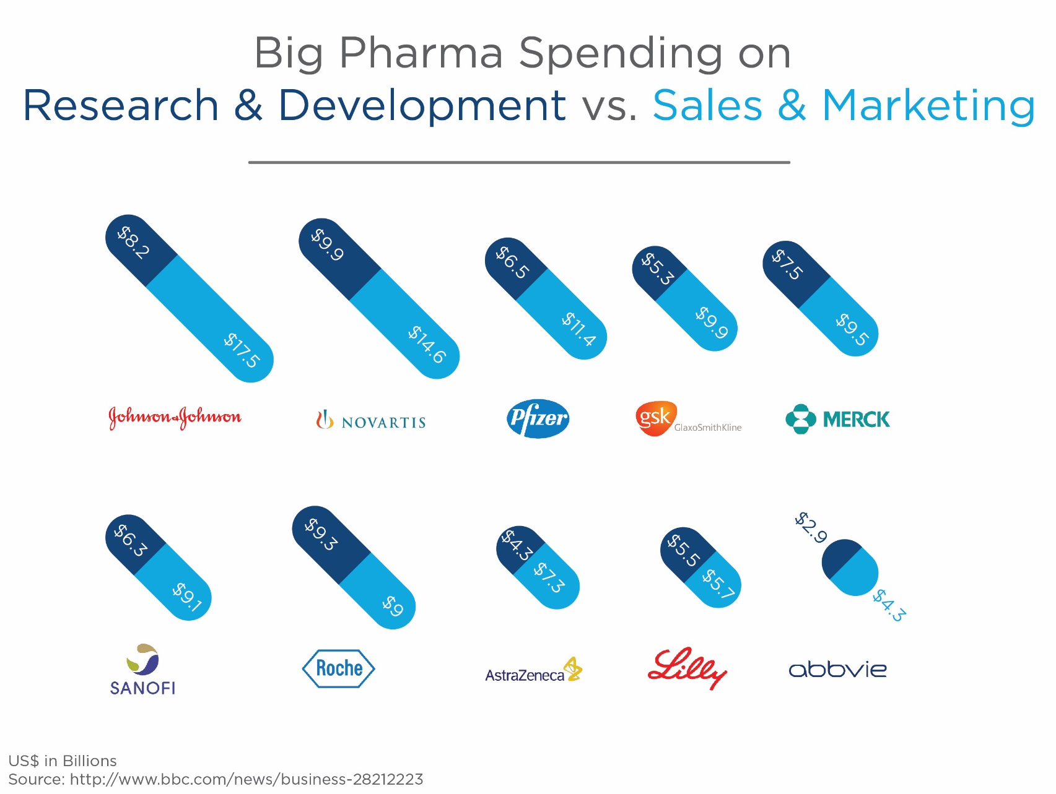
Invest in a salesforce
3

Slide 14


Invest in a salesforce
14_84
3

Slide 15

Bringing it all together

Slide 16



Helpful consulting firms
3_88 4_88 5_88
Human-Centered Design
Behavioral Science
Marketing

Slide 17
Worksheet: Pick a demand challenge
Question |  | Response
Service/ Product | For which service or product are you having challenges generating demand?
Target Population | From whom are you trying to generate demand?
Existing Demand | How many people are currently participating in or using your service or product?
Need | How large do you estimate the need to be for your service or product?

Slide 18
Worksheet: Design Spreadable Programs
Characteristics | How would beneficiaries rank your service/ product today? | How might you improve this ranking?
Better than what exists (both costs and benefits) | High Medium Low
Compatible with beneficiaries’ values, past experiences, and needs | High Medium Low
Simple to use (or do) and understand | High Medium Low
Testable without having to commit to it | High Medium Low
Observable such that others can see the benefit of adopting it | High Medium Low

Slide 19
Worksheet: Target Early Adopters
Step | Question | Answers
Define your target population | How would you describe your target population?
Identify your early adopters | Which portion of your target population knows they have a problem your service/product can solve and is looking for ways to solve the problem?
Determine how to selectively target early adopters | What are your early adopters’ characteristics or activities that would enable you to selectively target them? What characteristics make them distinct from the rest of your target population?

Slide 20
Worksheet: Invest in a Salesforce
Step | Question | Answers
Identify existing salesforce(s) | Is anyone already selling to your target population that you could partner with? If so, who?
Determine sales channels | Through what methods or means can you engage your target beneficiaries?
Identify influencers | Do your target beneficiaries have key influencers you should sell on your service/product first to build a referral base?
Describe needed capabilities | What types of capabilities would your organization overall or a sales team need to engage your beneficiaries and/or influencers?

Slide 21
Join the conversation
Transformative Scale Resource Center & Blog
www.Bridgespan.org/Transformative-Scale
Twitter
#TransformativeScale
Contact Us
Matthew.Plummer@Bridgespan.org

