Slide 1
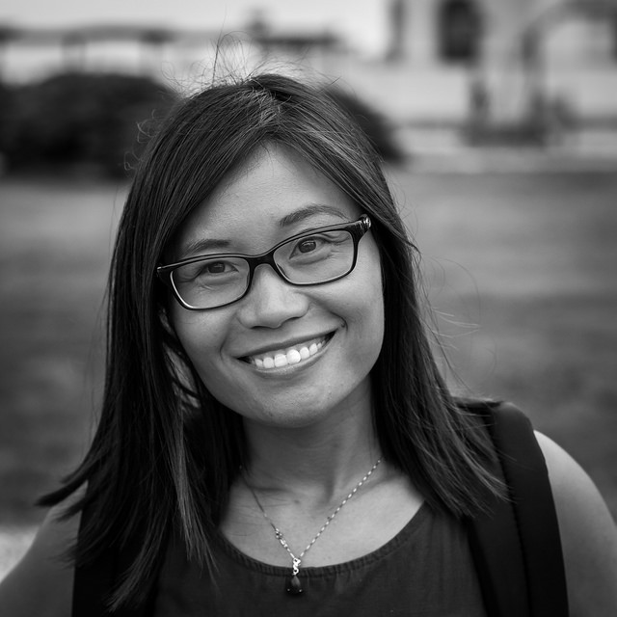

Matter More
Do More
Raise More
Mass Nonprofit Network Annual Conference 2016
Notes:
https://www.flickr.com/photos/131814204@N04/28508432803/

Slide 2
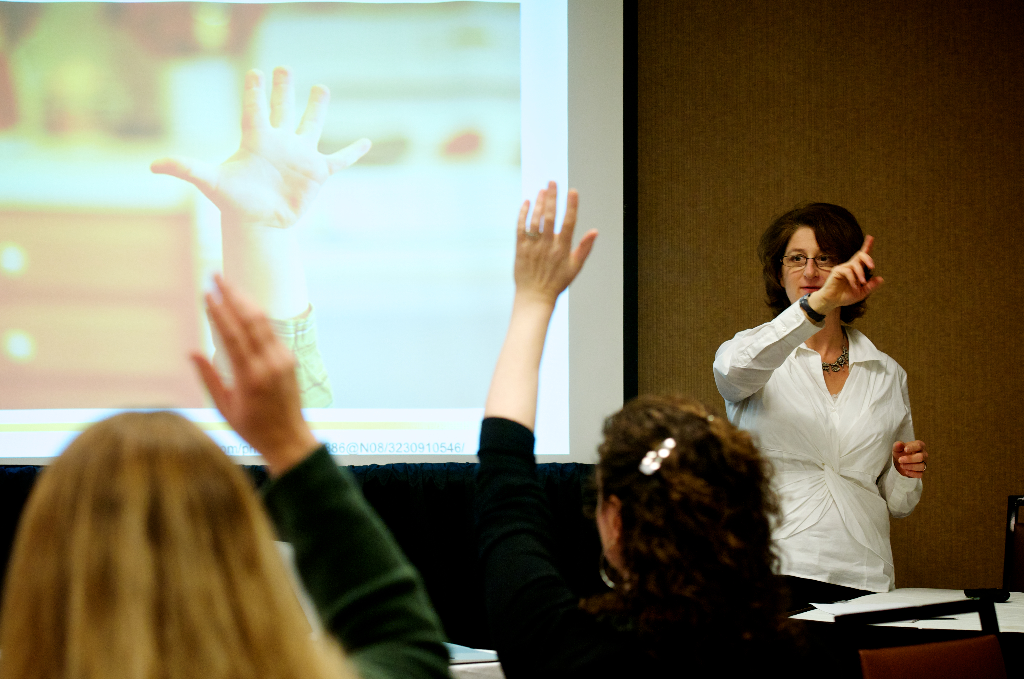
Debra Askanase
Social media & digital engagement strategy for mission-driven orgs since
2009
Tweet your “aha!” moments
@askdebra

Slide 3

Who’s in the room?

Slide 4


Slide 5
People don’t feel as if they matter
“Why don’t you talk to me like a person?”
“I’ve been a member for years!”
“You keep misspelling my name”
“I never got a thank you”

Slide 6
Matterness is a different way of working that turns passive stakeholders into active participants by making each person
known, acknowledged & invested
in your success.
Notes:
Matterness is the solution

Slide 7
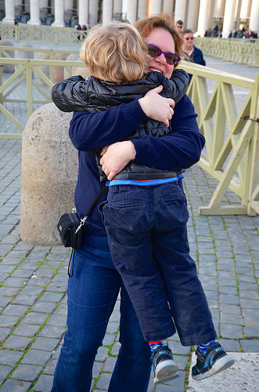
When has an organization or person made you feel
…like you matter?
Notes:
https://www.flickr.com/photos/40646519@N00/29342436224/

Slide 8
Why is Matterness so important?
Our stakeholders have a lot of choices
We need our resources to go further
Donor retention
Organizational sustainability
Countering negative publicity
Moving stakeholders to action!
Notes:
DELETE

Slide 9
Matterness is working with and not at people
Creating ways for people to participate
Being in conversation online and on land
Opportunities for supporters to tell their own stories
Opportunities to connect with each other
Leading by following
Treating everyone like people
Being real online

Slide 10
Do More, Matter More,
Raise More
Org Culture/Personal Engagement
Stakeholder Engagement
Capital
Unleashed
Notes:
Org culture is deeply intertwined with leadership. This is something that comes from the top and is part of the DNA of the org.

Slide 11
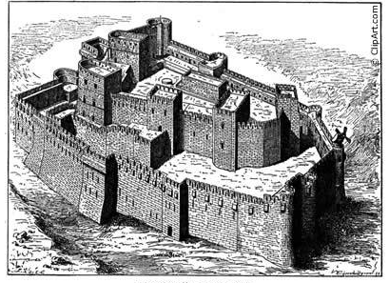
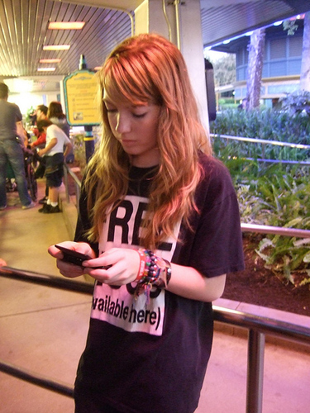
Org Culture
http://www.flickr.com/photos/47817241@N00/4094538566/
Notes:
Digital natives, 70+million, anti-institutional, cause but not nonprofit-oriented

Slide 12
Internal tensions can obstruct
Fear of losing control
Busyness trap of transactions
Push & pull of broadcasting content vs. online engagement
Need to raise money
Limited staff time
Hard to simultaneously “do the work” and strategize
And...?
Notes:
Everyone knows they want to practice Matterness, but there are these tensions that overwhelm. Orgs are determined to be busy. These tensions need to be conversation starters.

Slide 13
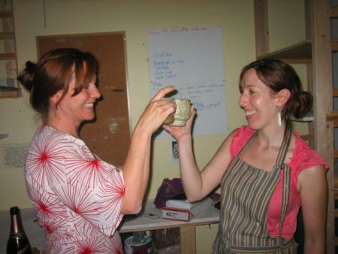

Part of the culture: #GivingTuesday
Notes:
If you can break through this.

Slide 14
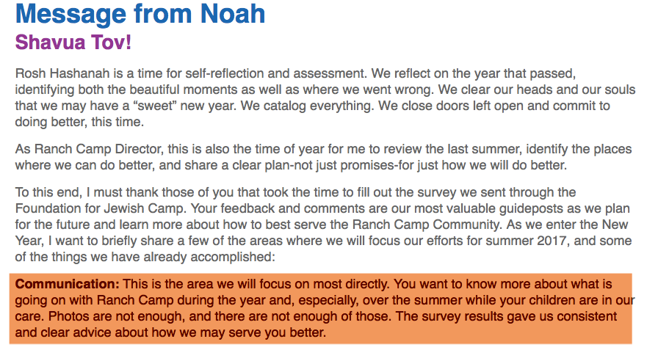

Slide 15
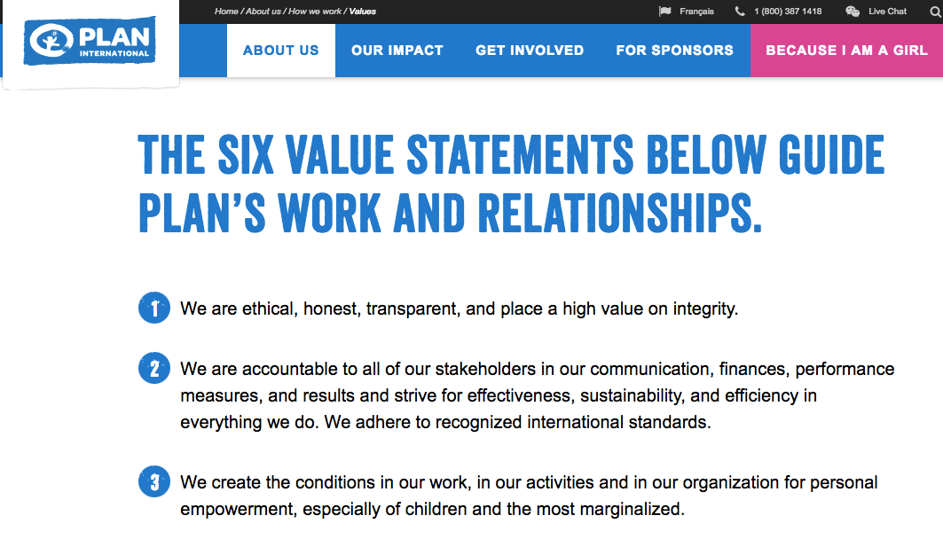
http://plancanada.ca/values

Slide 16
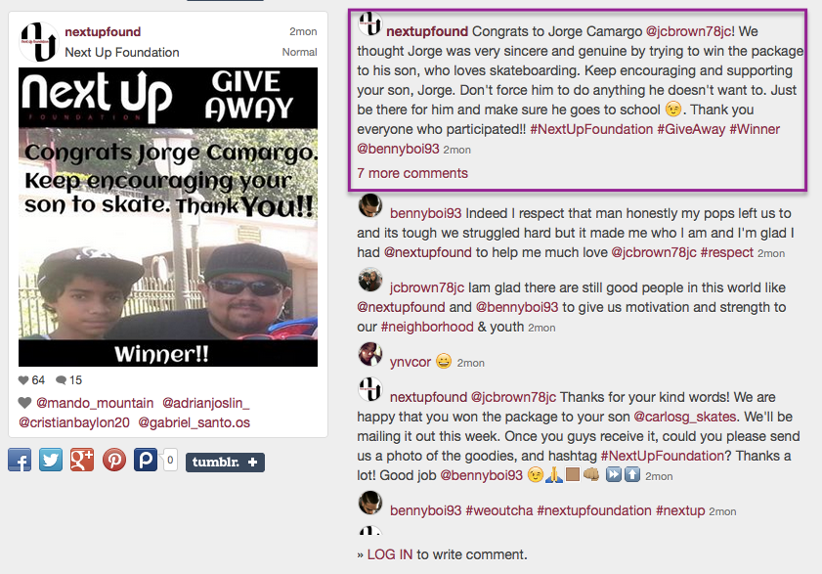

Slide 17
“Culture eats strategy for breakfast.”
Peter Druker,
“Father of modern business”
Notes:
Org culture is deeply intertwined with leadership. This is something that comes from the top and is part of the DNA of the org.

Slide 18
Share Pair Exercise
What is holding your organization back from implementing Matterness?
Notes:
Know what matters most to them, and when your organization has made them feel as if they don’t matter. Make time and space within your organization for thinking about this. What will make them feel like they matter, and aren’t just a number, dollar or percentage point? Or an ATM machine?

Slide 19
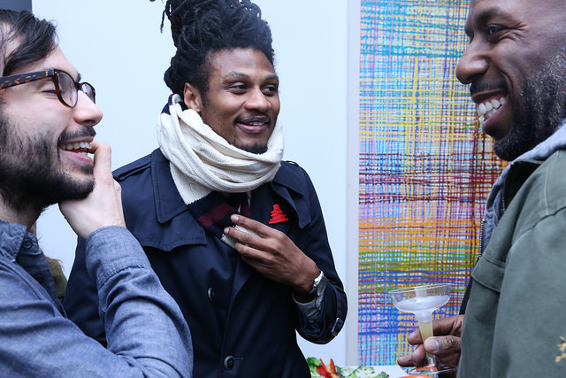
Personal engagement
https://www.flickr.com/photos/29155497@N06/23295108320/

Slide 20
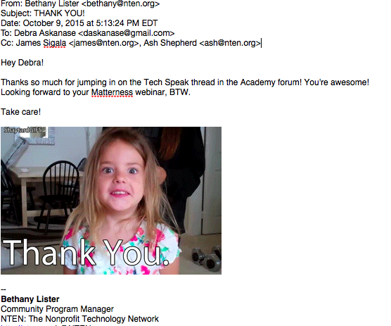
Notes:
Two caveats: Matterness can be done in small doses

Slide 21
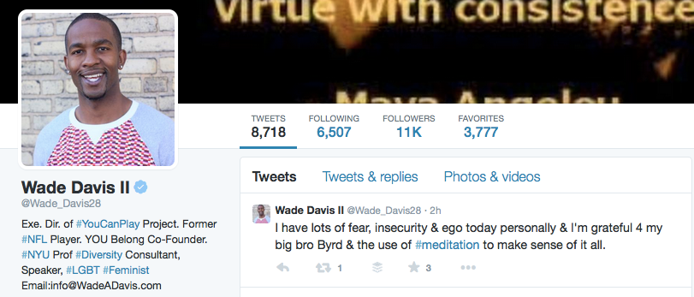
You have to be yourself to create connections

Slide 22
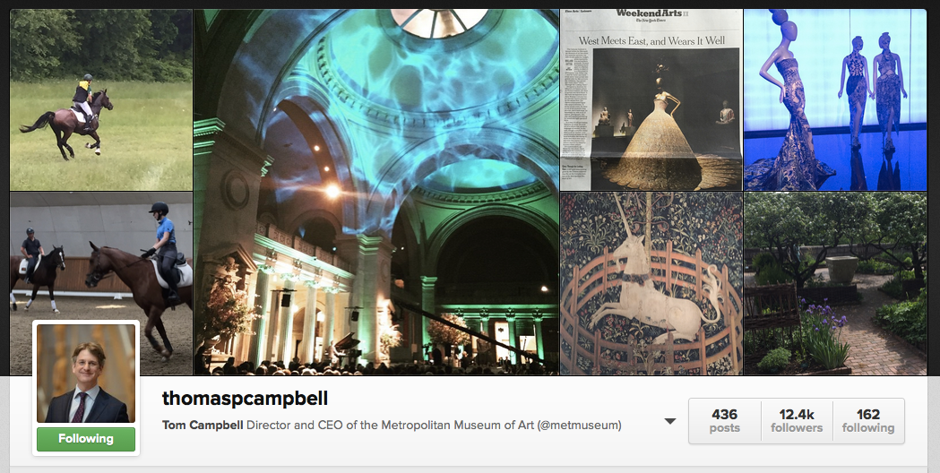
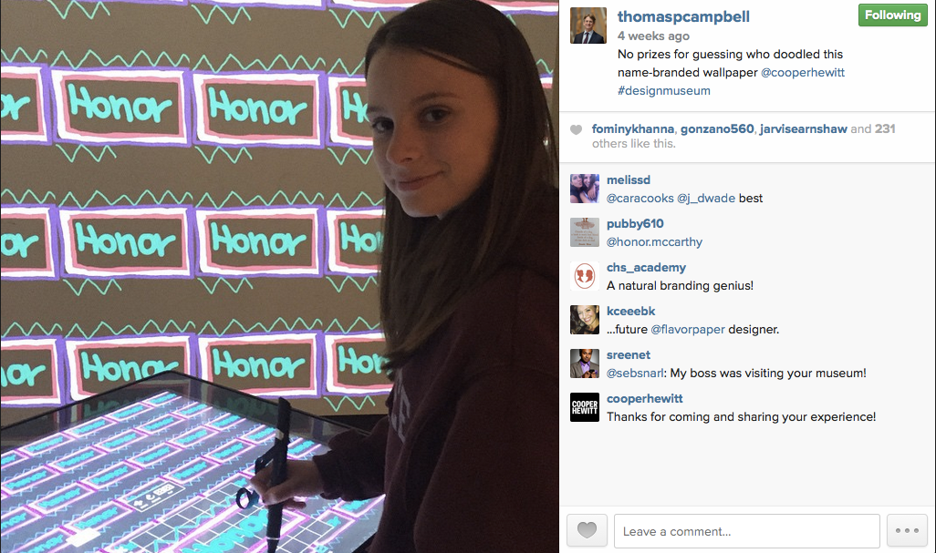
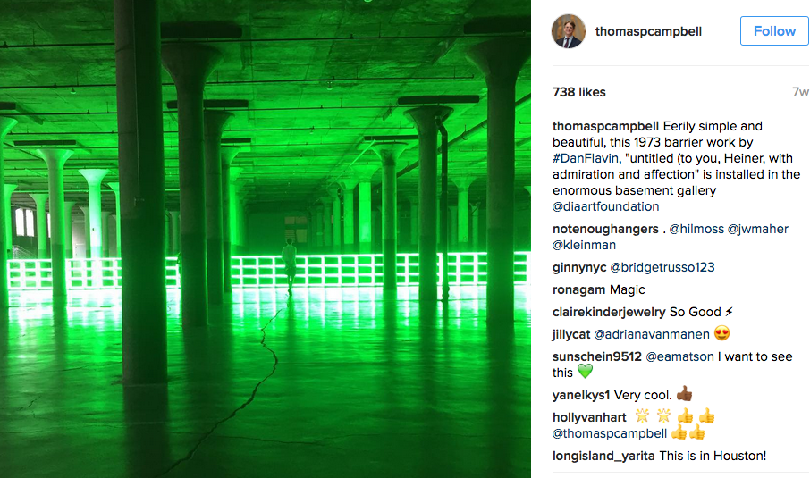
Notes:
Leadership

Slide 23
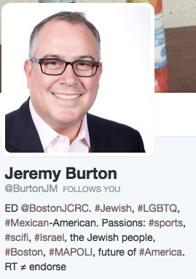
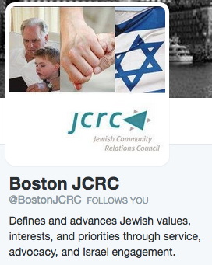

Slide 24
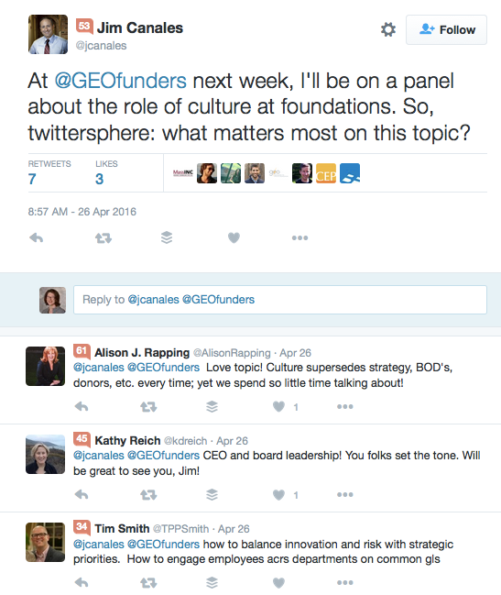
Barr CEO: Inviting input

Slide 25
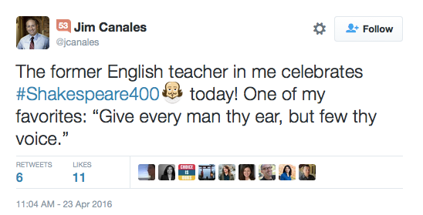
…and not afraid to be himself

Slide 26
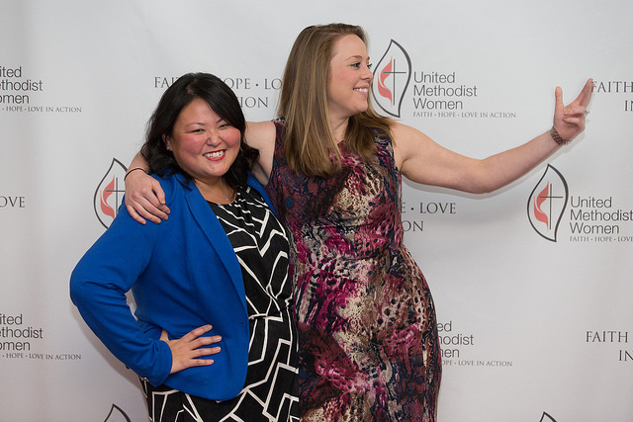
Transparent Trustworthy
Relational Authentic
Notes:
https://www.flickr.com/photos/53830190@N06/25556792662/

Slide 27
“82% of people are more likely to trust a company whose CEO and leadership team engage with social media.”
- BRANDfog CEO Social Media Leadership Survey
Notes:
http://www.text100.com/hypertext/2012/12/how-ftse-100-ceos-are-using-social-media/

Slide 28
Matter More,
Do More, Raise More
Org Culture/Personal Engagement
Stakeholder Engagement
Capital
Unleashed
Notes:
Org culture is deeply intertwined with leadership. This is something that comes from the top and is part of the DNA of the org.

Slide 29
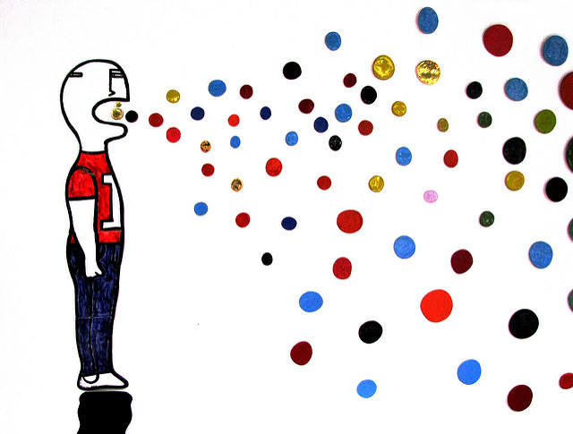
Matterness is not really what you want to talk about…
http://www.flickr.com/photos/47390431@N08/5549926350/

Slide 30
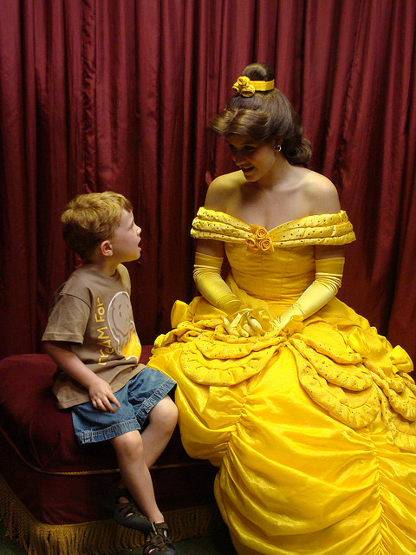
It’s what they want to talk about
http://www.flickr.com/photos/32454422@N00/4074805374/

Slide 31
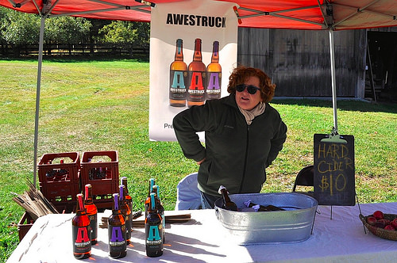
Matterness is not…
Customer service
Window dressing
A zero-sum game
A plan to raise money
https://www.flickr.com/photos/29261037@N02/30280411301/
Notes:
Social media
Sharing ideas and stories
Wired to be kind and generous
Abundance and spread of capital

Slide 32
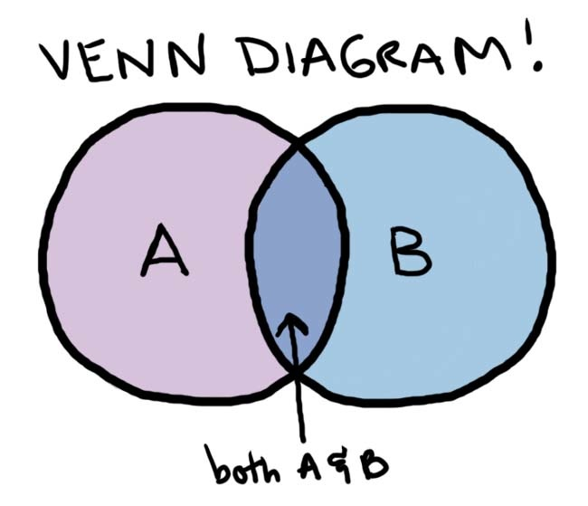
Finding the “conversation intersection”
Notes:
A is the org goals. B is what the audience is interested in (or their goals, needs, etc.) What's in the middle is generally where THE conversation topic is going to be.

Slide 33
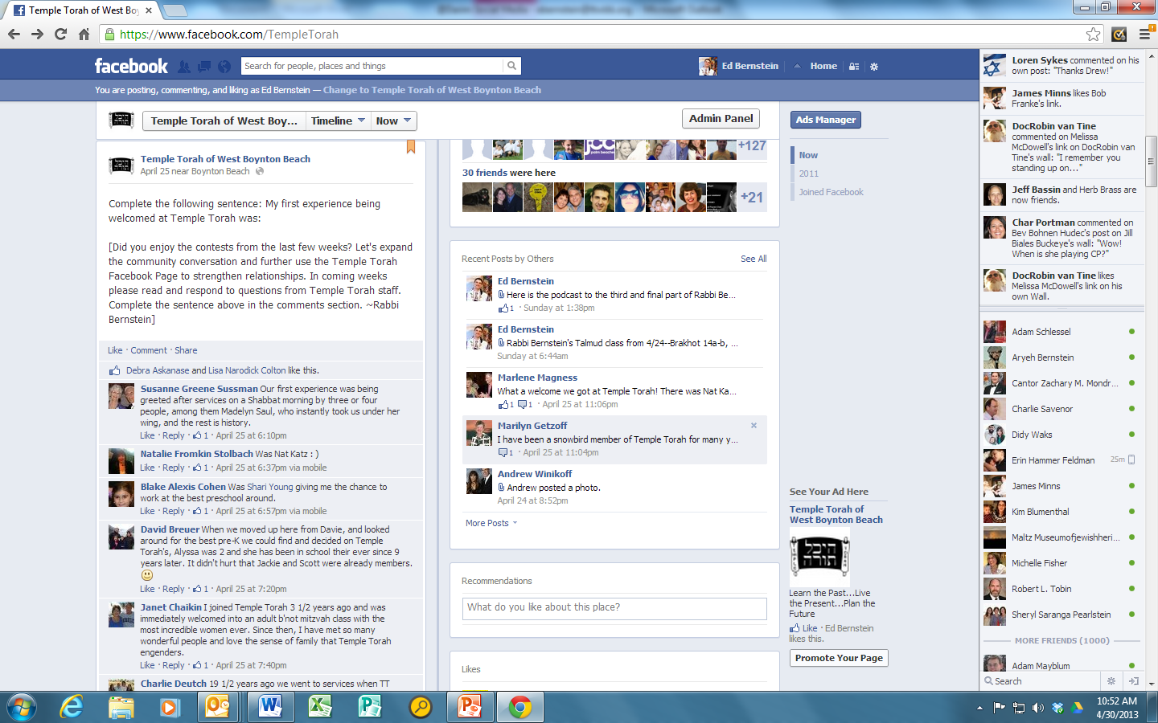

Slide 34
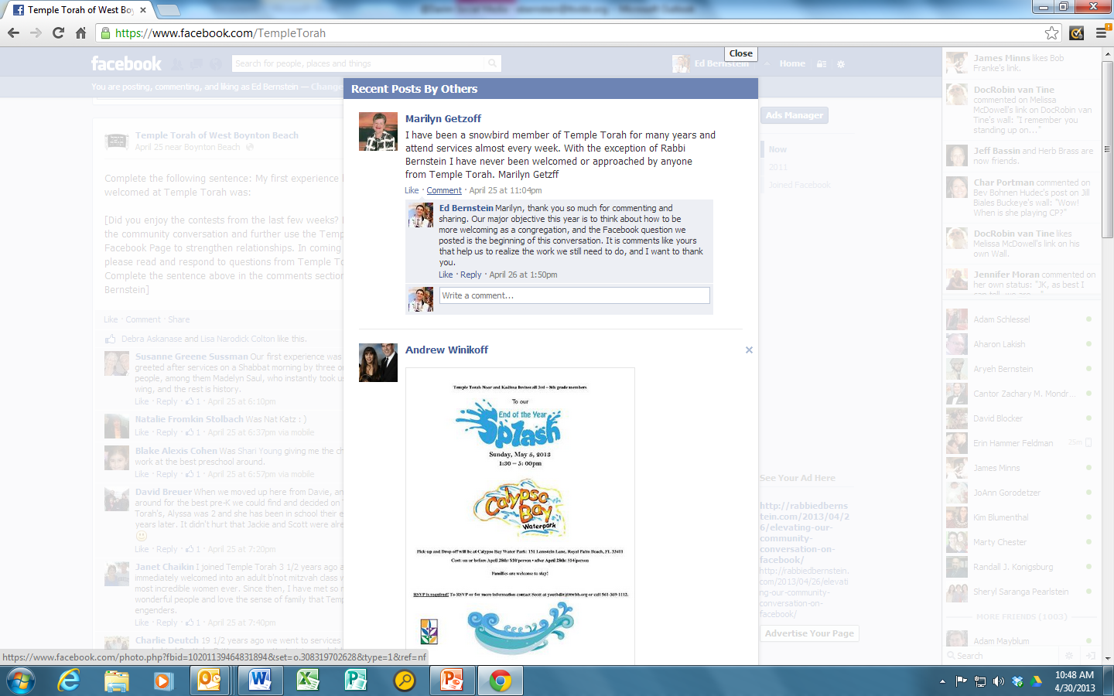
Even when it’s hard

Slide 35
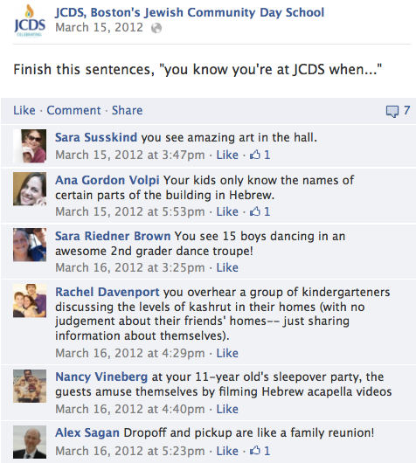
It is about them, not us

Slide 36


Slide 37
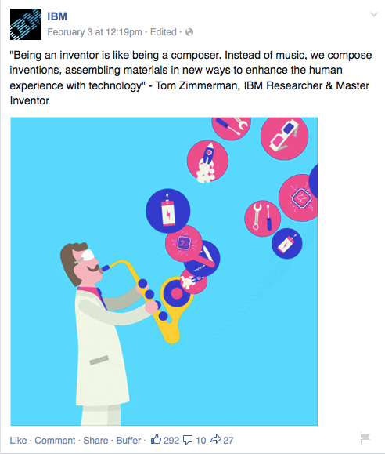

Slide 38
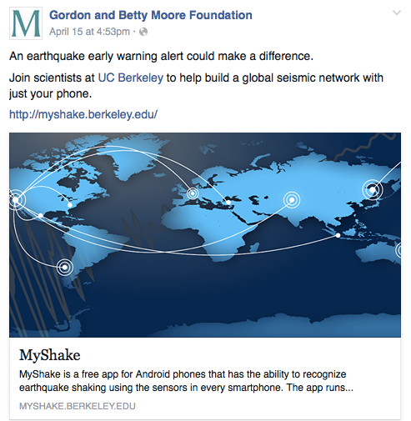
I/We can be part of the solution

Slide 39
Share Pair Exercise
What do your people really, really
want to talk about?
(Hint: It’s not you.)

Slide 40
Do More, Matter More,
Raise More
Org Culture/Personal Engagement
Stakeholder Engagement
Capital
Unleashed
Notes:
Org culture is deeply intertwined with leadership. This is something that comes from the top and is part of the DNA of the org.

Slide 41
Matterness
Org culture
Personal engagement
Understand stakeholders

Slide 42




Matterness = More Resources
What happens when they’re unleashed?

Slide 43

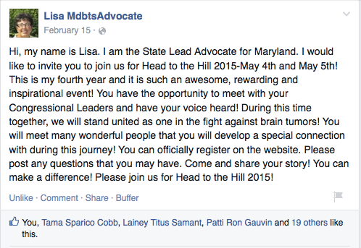

Slide 44
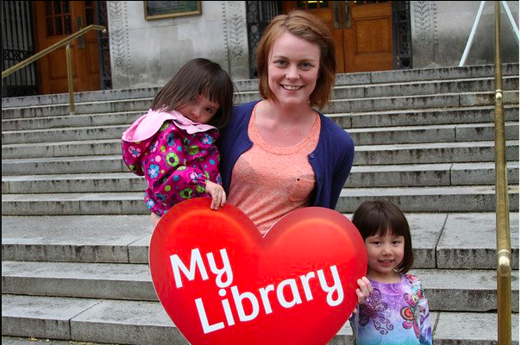
Libraries Yes! Multnomah County
http://communityorganizer20.com/2012/05/23/libraries-yes-a-place-based-community-advocacy-campaign/

Slide 45

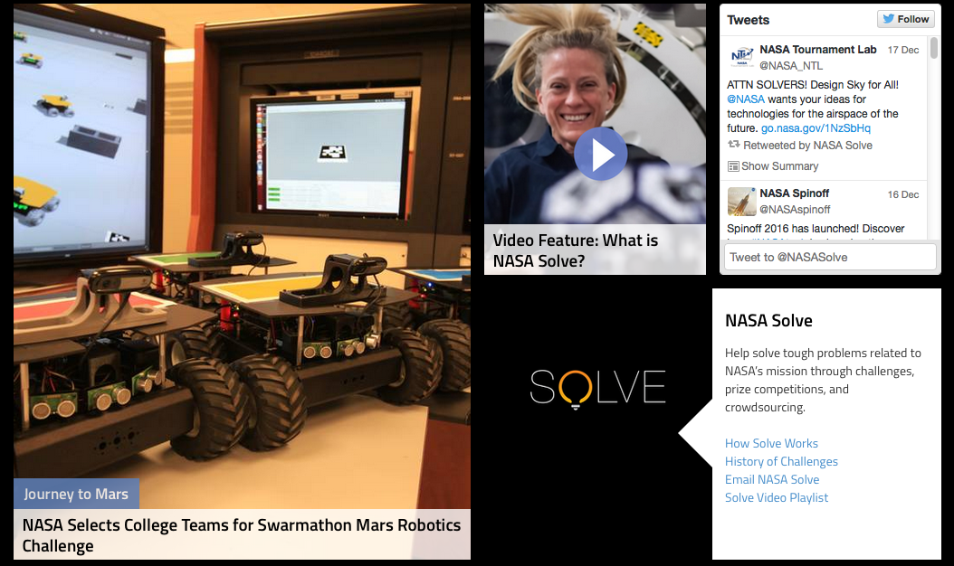
Spread out the work

Slide 46
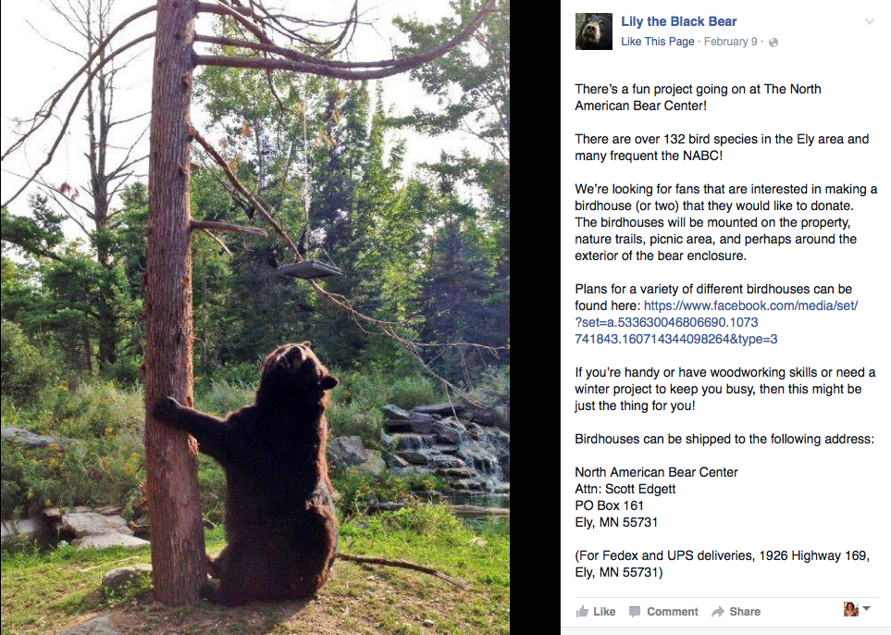

Slide 47


Slide 48
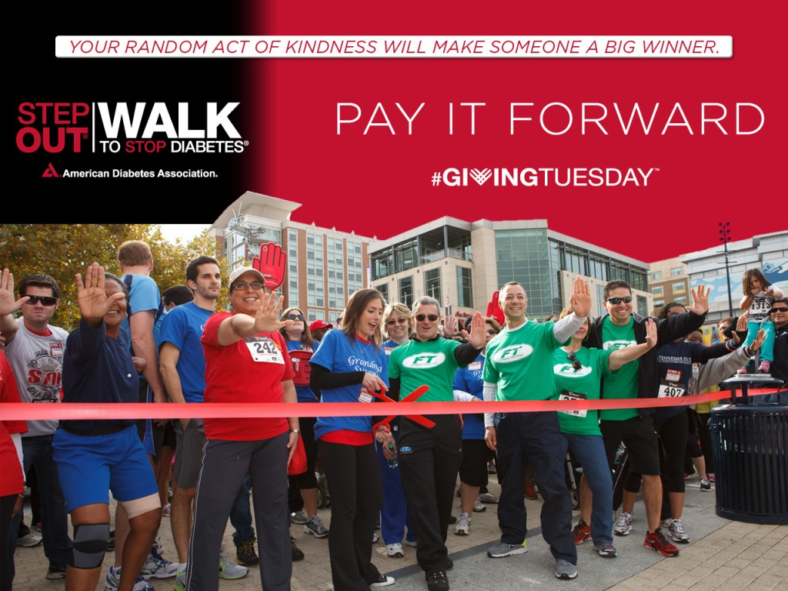

Slide 49
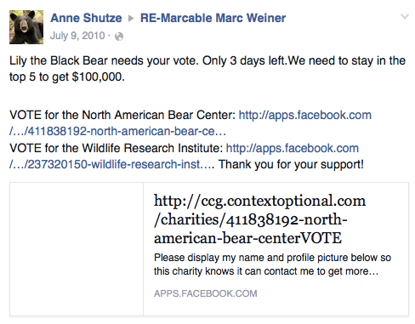
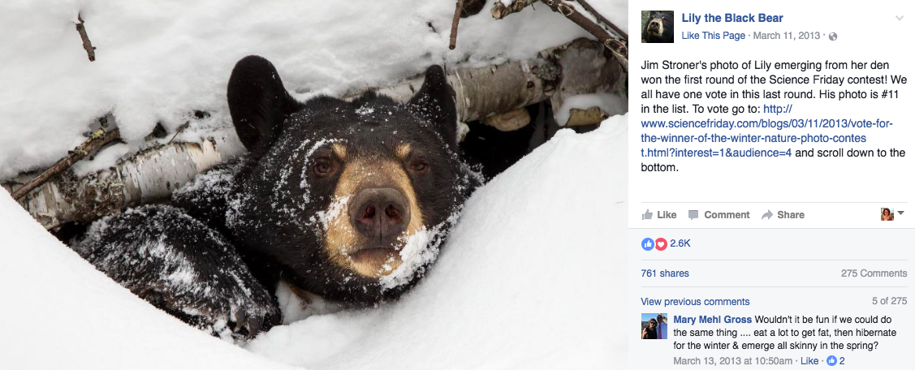

Slide 50
Matterness is working with and not at people
Creating ways for people to participate
Being in conversation online and on land
Opportunities for supporters to tell their own stories
Opportunities to connect with each other
Leading by following
Treating everyone like people
Being real online

Slide 51
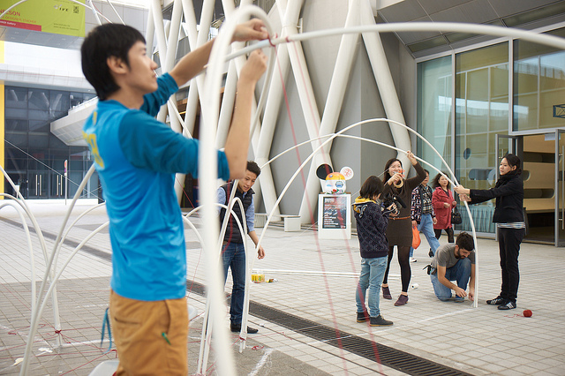
EXPERIMENT!
https://www.flickr.com/photos/27703797@N06/11908812463/

Slide 52
Your Matterness experiment
Think of one way that you will bring co-creation and stakeholder engagement into your organization.

Slide 53
Matter More
Do More
Raise More
Notes:
https://www.flickr.com/photos/131814204@N04/28508432803/

Slide 54

I’m always available to answer follow-up questions!
Don’t forget to have fun!
  Email: debra@communityorganizer20.com
  Website/blog: communityorganizer20.com
  Linkedin: linkedin.com/in/debraaskanase
  Twitter: @askdebra
  Other slides: slideshare.net/debask
  Telephone: (617) 682-2977

