Slide 1

A Cultural Literacy Toolbox: Developing Culturally Proficient Practices
“We promote mutual understanding and acceptance among diverse groups serving as a resource to both local institutions and the community at large. We serve as catalysts for change through collaboration, education, training, dialogue, fellowship and advocacy.”
Presenters: Gwendolyn VanSant & Jeff Lowenstein

Slide 2
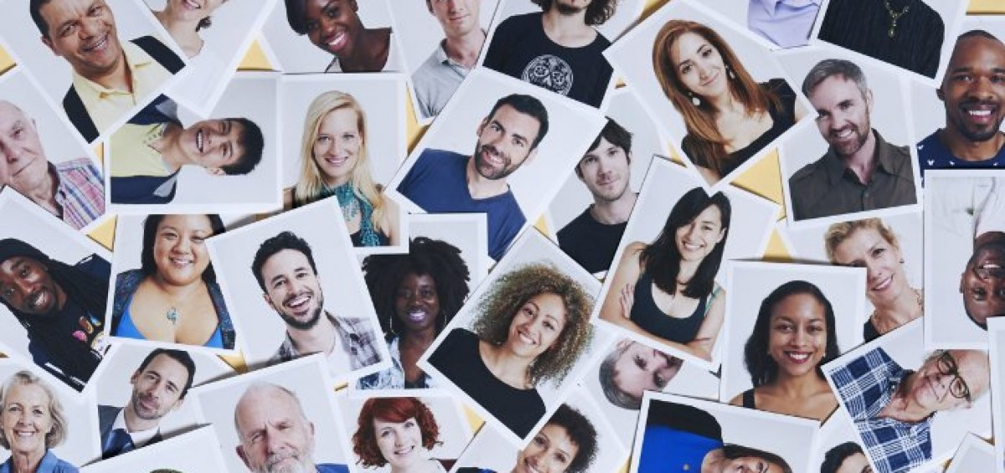
Cultural Competence
Set of congruent behaviors, attitudes, and policies that come together in a system, agency or among professionals
Enables effective work in cross-cultural situations to reach goals of program delivery
~Equitable Cultural and Linguistic Access~
Notes:
Purpose: Review
Action:
Ask participants if this makes more sense now.
Describe how you see this as continued intentional work?

Slide 3
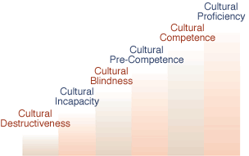
Cultural Competence Continuum
~Equitable Cultural and Linguistic Access~
Notes:
Purpose: Review
Action:
Ask participants if this makes more sense now.
Describe how you see this as continued intentional work?

Slide 4

Working Towards Organizational Cultural Competency
Cultural Competencey Ladder
Institutional Knowledge
Valuing Diversity
Ability to Conduct Self Assessment
Manage the Dynamics of Difference
Adapt to Diversity in the Workplace
Notes:
Instructor’s Guide:
Purpose: Outline how to work towards cultural competency.
Notes:
Stress that cultural competency is a continuum which we move along; State that it is ongoing intentional work and almost every lesson in this overview can be built out to a daylong training so this is an overview for managers to be acquainted for baseline skills for cultural competence and a framework to approach building cultural competence on their teams Say: “We don’t get to go to a few trainings and then say, ‘Well, guess we’re done now!’ Culturally competent-check. It’s a journey.”
Explain that there are, though, some basic steps to start us moving along that continuum. They are:
Institutional Knowledge: Identify Terms, Concepts, & Local Statistics
Valuing Diversity: Identify strengths, wisdom & goals
Ability to conduct Self Assessment: Identify Value systems personally and of the institution.
Manage the Dynamics of Difference: Identify Cultural Differences and develop strategies to work effectively among those differences
Adapt to diversity and the cultural contexts of the communities they serve: Assess barriers, Identify and address cultural norms; and make inquiries
Transition: “So, let’s begin with the first step in moving towards cultural competency; making sure that we share a base of institutional knowledge.”

Slide 5
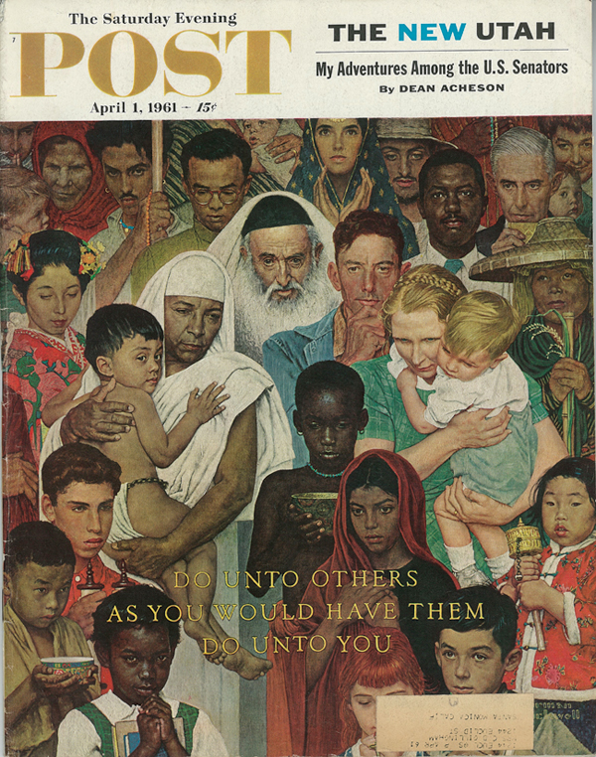
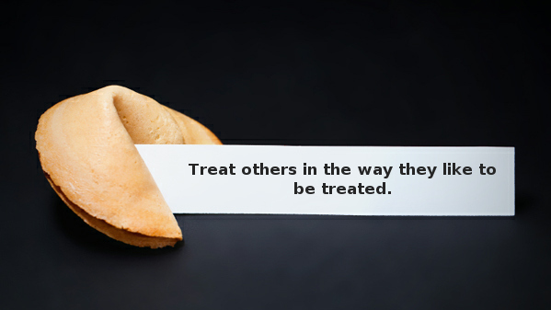
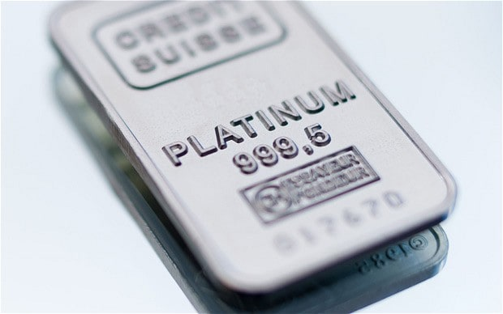
Valuing Diversity
Platinum Rule: (mutual respect) "Treat people in the way
they like to be treated.”
Golden Rule: (respect)
“Treat others how you would like to be treated.”
Valuing Diversity
Notes:
Instructor’s Guide:
Purpose: Introduce the platinum rule.
Notes:
Read the definitions of the golden rule and the platinum rule. Explain that while the golden rule demonstrates respect, the platinum rule, or cultural competency rule, demonstrates MUTUAL respect by not assuming that everyone is the same and wants to be treated in the same way.
Ask: “So, if we’re going to use the platinum rule and treat others the way they like to be treated, what do we have to do?” Usually, the response will be “ask,” if so, Ask: “And?” The answer you’re looking for is “Listen.”
Transition: “Now that we’ve looked at the platinum rule, we want to explore a situation where this could be usefully applied - different learning styles! Another important part of valuing diversity, tolerance.”

Slide 6
Multicultural BRIDGE
Training provided by:
www.multiculturalbridge.org
For more services and customizable training, see our website or call (413) 394-4029.
For a list of references, citations and resources used to compile this training, please contact Gwendolyn at Multicultural BRIDGE.
The compilation of this slide presentation is designed by Gwendolyn Hampton VanSant, certified Diversity Leader and Curriculum Consultant and Executive Director of Multicultural BRIDGE for BRIDGE purposes.
They are not to be distributed, shared, copied or reused without written permission from Gwendolyn Hampton VanSant & Multicultural BRIDGE.
© Gwendolyn VanSant 2010, 2016
Notes:
Copyright embedded in notes and/or on each slide

