Slide 1

November 2, 2016
Agile and Lean:
Improve Your Organization’s Ability to Capitalize on Emerging Opportunities
Presented by:
Russell Greenwald
Vice President
Ryan Ecclestone
Senior IT Project Manager
Scott Hagerty
IT Manager
Copyright © 2016 Insource Services, Inc. All Rights Reserved.

Slide 2
INTRODUCTION/AGENDA
Who we are & why listen to us?
What is Agile & Lean?
Workshop
Case Study
Questions

Slide 3
INSOURCE SERVICES, INC.
Finance, HR, and IT Consulting Firm
Based in MA and New Hampshire
At Insource Services, we believe
that HR, Finance and IT start with people
www.insourceservices.com

Slide 4
INSOURCE SERVICES, INC.
What we do:
Full department outsourcing; generally part-time and long term
“A la carte” services
Assessments
Trainings
Project/Interim assignment
How we do it:
Seek to understand client businesses and missions
Experienced, expert senior account leaders
Account team with multiple skill levels; work is performed at the most cost-effective level
Over 50 employees

Slide 5

WHAT AND FROM WHERE?
Agile | Lean
Practices based on principles and values in the Agile Manifesto | Approach to business operations that forever strives to eliminate waste through constant improvement
Originally conceived for software development, later applied to all areas of business practice | Originally developed in Auto Manufacturing (Toyota), later applied to all areas of business practice

Slide 6

AGILE ORIGINS
Values:
Individuals and interactions over process and tools
Working software over comprehensive documentation
Customer collaboration over contract negotiation
Responding to change over following a plan

Slide 7
AGILE ORIGINS
Principles (Distilled)
Customer satisfaction
Change is ok
Frequent delivery of results
Collaboration of requestor and deliverer is vital
Motivated individuals
Face-to-face communication
Results are primary measure
Steady pace of work, indefinitely
Continuous quality
Simplicity
Self-organizing teams
Regular reflection and adjustments

Slide 8
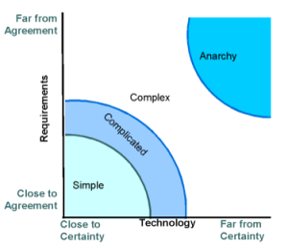
AGILE APPLICATIONS
Good for Environments with:
Changing or unknown requirements/priorities
High degree of customer
involvement
Varying Costs & Timelines

Slide 9
AGILE IN PRACTICE
(OR AGILE…QUICK & DIRTY)
Sprint – Time-boxed period during which the team selects & accomplishes work
(usually one or two weeks)
Story – A description of what work will be done, and why
(in our example, just tasks)
Size – Arbitrary unit for relative effort between tasks
(not specifically calculated hours, just comparison levels)
Priority – Relative importance that it be accomplished within the project
(we’ll use buckets: need to have, nice to have, etc.)

Slide 10
AGILE PREPARATION
Already given to us by the Owner:
Backlog – list of tasks to accomplish
Sizing – how much effort each task is estimated to require, compared to other tasks in the backlog
Prioritization – which ones are crucial, which ones are not

Slide 11
WORKSHOP: ROUND 1
New House
Populating Sprints

Slide 12

LEAN ORIGINS
Toyota in the 1930’s and 1940’s developed Toyota Production System in order to reduce wasteful steps in their Auto Manufacturing lines.
7 Forms of Waste:
Transportation
Defects/Errors
Over Processing
Over Production
Inventory
Motion
Waiting

Slide 13
QUESTION
How many people here have eliminated a wasteful step in a routine work task?
What was it?

Slide 14
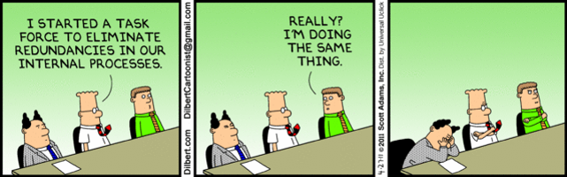
LEAN APPLICATIONS
Goal is to reduce areas of waste to save time, produce product/service more quickly.

Slide 15
CASE STUDY
New organization with funding for one year to prove success.
Need to garner more funding from donors
Need to attract program participants
Need to report on program effectiveness
Limited staff so efficiency is key
Programs are starting now
Programs
Case management
After school training
After school athletics
Adult training
Senior activities
Food services

Slide 16
CASE STUDY – TRADITIONAL PROCESS
Process (Think Gantt Chart)
Month 1 – Assessment and evaluation
Month 2 – Process review
Month 3 – Vendor vetting, RFP and selection
Month 4 - Design
Months 5-9 – Software build
Months 10-11 - Testing
Month 12 – Delivery
Pros
All scenarios imagined in advance
More control on budget
Well documented
Cons
No margin for change
Much longer lead time to deliverable
Project Team
Project Manager
Team Leads 1-4
Working Team 1
Team Lead
Technology
Working Team 2
Team Lead
Marketing & Communications
Working Team 3
Team Lead
Development
Working Team 4
Team Lead
Program Managers

Slide 17
CASE STUDY – PROCESS AGILE
Process
Kickoff meeting
Build the backlog
Weekly 1 hour meetings with Working Team
Weekly tasks and next steps
Team approach and group updates
Pros
Flexibility (handle feature creep)
Immediate feedback
No dependent teams
Cons
Hard to predict timeline
Hard to predict budgets
Working Team
Project Manager
Executive Director
Technology
Marketing & Communications
Development
Program Managers

Slide 18

CASE STUDY – CREATING A BACKLOG
Case Management System
Feature requirements Case Management
Documents usage process Case Management
Compliance regulations Case Management
Reporting needs Case Management
Research systems Case Management
Choose and develop deployment process Case Management
Deploy Case Management
Membership Management
Speak with other nonprofits with similar needs
Develop feature requirements for membership
Speak with current vendor to discuss feature requirements
Website
Discuss website needs
Research pricing and options for a new website
Develop phase 1 website deliverables
Choose hosting provider
Build internally with WordPress template and deploy
Events and Social Media
Layout feature requirements for social media
Evaluate Eventbrite
Set up Facebook and Twitter accounts
Implement Eventbrite

Slide 19
CASE STUDY – CREATING A BACKLOG
Development
Compare current membership system to Salesforce
Layout short term needs Development
Evaluate Salesforce consultants
Choose consultants and begin implementation
Attendance Tracking
Research and choose bar code scanners
Export names and ID’s from membership system to Google Sheets
Set up templated Google Sheets for grading
Set up barcode scanners with laptops and Google Sheets
Train staff

Slide 20
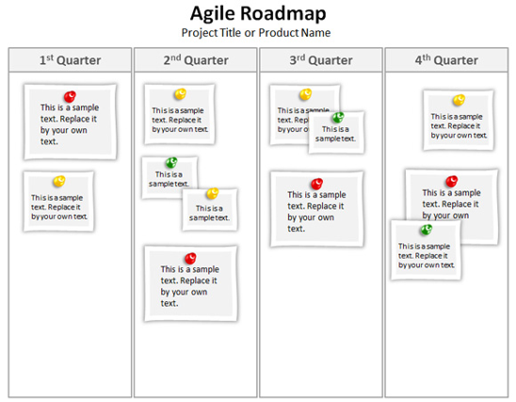
CASE STUDY – SCHEDULE
In Week 1-2 (Limit 50)
Feature requirements Case Management
Documents usage process Case Management
Reporting needs Case Management
Compliance regulations Case Management
Develop feature requirements for membership
Speak with current vendor to discuss feature requirements
Discuss website needs
Develop phase 1 website deliverables
In Week 3-4 (Limit 50)
Build internally with WordPress template and deploy
Export names and ID’s from membership system to Google Sheets
Compare current membership system to Salesforce
Layout short term needs Development

Slide 21
CASE STUDY – SCHEDULE
In Week 5-6 (Limit 50)
Feature requirements Case Management
Documents usage process Case Management
Reporting needs Case Management
Compliance regulations Case Management
Develop feature requirements for membership
Speak with current vendor to discuss feature requirements
Discuss website needs
Develop phase 1 website deliverables
In Week 6-8 (Limit 50)
Deploy Case Management
Research and choose bar code scanners
Set up templated Google Sheets for grading
Set up barcode scanners with laptops and Google Sheets
Train staff
Layout feature requirements for social media
Set up Facebook and Twitter accounts
In Week 8-10 (Limit 40)
Speak with other nonprofits with similar needs

Slide 22
CASE STUDY – OUTCOME
10 Week Process to Meet Primary Goals
Solutions
Salesforce for development
Google Docs with bar code for attendance
New website built internally off WordPress templates
Eventbrite, Facebook, Twitter
Case management software that can generate reports (HIPPA compliant)
Still using old database for printing ID cards

Slide 23
SUMMARY
Lean and Agile have their place; not a fit for every scenario
Agile: Create results now, adapt and revise when change comes
Lean: Trim the waste wherever you find it
These are introductions and concepts; there is much more to it

Slide 24
Questions

Slide 25
Contact Information
Ryan Ecclestone
Sr. IT Project Manager
recclestone@insourceservices.com
781-374-5126
Scott Hagerty
IT Manager
shagerty@insourceservices.com
781-374-5134
Russell Greenwald
Vice President
rgreenwald@insourceservices.com
781-374-5116
www.insourceservices.com

