Slide 1
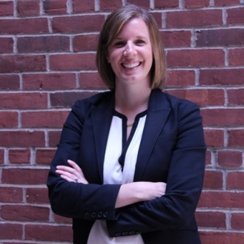

Nonprofit Lobbying:
Rules, Regulations & Potential Impact
July Webinar
Presented by Kevin P. Martin & Associates
Thanks for joining us. A few instructions before we begin:
You may join the audio by selecting the radio button for either “Telephone” or “Mic & Speakers”. If you are using telephone, please dial in using the conference line and audio pin provided.
If you are having any technical issues, please let us know in the chat box.
We will have time for Q&A at the end of the webinar. Please feel free to enter your questions in the chat box at any time.
This webinar is being recorded and we will distribute the slides and recording after the webinar has concluded.
Tonja Mettlach
Director of Government Affairs
www.massnonprofitnet.org

Slide 2
About the Speakers
Speakers:
Karen Kent, cpa, principal
Jola tuck, cpa, tax manager

Slide 3

Learning Objectives
Identify what constitutes lobbying
Identify what constitutes advocacy
Gain an understanding of the
Registration and reporting
requirements
Learn what’s needed for recordkeeping
Learn about the 501(h) Election

Slide 4
Where Does Lobbying Begin?
Work Offices
Emails Hallways
Phone calls text messages
Social media business meetings
Community meetings social events

Slide 5
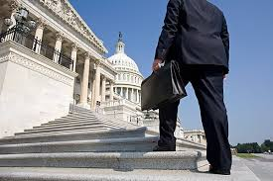
What is Lobbying?
“Lobbying” has a strict legal and IRS definition for nonprofits which generally only includes activities that asks policymakers to take a specific position on a specific piece of legislation, or that asks others to ask the same. In contrast, the common language definition of lobbying usually includes any discussion of issues with policymakers.
1

Slide 6

What is Advocacy?
“Advocacy” encompasses any activity that a person or organization undertakes to influence policies. There is great latitude in this definition, and some people consider advocacy to be all activities that are not specifically lobbying, such as public demonstrations.
2

Slide 7

Lobbying vs. Advocacy
Legally, lobbying is a form of advocacy with the intent of influencing a piece of legislation.
So if lobbying is a form of advocacy and you intend to influence legislation how do you know when you have stepped over the line and now you’re a lobbyist?
4

Slide 8
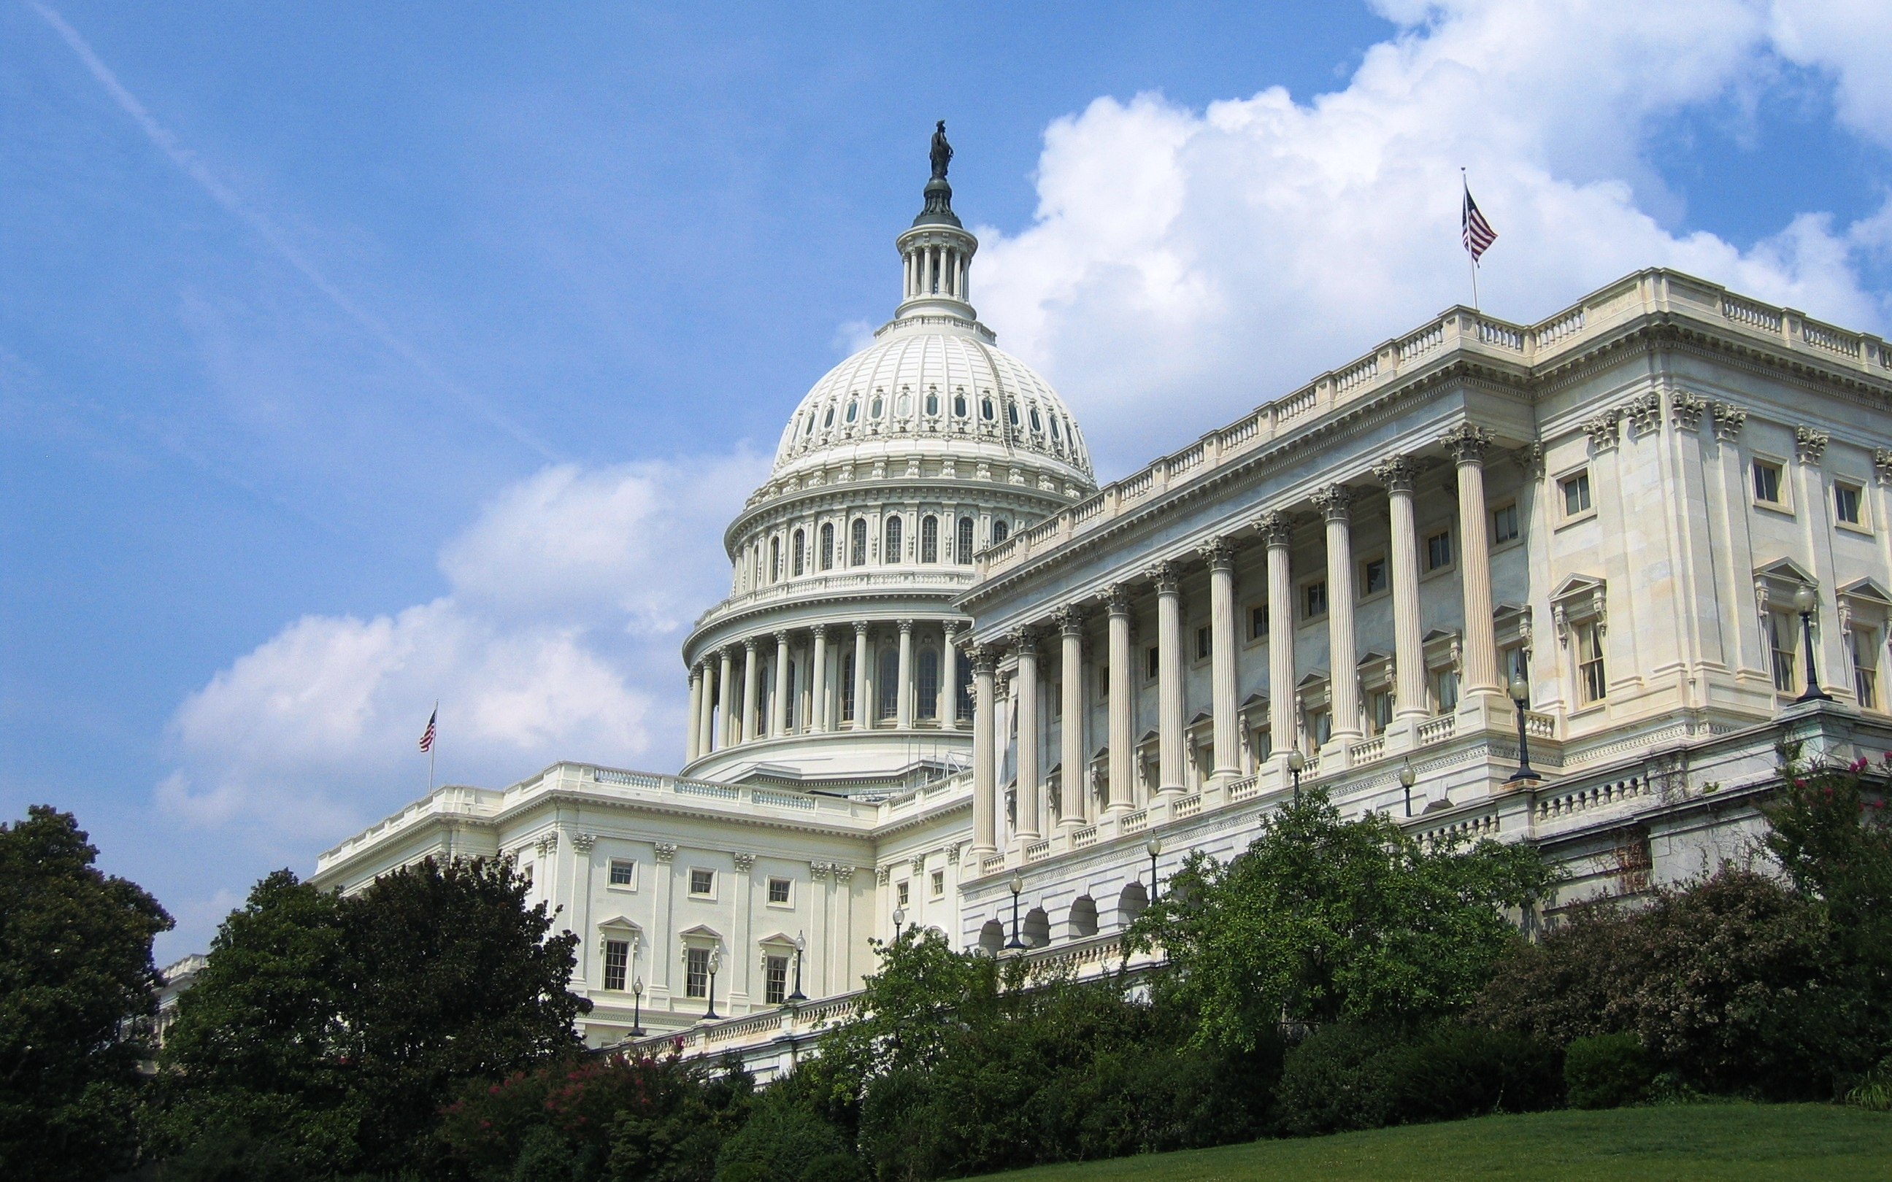
Lobbying vs. Advocacy
In broad terms, advocacy is educating and creating awareness among legislators and the general public.
In advocating you are not endorsing or opposing specific legislation but rather are educating others about the impact of policy decisions.
Once you begin to petition for or against a specific piece of proposed legislation you begin lobbying.
For example, advocating can include educating a member of the legislature about the impact that a bill would have on your community. Asking that member of the legislature to vote for or against that bill because of the impact it would have is lobbying.
For advocacy to be lobbying there are two required elements:
Communication must refer to a specific piece of legislation AND,
It must reflect a view on that legislation.

Slide 9

Polling Question
Are you a registered lobbyist?
Yes or No

Slide 10

Should We Be Lobbying?
Sparks Public Debate
Connects policymakers to ideas
Empowers individuals
Brings about change
Advocates clients mission/issues
3

Slide 11

Types of Lobbying
Grassroots Lobbying:
A call to action that attempts to motivate the general public to contact legislators to support or oppose legislation.
Reflects a view on the legislation
Encourages the recipient to take action with respect to the legislation
Refers to the many types of indirect attempts to communicate with and influence legislators, such as communication aimed at legislators’ constituents.
5

Slide 12
Types of Lobbying
Direct Lobbying:
Any attempt to influence any legislation through communication with:
Any member or employee of a legislative body;
Any governmental official or employee who may participate in the formulation of the legislation, only if the principal purpose is to influence legislation
Any communication with a legislator or government official is considered lobbying if and only if:
Refers to specific legislation and;
Reflects a view on such legislation
6

Slide 13
Lobbying – What it is not
It is not Lobbying to:
Communicate to support or oppose legislation as long as it does not contain a call to action (encouraging members to engage in direct or grassroots lobbying)
Sit in your Senator’s office and discuss a specific piece of legislation, as long as you don’t advocate for a specific view on that legislation
Sit in the same office and discuss your position on a policy issue or issues as long as the discussion is not about a specific bill
Meet with a legislator to discuss social problems, without mentioning a specific proposal
Provide a legislator with educational materials about a specific piece of legislation, without calling for specific action on the legislation
Track activities of legislators, including votes, positions taken, contributions accepted, etc.
Advocate for better enforcement of existing laws
Conduct public education campaigns
7

Slide 14

Do I have to Register?
Incidental (Safe Harbor)
Less than 25 hours during any reporting period AND receive less than $2,500 during any reporting period.
Reporting periods are January 1st to June 30th and July 1st to December 31st.
Note: If salary apportionment exceeds $2,500 may be required to register. The threshold is easy to trigger.

Slide 15
How do I Register?
In the state of Massachusetts all lobbyist are required to register with the Secretary of State.
An annual registration statement and $100. Lobbyist entity for which the executive or legislative agent is an employee, partner or shareholder must pay an annual filing fee of $1,000. Due by December 15 for the upcoming calendar year.
Also required to complete an in-person or online seminar.
Semi Annual Disclosure Reports (due July 15 and January 15)
Statement of lobbyist position
Identification of client or clients
Compensation received for lobbying
All direct business associations with public officials

Slide 16
What May Happen if I Fail to Register?
Civil and criminal penalties
$50 per day for every day such reports are late up to the 20th day, thereafter $100 per day until filed.
New investigatory powers of the secretary of state
Preliminary inquiry
Summons witness and production of documents
May suspend or revoke license and registrations, or impose a civil penalty of not more than $10K per violation
If convicted, imprisonment in state prison for not more than 5 years, or in a jail or house of correction for not more than 2.5 years.

Slide 17

Polling Question
Which is an example of lobbying?
Researching and comparing candidates in a political election.
Choosing political candidates by their beliefs on key issues.
Calling public officials to express views on upcoming votes

Slide 18

Lobbying by Private Foundations
Strictly Prohibited -
calls for an excise tax of 20%
General support grants to organizations that lobby are permissible and are not considered taxable expenditures.
May not earmark the “grant” for lobbying
Language in Foundation grant agreements often specify the grant may not be used for lobbying activities.
8

Slide 19

Lobbying by Charities
The “No Substantial Part” Test
Measured by time, attention, energy, cost, volunteer efforts, etc.
Exceeding this standard for just one year can mean loss of exempt status
Vaguely defined
Higher Risk of IRS Audit
9

Slide 20
Lobbying by Charities
Are there any adverse tax consequences on a non-profit organization, or its employees,
who does register as a lobbyist?
There is no prohibition from lobbying for an organization to maintain its exempt status.
However, in order to maintain a 501©(3) exempt status, an organization must not be
considered an “action organization”
An organization could be considered an action organization if a substantial part of its
activities are lobbying activities.
If an organization is determined to have a substantial part of their activities as lobbying
activities, then that will result in a loss of their exempt status.

Slide 21
What Does Substantial Mean?
What the IRS says is that ALL nonprofits may lobby as long as those activities do not comprise a substantial part of what the organization does. In other words, nonprofits may dedicate an insubstantial amount of resources to lobbying. The tricky part is that the IRS doesn’t define what it means by “substantial” or “insubstantial”.
OR, nonprofits can choose the expenditure test also known as the 501(h) Election.

Slide 22
Lobbying by Charities – 501(h) Election
There is a way for an organization to establish a safe harbor and
that is by filing what is called a 501(h) election.
The 501(h) election:
Unlimited volunteer activities
Most charities will benefit by higher limits by making the election
Penalty taxes on the organization only, not individual managers
Loss of exemption based on exceeding limit by 50% over a 4- year period
Lower risk of IRS examination

Slide 23
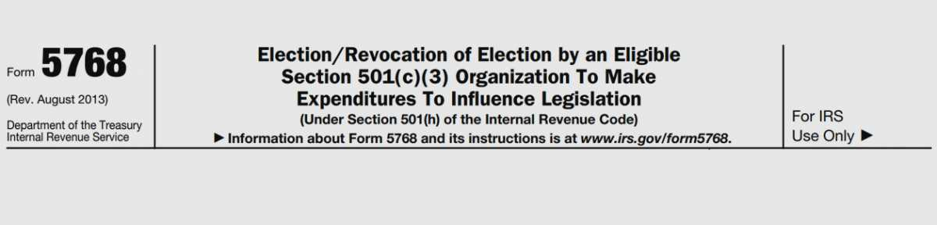
Lobbying by Charities – 501(h) Election
The 501(h) Election:
Form 5768, “Election/Revocation of Election by an Eligible 501(c)(3) Organization
To Make Expenditures to Influence Legislation”
Election may be made and revoked at any time
Election applies retroactively to beginning of tax year
Revocation applies prospectively

Slide 24

Lobbying by Charities – 501(h) Election
The 501(h) – Expenditure Limits
Total lobbying (direct and grassroots)
20% of the first $500,000 +
15% of the next $500,000 +
10% of the third $500,000 +
5% of the remaining exempt purpose expenditures
Not to exceed $1,000,000
Grassroots lobbying only
Cannot exceed 25% of the limit on total lobbying,
regardless of the actual amount of total lobbying.

Slide 25

Lobbying by Charities – 501(h) Election
The 501(h) Election – Exempt Purpose Expenditures
Includes all expenditures (program, administration and fundraising)
Except for:
Expenses deducted on form 990-T
Taxes paid on form 990-T
Capitalized expenditures
Professional fundraisers

Slide 26
Lobbying by Charities – 501(h) Election
The 501(h) election – Excise Tax
If an organization exceeds its lobbying expenditure limit in a particular year,
a 25% excise tax is paid on the excess
Excise tax is reported on form 4720
If an organization exceeds its lobbying limit of 150% of the nontaxable amount
Over a four-year period, tax exempt status may be revoked
Note: lobbying limits may be exceeded in a particular
year with the excise tax being paid as long as the four year period does not
exceed the 150% threshold

Slide 27

Lobbying by Charities – 501(h) Election
ABC’s Organization intends to spend
$2M on lobbying next year and the year after.
What is the impact, if any?
Grassroots nontaxable amount = $950,000
 | Exempt Purpose | Lobbying | Actual Lobbying | Excise
 | Expenditures | Nontaxable Amounts | Expenses | Tax Due
2014 | 14,000,000 | 850,000 | 823,562 | -
2015 | 16,000,000 | 950,000 | 974,333 | 6,083
2016 (proj) | 18,000,000 | 1,000,000 | 2,000,000 | 250,000
2017 (proj) | 20,000,000 | 1,000,000 | 2,000,000 | 250,000
4 yr. limit |  | 3,800,000
150% of 4 yr limit |  | 5,700,000
Actual 4 yr |  |  | 5,797,895
4 year excess |  |  | 97,895

Slide 28

Polling Question
A 501(h) election is:
An irrevocable election
Always protects an organization
Is also know as the Exempt Purpose Expenditure election

Slide 29

Accounting for Lobbying Activities
Adequate Records:
Documentation of all lobbying activities
Retention of all lobbying communications
Use of timesheets in support of compensation and overhead allocations
Maintenance of cost logs (postage, copying, delivery services)
10

Slide 30

Accounting for Lobbying Activities
Tracking Expenditures:
Cost of research, drafting, reviewing, copying, printing, publishing, mailing, etc.
Identify the audience (members/nonmembers)
Identify mixed-purpose communications (i.e. fundraising appeal that also
includes grass roots lobbying)
Track direct vs. grassroots activities

Slide 31
Form 990 Disclosure
Schedule C – Political Campaign and Lobbying Activities
When 501(h) election is made:
Substantially less reporting required
Total direct lobbying expenditures
Total grassroots lobbying expenditures
Compared to other exempt purpose expenditures to determine if there is excess

Slide 32
Form 990 Disclosure
When 501(h) election is NOT made:
Substantially more reporting required
Total dollar amount of lobbying expenditures based on type of activity
Volunteers
Paid staff
Mailings to members, legislators, or the public
Direct contacts with legislators
Seminars, conventions, speeches, lectures
Detailed description of the lobbying activity

Slide 33
Websites of Interest
Secretary of State Massachusetts:
http://www.sec.state.ma.us/LobbyistWeb/Common/Signin.aspx
Internal Revenue Service:
https://www.irs.gov/charities-non-profits/lobbying

Slide 34

Questions

Slide 35
How to Reach Us
Karen Kent Direct Line 781-849-5305
Email kkent@kpm-us.com
Jolanta Tuck Direct Line 781-849-5334
Email jtuck@kpm-us.com
12

Slide 36

The End

