Slide 1


Crowdfunding: It’s Not All About the Money
May Webinar
Presented by GiveGab
Thanks for joining us. A few instructions before we begin:
You may join the audio by selecting the radio button for either “Telephone” or “Mic & Speakers”. If you are using telephone, please dial in using the conference line and audio pin provided.
If you are having any technical issues, please let us know in the chat box.
We will have time for Q&A at the end of the webinar. Please feel free to enter your questions in the chat box at any time.
This webinar is being recorded and we will distribute the slides and recording after the webinar has concluded.
Emily Tamanaha
Director of Membership & Programs
www.massnonprofitnet.org

Slide 2
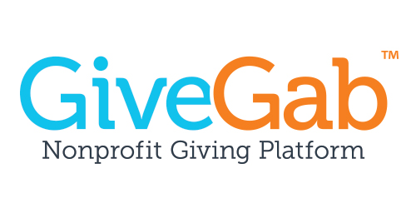
Is crowdfunding (online fundraising) part of your annual fundraising strategy?
Yes, no, maybe??

Slide 3
The Importance of
Online Fundraising
Engagement
New Donor Acquisition
Generational Pre-Requisite
$$$
Notes:
$$$ - not just more Typically for a lot less money than

Slide 4
How many fundraising activities do you have each year?
0-1, 2-5, 5+

Slide 5
1. Engagement
#givingtuesday
Spring Event
Jan
July
Dec
Annual Campaign Kickoff (Gala)
Late Summer / Early Fall Event
Final Year End Push
Major Donors
Notes:
Engagement
Additional touch points throughout the year
Complements major donors – story that we see major donors contribute to online campaigns b/c they want to be part of something cool and fun
Stewardship and reporting on use of money is key to
Opposite of too much is too much
Plan wisely
Thank
Show how it’s being used
Those that are passionate will come back over and over

Slide 6
Quiz: What is the average donor retention rate?
30%, 40%, 50%, 60%

Slide 7
2. New Donor Acquisition
Acquisition
Retention
Referral
Repeat giving (time or money)
Passionate about your cause
Bring others in
Major Gifts
Donors / volunteers
Online campaigns
Events
Ongoing Programs
Engagement
Lifetime givers
Extremely passionate
Relationships built up over time
P2P
Teams

Slide 8
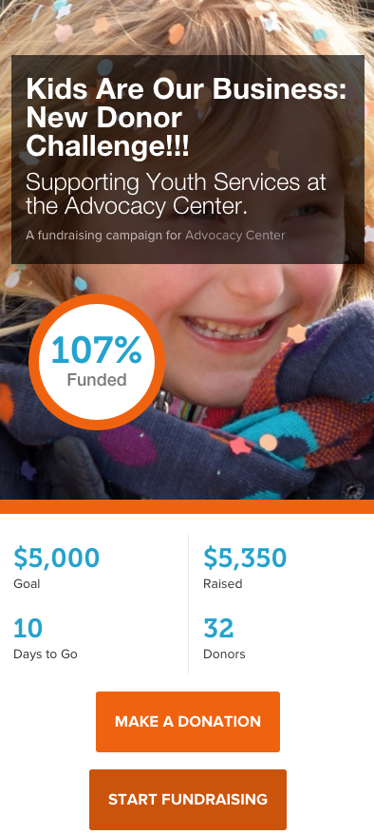
3. Generational Pre-Requisite
Online is the new
place of business
Social
Mobile
Great UX
Reduce friction to give

Slide 9
4. $$$
Extra money is always great...
Online fundraising is typically cheaper
A way to fund those smaller tangible projects
Analytics are better
  Who is a repeat giver?
  Who gives increasingly?
  Which campaigns are most successful at raising funds?
  At repeat giver engagement?
  Donor acquisition?

Slide 10
Online Fundraising: Best Practices
Put the donor in the story
Personal asks trump all
Momentum
Enthusiastic, public thanks
Have Fun!

Slide 11
1. It’s all about the donor!
The “you” test
Inspire the donor to battle
Multiple asks
Make a promise that makes a difference

Slide 12
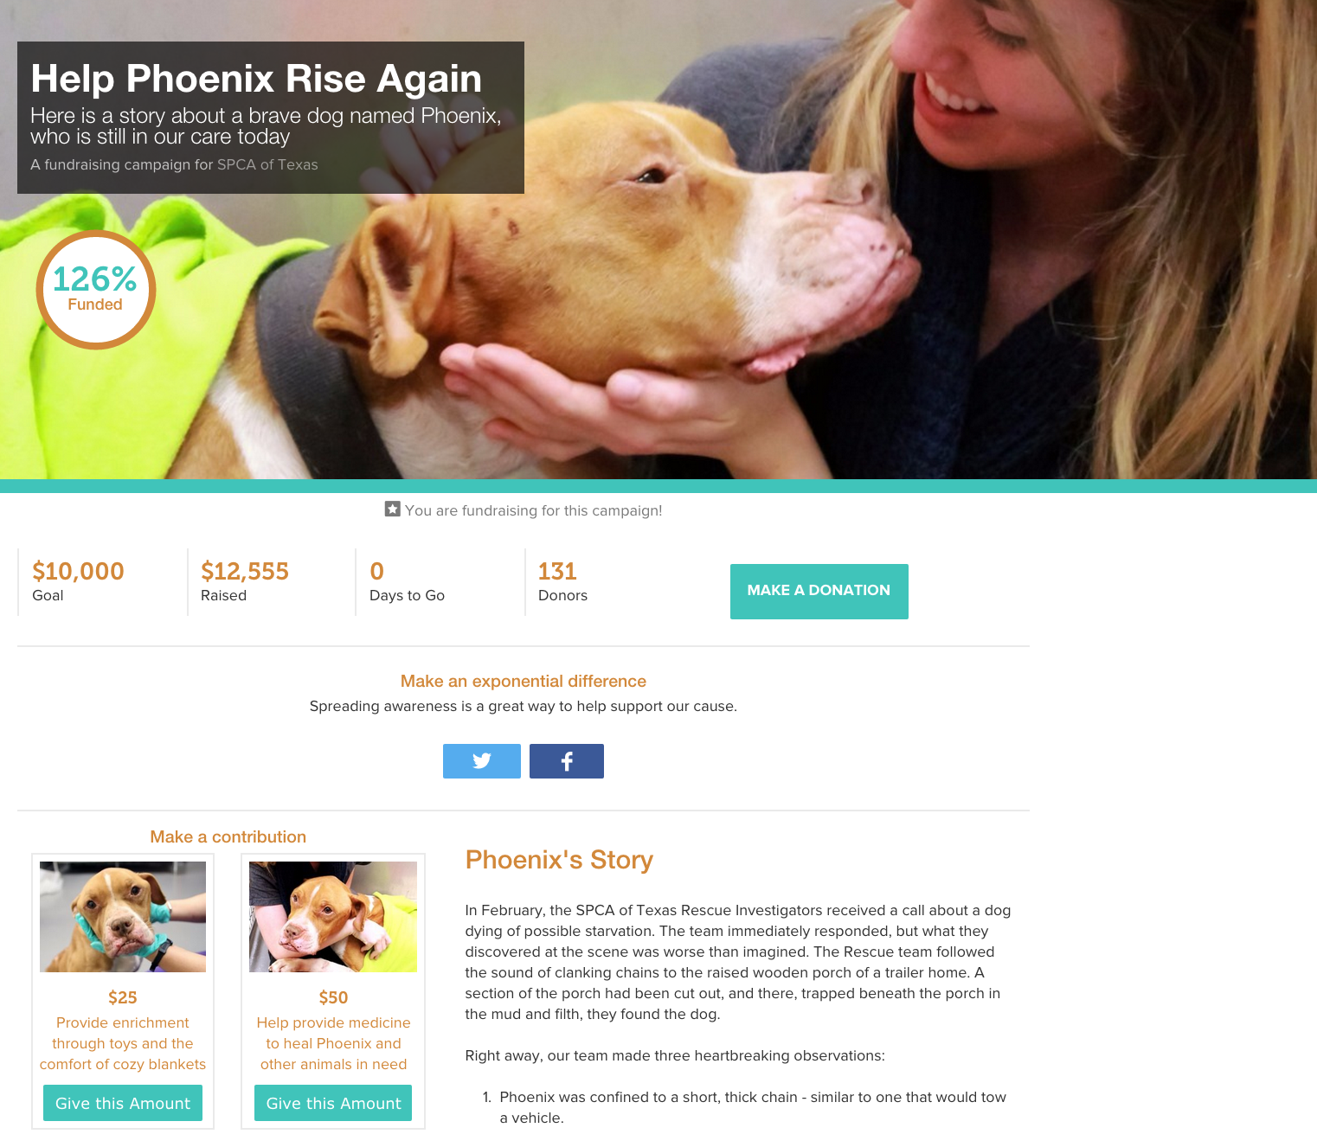

Slide 13
Quiz: What is the best way to attract donors to your campaign?
Direct mail, social media, email blasts, direct email, ads, phone

Slide 14
2. Personal asks trump all
 | Success Rate
Social Shares | .25%
Email Blasts
Personal Asks
 | Success Rate
Social Shares | .25%
Email Blasts | 2% - 8%
Personal Asks | 70%
 | Success Rate
Social Shares | .25%
Email Blasts | 2% - 8%
Personal Asks | 60%

Slide 15
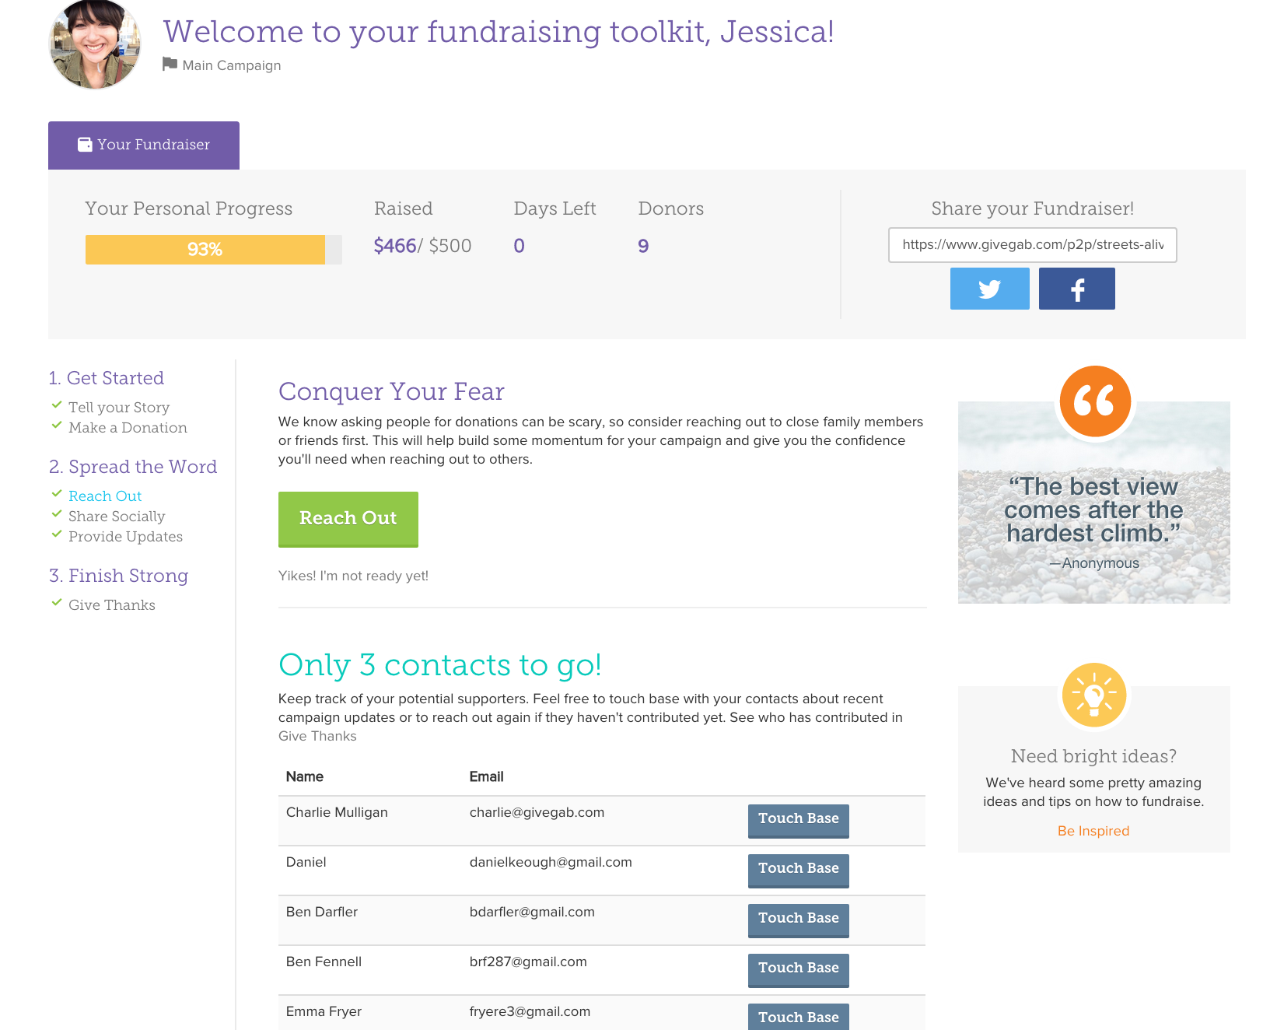

Slide 16
3. Momentum is King
No one donates to losers
Pre-seed is crucial
Last 70% easier than first 30%
Avoid the “trough of sorrow”
Fundraising Champs key

Slide 17
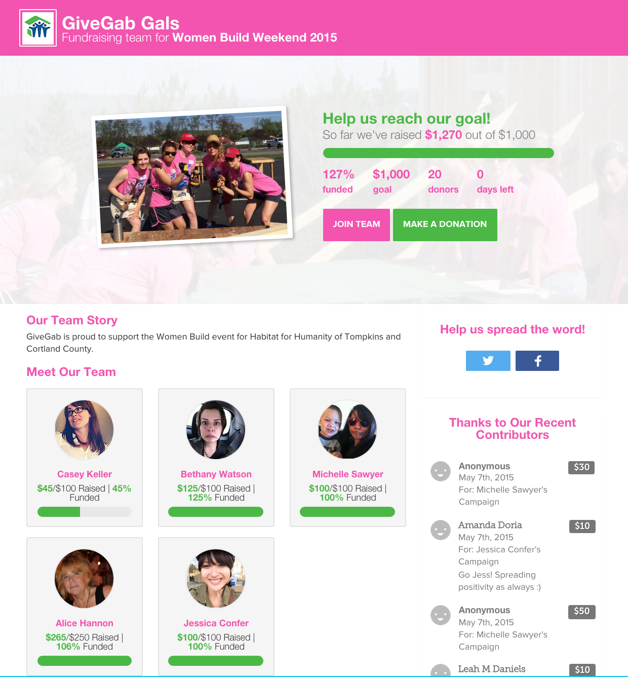
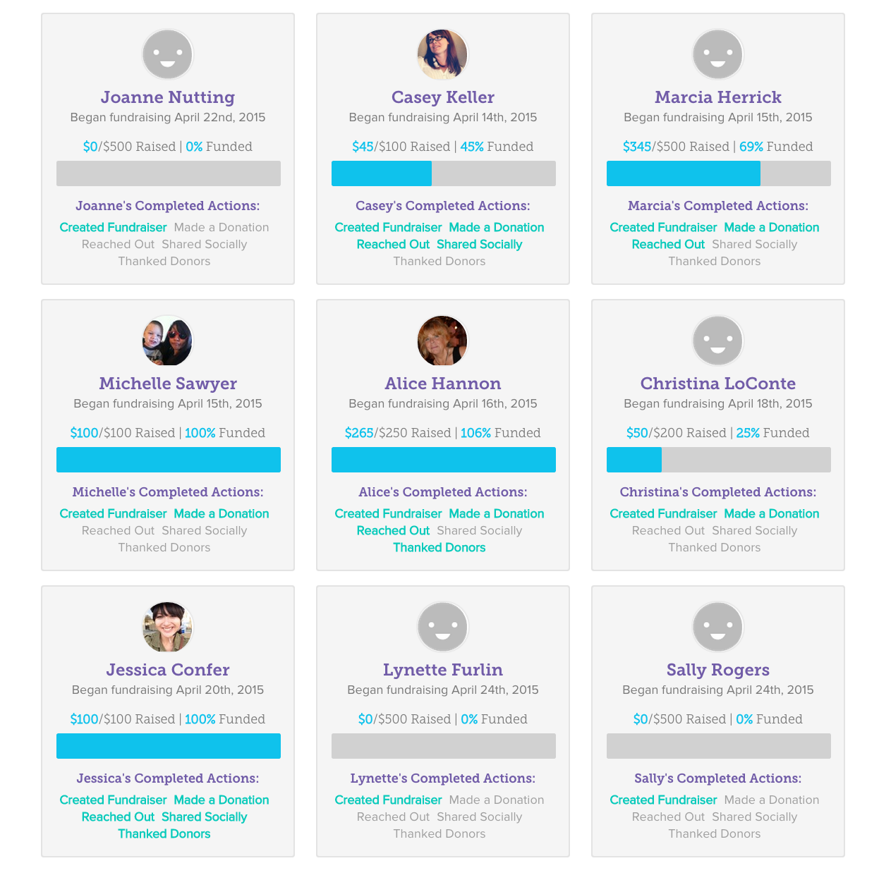

Slide 18
When do you perform “stewardship”?
Annual report, during fundraising activities, after fundraiser, whoops!

Slide 19
4. Thank You!
No thanks = no retention
Happy donors multiply
Segment
3-3-3 Rule:
  3 min, 3 days, 3 months

Slide 20
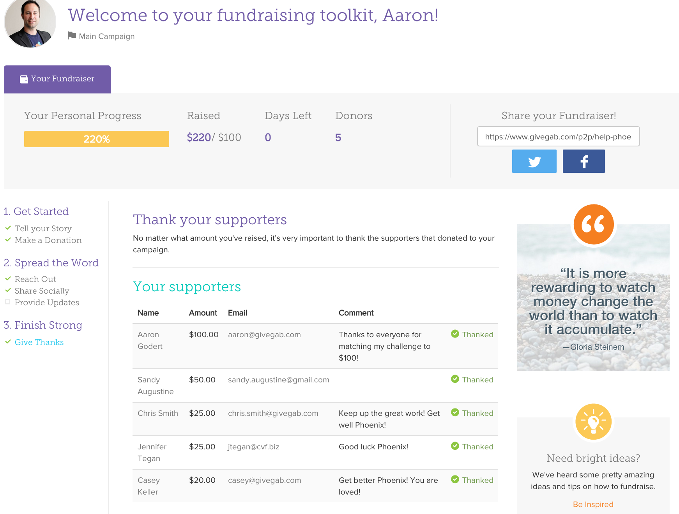

Slide 21
5. Have Fun!
Notes:
Look at your p2p fundraising campaigns as an opportunity to engage with your passionate supporters even more
We hold “p2p fundraising” happy hours!
Make it social…
Align your supporters behind a goal
Make the idea fun and quirky – stuffed animal campaign for Paleontological Research Institute

Slide 22
The Nonprofit Giving Platform
Aaron Godert
COO & Co-Founder
aaron@givegab.com
t: @aarongodert
607.342.8290

