Slide 1


Values-based
Human Resource Systems
No HR Experience Required!
Lyn Freundlich
Director of Human Resources
Third Sector New England
March 2016

Slide 2
Goals
Introduce the concept of values–based
human resources
Discuss trends, challenges and opportunities
To identify key human resources systems for values alignment
Provide examples of how to put your values into practice

Slide 3
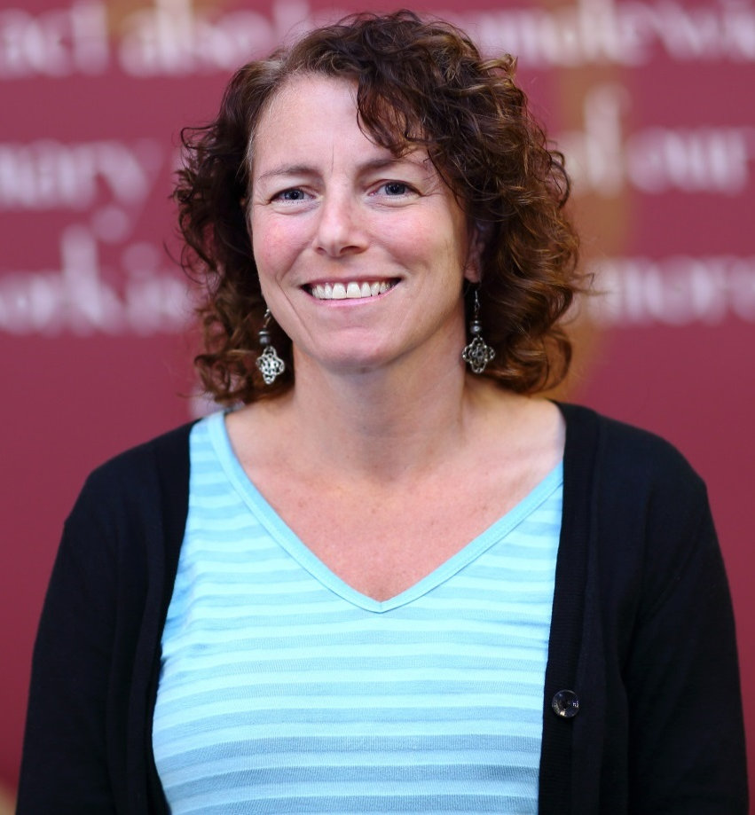
Thank you for attending!
30 years of nonprofit experience
Supervision and performance management training
Human resources consulting
Nonprofit compensation and benefits report
At TSNE for 13 years,
where…I’m not just a trainer and consultant, I am part of an organization where I supervise and am supervised…

Slide 4
What’s Your Role?
Poll: Please choose the title that best describes your role.
Admin or program assistant
Admin or program coordinator
Admin or program manager
Human resources professional
Executive director/CEO
Board member

Slide 5
‘Accidental Practitioners’
At a glance.

Slide 6
The basics
People: Our greatest resource
Human resource function: Supports employees’ effectiveness and ensures compliance with regulations.
Values alignment: Practices reflect organizational values. Policies treat staff in ways that are consistent with their mission and vision

Slide 7
Observations from the field
Living Wages
43% earn less than $28,000.
Equity
Male leaders earn significantly higher pay than female.
Diversity and Inclusion
86% of nonprofit leaders in New England are white.
Notes:
It’s not as straightforward as it seems.

Slide 8


How do we respond?
Don’t always have barrels of resources to pay more.
Can raise these issues with funders and partners!
Can’t necessarily change the way the sector operates singlehandedly.
Can create workplaces that model the world we want to create!

Slide 9

Why it matters.
Every day, I get up and I think ‘you know what? I’m going to do good things today.’
– Ready to Lead survey participant

Slide 10
Risk losing high performing staff.
“I like the challenge of my work and am passionate about the issues…
though the amount of work and worry does takes its toll.”
– Leadership New England survey participant
Notes:
2 out of 5 feel burned out.

Slide 11
Why it matters.
        A disparity between personal and organizational values reduces the desire to stay.
        Compatibility between these two values increases the desire to stay.
– Center for Values Research, study findings
Notes:
-Center for Values Research, Inc; studies of tens of thousands of employees in over 500 organizations

Slide 12
Why focus on values-based human resources specifically?
Effective organizations ‘walk their talk’
HR systems aligned with values bring our organizational mission to life
Better hiring practices; best fit
Employee satisfaction and retention

Slide 13
Human Resources Practices
  Job Descriptions
  Performance Reviews
  Orientation
  Compensation
  Benefits
  Reward and recognition
  Supervision

Slide 14
Job descriptions.
  Reflect culture and values
  Support effective hiring practices so you get the right people
  First handshake: Message your mission
  Foundation for performance management

Slide 15
Job descriptions (anatomy)
  Job Title
  Organizational description
  Position summary
  Essential duties
  Qualifications
Notes:
Future gardeners prepares urban youth for early employment success in the horticultural arts and supports them in developing a broad skill set as they transition to the work world.

Slide 16
Job descriptions (anatomy)
  Job Title
Genius: service technician – Apple retail stores
Ambassador of Buzz: communications associate – Grasshopper
Notes:
Future gardeners prepares urban youth for early employment success in the horticultural arts and supports them in developing a broad skill set as they transition to the work world.

Slide 17
Job descriptions (anatomy)
  Organizational description
Future gardeners prepares urban youth for early employment success in the horticultural arts and supports them in developing a broad skill set as they transition to the work world.
Notes:
Future gardeners prepares urban youth for early employment success in the horticultural arts and supports them in developing a broad skill set as they transition to the work world.

Slide 18
Job descriptions (anatomy)
  Position Summary
This position will work collaboratively to support and deliver youth services for
the Young Farmers after school classes.

Slide 19

Job descriptions (anatomy)
  Essential Duties: be descriptive!
Work with kids on their reading.
or
Tutor individuals and small groups of elementary age
students to support their reading and language skills.

Slide 20
Job descriptions (anatomy)
  Essential Duties: be descriptive!
Staff reception desk.
or
Greet visitors in a friendly manner and provide
Information or resources as needed.
Notify staff when visitors arrive; accompany guests to
appropriate offices and meeting rooms.

Slide 21
Job descriptions (anatomy)
  Qualifications
Experience What they have done
Skills What they can do
Knowledge What they know
Qualities Other (less tangible)
things applicants bring

Slide 22
Qualification (experience)
Vision: Achieving excellence in service
Qualification: Experience providing impeccable customer service

Slide 23
Qualification (skill)
Vision: We envision a world that is racially and economically just in which wealth, land and power are shared.
Qualification: Proven ability to engage in productive conversations about power and privilege in the workplace

Slide 24
Qualification (knowledge)
Mission: We teach children cooperative play as a way of problem solving.
Qualification: Demonstrable knowledge of cooperative play pedagogy

Slide 25
Qualification (qualities)
Mission: We nurture the joy of learning in school age children.
Qualification: Curiosity about the world and a passion for life-long learning

Slide 26

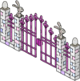

A word about college degree and other formal requirements

Slide 27
How useful are your performance reviews?
Poll: How useful are your organization’s performance reviews?
    Extremely
    Depends on who is doing the reviewing
    Just a formality
    What performance reviews?

Slide 28
Performance reviews
Notice what is working and what can be improved upon;
Facilitate planning for the upcoming year;
Provide an opportunity to shore up resources, including professional development and learning opportunities, to support effectiveness;
Help supervisors and staff to pay attention to their supervisory relationship and make adjustments as necessary;
Provide staff with an opportunity to explore the ways their work contributes to your organizational mission.

Slide 29

Performance reviews
Tied to:
Job description
Goals
Organizational values
Mission

Slide 30
Performance reviews
Value honesty and respect
Ask
Provide examples of ways in which the employee (or you) demonstrated this value.
Are there instances when this person could have done a better job being honest
and/or respectful?
Mission The mission of The Women’s Center is to improve the career, financial and legal well being of women.
Ask
Please give examples of the ways in which this person’s work helped improve the well being of women.

Slide 31
Performance reviews
Build systems that:
Recognize biggest accomplishments
Provide opportunities to discuss what staff can do
to be more impactful.
Plan for the future – working in your organization
and beyond
Provide opportunity for supervisors to solicit feedback

Slide 32
Orientation process?
Poll describe your organization’s new employee orientation process
Trial by fire (they are lucky if we show them where the bathroom is)
We take new people out to lunch
New employees meet with a number of people on their first day
We have an extensive orientation and training plan that takes place over a number of weeks or months

Slide 33

Orientation
Critical to success
Plan to invest plenty of time
Can require up to a year

Slide 34
Orientation
At the macro-level
History, structure, mission of organization
Organizational culture
Explanation of important personnel policies
Expectations as they relate to cultural competency
Notes:
Activity: Handout; individually rate, then talk together about prioritizing for action.

Slide 35
Orientation
At the department or program level
The program’s goals, objectives, history and place within the sector
How the person’s job contributes to program goals
The way members of your team work together
Notes:
Activity: Handout; individually rate, then talk together about prioritizing for action.

Slide 36
Orientation
At the job level
Job expectations and individual goals, using the job description as a framework
Skill building resources that the new staff person may need (e.g., computer training, writing workshops, etc)
How you will work with and communicate with this person
Decision making
Notes:
Activity: Handout; individually rate, then talk together about prioritizing for action.

Slide 37

Compensation and Benefits
Building a compensation structure isn’t just about the numbers…
… asking the right questions
is the first step
Notes:
Activity: Handout; individually rate, then talk together about prioritizing for action.

Slide 38
Compensation
How important is internal equity and fairness?
How important is pay competitively within the market?
Should employees with more tenure earn more than those doing similar jobs with less tenure?
What role should performance play in determining compensation?
Are there particular skills that are valuable enough to warrant additional financial reward?
What is the ideal ratio between the highest and lowest salary?
Notes:
Activity: Handout; individually rate, then talk together about prioritizing for action.

Slide 39
Benefits reflect values, too!
Health insurance
Waiting period
Individual, family, employee + 1 options
Domestic partner coverage
Premiums
Plan structure
Other benefits
Flexible schedules
Tuition reimbursement
Transportation benefit
Leave time
Number of days
Accrual rate
Carry over
What holidays are recognized
Notes:
Activity: Handout; individually rate, then talk together about prioritizing for action.

Slide 40





Employee reward and
recognition

Slide 41
Supervision
The role:
Provide thoughtful and well-planned support and direction enabling staff members to successfully meet individual and programmatic goals and to contribute to the overall mission-effectiveness of your organization.
Notes:
Activity: Handout; individually rate, then talk together about prioritizing for action.

Slide 42
Supervision
Effective supervisors:
Build mutually respectful and trusting relationships
Are adaptive
Meet regularly; one on one
Provide well thought-out, regular feedback
Model and raise up organizational values
Notes:
Activity: Handout; individually rate, then talk together about prioritizing for action.

Slide 43
Supervision
Effective organizations:
Recognize and value supervision
Have clear expectations for supervisors
Train and support supervisors
Encourage feedback TO supervisors
Notes:
Activity: Handout; individually rate, then talk together about prioritizing for action.

Slide 44
Getting started
Know your values
Choose a starting place
Consider how a particular policy or practice does or does not align with values
Involve others
Be willing to experiment
Get a human resources assessment

Slide 45
Human Resources Assessment
 | Over all practices | Red flags | Suggestions
Hiring | Excellent | None | Develop standard questions
 |  |  | Add organizational values to postings and ads
Supervision | Acceptable |  | Consider individual, regularly scheduled supervision meeting for all staff
 |  |  | Consider implementing a written job description for supervisors (See Appendix D)
OK
Payroll and Record Keeping | Needs Improvement | No signed records | Secure signed time cards
 |  | All records in one file per employee | Separate I-9s and health related information from personnel file

Slide 46

Biennial nonprofit compensation study
Insights and analysis from the field
Information from 250 organizations in Massachusetts and Connecticut
New study launches this fall for 2017
www.tsne.org/compensation-data

Slide 47
Look for our survey in the
Massachusetts Nonprofit Network newsletter coming this fall.
www.tsne.org/compensation-data

Slide 48

Thank You!
  Lyn Freundlich
  Director of Human Resources
  Third Sector New England
  617-896-9326
  lfreundlich@tsne.org
  www.tsne.org
Notes:
Stewart

Slide 49
Mission sustainability is basis for aligned human resource systems
Recruiting and Hiring
Compensation
Benefits
Performance Management and Supervision
Mission, Vision and Values

