Slide 1
Emerging Leaders:
Navigating Challenges & Opportunities for a Thriving Nonprofit Career
Presented by: Colby Swettberg
Chief Executive Officer
Silver Lining Mentoring
Notes:
Materials: sticky poster paper, markers, table tents with 4 sets of #s 1-6
To do: bullet notes for what to cover quickly in my story that highlight topics. Add slide with fam photo. Write out timing.

Slide 2
Topical Goals
How to effect organizational change as a young, or aspiring leader
Ways to pursue networking and professional development opportunities
How to forge a career path, such as a move from direct service to management

Slide 3
Introductions
In 30 seconds or less, please share:
Your name
Current organization & role
The next org change, title change or promotion you’d like to go after

Slide 4
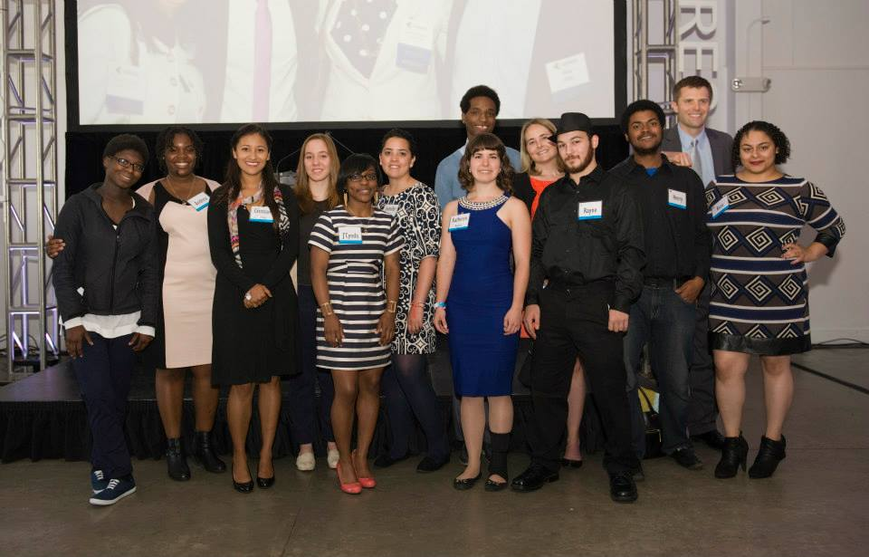
Who I am and How I got here
Silver Lining Mentoring
Notes:
Insert fam photo

Slide 5
Managing Up
Managing up is the process of consciously working with your boss to obtain the best results for your organization, your boss and for you. This is not political maneuvering or kissing up. Rather it is a deliberate effort to bring understanding and cooperation to a relationship between individuals who often have different perspectives.
-Thomas Zuber and Erica James
Creating a Win, Win and Win situation

Slide 6
Benefits of Effective Upward Management
Better outcomes for the organization
Improved relationships
Increased professional opportunity
More trust, freedom
Increased innovation
Agency loyalty
Better quality of work life
Increased motivation, productivity
Credit: Institute for Nonprofit Management & Leadership

Slide 7
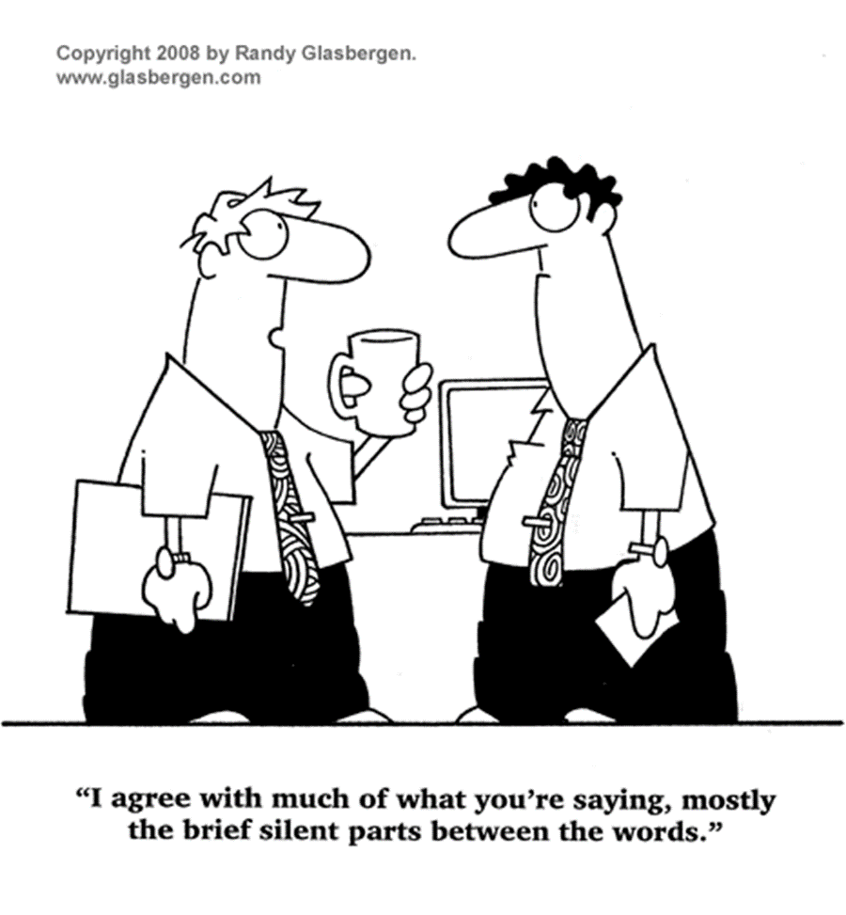
Effecting Change by Managing Up

Slide 8
Managing Up – Do’s & Don’ts
Don’t publicly challenge your boss. EVER.
Don’t go over or around their head (Unless it becomes necessary)
Demonstrate that you’ve got their back (Be trustworthy/honest)
Publicly play to your strengths, privately work on your development areas
Find out what’s important to your boss and deliver that as much as possible (Know their agenda/preferences)
Tactfully but deliberately celebrate/promote the success of your team
Keep your boss informed (Don’t surprise them, even with good stuff)
Be proactive: identify your professional goals and identify who can help you reach them
Credit: Institute for Nonprofit Management & Leadership

Slide 9
Managing Up Do’s & Don’ts continued…
Be authentic (Don’t just “yes” your boss)
Have integrity
Let your boss know when they’ve done a nice job, they’re people too
Come to a dilemma prepared with a solution
Ask questions (Don’t assume)
Coach them to be effective
Know your boss’s strengths and weaknesses
Expect to manage up (Don’t set yourself up)
Credit: Institute for Nonprofit Management & Leadership

Slide 10

Building your Network & Professional Development Opportunities
Notes:
The most successful people look for and build networks, everyone else looks for work.

Slide 11
Networking Tips
Be helpful - Share your expertise and ideas. Share information. Promote your network’s work and accomplishments. Be a connector.
Listen - People love to talk about themselves and appreciate when you take a genuine interest in what they have to say.
Build a reputation - By building a reputation as someone who is talented, helpful, and valuable, people will be more motivated to meet you and stay in touch with you.
Be intentional - Go where the people you want to meet hang out both online and offline. Interact with people and build rapport.
Follow up - Be the person who follows up promptly with a thank you (note or email) and deliver on any promises or offers you made. Stay in touch with people you like!
Source: 10 Business Networking Tips: Grow Your Professional Network By Mike Fishbein

Slide 12
Build Your Personal Board of Directors
If you were to create a personal board of directors, what types of people would you like to have on your board?
Who specifically would you like to be on your board?
How would you use your board?
What would you contribute to your board members?
Credit: Bill George, True North

Slide 13


Forging a Career Path & Moving up

Slide 14
The 70-20-10 model of Leadership Development
Notes:
Pioneered by the Center for Creative Leadership and based on 30 years of study of how executives learn to lead, it rests on the belief that leadership is learned through doing. There's plenty of evidence to support that belief, including a study by the Corporate Leadership Council that concluded that on-the-job learning has three times more impact on employee performance than formal training.¹
As the 70-20-10 name implies, the learning model calls for 70 percent of development to consist of on-the-job learning, supported by 20 percent coaching and mentoring, and 10 percent classroom training. The model has spread widely in the corporate and nonprofit worlds, with various organizations putting their own imprint on it.
The 70-20-10 model's three components reinforce one another, adding up to a whole that's
greater than the sum of its parts. The model builds on research showing that human beings
retain information most effectively when they gain it in a practical context. Learning is even more
powerful when the lessons of experience are reinforced through informal discussion with people
who have performed similar work. These veterans can point out common pitfalls, offer practical
advice, and help steer the learner away from bad habits.

Slide 15
Guiding Questions for Small Groups
What's getting in the way of the next step in your career?
What strategies do you use to develop professionally?
How do you effect change when you're not in charge?
How do you build your network?
How do you set yourself up for promotions?
What jobs are available in the field for non-profit leaders?

Slide 16
Introductions in Small Groups
In 30 seconds or less, please share:
Your name
Current organization & role
The next org change, title change or promotion you’d like to go after

Slide 17
Resource Sharing
Using the poster paper around the room, please write up one resource/idea to share (it could be something you learned today or something you already knew about).
Feel free to take a picture of completed poster comments for future reference.

Slide 18
Thank You!
Questions?
Go forth and take advantage of your next opportunity!
Feel free to stay in touch:
Colby@silverliningmentoring.org

