Slide 1

Boost Your Efficiency & Productivity
Presented by:
Russell Greenwald, Vice President,
Director of Technology Consulting Practice
Ryan Ecclestone, Senior IT Project Manager
Scott Hagerty, IT Manager
October 2015
Copyright © 2015 Insource Services, Inc. All Rights Reserved.

Slide 2
Agenda
Email Etiquette
Email Inbox Management
Calendaring
Task Management
Communication Strategies
Summary
Notes:
Email Etiquette - (Scott) - 15 min
Email Inbox Management - (Russ) - 15 min
Calendaring - (Scott) - 15 min [currently too long]
Task Management - (Ryan) - 10 min
Communication Strategies - (Ryan) - 5 min
Summary - (Russ) - 2-5 min

Slide 3
Objectives
Give you tools and information to:
Shorten time to complete daily tasks
Look to automate repetitive tasks
Organize your work
Define guidelines with coworkers around focus time

Slide 4
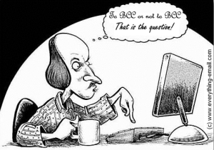
Email Etiquette
Recipients
Who is your audience?
To: Who needs to read the message and may need to reply?
CC: Who should be kept informed throughout the conversation?
BCC: Who should know the conversation is occurring, but doesn’t need to follow later steps?
Notes:
CC: May wish to follow along, but not expected to necessarily reply
BCC: Say so, that the particular someone is informed but doesn’t need responses
Who has had a BCC’ed recipient Reply All - Forward instead
“Who has ever…”
In sensitive chains, be very judicious about recipients. Consider leaving field blank until the message is ready.
Proper email etiquette saves others’ time

Slide 5
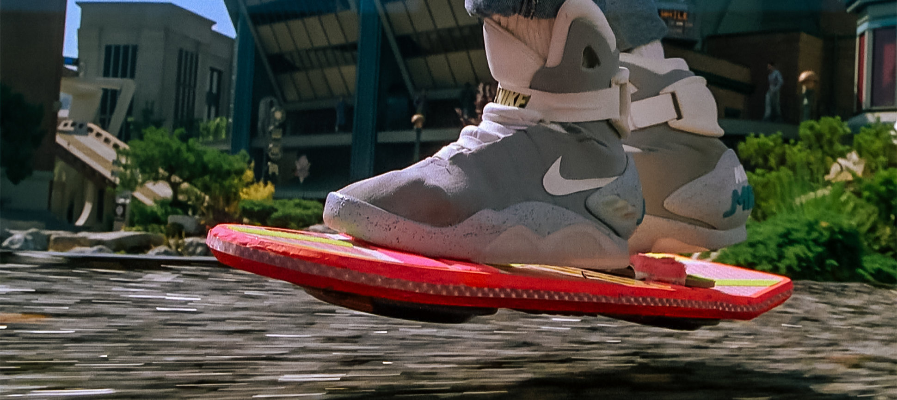
Email Etiquette
Recipients
Who is your audience?
BCC’ing
No secret BCC’ing! - Forward instead
“I am including Marty on BCC so he is aware this conversation is occurring.”
“I’ve moved Calvin to BCC; thanks for introducing Lorraine and me!”
“I hope they bought your message - if we’re lucky they won’t figure out that whole water and hovercraft glitch before we track them down.”
Notes:
CC: May wish to follow along, but not expected to necessarily reply
BCC: Say so, that the particular someone is informed but doesn’t need responses
Who has had a BCC’ed recipient Reply All - Forward instead
BCC: After introduction, move middleman to BCC
BCC: Can also be used for larger one-way mailings where recipients don’t need others’ addresses or replies, might get flagged as SPAM
“Who has ever…”
In sensitive chains, be very judicious about recipients. Consider leaving field blank until the message is ready.
Proper email etiquette saves others’ time

Slide 6
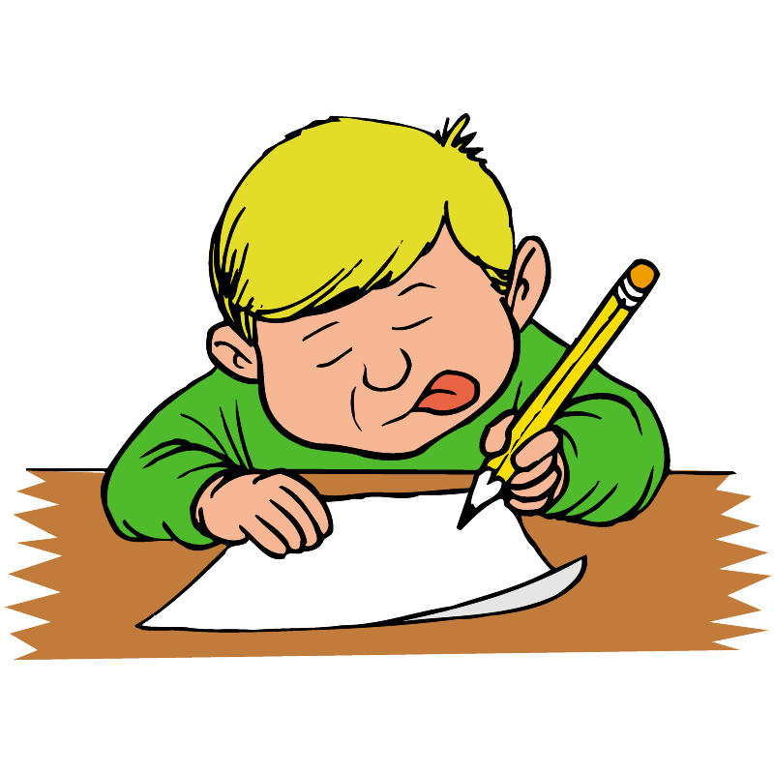
Email Etiquette
Message Body
How do you say your message?
Position of key message
Consistent VISUAL style
Brief, direct, professional
Proofreeding
Notes:
Key message: Key message or question at the top
Style: Use consistent fonts, italics for emphasis, caps comes across as YELLING
Brief: Bullet points, numbered lists
Direct: Trim the fat (“I just want to say” “I think that”)
Professional: No jokes or sarcasm unless it’s VERY clear - no body language nor vocal inflections = terrible medium for comedy
Proofreading: Select key message at the end, move to top. Re-read the message according to the number or roles of its recipients
Time spent preparing the message can save back-and-forth, clarifying questions, scheduling headaches
Compose very complex messages in another program, where it can’t be easily discarded

Slide 7
Email Etiquette
Message Body
How do you say your message?
Use the below tactics to save their time and, ultimately, yours.
Brief, bulleted lists
Use consistent visual style, with emphasis or YELLING
“Great meeting, haha!”
Invest tim for important or large audiences
I just wanted to say, I think that we should Trim the fat and be direct.
Notes:
Key message: Key message or question at the top
Style: Use consistent fonts, italics for emphasis, caps comes across as YELLING
Brief: Bullet points, numbered lists
Direct: Trim the fat (“I just want to say” “I think that”)
Professional: No jokes or sarcasm unless it’s VERY clear - no body language nor vocal inflections = terrible medium for comedy
Proofreading: Select key message at the end, move to top. Re-read the message according to the number or roles of its recipients
Time spent preparing the message can save back-and-forth, clarifying questions, scheduling headaches
Compose very complex messages in another program, where it can’t be easily discarded

Slide 8

Email Etiquette
Subjects
What is the message about?
Denote a specific topic
One topic per chain
Grabs attention
Occasionally visible to others
Conversation View
Consolidates multiple messages on the same topic
Splits when subject line changes (except RE: & FWD:)
Notes:
Left last intentionally, for my style
Either way, keep subject tied to message of body
Subject examples:
Bad Subject: Lunch
Good Subject: Missing meatloaf from staff fridge
Ugly Subject: Is Ryan stealing leftovers?

Slide 9
Email Etiquette
Subjects
What is the message about?
Bad Subject: Lunch
Good Subject: Missing meatloaf from staff fridge
Ugly Subject: Is Ryan stealing leftovers?
Notes:
Subject examples:
Bad Subject: Lunch
Good Subject: Missing meatloaf from staff fridge
Ugly Subject: Is Ryan stealing leftovers?

Slide 10

Email Inbox Management
Goal
Be more productive
  Schedule time for and away from email
Create a system to process email
Turn off notifications
Make it a habit
Notes:
Focus your best self on the most important things that day
When you are checking your email be productive, don’t spend that time doing nothing with it, when you could be doing something else.
Which means no pop ups, dings, vibrates, or other intrusive notifications
practice, practice, practice..

Slide 11
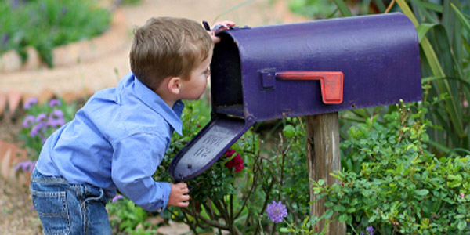
Email Inbox Management
Scheduling
10/60 rule
1 minute rule
Scheduled time for complex email
End of the day - Inbox Zero
Don’t be this little kid
Notes:
When to check email - 10 min out of every hour
Types of email
Emails you can get through in less than a minute
Complex emails are work. Schedule time in your day to do Email work..
Ultimate goal - End of day nothing left in the proverbial mailbox (we will get to this)
Don’t have a staring contest with your email

Slide 12
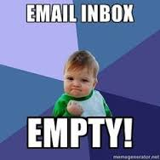
Email Inbox Management
Inbox Zero
Defining Inbox Zero
Dealing with email - Reply, Forward, Delete, Archive, Tag for a task
Organizing
Keyboard shortcuts
Custom filters/rules
Do not mark as unread
Notes:
Merlin Mann created the inbox zero concept, based off of GTD principles
Lets talk about this
1 min emails - What are they and what you can do about them
Longer emails - Same..
Organizing
Important Emails or tasks
Waiting on label
Why are keyboard shortcuts important- improve speed.
Custom Filters/Rules - Helps keep the inbox to emails you want to process.
Marking unread is a form of strategic procrastination or what I call “lazy effort”

Slide 13
Email Inbox Management
Demo
Outlook | Google
Layout | Layout
Quick Steps | Keyboard Shortcuts
Rules | Filters
Folders | Labels
Notes:
Emergency user for google - user:Emergency@insourceservices.com, Oct32015
IT demo user for Outlook - user: itdemo, Oct32015
Why I don’t like message preview

Slide 14
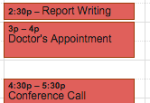
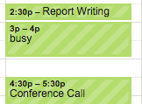
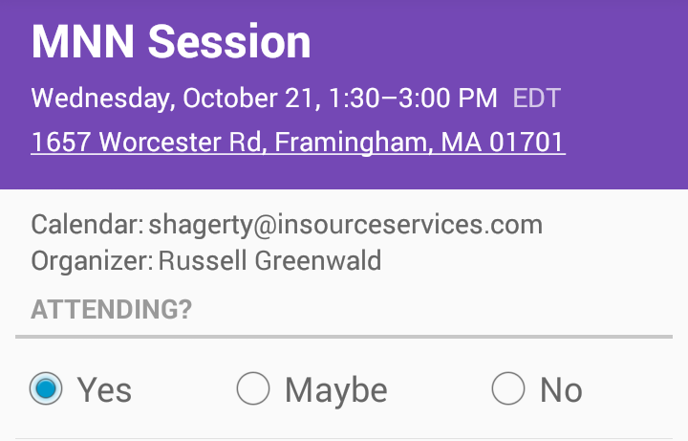
Calendaring
Calendaring
Attendees
Required vs. Optional
Personal Life
Block time in your calendar, but keep the event Private
Meeting Details
Add address in location for easy navigation on mobile
Phone number in location for linked dialing
Convert email to meeting
Notes:
Required vs Optional will affect automated schedulers, lets others know if they are expected to attend.
Private events like doctors’ appointments still consume your time, even if you don’t share the details with others.
If meeting in person, add the address for easy navigation from one’s phone
If meeting via a conference call, add the dial-in number and any codes in the location for easy reference at the time of the call
Put in an agenda or linked documents, or just convert an email chain into a meeting

Slide 15
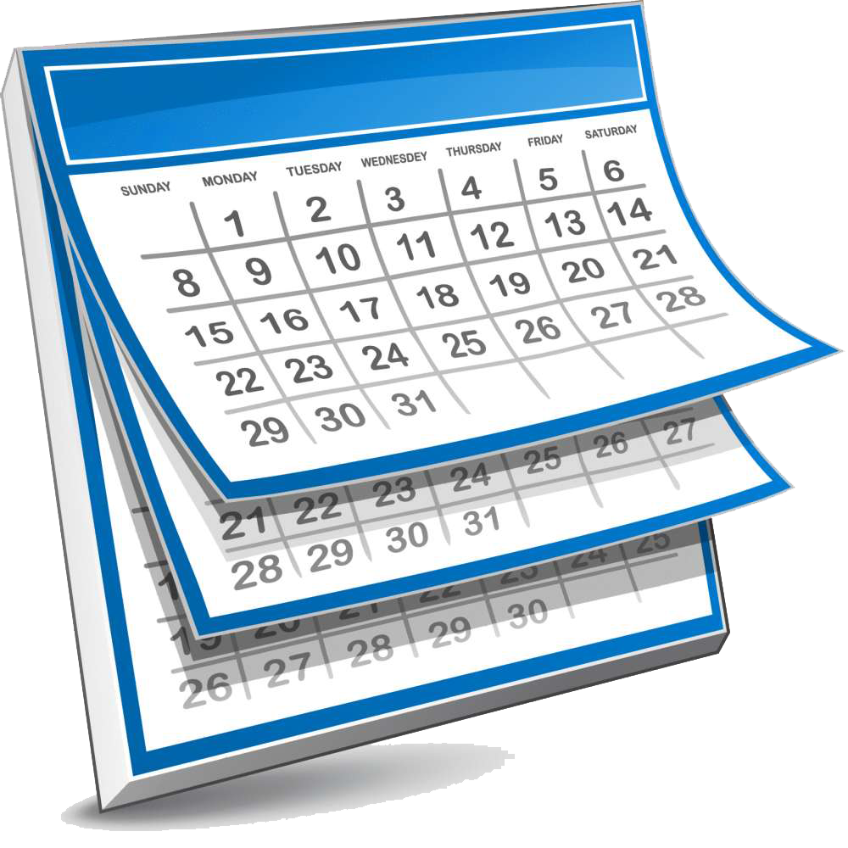
Calendaring
Calendaring
Internal Scheduling
Email with your availability choices first - skip calendaring
Outlook - Scheduling Assistant
Gmail - Find a Time
Allow attendees to change/propose new time
External Scheduling
Email with your availability choices first - skip calendaring
Sharing via Outlook
Sharing via Gmail

Slide 16
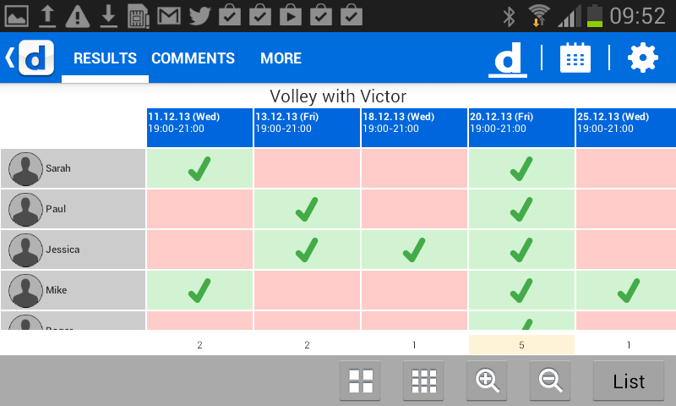
Calendaring
Calendaring
Doodle
Doodle - allows for choosing what gets moved if there isn’t a free slot
Sync Google/Outlook to Doodle
Notes:
Doodle - here’s what it looks like, not how to do it (assistants)

Slide 17
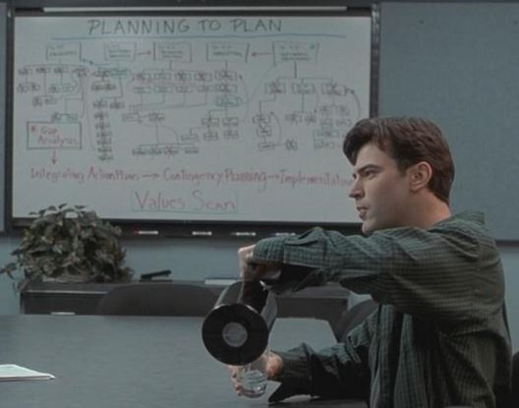
Task Management
Planning
Focus on single tasks
Group like tasks
Do tasks in time efficient order - “Do the Laundry”
Use a task management system (not your inbox)
Notes:
Importance of planning
We dont multi-task, we task switch horribly
Grouping like tasks - the Henry Ford Model - assembly line
Dont watch paint dry - start something that can be left alone for a bit and then move on to task #2
Don’t use your inbox to manage tasks - think of your inbox like your actual mailbox

Slide 18
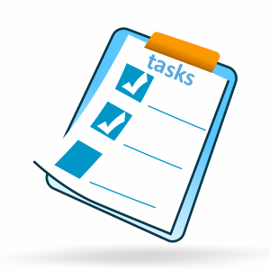
Task Management
Strategies:
Spend 10-15 minutes each morning and afternoon planning out the next four hours
Dedicate time to Email
  Check email once an hour for 10 minutes, reply only to anything urgent
  Spend an hour replying to everything else later in the day
Figure out your efficient times for different tasks
  Writing in the morning, meetings late morning through mid afternoon, tasks from meetings end of day
Demo of Asana
Notes:
Carve time out to plan your tasks, dont get wrapped up in doing and lose sight of the big picture
Dont let email weigh you down
Track your own productive times and use them wisely for certain tasks
Find a task management system that works for you, Demo of Asana, due dates, etc

Slide 19
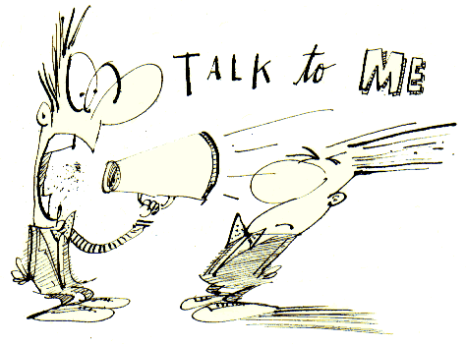
Communication Strategies
Interruptive | Non-Interruptive
Calls Text/IM’s Walking into someone’s office | Email Calendar invitations Snail mail
Notes:
Pick the right communication medium based on response time required
If you can take a vacation, you can spend a few hours writing a report.
Set Computer/Phone to only buzz for interruptive communications
Once you and colleagues are utilizing the tools and techniques we’ve already shown you, there will be the question of which method of communication to use. It usually boils down to a single question. If it can wait, then allow the other person to deal with it in their own way, at their own pace.
If it cannot, use whichever method fits that individual, the company’s culture, or privacy and noise concerns.

Slide 20
Summary
Take time to compose your email
Show your email who’s boss
Make scheduling easy on the recipients
Organize your work based on your productivity
Team habits can increase efficiency

Slide 21
Questions

Slide 22
Contact Information
Russell Greenwald, Vice President,
Director of Technology Consulting Practice
rgreenwald@insourceservices.com
781-374-5116
Ryan Ecclestone, Senior IT Project Manager
recclestone@insourceservices.com
781-374-5126
Scott Hagerty, IT Manager
shagerty@insourceservices.com
781-374-5134
www.insourceservices.com

