Slide 1

Digital strategy for today and tomorrow
Todd Felton &
Mitch Anthony

Slide 2

Welcome!
Write your name on front of card
On back side of card, please write 1 thing you wish was different about your website, social media, or email

Slide 3
Digital strategy for today and tomorrow
What can I do today, next week, and in three months?
Todd Felton: Digital strategist
@rtfelton
Mitch Anthony: Brand Strategist
@mitchanthony
We are Clarity: http://clarity-first.com
@clarity-first
Notes:
I introduce the session and myself
Mitch introduces himself and Clarity

Slide 4
Always start with a story
So, This is a story about fear...
Notes:
What I have found with working with large and small clients in social media, website rebuilds, and digital strategy is a concern about doing it right. Whether it is developing a clear messaging strategy to roll out online, developing digital collaboration tools, or ramping up a social media campaign, most people I’ve worked with are reluctant.

Slide 5
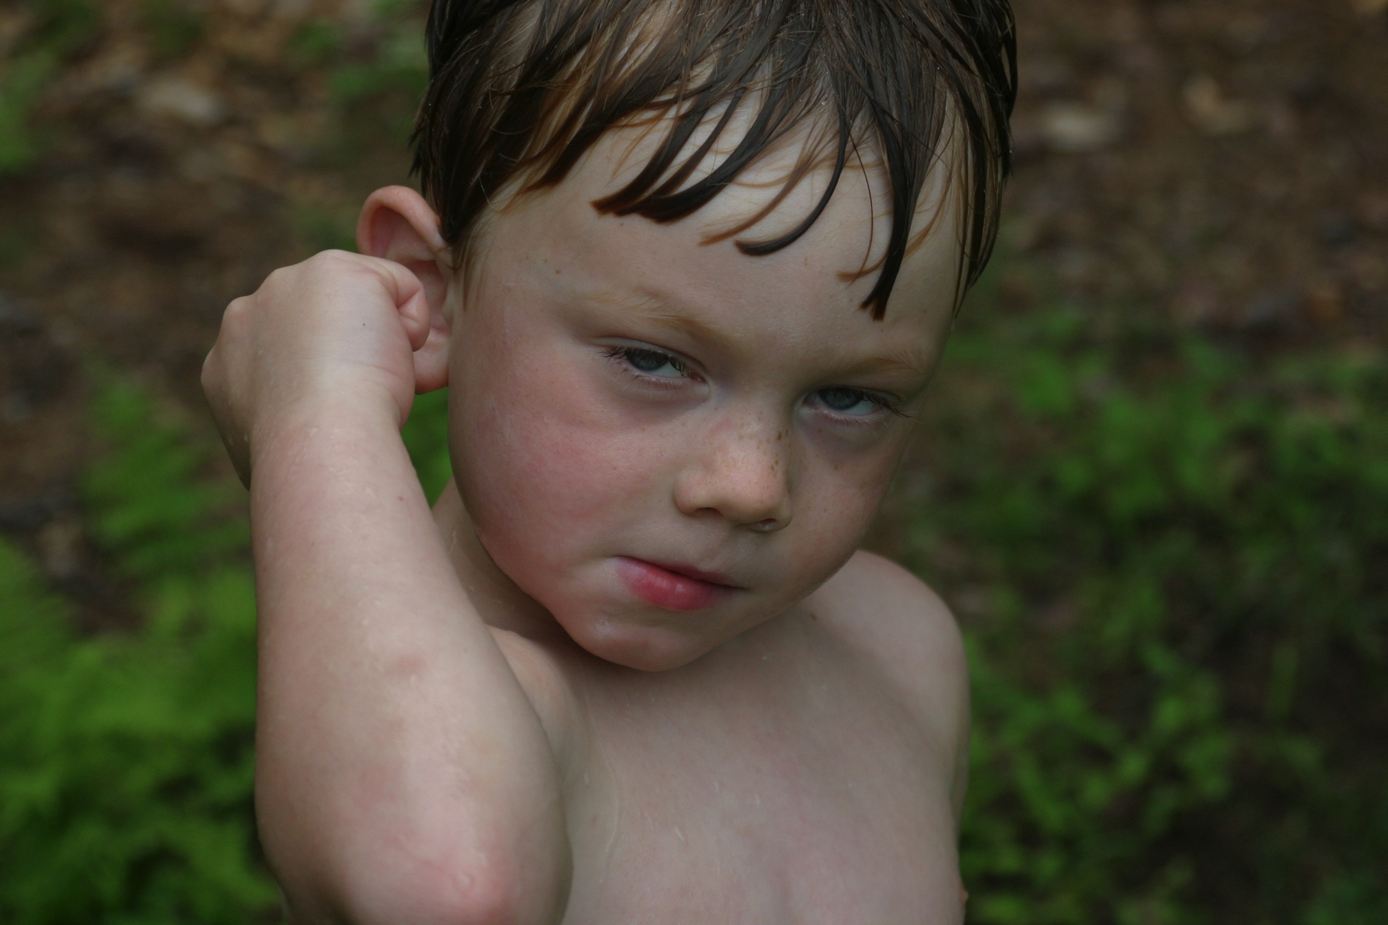
Process
Notes:
The hero. He loves water and his entire goal is getting to water. He believes a slip and slide is the best way to achieve this. He is sure that if he gets a slip and slide, his path will be clear to achieve his goals.

Slide 6
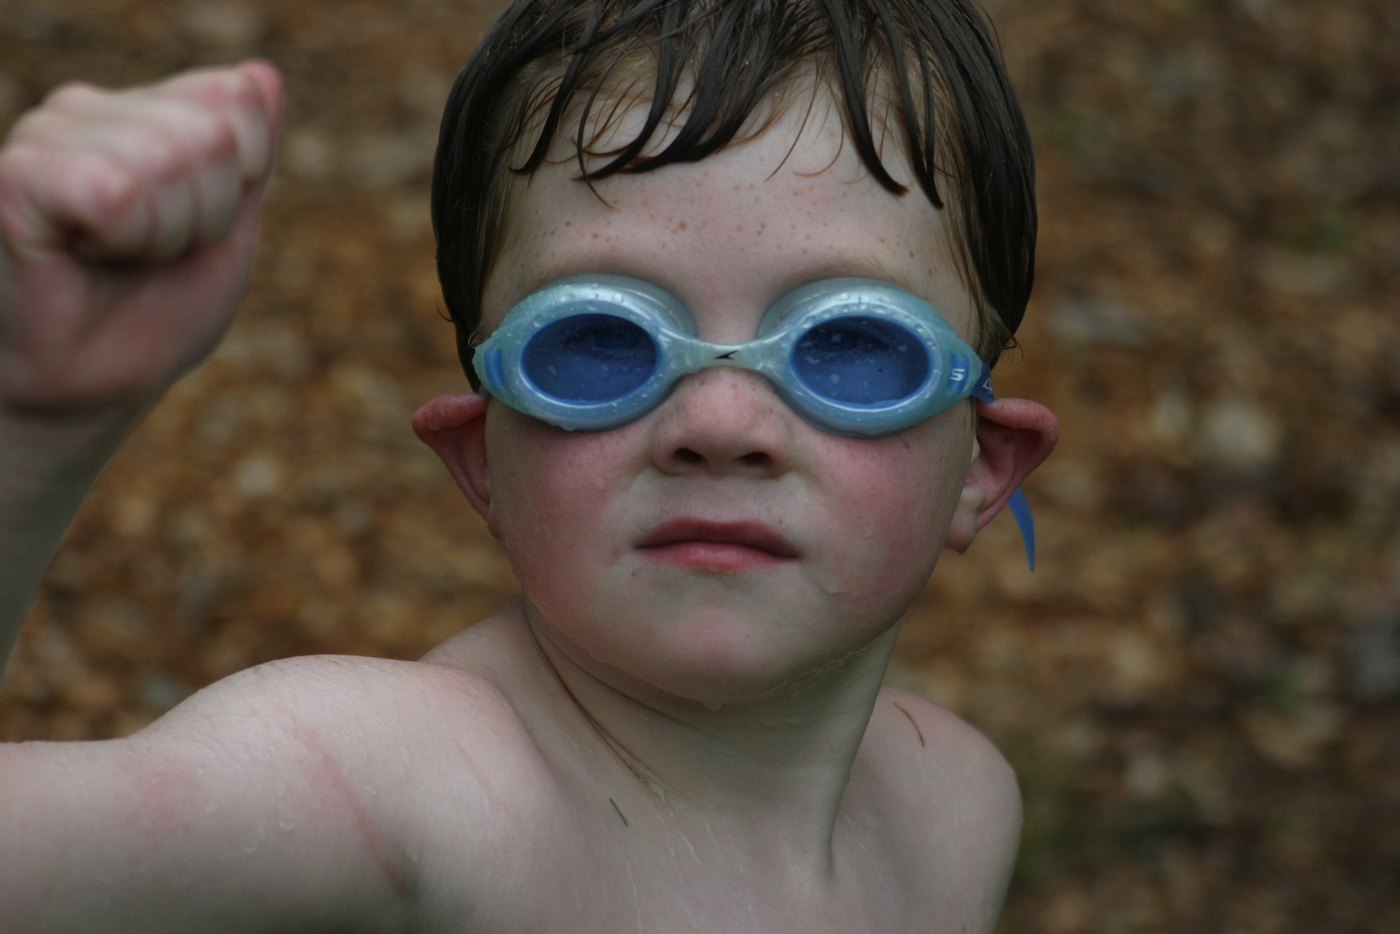
Process
Notes:
His older brother, however, is deathly afraid of getting wet – hates showers, won’t go swimming, and definitely doesn’t want to play in the slip and slide. What the real issue is, it that he just doesn’t like water in his eyes. So, we got him a pair of goggles.

Slide 7
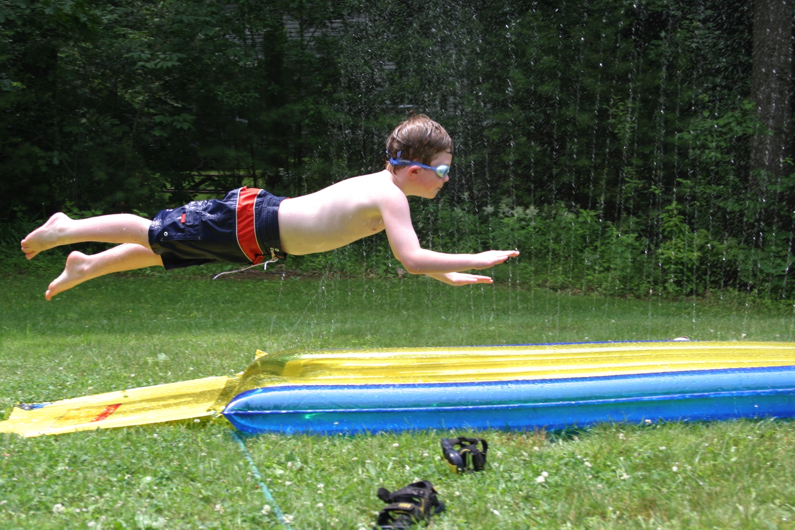
Process
Notes:
Success! So – today’s session is all about giving you your goggles

Slide 8
Overview
Learning Target: I can identify, prioritize, and take actions to use digital tools in support of my organization’s strategic goals
Parking Lot: a place for questions and issues
Ground Rules:
Be present
Speak your truth
Assume best intent
Others?
Notes:
3 minutes

Slide 9
First Exercise
Write your name on front of card
Pair/Share – explain why and what you think it will accomplish being different
Share out
Notes:
10 minutes

Slide 10
What is a brand?
A brand is a promise to the person you serve of how you help them.
When executed effectively the person you are best suited to serve will think of this promise when they think of you.
This promise is the “position” you will own in their mind.
|
‹#›
Notes:
Important to take a moment to understand what we are talking about

Slide 11
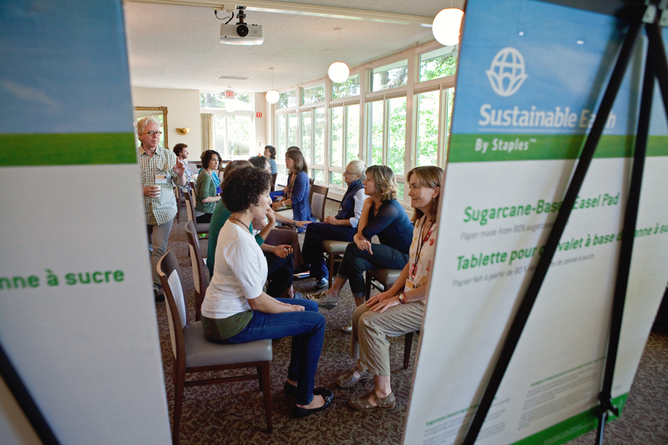

Slide 12
Process
Learning to use your story as a strategic tool
Understand the audience and their needs
Develop look, feel, UX and update the plumbing
Content development/
Content management
Listen first
Dialog Interviews
Core Sample Workshops
Secondary Research
Segmentation
Needs Analysis
Features and Benefits
Primary Brand Promise
Messaging Strategy
Logo
Type and color palettes
Use of imagery
Website
Collateral system
Social media platforms
SEO
Communications plan
Content calendar
Content design & development
Social media management
Testing/Analytics
Notes:
This is everything we might do over a 3-6 month engagement. We can’t explain everything here, so we are going to focus on…

Slide 13
What can we do today?
Identify your primary audiences
Refine or rewrite your social media bios

Slide 14
With whom are we speaking?
We have three primary audiences:
Our own people. The leaders and staff who serve our organization,
Our clients: The people and issues we exist to serve
The community at large. Collaborators, donors and potential donors, the press and key influencers...
The more targeted our audience the more effective our communications.
|
‹#›
Notes:
Mitch to explain this slide and next slide – 3

Slide 15

With whom are we speaking?
1
If we envision our audience map as a dartboard, the organization stands at the middle.
2
The client, the people and issues we serve
are the center ring.
The client, and the people who influence the client
Company
3
The largest ring is made
up of the community at large. This includes collaborators, donors and potential donors, the press and key influencers.
Community, donors, press, influencers
|
‹#›

Slide 16
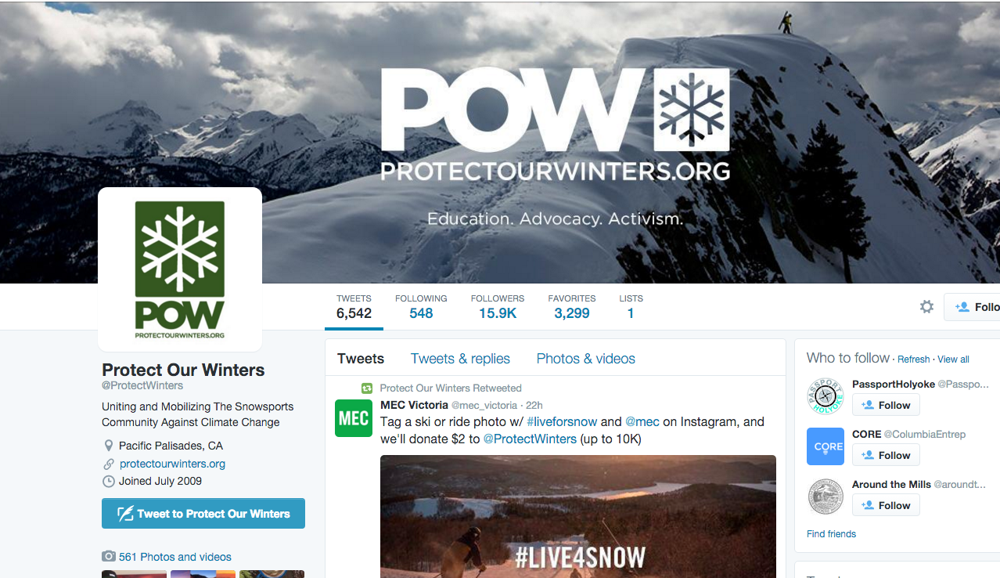
Process
Notes:
Todd to quickly explain next two slides – 2 minutes – Twitter bio – 9 words.

Slide 17
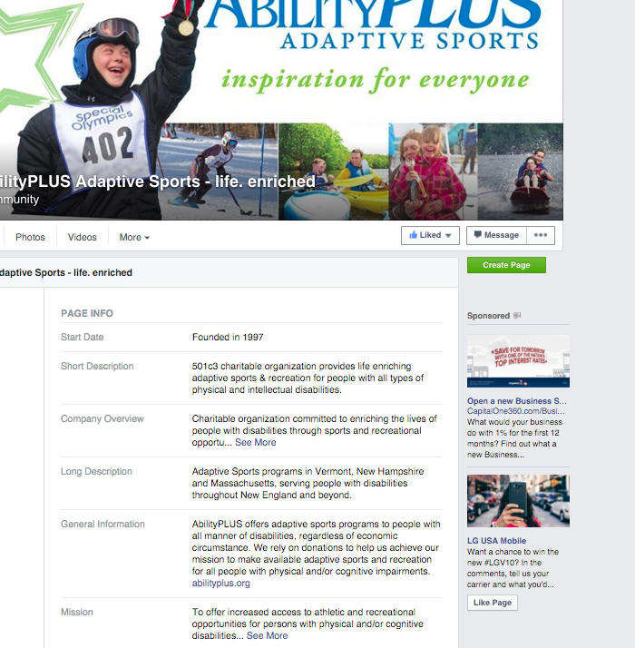
Notes:
Multiple places to tackle – maybe start with long description – as the Frenchman, Blaise Pascal noted, it is much easier to write a longer piece than a shorter one.

Slide 18
What can we do today?
Take 5 minutes to do either:
Identify your primary audiences
Refine or rewrite your social media bios
Notes:
Give them 4 minutes to write, 3 minutes to share, 3 minutes to share out

Slide 19
What can we do next week?
Digital Profile Audit
Creative Brief

Slide 20
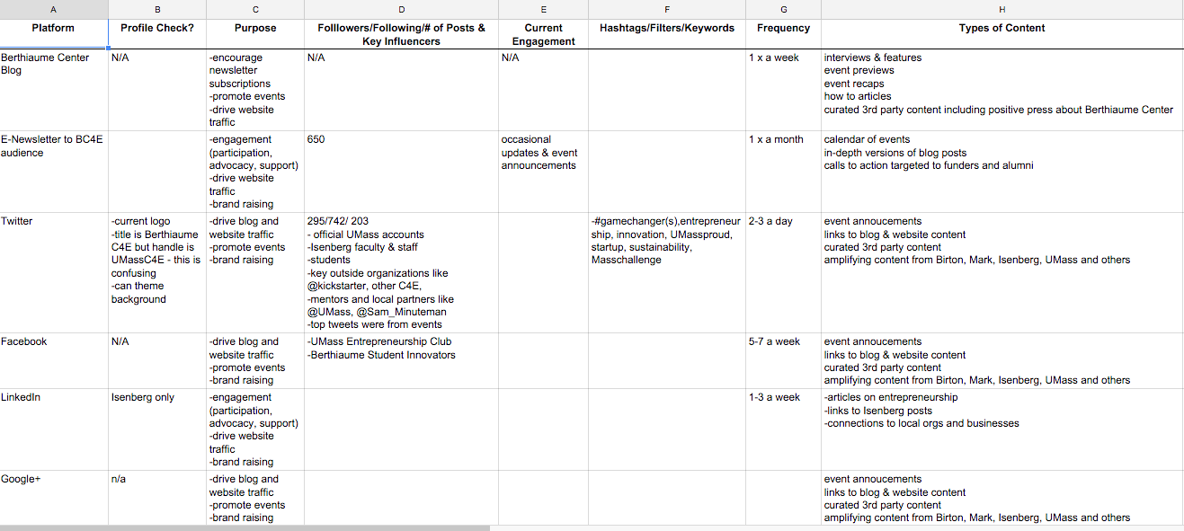
Notes:
Todd – 2 minutes

Slide 21
8 July 2015
Creative Brief
Berthiaume Web Pages
Objective
Update messaging to better reflect refined attitude, spirit and positioning. Invite and encourage student participation in the center.
Invite and encourage faculty participation in the center.
With whom are we speaking?
We have three primary audiences:
Our own people. The leaders, staff and faculty who serve Berthiaume Center,
Student and faculty entrepreneurs and potential entrepreneurs, and
The business community at large. Collaborators, donors and potential donors, others who serve entrepreneurs, the press and key influencers...
What do we want them to know?
Entrepreneurship is a viable and rewarding career path for people like them - strong,
Notes:
Mitch - 2minutes

Slide 22
What can we do in three months?
Develop an editorial calendar
Rebuild a website

Slide 23
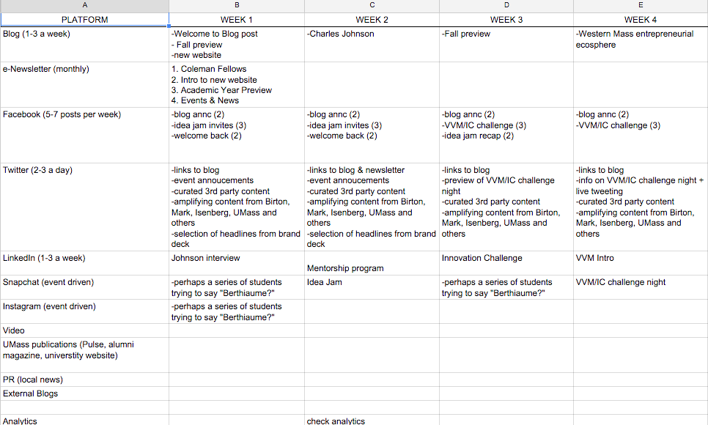
Notes:
Todd – 2 minuts

Slide 24
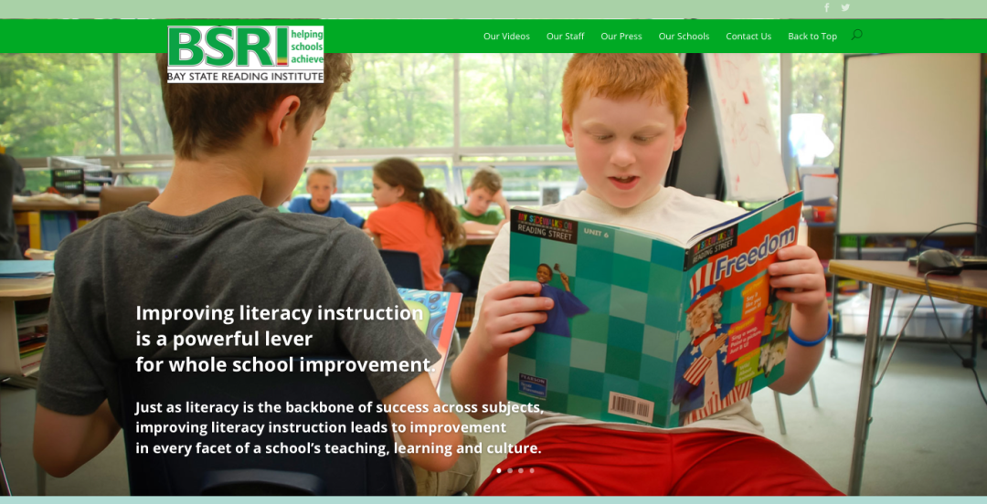
Notes:
Todd – 2 minutes

Slide 25
Questions?
Notes:
Take questions for whatever time is left

Slide 26
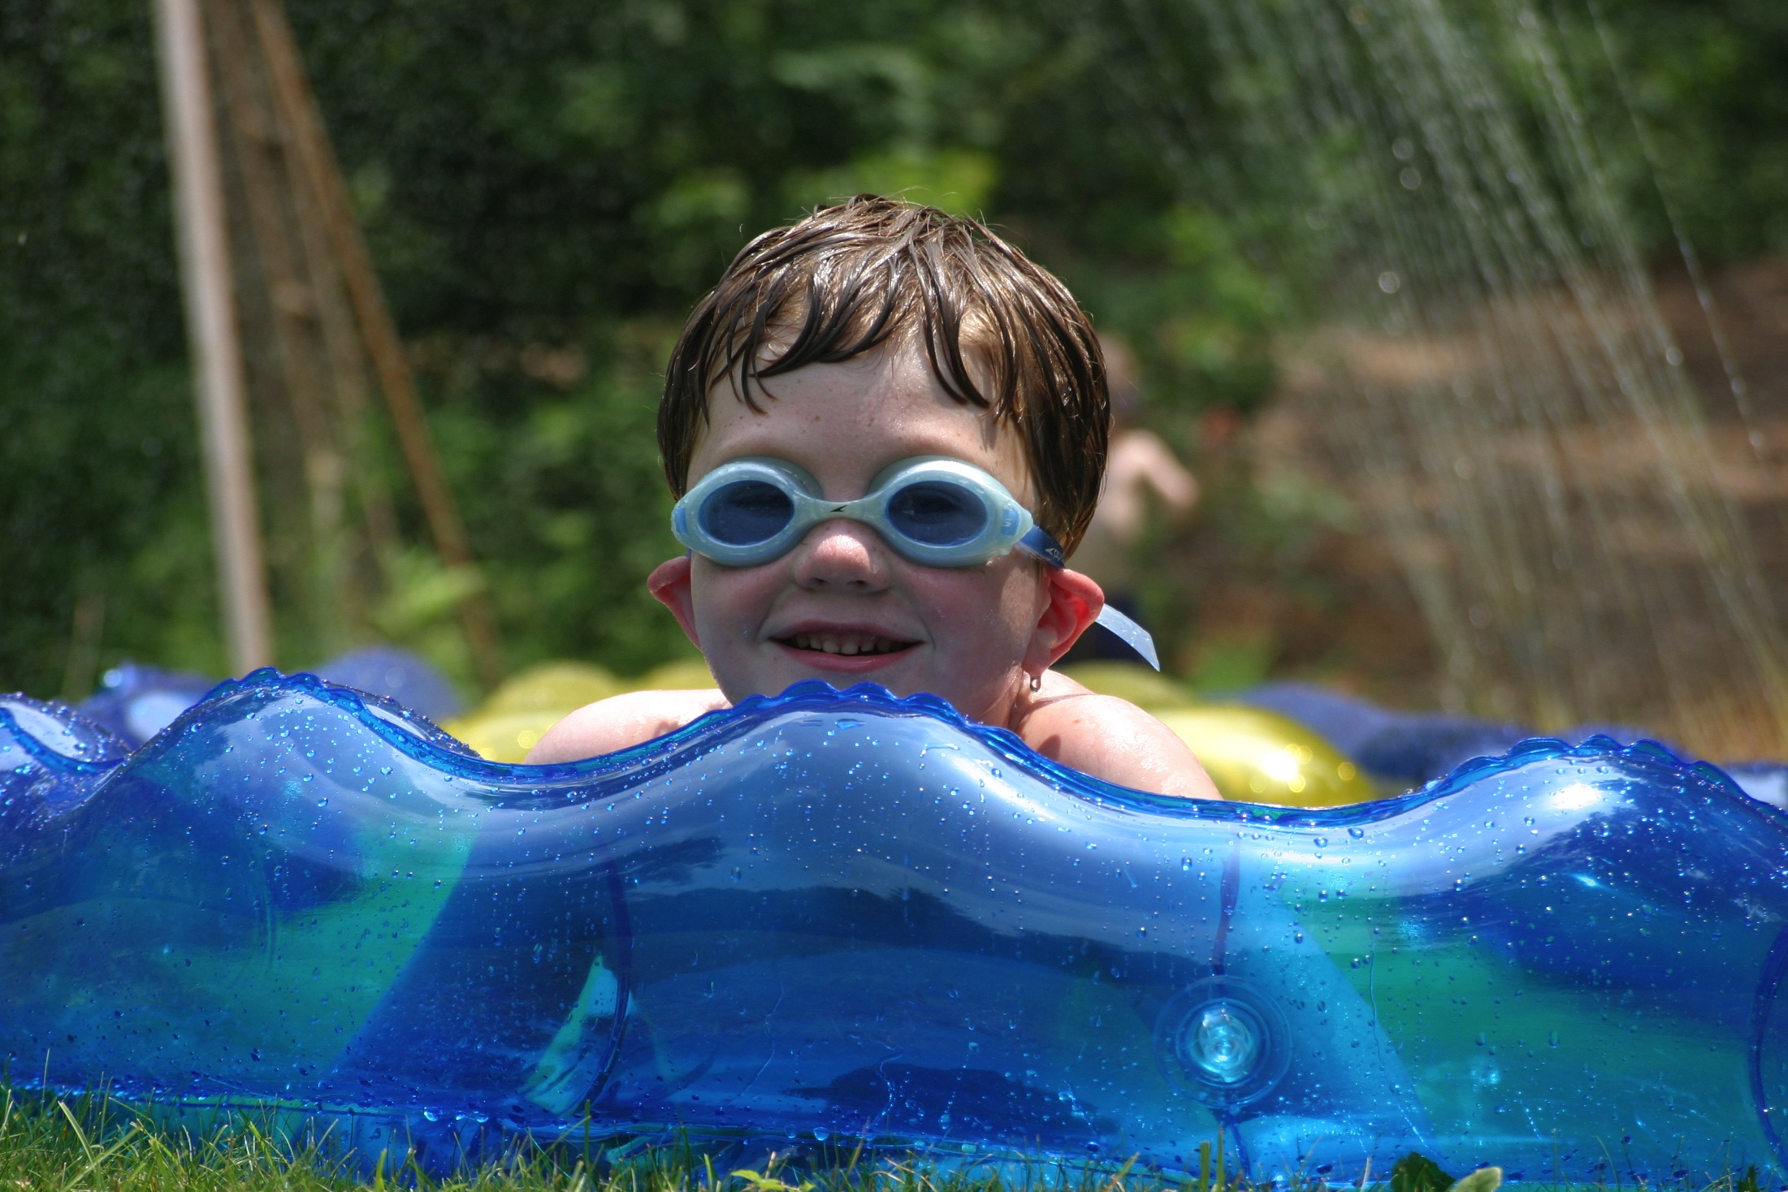
Process
Notes:
Big takeaway: go for it! Get your goggles on and get wet

