Slide 1

THEY’RE WAITING
TO BE ASKED
INFLUENCE * INCREASE * IMPACT

Slide 2
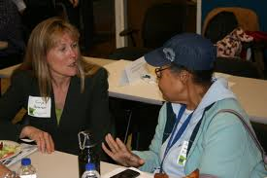

Share Some Ideas
Turn to the person next to you, share with them your earliest recollection of giving; how did you learn to give – who taught you and how it made you feel
Then reverse the process

Slide 3
Philanthropy is NOT About Money
Philanthropy is about VALUES
“Philanthrōpos” - loving people
goodwill to fellow members of the human race

Slide 4
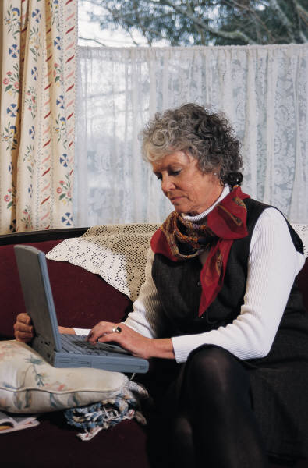
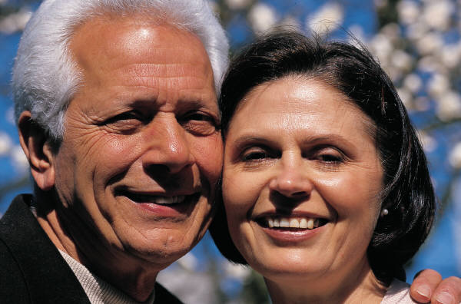
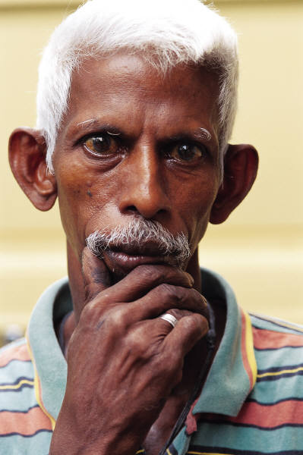
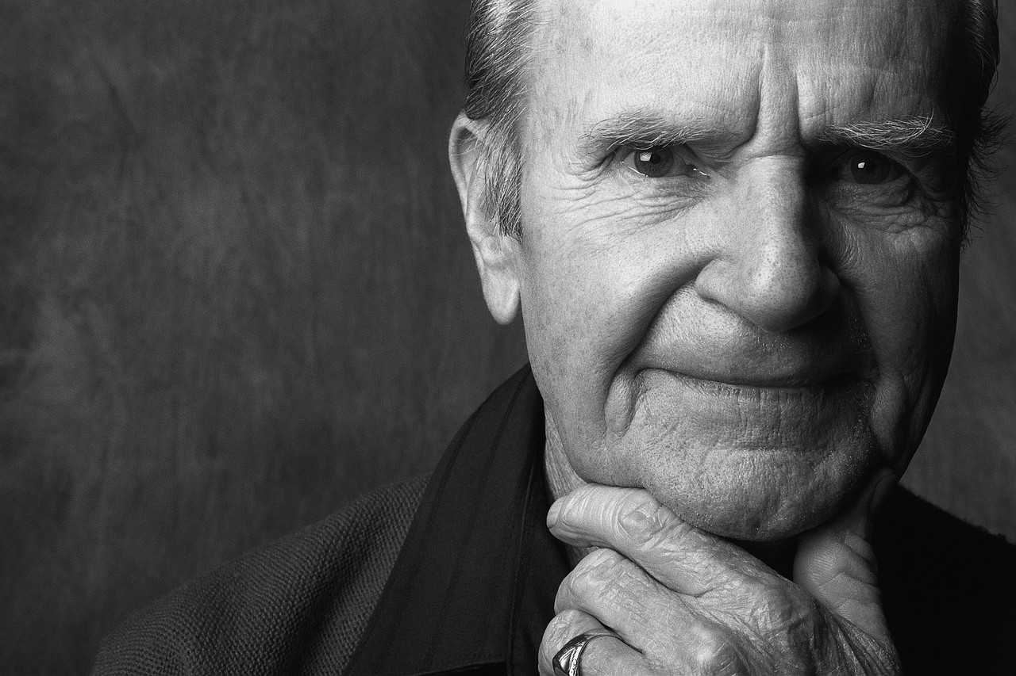
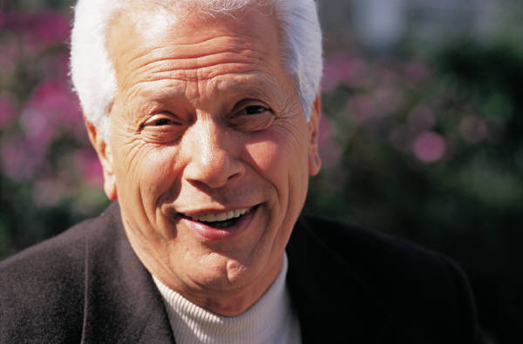
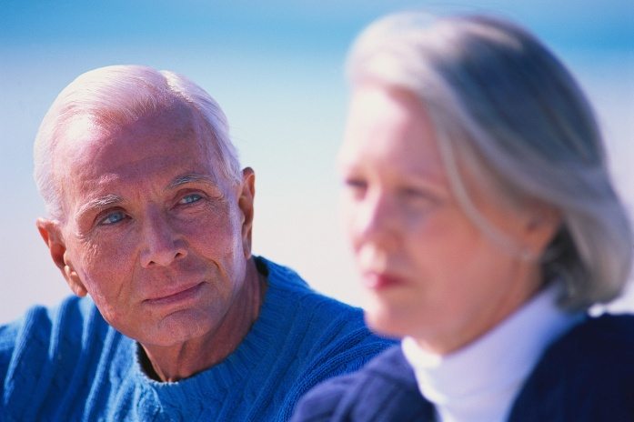
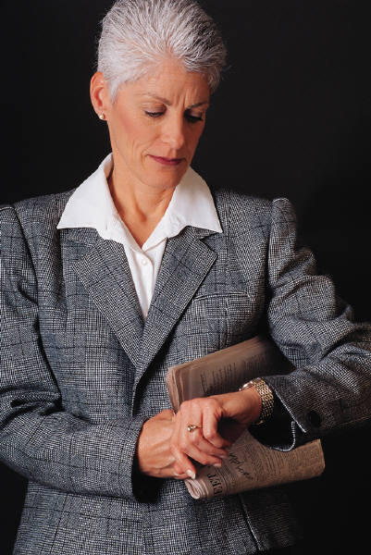
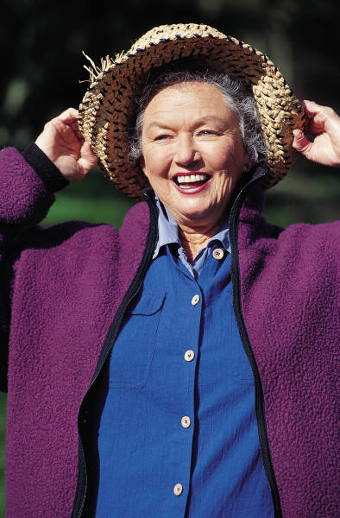
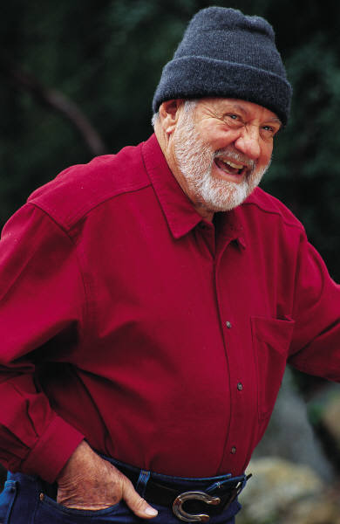
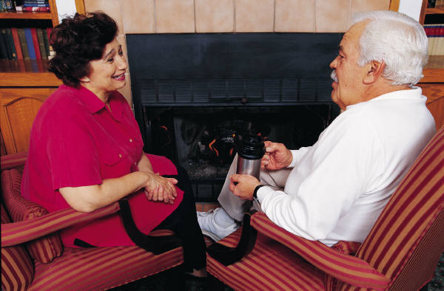
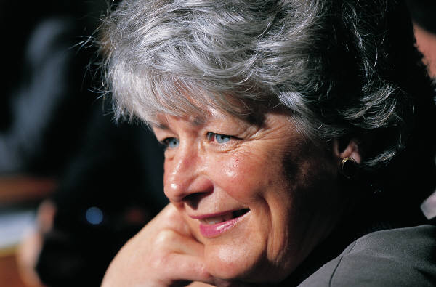
Why People Give
The Ability to Make An Impact
The ability to make an impact
Belief in the cause
Belief in the organization
Belief in the people who do the work
Because someone asked them

Slide 5
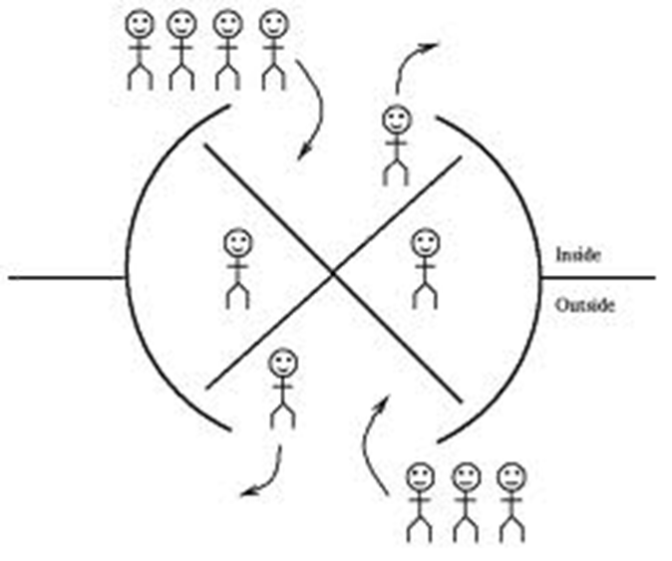

The Revolving Door of Philanthropy
Of the 1.8 million people who donated to 2,342 nonprofit organizations in 2009 and 2010 only 43% renewed their gifts; 57% DID NOT!*
Of the new donors giving in the same period – only 27% renewed; 77% DID NOT !
* January 2013, the Center on Nonprofits and Philanthropy

Slide 6

10% of donors
90% of funds
Basic Giving Pyramid of a
funds development program
.
Planned
Giving
Major Gifts
Cultivation and stewardship
Inspire Major Support
Donor Renewal & Retention:
Annual Giving, Events
Direct Mail, Memorials
Retention Efforts
Relationship Building
Retain & Grow
Cultivate & Appreciate
Donor Acquisition:
Events, Direct Mail
Constituency building
Social Networks
90% of your donors
10% of your funds
Build the Base

Slide 7
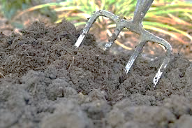
Donor Cultivation

Slide 8
Donor Motivation
Donors fall into one of two groups
Those whose lives have been touched by the organization
Those who are influenced and impressed by its work or its leadership
They give because they are connected …

Slide 9
How Do You Build a Donor Relationship?
Giving and Renewing is a Matter of Connecting A Donor to your Organization’s Vision
and Helping Them See it Unfold
Cultivation = enrolling prospects in a vision
Solicitation = engaging a prospect to become an investor in the vision
Stewardship = progress towards vision

Slide 10
How Do You Build a Donor Relationship?
Giving and Renewing is a Matter of Connecting A Donor to your Organization’s Vision
and Helping Them See it Unfold
Cultivation = enrolling prospects in a vision
Solicitation = engaging a prospect to become an investor in the vision
Stewardship = progress towards vision

Slide 11
Donor Disconnect
Donors and the nonprofit organizations they support financially have different views and that disconnect results in lost donations
Nonprofits were 10 times more likely than donors to say that their organizations are not communicating enough with supporters, while donors regard the information they receive from charities as adequate or, in many cases, far too frequent.
So, it’s not about how many newsletters you send …..
Edge Research for Abila, a software company working with North American nonprofits

Slide 12
It’s About What You Are Saying
Most charities use only one piece of information —
how much each person contributes
to shape the communications their supporters receive while ignoring other important factors.

Slide 13
What matters to donors
Research surveyed 206 nonprofit organizations and more than 1,250 donors
Knowing their money is used wisely (71 percent),
Feeling that organizations they support have a good reputation (69 percent),
Having a strong belief in the organization’s mission (68 percent), and
Believing that their support makes a difference (53 percent).
* Edge Research for Abila, a software company working with North American nonprofits

Slide 14
It’s Not Just What You Say
it’s also
HOW YOU SAY IT!

Slide 15
What Do They Do?
Passageways Home embodies the spirit of recovery: embracing an attitude of hope, self-determination and partnering with each individual on their personal journey toward achieving self-fulfillment and realizing their dreams.
We fulfill our mission by making available to individuals with mental illness and co-occurring disabilities a variety of non-time-limited housing and services to enable them to realize their individual potential.

Slide 16
How Could They Have Said It Better?

Slide 17
How Do You Communicate Your Organization’s Value?
TIME-OUT EXERCISE
Look at your organization through the eyes of your donor and describe what they want to see
What does your organization accomplish
How is it making your community better
How is it helping people
Now – if you were the donor – what would you want to know that would make you give more

Slide 18
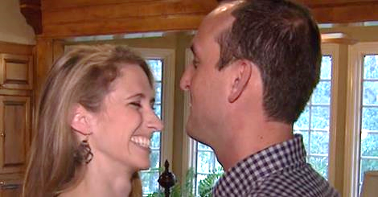

Love for Liza
Hope of research for a rare disease
Liza was diagnosed with a rare cancer, synovial sarcoma, in 2011. After a few years of remission, it returned aggressively. After a surprise wedding thrown for her ended, she received hope in the form of a non-traditional treatment method. This campaign was created to help fund clinical research for many people suffering from this rare disease.
$561,721
Raised by 3,532 people
in 3 months
To fund clinical research

Slide 19

Love for Liza

Slide 20
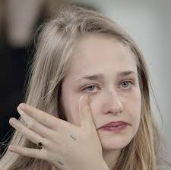
Tell a Good Story

Slide 21
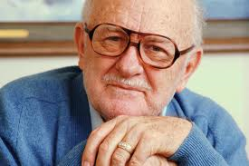
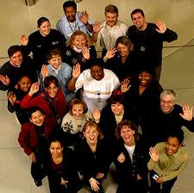
Rethink Old Generalizations About Motivation
This is not your father’s philanthropy
Today’s donors are not always motivated by the old “carrots” – recognition, peer pressure, guilt, quest for immortality
They are cause-drawn and outcome-motivated
They want accountability and transparency
They want to have an impact and they want to know the impact they are having

Slide 22
Building a Stewardship Program

Slide 23
Motivation is Ignited by Passion for the Mission
The age of passive philanthropy is ending; as the face of philanthropy changes, so does its quest.
A heightened interest in outcomes is replacing a need for rewards and recognition
Passion is fueled by involvement (previews, volunteerism, on-site visits, opportunities for advocacy)
Engaging a donor must be mission-connected
All meetings involving donors and volunteers need to have a “mission moment” with a direct message from those who benefit from what you do

Slide 24
How do you build a strong development program?
A systematic process of:
identifying
cultivating
soliciting
stewarding
donors who have the affinity for your cause and the capacity to make a magnificent contribution

Slide 25
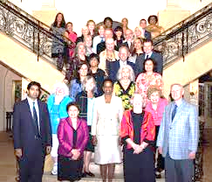
Who are Your Major Donors? Make a list – do it once

Slide 26
Engaging Major Donors
Who Are Your Best Donors
What do you Do?
Current donors to your annual fund
10 – 20% of donors at the high end of your gift table for the past three years
1st time donors at a higher than average gift level
Event donors who have given more than is expected at an event
Donors who have given for 10-15-20 years or more.
Volunteers who have been loyal to you
Call Them
Write Them a Meaningful Note or Letter
Invite Them to An Event (as your guest!)
Share NEW Information (not in a newsletter)
Meet with them annually and don’t ask for money

Slide 27
What About Your Other Donors
Who They Are?
What Can You do?
Loyal, Consistent Donors
First time donors
Great Give Donors
Returning Donors
Have a Thank-a-thon
Send an update after an appeal and let them know what you did with the funds
Share a Story A Month

Slide 28

So Start Saying “Thank you” Instead!
No One Likes to Ask For Money

Slide 29
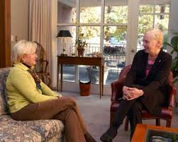
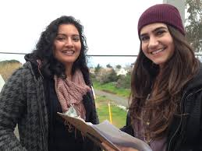
Motivated Donors Should be Linked with Motivated Volunteers
Peer stewardship is the most effective and most motivating in most individual giving programs:
Volunteers represent the community
You demonstrate commitment to the organization
You can link better with the prospect’s experience and values.
You are critical to relationship-based social investment
The best approach is to have trained and knowledgeable staff working with motivated and committed volunteers

Slide 30
Fundraising is a Conversation
When Socializing with friends over dinner, golf or shopping, have a (deliberate) 5-10 minute conversation about the organization:
I was at a meeting today about ……
I have really gotten involved with …..
I just heard the most amazing story …..

Slide 31
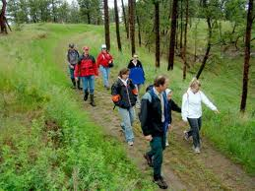
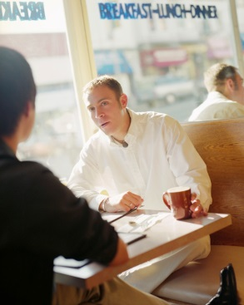
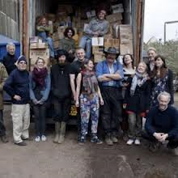
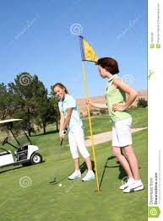
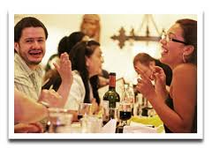
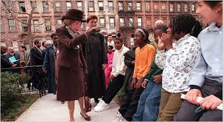
How to Steward a Donor Instead
Call and say thank you
Ask a donor out for coffee
Talk on the 12th hole
Bring it up when you’re out to dinner
Invite them to join you at the gala
Ask them to be ambassadors

Slide 32
Use An Event
Ask Them to Join You
Ask the Right Questions
Invite them to sit at your table
Ask them to join you for the Annual Meeting
Include them when there is a particular activity
How are you connected with this organization?
What made you decide to come here tonight?
Why does this organization matter to you?

Slide 33
Boards are Great Stewards
Communicate Via E-mail or Notes
Personalize a thank you for a gift
Call them and thank them for the contribution
Add an e-mail note to a newsletter you received
Write a personal note on an invitation or appeal

Slide 34
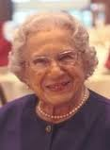
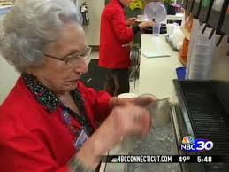
RITA

Slide 35

Gratitude is Where Giving Begins
Engaging philanthropy … empowering your cause

Slide 36

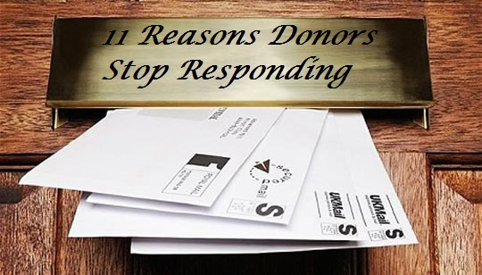
Why Do We Lose 57% of Our Donors?
They suffer financially
They die, move, or face tragedy
They forget
They get distracted
They lose interest
You mail them too often
You don’t mail often enough
You don’t listen
You treat them like a stranger
They feel unappreciated
You make them mad

Slide 37
What Donors Want
Prompt, personalized acknowledgment of their gifts
Confirmation that their gifts have been put to work as intended
Measurable results on their gifts at work prior to being asked for another contribution
Donor Centered Fundraising, Penelope Burk, 2003

Slide 38
Why People Give
They believe in the work you do
They were personally touched by the organization
They were asked
And the reason they give a major gift
They feel appreciated
They have become vested in your organization
They understand the impact they can have

Slide 39

Questions to Ask Yourself
When a donor gives to you – how do you really make them feel?
Will you keep the donors you have and give them a reason to grow with you?
Do you build relationships with the emerging philanthropists of your organization?

Slide 40
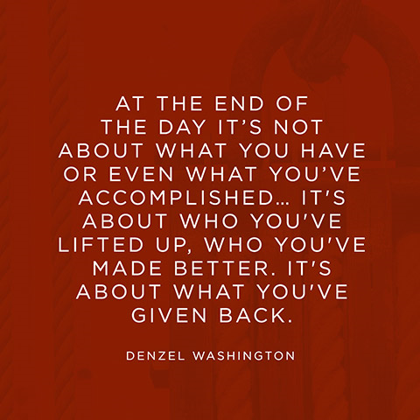

Slide 41

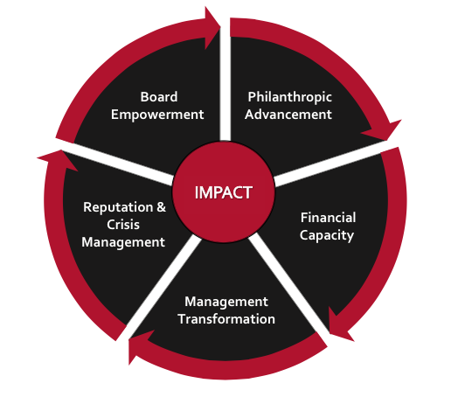


Influence * Increase * Impact
Danosky & Associates helps non-profit organizations build the capacity to move their strategic vision forward with a solid foundation
and an army of support behind them
IMPACT
www.danosky.com
info@danosky.com
860-799-6330
Friend Us!
Follow Us!

