Slide 1
21st Century Grant Applications: Brief and to the Point
2015 Annual MNN Conference
October 21, 2015
Diane Gedeon-Martin
The Write Source, LLC
www.write-source.com
© 2015, The Write Source, LLC, Glastonbury, CT. All rights reserved.

Slide 2

Today’s Session
Identify key elements that will grab the attention of grant reviewers.
Use simple, direct language to make your point.
Edit your proposals for strong content.
Recommended reading

Slide 3
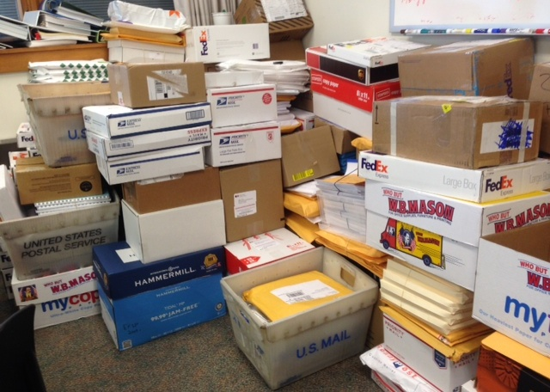
Say Goodbye to Long-Winded Narratives
In 2000,
  Grants.gov was in its infancy.
  The length of a foundation proposal was 10 15 single-spaced pages of narrative, a cover letter, half- to full-page summary, and at least 10 pages of attachments.
  The average length of federal proposal was 80 double-spaced pages of narrative, a cover letter, full-page summary, and 40 pages of attachments.
  We were still learning about Logic Models and expressing outcomes.
  Nearly all proposals were sent via the US Postal Service or overnight courier.

Slide 4

Welcome to 2015 and Beyond
Nearly 80% of all grant applications are sent electronically via web portal or e-mail.
Foundation proposals average five single-spaced pages of narrative, a cover letter, and five to six attachments.
Federal proposals limit the number of pages to upload with more than half of the allotment as required attachments.
Narrative sections for online applications limited to 2,000 characters with spaces and punctuation or less instead of nearly 5,000 characters with spaces and punctuation in 2000.

Slide 5
We are Still Using Paper...
Common Application Forms for selected foundations
  CT and MA offer these forms
  Submitted on paper through post office or via e-mail
  Require completed application form
  Narratives five and eight pages respectively
    Follow the guidelines and include headings for each questions/statement as a guide for the reviewer
Small family foundations only want paper proposals

Slide 6
...And More Paper
Federal Grant Applications
  26 Federal agencies and department - different requirements
  Submitted electronically with strict page limits
    DHHS - ACF & HRSA
      Must adhere to proposal preparation guide requirements
      Maximum 100 double-spaced pages uploaded with 50 allocated for attachments through grants.gov
    NSF
      Must adhere to proposal preparation guide requirements
      Maximum 15 single-spaced pages for narrative
      Submit through Fastlane or grants.gov systems

Slide 7
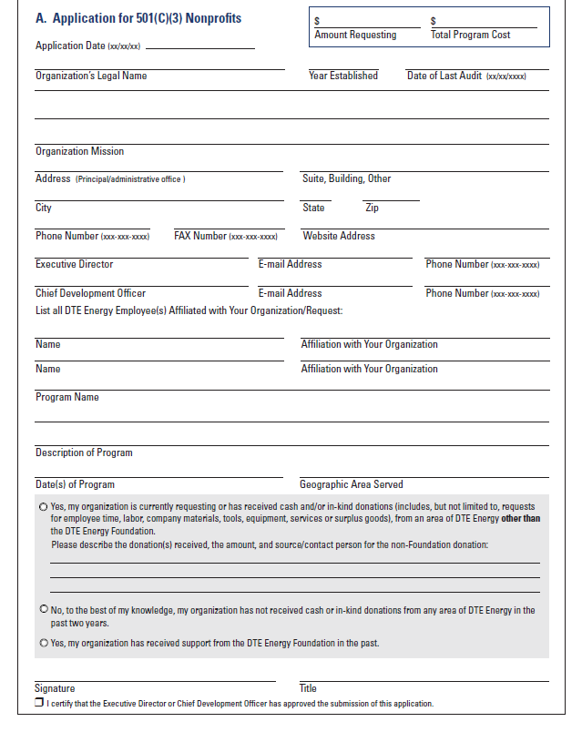
What are Grantmakers Telling Us?
Guidelines of several large foundations tell grantseekers to provide all the information required in a concise manner
  They ask us NOT to use all the space provided (online and paper)
  Use plain language
  Just get to the point!

Slide 8

What are Grantmakers Telling Us?
Federal agencies are asking for the same
  "Applicants are strongly encouraged to provide a high-quality narrative that includes a compelling justification...This should be addressed in a concise manner; lengthy applications will not receive greater consideration."
  - Economic Development Administration, US Department of Commerce, 2015 Economic Development Assistance Programs Federal Funding Opportunity

Slide 9
What Does this Mean for Us?
Our writing style must accommodate different types of reviewers
  Skimmers - mostly foundation and corporate reviewers
    Reads open and closing paragraphs, topic sentences of subsequent paragraphs
    Reviews bullet points, tables, charts, budget spreadsheets
    Lightly skims the rest of the content including footnotes or cited works
  Searchers - mostly government proposal reviewers
    Follows score sheets
    Looks for specific information in the required sections
  Deep Readers - all of the above
    Government reviewers MUST read the entire document and provide a score
    Foundation and corporate reviewers may or may not read the entire document

Slide 10
Think Like a Reviewer
Get to the point quicker
Be specific and clear as to your intent
Provide additional information not required by the RFP
Use headers to guide reviewers
Place information in the required sections not elsewhere
Incorporate success stories or examples
Format your proposal using specific type fonts
Incorporate visuals to help reviewers grasp concepts quickly
Use tables to communicate statistics instead of burying them in long-winded paragraphs

Slide 11
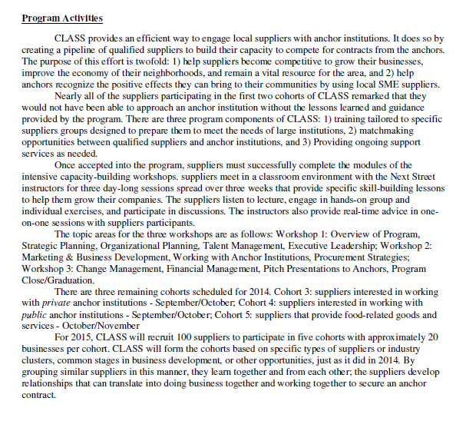
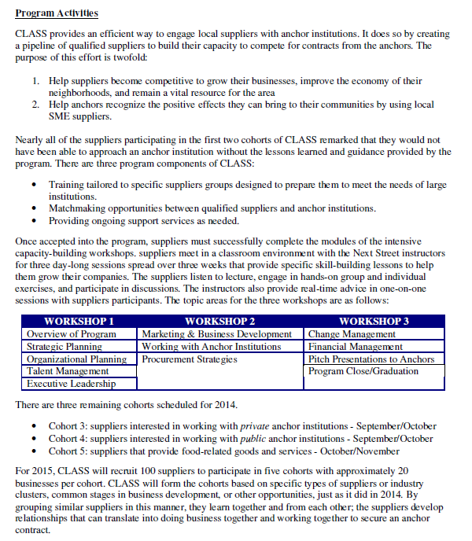
What Would You Prefer?
OR

Slide 12
Four C’s of Effective
Grant Proposals
  Clear
    Active, engaging language makes it easy to read
    Short sentences
    Small paragraphs
  Comprehensive
    Detailed
    Anticipates every possible question of grant reviewer
  Concise
    Well-organized
    Gets to the point as quickly as possible
  Competitive
    Attainable outcomes that will impact the community
    Furthers the mission of the grantmaker
    Persuasive

Slide 13

Brief and to the Point
We live in a society with limited attention spans...
  Put yourself in the shoes of the reviewer
    Reviewers of our grant proposals are people not computers (at least not yet!)
      How am I supposed to find time to read 50 to 100 grant proposals in a week for a single competition?
      I can't understand what they're trying to tell me.
      How many more proposals do I have to review before I can go to sleep tonight?

Slide 14
Brief and to the Point
Reviewers want us to develop reader friendly proposals
  Write clearly, succinctly, and directly
    Use everyday language
    Keep it simple
    Use proper grammar and punctuation
    Eliminate verbose passages and language
    Use bullet points instead of a long lists separated by semicolons
      For online applications use a '-' or '*'
      Online systems do not recognize special symbols
    Stop using jargon and more than three acronyms
    Make the content flow

Slide 15
Brief and to the Point
Think in short, firm sentences
  Cut every unnecessary word, but never sacrifice clarity for brevity
  Remember: Subject-Verb-Object
    I used the hammer.
    The organization obtained the required signatures.
    Eliminate words or phrases between the subject and the verb

Slide 16
Brief and to the Point
  Use a deductive writing style
    Get the point clearly in the first sentence (topic sentence) of a paragraph and use the remainder of the paragraph for support and documentation.
      Cuts to the chase, delivering information in an accessible and powerful way
      Makes easier for the reviewer to quickly check the logic of the argument before diving in for a deep read
      Makes it easier for the reviewer to find the information that corresponds to the scoring mechanism.

Slide 17
Brief and to the Point
Example of Deductive Writing Style
The population of rural Washington County grew 11.8% from 2000 to 2010 to 147,430 residents. Farmlands and very small towns dot the landscape. Hagerstown, the county seat and only city, has a population of 39,662. According to the 2010 US Census, there are 56,036 women over the age of 18 living in the county. Of the total population, 9.6% are African American, 1.4% are Asian, and 3.5% are Hispanic. Compared to 2000, the number of minorities living in the county grew at proportionally higher rates: African Americans by 38%, Asians by 95%, and Hispanics by 225%. The majority of minorities and immigrants reside in Hagerstown with 15.5% African American and 5.6% Hispanic.
Breast cancer is the number one cancer treated at JMCC, representing 20.3% of all cancers diagnosed. In 2012, JMCC diagnosed 185 cases of breast cancer, up 4% from 178 cases in 2011. According to the National Cancer Institute, the incidence of breast cancer in Washington County is 115.6 for 2005-2009. This follows the trend identified in the Komen 2011 Community Profile report that shows the incidence of breast cancer for the county has decreased from 119.1 during 2002-2006 to 115.4 during 2003-2007. The National Cancer Institute also reports that the number of deaths from breast cancer in Washington County continue to decline. For the period of 2006-2010, the breast cancer mortality rate for Washington County was 19.8, dropping from 20.8 from 20005-2009 placing it lower than that of the United States at 22.6 and Maryland at 24.5.

Slide 18
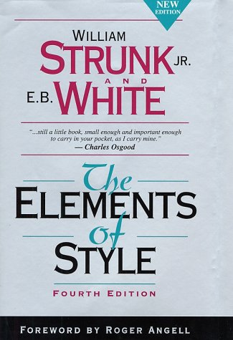
Brief and to the Point
William Strunk, Jr, author of The Elements of Style
  "A sentence should contain no unnecessary words, a paragraph no unnecessary sentences, for the same reason that drawing should have no unnecessary lines and a machine no unnecessary parts. This requires not that the writer make all of his sentences short, or that he avoid all detail and treat his subjects only in outline, but that every word tell."

Slide 19
Brief and to the Point
Forget the witty prose and just say what you mean
  Scintillate, scintillate, diminutive celestial body
  It is impossible to determine the value of a leather-bound volume by its exterior
  Veracity is the superlative course of action.
  Pulchritude does not extend beneath the surface of the epidermis.

Slide 20

Brief and to the Point
George Orwell said:
  "Never use a long word where a short one will do."
  "If it is possible to cut a word out, always cut it out."

Slide 21
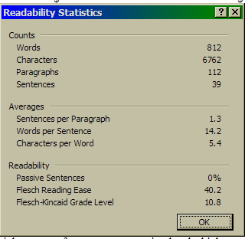
Brief and to the Point
Vary length of paragraphs
  Minimum two sentences per paragraph
  Provide no more than 10 lines per paragraph
Average sentence should have no more 15 to 17 words
    Passive voice less than 10%
    Flesch Reading Ease score of ~40 - the higher the score, the easier it is to read.
    Flesch-Kincaid Grade Level at 10.5 or 12

Slide 22
Brief and to the Point
A few words about Writing Style for grant proposals
  Your organization is asking for money - do not beg
    Different in content from an annual appeal letter
    Eliminate the phrase: With your help, we can make a difference in the lives of …
  This is a business transaction
    Focus is on the community benefit not how your organization will benefit
    Do not write to shock - If we don't receive money, a thousand people will starve.
    Make an emotional connection but stick to the facts
    Rely on published statistics, data, and case studies to make your case for support
    Don't make the proposal too dry, but don't overpower it with flowery prose

Slide 23
Brief and to the Point
Avoid clauses, particularly introductory causes and phrases
  Introductory clauses start with adverbs like after, although, as, because, before, if, since, though, until, when, etc.
  Introductory phrases also set the stage for the main action of the sentence, but they are not complete clauses.
  Rewrite to get to the point

Slide 24
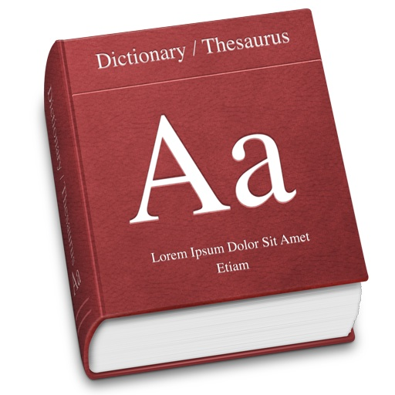
Brief and to the Point
  Eliminate redundancy – do not use the same word twice in the same sentence
    Word Web – free dictionary/thesaurus www.wordwebonline.com
    Thesaurus.com
    Microsoft Word Thesaurus
  NEVER rely on Microsoft Word grammar program
    Grammar Slammer at http://englishplus.com/grammar/
    Grammar Expert Plus at http://www.wintertree-software.com/app/gramxp/index.html (free trial that doesn’t expire)

Slide 25
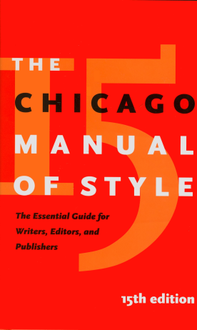
Brief and to the Point
  Obtain a style and grammar book for quick reference!
    The Handbook of Good English, Edward D. Johnson
    The Elements of Style, William Strunk, Jr. and EB White
    The Chicago Manual of Style, University of Chicago Press
    The MLA Style Manual, Walter S. Achtert and Joseph Gibaldi

Slide 26
Brief and to the Point
Write in an active voice, avoid being passive
  Writing in the past tense or passively can:
    Weaken your case for support
    Disrupts the reviewer’s focus
  Writing in an active voice is easier to understand, shows determination
    “We will…” vs. “we would like to…” or “we want to…”
    Eliminate “would,” “could,” “should” – will, can, shall
  Restructure passive sentences into active ones
    “All programs are clinically supervised by a licensed clinical social worker (LCSW).”
    “A licensed clinical social worker (LCSW) supervises all programs.”

Slide 27
Brief and to the Point
Get rid of wishy-washy language
  The program budget is projected to be approximately $70,000.
  We hopefully can find other funders to support our program.
  If you give us a grant, we can implement the program.
  It is currently anticipated that we will collaborate with a few other neighborhood organizations.

Slide 28

Brief and to the Point
  Use strong, determined language when creating objectives and outcomes
  Eliminate the preposition 'to' before the power verb
  ALWAYS bullet point objectives and outcomes
Use power verbs Increase Improve Reduce Empower Engage | Avoid weak verbs Provide Manage Create Develop Offer

Slide 29
Brief and to the Point
  Use abbreviations wisely
    Spell out acronyms once
      Use Chicago Manual of Style version: ( ) after spelling out the full name or title
        The Centers for Disease Control (CDC) previously underreported…
      Don’t assume that if you spell out the full name or title that the reviewer will catch the acronym – AP Style
        The Centers for Disease Control previously underreported the rate of HIV infections in America. The CDC apologized for the error.
    This is not TXT SPK - OMG!!
  Do not speak in parentheses
    Reviewers don’t read passages in parentheses
    If you have to say it using parentheses, you aren’t making a point
    Rewrite without parentheses and see how the thought flows

Slide 30
Brief and to the Point
Be aware of misused words and terms
Internet - upper case website - lower case email - one word, no hyphen data - plural, datum - singular database - all one word % or percent - just be consistent online - one word United States - use as noun U.S. - use as adjective, not US or USA | toward not towards - only if British compliment versus complement it's versus its - know the difference affect versus effect summer, spring, fall, winter - lower case project manager versus Susan Smith, Project Manager

Slide 31
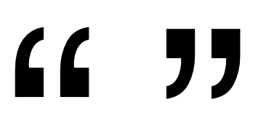
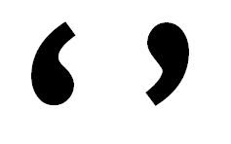
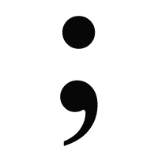
Brief and to the Point
Be aware of proper punctuation
  Period and comma ALWAYS inside single (') or double (") quotation marks - even at the end of a sentence or quoting a single word.
    ...the report showed that 42% of teens in the district were 'overweight,' 25% were 'obese,' and 10% were 'morbidly obese.'
  Oxford comma versus no comma
  Use semicolons properly
    NOTused to separate long lists of fragmented sentences
    Use when joining two independent clauses or complete sentences

Slide 32

Brief and to the Point
  Avoid qualifiers - they suck the blood out of good prose
    May
    Somewhat
    A few
    Very
    Rather
    Little
    Quite
  Avoid the use of i.e., e.g., or etc. Instead, organize your examples.

Slide 33
Brief and to the Point
  Page format
    One-inch margins
    12-point type font
      Times New Roman
      CG Times
      Garamond
    Single space unless otherwise directed
  Left justify ONLY – never fully justify
    Keep right margin ragged
    Easier on the eyes of the reviewer
  Number each page
    Automatic numbering in upper right or bottom right or bottom center
    Use header or footer to also include name of organization on each page
    DO NOT number first page of narrative

Slide 34

Brief and to the Point
  ALWAYS use block paragraphs instead of indenting 5 spaces or .5"
    For online applications, the space between the paragraphs equals 1 character and 5 spaces equals 5 characters
    Cleaner, easier read for the reviewer
  Leave as much white space as possible

Slide 35
Brief and to the Point
AVOID
  Using bold face type and underlining within the narrative
    Slows down the reader
    Skimmers will only see the emphasis words
    Acceptable for section headings and subheads only
      Section headings should be in CAPS and underlined
      Subheads should be in Upper and Lower Case and underlined
    Italics are acceptable when referring to the name of the project/program

Slide 36
Brief and to the Point
  Be aware of character counts - spaces are characters!
    3,500 characters w/spaces ~ 555 words
    2,600 characters w/spaces ~ 500 words
    2,000 characters w/spaces ~ 300 words
    800 characters w/spaces ~ 150 words
    In Microsoft Word, go to Review (2007+) then click on Wordcount, find Characters (with spaces)
      Microsoft Word does not count punctuation!
      Avoid Oxford commas if you can
      Use semicolons sparingly
      _______ Characters (with spaces) = 2,000 characters in an online application box

Slide 37
Brief and to the Point
  Proposal writing is persuasive
    Gets the reviewer to see your point of view
    Convinces them that you can achieve the outcomes
    Always focus on achieving the mission of the grantmaker!
  Speak in terms of quantity and quality
    Discuss current and future target populations in detail
    Show numbers of those currently served AND those you expect to serve in the future
    Discuss the distinctiveness of the program
      Identify current and anticipated level of resources
      Share past evaluation data
      Forecast what will happen if the problem is not addressed

Slide 38
Brief and to the Point (cont.)
Outline benchmarks for activities in spreadsheet format
  Gantt Chart or timeline
    Use calendar format with month and year references across top
    Provide tasks and person(s) responsible for achieving the benchmark in left column
    Express the start and end dates for each activity
Task | Jan-Jun | Jul-Oct | Nov-Dec | January
1.
2.
3.

Slide 39
Brief and to the Point (cont.)
  Flowcharts
    Gives reader sense of processes, a roadmap to the workings of the project or program
    Helps to understand the dynamics of change for participants or organization
Client referrals from community partners
Intake and assessment
Case management
Client begins classroom sessions
GED, post-secondary education
Business etiquette, soft skills
Client receives wrap-around services before exiting
Housing
Employment

Slide 40
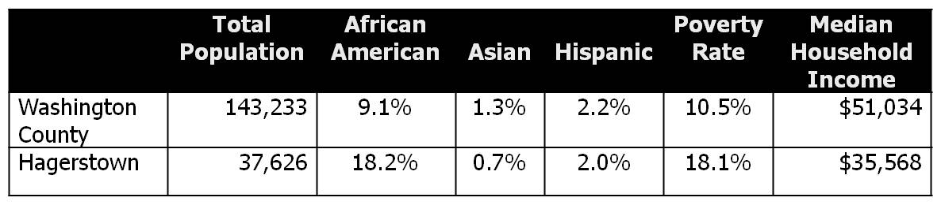
Brief and to the Point (cont.)
Use Visual Aids
  Within the narrative, selectively insert tables and charts
    Center the graphics on the page
    Do not wrap-text around or position on the margin

Slide 41
Brief and to the Point (cont.)
Example of What NOT to Use:

Slide 42
Brief and to the Point (cont.)
Example of What NOT to Use:

Slide 43
Brief and to the Point (cont.)
The perfect use of a chart in a grant proposal

Slide 44

Remember…
Your proposed project/program must make an impact on the community you serve!
  Successful proposals describe changes that will be beneficial to the community
  Federal government wants to see collaboration among organizations to work together to make change
  Competition is fierce in securing government grants. Planning and advanced preparation is key to success!

Slide 45
Recommended Reading
Write Tight by William Brohaugh. (ISI Books, 2002) ISBN 1-882926-88-9
The Elements of Style - 4th Edition by William Strunk, Jr. and EB White. (Allyn & Bacon, 2000) ISBN-10 0205313426 OR ISBN-13 987-0205313426
The Chicago Manual of Style - 15th Edition by the University of Chicago Press. (University of Chicago Press, 2003) ISBN 0-226-10403-06
Brevity Isn’t Enough - You Need to Write - Take the Fat Our of Your Writing by Kathy Henning. http://hbswk.hbs.edu/archive3443.html
Drowning in Paperwork: Distracted from Purpose. Project Streamline. http://www.projectstreamline.org/projectstreamline.org/documents/PDF_Report_final.pdf
Online Applications and Reporting. Project Streamline. http://www.projectstreamline.org/sites/projectstreamline.org/files/Online%20Applications%20and%20Reporting.pdf

Slide 46

Thank You!
Diane Gedeon-Martin
583 Goodale Hill Road
Glastonbury, CT 06033-4022
www.write-source.com
diane@write-source.com
(860) 657-9734

