Slide 1

Welcome to
Knowledge Management
for Nonprofits

Slide 2

Annkissam’s KM Experience
Annkissam builds and implements tools and systems to help manage nonprofit information and knowledge
We work with organizations to better understand and leverage their knowledge

Slide 3
What is Knowledge Management?
Knowledge management is the process of choosing and using tools and systems to effectively gather, organize, share, and use information; of any topic and any type; within and between individuals, organizations, and groups.
* Knowledge Management is like Sorting Socks: KM for Nonprofit Organizations, Rachel Stark and Deborah Elizabeth Finn

Slide 4
What Makes Nonprofit KM Unique?
Principles are generally the same as with other sectors, the practical application is different
Smaller teams, larger turnover impact
Volunteer populations
Bottom line is different than for profits
Staff wear multiple hats and may not be able to invest significant time in KM initiatives

Slide 5
Common Issues in KM
Staff members don’t know about existing resources that could help them make good strategic decisions
When a staff member gets sick, takes a leave, retires, resigns, or goes on vacation, then other employees are unable to locate crucial information
Staff members don’t know which colleague to approach with questions on a specific topic
Standard information that is needed for a routine operation must be gathered by hand from disparate paper and electronic sources each time it is needed
Project teams generate multiple versions of key documents, but no one knows for sure which version is the final one

Slide 6
Objectives of this Webinar
Explore different kinds of knowledge and the distinctions between each
Understand different approaches to knowledge management
Examine how to create a supportive and enabling culture of sharing knowledge
Notes:
Explore different kinds of knowledge and the distinctions between each
Be able to distinguish between each and understand how and why they are important/necessary

Slide 7

Kinds of Knowledge
Tacit knowledge vs. explicit knowledge
How do these relate to your organization?

Slide 8
Kinds of Knowledge
Tacit vs. Explicit
Explicit knowledge
can be expressed in numbers or words...essentially, explicit knowledge is “knowing about”
Tacit knowledge
is “knowing how” and includes contexts, insights, intuition, and hunches -- which are often built by experience and difficult to formalize and share
Notes:
The role of the NGO is to establish and encourage an organizational culture that values and rewards the transferring of tacit knowledge to explicit knowledge among employees and workgroups. Cultural and structural changes can encourage this formal and informal sharing of knowledge among employees. Strategies that can facilitate this type of knowledge sharing include training, communities of practice, and mentor programs.
The benefits of training can be leveraged even more when employees are required to share the information, skills, and knowledge they gained from their training (Yang, 2004; Swart & Kinnie, 2003).
A common mechanism for gaining knowledge is to request help from another (Sharratt & Usoro, 2003). These activities assist knowledge sharing among individuals on a reciprocal basis, building trust and friendship among workers (Yang, 2004).

Slide 9
A Quick Example
A retiring executive director leaves your organization. They have entered contact information into your organization's CRM/Donor Management tool. However, there is a vast amount of knowledge about those contacts stored within the outgoing executive director’s head and is not documented anywhere.
* Third Sector New England (TSNE) Leadership New England Report
(http://tsne.org/leadership-new-england)
68.2% of MA nonprofit leaders leaving within 5 years
65.5% of MA nonprofit organizations have 0-10 staff

Slide 10
Kinds of Knowledge
Tacit vs. Explicit
Explicit knowledge transfer is a relatively common occurrence. Employees share donor information, reports, financial budgets, policies, etc.
Tacit knowledge, however, needs to be converted into explicit knowledge in order to be easily shared. This needs to be done without losing critical parts of the tacit knowledge.

Slide 11
Kinds of Knowledge
One of the most difficult aspects of building out a successful KM initiative is turning tacit knowledge into explicit knowledge

Slide 12
Kinds of Knowledge
Quick Poll:
Does your organization have systems in place for capturing and sharing critical tacit knowledge?

Slide 13

Approaches to Knowledge Management
Knowledge creation and capture
Knowledge organization systems

Slide 14
Approaches to Knowledge Management
Approach | Pluses | Minuses
Physical Copies (Handwritten Notes) | Inexpensive Easy to use Very Flexible | Cumbersome Cannot be accessed from Everywhere
Emails (Gmail, Outlook) | Familiar & easy to use Can be organized into folders for easy retrieval | Not secure Tracking file versions difficult with long threads
Spreadsheets (Excel) | Flexible Can easily transform and manipulate data | Little validation Version control between multiple people is difficult
Shared Online Docs (Google Docs) | Ability to edit simultaneously Widely accessible when shared | Typically need to have stable internet connection Security concerns in web-based service
Proprietary Doc/Info Mgmt Systems (Sharepoint, Basecamp) | Allows for more complex, standardized data structuring Thoroughly developed and tested | Expensive Less flexible, difficult to customize
Notes:
Knowledge creations and capture approaches focus on how new knowledge is developed and how it is codified to be shared with others.
“Knowledge harvesting” → gain access to tacit knowledge of experts and top performers in an organization and to document that knowledge
Exit interviews → “...used as a way of capturing knowledge from departing staff so that knowledge is not lost to the organization when a person leaves.”
After action review (AAR) → ‘...structured, facilitated review process that allows a team to come together to do an assessment after a project or major activity … [AARs] are actually most useful during the course of a project, serving as a live learning process at a time when lessons can be immediately applied.”
Blogging → “ [internal group blogs] … provide online, searchable forums for information exchange and sharing ... can be a way to translate the type of exchange that now occurs by email into a form accessible to a broader internal audience.”

Slide 15
A Quick Example
Your organization has historically had 3 staff managing summer program enrollees on a single spreadsheet that is emailed between the group. The program has expanded and now there are 8 staff editing and emailing the same spreadsheet, causing reconciliation issues across multiple file versions and a lack of reliable, real-time information. The ability to use the spreadsheet to make timely decisions becomes slow and cumbersome as the programs have scaled.

Slide 16
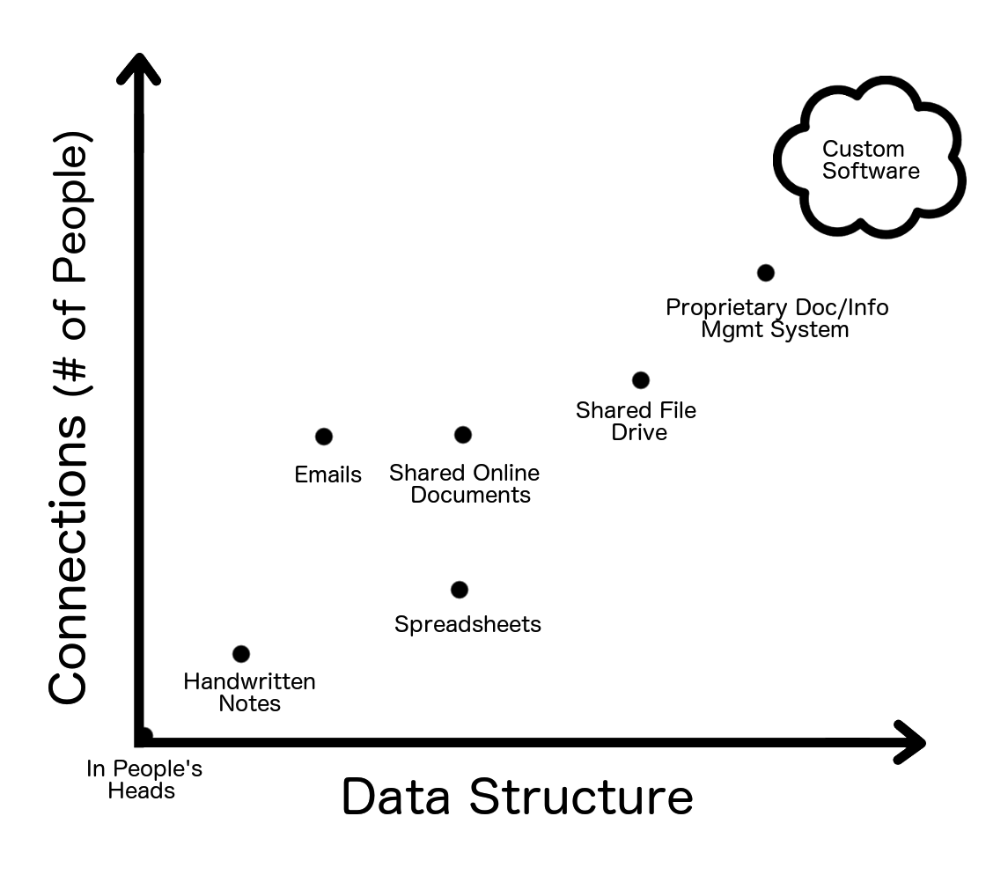
Approaches to Knowledge Management

Slide 17
Approaches to Knowledge Management
Knowledge organization systems
(Turning tacit into explicit knowledge)
Codification
Standardized fields, leverage to help filtering, sorting and reporting
Personalization
Tailor content to be displayed to users based on profile or other related information, foster communication of timely knowledge
Tagging
Using structured or unstructured (free tagging) words or phrases to loosely categorize files and content
Notes:
Knowledge organization systems provide tools for storing, categorizing, and accessing information.
Codification-based knowledge systems → content management systems (software systems) that assist users in the organization, control, and publication of documents and other content, such as images & multimedia resources
Personalization-based knowledge systems → content management that focus primarily on capturing and storing codified knowledge
Tagging systems → systems by which you find and access content over time

Slide 18
A Quick Example
Your organization has been tracking annual program reports in Word doc templates with naming structure of “[Year]-[Program]-Annual.doc”. The file naming convention becomes difficult to maintain as multiple final versions crop up with staff initials and updated dates appended to the end of the file name. Switching to a web-based file management platform (like Dropbox), enables a centralized storage location where final versions of files can be tagged with standardized options such as year, program and “final”.
Notes:
Chaotic and disorganized naming of different versions of information is common. In last minute rushes to finish, many versions of information - that really are the final version - end up with names that do not make that clear. As revisions are made, many individuals and organization find themselves with multiple different versions, all labeled “final”. Lack of good version control nearly guarantees that some amount of error in information use will occur.
----
It is important to give draft versions of information and final versions separate names, and to store them in separate folders, or is some other way that makes is clear which is which. Typically, draft or archival versions do not need to be stored in such a way as to be immediately accessible. If storage space is small, then place draft or older versions in an archive. If information is stored in more than one place, clear and consistent naming within and across locations is essential.
Systems of file naming, folder naming and version naming need not be elaborate. But each set of information must have some way to differentiate between different elements of information and different versions of those elements. See the handout “Version Control of Information” for suggestions on how to create effective systems and avoid undue errors.

Slide 19
Approaches to Knowledge Management
Quick Poll:
What is your organization’s primary approach for managing critical knowledge?

Slide 20

Creating a Supportive, Enabling Culture
What do nonprofits need to successfully implement a KM initiative?
Collaboration across teams/departments
Effective culture that encourages working together and sharing knowledge
Encourage, allow, and reward sharing of knowledge
Someone who will have the role of knowledge manager (“if you build it they will probably not come”)

Slide 21
Creating a Supportive, Enabling Culture
Leadership is responsible for creating the knowledge vision of the organization, communicating that vision, and building a culture that regards knowledge as a vital company resource
A garden needs a gardener – create a role for managing and facilitating knowledge sharing within your organization

Slide 22
Creating a Supportive, Enabling Culture
Key issues to consider:
Start with small successes
Make it easy, low barriers to access
Create incentives for knowledge sharing
Consider KM as part of human resource activities
Get buy-in from the top
Be inclusive
Notes:
Start with small successes → people need to see the value of a commitment to leveraging what they know right from the start.
Make it easy → the problem with KM systems is they don’t take into account human nature and people’s real-life behavior (can’t be seen as ‘extra’ work)
Facilitate personal relationships → importance of building personal relationships as an essential ingredient of implementing successful KM strategies
Create incentives for knowledge sharing → most organizations are still grappling with how to provide the appropriate incentives to encouraging collaborative learning
Consider knowledge in human resource activities → KM can be integrated into the hiring process -- organizations are now trying to include knowledge sharing in job descriptions & view KM as a key skill for new hires
Get buy-in from the top → “Efforts to change knowledge management practices must have support from organizational leadership.”
Be inclusive → “As organizations grow, it is important to cast the ‘knowledge’ net broadly, drawing information from a wide range of sources and transferring knowledge outside the organizational walls.”

Slide 23
Creating a Supportive, Enabling Culture
Quick Poll:
What is the biggest block to adopting a KM strategy at your organization?

Slide 24
Common Missteps When Planning a Knowledge Management Initiative
Lack of executive support
KM is not just a one off “project”, but a permanent change
Too much focus on tools, ignoring needed changes in incentives, processes, metrics and behaviors
Not aggressive enough of a schedule – miss window to create momentum
Don’t focus (or not enough focus) on real-time capture, modification, and publishing of knowledge

Slide 25
What Can Successful KM Do?
Shorten time to proficiency for new hires
Increase efficiency of internal communications
Improve employee (and manager) skills & knowledge
Increase productivity throughout organization
Strengthen ties across teams

Slide 26
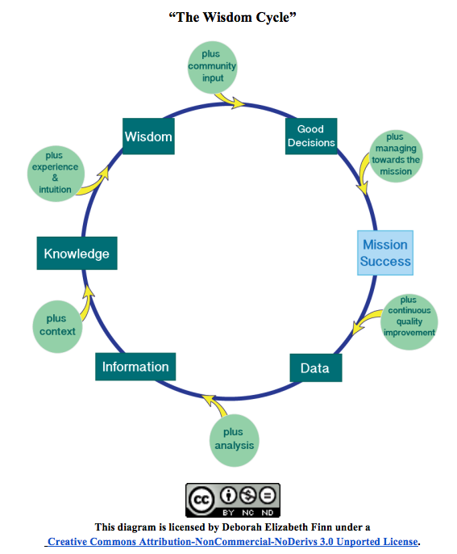
A Model for Success

Slide 27
Thank you!
Please visit
http://nonprofitknowledgemanagement.com/
for more information!
Feel free to contact Kevin Palmer
with questions or comments:
kevin.palmer@annkissam.com

