Slide 1

Investments & Endowments
A Primer for Nonprofit Leaders

Slide 2



Investment Management Group
The Chartered Financial Analyst (CFA) designation is conferred by the CFA Institute to financial analysts who complete a series of rigorous examinations. CFA charterholders are obligated to adhere to a strict code of ethics and standards governing their professional conduct.
The Certified Financial Planner (CFP®) designation is administered by the CFP Board. CFP applicants must pass a comprehensive certification examination, pass the CFP Board’s Fitness Standards for Candidates and Registrants, and agree to abide by the CFP Board’s Code of Ethics and Professional Responsibility which puts clients’ interests first.
The Certified Trust and Financial Advisor (CTFA) certification was established and
is endorsed by the American Bankers Association. To qualify for the certification, individuals must have substantial levels
of experience and education in the
wealth management profession, pass a comprehensive exam and agree to abide by a strict code of ethics.
Invests for individuals, businesses, and not-for-profit organizations.
Manages $2.5 billion in assets.
Provides clients with access to the expertise of a dedicated team of over 60 professionals.
Many team members hold high-level professional designations, including:
  Nine CFA charterholders
  Thirteen CFP® practitioners
  Six CTFA practitioners
  One JD, LLM
One of the largest independent investment advisors in Greater Boston.*
Maintains five investment offices: Boston, Hanover, Providence, RI, Osterville, and Attleboro.
* Source: Boston Business Journal

Slide 3
Speaker Bios
Nancy Chisholm, CRPC
Vice President and Financial Consultant
  Nancy brings over 30 years of financial services experience to Rockland Trust. Previously she worked at The Colony Group as Director of Business Development. Prior to 2010 Nancy had a successful 27 year career at Fidelity Investments, working in both the Retail and Institutional Marketing and Sales organizations. Nancy has a BSBA from Northeastern University, the designation of Chartered Retirement Planning Counselor and Series 65 licensed. She is member of the Boston Estate Planning Council and the Boston Chamber of Commerce Women’s Network Advisory Board.
Damon Barglow, CFA, CFP®
Vice President & Portfolio Manager
Damon is responsible for managing client portfolios, performing securities research, and setting investment policy. Damon brings 19 years of financial services experience including 10 years as a Portfolio Manager to the Rockland Trust team. Damon holds a Masters in Finance from the Kellogg Graduate School of Management at Northwestern University. He is also a CFA charter holder and has received his designation as a Certified Financial Planner®. Prior to joining Rockland Trust, Damon was a Managing Director at Eastern Bank's Wealth Management division where he managed Core, Growth and Socially Responsible Investment strategies.
Susan Daileader, CFP®, CLTC
Vice President & Financial Consultant
Susan is responsible for business development in Plymouth County. Susan began her career in financial services in 1983 at Bank of Boston . Susan has a B.A. from the University of Vermont, the designation of Certified Financial Planner™, and holds a Certification in Long-Term Care (CLTC). Susan is a member of the Board of Directors of Friendship Home, Inc., a not-for-profit serving adults with developmental disabilities. She is involved in fundraising activities for South Shore Hospital and is on the Board of Trustees of the South Shore YMCA. Susan is also the incoming Vice Chairperson on the Leadership Team for the South Shore Chamber’s Women’s Business Connection.

Slide 4
Agenda
Investment Accounts and Endowment Comparison
Fiduciary Obligations
Fiduciary Responsibilities
  Investment Committee Activities
    Investment Policy Statement
    Select and Monitor Investment Managers
    Develop RFP Process
    Document Process
  Conclusion

Slide 5
Investments / Endowment Comparison
 | Investments | Endowment | 403(b)
Who is Responsible? | Generally in house (Finance Director, CFO, CEO). Auditors may have some influence May have an Independent Investment Committee/Finance Committee May have an Investment Adviser or Broker | Generally in house (Finance Director, CFO, CEO). Auditors may have some influence Professional Investment Adviser or Broker Investment Committee/Finance Committee charged with conducting interviews with investment advisers/brokers | Generally in house (Finance Director, CFO, CEO). Auditors may have some influence. Plans may be either ERISA 403(b) or Non-ERISA 403(b) Trend to consolidate to single vendor solution to simplify administrative oversight Employer may hire independent Investment Manager (Fiduciary) or may maintain oversight in-house
Investment Policy Statement | Recommended but size of Investment Account can influence this Created with input from Executive Team and Investment Committee/Finance Committee | Finance/Investment Committee will create with input from Investment Adviser Brokers use suitability criteria for determining Investments. Advisers use fiduciary criteria. (See Appendix for Definitions) | Finance/ Investment Committee to outline due diligence criteria \ Default Investment Alternative (QDIA) Target Date Funds (if applicable) Brokers use suitability criteria for determining Investments. Advisers use fiduciary criteria. (See Appendix for Definitions)
Portfolio Time Horizon | Typically funding for 1-3 years | 3 years to perpetuity | As long as Plan is in effect, participant dependent
Investment Portfolio Holdings | Dictated by time horizon, usage of funds and size of portfolio If Investment Policy Statement is utilized, it will provide investment parameters | Investment Policy Statement provides specific guidelines as to investments permitted, for example: Government Bonds, High Yielding Bonds, Domestic Stock and International Stocks Generally, states mission, distribution criteria and goals for investments | Participant directed accounts are offered fiduciary protection through Section 404c of ERISA Plan Document must request 404c protection Investment/Finance Committee work with Adviser/Broker to determine choices

Slide 6
Investment Committee Fiduciary Obligations
  A fiduciary is a person who has power and obligation to act on behalf of another under circumstances that require total trust, good faith and honesty.
  In addition, a fiduciary should have greater knowledge and expertise about the matters being handled and is held to a higher standard of conduct and trust above that of a stranger or casual business person.
Uniform Prudent Management of Institutional Funds Act (UPMIFA)
http://uniformlaws.org/ActSummary.aspx?title=Prudent%20Management%20of%20Institutional%20Funds%20Act
UPMIFA ACT
http://www.uniformlaws.org/shared/docs/prudent%20mgt%20of%20institutional%20funds/upmifa_final_06.pdf
Notes:
Source?

Slide 7
Investment Committee Primary Fiduciary Responsibilities
  Understand Legal Framework
  Endowment, Pension, 403(b), Restricted/Unrestricted
  Investment Committee By-Laws
  Roles and Responsibilities are Defined and Acknowledged in Writing
  Conflict of Interest Policy (Self-Dealing)
  Conduct Regular Meetings
  Agenda and Meeting Minutes
  Determine Investment Responsibility of Investment Committee
  Self Review of Investment Committee
  Stay Informed of Changes in Legal Environment
Notes:
What is UPIA UPMIFA and MPERS?

Slide 8
Investment Committee Activities
  Define Committee Responsibility
  Develop an Investment Policy Statement
  Select and Monitor Investment Managers
  Develop an RFP Process
  Document Process

Slide 9
What Is An Investment Policy Statement ?
An Investment Policy Statement (IPS) is the foundation on which your financial future is built. An IPS creates the map future trustees, and stakeholders, will follow and interpret…It is your financial charter, or constitution.
  Key Components
  Maintain Written Detailed Policy
  Outline Objectives and Purpose
  Determine Investment Strategy
  Set Asset Allocation and Diversification Guidelines
  Stocks, Bonds, Cash
  Establish Payout Policy and Cash Flow Requirements
  Determine Permitted Investments
  Large, Mid, Small Company Stocks
  Treasury, Government, Corporate Bonds
  International Stocks/Bonds, Alternative Classes (REITS, Venture Capital, Private Equity, Hedge Funds)

Slide 10
Investment Policy Statement (Cont.)
  Key Components
Don’t Panic! Your Adviser will work with you to create an IPS if you don’t have one today.
  Identify Risk, Return and Time Horizon
  Determine Modeled or Expected Portfolio Return
  Establish a Review Schedule
  Caveats:
  Be careful not to be too limited
  Set guidelines for restricted vs. unrestricted gifts
  Don’t forget periodic evaluations
  Include responsibilities

Slide 11
When It’s Time to Hire an Investment Manager
  Set Your Goals and Objectives for the Request For Proposal (RFP)
  Prepare the RFP
  Identify Candidates
  Evaluate Responses and Select Finalists for Presentation
  Schedule Manager Interviews (Presentations)
  Select Managers
Let’s Take a Look At These In More Detail…

Slide 12
RFP Process
1. Set Goals & Objectives
3. Identify Candidates
  Create or Review Current IPS
  Determine Scope of Engagement
  Determine Who From the Organization Will be Participating in RFP Process
  Establish a Time Frame
  Identify Investment Management Firms Based Upon the Parameters Established in Step 1.
  Consistent with Organization’s Philosophy
  Required Asset Classes
  Service Model
  How Many Firms Should be Included?
2. Prepare the RFP
4. RFP Evaluation
  Construct a Standard List of Questions and Tailored to Your Particular Goals, Needs and Objectives
The Four “P’s”: People, Philosophy, Process and Performance…

Slide 13
The Four P’s – People, Philosophy, Process and Performance
People | Tenure of Key Personnel, Professional Credentials, Consistent Growth in Assets Change in Ownership, Account Servicing Problems
Philosophy | Does the firm’s investment style and approach align with your organization’s investment objectives? Is it clearly articulated and understood?
Process | Is the Investment Process Understandable? Has There Been an Increase in Portfolio Turnover? Does the firm use a team approach? Are fees reasonable?
Performance | Has the Firm Shown Competitive Results Versus Peer Groups and Appropriate Benchmarks? Are the Returns Consistent with the Manager’s Style? How Does the Portfolio Perform in Up and Down Markets?

Slide 14
5. Schedule Manager Interviews
6. Select Manager
  Manager Interviews Rather Than Manager Presentations
  This is Your Time to Ask Questions!
  Place a Strict Time Limit on Manager Presentations
  Be Prepared with a List of Questions
  This is Your Last Opportunity to Perform Due Diligence
  Congratulations! All of the Hard Work is Now Done
  Choose the Investment Manager That is the Best Fit With Your Overall Investment Philosophy and Goals
  Notify all Finalists of your Decision
  If You Have Followed an Impartial, Consistent Evaluation Methodology, You Should Feel Confident That You Have Made a Proper Decision

Slide 15
Document The Process
  Written Investment Policy Statement
  Establish meeting schedule
  Agendas and minutes from all meetings
  RFP records
  Relevant legal and educational documents

Slide 16
Conclusion and
Thank You!

Slide 17
Appendix

Slide 18
Suitability: Investment Recommendations must be based on income, net worth, investment objectives, risk tolerance and other security holdings. (http://www.sec.gov/answers/suitability.htm)
Fiduciary: A fundamental obligation to act in the best interests of your clients and to provide investment advice in your clients’ best interests. You owe your clients a duty of undivided loyalty and utmost good faith.

Slide 19
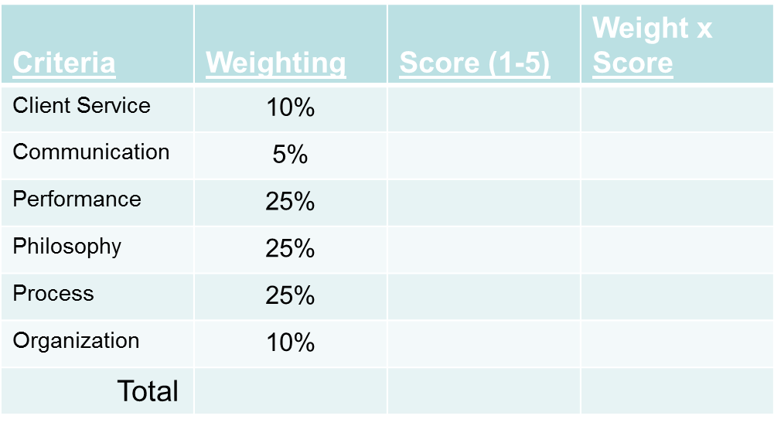
RFP Evaluation of Finalists
  Establish a Methodology for Scoring to Help Evaluate Investment Mangers (example below)
  Check the References of Finalists Before Invitation to Presentation Round.
Sample Evaluation Grid

