Slide 1

Tying Mission and Finances Together
Chart Your Strategic Course

Slide 2


Financial Empowerment
Board Fiduciary Responsibility
Evaluate Mission Effectiveness
Measure outcomes
Ensure Financial Viability
Ensure adequate resources
Consider long-term viability
Assure long-term sustainability

Slide 3

Major Issues Facing Non -Profits
Capacity Building
Resources
Infra-structure
Employees
Volunteers
Governance & Accountability
Boards
CEO/Executive Directors/Founders
Transparency of Operations
People served – constituent rights
Community Impact
Outcome measures
Benchmarks
Logic Models
Transformational Scale

Slide 4

How Do You Plan in an Ever-Changing World?
"I always skate to where
I think the puck is going to be." - Wayne Gretsky

Slide 5
Purpose and Values
Mission
Values
Strategic Plan
Organizational Objectives
Vision
Service Imperatives

Slide 6
The Fundamentals
1
MISSION
Why the organization exists
2
VISION
What the organization seeks to do
3
VALUES
The beliefs driving the organization
The benefit to the community
What kind of resource do we want to be
What do we want people to think of when they think of us
4
STRATEGIC PLAN
The map that leads to the vision
What do we need to realize our mission, vision and values?

Slide 7
The Role of Planning
Operations – beginning organization
Functionality
What is not working – how do we fix it
Organizational
What do we need to grow
Are our systems working
Visionary
How do we move the needle
How do we scale
How do we affect transformational change

Slide 8
Measuring Organizational Impact & Sustainability

Slide 9

Determining Impact

Slide 10

Program Criteria Summary

Slide 11
Determining Profitability

Slide 12
Mission Margin Matrix Table

Slide 13




Mission Margin Matrix As a Chart

Slide 14
Practice …..
Choose 3 or 4 of your organization’s programs
Rank them on a scale of 1-4; 2 is the mean (or x axis) based on the following criteria
Alignment with mission
Excellence in execution
Scale or Volume
Depth
Filling an important gap
Community constituent building
Leverage for funding

Slide 15
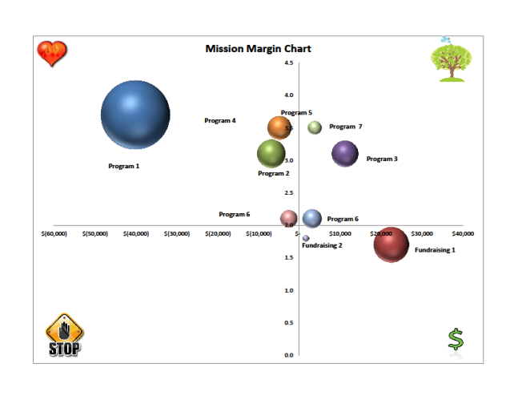
Questions you should ask
HOW CAN YOU MOVE THE MATRIX?
What can you grow?
What should you reduce or eliminate?
Where are you at risk?
How do you mitigate risk?
Where can you collaborate?
Can your fundraising offset programs that are not funded?
What is the impact of reducing a program in terms of administrative allocation?

Slide 16

Trouble
Ahead ……
How do you plan for contingencies?

Slide 17
Financial Empowerment – Know Where You Are
Financial Management - capacity building activity that improves non-profit ability to achieve mission
Financial analysis gives management and the board a clear picture of the financial “reality”
Financial Management is key to a healthy organization

Slide 18
Forecasting
Predicting the future based on extrapolating from the present
Exercise – Forecast Changes Numbers:
Program 1 is only going to realize $700,000 in revenue instead of $ 737,000 (drop of 5%) resulting in a larger loss
Program 3 expenses are 20% higher than budgeted

Slide 19
Forecasting Matrix Table

Slide 20
Mission Margin Matrix Original

Slide 21
Forecasting Mission Margin Chart

Slide 22
Scenario Planning
Rather than forecasting just one outcome (“the” future, as fans of forecasting might call it), imagine a few different outcomes (or “futures”).
Explore these alternative business landscapes to understand how key elements affecting your business might change– and thus how you might start getting ready.
Plan if you lose major source of revenue – what programs can be impacted and still maintain mission
Plan if you receive an unexpected significant contribution

Slide 23

Scenario Planning
Exercises:
What if Program 1 revenue was $850,000 with $950,000 in expenses
What if program 2 doubled its size and saw twice as many people
Mission impact would be higher
Cost would be 1/3 higher
Revenue would be 70% higher

Slide 24
Scenario Planning Matrix Table

Slide 25
Mission Margin Matrix Original

Slide 26
Scenario Planning Mission Margin Chart

Slide 27
Crisis Management
You have identified the X factor and it has happened. What does it look like and what are your options?
Your major funding source has pulled the plug
The volume has dropped 70% on Program 1 – moving it close to the line relative to mission

Slide 28
Crisis Management Matrix Table

Slide 29
Mission Margin Matrix Original

Slide 30
Crisis Management Matrix as a Chart

Slide 31
What Have We Learned?
Mission is critical – understand and review the impact you want to have
Finances can shift
Forecast
Plan by scenario’s
Manage crisis well
Plan for the future
Align collaborations well

Slide 32

“If you don’t know where you are going, you are certain to end up somewhere else.” Yogi Berra

Slide 33
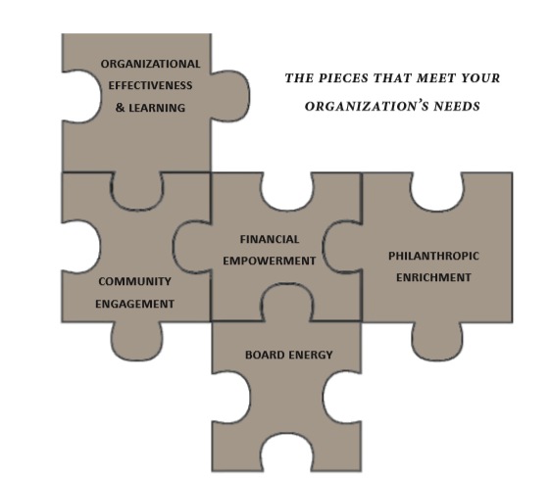



Engaging philanthropy … empowering your cause
Danosky & Associates helps non-profit organizations build the capacity to move their strategic vision forward with a solid foundation
and an army of support behind them
Friend
Us!
Connect
with Us!
Follow
Us!
www.danosky.com
info@danosky.com
860-799-6330

