Slide 1
Communicating Your Mission
through Storytelling

Slide 2
Groups of four or five
Last name, alphabetically first goes first
Last name, alphabetically last is timekeeper
Think of a time you learned a valuable lesson
Tell the group that story in 2 minutes

Slide 3

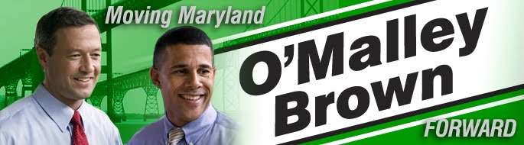

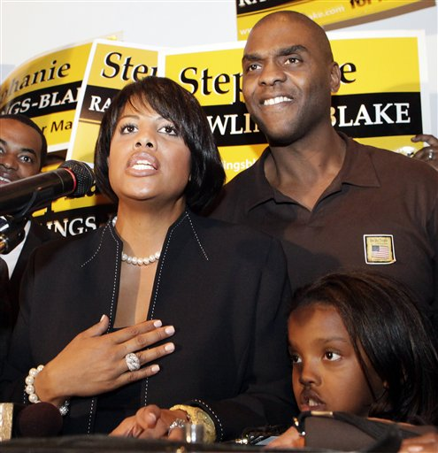



Notes:
Shaun introduction slide

Slide 4
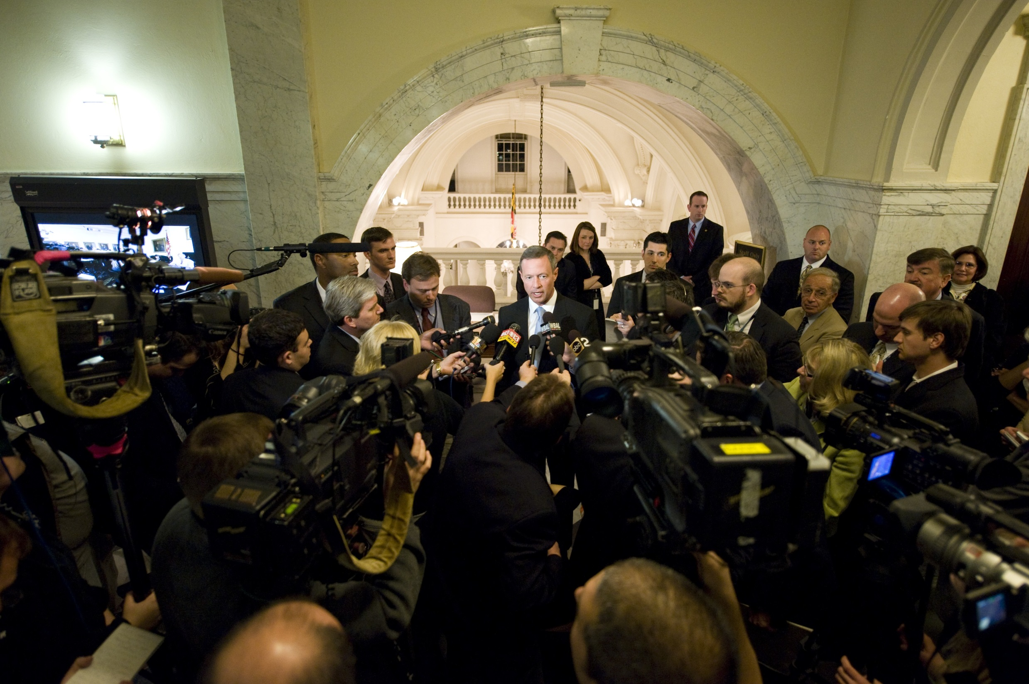

Slide 5


Slide 6
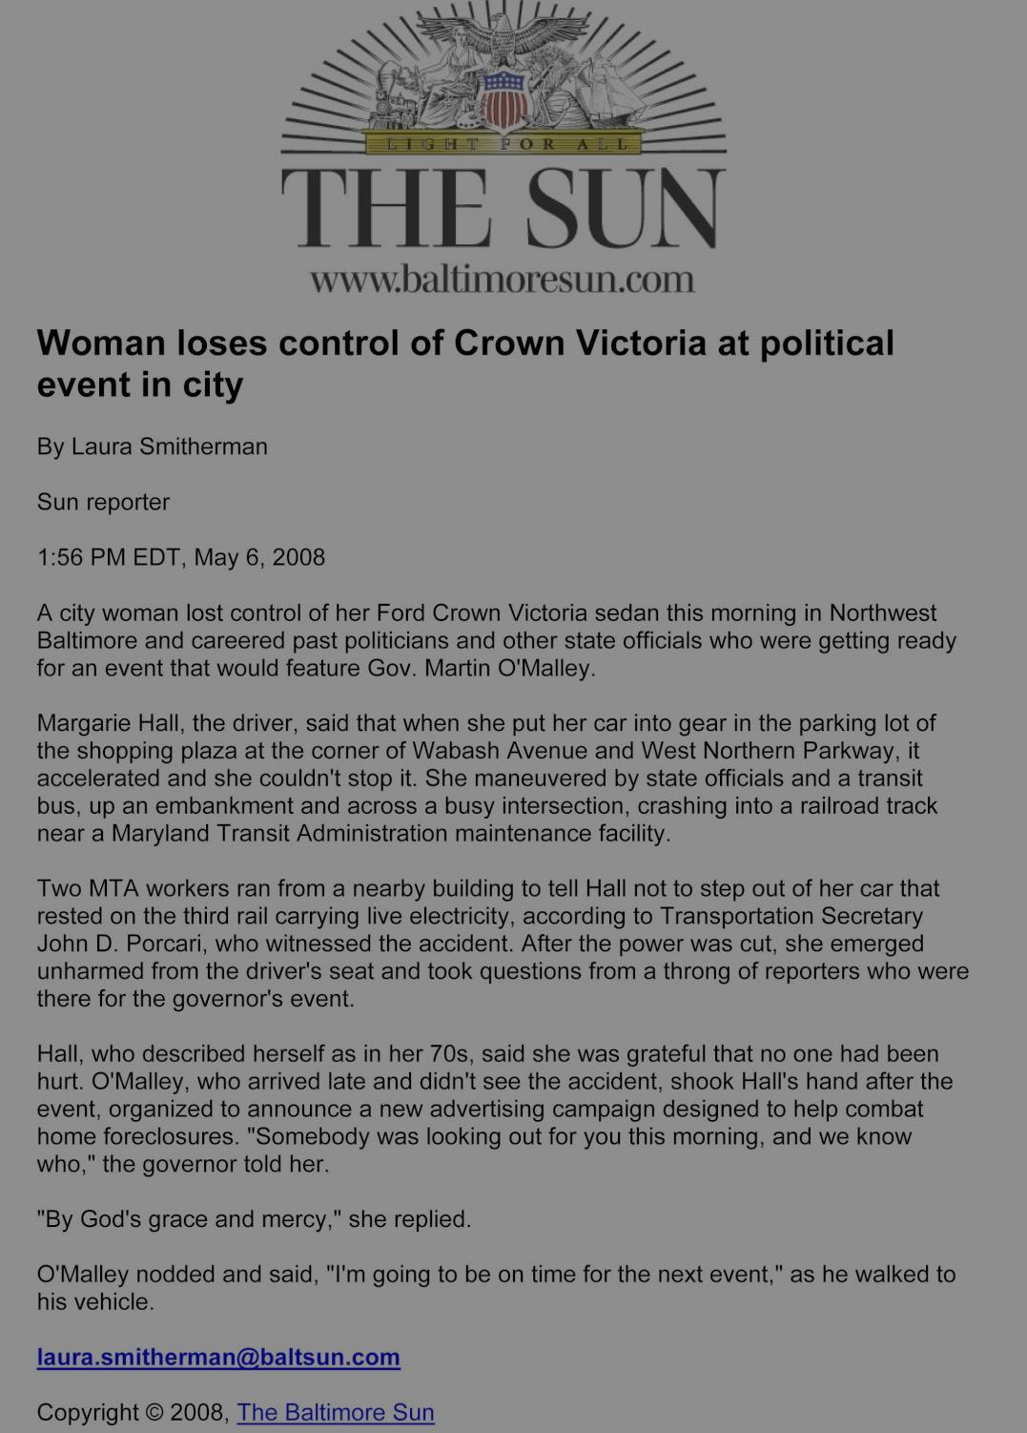
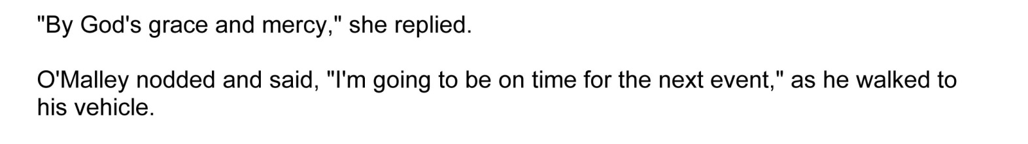

Slide 7



PROCESS
PROBLEM
PEOPLE
SOLUTION

Slide 8

Hattaway Aspirational Communications Model

Slide 9
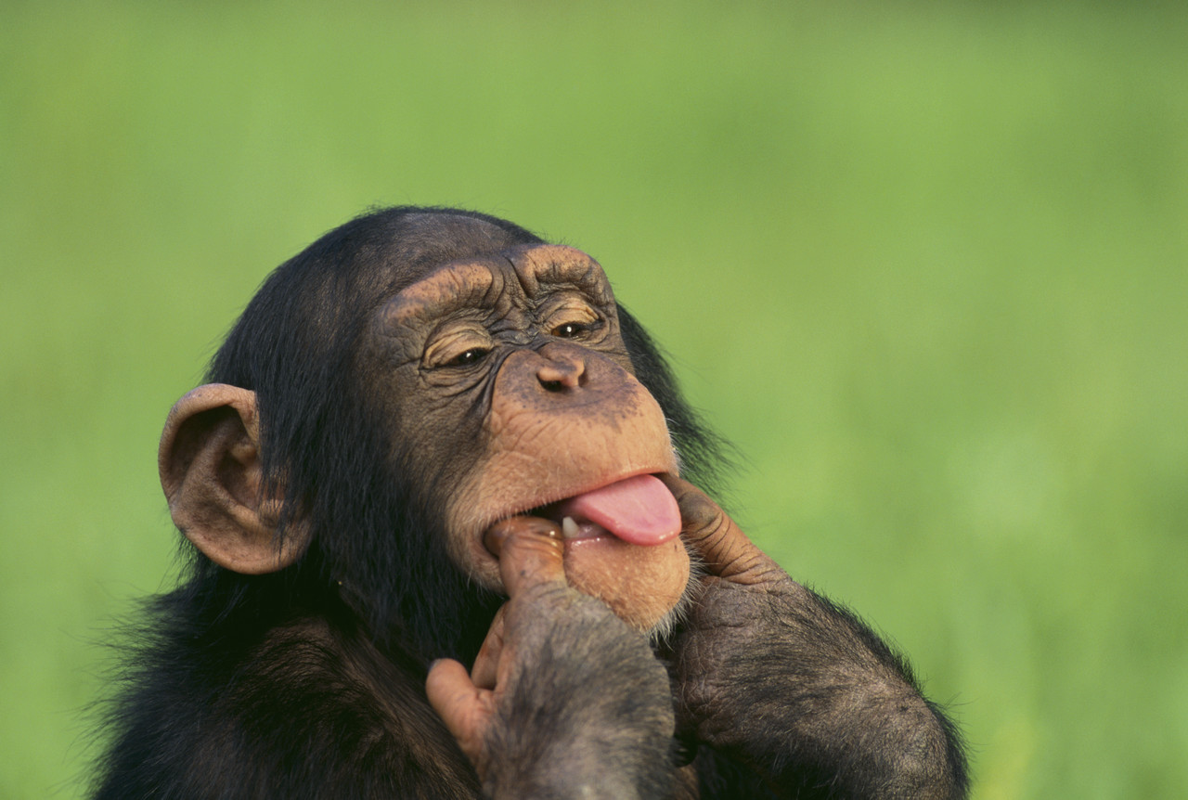
Show. Don’t tell.

Slide 10
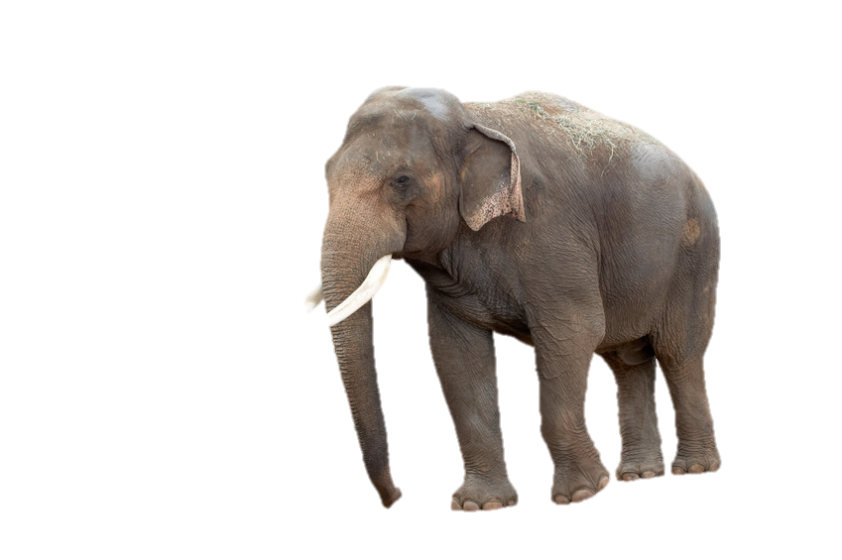
Every word evokes a frame.
Negating a frame evokes it.
Evoking the frame reinforces it.

Slide 11


Feel it.
What is the emotional reaction?
Will people believe the spirit of the story, and believe that you believe it?
Believe it.
See it.
What is the visual?
Repeat it.
Can people repeat it?

Slide 12
PROCESS
PROBLEM
PEOPLE
SOLUTION

Slide 13
PROCESS
PROBLEM
PEOPLE
SOLUTION
1
Who benefits?

Slide 14
PROCESS
PROBLEM
PEOPLE
SOLUTION
2
What are you fighting?

Slide 15
PROCESS
PROBLEM
PEOPLE
SOLUTION
3
What makes you unique?

Slide 16
PROCESS
PROBLEM
PEOPLE
SOLUTION
4
How do they benefit?

Slide 17
PROCESS
PROBLEM
PEOPLE
SOLUTION

Slide 18
How do I apply storytelling?
Mission / vision statement
Executive communication
Collateral
Website, digital communication
Board / staff meetings
Fundraising

Slide 19

DO MORE OF:
METAPHOR
IMAGES & VISUALIZATION
STORIES
DO LESS OF:
FACTS & FIGURES
ACRONYMS
WONK LANGUAGE

Slide 20
“HOW WOULD I EXPLAIN THIS OVER DINNER?”

Slide 21
“HOW WOULD YOU EXPLAIN THIS TO A 4-YEAR-OLD?”

Slide 22
Shaun Adamec
Founder & President
shaun@AdamecCommunications.com
617-888-2213
www.AdamecCommunications.com

