Slide 1
Presented to the Massachusetts Nonprofit Network The Nonprofit Centers Network October 29, 2014 Sarah Eisinger & Jackie Cefola
Building Together: Sharing Space and Staffing for Impact

Slide 2
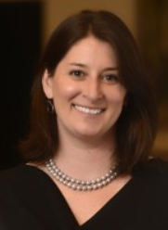
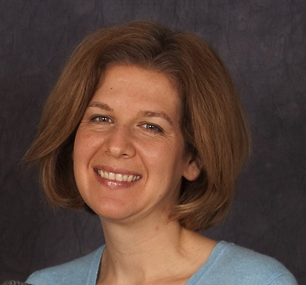
Who We Are
Sarah Eisinger Executive Director The Nonprofit Centers Network
sarah@nonprofitcenters.org
Jackie Cefola
Principal Jackie Cefola Consulting info@jackiecefola.com

Slide 3

The premiere learning community for nonprofit
shared space and services across North America.
www.nonprofitcenters.org

Slide 4
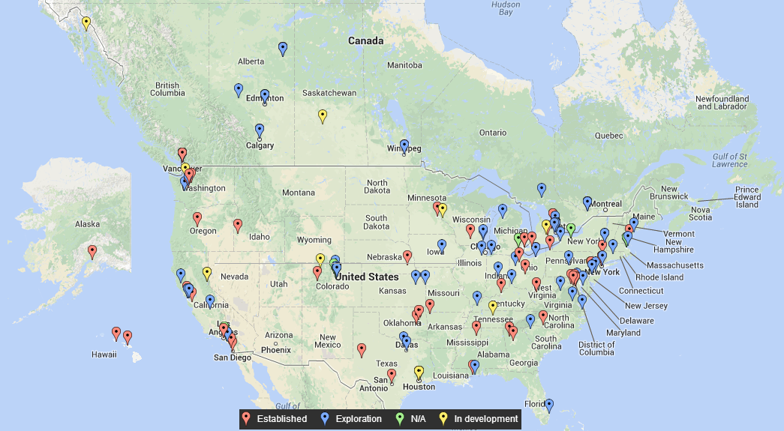
NCN Members Across North America
Notes:
This map is a snapshot of our membership. The red balloons are established centers. The Blue balloons are projects in some stage of exploration, and yellow balloons are projects underway – either in the construction or capital campaign state.
We have 152 members in the Network.
In the Northeast: a few examples: Third Sector New England, Foundation for Seacoast Health in Portsmouth, NH, CT Nonprofits in Hartford.

Slide 5
Session Objectives
Introduce the shared space and shared services model
Highlight case studies of best practices
Explore potential benefits for your organization
Introduce key implementation steps
Add to regional dialogue about collaborative resources

Slide 6
More About You
Notes:
What sector are you in? Nonprofit? For-profit? Government?
How many of you are EDs? Board members? Program staff? Operations? Consultants? Other?
How many organizations already own real estate?
How many of you are thinking of a real estate project?
How many are thinking about shared space? Shared staffing?
What do you want to get out of this session? Top three questions.

Slide 7
What is a Nonprofit Center?
Buildings - Exists as a physical site (one or more buildings)
Shared Space - Provides affordable, stable workspace, builds capacity, and supports mission-driven services.
Multiple Uses & Users - Composed of multiple (2 or more), primarily not-for-profit, tenant organizations
Notes:
Nonprofit centers come in all shapes and sizes and serve many different kinds of communities. All centers, however, share three basic features
What are we really talking about?
The collaborative use of space and resources across traditional organizational boundaries
Creating a network among collaborating partners to create value
Powerful shift in thinking away from independent organizations operating in isolation
A new model for funding: may involve earned income; subsidized rent; shared administrative expenses

Slide 8
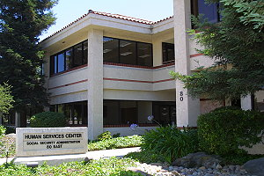
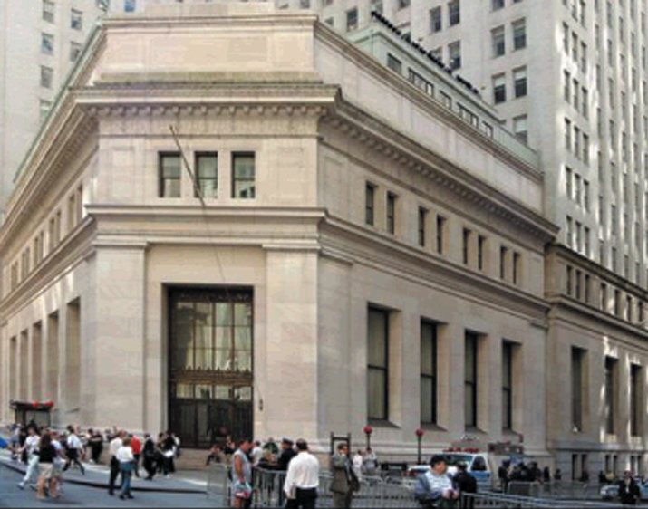
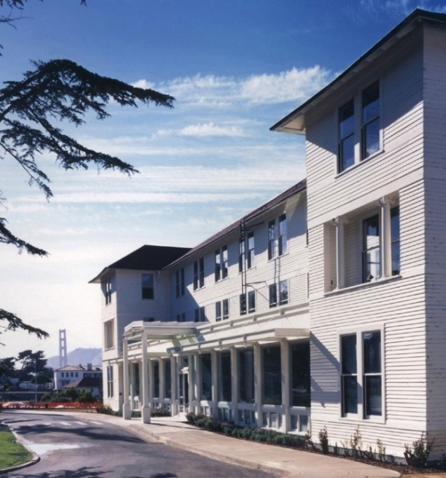
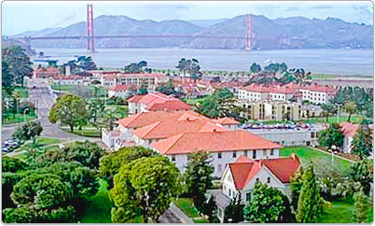
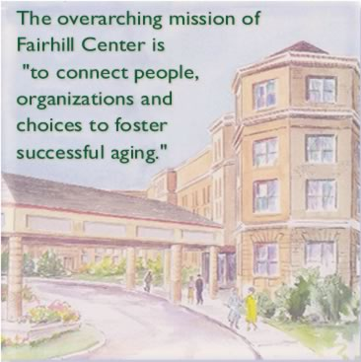
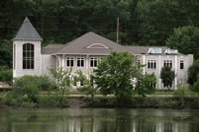
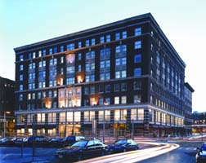
Buildings
Notes:
Anything that is not uniquely designed for mission-related activities has potential to be shared.
For example, at the Cambridge Innovation Center, organizations can share technology equipment and services that align with the type of space rented. All have internet. Some have video conferencing, hard wired phone lines. Level of commitment depends - customized.

Slide 9
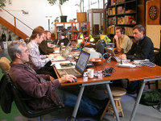
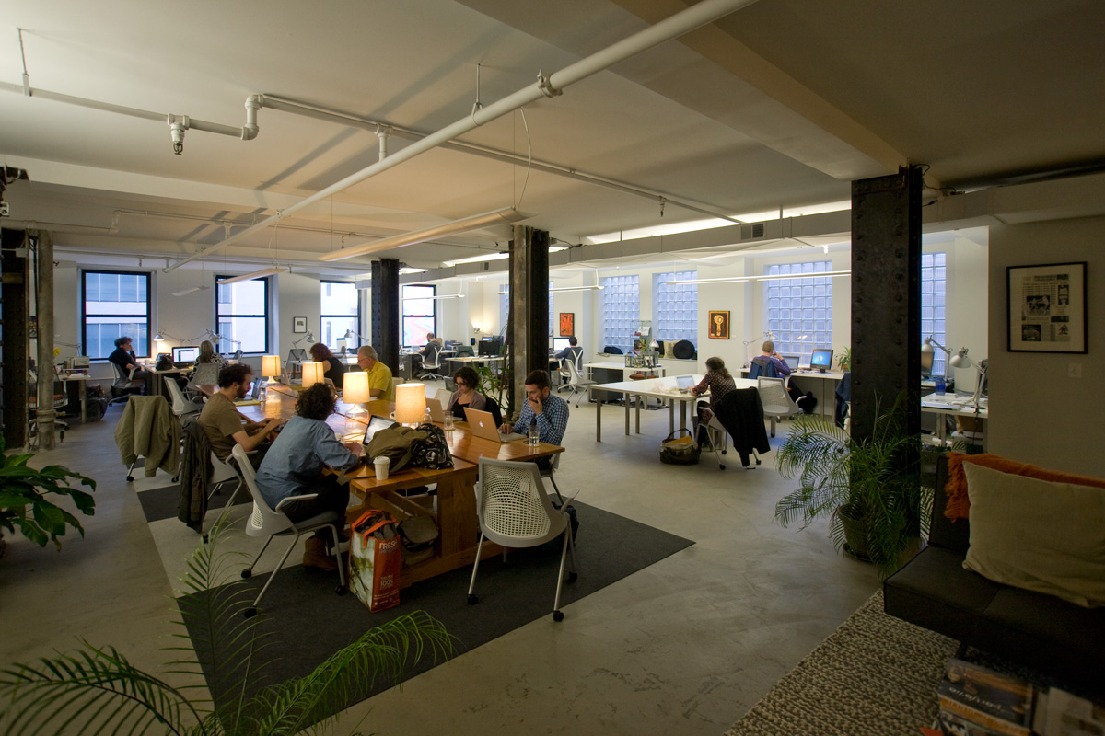
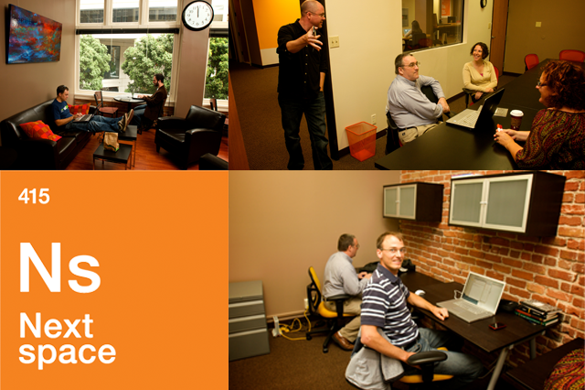
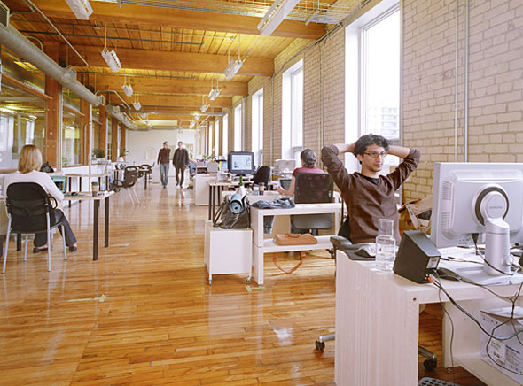
Spaces and Services
Notes:
Shared services:
Reception, administration
Financial management
Human resources
IT services
Marketing & communications
Lobbying
Fundraising/grant-writing

Slide 10
Types of Centers
Measuring Collaborations: The Benefits and Impacts of Nonprofit Centers, The Nonprofit Centers Network, 2011
Notes:
Service centers: serve a specific population, like a one-stop center, provides direct services
Theme centers: arts, environment or other
Multi-sector – serves all kinds of organizations

Slide 11
More Trust, More Sharing
Short-term Programs
Space
In depth
Program
Equipment
Staffing
Integration
Low
High
Trust
Notes:
Shared resources can be small in scope around non-core activities
Non threatening
Simple outsource decision
Easy to finance and enter into
Simple contractual relationship
Shared resources can be a very big organizational change effort. Requires
Careful planning
Considerable commitment
Different philosophy for control and accountability
Investment - time, people, money, reputation
Complicated financing allocations
High level of trust typically built over time with shared positive experiences
QUESTION TO PARTICIPANTS: Look again at this spectrum of shared services and associated levels of trust
Where is your organization now?
Where do you want your organization to be in 5 years, why?

Slide 12
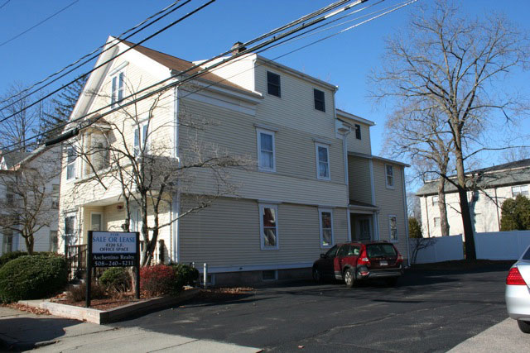
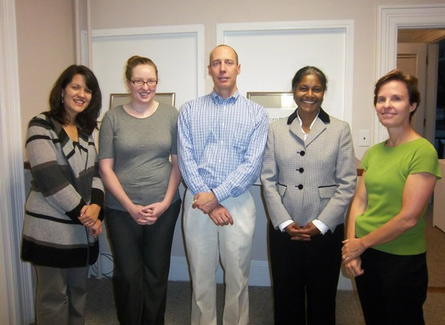
Mission-based Non-profit Building Framingham, MA
Notes:
In 2010 Fenix acquired a 3-floor, 4300 square foot building in downtown Framingham, MA zoned for commercial office space.
Located in residential neighborhood, victorian building
Houses 7 non-profits serving the Metro-West communities
Rented is well below market prices (approximately 50%).
Rent includes common conference room and internet access
Personal connections led the owner to Metrowest Nonprofit Network. MWNN acted as marketing partner to help get word out to local nonprofits about space.
Original vision for shared space, equipment and conference room. When 2 organizations rented the entire first and second floors the shared space concept changed.
Third floor houses 5 small organizations
Rental terms are negotiated; year to year lease agreements
Intended for people to not work at home, increase connection and potentially collaboration
Challenge to implement though because many organizations are not using space regularly during business hours – small organizations use space more flexibly.
Previously talked about sharing copier and coffee maker but not established
Severely reduced rent for smaller organizations.
The following organizations currently occupy the Fenix Deloss Building:
Impact Framingham www.impactframingham.org ITN Greater Boston www.itngreaterboston.org Jeff's Place www.jeffsplacemetrowest.org Metro-West Free Medical Program www.metrowestfreemedicalprogram.org Metro-West Non-Profit Network www.metrowestnonprofitnetwork.wordpress.com
Reaching Independence and Striving for Excellence The Volunteer Family www.thevolunteerfamily.org

Slide 13


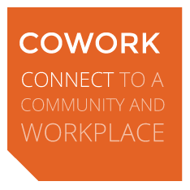

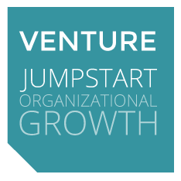
THE PROGRAMS
YOUR ORGANIZATION OR PROJECT
The Model Projects and organizations start with CONTENT, SERVICES , OR PRODUCTS but struggle to build capacity in the following areas:
Planning & Implementation Support
Space & Community
Nonprofit Umbrella & Back Office Management
Marketing & Fundraising Support
Notes:
Everything starts w content but people struggle w infrastructure
5,000 SF in a commercial building, center city, Philadelphia
Open plan with dedicated common spaces
Divided roughly 50/50 work space and “commons”
High-volume copier/printer, WiFi, expendables
Reception, coat closet, locked storage
Lounge/living room, full kitchen with eating area
Mail area/boxes, lockers, 4 break out rooms
Telephones available in all break-outs and conference
Conference room (20/50), with phone, full A/V
30 full member desks + 35 transient places rolling
6-year lease with 3-month abatement @ ca. USD $22/SF
Self-contained business unit within CultureWorks
USD $15k/month total expenses, inclusive:
1 Staff Position @ USD $42k + Fringe
All IT, Telephone, Security, and Equipment Leases
Rent, Utilities, and Building CAM Costs
Expendables
Current roll of 152 members = ca. USD $16k/month
USD $75k in fit-out investment + phased staffing implementation
Cash flow positive at 4 months post-opening

Slide 14

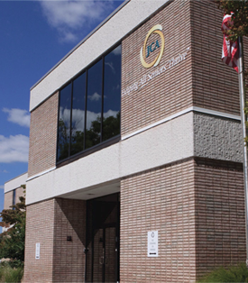
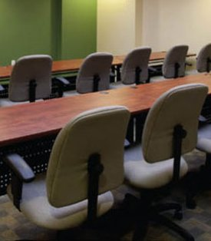
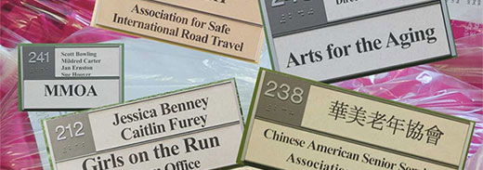
Notes:
Nonprofit Village, Rockville, MD
10,000 SF opened in 2006, shared space and some private offices for 17 organizations
Master lease and sublease to smaller nonprofits
Shared reception, kitchen, office equipment, Internet
New virtual services in 2013: reservations for meeting rooms, Wi-Fi, copier, printer; networking and training; referrals to other nonprofit services and resources; mailboxes; annual fee
Looking to shared communication services and professional development
Took two years to fill up – didn’t plan enough for vacancy rates
Looking to replicate

Slide 15
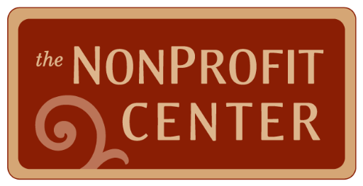
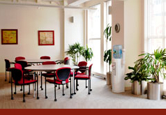
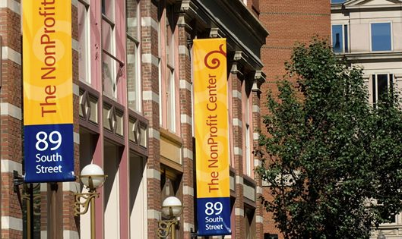
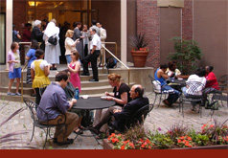
Notes:
MISSION: To be the home for progressive social change in Boston
SHARED RESOURCE BASICS: Shared space at or below market rate
Over 110,000 SF in renovated historic building, opened in 2005
Over 8,000 SF of affordable shared spaces for organizations with less than 6 employees (budgets typically under $100k, sometimes under $20k)
30 + tenants, all 501c3s, extremely diverse mission, diverse size and budget
Admin offices only – no client services; art gallery, conference rooms, kitchens, bike storage
Extensive shared training and programs
Shared facility staff including reception
Opt in for fiscal sponsorship services (shared financial, accounting, budget and HR services)
ORGANIZATION STRUCTURE:
Program of a 501c3
Programmatic collaborations = agencies self-organize though encouraged by center’s staff

Slide 16

Why Collaborate?
Formal & Informal -
Two or more parties
Common purpose or goal
Working together = organizational priority for all parties
Mutually agreed upon decision-making process
Mechanism for accountability between partners
Notes:
Affect change
Do more together
Secure resources
Enhance community relationships
Leverage the strengths and resources
Increase political will
What else?
Denver Shared Spaces defines intentional collaboration as the process by which two or more entities work together to achieve a common purpose or goal.
The process of intentionally collaborating involves setting collaboration as an organizational priority, developing a mutually agreed upon decision-making or governance structure, and ensuring on-going maintenance of the collaboration through consistent accountability between the partner organizations.

Slide 17
Benefits: Cost Savings
Lease Rates Relative to Market
Measuring Collaborations: The Benefits and Impacts of Nonprofit Centers, The Nonprofit Centers Network, 2011
Notes:
Average annual cost savings about 7 percent of annual operating costs
About 15% of centers are around or more than market rates
Slightly over 30% of centers are closer to market rate in last 3 years
Just under 70% have 25% or greater rental discount

Slide 18
Benefits: Organizational Capacity
Measuring Collaborations: The Benefits and Impacts of Nonprofit Centers, The Nonprofit Centers Network, 2011
Notes:
Significant increases in organizational capacity just by co-locating.
Affects operations, visibility, and allows organizations to grow.

Slide 19
Activity: Determine Your Readiness
What is your organization’s goal? What are you trying to achieve?
Is collaboration the right method to achieve this goal?
What resources are available to support the collaboration?
Notes:
If you are ready to partner/collaborate, a key element is to then ensure that you have clear, shared understanding of the goals, strategy and available resources.
In pairs, talk through a possible shared space or shared staffing collaboration:
What are the goals?
Is shared space/shared services the right method to achieve the goal?
What resources are available to support the project?

Slide 20
Development of Centers
Notes:
About 35% of centers are operated by nonprofits with a master lease or management contract

Slide 21
Staffing & Operations
Budget
Tenant Selection
Community Council
Directors/ Tenant Council
Advisory Committee
Board Members
Co-owners
Operations
Programming
Control & Risk
Low
High

Slide 22
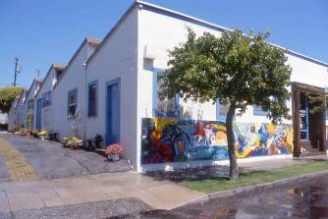
Ownership Options
Sole Owner
Master Lease
Community Nonprofit Ownership
Limited Liability Corporation
Commercial Condominium
18th Street Arts Center
Santa Monica, CA
Notes:
Focus on top two

Slide 23
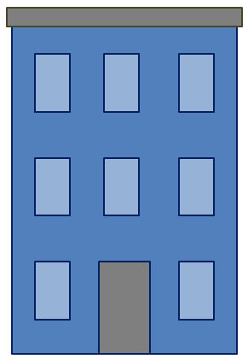
Sole Owner
B
nonprofit
Owner:
A nonprofit
C
nonprofit
Leases
D
Notes:
Sarah
Most control and risk for owner
Existing or new entity
Governed by a board of
directors
Be aware of UBIT issues
Loans based on owner’s
credit-worthiness

Slide 24
Master Lease
Owner:
Government or Commercial
B
nonprofit
Lessee:
A
nonprofit
C
nonprofit
Sub- Leases
D
Notes:
Private owner
Tighter test on nonprofit

Slide 25
Capital Financing
Notes:
Over $405 million in investments in 31 centers, not adjusted for inflation
If extrapolate out to over 200 centers and adjust for inflation, investment in the billions.

Slide 26
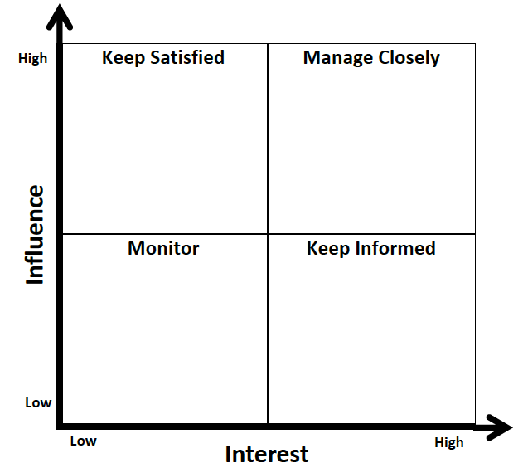
Activity: Stakeholder Analysis
Credit: Denver Leadership Institute
Notes:
Identify stakeholders involved with the collaboration: partner organizations, funders, sponsors, service providers, landlords, tenants, public agencies
Identify the most important 5 – 10 stakeholders for this exercise; those who have power to block or advance the project
Consider – Influence related both to relationships as well as what folks bring to the table (assets, client base, political or social influence, expertise, funding and financial contribution, relationships to [funders, networks, programs]); you can't just have one and expect success, how do you leverage the resources/assets that you and your partners have
3. Map the top 10 stakeholders on the graph and understand potential next steps (manage closely; keep satisfied; keep informed; monitor)

Slide 27
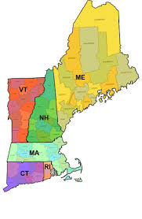
What’s Next: Regional Dialogue
How can shared resources impact your organization, community, region?
Who should be included in the discussion about shared resources?
Who leads the effort?
What are the key first steps?

Slide 28

Join us in Vancouver: June 1-3, 2015!

Slide 29
Thank you!
Sarah Eisinger Executive Director The Nonprofit Centers Network
sarah@nonprofitcenters.org
Jackie Cefola
Principal Jackie Cefola Consulting info@jackiecefola.com

