Slide 1
Maintaining Continuity, Inspiring Change: Best Practices for Board Recruitment
2014 Massachusetts Nonprofit Network Annual Conference
Presented by: Theresa Hamacher

Slide 2
Agenda
The importance of recruiting
5 dos and don’ts of nonprofit recruiting

Slide 3
The Importance of Recruiting
You know it’s time to recruit when . . . .

Slide 4
The Importance of Recruiting
Common presenting symptoms:
The board keeps shrinking
No one has joined the board in the past two years
No one has left the board in the past two years
Board members feel stuck
The board can’t seem to move forward with critical projects

Slide 5
Goals of Recruiting
Continuity
  Offset normal attrition
Change
  Move the board in a different direction
  Add new skills
  Raise profile in the community
  Reboot failed board
Notes:
5

Slide 6
Dos and Don’ts of Recruiting
#1
Don’t make recruiting an option

Slide 7
Dos and Don’ts of Recruiting
#1
Don’t make recruiting an option
Do have term limits
-- and enforce them!

Slide 8
What Really Matters
Establish and enforce term limits for all board, advisory board and committee positions.
BP
BP = Best Practice
Notes:
8
Compensation information:
Guidestar
Salary.com
Form 990s
“Trade Association” studies (i.e. New England Museum Association)
Most nonprofits in Boston are cooperative in sharing information

Slide 9
Dos and Don’ts of Recruiting
#2
Don’t take the menu approach to recruiting
Do focus on your organization’s specific needs when developing recruiting priorities

Slide 10
The Functions of Non-Profit Boards
How do boards spend their time?
  Role 1: Executive Oversight
  Role 2: Operational Support
  Role 3: Resource Development
  Role 4: Self Renewal

Slide 11
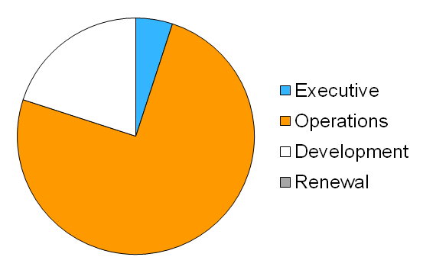
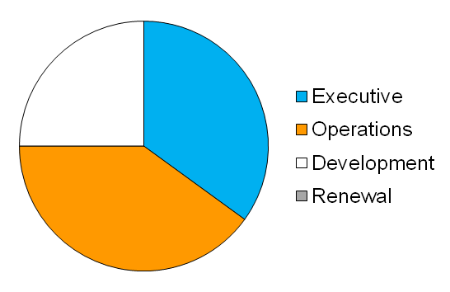
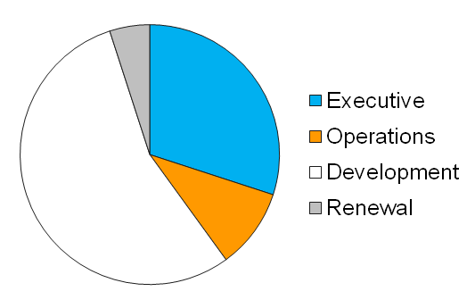
How Boards Spend Their Time
Small
Mid Sized
Large
Notes:
11

Slide 12
What Really Matters
How a Board spends its time should match the needs and resources of the organization.
BP
Notes:
12
Compensation information:
Guidestar
Salary.com
Form 990s
“Trade Association” studies (i.e. New England Museum Association)
Most nonprofits in Boston are cooperative in sharing information

Slide 13
Dos and Don’ts of Recruiting
#3
Don’t get ahead of yourself
Do avoid “board freeze” by
following the 10-step plan
-- one step at a time!

Slide 14
10 Step Recruiting Plan
Step 1: Determine needs and priorities
Step 2: Set goals
Step 3: Review by-laws
Step 4: Assign overall responsibility to individual or committee
Step 5: Develop talking points

Slide 15
10 Step Recruiting Plan
Step 6: Identify sources of recruits
Step 7: Generate a list of potential candidates and prioritize
Step 8: Establish a follow up procedure to both positive and negative responses
Step 9: Assign responsibility for making the calls
Step 10: Make the calls

Slide 16
Dos and Don’ts of Recruiting
#4
Don’t set unrealistic targets
Do think about who is most likely to volunteer

Slide 17
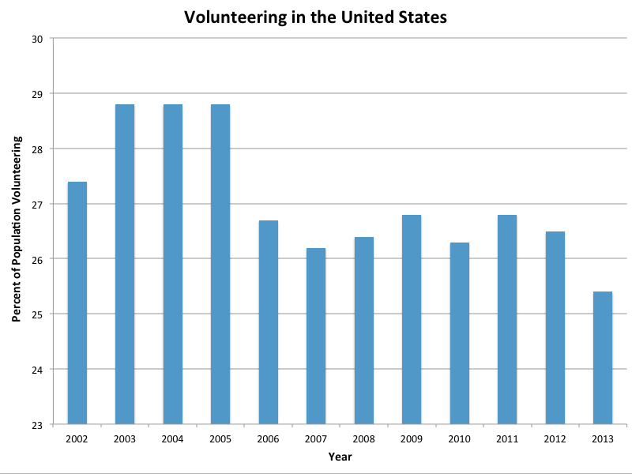
Volunteering Landscape
The competition for volunteers is high, with volunteer rates at their lowest in a decade. Only 25.4% of Americans spent time as volunteers in 2013.
*U.S. Bureau of Labor Statistics, February 25, 2014

Slide 18
The Big Picture on Volunteers*
Women volunteer at a higher rate than men across all age groups, educational levels, and other major demographic characteristics
33 – 44 year-olds most likely to volunteer
People in early 20’s least likely to volunteer
Married persons volunteer at a higher rate
Parents with children under age 18 volunteer more than persons without children
*U.S. Bureau of Labor Statistics, February 25, 2014

Slide 19
The Big Picture on Volunteers*
In order of magnitude, type of organizations people volunteered for:
  Religious (tend to be older)
  Educational or youth service (increases with educational level)
  Social or community service organizations
Equal proportions volunteered because they were asked to volunteer or became involved on their own initiative
*U.S. Bureau of Labor Statistics, February 25, 2014

Slide 20
Volunteer Retention is Hard
1 of 3 people who volunteer at a nonprofit in one year do not volunteer at any nonprofit the next year.
Episodic volunteering (on short duration tasks) has increased (short duration tasks)
*Issue Brief: Volunteer Retention. Corporation for National and Community Service and USA Freedom Corps, April 2007. Volunteer Growth in America: A Review of Trends Since 1974. Corporation for National and Community Service, December 2006.

Slide 21
Board Members as Volunteers*
Two-thirds of smaller nonprofit boards have only white, non-Latino members
78% of board members are between ages 36 and 65
  Only 7% are under age 36
On average, 49% of board members are women
  Percentage is lower on larger boards
Recruiting from among board members’ friends and acquaintances can be counterproductive.
  “Friends and family boards” have lower levels of effectiveness on all aspects of board work other than fundraising.
*Francie Ostrower, “Nonprofit Governance in the United States: Findings on Performance and Accountability from the First National Representative Study,” the Urban Institute Center on Nonprofits and Philanthropy, 2007

Slide 22
Board Members as Volunteers
Board member motivations for serving can be grouped into six categories:
Enhancement of self-worth
Learning through community
Helping community
Developing individual relationships
Unique contributions to the board
Self-healing
*Sue Inglis and Shirley Cleave, “A Scale to Assess Board Members’ Motivations in Nonprofit Organizations”,” Nonprofit Management and Leadership, 2006

Slide 23
What Really Matters
BP
Congruence of vision
Notes:
23
Compensation information:
Guidestar
Salary.com
Form 990s
“Trade Association” studies (i.e. New England Museum Association)
Most nonprofits in Boston are cooperative in sharing information

Slide 24
Dos and Don’ts of Recruiting
#5
BP
Recruit or DIE!
Notes:
Recruit or DIE! handout in the tools section.

Slide 25
Potential Pitfalls
The board is convinced that recruiting is taking time away from its real work.
PP
Changing one or two board members may not lead to overall change.
PP
Notes:
25
We’ll discuss the second pitfall in the group dynamics section.

Slide 26
5 Dos of Recruiting
Have and enforce term limits
Focus on your organization’s specific needs
Follow the 10-step recruiting plan – step by step
Think about who’s most likely to volunteer
Recruit or die!

Slide 27
Thank you for your participation!
ESC of New England
www.escne.org

