Slide 1
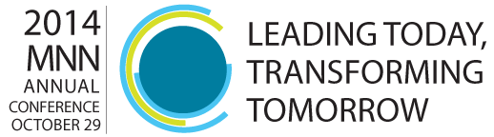
Making the Case for Change: Tools for Change Leadership
Bob Voss, PhD
Partner & Nonprofit Practice Leader
Growth River
Robert Heinzman
Partner & Global Science Practice Leader
Growth River

Slide 2
Transformational Change is Hard
People have to change the way they see things, how they behave and how they work together.
The path and endpoint are uncertain.
Transformational change needs to be led not managed.

Slide 3
Leading transformational change requires aligning culture, structure and business models simultaneously.

Slide 4
Objectives for This Workshop
AN INTEGRATED FRAMEWORK for understanding how to lead transformational change in your organization.
AN EXPERIENCE of how to develop some of the key capabilities essential for mastering change leadership.

Slide 5
Leading People Through Change
Creating Higher-Performing Teams & Cultures
Structuring Systems-of-Roles
Optimizing Business Models
Notes:
The Critical Capabilities to Effectively Lead Change
Business Model Design and Execution.
Architecting a Complete System-of-Roles.
Assessing and Driving Culture Change.
Designing Change Initiatives.

Slide 6
Leading People Through Change
Creating Higher-Performing Teams & Cultures
Structuring Systems-of-Roles
Optimizing Business Models

Slide 7
Leading People Through Change
Creating Higher-Performing Teams & Cultures
Structuring Systems-of-Roles
Optimizing Business Models

Slide 8
Leading People Through Change
Creating Higher-Performing Teams & Cultures
Structuring Systems-of-Roles
Optimizing Business Models

Slide 9
Creating Higher-Performing Teams & Cultures
Culture
The ways-of-thinking and acting that are taught and reinforced in an organization. Leadership mindset is the primary source.
Notes:
Culture: The conscious, intentional agreements around how people show up and how people interact in order to drive performance.

Slide 10
Structuring Systems-of-Roles
Structure
Architecting a complete system-of-roles:
All key issues have an owner.
Clear accountabilities and final call authority.
Incentives and interdependencies across roles are optimized.
Notes:
With clear accountabilities, final call authority, transparent and effective interdependencies, and incentives) to drive innovation and shared learning across the enterprise.

Slide 11
Optimizing Business Models
  Business Models
  A system-of-roles and capabilities to develop, sell and deliver products and services to customers with the help of partners in order to creative competitive advantage.

Slide 12
Leading People Through Change
Creating Higher-Performing Teams & Cultures
Structuring Systems-of-Roles
Optimizing Business Models

Slide 13
Optimizing Business Models
  Business Models
  A system-of-roles and capabilities to develop, sell and deliver products and services to customers with the help of partners in order to creative competitive advantage.

Slide 14
“…develop, sell & deliver
products and services to customers…”
The Business Triangle
1) DEVELOPING
2) SELLING
The
Customer’s
Experience
3) DELIVERING
Notes:
The Business Triangle – To visualize “why” capabilities are deployed in your organization: to develop, to sell, to deliver and to support.
The business triangle is the first major concept in this framework:
The business triangle is a universal pattern that exists in all stages and kinds of organizations including .com, .org, .gov, and .edu.
Business triangles are the basic market facing elements in your organization’s structure.
Please read these descriptions:
Four Basic Rationales For “Why”
In all businesses capabilities the rationale for “why” capabilities are deployed is to create four fundamental deliverables.
To Develop −> in order to create Targeted Value Propositions
To Sell −> in order to create Successful Purchase Moments
To Deliver −> in order to create Customers Who Make Positive Referrals
To Support −> in order to create Economies of Scale.
The Logic Of Business Triangles
The business triangle is a way to envision business capabilities as part of an integrated go-to-market system.
In a business triangle, capabilities are designed and deployed to develop, sell and deliver products and services to target customers with help from partners in a way that creates competitive advantage.
Business growth can be envisioned as an acceleration in throughput around a business triangle (1,2,3,1…Developing, Selling, Delivering, Developing…).

Slide 15
“…to create competitive advantage…”
CUSTOMER SEGMENTATION:
  Buyers
  End-users
Targeted
Value
Propositions
1) DEVELOPING
2) SELLING
The
Customer’s
Experience
Customers
Who Make
Positive Referrals
Successful
Purchase
Moments
3) DELIVERING
Notes:
The Business Triangle – To visualize “why” capabilities are deployed in your organization: to develop, to sell, to deliver and to support.
The business triangle is the first major concept in this framework:
The business triangle is a universal pattern that exists in all stages and kinds of organizations including .com, .org, .gov, and .edu.
Business triangles are the basic market facing elements in your organization’s structure.
Please read these descriptions:
Four Basic Rationales For “Why”
In all businesses capabilities the rationale for “why” capabilities are deployed is to create four fundamental deliverables.
To Develop −> in order to create Targeted Value Propositions
To Sell −> in order to create Successful Purchase Moments
To Deliver −> in order to create Customers Who Make Positive Referrals
To Support −> in order to create Economies of Scale.
The Logic Of Business Triangles
The business triangle is a way to envision business capabilities as part of an integrated go-to-market system.
In a business triangle, capabilities are designed and deployed to develop, sell and deliver products and services to target customers with help from partners in a way that creates competitive advantage.
Business growth can be envisioned as an acceleration in throughput around a business triangle (1,2,3,1…Developing, Selling, Delivering, Developing…).

Slide 16
“A system-of-roles and capabilities…”
CAPABILITY 3
Targeted
Value
Propositions
CAPABILITY 4
CAPABILITY 2
CAPABILITY 5
1) DEVELOPING
2) SELLING
CAPABILITY 6
The
Customer’s
Experience
CAPABILITY 1
CAPABILITY 7
Customers
Who Make
Positive Referrals
Successful
Purchase
Moments
3) DELIVERING
CAPABILITY 11
CAPABILITY 10
CAPABILITY 9
CAPABILITY 8
Notes:
The Business Triangle – To visualize “why” capabilities are deployed in your organization: to develop, to sell, to deliver and to support.
The business triangle is the first major concept in this framework:
The business triangle is a universal pattern that exists in all stages and kinds of organizations including .com, .org, .gov, and .edu.
Business triangles are the basic market facing elements in your organization’s structure.
Please read these descriptions:
Four Basic Rationales For “Why”
In all businesses capabilities the rationale for “why” capabilities are deployed is to create four fundamental deliverables.
To Develop −> in order to create Targeted Value Propositions
To Sell −> in order to create Successful Purchase Moments
To Deliver −> in order to create Customers Who Make Positive Referrals
To Support −> in order to create Economies of Scale.
The Logic Of Business Triangles
The business triangle is a way to envision business capabilities as part of an integrated go-to-market system.
In a business triangle, capabilities are designed and deployed to develop, sell and deliver products and services to target customers with help from partners in a way that creates competitive advantage.
Business growth can be envisioned as an acceleration in throughput around a business triangle (1,2,3,1…Developing, Selling, Delivering, Developing…).

Slide 17
“A system-of-roles and capabilities…”
ROLE 3
Targeted
Value
Propositions
ROLE 4
ROLE 2
ROLE 5
1) DEVELOPING
2) SELLING
ROLE 6
The
Customer’s
Experience
ROLE 1
ROLE 7
Customers
Who Make
Positive Referrals
Successful
Purchase
Moments
3) DELIVERING
ROLE 11
ROLE 10
ROLE 9
ROLE 8
Notes:
The Business Triangle – To visualize “why” capabilities are deployed in your organization: to develop, to sell, to deliver and to support.
The business triangle is the first major concept in this framework:
The business triangle is a universal pattern that exists in all stages and kinds of organizations including .com, .org, .gov, and .edu.
Business triangles are the basic market facing elements in your organization’s structure.
Please read these descriptions:
Four Basic Rationales For “Why”
In all businesses capabilities the rationale for “why” capabilities are deployed is to create four fundamental deliverables.
To Develop −> in order to create Targeted Value Propositions
To Sell −> in order to create Successful Purchase Moments
To Deliver −> in order to create Customers Who Make Positive Referrals
To Support −> in order to create Economies of Scale.
The Logic Of Business Triangles
The business triangle is a way to envision business capabilities as part of an integrated go-to-market system.
In a business triangle, capabilities are designed and deployed to develop, sell and deliver products and services to target customers with help from partners in a way that creates competitive advantage.
Business growth can be envisioned as an acceleration in throughput around a business triangle (1,2,3,1…Developing, Selling, Delivering, Developing…).

Slide 18
“…with the help of partners…”
HR
Targeted
Value
Propositions
IT
1) DEVELOPING
2) SELLING
The
Customer’s
Experience
Legal
Customers
Who Make
Positive Referrals
Successful
Purchase
Moments
Facilities
3) DELIVERING
Finance
4) SUPPORT
Notes:
The Business Triangle – To visualize “why” capabilities are deployed in your organization: to develop, to sell, to deliver and to support.
The business triangle is the first major concept in this framework:
The business triangle is a universal pattern that exists in all stages and kinds of organizations including .com, .org, .gov, and .edu.
Business triangles are the basic market facing elements in your organization’s structure.
Please read these descriptions:
Four Basic Rationales For “Why”
In all businesses capabilities the rationale for “why” capabilities are deployed is to create four fundamental deliverables.
To Develop −> in order to create Targeted Value Propositions
To Sell −> in order to create Successful Purchase Moments
To Deliver −> in order to create Customers Who Make Positive Referrals
To Support −> in order to create Economies of Scale.
The Logic Of Business Triangles
The business triangle is a way to envision business capabilities as part of an integrated go-to-market system.
In a business triangle, capabilities are designed and deployed to develop, sell and deliver products and services to target customers with help from partners in a way that creates competitive advantage.
Business growth can be envisioned as an acceleration in throughput around a business triangle (1,2,3,1…Developing, Selling, Delivering, Developing…).

Slide 19
Business Triangle for Human Services Organization
Marketing
Communications
Targeted
Value
Propositions
Grant Writing
Program
Development
1) DEVELOPING
2) SELLING
Major Donors
The
Customer’s
Experience
Planned Giving
Policy
Customers
Who Make
Positive Referrals
Successful
Purchase
Moments
Gov’t Relations
3) DELIVERING
Volunteer Coordination
Quality Assurance
Clinical
Intake
Staff Training
Notes:
The Business Triangle – To visualize “why” capabilities are deployed in your organization: to develop, to sell, to deliver and to support.
The business triangle is the first major concept in this framework:
The business triangle is a universal pattern that exists in all stages and kinds of organizations including .com, .org, .gov, and .edu.
Business triangles are the basic market facing elements in your organization’s structure.
Please read these descriptions:
Four Basic Rationales For “Why”
In all businesses capabilities the rationale for “why” capabilities are deployed is to create four fundamental deliverables.
To Develop −> in order to create Targeted Value Propositions
To Sell −> in order to create Successful Purchase Moments
To Deliver −> in order to create Customers Who Make Positive Referrals
To Support −> in order to create Economies of Scale.
The Logic Of Business Triangles
The business triangle is a way to envision business capabilities as part of an integrated go-to-market system.
In a business triangle, capabilities are designed and deployed to develop, sell and deliver products and services to target customers with help from partners in a way that creates competitive advantage.
Business growth can be envisioned as an acceleration in throughput around a business triangle (1,2,3,1…Developing, Selling, Delivering, Developing…).

Slide 20
Optimizing Business Models
  Business Models
  A system-of-roles and capabilities to develop, sell and deliver products and services to customers with the help of partners in order to creative competitive advantage.

Slide 21
Primary Constraint to Growth
HOW FAST?
Targeted
Value
Propositions
*
1) DEVELOPING
2) SELLING
The
Customer’s
Experience
Customers
Who Make
Positive Referrals
Successful
Purchase
Moments
3) DELIVERING
Notes:
The Business Triangle – To visualize “why” capabilities are deployed in your organization: to develop, to sell, to deliver and to support.
The business triangle is the first major concept in this framework:
The business triangle is a universal pattern that exists in all stages and kinds of organizations including .com, .org, .gov, and .edu.
Business triangles are the basic market facing elements in your organization’s structure.
Please read these descriptions:
Four Basic Rationales For “Why”
In all businesses capabilities the rationale for “why” capabilities are deployed is to create four fundamental deliverables.
To Develop −> in order to create Targeted Value Propositions
To Sell −> in order to create Successful Purchase Moments
To Deliver −> in order to create Customers Who Make Positive Referrals
To Support −> in order to create Economies of Scale.
The Logic Of Business Triangles
The business triangle is a way to envision business capabilities as part of an integrated go-to-market system.
In a business triangle, capabilities are designed and deployed to develop, sell and deliver products and services to target customers with help from partners in a way that creates competitive advantage.
Business growth can be envisioned as an acceleration in throughput around a business triangle (1,2,3,1…Developing, Selling, Delivering, Developing…).

Slide 22
Primary Constraint to Growth
HOW FAST?
Targeted
Value
Propositions
1) DEVELOPING
2) SELLING
The
Customer’s
Experience
Customers
Who Make
Positive Referrals
Successful
Purchase
Moments
3) DELIVERING
*
Notes:
The Business Triangle – To visualize “why” capabilities are deployed in your organization: to develop, to sell, to deliver and to support.
The business triangle is the first major concept in this framework:
The business triangle is a universal pattern that exists in all stages and kinds of organizations including .com, .org, .gov, and .edu.
Business triangles are the basic market facing elements in your organization’s structure.
Please read these descriptions:
Four Basic Rationales For “Why”
In all businesses capabilities the rationale for “why” capabilities are deployed is to create four fundamental deliverables.
To Develop −> in order to create Targeted Value Propositions
To Sell −> in order to create Successful Purchase Moments
To Deliver −> in order to create Customers Who Make Positive Referrals
To Support −> in order to create Economies of Scale.
The Logic Of Business Triangles
The business triangle is a way to envision business capabilities as part of an integrated go-to-market system.
In a business triangle, capabilities are designed and deployed to develop, sell and deliver products and services to target customers with help from partners in a way that creates competitive advantage.
Business growth can be envisioned as an acceleration in throughput around a business triangle (1,2,3,1…Developing, Selling, Delivering, Developing…).

Slide 23
Business Triangle for Human Services Organization
Marketing
Communications
Targeted
Value
Propositions
*
Grant Writing
Program
Development
1) DEVELOPING
2) SELLING
Major Donors
The
Customer’s
Experience
Planned Giving
Policy
Customers
Who Make
Positive Referrals
Successful
Purchase
Moments
Gov’t Relations
3) DELIVERING
Volunteer Coordination
Quality Assurance
Clinical
Intake
Staff Training
Notes:
The Business Triangle – To visualize “why” capabilities are deployed in your organization: to develop, to sell, to deliver and to support.
The business triangle is the first major concept in this framework:
The business triangle is a universal pattern that exists in all stages and kinds of organizations including .com, .org, .gov, and .edu.
Business triangles are the basic market facing elements in your organization’s structure.
Please read these descriptions:
Four Basic Rationales For “Why”
In all businesses capabilities the rationale for “why” capabilities are deployed is to create four fundamental deliverables.
To Develop −> in order to create Targeted Value Propositions
To Sell −> in order to create Successful Purchase Moments
To Deliver −> in order to create Customers Who Make Positive Referrals
To Support −> in order to create Economies of Scale.
The Logic Of Business Triangles
The business triangle is a way to envision business capabilities as part of an integrated go-to-market system.
In a business triangle, capabilities are designed and deployed to develop, sell and deliver products and services to target customers with help from partners in a way that creates competitive advantage.
Business growth can be envisioned as an acceleration in throughput around a business triangle (1,2,3,1…Developing, Selling, Delivering, Developing…).

Slide 24
Business Triangle for Human Services Organization
Marketing
Communications
Targeted
Value
Propositions
Grant Writing
Program
Development
1) DEVELOPING
2) SELLING
Major Donors
The
Customer’s
Experience
Planned Giving
Policy
Customers
Who Make
Positive Referrals
Successful
Purchase
Moments
Gov’t Relations
3) DELIVERING
Volunteer Coordination
Quality Assurance
Clinical
Intake
Staff Training
*
Notes:
The Business Triangle – To visualize “why” capabilities are deployed in your organization: to develop, to sell, to deliver and to support.
The business triangle is the first major concept in this framework:
The business triangle is a universal pattern that exists in all stages and kinds of organizations including .com, .org, .gov, and .edu.
Business triangles are the basic market facing elements in your organization’s structure.
Please read these descriptions:
Four Basic Rationales For “Why”
In all businesses capabilities the rationale for “why” capabilities are deployed is to create four fundamental deliverables.
To Develop −> in order to create Targeted Value Propositions
To Sell −> in order to create Successful Purchase Moments
To Deliver −> in order to create Customers Who Make Positive Referrals
To Support −> in order to create Economies of Scale.
The Logic Of Business Triangles
The business triangle is a way to envision business capabilities as part of an integrated go-to-market system.
In a business triangle, capabilities are designed and deployed to develop, sell and deliver products and services to target customers with help from partners in a way that creates competitive advantage.
Business growth can be envisioned as an acceleration in throughput around a business triangle (1,2,3,1…Developing, Selling, Delivering, Developing…).

Slide 25
Exercise: Create Business Triangle
What are the key capabilities in sequence around your business triangle?

Slide 26
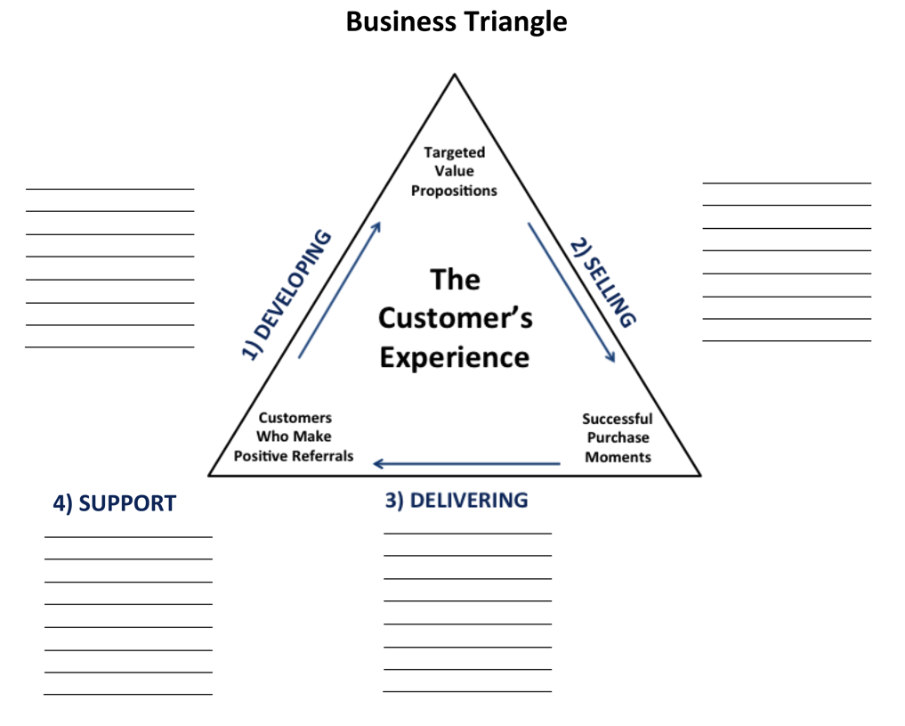

Slide 27
Business Triangle for Human Services Organization
Marketing
Communications
Targeted
Value
Propositions
Grant Writing
Program
Development
1) DEVELOPING
2) SELLING
Major Donors
The
Customer’s
Experience
Planned Giving
Policy
Customers
Who Make
Positive Referrals
Successful
Purchase
Moments
Gov’t Relations
3) DELIVERING
Volunteer Coordination
Quality Assurance
Clinical
Intake
Staff Training
Notes:
The Business Triangle – To visualize “why” capabilities are deployed in your organization: to develop, to sell, to deliver and to support.
The business triangle is the first major concept in this framework:
The business triangle is a universal pattern that exists in all stages and kinds of organizations including .com, .org, .gov, and .edu.
Business triangles are the basic market facing elements in your organization’s structure.
Please read these descriptions:
Four Basic Rationales For “Why”
In all businesses capabilities the rationale for “why” capabilities are deployed is to create four fundamental deliverables.
To Develop −> in order to create Targeted Value Propositions
To Sell −> in order to create Successful Purchase Moments
To Deliver −> in order to create Customers Who Make Positive Referrals
To Support −> in order to create Economies of Scale.
The Logic Of Business Triangles
The business triangle is a way to envision business capabilities as part of an integrated go-to-market system.
In a business triangle, capabilities are designed and deployed to develop, sell and deliver products and services to target customers with help from partners in a way that creates competitive advantage.
Business growth can be envisioned as an acceleration in throughput around a business triangle (1,2,3,1…Developing, Selling, Delivering, Developing…).

Slide 28
On which side of the triangle is the current primary constraint?
What capability is currently the primary constraint?
Who owns it?
What investment will resolve it?

Slide 29
Leading People Through Change
Creating Higher-Performing Teams & Cultures
Structuring Systems-of-Roles
Optimizing Business Models

Slide 30
Most organizations are portfolios of triangles
ENTERPRISE LEADER ROLE
FUNCTIONAL LEADER ROLES
DEVELOP
SELL
DELIVER
SUPPORT
BUSINESS LEADER ROLES

Slide 31
Policy
Program Dev.
Marketing
Comms
Development
Gov’t Reln’s
Quality
Staff Training
Intake
HR
IT
Finance
Legal
DEVELOP
SELL
DELIVER
SUPPORT
Social Services Agency
Homeless
School
Foster Care
Trauma
Complete System-of-Roles = Complete System-of-Strategies

Slide 32
Policy
Program Dev.
Marketing
Comms
Development
Gov’t Reln’s
Quality
Staff Training
Intake
HR
IT
Finance
Legal
DEVELOP
SELL
DELIVER
SUPPORT
Social Services Agency
*
Homeless
School
Foster Care
Trauma
*
*
*

Slide 33
Complete System-of-Roles
What happens when all major issues in your organization are owned?
And each person advocates strategies to win from the perspective of their role?
And everyone is using the same precise language to define and resolve issues?

Slide 34
Leading People Through Change
Creating Higher-Performing Teams & Cultures
Structuring Systems-of-Roles
Optimizing Business Models

Slide 35
Creating Higher-Performing Teams & Cultures
Culture
The ways-of-thinking and acting that are taught and reinforced in an organization. Leadership mindset is the primary source.
Notes:
Culture: The conscious, intentional agreements around how people show up and how people interact in order to drive performance.

Slide 36
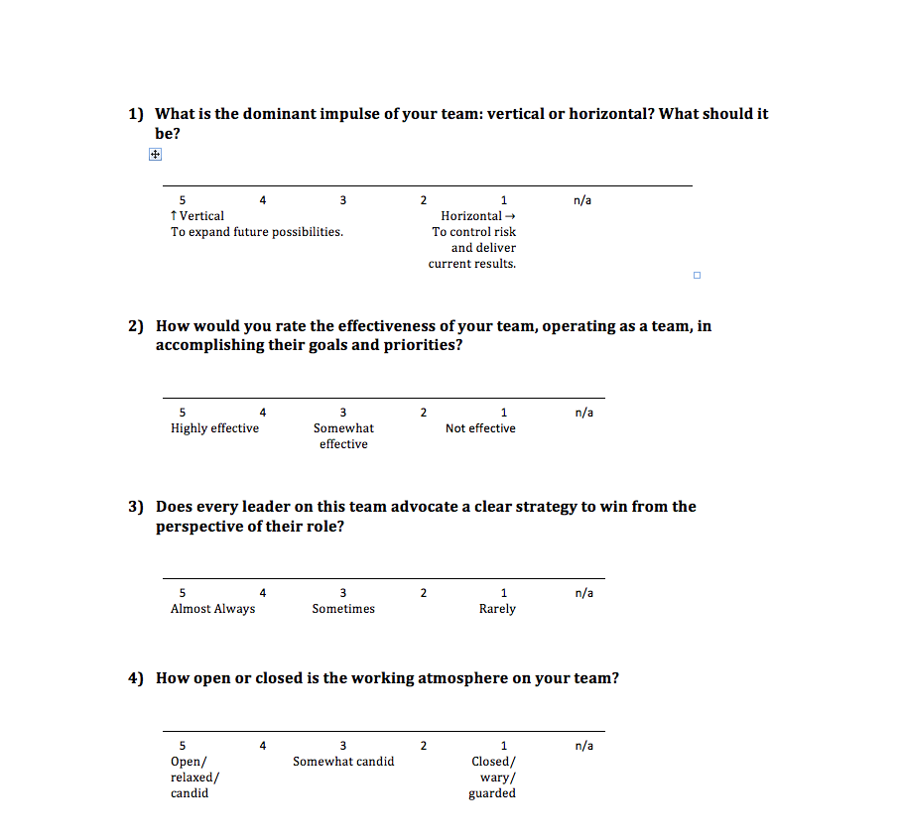

Slide 37
Exercise: Team Capability Assessment
Answer the ten questions in the Team Capability Assessment questionnaire.

Slide 38
What attributes stand out as being issues that need to be addressed on your team?
What one attribute is currently the primary constraint to higher team performance?
What do you envision as the solution path for resolving this constraint?

Slide 39
Leading People Through Change
Creating Higher-Performing Teams & Cultures
Structuring Systems-of-Roles
Optimizing Business Models
Notes:
Talking Points for Leading Change
Organizing and navigating change in a way that creates engagement and focus, despite uncertainty and disruption.
Occurs at the intersection between business culture and business model(s).
Versus change management, which includes tools and techniques and is a subset of change leadership.
Going from domains of less to domains of higher possibility.
Moving into uncertain futures together.

Slide 40
Change Plan
    Desired Future State
    Current State
    Gaps and Primary Constraints
    Milestones and Next Steps

Slide 41
Leading People Through Change
Creating Higher-Performing Teams & Cultures
Structuring Systems-of-Roles
Optimizing Business Models
Notes:
The Critical Capabilities to Effectively Lead Change
Business Model Design and Execution.
Architecting a Complete System-of-Roles.
Assessing and Driving Culture Change.
Designing Change Initiatives.

Slide 42
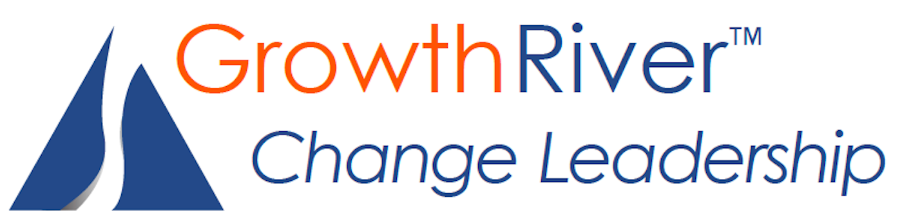
Bob Voss, PhD
Growth River
Partner & Nonprofit Practice Leader
Cell: 617.905.5156
Email: bob.voss@growthriver.com
Robert Heinzman
Growth River
Partner & Global Science Practice Leader
Cell: 413.329.3708
Email: robert.heinzman@growthriver.com

