Slide 1
Financial Sustainability: Myth or Reality?
Andrew Wolk, CEO Root Cause
July 23rd, 2014
Notes:
Go around and get sense of who is in the room. See funders vs programs and also life outcomes

Slide 2
What Frustrates You About Sustainability?
Notes:
I want to know, which would you choose reliable revenue and poor results or excellent results and wondering where next dollar is coming from?
Unpredictable
Performance does not follow money
Short Term
Restricted
Assumption there is a path
Government cant keep what don’t use

Slide 3
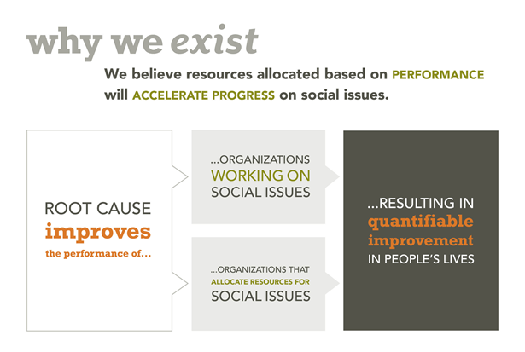
Continuous Improvement
Notes:
Andrew

Slide 4
What We Do
Since 2003, Root Cause has improved the performance of more than 200 organizations and funders in a wide range of social service sectors, including economic empowerment, education and youth development, and health and well-being.
Notes:
Andrew

Slide 5
Funder-Organization: A Partnership
Financial Sustainability
Performance Measurement
Notes:
Move from transactional to partnership that links these two

Slide 6
Financial Sustainability
The capacity of an organization to maintain a strong financial condition and continually identify and secure recurring, reliable revenue streams. This includes maintaining basic financial stability, having a clear strategy for longer-term sustainability, and a solid process in place to execute that strategy.

Slide 7
Performance Measurement
The capacity of an organization to measure its outcomes based on the social issue(s) it is working on as well, and the ability to use data about its performance to support continuous improvement toward improving those outcomes.
Notes:
Andrew

Slide 8
Performance Measurement
The capacity of an organization to measure its outcomes based on the social issue(s) it is working on as well, and the ability to use data about its performance to support continuous improvement toward improving those outcomes.
Notes:
Andrew

Slide 9
Funder-Organization: A Partnership
Financial Sustainability
Performance Measurement
Communication
and
Agreement
Notes:
Not transactional – how do we get here – break out at tables and discuss – what can I do to drive greater partnership to invest in sustainability

Slide 10
Steps to Increase Communication and Agreement
Continuous dialogue
Assess organizations performance on consistent basis and proactively discuss results
Invest in the capacity to improve performance
Mutual commitment to renewals at each funding cycle based on agreed upon set goals with some flexibility
Notes:
When relevent bring up best practice to improve life outcomes
Measurement systems for continuous improvement

Slide 11
What Frustrates You About Sustainability?
Funding is most often unpredictable
Money does not follow performance
Funding often short term (1 yr)
Funding is often restricted
You have to spend what government allocates
Government often does not fund true cost
Outcomes are over emphasized
Often asked to ‘wean off’ funder
How to establish core funding
Notes:
I want to know, which would you choose reliable revenue and poor results or excellent results and wondering where next dollar is coming from?
Unpredictable
Performance does not follow money
Short Term
Restricted
Assumption there is a path
Government cant keep what don’t use

