Slide 1


Keeping Your Friends Close and Your Donors Closer
Presented by Liz Cohen, Executive Director, Families First Parenting Programs

Slide 2

Agenda
Introductions
Gatherings: A Case Study
Dos and Don’ts of Small Cultivation Events
Branding 101
Practice, Practice, Practice
Notes:
Ask everyone to go around the room and mention: their name, title, organization and what they are looking to learn from the workshop
Tie-in to development strategy

Slide 3
Mission and Future Vision
Mission
Families First promotes the secure and nurturing parent-child relationships that are the foundation of every child’s overall well-being and future success.
Vision
Every child is secure, confident, resilient, and able to seize opportunities and succeed. All of our children are loved, guided, and supported by strong, knowledgeable, and collaborative parents, caregivers, schools, and communities.
Notes:
Great Mission and Vision
But a challenge exists in with engaging donors and volunteers

Slide 4
Where did Families First’s funding
come from in FY14?
Notes:
25% of budget is raised from individual– FF is responsible

Slide 5
Development Trends
Economic = diversification
Savvy donors want the inside scoop
It’s the relationships, stupid
New donors are 6-7 times more costly than keeping an existing donor
Notes:
The economic crisis made diversification more important, therefore major donors are more important Savvy donors want to know more about the orgs they fund
Donors with personal relationships to staff and board give more and stay longer
Since donor acquisition is expensive, it’s more efficient to keep the donors you have and to spend on acquiring donors who are likely to stay with you

Slide 6
Large Events vs. Cultivation
Large, ticketed events | Small, content-rich cultivation events
Expensive, heavy lift | Inexpensive, lighter lift
Transactional—many donors come as a favor to a committee member | Donors come for mission-related content they want
Unlikely to deepen relationship with donors | Develop invite lists through networks of friends and neighbors
One shot annually—no natural reason for follow-up | Series gives multiple opportunities at prospective donors
Hard to have meaningful conversations due to size of event | Intimate size lets board and staff develop personal relationships
Notes:
Development trends moving away from event, transaction-based models

Slide 7

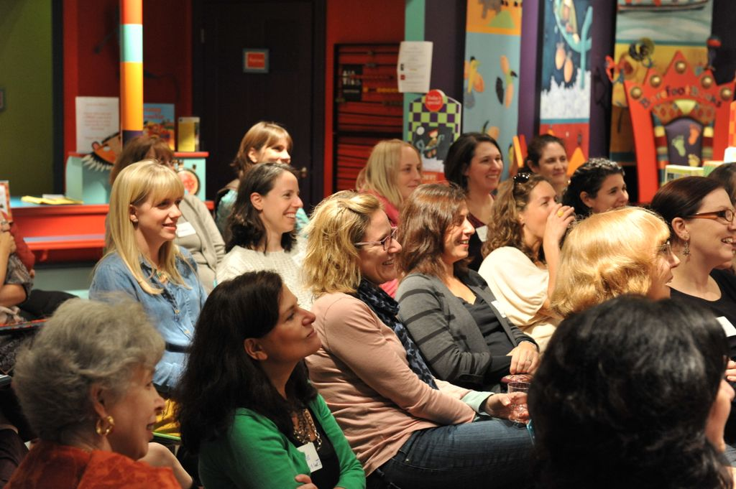
Notes:
Creation of Gatherings Speaker Series
Inspiration
Overall concept and plan
How we started and how we grew

Slide 8
Hosted in private homes, invite only
Targets board members, major donors, and their friends and neighbors
Firsthand exposure to organization goals
Access to new pipeline
“An organization's strongest donors are usually those who are the most involved.”
Notes:
#1 This works shop will explore the use of non-traditional development vehicles to bring existing major donors closer to your organization while widening your overall pool of prospects.
#2 Two years ago, Families First started a series of content-rich cultivation events, called Gatherings.

Slide 9
FY14 Gatherings
Location | Topic | Speaker | New Contacts | % New Contacts | Total Gifts
Needham | Discovering Gratitude | Karen Weisgerber | 9 | 50% | $6,250 4 gifts
Cambridge | Cultural Influences on Parenting | Nancy Hill | 4 | 22% | $1,000 2 gifts
Brookline | Volunteering: Ages & Stages | Louise Sawyer | 14 | 64% | $50 1 gift
Brookline | Parenting in the Digital Age | Catherine Steiner-Adair | 17 | 43% | $1450 5 gifts
West Newton | Promoting a Healthy Body Image | Amy Cody | 15 | 56% | $100 1 gift
Beacon Hill | Social-Emotional Learning | Milly Arbaje (Parenting Educator) | 12 | 71% | $500 1 gift
Notes:
Reference hand written notes
Create chart

Slide 10
The Stats
Unique attendance total: 114
New contacts: 71 (62%)
Average attendance at each Gathering: 19
Repeat attendance: In FY14, 85% of guests only attended 1 event
New leadership: 1 new working group member, 1 new event planning committee member, and 1 new board member

Slide 11
Best Practices
Dos
Engage your board members and volunteers, and encourage them to bring friends
Make the program something educational, captivating, unique, or fun
Bring in a client story
Ask supporters to do the ask and share why they give
Pick a house or host that is a draw
Research every person who will be in the room
Follow up with all attendees
Survey the crowd to see what they thought

Slide 12
Best Practices
Don’ts
Spend lots of time on data or just on your programming
Make the program too long or make the ask too big of a focus
Use a PowerPoint
Choose a location that is difficult to find or park near
Make assumptions about anyone who comes – be curious!
Overpack a room – make it an exclusive event

Slide 13
Branding Tool: Logo
Families First font and colors - communicates tie-back to brand
Title of program
Emphasized with
new color
Tagline communicates “support,” which was a project objective

Slide 14
Program Branding & Communications
Why it’s important to brand it separate from your organization
Allow the program to stand on its own
Internal communications & external communications
Extension of your overall brand
Leverage free communication tools
Notes:
Give each group a scenario of a non-profit and ask them to come up with an idea for how they will create cultivation events.
They will then report out to the larger group. Each group must answer the following questions:
Make questions larger

Slide 15
Group Exercise
How can this non-profit bring donors and potential donors together to highlight their work?
Who is the target audience, and what will motivate them to come?
How could this be promoted or branded?
Notes:
Give each group a scenario of a non-profit and ask them to come up with an idea for how they will create cultivation events.
They will then report out to the larger group. Each group must answer the following questions:
Make questions larger

Slide 16
Q&A

Slide 17


/familiesfirstma
/familiesfirstma
www.Families-First.org

