Slide 1
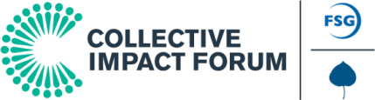

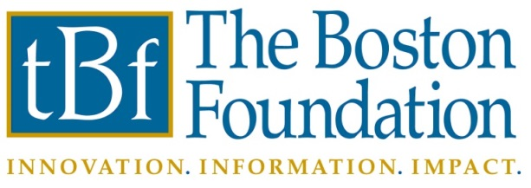
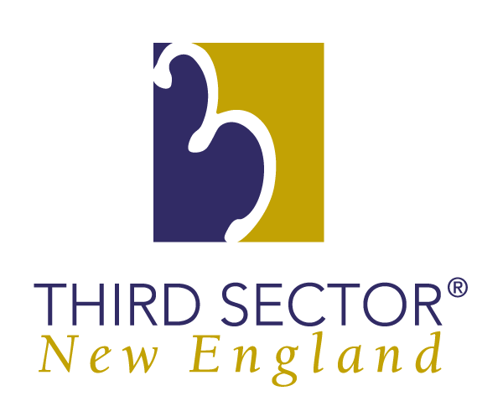
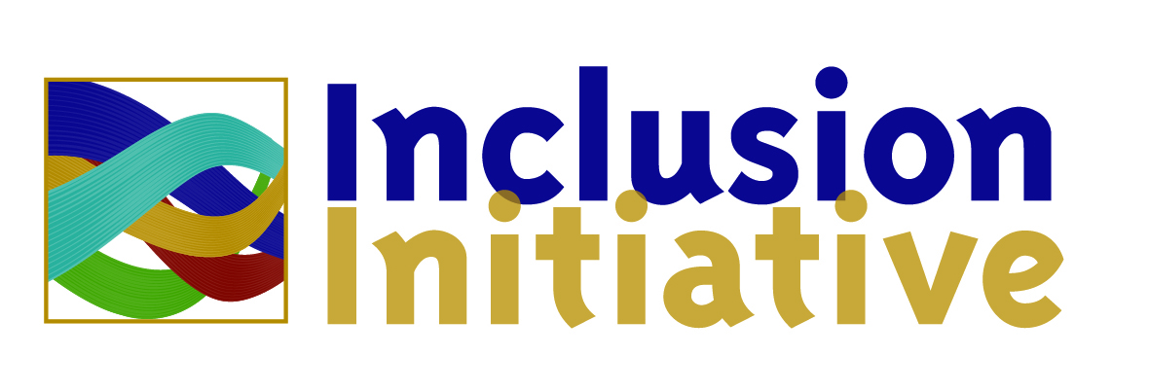
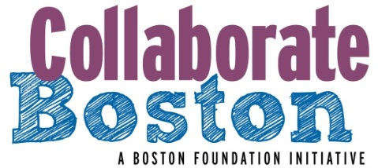
IdeaLab Collaborating for Social Change Three Models for Impact
Massachusetts Nonprofit Network Conference
October 29, 2014

Slide 2
Arani Kajenthira Grindle
Senior Consultant
FSG

Slide 3








FSG is a mission-focused consulting firm that works across sectors to drive social change
Founded by Michael Porter and Mark Kramer in 2000, we are a 150-person firm driving social change in three mutually-reinforcing ways:
Hands On Consulting
Idea Generation
Communities
of Practice
Sample consulting clients | Sample content partners | Current communities
This work is licensed under a Creative Commons Attribution-NoDerivs 3.0 Unported License.
http://creativecommons.org/licenses/by-nd/3.0/deed.en_US
Notes:
Hands on consulting:
We conduct about 100 consulting projects per year, in strategic planning, learning and evaluation, implementation and organizational change.
Idea generation
Through papers, articles, blogs, and webinars, we influence more than 250K people per year – particularly through the two concepts of Shared Value and Collective Impact
Communities of practice
With the goal of advancing knowledge and practice, we also currently host communities for community foundations, as well as for practitioners of Shared Value and Collective Impact

Slide 4
In our work, we found that traditional approaches to social change are struggling to address complex social problems
Funders select individual grantees
Organizations work separately and compete for available resources
Isolated Impact
The corporate and government sectors are often disconnected from foundations and nonprofits
Target groups are unaware or struggle to differentiate between different services
Evaluation processes attempt to isolate a single organization’s impact
This work is licensed under a Creative Commons Attribution-NoDerivs 3.0 Unported License.
http://creativecommons.org/licenses/by-nd/3.0/deed.en_US

Slide 5
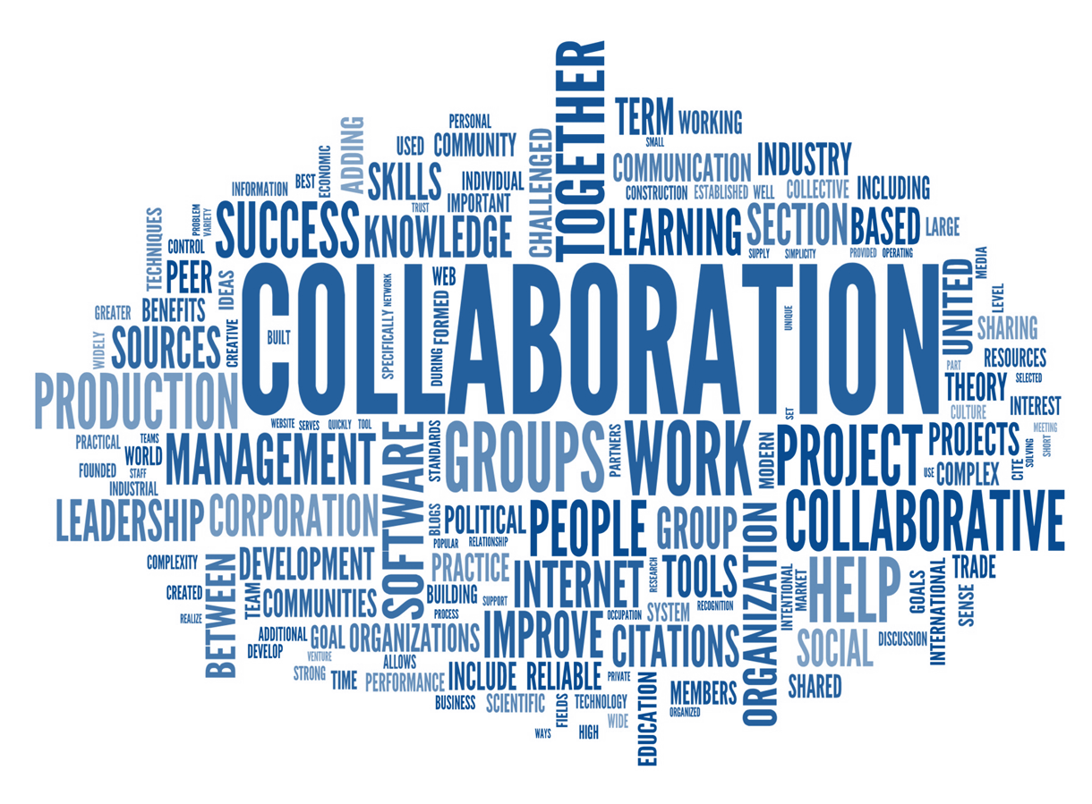
To effectively and sustainable address these challenges,
we all recognize the need for greater collaboration
This work is licensed under a Creative Commons Attribution-NoDerivs 3.0 Unported License.
http://creativecommons.org/licenses/by-nd/3.0/deed.en_US

Slide 6
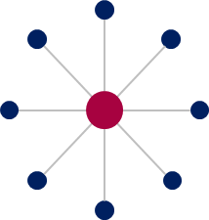
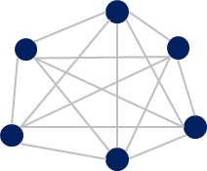
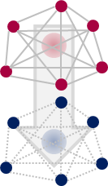
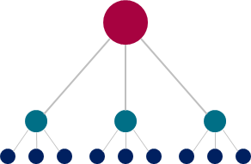
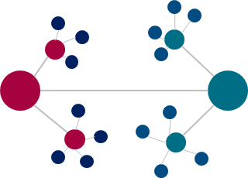
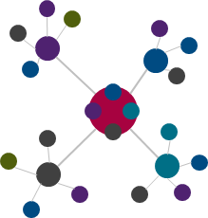
There are many different types of collaboration
Models of Collaboration
Hub and Spoke
e.g., traditional funder grantee model
Coalition
e.g., alliances and learning communities
Influence Collaborative
e.g., funder groups,
advocacy coalitions
Affiliate Network
e.g., nonprofit networks
Bilateral Partnership
e.g., public private partnerships
Multi-Sector Initiative
e.g., collective impact
This work is licensed under a Creative Commons Attribution-NoDerivs 3.0 Unported License.
http://creativecommons.org/licenses/by-nd/3.0/deed.en_US

Slide 7
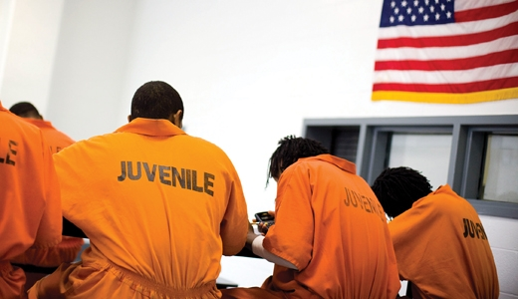
Let me share a story about collective impact in New York
This work is licensed under a Creative Commons Attribution-NoDerivs 3.0 Unported License.
http://creativecommons.org/licenses/by-nd/3.0/deed.en_US
Notes:
Let’s begin with a story.
Imagine you are 15 years old (again)…did you ever made a mistake?...I want to tell you a story about a 15 year old boy named [WHATEVER]. 15 years old, African American, low-income, and living with his Aunt in the Bronx. Shoplifts a $50 pair of shoes. This is his first and only offense. He goes to court, is put on probation but unfortunately, he violates his probation by missing a day of school and winds up being placed in a limited-secure facility for almost a year. This facility is located 2 hours upstate, and is difficult for his aunt to get to. At 15 years old. He is not alone. In NY state there are many young people who just shouldn’t be incarcerated but get dumped into the system for moderate infractions. 53 percent of the roughly 1,600 young people who entered the state’s juvenile facilities had a misdemeanor as their most serious offense.
What we’re talking about here is a broken system that fails to deliver on its responsibilities to care for and rehabilitate young people, while also failing in its responsibilities to improve public safety. The system is ineffective, inefficient, and unsafe. In New York State, youth who end up in secure facilities have near a 90% recidivism rate. And incarcerating these youth costs the state $290K per year.

Slide 8
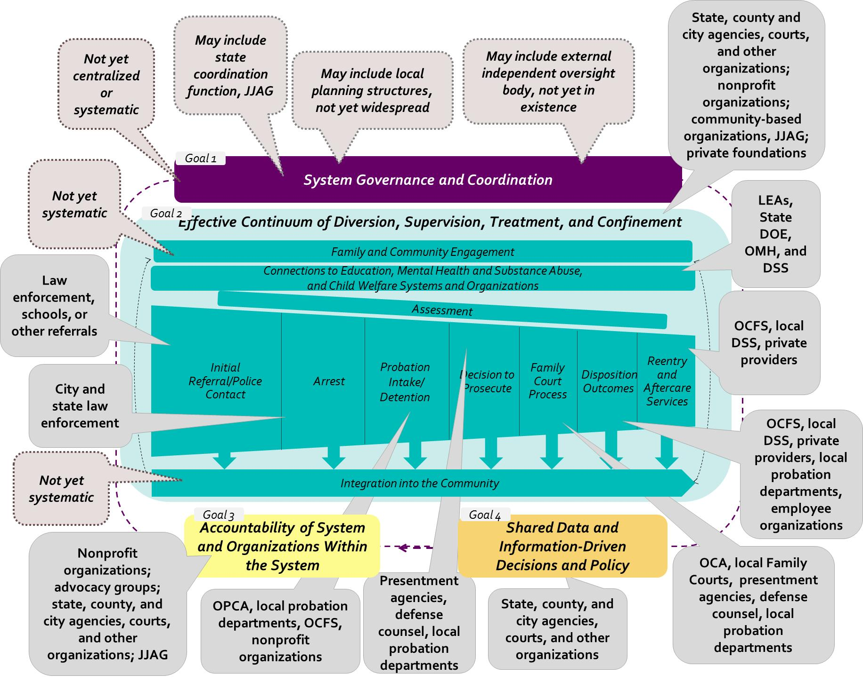
The NY juvenile justice system is fragmented, with dozens of agencies at the state, county, and city Levels
This complexity is increased due to varying processes and structures across New York State’s 62 counties
Source: FSG Interviews and Analysis; State of NY Juvenile Justice Advisory Group, “State of NY, 2009–2011: Three-Year Comprehensive State Plan for the JJ and Delinquency Prevention Formula Grant Program.”
Notes:
What exactly are we talking about when we say the system doesn’t work? Well, the NYJJ “system” is comprised of hundreds of public and private agencies that span the courts, law enforcement, probation, county services, state agencies, multiplied across 62 counties. In addition, the juvenile justice “system” must coordinate with education, mental health, child welfare, in order to serve youth while they are in state care and to responsibly transition them back into the communities—and today, this just isn’t happening to the degree it needs to.
What challenges does it face?
Despite state annual placement costs that are among the highest in the nation, the vast majority of youth who pass through the deep-end of the system (less than 3% of youth who encounter the system) return as adult offenders
In NYS, over 60% of youth are rearrested within two years of release from state custody
Parts of the state placement system are under U.S. Department of Justice oversight and are the subject of a lawsuit for brutal conditions of confinement, and the system does not ensure the safety of all youth and system professionals
How do you go about addressing a problem like this? It’s clear that a single intervention isn’t going to do it. Scaling up one rehabilitation provider, changing one law, re-engineering one state agency isn’t going to cut it – this is a complex social problem.
So what do you do about it? Well, here’s a start. We spent a year with these stakeholders, helping them to come together to have collective impact. And:
Because of our work, key stakeholders (fill in: law enforcement, county services, state agencies, the courts, child advocacy orgs, etc) were able to work across decades-old silos to get to a common understanding of the problem, and a common vision around youth success and public safety.

Slide 9






Through our work, the steering committee agreed on a collective vision, outcomes, strategies, and principles
Vision: Across New York State, the juvenile justice system promotes youth success and ensures public safety
Community Outcomes
Youth Outcomes
Community safety and quality of life
Just and fair to youth
Services to meet youth development needs
Delinquent acts
Victims have a voice
in the process
Successful reintegration of youth
Strategies for System Excellence
1
2
3
4
System Governance and Coordination
Effective Continuum of Diversion, Supervision, Treatment, and Confinement
Accountability of System and Organizations Within the System
Shared Data and Information Driven Decisions and Policy
Effectiveness
Fairness
Safety
Accountability
Principles
This work is licensed under a Creative Commons Attribution-NoDerivs 3.0 Unported License.
http://creativecommons.org/licenses/by-nd/3.0/deed.en_US

Slide 10
In just three years, the juvenile justice system in New York State has seen transformative outcomes
24% decline in juvenile arrests
23% decline in juveniles admitted to detention
20% decline in probation intake cases
21% decline in juvenile petitions filled
That is the power of collective impact
Source: FSG Interviews and Analysis; State of NY Juvenile Justice Advisory Group, “State of NY, 2009–2011: Three-Year Comprehensive State Plan for the JJ and Delinquency Prevention Formula Grant Program.”

Slide 11
In our work, we’ve found that creating measurable change through collective impact requires five key elements
1
Common Agenda
Common understanding of the problem
Shared vision for change
2
Collecting data and measuring results
Focus on performance management
Shared accountability
Shared Measurement
3
Mutually Reinforcing Activities
Differentiated approaches
Coordination through joint plan of action
4
Continuous Communication
Consistent and open communication
Focus on building trust
5
Organization(s) with dedicated staff
Resources and skills to convene and coordinate participating organizations
Backbone Support

Slide 12




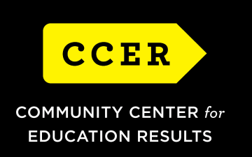

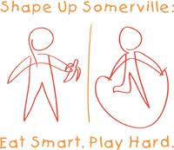


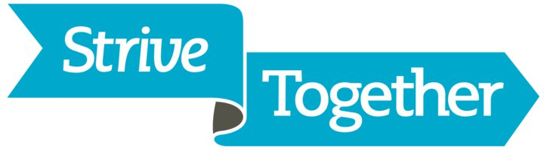



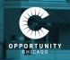





These five elements can be applied to complex challenges in multiple issue areas
Education
Health
Environment
*
Youth Development
Economic Development
Community Development
*
*
*
Source: www.roadmapproject.org; FSG Interviews and Analysis
Notes:
In Jan 2010, Community Center for Education Results (CCER), the organization which staffs the Road Map Project, was officially incorporated as a Washington state nonprofit.
Extra clarification notes:
The South King County and South Seattle region is one of the most diverse in the country. The Road Map Region is
home to almost 20,000 English Language Learners (ELL) who speak more than 160 different languages. Some of
these students are immigrants and refugees, and many are fi rst-generation Americans. When we use the term “ELL
student,” we mean those students who are in the State-funded English language acquisition program.

Slide 13
One thing to keep in mind is that working in collective impact requires a mindset shift
Technical Solutions
Adaptive Solutions
Silver Bullet
Silver Buckshot
Taking Credit
Sharing Credit
This work is licensed under a Creative Commons Attribution-NoDerivs 3.0 Unported License.
http://creativecommons.org/licenses/by-nd/3.0/deed.en_US

Slide 14
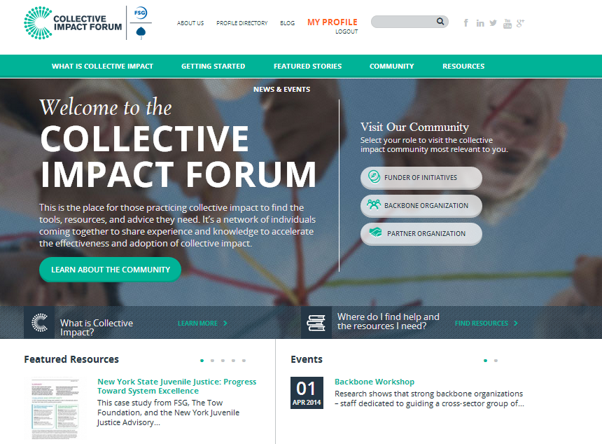
Interested in learning more?
The Collective Impact Forum contains additional resources
http://www.collectiveimpactforum.org
Collective Impact resources are also available on FSG’s website: http://fsg.org/KnowledgeExchange/FSGApproach/CollectiveImpact.aspx
This work is licensed under a Creative Commons Attribution-NoDerivs 3.0 Unported License.
http://creativecommons.org/licenses/by-nd/3.0/deed.en_US

Slide 15

Jennifer Aronson, Senior Director Program & Nonprofit Effectiveness
The Boston Foundation

Slide 16
About the Boston Foundation
Mission:
As Greater Boston’s community foundation, the Boston Foundation devotes its resources to building and sustaining a vital, prosperous city and region, where justice and opportunity are extended to everyone.
Major Grantmaker:
Support nonprofit organizations doing good work in the city and region
Provide seed capital for promising innovations
Partner to Donors:
Invest and grow the region’s pool of philanthropic capital
Help local philanthropists with their giving through Donor Advised Funds or other assistance
Civic Leader /Convener:
Conduct research and share information about the region’s biggest challenges
Bring people together to discuss and advocate for system-wide changes to address these challenges

Slide 17
Three Pillars of Nonprofit Effectiveness
The Boston Foundation’s Nonprofit Effectiveness Group believes that the nonprofit organization is a primary lever of impact for social change, and our work is designed to support and enhance this lever in three ways:
Capacity Building: We help nonprofits do what they do better by
Strengthening Organizational Infrastructure
Developing Leadership
Connecting to Resources

Slide 18
Three Pillars of Nonprofit Effectiveness Cont.
Collaboration: We facilitate collaboration across the nonprofit community by
Fostering Cross-Sector Collaboration
Supporting Deep Strategic Collaborations and Mergers
Building Capacity for Collective Advocacy and Action
Transparency (www.GivingCommon.org): We make the nonprofit sector more open and transparent with
Access to Information
Data-Driven Giving
Using Data to Tell Nonprofit Stories

Slide 19

Collaboration
Collaboration
Community Voice
Power of the Prize

Slide 20
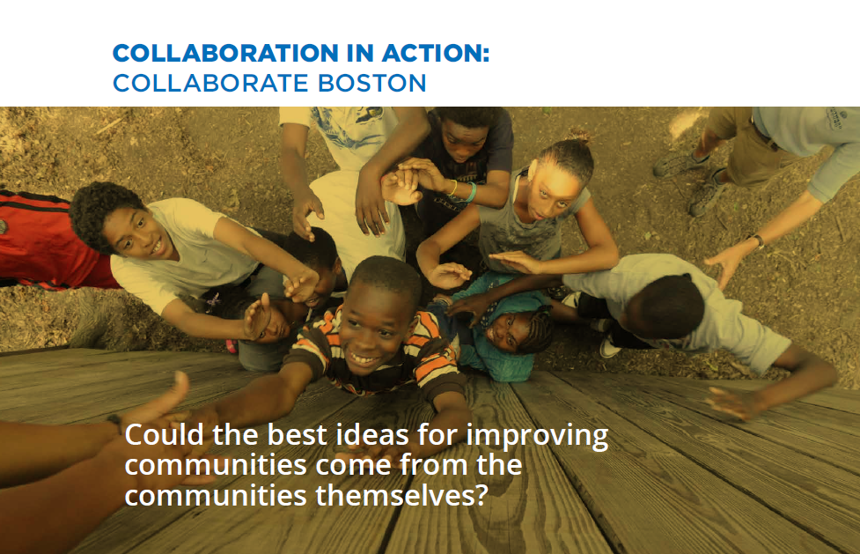

Slide 26
What We’ve Learned
Lessons on Process
3 Core Elements of Successful Collaborations:
Mutual Trust
Shared Commitment to Goals
Inclusive Participation

Slide 27
Thank You
www.CollaborateBoston.org

Slide 28

Eradicating Poverty through
Cross-Sector Community
Collaborations
A grant program of Third Sector New England
Ayeesha Lane, Program Manager
Notes:
Good Morning,
My name is Ayeesha Lane and I am the Program Manager for Third Sector New England’s Inclusion Initiative.

Slide 29
What is the Inclusion Initiative?
We support:
Groups in communities of color in Massachusetts and Rhode Island
Development of inclusive communities through community led, cross sector networks examining the root causes of poverty in order change the systems that hold up poverty
Focus in five areas: education, youth development, community and economic justice, healthcare and environmental justice.

Slide 30
What we believe.
If we support community-led efforts in communities of color to examine root causes of poverty to create vehicles of change, the poverty needle will begin to move in the right direction and poverty will be eradicated.

Slide 31
Network Focused
Where we began with inclusion work.
20+ years (funder’s collaborative at the Hyams Foundation)
Supported over 100 organizations to meet their missions more effectively through:
Greater racial, ethnic and cultural diversity within their staff and boards
Inclusion of diverse perspectives in the development of programs and delivery of services
Strategic planning and application of inclusive practices to achieve shifts in their instructional culture.
$1.7 million in Technical Assistance Grants
Countless hours in peer learning sessions, trainings, and one-on-one coaching
Notes:
The Inclusion initiative began 20 years ago at the Hyams Foundation. Formerly known as the Diversity Initiative it provided resources, money and technical assistance to organizations to support their committed efforts to change the composition of their boards and staff to be more reflective of their community and the people they serve.

Slide 32
Network Focused
Where we began with networks.
Capacity Building Fund of Third Sector New England between 2004-2012
Supported 67 learning networks, over 400 organizations
Plan, learn and build relationships that would enable them to work together to achieve common goal.
$1.9 million in technical assistance grants

Slide 33
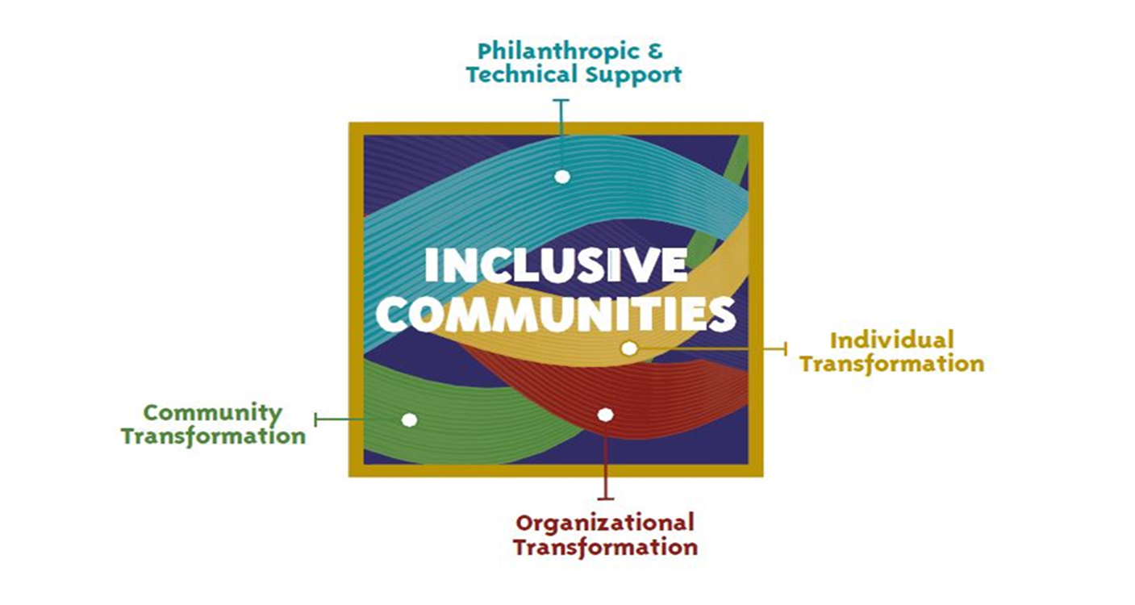
Development
Building inclusive communities
Networks
Inclusion

Slide 34
Inclusion Initiative is making a strategic investment in community transformation
By supporting the people that are directly impacted by poverty and who hold the solutions to addressing and eradicating poverty.

Slide 35
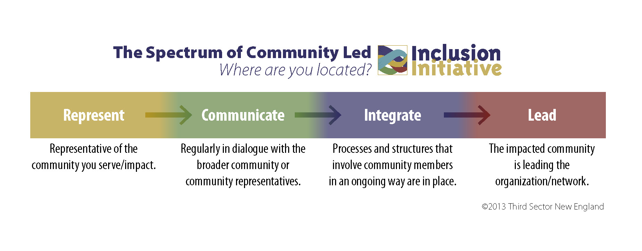
How do you get to community transformation?

Slide 36
What we have learned about successful collaborations.
Process is product
Relationships drive the work
Peer learning sessions, technical assistance are key tools for collaboration

Slide 37
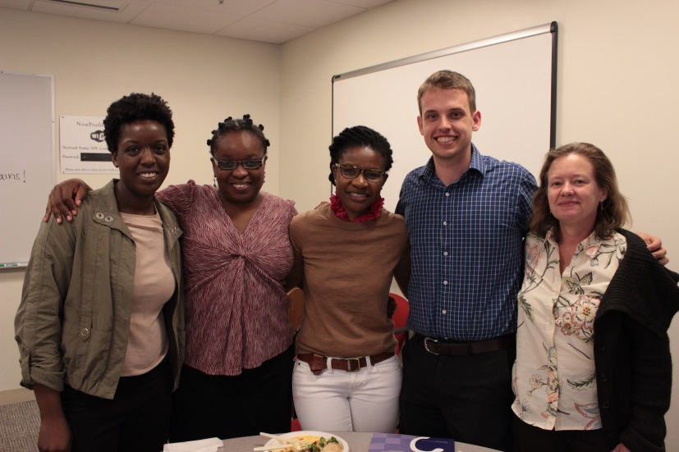
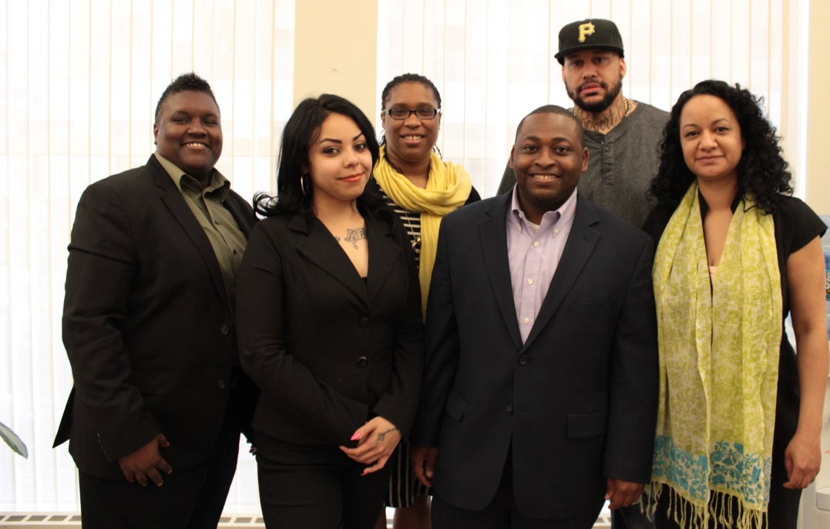
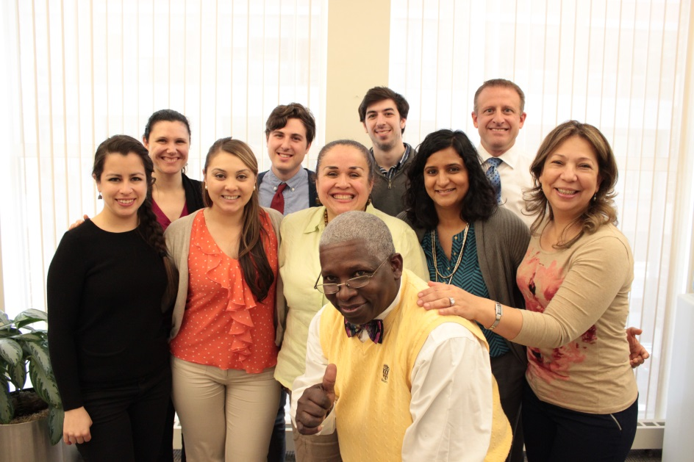
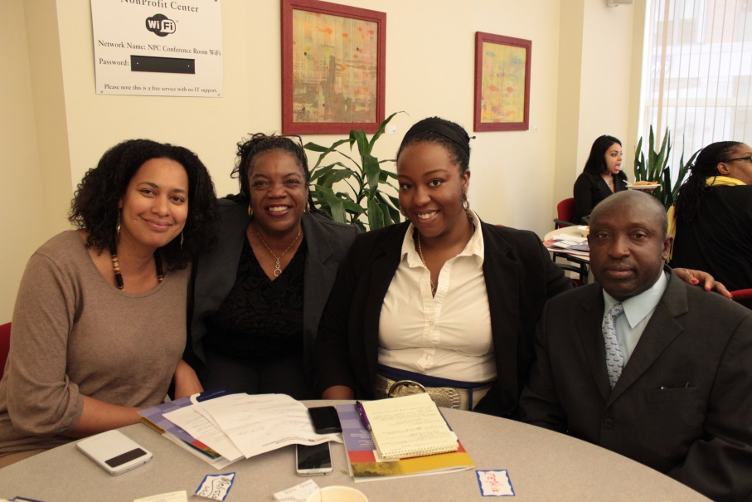
Support seven networks in their planning phase

Slide 38
Eradicating Poverty through
Cross-Sector Community
Collaborations
www.tsne.org/inclusion-initiative
Notes:
Good Morning,
My name is Ayeesha Lane and I am the Program Manager for Third Sector New England’s Inclusion Initiative.

Slide 39


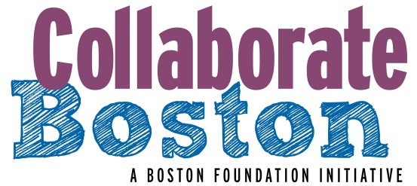
Thank You!
Jennifer Aronson, The Boston Foundation
Arani Kajenthira Grindle, FSG
Ayeesha Lane, Third Sector New England

