Slide 1



A Leader’s Guide to
Inspiring Others to Action

Slide 2

Thank You!

Slide 3
Agenda & Goals
Today, we will cover:
Why you need to inspire people?
What inspires you?
How do you get people on board and fired up to succeed?
How do you keep them motivated over the long haul?

Slide 4

Thank You!

Slide 5



Relationships for Application
Identify an inspired staff member/person.
Identify a staff member/person who needs a jolt?
Consider these two throughout our discussion.
Notes:
Individually take a few minutes to identify the issues that make that relationship difficult
Can debrief as whole class to identify some commonalities

Slide 6

Notes:
Transition: As EBoard members, you will lead your chapter and your goal is to provide the best member experience possible. To ensure this, let’s not take a look at the components of the Member Experience that you will lead.

Slide 7
ACTIVITY
Create groups of 4 to 5
Identify roles: A – B – C – D - E
Rules for Roles
The Task @ Hand
Notes:
Individually take a few minutes to identify the issues that make that relationship difficult
Can debrief as whole class to identify some commonalities

Slide 8
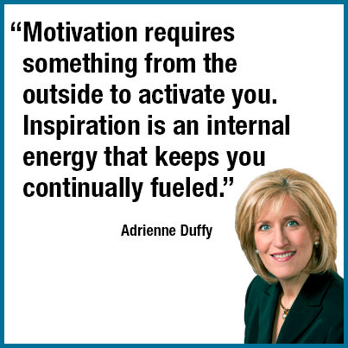

Motivation Versus Inspiration?

Slide 9

Thank You!

Slide 10
Your Motivators
Identify what motivates you (the most) @ work!
Share your Top 3 with a partner.
Identify what motivates:
  The Inspired Person
  The JOLT Needer
Notes:
SWOT Analysis…take a look in the mirror and reflect on your perception of how you handle conflict
This exercise is to get the participants thinking about how everyone can be difficult, given the situation, and that change and improvement starts with internal changes

Slide 11

How do we Inspire others?
Notes:
SWOT Analysis…take a look in the mirror and reflect on your perception of how you handle conflict
This exercise is to get the participants thinking about how everyone can be difficult, given the situation, and that change and improvement starts with internal changes

Slide 12
#1: Set Crystal Clear Goals
The more concrete the better. Try to have a few action goals to go with the result goals.
Be ready to clarify actions, too. They may not know where to start.
Keep the goals short term. People want to be able to see the end in sight. If it's too big, think sub-goals.

Slide 13
#2: Get in the Trenches!
Show them that you are willing to sacrifice, too.
Take the hardest thing you are asking them to do and model it for them.

Slide 14
#3: Find Their “Why?”
People like to act in accordance with their values.
Create a “motivation grid” so you remember quickly what moves each of your employees.

Slide 15
#4: Challenge Them!!!!
People aren’t inspired by doing the ordinary or by meeting expectations.
They’re inspired by the exertion, creativity, and sacrifice needed to exceed what they themselves thought possible.

Slide 16
#5: Check Back Often
Incorporate it into your walk arounds. If they hear it from you regularly, they will know it really is important to you.
Ex. How are you? How's it going with the.....................?

Slide 17
#6: Reinforce and Reward
Consistency is key.
Reward actions, not just results. With many goals, it takes making the actions part of your habit before you begin to see results.

Slide 18

Activity

Slide 19

Activity

Slide 20

Activity

Slide 21



Slide 22

How will you apply today?
What will you do to keep others inspired?
What will you do to provide a jolt to those in need?
How will you keep yourself inspired?!
Notes:
SWOT Analysis…take a look in the mirror and reflect on your perception of how you handle conflict
This exercise is to get the participants thinking about how everyone can be difficult, given the situation, and that change and improvement starts with internal changes

Slide 23


Slide 24
Kenya J. Rutland
Chief Enthusiasm Officer
860) 286-9557
Kenya@KJRConsulting.com

